Slide 1
The use and economic value of genomic testing for calves on dairy farms

Slide 2
Introduction
Genomic selection increases selection response.
Bulls were genotyped first due to cost.
Many more cows than bulls have now been genotyped.
How can you use genomics to make better decisions on your farm?

Slide 3
Many animals have been genotyped
335,929 genotyped animals
Genotypes
Evaluation Date (YYMM)
Notes:
3

Slide 4
Why are good decisions important?
Milk:Feed Price Ratio
July 2012 Grain Costs
Soybeans: $15.60/bu (€0.46/kg)
Corn: $ 7.36/bu (€0.23/kg)
Month
M:FP = price of 1 kg of milk /
price of 1 kg of a 16%
protein ration

Slide 5

How does genetic selection work?
ΔG = genetic gain each year
reliability = how certain we are about our estimate of an animal’s genetic merit (genomics ⬆)
selection intensity = how “picky” we are when making mating decisions (management can ⬆)
genetic variance = variation in the population due to genetics (we can’t really change this)
generation interval = time between generations (genomics ⬇)

Slide 6



Can I afford genomic testing?
Number of SNP 9K 50K 800K
U.S. Price €32 €92 €184
International Price €41 €100 €192

Slide 7
Four ways to use use genomics
Animal ID and parentage verification
  Is this the animal that I think it is?
Early culling decisions
  Am I raising the right animals?
Mate selection
  How do I produce the best calves?
Identification of elite cows

Slide 8
Odds of finding a missing relative…
…if the missing relative has been genotyped:
100%
Animal
98%
Missing
92%
Missing
If a missing parent is genotyped, we will find it!
Notes:
8
We are all familiar with a traditional pedigree chart. Animal is expected to be an average of his parents.

Slide 9
Genotyped heifers in the US
73% of genotyped US Holsteins are < 15 mo old!

Slide 10
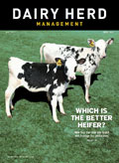
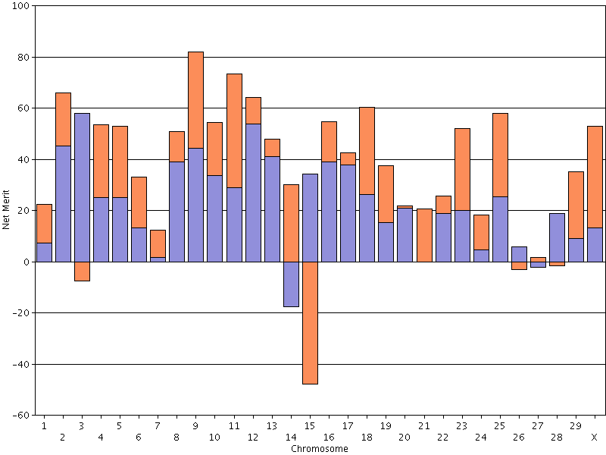
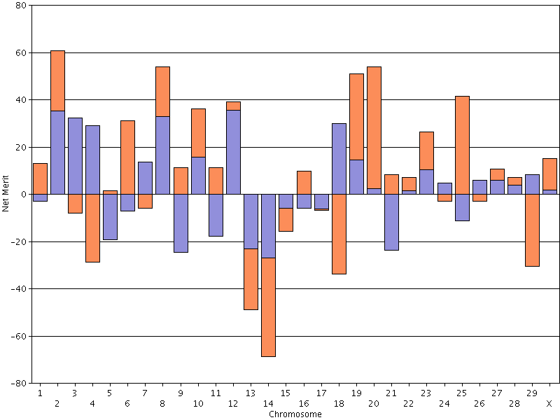
Now we know which heifer is best
The best has a PTA NM$ of +868 and a REL of 73%.
PLANET has 3,783 genotyped daughters – which one do you want in your herd?
The worst has a PTA NM$ of +48 and a REL of 68%.

Slide 11
46 US Holsteins – unknown parents
Genetic Merit for NM$
Without any pedigree information, they all appear the same!

Slide 12
46 US Holsteins – genotyped
Genetic Merit for NM$

Slide 13
The poorest animals can be culled
Genetic Merit for NM$

Slide 14
How should you select mates?
Selected 3 Jersey herds from the US
Compared actual matings with other possible choices
  Could the herd manager have selected better mate pairs?
  Data included 220 actual matings from 142 mate pairs

Slide 15
Comparison to actual matings
Three strategies tested in simulation
  Mating plans using traditional and genomic PTA as in Pryce et al. (2012)
  Selection of mate pairs with greatest mean DGV
  Bulls limited to 10 matings

Slide 16
What bulls were available?
Cows in herd
Simulated calves
Consider each bull as a mate for each cow using different strategies.
Bulls used in herd
Genotyped calves
Actual calves born to these parents.

Slide 17
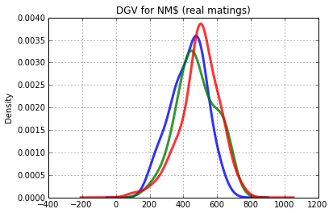
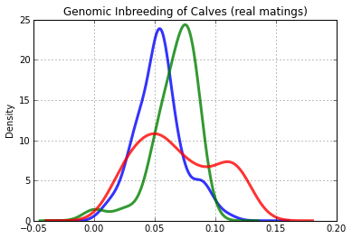
Actual DGV and inbreeding
Similar distribution of direct genomic values (DGV)
Different distribution of relation-
ships – different sire portfolios

Slide 18
What did we learn about mating?
Each of the 3 herds could have made better mating decisions
  Differences between the methods were moderate
  Inbreeding continues to be a concern
In the US, many farmers do not use mating programs!

Slide 19

Identify your elite animals
When you genotype your
cows you will know which
animals to contract as bull
dams
You will also know which embryos from a flush are the good ones and bad ones
The sale of elite genetics can supplement your income from milk sales
http://vet.tufts.edu/tas/dairy_farm_services/embryo_transfer_service.html

Slide 20
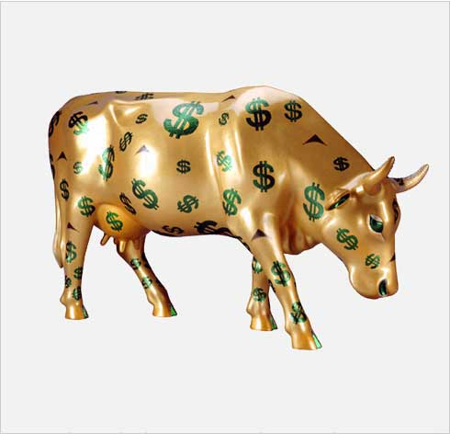
Conclusions
Genotyping can increase
rates of genetic gain
Pedigree errors can be
found and fixed
Accurate culling decisions save money
Better mate selection produces better offspring
Elite genetics can be marketed
http://houston.cowparade.com/cow/large/917

Slide 21
Acknowledgments
Tom Lawlor
Holstein Association USA
Brattleboro, VT
Albert De Vries
Department of Animal Sciences
University of Florida, Gainesville, FL
Paul VanRaden, Dan Null, and Tabatha Cooper
Animal Improvement Programs Laboratory, ARS, USDA Beltsville, MD

Slide 22

Questions?

