Slide 1


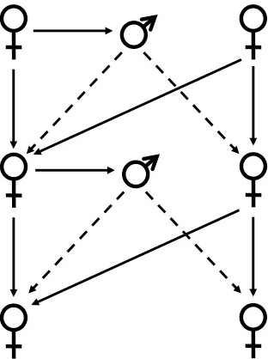
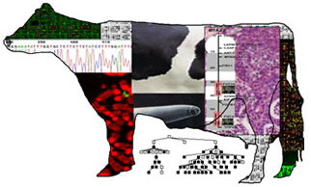


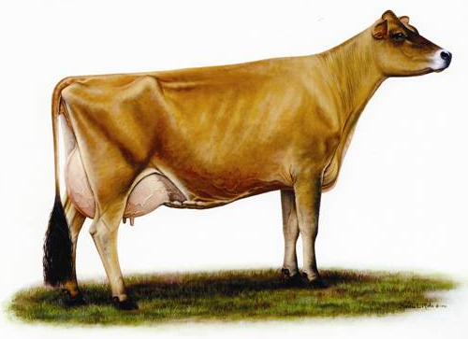
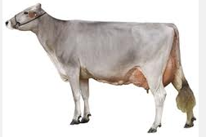
Mating Programs Including Genomic Relationships and Dominance Effects
Chuanyu Sun¹, Paul M. VanRaden², Jeff R. O'Connell³
¹ National Association of Animal Breeders, USA, Columbia, MO;
² Animal Improvement Programs Laboratory, Agricultural Research Service, USDA, Beltsville, MD, USA.
³ School of Medicine, University of Maryland, Baltimore MD, USA
INTRODUCTION
In genomic era, dense single nucleotide polymorphism (SNP) markers across the whole genome have been widely used for genomic selection. Correspondingly, new methods and programs for mating programs including genomic relationship, instead of pedigree relationship, should be developed to maximize progeny values and control genome-based inbreeding with genome-based estimated breeding values (Sonesson et al. 2012). Dominance effects could not only increase the accuracy of genomic selection, but predicted dominance effects could also be used to find mating pairs with good combining abilities by recovering inbreeding depression and utilizing possible overdominance.
Results
Table 2. The effective method for provide elements of the genomic relationship matrix from the central database to customers via a web query
Breed | Required animals | Computation time
 |  | Extraction | Recalculation
BS | 338 | 1 s | 4 s
JE | 585 | 1 min, 46 s | 6 s
HO | 1,817 | 1 h, 58 min, 6s | 31 s
Table 3. Average genomic inbreeding of calves as well as increase in calf value from mating of top 50 marketed bulls selected for genomic lifetime net merit (LNM) with the youngest genotyped cows of the same breed in the same herd compare to randomly selected bulls and randomly mating
Mating method | Mates’ inbreeding | Increase in calf value ($) |  |  | Calf inbreeding (%)
 |  | BS | JE | HO | BS | JE | HO
LP | Genomic | 205 | 358 | 494 | 6.94 | 3.72 | 5.17
 | Pedigree | 184 | 326 | 462 | 7.87 | 5.12 | 6.58
SM | Genomic | 181 | 333 | 474 | 7.97 | 4.78 | 6.03
 | Pedigree | 175 | 312 | 450 | 8.27 | 5.70 | 7.09
RM |  | 138 | 255 | 422 | 9.83 | 8.173 | 8.31
Figure 1. The increase of predicted milk yield for calves including or non-including dominance effect using top 50 bulls and different mating allocation methods compare to randomly selected bull and randomly mating.
MATERIALS AND METHODS
Data information in the Table 1
The strategy of allocating matings including linear programming (LP), simple method (SM) from Pryce et al. (2012) and random mating (RM)
Calf value equals to the average of parents’ genomic breeding values plus inbreeding loss times the average of parents’ expect future inbreeding and minus inbreeding loss times calf inbreeding coefficient, then plus calf’s dominance effect if dominance was included
Conclusions
Mating programs including genomic relationships were much better than using pedigree relationships
Earning a total annual value of greater than $2 million for HO
Extra benefit was gained when dominance effects were included in the mating program.
Combining LP and genomic relationship was always better than other methods regardless of the selection done and whether dominance effect was included or not.
How to earn 2 million dolloars for Holstein cattle?
(494-262) *160000 /2.5 >2 million
Table 1. The description of data records for mating programs and dominance effect.
Items |  | Breed
 |  | BS | JE | HO
Genotyped population Pedigree |  | 7,623 35,193 | 28,618 138,247 | 233,482 656,079
Mating program | Males | 8 | 50 | 50
 | Females | 79 | 500 | 500
Dominance estimation |  |  | 8,323 | 30,583
Trait |  | LNM | LNM | LNM
 |  |  | Milk | Milk
Reference
Pryce, J. E., B. J. Hayes, and M. E. Goddard. 2012. Novel strategies to minimize progeny inbreeding while maximizing genetic gain using genomic information. J. Dairy Sci. 95:377–388.
Sonesson, A. K., J. A. Woolliams, and T. H. E. Meuwissen. 2012. Genomic selection requires genomic control of inbreeding. Genet. Sel. Evol. 44:27-36.

