Slide 1
Opportunities for genetic improvement of health and fitness traits

Slide 2
What are health and fitness traits?
Health and fitness traits do not generate revenue, but they are economically important because they impact other traits.
Examples:
  Poor fertility increases direct and indirect costs (semen, estrus synchronization, etc.).
  Susceptibility to disease results in decreased revenue and increased costs (veterinary care, withheld milk, etc.
Notes:
2
2

Slide 3
Challenges with health and fitness traits
Lack of information
  Inconsistent trait definitions
  No national database of phenotypes
Low heritabilities
  Lots of records are needed for accurate evaluation
  Rates of change in genetic improvement programs are low
Notes:
3
3

Slide 4
Why are these traits important?
Milk:Feed Price Ratio
July 2012 Grain Costs
Soybeans: $15.60/bu (€0.46/kg)
Corn: $ 7.36/bu (€0.23/kg)
Month
M:FP = price of 1 kg of milk /
price of 1 kg of a 16%
protein ration

Slide 5
Increased emphasis on functional traits
Trait | Relative emphasis on traits in index (%)
 | PD$ 1971 | MFP$ 1976 | CY$ 1984 | NM$ 1994 | NM$ 2000 | NM$ 2003 | NM$ 2006 | NM$ 2010
Milk | 52 | 27 | –2 | 6 | 5 | 0 | 0 | 0
Fat | 48 | 46 | 45 | 25 | 21 | 22 | 23 | 19
Protein | … | 27 | 53 | 43 | 36 | 33 | 23 | 16
PL | … | … | … | 20 | 14 | 11 | 17 | 22
SCS | … | … | … | –6 | –9 | –9 | –9 | –10
UDC | … | … | … | … | 7 | 7 | 6 | 7
FLC | … | … | … | … | 4 | 4 | 3 | 4
BDC | … | … | … | … | –4 | –3 | –4 | –6
DPR | … | … | … | … | … | 7 | 9 | 11
SCE | … | … | … | … | … | –2 | … | …
DCE | … | … | … | … | … | –2 | … | …
CA$ | … | … | … | … | … | … | 6 | 5
Notes:
5
5

Slide 6
What does “low heritability” mean?
P = G + E
The percentage of total variation attributable to genetics is small.
CA$: 0.07
DPR: 0.04
PL: 0.08
SCS: 0.12
The percentage of total variation attributable to environmental factors is large:
Feeding/nutrition
Housing
Reproductive management
Notes:
6
6

Slide 7
Accuracy is a function of heritability

Slide 8

How does genetic selection work?
ΔG = genetic gain each year
reliability = how certain we are about our estimate of an animal’s genetic merit (genomics can ⬆)
selection intensity = how “picky” we are when making mating decisions (management can ⬆)
genetic variance = variation in the population due to genetics (we can’t really change this)
generation interval = time between generations (genomics can ⬇)

Slide 9
Ways to increase genetic gain
Reliability¹ | Selection Intensity² | Genetic Variance³ | Genetic Gain | Genetic Variance³ | Genetic Gain | Relative Gain⁴
0.24 | 0.20 | 0.16 | 0.0078 | 0.44 | 0.0129 | 1.00
0.35 | 0.20 | 0.16 | 0.0094 | 0.44 | 0.0156 | 1.21
0.24 | 0.64 | 0.16 | 0.0250 | 0.44 | 0.0415 | 3.20
0.35 | 0.64 | 0.16 | 0.0302 | 0.44 | 0.0502 | 3.86
0.24 | 1.76 | 0.16 | 0.0689 | 0.44 | 0.1143 | 8.80
0.35 | 1.76 | 0.16 | 0.0832 | 0.44 | 0.1381 | 10.63
¹Traditional (0.24) and genomic (0.35) reliability for ketosis (Parker Gaddis, 2013, unpublished data).
²Values correspond to culling rates of 10% (0.2), 50% (0.64), and 90% (1.76).
³From the ketosis (0.16) and milk fever (0.44) results of Neuenschwander et al. (2012; Animal 6:571–578).
⁴Genetic gain relative to the smallest rate of gain (reliability = 0.24, selecion intensity = 0.2).

Slide 10
What are other countries doing?
Scandinavia – Long-term recording and selection program
Canada – Recent work on producer-recorded health event data
Interbull – Limited health traits (clinical mastitis)
Notes:
10
10

Slide 11
International challenges
National datasets often are siloed
Recording standards differ between countries
Many populations are small
Interbull only evaluates a few health traits (e.g., clinical mastitis)
Notes:
11
11

Slide 12

Functional traits working group
ICAR working group
  7 members from 6 countries
Standards and guidelines for functional traits
  Recording schemes
  Evaluation procedures
  Breeding programs
Notes:
12
12

Slide 13
New and revised ICAR guidelines
Section 16: Recording, Evaluation and Genetic Improvement of Health Traits
  Included in the 2012 ICAR Guidelines
New: Recording, Evaluation and Genetic Improvement of Female Fertility
  Draft guidelines under review
Section 7: Recording, Evaluation and Genetic Improvement of Udder Health
  Currently under revision
Notes:
13
13

Slide 14
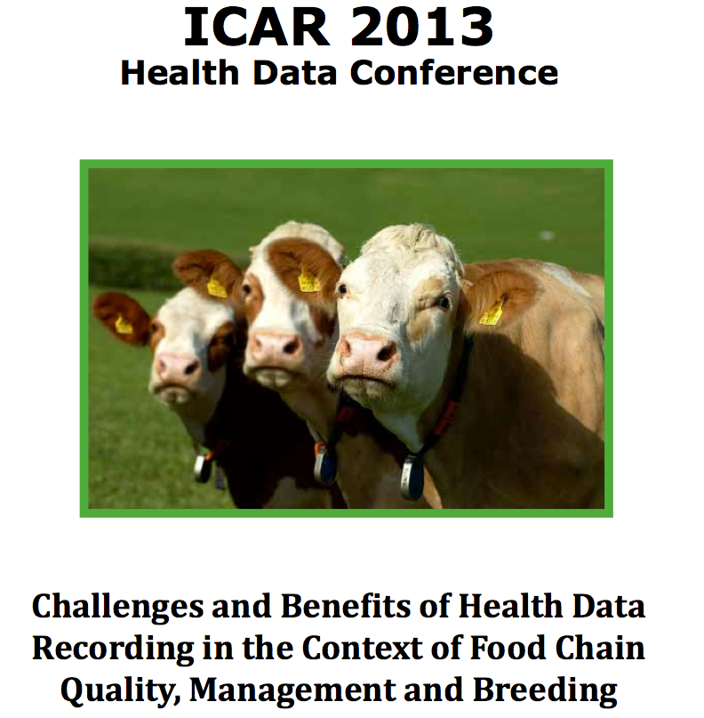
2013 ICAR Health Conference
Challenges and benefits of health data recording in the context of food chain quality, management and breeding.
May 30th and 31st in Aarhus, Denmark
20 speakers from around
the world.
Roundtable discussion with
industry leaders.
Notes:
14
14

Slide 15
Domestic challenges
What incentives are there for producers to provide data?
  Recording, storage, and transmission of data aren’t free
  Will reporting expose producers to liability?
Time versus expectations
Notes:
15
15

Slide 16
Domestic opportunities
Improving health increases profit
Consumers associate better health with better welfare
Not much movement towards a national solution
  Nov. 2012 Hoard’s editorial, “Let’s Standardize Our Herd Health Data”
  We’ve submitted a follow-up article
Notes:
16
16

Slide 17
What are we doing at AIPL?
Use of producer-recorded health data
Stillbirth in Brown Swiss and Jersey
Gene networks associated with dystocia
Upcoming net merit revision
  May add polled to index
  Work on calf health led by Minnesota
Notes:
17
17

Slide 18
Path for data flow
AIPL introduced Format 6 in 2008
  Permits reporting of 24 health and management traits
  Simple text file
Tested by DRPCs
  No data are routinely flowing
  Will this change with the new NFCA?
Notes:
18
18

Slide 19
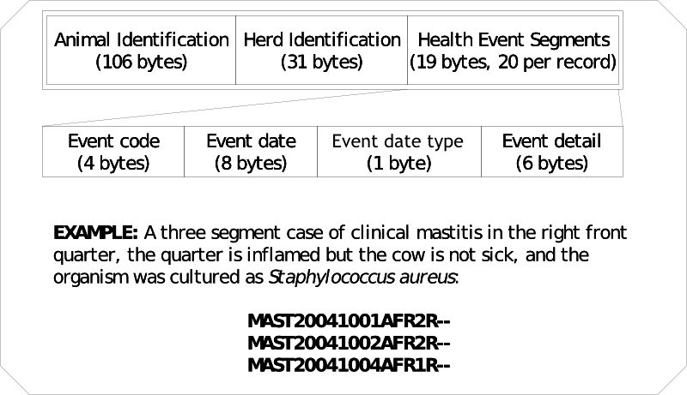
Format 6 records
Animal Identification
(106 bytes)
Herd Identification
(31 bytes)
Health Event
Segment
(19 bytes, 20/record)
Event code
(4 bytes)
Event date
(8 bytes)
Event date type
(1 byte)
Event detail
(6 bytes)
(optional, format varies)
A three-segment case of clinical mastitis in the right front quarter; the quarter is inflamed
but the cow is not sick, and the organism was cultured as Staphylococcus aureus:
MAST20041001AFR2R--
MAST20041002AFR2R--
MAST20041004AFR1R--

Slide 20
Potential new data in Format 6
Traits not in Format 6
  Efficiency and feed intake
  Thermotolerance
What about herd-level information?
  Housing systems
  Rations/nutritional information
Notes:
20
20

Slide 21
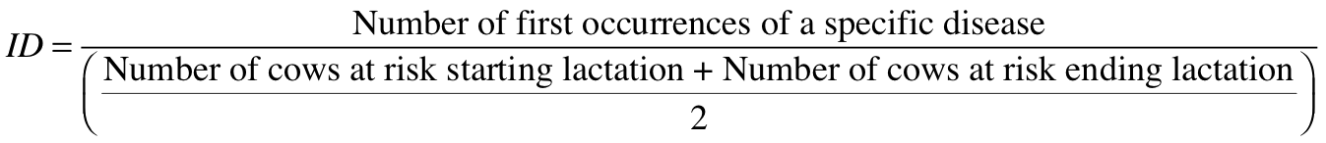
Health Event Incidence
Lactational incidence rate (LIR) or incidence density (ID) was calculated for each event:

Slide 22
Literature Incidence
The red asterisk indicates the mean ID/LIR from the data over all lactations, while the box plots represent the ID/LIR based on literature estimates (data from Parker Gaddis et al.. 2012, J. Dairy Sci. 95:5422–5435).

Slide 23
Variations in incidence rates
Incidence rates in our data are on the low end of those reported in the literature.
Producers may be recording events to denote actions taken, not just observed illness.
Patterns of recording are not constant over time, even within a herd.
Notes:
23
23

Slide 24
Relationships among health events
Logistic regression was used to analyze putative relationships among common health events
Generalized linear model – logistic regression:
η = Xβ
    η = logit of observing health event of interest
    β = vector of fixed effects (herd, parity, year, breed, season)
    X = incidence matrix

Slide 25
Relationship Analysis: 0 to 60 DIM

Slide 26
Genetic Analysis
Estimate heritability for common health events occurring from 1996 to 2012
Similar editing applied
  US records
  Parities 1 to 5
  Minimum/maximum constraints
Lactations lasting up to 400 days
Parity considered first versus later

Slide 27

Single Trait Genetic Analyses
Sire model using ASReml (Gilmour et al., 2009):
  η = logit of observing health event of interest
  β = vector of fixed effects (parity, year-season)
  X = incidence matrix of fixed effects
  h = random herd-year effect where h~N(0,Iσ_{h}²)
  s = random sire effect where s~N(0,Aσ_{s}²)
  Z_{h}, Z_{s} = incidence matrix of corresponding random effect

Slide 28
Single Trait Genetic Analyses
1st lactation only
Lactations 1 to 5
Health Event | Heritability (± SE)
Cystic ovaries | 0.03 (0.010)
Digestive problem | 0.04 (0.028)
Displaced abomasum | 0.30 (0.042)
Ketosis | 0.08 (0.019)
Lameness | 0.01 (0.006)
Mastitis | 0.05 (0.009)
Metritis | 0.05 (0.009)
Reproductive problem | 0.03 (0.009)
Retained placenta | 0.09 (0.021)
Health Event | Heritability (± SE)
Cystic ovaries | 0.03 (0.006)
Digestive problem | 0.07 (0.018)
Displaced abomasum | 0.22 (0.024)
Ketosis | 0.06 (0.012)
Lameness | 0.03 (0.005)
Mastitis | 0.05 (0.006)
Metritis | 0.06 (0.007)
Reproductive problem | 0.03 (0.007)
Retained placenta | 0.08 (0.012)

Slide 29
Single Trait Genetic Analyses
Number of sires
Health Event

Slide 30
Single Trait Genetic Analyses
Lactational Incidence Rate (%)
LIR for 10 worst sires’ daughters
Health Event
LIR for 10 best sires’ daughters

Slide 31
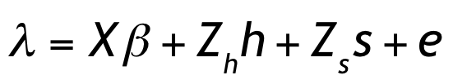
Multiple Trait Genetic Analysis
Multiple trait threshold sire model using thrgibbs1f90 (Misztal et al., 2002):
  λ = unobserved liabilities to disease
  β = vector of fixed effects (parity, year-season)
  X = incidence matrix of fixed effects
  h = random herd-year effect where h~N(0,Iσ_{h}²)
  s = random sire effect where s~N(0,Hσ_{s}²)
  Z_{h}, Z_{s} = incidence matrix of corresponding random effect

Slide 32
Multiple Trait Genetic Analysis
Health traits included in the analysis:
  Mastitis
  Metritis
  Lameness
  Retained placenta
  Cystic ovaries
  Ketosis
  Displaced abomasum

Slide 33
Multiple Trait Genetic Analysis
 | Mastitis | Metritis | Lameness | Retained placenta | Cystic ovaries | Ketosis | Displaced abomasum
Mastitis | 0.10 (0.09, 0.12)
Metritis | -0.30 (-0.45, -0.15) | 0.04 (0.03, 0.05)
Lameness | -0.29 (-0.46, -0.11) | 0.21 (0, 0.45) | 0.019 (0.01,0.03)
Retained placenta | 0.01 (-0.14, 0.16) | 0.78 (0.68, 0.88) | -0.14 (-0.36, 0.07) | 0.05 (0.03, 0.06)
Cystic ovaries | -0.09 (-0.29, 0.13) | -0.17 (-0.37, 0.06) | -0.19 (-0.40, -0.06) | -0.12 (-0.34, 0.12) | 0.026 (0.02, 0.03)
Ketosis | -0.28 (-0.47, -0.07) | 0.45 (0.26, 0.64) | 0.08 (-0.17, 0.34) | 0.10 (-0.17, 0.35) | -0.15 (-0.367, 0.13) | 0.08 (0.05, 0.11)
Displaced abomasum | 0.005 (-0.15, 0.17) | 0.44 (0.28, 0.60) | -0.10 (-0.29, 0.09) | 0.06 (-0.12, 0.25) | -0.10 (-0.31, 0.10) | 0.81 (0.70, 0.92) | 0.13 (0.11, 0.16)
Estimated heritabilities (95% HPD) on diagonal and estimated genetic correlations (95% HPD) below diagonal.

Slide 34
Multiple Trait Genomic Analyses
Multiple trait threshold sire model using single step methodology
  Used thrgibbs1f90 with genomic options
  50K SNP data available for 7,883 bulls

Slide 35
Multiple Trait Genomic Analyses
2,649 sires with 38,416 markers were used in the following model:
  λ = unobserved liabilities to disease
  β = vector of fixed effects (parity, year-season)
  X = incidence matrix of fixed effects
  h = random herd-year effect where h~N(0,Iσ_{h}²)
  s = random sire effect where s~N(0,Hσ_{s}²)
  Z_{h}, Z_{s} = incidence matrix of corresponding random effect

Slide 36
Multiple Trait Genomic Analyses
 | Mastitis | Metritis | Lameness
Mastitis | 0.09 (0.07, 0.10)
Metritis | -0.27 (-0.38, -0.11) | 0.04 (0.039, 0.05)
Lameness | -0.15 (-0.33, 0.14) | -0.02 (-0.21, 0.14) | 0.01 (0.004, 0.014)
Select estimated heritabilities (95% HPD) on diagonal and estimated genetic correlations (95% HPD) below diagonal.

Slide 37
Reliability with and without genomics
Event | EBV Reliability | GEBV Reliability | Percent Increase
Displaced abomasum | 0.29 | 0.40 | 38%
Ketosis | 0.24 | 0.35 | 46%
Lameness | 0.25 | 0.37 | 48%
Mastitis | 0.30 | 0.41 | 37%
Metritis | 0.31 | 0.41 | 32%
Retained placenta | 0.27 | 0.38 | 41%

Slide 38
What do we do with these PTA?
Focus on diseases that occur frequently enough to observe in most herds
Put them into a selection index
Apply selection for a long time
  There are no shortcuts
Collect phenotypes on many daughters
  Repeated records of limited value

Slide 39
Conclusions
…

Slide 40

Questions?
http://gigaom.com/2012/05/31/t-mobile-pits-its-math-against-verizons-the-loser-common-sense/shutterstock_76826245/

