Slide 1
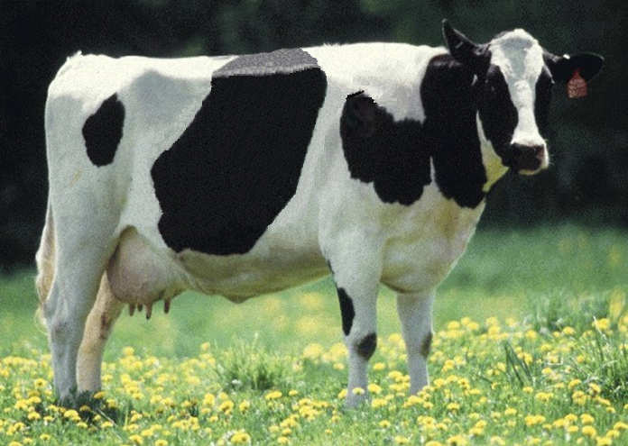
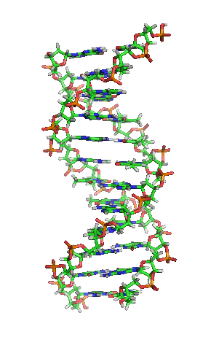
Animal
Improvement
Programs
Laboratory

Slide 2
Mission
Discovery and development of improved methods for genetic and genomic evaluation of economically important traits of dairy animals
  Yield (milk, fat, and protein)
  Conformation (overall and individual traits)
  Longevity (productive life)
  Fertility (conception and pregnancy rates)
  Calving (dystocia and stillbirth)
  Health (resistance to disease and heat stress)
  Feed efficiency

Slide 3
U.S. dairy background
9 million cows
Attempt to have a calf born every year
Replaced after 2 or 3 years of milking
Breeding through artificial insemination (AI)
Popular bulls have 10,000+ offspring
Cows can have many progeny though superovulation and embryo transfer
Notes:
3

Slide 4
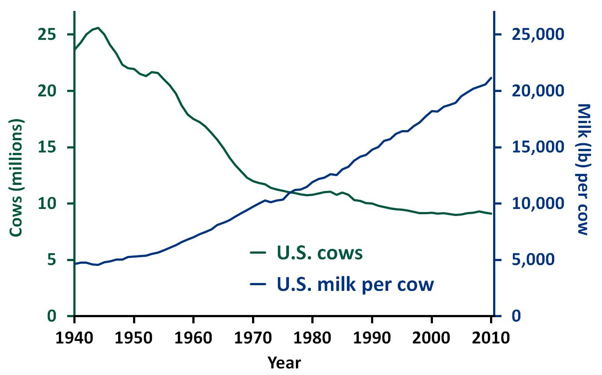


U.S. dairy population and milk yield

Slide 5
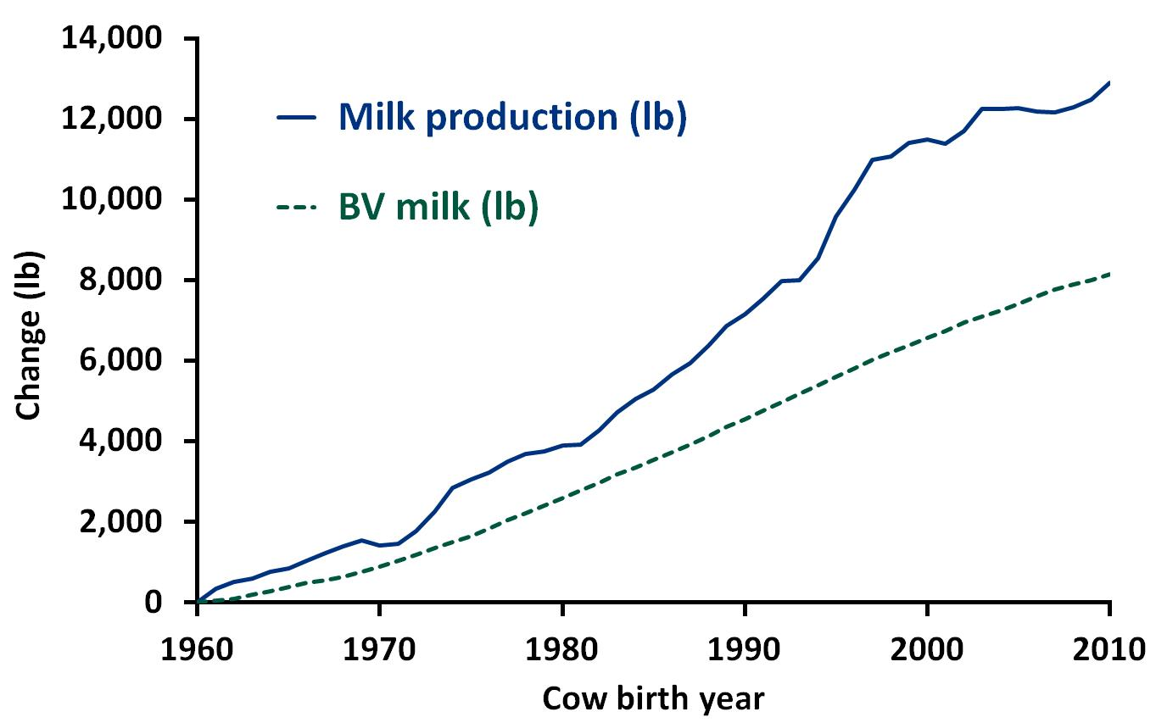

Trend for DHI Holsteins

Slide 6
Dairy cattle traits evaluated by USDA
Year | Trait
1926 | Milk & fat yields
1978 | Protein yield, conformation (type)
1994 | Productive life, somatic cell score (mastitis resistance)
1999 | Calving ease
2003 | Daughter pregnancy rate
2006 | Stillbirth rate, bull conception rate, milking speed
2009 | Cow and heifer conception rates, genomic evaluation
2012 | Mobility, calving-to-insemination interval

Slide 7

Benefit of genomics
Determine value of bull at birth
Increase accuracy of selection
Reduce generation interval
Increase selection intensity
Increase rate of genetic gain
Bovine G-Nome
Notes:
7

Slide 8
Why genomics works for dairy cattle
Extensive historical data available
Well-developed genetic evaluation program
Widespread use of AI sires
Progeny-test programs
High-value animals worth the cost of genotyping
Long generation interval that can be reduced substantially by genomics
Notes:
8

Slide 9
Project 1245-31000-101-00D
Improving genetic predictions in dairy animals using phenotypic and genomic information
  Objective 1: Expand national and international collection of phenotypic and genotypic data
  Objective 2: Develop more accurate genomic evaluation system with advanced, efficient methods to combine pedigrees, genotypes, and phenotypes for all animals
  Objective 3: Use economic analysis to maximize genetic progress and financial benefits from collected data

Slide 10
Recent accomplishments
Introduction of free genetic tests for inherited defects of dairy cattle
Development of a genomic mating program for dairy cattle
Development of international genomic evaluations for young bulls
Identification of specific chromosomal regions with significant effects on economically important traits
Determination of accuracy improvement for genomic evaluations through use of more DNA markers

Slide 11
AIPL staff
Laboratory
  4 SYs
  6 support scientists
  4 IT specialists
  1 PSA
On-site collaborators
  Council of Dairy Cattle Breeding (2 consultants)
  National Association of Animal Breeders
  (1 postdoctoral researcher)

Slide 12

George Wiggans
Ph.D., Cornell University, 1978
Genomic data collection, quality,
  and management
Development of special-purpose genotyping chips
Enhancement of genomic evaluation methods

Slide 13

Paul VanRaden
Ph.D., Iowa State University, 1986
Development of genomic
  evaluation methods
Imputation of missing genomic data
Dominance, epistasis, and imprinting of marker effects
Fine mapping of causative mutations

Slide 14

John Cole
Ph.D., Louisiana State University,
2003
Visualization of genomic data
Use of haplotypes in breeding programs
Genetic evaluation of health and fertility
Development and enhancement of genetic-economic selection indexes

Slide 15

Derek Bickhart
Ph.D., University of Connecticut,
2010
Identification of genetic variants
using full-sequence genomic data
Tools to exploit DNA sequence data to find new markers and disease loci
Enhancement of genomic evaluation methods

Slide 16

Chuanyu Sun (NAAB)
Ph.D., China Agricultural and
Aarhus Universities, 2009
Mating programs with genomic
relationships and dominance effects
Increased long-term response to genomic selection by selecting for favorable alleles
Improved prediction ability for genomic selection by including dominance effect

Slide 17
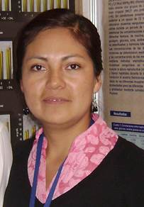
Adriana García-Ruiz
Ph.D. candidate, UNAM, México
Graduate student visiting jointly
  with Bovine Functional Genomics
  Laboratory and AIPL
Genomic determination of similarity between Mexican and U.S. Holsteins

Slide 18
CDCB NFCA
CDCB responsible for receiving data, computing, and delivering U.S. genetic evaluations for dairy cattle
USDA responsible for research and development to improve the evaluation system
CDCB and USDA employees co-located in Beltsville

Slide 19

CDCB consultants
Duane Norman,
interim administrator
(retired AIPL RL)
Leigh Walton,
interim technical applications manager (retired AIPL IT section leader)

Slide 20
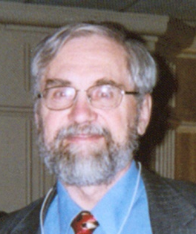
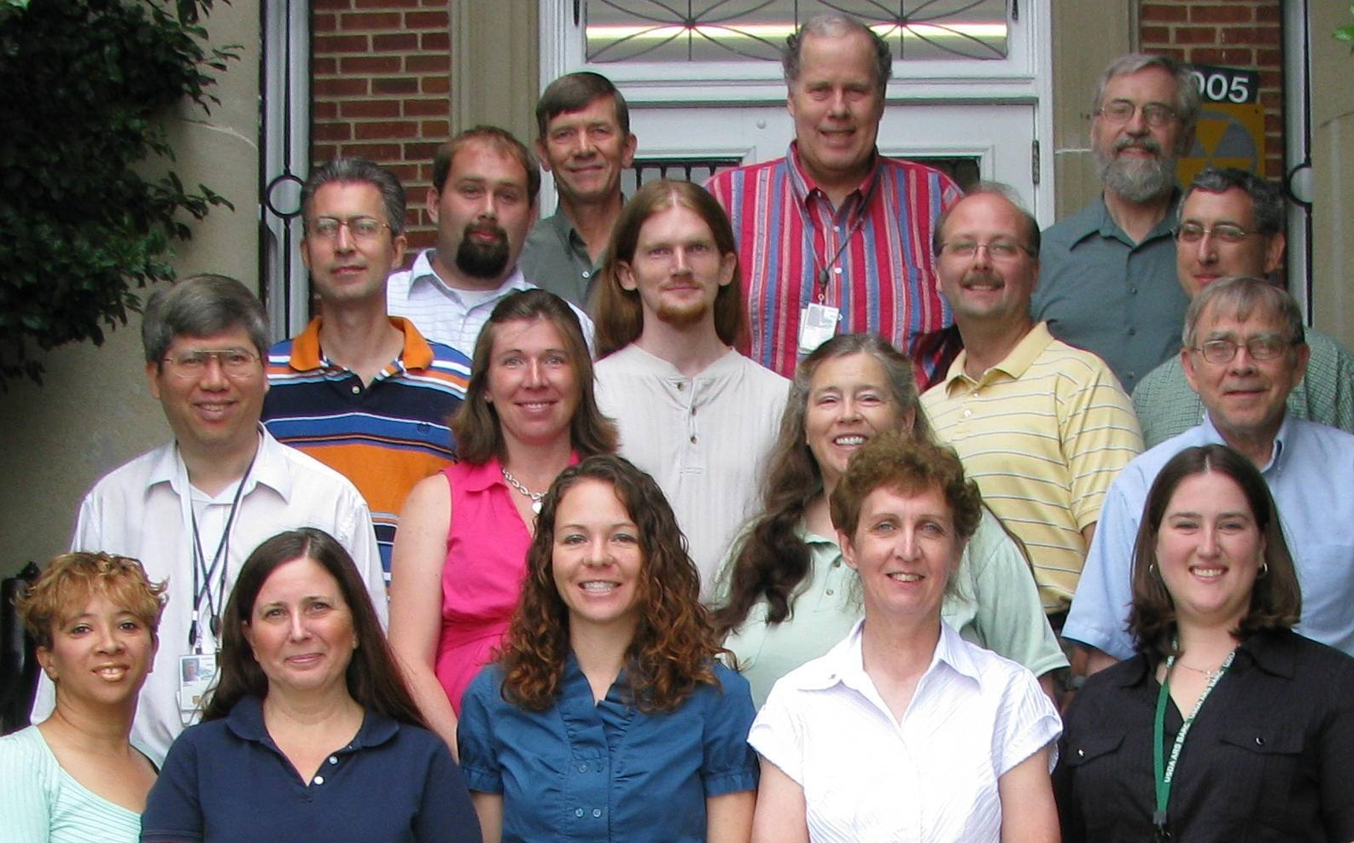
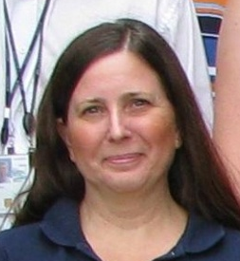
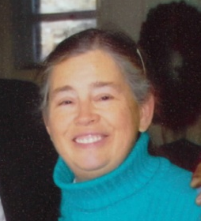



Current AIPL research group

