Slide 1
Algorithms and genotype densities
100
011110
1220020012
02121110111121
10111100112110002012200222011112021012002111221100211120220
00111100101101101022001100220110112002011010202221211221012202
2010011100011220221222112021120120201002022020002122
21122011101210011121110211211002010210002200020221
2010002011000022022110221121011211101222200120111
12220020002002020201222110022222220022121111220
21002111120011011101120020222000111201101021211
1121211102022100211201211001111102111211020002
122000101101110202200221110102011121111011221
202102102121101102212200121101121101202201100
01 22200210021100011100211021101110002220021121
2 21212110002220102002222120012211212101110112
11 200201102020012222220021110 22001120 211122 10101121211 202111
2112 12112121 10120
1021 01 11220 012 10 0 21
00 2 2 11
12 0 21
1 2 12001
0 12

Slide 2
Genotyping Chips
BovineSNP50
Version 1 54,001 (43,593) SNP
Version 2 54,609 (43,289) SNP
HD
777,962 (40,241) SNP
LD
6,909 (6,836) SNP
GeneSeek Genomic Profiler
GGP 8,762 (8,032) SNP
GP2 19,725 (8,189) SNP
GHD 76,999 (27,732) SNP
(used in evaluation)

Slide 3
Common SNP
Chip | HD | GHD | 50K_V2 | GP2 | GGP | LD
HD | 302,169 | 65,370 | 38,185 | 11,105 | 7,484 | 6,540
GHD |  | 72,105 | 26,245 | 8,589 | 7,137 | 6,485
50K_V2 |  |  | 42,608 | 7,865 | 7,698 | 6,599
GP2 |  |  |  | 11,805 | 7,492 | 6,633
GGP |  |  |  |  | 7,780 | 6,633
LD |  |  |  |  |  | 6,633

Slide 4
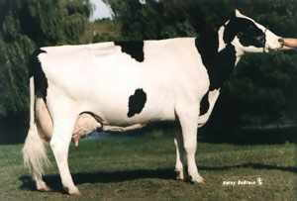
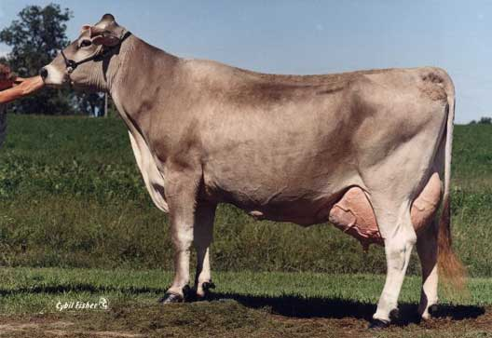
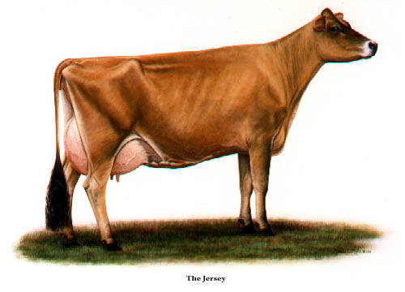
Across breed evaluation
Multibreed methods are currently used in traditional evaluations
Only within breed methods are used for genomic evaluations
Research has shown little improvement in accuracy from combining breeds for genomic evaluations.

Slide 5
Correlation GPTAs and other Breeds’ GPTAs

Slide 6
Multi Trait by Breed
Permits correlation <1 for performance in different breeds
Places an upper limit on influence of one breed on any other
SNP with opposite effects will not be useful
Experiences so far have not improved accuracy of breeds with low numbers

Slide 7
Genotyped Animals (April 2013)
Chip | Traditional evaluation? | Animal sex | Holstein | Jersey | Brown Swiss | Ayrshire
≥50K | Yes | Bulls | 21,904 | 2,855 | 5,381 | 639
 |  | Cows | 16,062 | 1,054 | 110 | 3
 | No | Bulls | 45,537 | 3,884 | 1,031 | 325
 |  | Cows | 32,892 | 660 | 102 | 110
<50K | Yes | Bulls | 19 | 11 | 28 | 9
 |  | Cows | 21,980 | 9,132 | 465 | 0
 | No | Bulls | 14,026 | 1,355 | 90 | 2
 |  | Cows | 158,622 | 18,722 | 658 | 105
Imputed | Yes | Cows | 2,713 | 237 | 103 | 12
 | No | Cows | 1,183 | 32 | 112 | 8
All |  |  | 314,938 | 37,942 | 8,080 | 1,213

Slide 8
Reliability of Holstein predictions
Traitª | Bias^{b} | b | REL (%) | REL gain (%)
Milk (kg) | −64.3 | 0.92 | 67.1 | 28.6
Fat (kg) | −2.7 | 0.91 | 69.8 | 31.3
Protein (kg) | 0.7 | 0.85 | 61.5 | 23.0
Fat (%) | 0.0 | 1.00 | 86.5 | 48.0
Protein (%) | 0.0 | 0.90 | 79.0 | 40.4
PL (months) | −1.8 | 0.98 | 53.0 | 21.8
SCS | 0.0 | 0.88 | 61.2 | 27.0
DPR (%) | 0.0 | 0.92 | 51.2 | 21.7
Sire CE | 0.8 | 0.73 | 31.0 | 10.4
Daughter CE | −1.1 | 0.81 | 38.4 | 19.9
Sire SB | 1.5 | 0.92 | 21.8 | 3.7
Daughter SB | − 0.2 | 0.83 | 30.3 | 13.2
a PL=productive life, CE = calving ease and SB = stillbirth.
b 2011 deregressed value – 2007 genomic evaluation.

Slide 9
Council on Dairy Cattle Breeding
CDCB
PDCA
NAAB
DRPC
DHI
3 members from each organization for a total of 12 voting members

Slide 10
Council on Dairy Cattle Breeding
CDCB assuming responsibility for receiving data, computing, and delivering U.S. evaluations
USDA will continue research and development to improve evaluation system
CDCB and USDA employees collocated in Beltsville

Slide 11
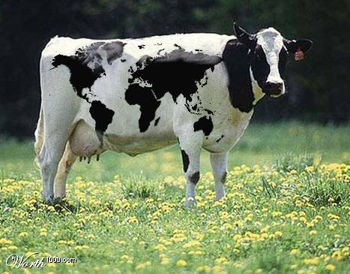
Questions?

