Slide 1
Computation of Large-Scale Genomic Evaluations

Slide 2
Early genomic theory
Nejati-Javaremi et al (1997) tested use of genomic relationship matrix in BLUP
Meuwissen et al (2001) tested linear and nonlinear estimation of haplotype effects
Both studies assumed that few (<1,000) markers could explain all genetic variance (no polygenic effects in model)
Polygenic variance was only 5% with 50,000 SNP (VanRaden, 2008), but 50% with 1,000

Slide 3
Multi-step genomic evaluations
Traditional evaluations computed first and used as input data to genomic equations
Allele effects estimated for 45,187 markers by multiple regression, assuming equal prior variance
Polygenic effect estimated for genetic variation not captured by markers, assuming pedigree covariance
Selection index step combines genomic info with traditional info from non-genotyped parents
Applied to 30 yield, fitness, calving and type traits

Slide 4
Single-step genomic evaluation
Benefits of 1-step genomic evaluation
  Account for genomic pre-selection
  Expected Mendelian Sampling ≠ 0
  Improve accuracy and reduce bias
  Include many genotyped animals
Redesign animal model software used since 1989

Slide 5
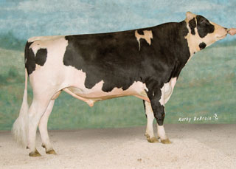
Pedigree: Parents, Grandparents, etc.
 |  | Manfred
 | O-Man
 |  | Jezebel
O-Style
 |  | Teamster
 | Deva
 |  | Dima
Notes:
We are all familiar with a traditional pedigree chart. Animal is expected to be an average of his parents.

Slide 6
O-Style Haplotypes chromosome 15

Slide 7
Expected Relationship Matrix¹
1HO9167 O-Style
 | PGS | PGD | MGS | MGD | Sire | Dam | Bull
Manfred | 1.0 | .0 | .0 | .0 | .5 | .0 | .25
Jezebel | .0 | 1.0 | .0 | .0 | .5 | .0 | .25
Teamster | .0 | .0 | 1.0 | . 0 | .0 | .5 | .25
Dima | .0 | .0 | .0 | 1.0 | .0 | .5 | .25
O-Man | .5 | .5 | .0 | .0 | 1.0 | .0 | .5
Deva | .0 | .0 | .5 | .5 | .0 | 1.0 | .5
O-Style | .25 | .25 | .25 | .25 | .5 | .5 | 1.0
¹Calculated assuming that all grandparents are unrelated

Slide 8
Pedigree Relationship Matrix
1HO9167 O-Style
 | PGS | PGD | MGS | MGD | Sire | Dam | Bull
Manfred | 1.053 | .090 | .090 | .105 | .571 | .098 | .334
Jezebel | .090 | 1.037 | .051 | .099 | .563 | .075 | .319
Teamster | .090 | .051 | 1.035 | .120 | .071 | .578 | .324
Dima | .105 | .099 | .120 | 1.042 | .102 | .581 | .342
O-Man | .571 | .563 | .071 | .102 | 1.045 | .086 | .566
Deva | .098 | .075 | .578 | .581 | .086 | 1.060 | .573
O-Style | .334 | .319 | .324 | .342 | .566 | .573 | 1.043

Slide 9
Genomic Relationship Matrix
1HO9167 O-Style
 | PGS | PGD | MGS | MGD | Sire | Dam | Bull
Manfred | 1.201 | .058 | .050 | .093 | .609 | .054 | .344
Jezebel | .058 | 1.131 | .008 | .135 | .618 | .079 | .357
Teamster | .050 | .008 | 1.110 | .100 | .014 | .613 | .292
Dima | .093 | .135 | .100 | 1.139 | .131 | .610 | .401
O-Man | .609 | .618 | .014 | .131 | 1.166 | .080 | .626
Deva | .054 | .079 | .613 | .610 | .080 | 1.148 | .613
O-Style | .344 | .357 | .292 | .401 | .626 | .613 | 1.157

Slide 10
Difference (Genomic – Pedigree)
1HO9167 O-Style
 | PGS | PGD | MGS | MGD | Sire | Dam | Bull
Manfred | .149 | -.032 | -.040 | -.012 | .038 | -.043 | .010
Jezebel | -.032 | .095 | -.043 | .036 | .055 | .004 | .038
Teamster | -.040 | -.043 | .075 | -.021 | -.057 | .035 | -.032
Dima | -.012 | .036 | -.021 | .097 | .029 | .029 | .059
O-Man | .038 | .055 | -.057 | .029 | .121 | -.006 | .060
Deva | -.043 | .004 | .035 | .029 | -.006 | .087 | .040
O-Style | .010 | .038 | -.032 | .059 | .060 | .040 | .114

Slide 11
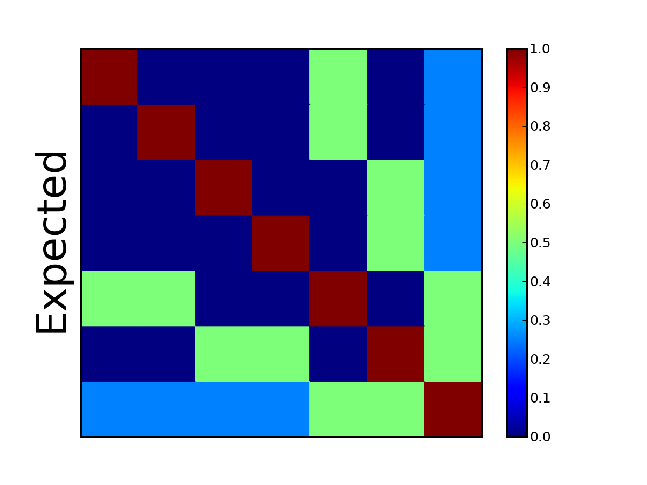
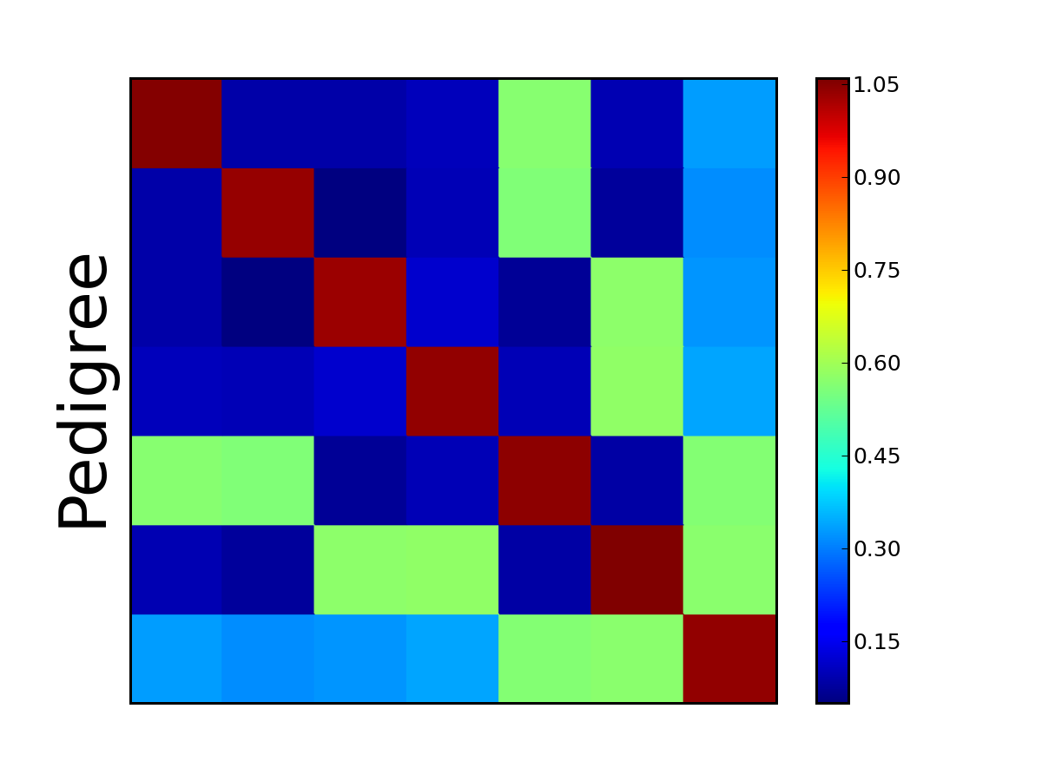

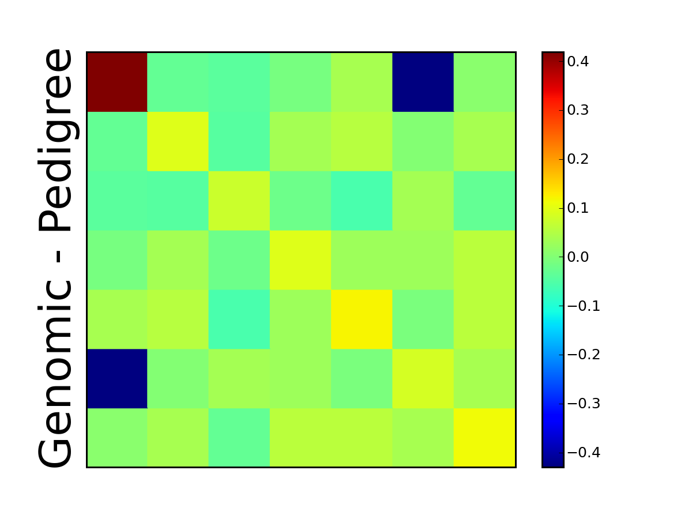
Pseudocolor Plots ― O-Style

Slide 12
1 – Step Equations
Aguilar et al., 2010
Model: y = X b + W u + e
+ other random effects not shown
X’ R⁻¹ X X’ R⁻¹ W
W’ R⁻¹ X W’ R⁻¹ W + H⁻¹ k
b
u
X’ R⁻¹ y
W’ R⁻¹ y
=
H⁻¹ = A⁻¹ +
0 0
0 G⁻¹ – A₂₂⁻¹
Size of G and A₂₂ >300,000 and doubling each year
Size of A is 60 million animals

Slide 13
Modified 1-Step Equations
Legarra and Ducrocq, 2011
To avoid inverses, add equations for γ, φ
Use math opposite of absorbing effects
X’R⁻¹X X’R⁻¹W 0 0
W’R⁻¹X W’R⁻¹W+A⁻¹k Q Q
0 Q’ -G/k 0
0 Q’ 0 A₂₂/k
b
u
γ
φ
X’ R⁻¹ y
W’ R⁻¹ y
0
0
=
Iterate for γ using G = Z Z’ / [ 2 Σp(1-p)]
Iterate for φ using A₂₂ multiply (Colleau)
Q’ = [ 0 I ] (I for genotyped animals)

Slide 14
Genomic Algorithms Tested
1-step genomic model
  Add extra equations for γ and φ (Legarra and Ducrocq)
  Converged ok for JE, bad for HO
  Extended to MT using block diagonal
  Invert 3x3 A⁻¹u, Gγ, -A₂₂φ blocks? NO
  PCG iteration (hard to debug) Maybe

Slide 15
Genomic Algorithms (continued)
Multi-step insertion of GEBV
  [W’R⁻¹W + A⁻¹k] u = W’R⁻¹y (without G)
  Previous studies added genomic information to W’R⁻¹W and W’R⁻¹y
  Instead: insert GEBV into u, iterate
1-step genomic model using DYD
  Solve SNP equations from DYD & YD
  May converge faster, but approximate

Slide 16
Data for 1-Step Test
National U.S. Jersey data
  4.4 million lactation phenotypes
  4.1 million animals in pedigree
  Multi-trait milk, fat, protein yields
  5,364 male, 11,488 female genotypes
  Deregressed MACE evaluations for 7,072 bulls with foreign daughters (foreign dams not yet included)

Slide 17
Jersey Results
New = 1-step GPTA milk, Old = multi-step GPTA milk
Statistic | Animals
Corr(New, Old) | All bulls | 0.994
Corr(New, Old) | Genotyped bulls | 0.992
Corr(DYD_{g}, DYD) | Genotyped bulls | 0.999
Corr(New, Old) | Young genomic | 0.966
SD old PTA milk | Young genomic | 540
SD new PTA milk | Young genomic | 552
Old milk trend | 1995-2005 cows | 1644
New milk trend | 1995-2005 cows | 1430

Slide 18
1-Step vs Multi-Step: Results
Data cutoff in August 2008
Evaluation | Regression | Squared Correlation
Parent Average | .73 | .436
Multi-Step GPTA | .75 | .520
1-Step GPTA | .85 | .520
Expected | .93
Multi-step regressions also improved by modified selection index weights

Slide 19
Computation Required
CPU time for 3 trait ST model
  JE took 11 sec / round including G
  HO took 1.6 min / round including G
  JE needed ~1000 rounds (3 hours)
  HO needed >5000 rounds (>5 days)
Memory required for HO
  30 Gigabytes (256 available)

Slide 20
Remaining Issues
Difficult to match G and A across breeds
Nonlinear model (Bayes A) possible with SNP effect algorithm
Interbull validation not designed for genomic models
MACE results may become biased

Slide 21
Steps to prepare genotypes
Nominate animal for genotyping
Collect blood, hair, semen, nasal swab, or ear punch
  Blood may not be suitable for twins
Extract DNA at laboratory
Prepare DNA and apply to BeadChip
Do amplification and hybridization, 3-day process
Read red/green intensities from chip and call genotypes from clusters
Notes:
21

Slide 22
Ancestor Validation and Discovery
Ancestor discovery can accurately confirm, correct, or discover parents and more distant ancestors for most dairy animals because most sires are genotyped.
  Animal checked against all candidates
  SNP test and haplotype test both used
Parents and MGS are suggested to breed associations and breeders since December 2011 to improve pedigrees.

Slide 23
Ancestor Discovery Results by Breed
 | SNP Test | Haplotype Test
 | MGS | MGS | MGGS
Breed | % Confirmed* | % Confirmed | % Confirmed
Holstein | 95 (98)† | 97 | 92
Jersey | 91 (92) | 95 | 95
Brown Swiss | 94 (95) | 97 | 85
*Confirmation = top MGS candidate matched true pedigree MGS.
†50K genotyped animals only.

Slide 24
Data (Yield and Health)
One step model includes:
  72 million lactation phenotypes
  50 million animals in pedigree
  29 million permanent environment
  7 million herd mgmt groups
  11 million herd by sire interactions
  7 traits: Milk, Fat, Protein, SCS, longevity, fertility
  Genotypes not yet included

Slide 25
New Features Added
Model options now include:
  Multi-trait models
  Multiple class and regress variables
  Suppress some factors / each trait
  Random regressions
  Foreign data
  Parallel processing
  Genomic information
Renumber factors in same program
Notes:
Renumber factors in same program

Slide 26
Computation Required: Evaluation
CPU for all-breed model (7 traits)
  ST: 4 min / round with 7 processors and ~1000 rounds (2.8 days)
  MT: 15 min / round and ~1000 rounds
  ~200 rounds for updates using priors
  Little extra cost to include foreign
Memory required
  ST or MT: 32 Gbytes (256 available)

Slide 27
Computation Required: Imputation
Impute 636,967 markers for 103,070 animals
  Required 10 hours with 6 processors (findhap)
  Required 50 Gbytes memory
  Program FImpute from U. Guelph slightly better
Impute 1 million markers on 1 chromosome (sequences) for 1,000 animals
  Required 15 minutes with 6 processors
  Required 4 Gbytes memory

Slide 28
Methods to Trace Inheritance
Few markers
  Pedigree needed
  Prob (paternal or maternal alleles inherited) computed within families
Many markers
  Can find matching DNA segments without pedigree
  Prob (haplotypes are identical) mostly near 0 or 1 if segments contain many markers

Slide 29
Haplotype Probabilities
with Few Markers (12 SNP / chromosome)

Slide 30
Haplotype Probabilities
with More Markers (50 SNP / chromosome)

Slide 31
Haplotyping Program: findhap.f90
Population haplotyping
  Divide chromosomes into segments
  List haplotypes by genotype match
  Similar to FastPhase, IMPUTE, or long range phasing
Pedigree haplotyping
  Look up parent or grandparent haplotypes
  Detect crossovers, fix noninheritance
  Impute nongenotyped ancestors

Slide 32
Coding of Alleles and Segments
Genotypes
  0 = BB, 1 = AB or BA, 2 = AA, 5 = __ (missing)
  Allele frequency used for missing
Haplotypes
  0 = B, 1 = not known, 2 = A
Segment inheritance (example)
  Son has haplotype numbers 5 and 8
  Sire has haplotype numbers 8 and 21
  Son got haplotype number 5 from dam

Slide 33
Population Haplotyping Steps
Put first genotype into haplotype list
Check next genotype against list
  Do any homozygous loci conflict?
    If haplotype conflicts, continue search
    If match, fill any unknown SNP with homozygote
    2nd haplotype = genotype minus 1st haplotype
    Search for 2nd haplotype in rest of list
  If no match in list, add to end of list
Sort list to put frequent haplotypes 1st

Slide 34
Check New Genotype Against List
1st segment of chromosome 15
Search for 1st haplotype that matches genotype:
022112222011221022021110220010110212202000102020120002021
5.16% 022222222020020022002020200020000200202000022022222202220
4.37% 022020220202200020022022200002200200200000200222200002202
4.36% 022020022202200200022020220000220202200002200222200202220
3.67% 022020222020222002022022202020000202220000200002020002002
3.66% 022222222020222022020200220000020222202000002020220002022
Get 2nd haplotype by removing 1st from genotype:
022002222002220022022020220020200202202000202020020002020
3.65% 022020022202200200022020220000220202200002200222200202222
3.51% 022002222020222022022020220200222002200000002022220002220
3.42% 022002222002220022022020220020200202202000202020020002020
3.24% 022222222020200000022020220020200202202000202020020002020
3.22% 022002222002220022002020002220000202200000202022020202220

Slide 35
Net Merit by Chromosome
Freddie - highest Net Merit bull

Slide 36
Net Merit by Chromosome
O Man – Sire of Freddie

Slide 37
Net Merit by Chromosome
Die-Hard - maternal grandsire

Slide 38
Net Merit by Chromosome
Planet – high Net Merit bull

Slide 39
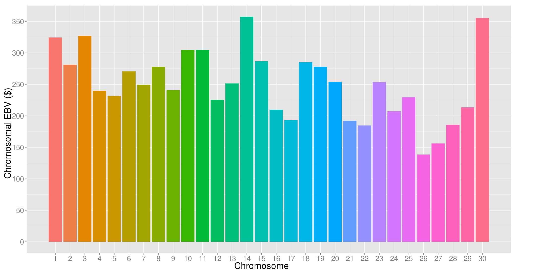
What’s the best cow we can make?
A “Supercow” constructed from the best haplotypes in the Holstein population would have an EBV(NM$) of $7515

Slide 40
Conclusions
1-step genomic evaluations tested
  Inversion avoided using extra equations
  Converged well for JE but not for HO
  Same accuracy, less bias than multi-step
  Foreign data from MACE included
Further work needed on algorithms
  Including genomic information
  Extending to all-breed evaluation

Slide 41
Conclusions
Foreign data can add to national evaluations
  In one step model instead of post-process
  High correlations of national with MACE
Multi-trait all-breed model developed
  Replace software used since 1989
  Many new features added
  Correlations ~.99 with traditional AM
  Tested with 7 yield and health traits
  Also tested with 14 JE conformation traits

Slide 42
Acknowledgments
George Wiggans, Ignacy Misztal, and Andres Legara provided advice on algorithms
Mel Tooker, Tabatha Cooper, and Jan Wright assisted with computation, program design, and ancestor discovery
Members of the Council on Dairy Cattle Breeding provided data

