Slide 1
Global Impact of Genomic Selection in Dairy Cattle

Slide 2
Why Go Global?
Genetic effects are mostly small (many genes)
Very large datasets needed to estimate effects of individual genes
Global dairy populations share many copies of the same DNA from famous bulls
Traditional selection was already global

Slide 3
Timeline in dairy cattle
1926 Selection with phenotypes, pedigrees
1994 Bull DNA repository, QTL detection
2007 Bovine 50K chip developed
2009 Official genomic predictions
2010 Prediction from less dense chips
2011 Research on higher density chips

Slide 4
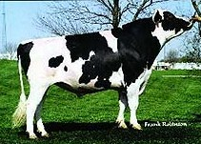
Traditional Selection
O-Bee Manfred Justice (O-Man)
Semen sales >1 million units
Semen price ~$40/unit
Income ~$40 million
96,293 daughters milking, 59,185 in United States, 37,108 in 23 other countries

Slide 5
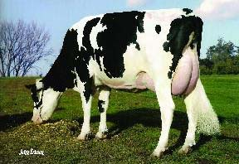
O-Man Daughters vs. Average Cows
Trait | O-Man daughter | Average Holstein
Milk (gallons/day) | 10.5 | 10.1
Protein (lbs/day) | 2.82 | 2.62
Cell count (1000/ml) | 231 | 288
Productive life (mo) | 34.0 | 27.7
Pregnancy rate (%) | 23.9 | 21.0
Calving difficulty (%) | 3% | 8%

Slide 6
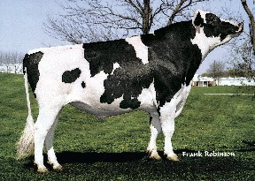
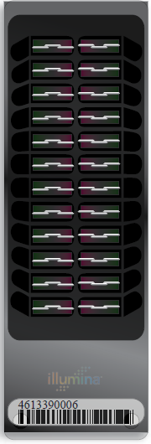
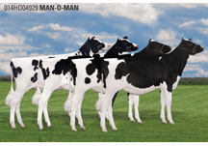
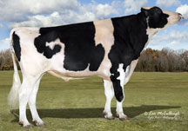
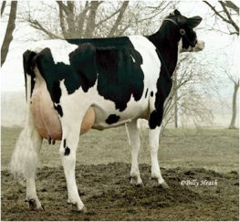
Genomic prediction of progeny test
0
1
2
3
4
5
  Select parents, Transfer embryos to recipients
Calves born from DNA selected parents
  Calves born and DNA tested
Bull Receives Progeny Test
Reduce generation interval from 5 years to 2 years

Slide 7
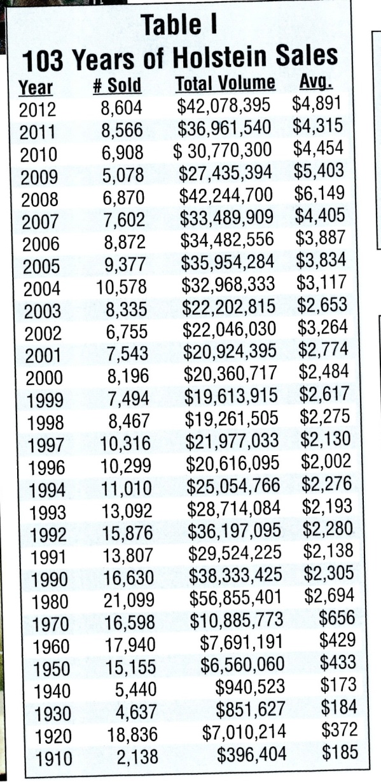

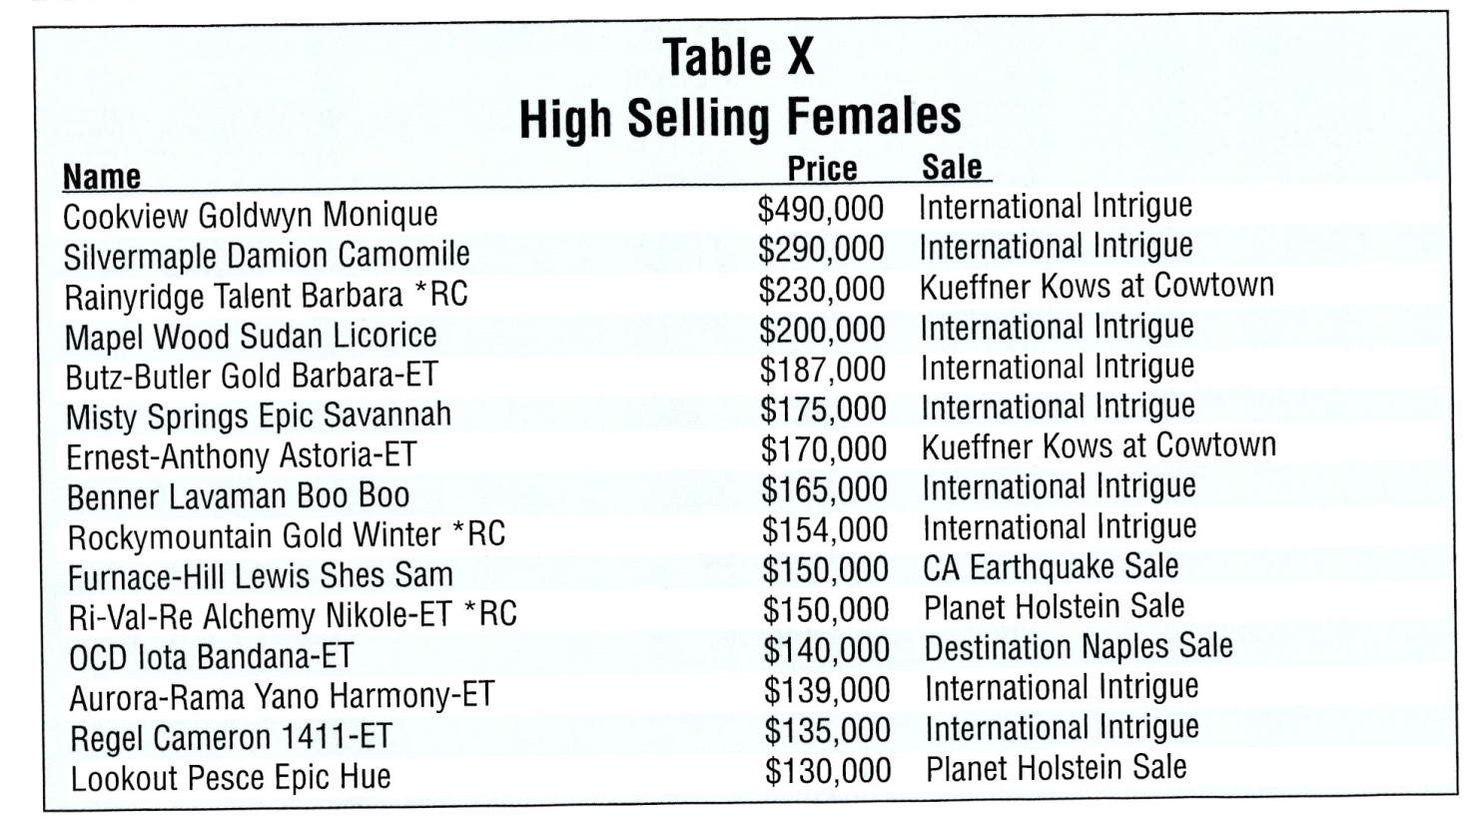
Example animals of high value

Slide 8
Reliability of Holstein predictions
Traitª | Bias^{b} | b | REL (%) | REL gain (%)
Milk (kg) | −64.3 | 0.92 | 67.1 | 28.6
Fat (kg) | −2.7 | 0.91 | 69.8 | 31.3
Protein (kg) | 0.7 | 0.85 | 61.5 | 23.0
Fat (%) | 0.0 | 1.00 | 86.5 | 48.0
Protein (%) | 0.0 | 0.90 | 79.0 | 40.4
PL (months) | −1.8 | 0.98 | 53.0 | 21.8
SCS | 0.0 | 0.88 | 61.2 | 27.0
DPR (%) | 0.0 | 0.92 | 51.2 | 21.7
Sire CE | 0.8 | 0.73 | 31.0 | 10.4
Daughter CE | −1.1 | 0.81 | 38.4 | 19.9
Sire SB | 1.5 | 0.92 | 21.8 | 3.7
Daughter SB | − 0.2 | 0.83 | 30.3 | 13.2
a PL=productive life, CE = calving ease and SB = stillbirth.
b 2011 deregressed value – 2007 genomic evaluation.

Slide 9
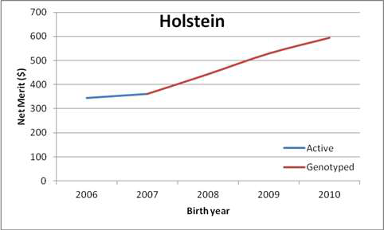
Average genetic merit for marketed bulls

Slide 10
North American genomic partners
USA and Canada
  Combined DNA repository since 1994
  Share genotypes and software since 2008
Italy and United Kingdom share all male genotypes with N. America since 2011
Switzerland, Germany, and Austria traded male Brown Swiss genotypes with USA since 2010

Slide 11
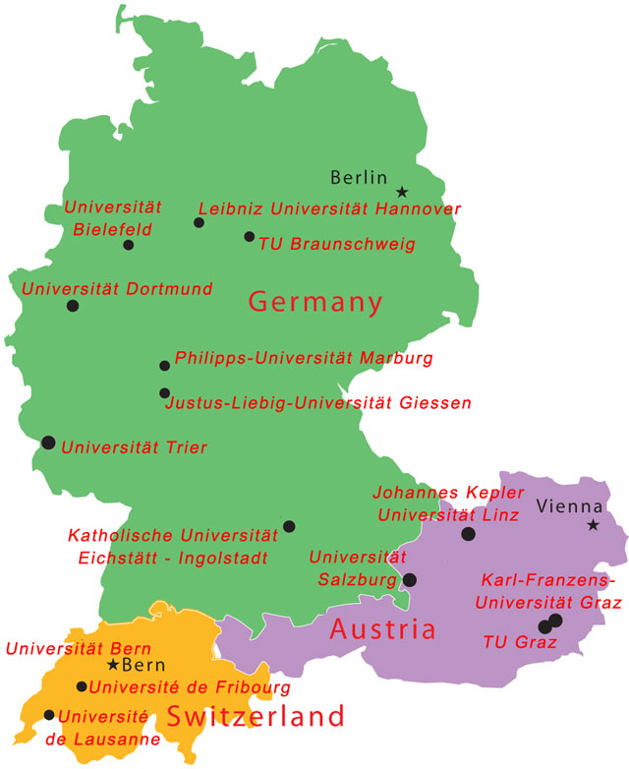
Foreign Brown Swiss Bulls
Began trading in 2010
Germany
318 bulls
Austria
52 bulls
Switzerland
403 bulls
Added 8,000 bulls from InterGenomics in 2012,
Previously only 891 bulls from United States

Slide 12
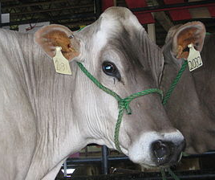
InterGenomics for Brown Swiss
Worldwide (7 country) database of Brown Swiss genotypes at Interbull (Sweden)
  Computed genomic evaluations on each scale using VanRaden software since 2011
  Exchanged genotypes of reference males since 2012 so that each country can compute predictions for females, monthly, low density, etc.

Slide 13
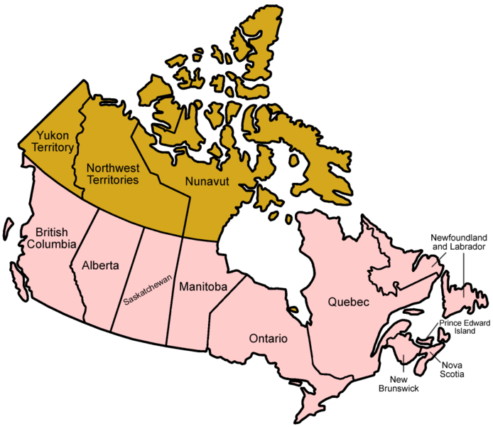
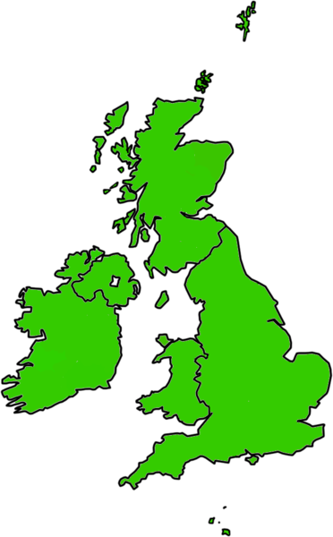
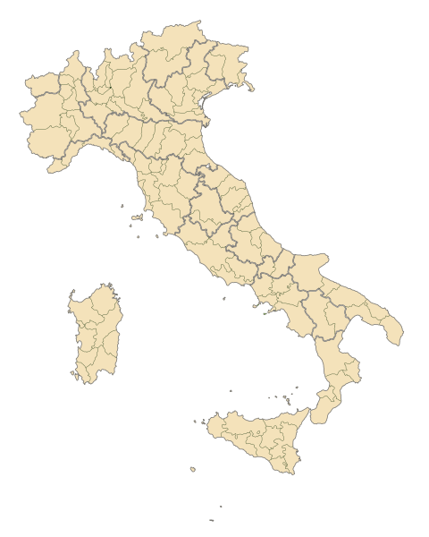
Foreign Holstein Reference Bulls
3,593 (28% of total bulls) had only foreign daughters
CAN
1,321 bulls
GBR
247 bulls
ITA
1,677 bulls

Slide 14
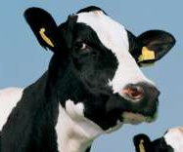
REL – REL_{PA} (Holstein)
Trait | Foreign excluded | Single Trait | Multiple Trait
Average (9 traits) | 21.9 | 24.6 | 24.5
Milk | 26.6 | 28.7 | 28.6
Fat | 29.0 | 31.3 | 31.1
Protein | 20.2 | 22.5 | 22.3
Productive life | 19.5 | 21.8 | 22.2
SCS | 23.7 | 27.2 | 27.2
Daughter pregnancy rate | 17.5 | 21.3 | 21.2
Final score | 22.2 | 24.0 | 24.1
Stature | 29.4 | 34.0 | 33.9
Sire calving ease | 8.8 | 10.4 | 9.7

Slide 15
EuroGenomic Holstein Partners
Germany, France, Netherlands, Scandinavia
  Shared reference bull genotypes since 2010
Spain, Poland
  Joined as partners in 2012
EuroGenomic partners and N. American partners maintain separate databases, each containing >20,000 reference bulls

Slide 16
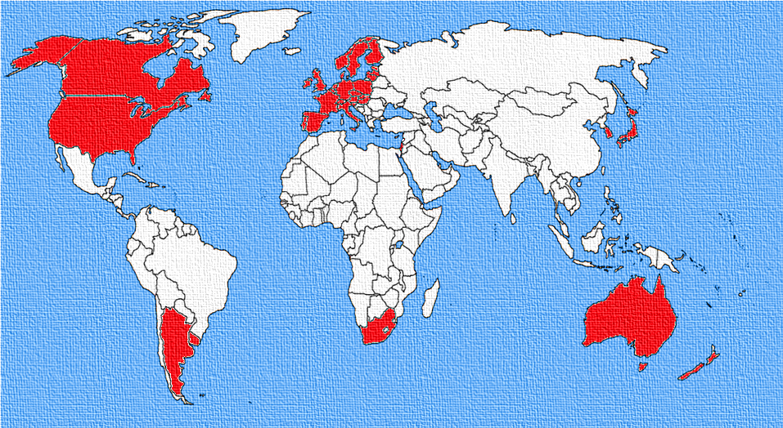
Interbull breeding value providers

Slide 17

Interbull data flow (began 1994) based in Sweden
200000 bulls
32 countries
81 populations
2 test runs/yr
6 breeds
3 routine runs/yr
40 traits

Slide 18
GMACE and genomic validation
Genomic multi-trait across country evaluation
  Each country computes genomic rankings
  Interbull combines into worldwide ranking
  Scheduled for August 2013 implementation
Genomic validation
  Each country must test its predictions first

Slide 19
Country A
Progeny records
National EBVs
Pedigrees
SNP genotypes
National GEBVs
Interbull
GMACE: International GEBVs
Common Reference Population
MACE: International EBVs
International Pedigree
Country B
SNP genotypes
National GEBVs
Pedigrees
Progeny records
National EBVs

Slide 20
Test predictions on truncated data
BLUP
EBV
Full Model
Phenotypes
Time
BLUP
EBVr
Reduced Model
Phenotypes
Time
TEST BULLS: first progeny test in the end of the period and have only parent information in the reduced model
Current phenotype = b0 + (b1*EBVr) + Ԑ
E(b1) = 1
R²>Model with PAs

Slide 21
Example of Genomic Validation
Animals genotyped as of February 2010
12,000 more old bulls in DNA repository yet to genotype

Slide 22
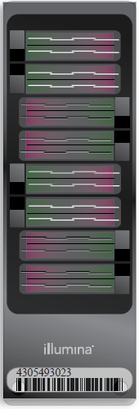

Chips and Marker Densities
50KV2
Illumina BovineSNP50
  Version 1 54,001 SNP
  Version 2 54,609 SNP
  45,187 used in evaluations
Higher Density
  777,962 SNP
  Only 50K SNP used,
  >1700 in database
Lower Density
  6,909 or 8,032 SNP
  Replaced 3K (2,900 SNP)
HD
LD
Notes:
22

Slide 23
Imputation
Based on splitting the genotype into individual chromosomes (maternal & paternal contributions)
Missing SNP assigned by tracking inheritance from ancestors and descendents
Imputed dams increase predictor population
3K, 6K, 8K, & 50K genotypes merged routinely by imputing SNP not present on less dense chips
777K & full sequence imputed in research studies

Slide 24
High Density Genotypes
1,510 Holstein Illumina BovineHD
  460 Italian bulls
  305 US bulls and 172 US cows
  284 British bulls
  93 Canadian bulls
  196 bulls from other countries
Earlier studies of 342 or 1,078 HD

Slide 25
High Density Reliability Gains
Trait | REL_{50K} REL_{PA} | REL_{HD} REL_{50K} | HD_{nonlinear} HD_{linear}
Average (28 traits) | 31.5 | 0.4 | 0.8
Milk | 28.7 | 0.3 | 1.2
Fat | 31.3 | 0.2 | 1.8
Protein | 22.5 | 0.5 | 0.3
Productive life | 21.8 | 1.6 | 1.3
SCS | 27.2 | 0.5 | 0.4
Daughter pregnancy rate | 21.3 | 0.7 | 0.4
Final score | 24.0 | 0.2 | 0.1
Stature | 34.0 | 1.8 | 0.7
Sire calving ease | 10.4 | 2.3 | 1.9

Slide 26
Preliminary HD Studies
Average REL gain of HD compared with 50K across 28 traits
  0.5% decrease using 342 HD
  0.5% increase using 1,074 HD
  0.4% increase using 1,510 HD
Imputation accuracy tested using simulated chromosome and same population structure as actual

Slide 27
Imputation Accuracy (% correct)
Markers | Animals | Findhap all |  | FImpute
 |  |  |  | All |  | 2-step¹
330,000 | 1,112 | 99.89 |  | 99.96 |  | 99.96
41,250 | 72,532 | 99.0 |  | 99.3 |  | 99.3
5,130 | 1,000 | 94.6 |  | 94.7 |  | 96.1
2,550 | 38,441 | 90.5 |  | 91.1 |  | 93.7
0² | 3,295 | 93.5 |  | 95.1 |  | 96.7
¹Imputing lower densities to 41,250 and then imputing to
330,000 in a second step instead of all together
²Dams imputed from 4 progeny

Slide 28
Lethal recessive discoveries (2011)
Checked for absence of homozygous haplotypes
  Used haplotype blocks ~5Mbp long
  7 – 90 homozygotes expected, but 0 observed in living animals
  5 of top 11 haplotypes confirmed as lethal recessives
  Investigated 936 – 52,449 carrier sire × carrier maternal grandsire (MGS) fertility records found 3.0 – 3.7% lower conception rates
  Sequenced carrier animals and used bioinformatics to identify mutations (U. of IL, USDA-BFGL, Australia)

Slide 29
Haplotypes impacting fertility
Breed | BTA chromo-some | Location | Carrier frequency (%)
Holstein | 5 | 63,150,400 | 4.5
Holstein | 1 | 94–97 Mbase | 4.6
Holstein | 8 | 95–96 Mbase | 4.7
Jersey | 15 | 15,707,169 | 23.4
Brown Swiss | 7 | 42–47 Mbase | 14.0

Slide 30
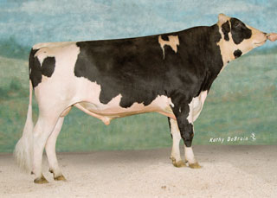
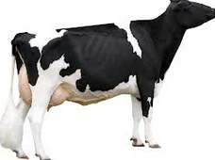
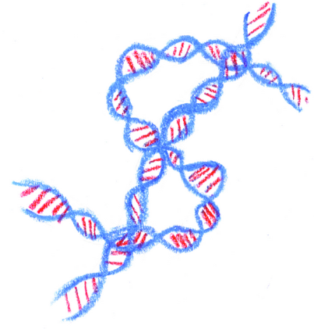
Mating Programs Including Genomic Relationships and Dominance Effects

Slide 31
Computer Mating Programs
For millions of dairy cows, mates are chosen by computer programs
  Inbreeding avoided using pedigrees
  Carriers of same defect not mated
  Weak traits of cow matched to strong traits of bull
  Sires with easy birth chosen for first calf

Slide 32
Genomic mating and inbreeding
Use genomic relationships (G) instead of pedigree relationships (A) to minimize calf inbreeding
Matrix A is the expected proportion of the genome identical by descent (IBD) given the pedigree, whereas matrix G is the realized proportion given the markers
Compared to random mating, pedigree mating reduced homozygosity by only 60% of the advantage from genomic mating

Slide 33
Genomic Mating Programs
Markers across the whole genome are now widely used for genomic selection
Inbreeding should be controlled on the same basis as used to estimate breeding values, i.e. pedigree-based inbreeding control with traditional pedigree-based method estimated breeding values and genome-based inbreeding control with genome-based estimated breeding values (Sonesson et al. 2012)
New programs to minimize genomic inbreeding by comparing genotypes of potential mates should be developed and implemented by breed associations, AI organizations, and on-farm software providers

Slide 34
Mating Methods
Strategies for allocating matings:
  Linear programming
  (find mate pair set that maximizes progeny merit)
  Simple methods
  (sequential selection of least-related mates, Pryce et al., 2012)
  Random mating
  (no avoidance of inbreeding)

Slide 35
Progeny Merit
Average calf value (without dominance)
Average calf value (with dominance)

Slide 36
Results – without dominance
Selected Bulls | Mating method | Mates’ inbreeding source | Increase in calf value¹ ($) |  |  | Calf inbreeding (%)
 |  |  | Brown Swiss | Jersey | Holstein | Brown Swiss | Jer-sey | Hol-stein
Top 50 for GLNM | LP | Genomic | 205 | 358 | 494 | 6.94 | 3.72 | 5.17
 |  | Pedigree | 184 | 326 | 462 | 7.87 | 5.12 | 6.58
 | SM | Genomic | 181 | 333 | 474 | 7.97 | 4.78 | 6.03
 |  | Pedigree | 175 | 312 | 450 | 8.27 | 5.70 | 7.09
 | RM |  | 138 | 255 | 422 | 9.83 | 8.17 | 8.31
Random 50 | LP | Genomic | 64 | 78 | 70 | 6.64 | 3.65 | 4.46
 |  | Pedigree | 43 | 42 | 40 | 7.56 | 5.22 | 5.77
 | SM | Genomic | 37 | 46 | 36 | 7.83 | 5.04 | 5.97
 |  | Pedigree | 27 | 29 | 21 | 8.26 | 5.76 | 6.58
 | RM |  | 0 | 0 | 0 | 9.30 | 7.04 | 7.51

Slide 37
Results – with dominance
Selected bulls | Mating method | Domi-nance | Inbreeding | Increase in calf milk¹ (kg) |  | Calf inbreeding (%)
 |  |  |  | Jersey | Holstein | Jersey | Holstein
Top 50 bulls by G_MK | LP | Included | Genomic | 732 | 964 | 4.34 | 5.38
 |  |  | Pedigree | 719 | 957 | 4.96 | 5.72
 |  | Excluded | Genomic | 680 | 878 | 3.63 | 4.62
 |  |  | Pedigree | 604 | 763 | 5.11 | 6.11
 | SM | Included | Genomic | 662 | 889 | 4.98 | 5.85
 |  |  | Pedigree | 649 | 881 | 5.48 | 6.11
 |  | Excluded | Genomic | 612 | 793 | 4.83 | 5.60
 |  |  | Pedigree | 578 | 714 | 5.62 | 6.66
 | RM |  |  | 537 | 618 | 6.46 | 7.92
Random 50 | LP | Included | Genomic | 252 | 319 | 4.10 | 5.52
 |  |  | Pedigree | 237 | 313 | 4.84 | 5.83
 |  | Excluded | Genomic | 198 | 214 | 3.39 | 4.62
 |  |  | Pedigree | 122 | 134 | 4.92 | 5.92
 | SM | Included | Genomic | 155 | 220 | 5.08 | 6.08
 |  |  | Pedigree | 142 | 208 | 5.44 | 6.34
 |  | Excluded | Genomic | 120 | 112 | 5.06 | 6.10
 |  |  | Pedigree | 92 | 65 | 5.61 | 6.74
 | RM |  |  | 0 | 0 | 7.51 | 7.57

Slide 38
Mating Program Conclusions
Mating programs including genomic relationships were much better than using pedigree relationships
Earning a total annual value of greater than $2 million for Holsteins
Extra benefit was gained when dominance effects were included in the mating program.
Combining LP and genomic relationship was always better than other methods regardless of the selection done and whether dominance effect was included or not.

Slide 39
Other species
Sequencing proceeding very quickly
Many lack historical phenotype database
Many lack historical DNA repository
Many are local rather than global populations
Predictions work poorly across breeds
Lots of projects to do for future graduates

Slide 40
Summary
Genomic evaluations were very rapidly accepted across many countries
Young animals now marketed on genomic predictions
Reliability improves when foreign bulls added
Many females now genotyped with lower cost, low density chips
High density (300K) only 0.4% higher REL than 50K

Slide 41
Acknowledgments
Genotypes provided by
  Cooperative Dairy DNA Repository (USA)
  Canadian Dairy Network (CAN)
  Italian Ministry of Agriculture (MIPAAF) Innovagen project (DM 10750-7303-2011) and ANAFI (ITA)
  Defra and Ruminant Genetic Impr. Network (GBR)
  Swiss Brown Cattle Breeders’ Federation (CHE)
  Bavarian State Research Center for Agriculture (DEU)

Slide 42
Acknowledments
Staff of Animal Improvement Programs Lab and Bovine Functional Genomics Lab, USDA
Joao Durr (Interbull Centre) and Chuanyu Sun (NAAB) provided several slides and graphics
Genotype exchanges coordinated by Marj Faust, Brian Van Doormaal, Gordon Doak, and Dan Gilbert

Slide 43
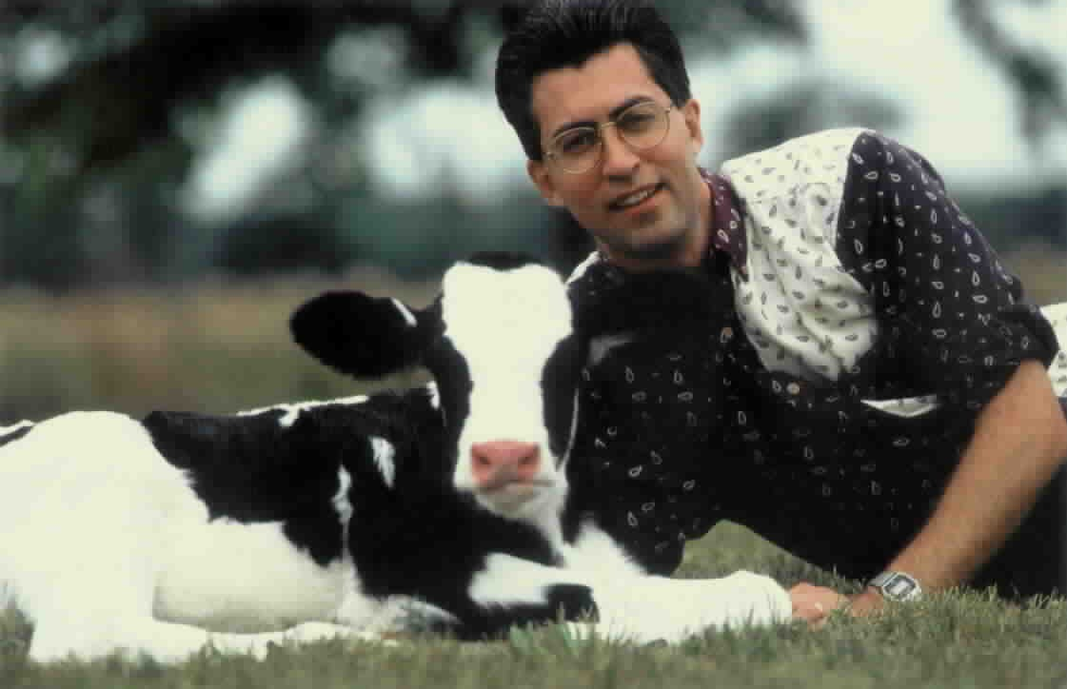
Questions?

