Slide 1

Big data in support of genetic improvement of dairy cattle
100
011110
1220020012
02121110111121
10111100112110002012200222011112021012002111221100211120220
00111100101101101022001100220110112002011010202221211221012202
2010011100011220221222112021120120201002022020002122
21122011101210011121110211211002010210002200020221
2010002011000022022110221121011211101222200120111
12220020002002020201222110022222220022121111220
21002111120011011101120020222000111201101021211
1121211102022100211201211001111102111211020002
122000101101110202200221110102011121111011221
202102102121101102212200121101121101202201100
01 22200210021100011100211021101110002220021121
2 21212110002220102002222120012211212101110112
11 200201102020012222220021110 22001120
211122 10101121211 202111
2112 12112121 10120
1021 01 11220
012 10 0 21
00 2 2 11
12 1 0 21
1 2 12001
0 12

Slide 2
Mission
Genetic improvement of dairy cattle for economically important traits
  Yield (milk, fat, and protein)
  Conformation (overall and individual traits)
  Longevity (productive life)
  Fertility (conception and pregnancy rates)
  Calving (dystocia and stillbirth)
  Disease resistance (mastitis)

Slide 3
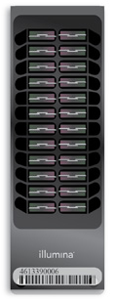
Data types
Identification information for animal:
  Name
  ID number
  Birth date
  Sire
Animal genotypes from marker panels that
that range from 2,900 to 777,962 markers
  Breed
  Herd
  Country
  Dam
Courtesy of Illumina, Inc.

Slide 4
Data types (continued)
Records for milk yield, fat percentage, protein percentage, and somatic cell count (1/month)
Appraiser-assigned scores for ∼16 body and udder characteristics related to conformation (e.g., stature)
Breeding records that include indicator for conception success
Calving difficulty scores and stillbirth indication

Slide 5
Data amounts
68,270,792 identification records
334,402 animal genotypes
142,157,859 lactation records (since 1960)
558,425,959 daily yield records (since 1990)
139,043,355 reproduction event records
25,223,471 calving difficulty scores
21,971,890 stillbirth scores

Slide 6
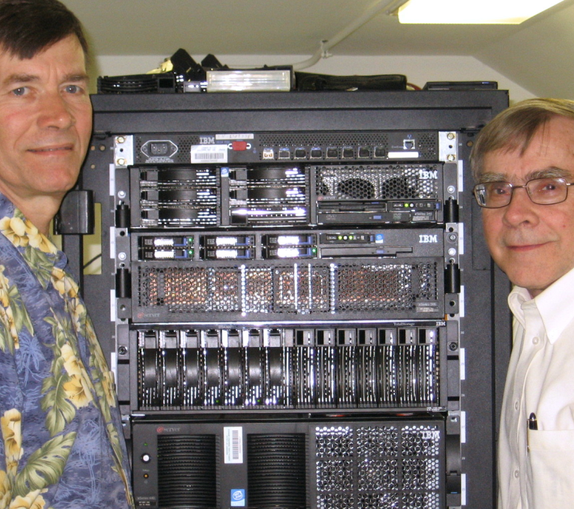
Computing environment
Computation server
  2.3–2.7 GHz CPU (32 cores, 64 threads)
  256 GB RAM
  5 TB local storage
Database server
  3.0 GHz CPU (8 cores)
  40 GB RAM
  2 TB local storage
Shared storage
  19 TB

Slide 7
Data management
Variable length segments for database rows to minimize space and overhead in identifying data
All marker genotypes for an animal stored each as a single byte in a character large object (CLOB)
All breedings and monthly milk yield and component information for a cow’s lactation stored in variable character data types

Slide 8
Programming languages
C
  Database interface including data editing
FORTRAN
  Calculation of genetic merit estimates
SAS
  Data preparation, checking, and delivery

Slide 9
Calculation schedule
Triannual genetic merit estimates
from processed phenotypic data
Monthly genomic evaluations based on estimates of marker effects using genotypic data and triannual phenotype-based evaluations
DEC
APR
AUg
nov
may
jul
sEp
mar
jAn
Oct
DEC
feb
APR
Jun
AUg

Slide 10
Transition to industry
Council on Dairy Cattle Breeding
  Database maintenance
  Calculation and distribution of genetic merit estimates
ARS
  Research and development using data made available by Council
Adjacent work areas planned

Slide 11
Research resource
Massive amount of genomic data
  Location of causal genetic variants
Investigation of haplotypes never found in a homozygous state
  Discovery of chromosomal abnormalities resulting in early embryonic death
Investigation of sons of heterozygous sires
  Detection of QTL from differences between sons by haplotype

Slide 12
Summary
Highly successful program leading to annual increases in genetic merit for production efficiency
Large database of phenotypic and genomic data provided by industry
Big data supports research to determine mechanism of genetic control of economically important traits
Data processing techniques developed to meet needs of industry

