Slide 1
Using genotyping and whole-genome sequencing to identify causal variants associated with complex phenotypes

Slide 2
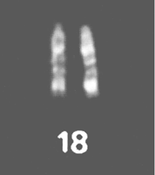
Overview
What have we learned about causal variants?
What do we know about chromosome 18?
How can sequencing help us
learn more?
What did we learn when we
looked at the data?
How did we approach these
new challenges?
Source: Ianuzzi (Chromosome
Res., 4:448–456)

Slide 3
Genotypes evaluated
2009
2010
2011
2012
2013

Slide 4
Genotypes received since July 2013
Breed | Female | Male | All animals | % female
Ayrshire | 1,359 | 229 | 1,588 | 86
Brown Swiss* | 892 | 6,253 | 7,145 | 12
Holstein | 172,956 | 31,657 | 204,613 | 85
Jersey** | 26,434 | 4,804 | 31,238 | 85
All | 201,641 | 42,943 | 244,584 | 82
*Includes >5,000 bulls added from Interbull in June 2014
**Includes 1,068 Danish bulls added in November 2013

Slide 5
Phenotypes may come from genotypes
Name | Chrome | Location (Mbp) | Freq of minor haplotype |  | Gene Name
HH1 | 5 | 63.15 | 1.92 |  | APAF1
HH2 | 1 | 94.8 to 96.6 | 1.66 |  | unknown
HH3 | 8 | 95.41 | 2.95 |  | SMC2
HH4 | 1 | 1.27 | 0.37 |  | GART
HH5 | 9 | 92 to 94 | 2.22 |  | unknown
JH1 | 15 | 15.70 | 12.10 |  | CWC15
BH1 | 7 | 42.8 to 47.0 | 6.67 |  | unknown
BH2 | 19 | 10.6 to 11.7 | 7.78 |  | unknown
AH1 | 17 | 65.86 to 66.16 | 11.80 |  | unknown
For a complete list, see: http://aipl.arsusda.gov/reference/recessive_haplotypes_ARR-G3.html.

Slide 6
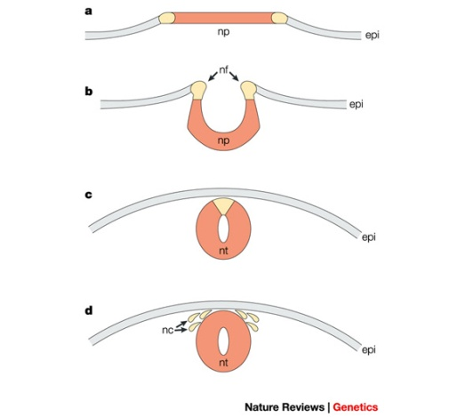
Success – APAF1 (HH1)
APAF1 - Bos taurus apoptotic peptidase activating factor 1
  ATP binding factor
Gene expression for APAF1 in murine development begins between 7 and 9 d in heart, mesenchyme, periderm, and primitive intestine (Muller et al., 2005)
Gene knockout of APAF1 in mice leads to embryonic lethality (Muller et al., 2005)
  Proteins required for this
  pathway/cascade are important
  for neural tube closure in vivo

Slide 7
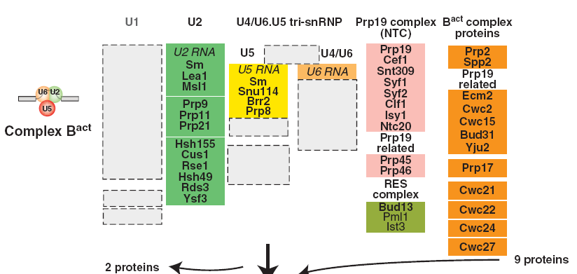
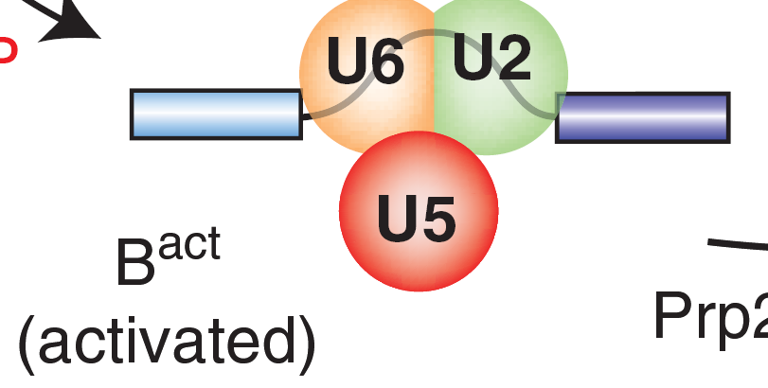
Success – CWC15 (JH1)
Will and Lührmann. 2011.
Spliceosome structure and
Function. Cold Spring
Harb Perspect Biol.

Slide 8
There’s still a gap to bridge
Causal variants for Mendelian recessives are sometimes easy to identify
Identification of causal variants for QTL associated with quantitative traits is much more complex
  It can be done (e.g., DGAT1)
  Does genomics and next generation sequencing make that easier?

Slide 9
A simple strategy doesn’t always work
Compute SNP effects for trait of interest
Look for peaks
Perform bioinformatics on regions under interesting peaks
  NCBI/Ensembl
  Bovine Gene Atlas
  Bovine QTLdb
This doesn’t always work…as we’ll see!

Slide 10
Introduction to chromosome 18
Several studies (Kuhn et al., 2003; Cole et al., 2009; Seidenspinner et al., 2009) have reported QTL on BTA 18 associated with dystocia
Bioinformatic analysis using SNP data has not identified the causal variant
Next generation sequencing (NGS) has recently been used to find causal variants for novel recessive disorders

Slide 11
Chromosome 18 is different
Markers on chromosome 18 have large effects on several traits:
  Dystocia and stillbirth: sire and daughter calving ease and sire stillbirth
  Conformation: rump width, stature, strength, and body depth
  Efficiency: longevity and net merit
Large calves contribute to reduced cow lifetimes and decreased profitability

Slide 12
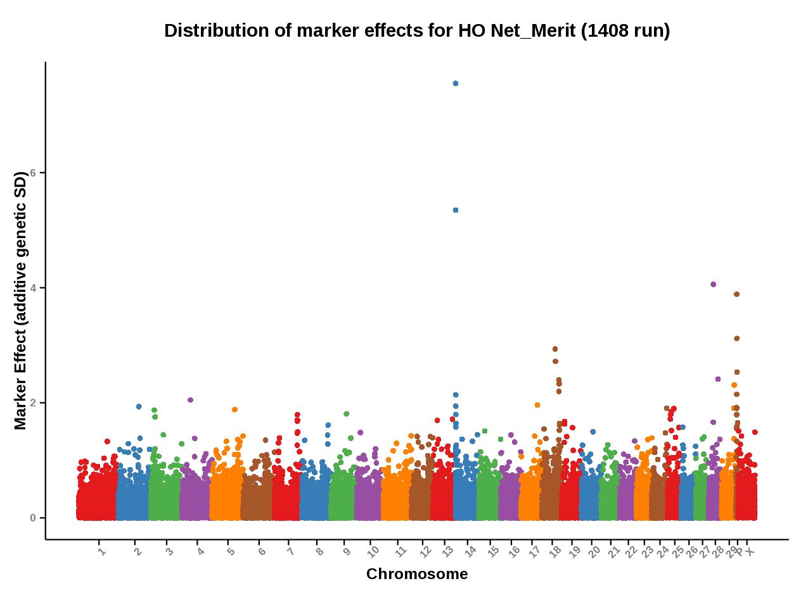
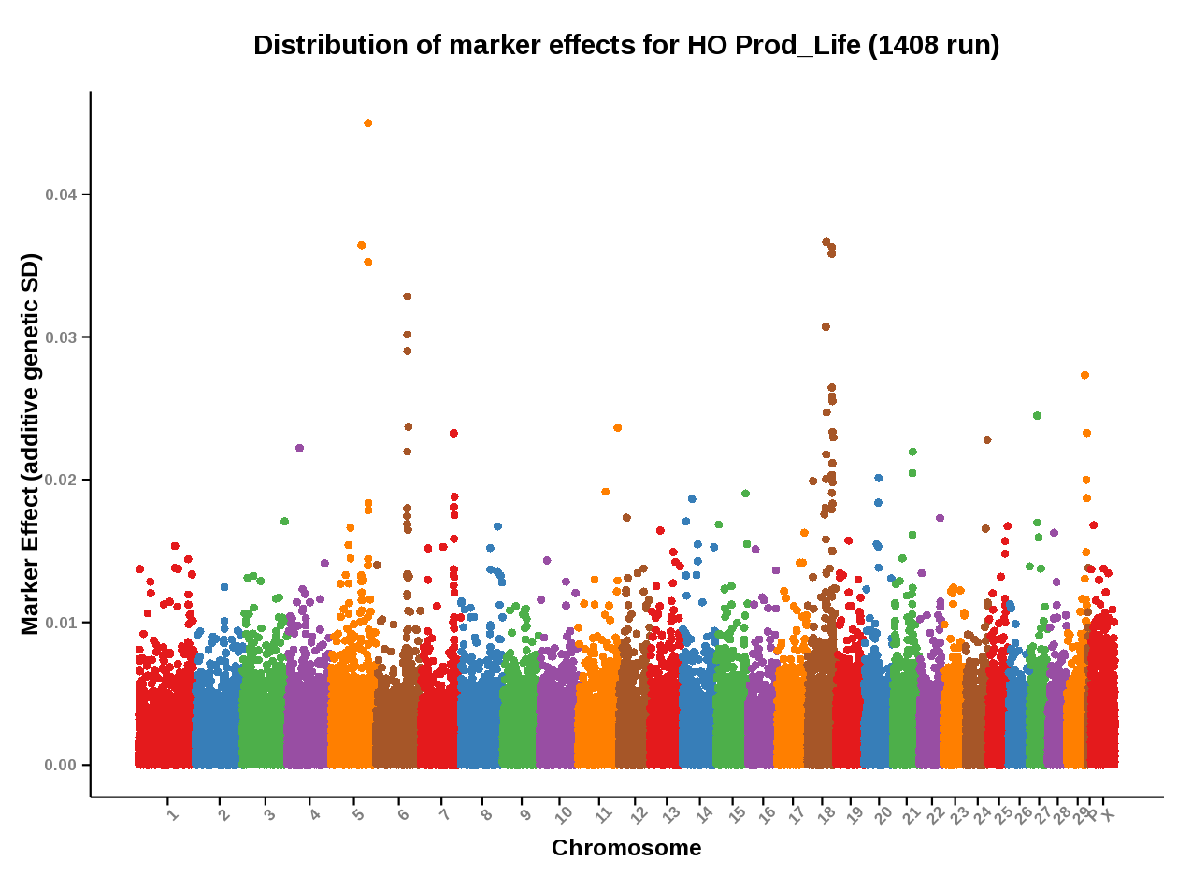

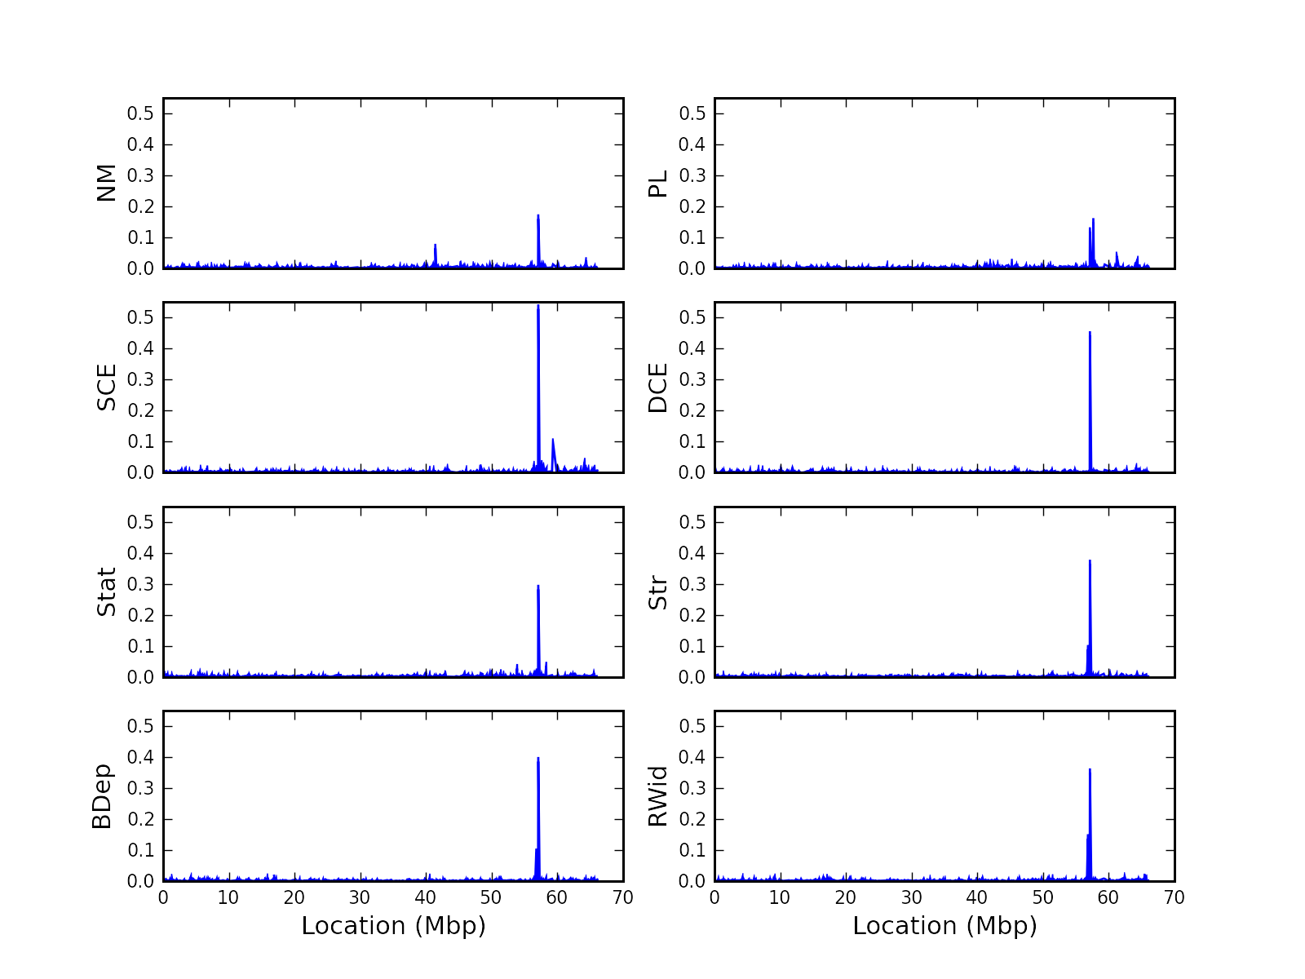
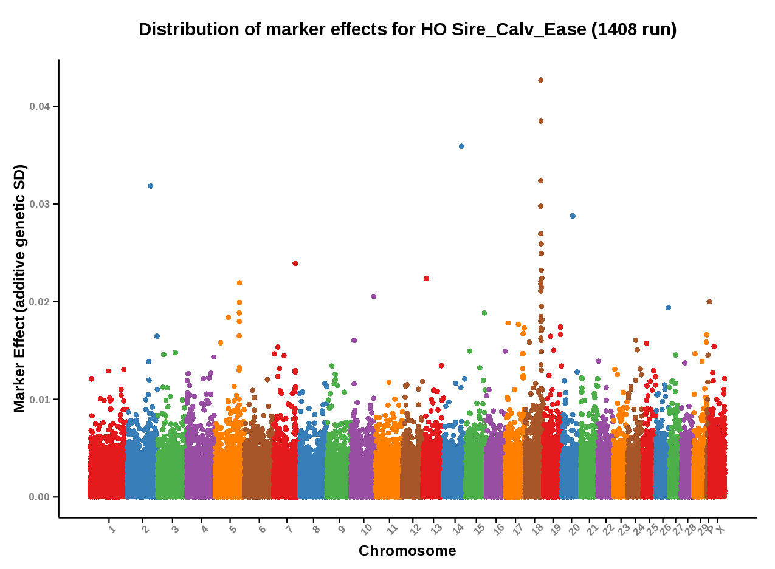
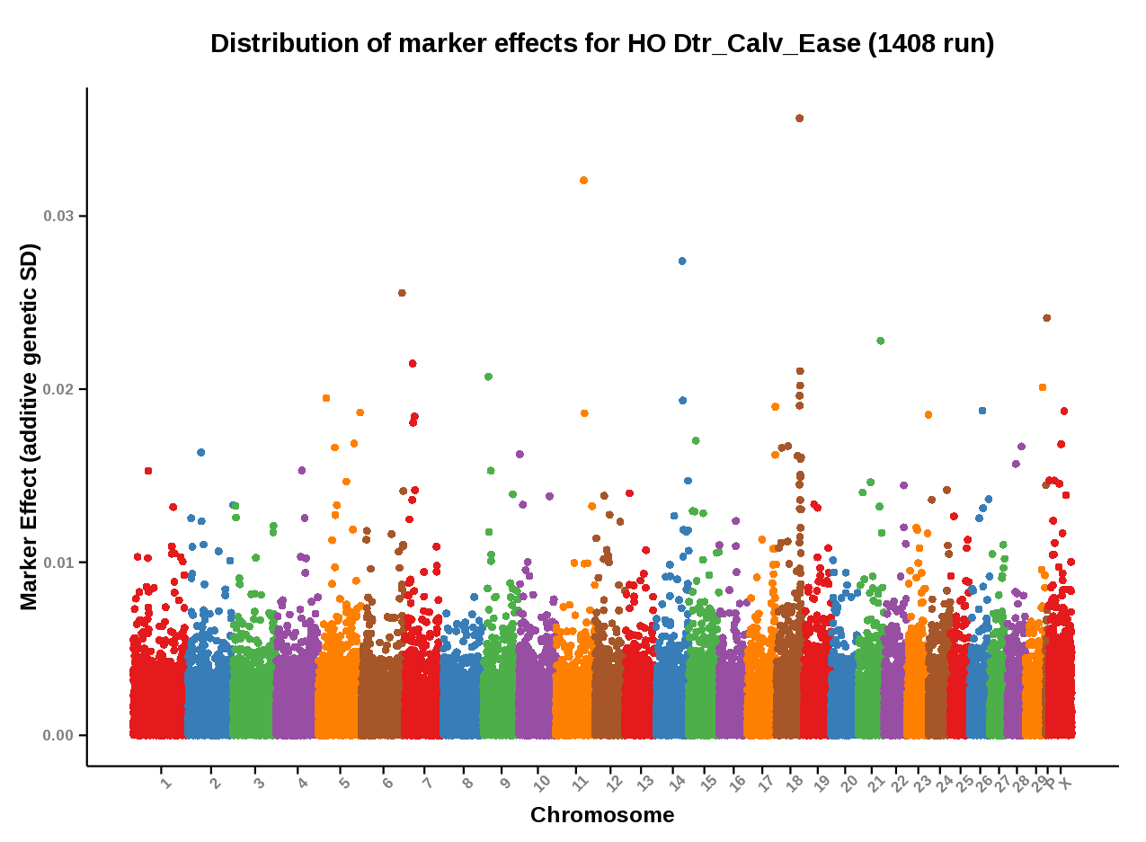
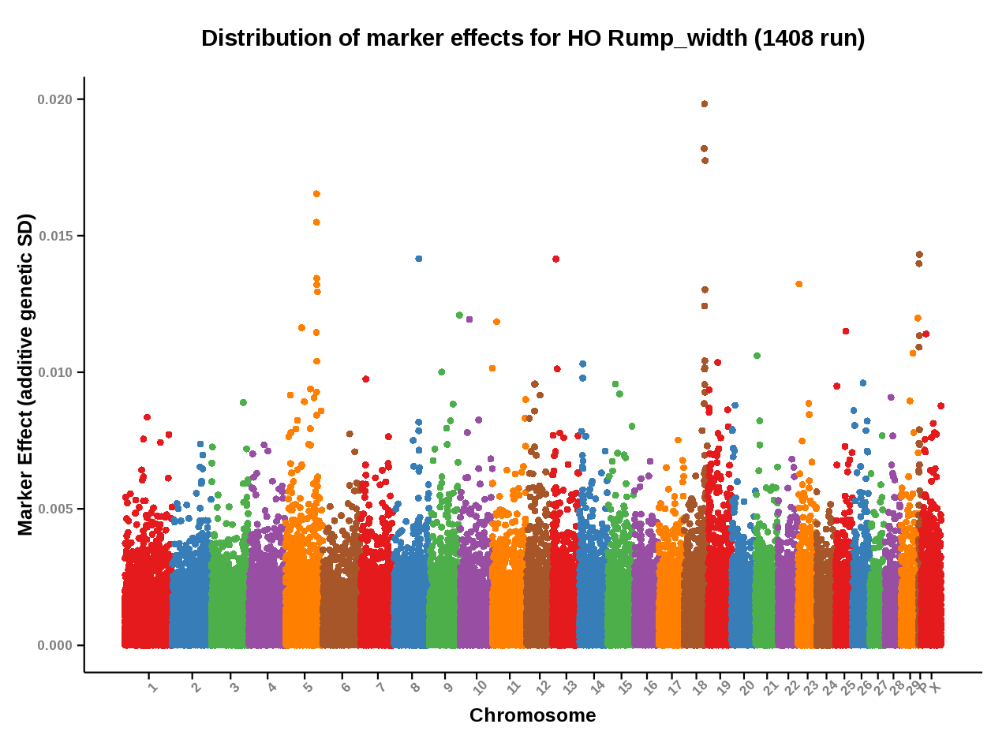
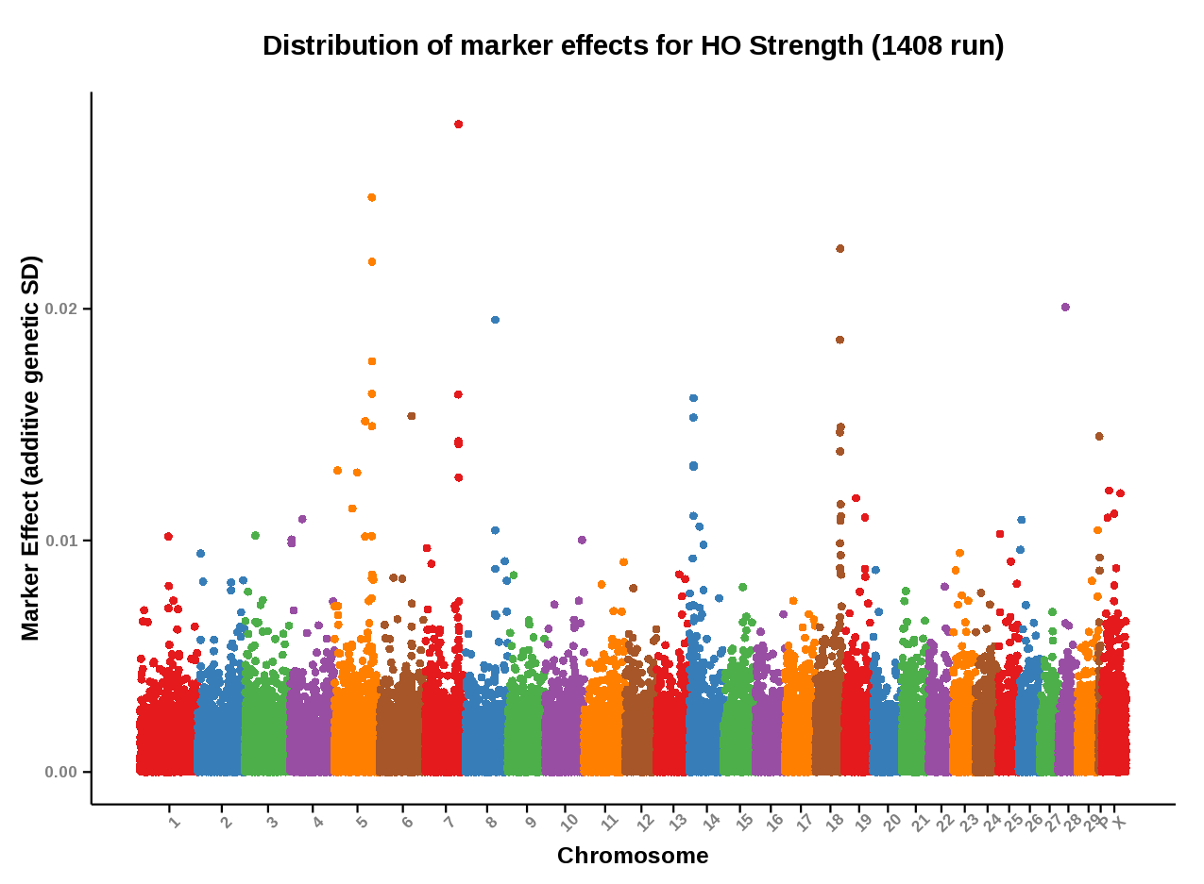
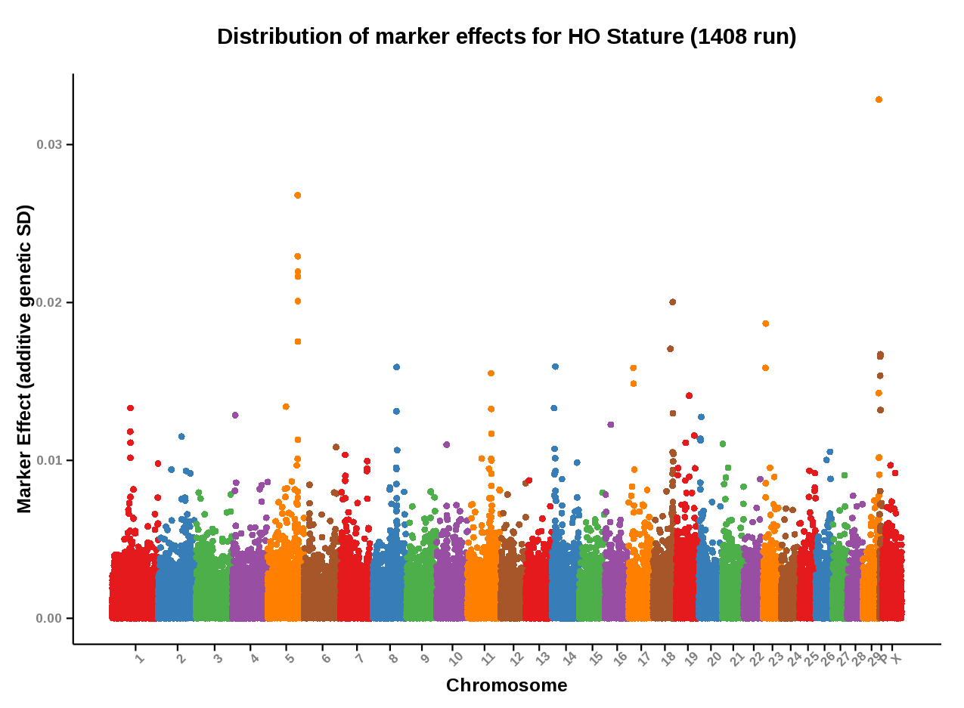
Marker effects for dystocia complex
AR-BFG-`GS-109285
ARS-BFGL-NGS-109285
Source: https://www.cdcb.us/Report_Data/Marker_Effects/marker_effects.cfm?Breed=HO
Cole et al., 2009 (J. Dairy Sci. 92:2931–2946)

Slide 13
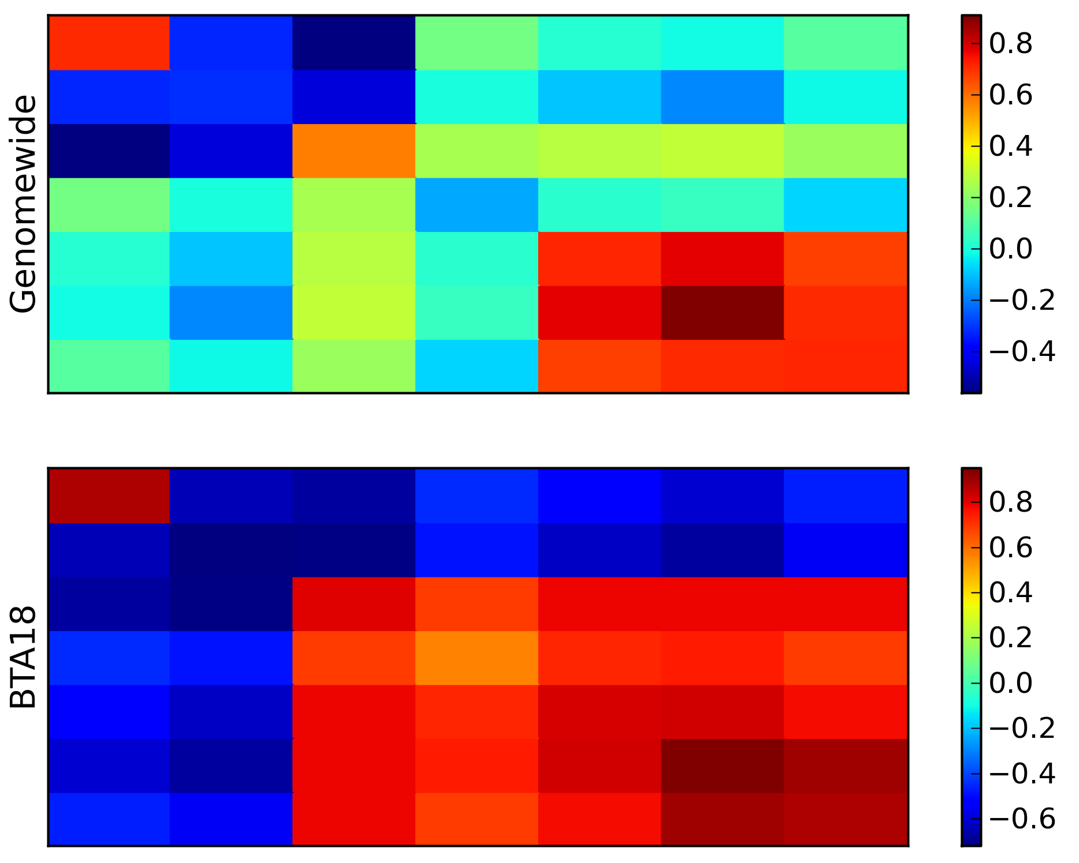
Correlations in dystocia complex

Slide 14
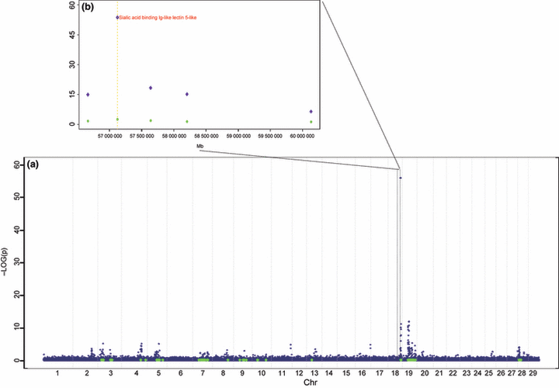
The QTL also affects gestation length
Maltecca et al., 2011 (Animal Genet. 42:585-591)

Slide 15
The dystocia complex
The key marker is ARS-BFGL-NGS-109285 at (rs109478645 ) 57,589,121 Mb on BTA18
Intronic to Siglec-12 (sialic acid binding Ig-like lectin 12)
Recent results indicate effects on gestation length (Maltecca et al., 2011) and calf birth weight (Cole et al., 2014), as well as calving traits (Purfield et al., 2014)

Slide 16
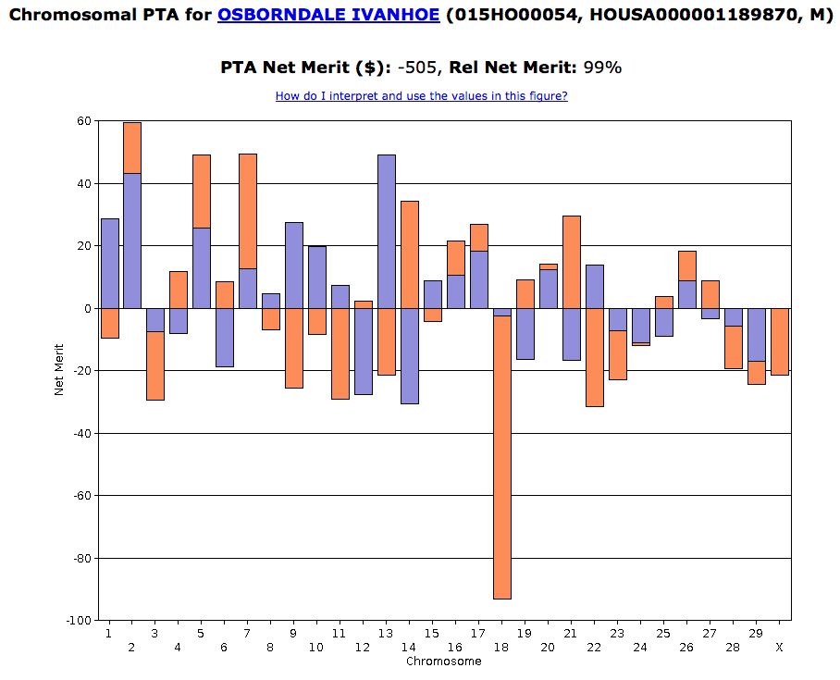
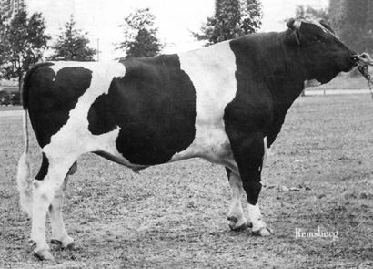
Where did it come from?
Source: http://bit.ly/VsIups
Source: https://www.cdcb.us/CF-queries/Bull_Chromosomal_EBV/bull_chromosomal_ebv.cfm?

Slide 17
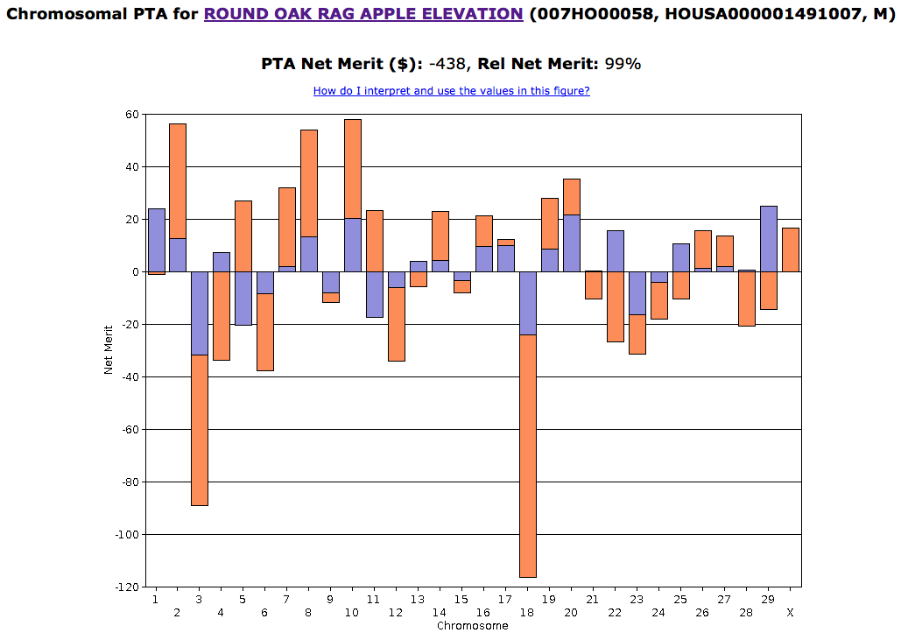
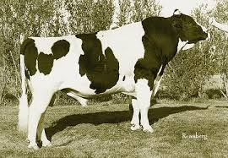
Who popularized it?
57,861 daughters
>2 million granddaus
Maternal haplotype from
Ivanhoe
Source: http://bit.ly/1BkTTsE.
Source: https://www.cdcb.us/CF-queries/Bull_Chromosomal_EBV/bull_chromosomal_ebv.cfm?

Slide 18
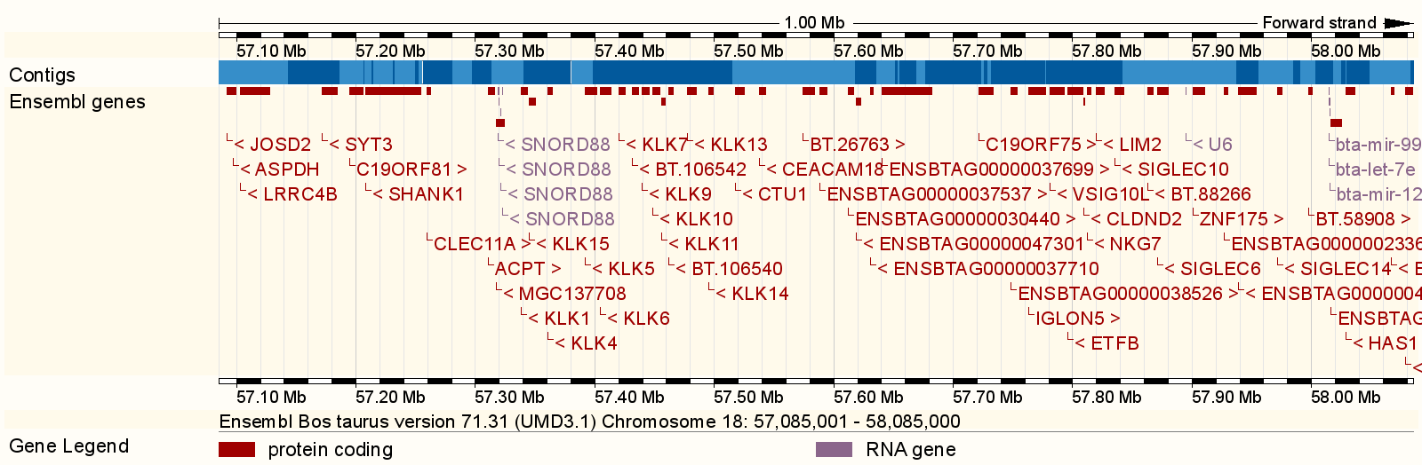

This is a gene-rich region
Discussed on Tuesday
(Abstract 288, Mao).
http://useast.ensembl.org/Bos_taurus/Location/View?r=18%3A57583000-57587000
http://www.ncbi.nlm.nih.gov/gene?cmd=Retrieve&dopt=Graphics&list_uids=618463

Slide 19
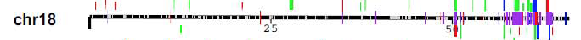
Copy number variants are present
Hou et al. 2011 (BMC Genomics,12:127)
ARS-BFGL-NGS-109285 is flanked by CNV
  There’s a loss and a gain to the left (8 SNP region)
  There’s a gain to the right (10 SNP region)
This can result in assembly problems

Slide 20
What if we look at a different trait?
Cole et al. (2009) proposed the following mechanism:
  Siglec-12 may sequester circulating leptin
  This increases gestation length
  Calf birth weight (BW) is higher because of increased gestation length
  Higher BW is associated with dystocia

Slide 21
We don’t have birth weight data
Birth weights are not routinely recorded in the US
Collaborated with Hermann Swalve’s group to develop a selection index prediction of BW PTA
Performed GWAS and gene set enrichment analysis to search for interesting associations (Cole et al., 2014, JDS 97:3156-3172)

Slide 22
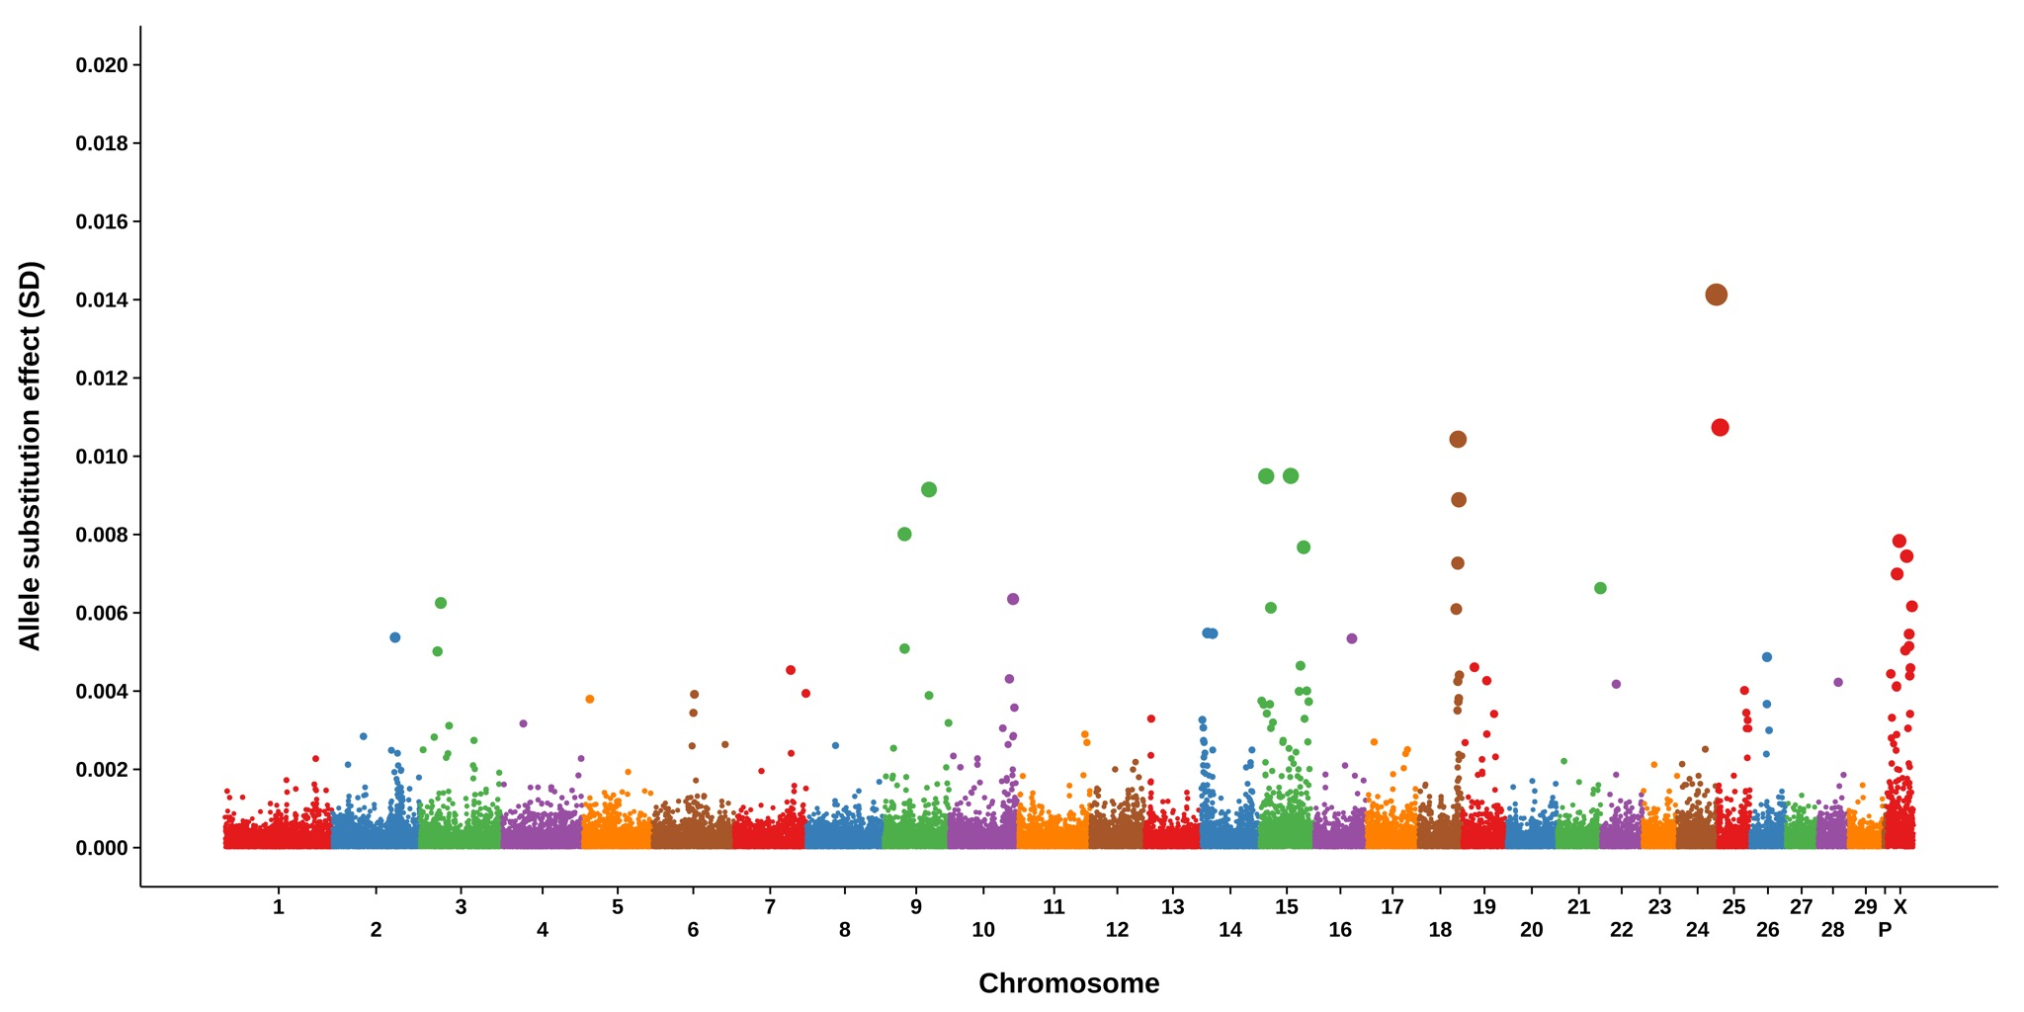
GWAS for birth weight PTA
h
Cole et al., 2014 (J. Dairy Sci., 97:3156–3172)

Slide 23
Are we measuring anything new?
Identified a SNP on BTA16 intronic to LHX4, which is associated with cow body weight and length (Ren et al., 2010, Mol. Bio. Reprod., 37:417-422).
4 SNP in the QTL region on BTA 18 had large effects
Several other SNP with large effects intronic or adjacent to genes with unknown functions

Slide 24
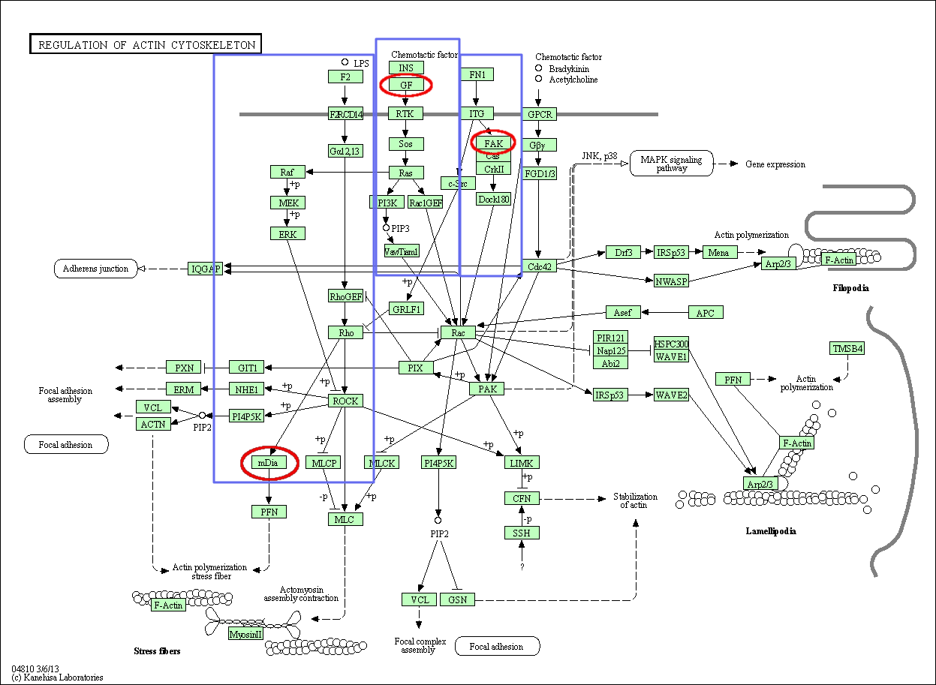
KEGG pathways for birth weight
What does regulation of the actin cytoskeleton have to do with birth weight in cattle?
That is, do these results make sense?
Maybe…these pathways may be involved in establishment & maintenance of pregnancy, as well as coordination of growth and development.
Cole et al. (2014)

Slide 25
Pedigree & haplotype design
These bulls carry
the haplotype with
the largest, negative
effect on SCE:
Arlinda Chief
AA, SCE: 8
Chief
AA, SCE: 7
MGS
Rockman Ivanhoe
Aa, SCE: 6
Arlinda Rotate
AA, SCE: 8
δ = 10
Tradition
Aa, SCE: 10
Delegate
Aa, SCE: 15
Laramie
aa, SCE: 15
MGS
Melwood
Aa, SCE: 8
Jed
Aa, SCE: 15
Couldn’t obtain DNA:
Combination
??, SCE: 7
CMV Mica
Aa, SCE: 14
Leduc
Aa, SCE: 18

Slide 26
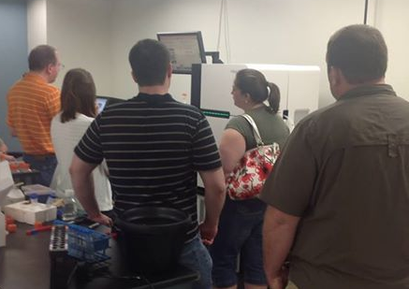
How many scientists does it take…
You just missed his talk
(Abstract 164, Bickhart
et al.)!
He’s back in
Maryland,
working.
You went to her
poster on Tuesday
(Abstract 799,
Cooper et al.), right?

Slide 27
Sequencing coverage
Bull name | SCE¹ | Genotype² | Total reads | Coverage
Pawnee Farm Arlinda Chief | 7 | AA | 333,628,731 | 12.03
Glendell Arlinda Chief | 8 | AA | 981,726,824 | 35.41
Sweet Haven Tradition | 10 | Aa | 390,387,538 | 14.01
Arlinda Rotate | 8 | AA | ~476,000,000 | 17.00
Arlinda Melwood | 8 | Aa | ~448,000,000 | 16.00
Juniper Rotate Jed | 15 | Aa | 656,190,604 | 23.66
CMV Mica | 14 | Aa | 433,353,161 | 15.63
Lystel Leduc | 18 | Aa | 767,440,677 | 27.68
Willow-Farm Rockman Ivanhoe | 6 | Aa | 195,769,690 | 7.06
Cass-River Select Delegate | 15 | Aa | 377,380,110 | 13.61
Wedgwood Laramie | 15 | aa | 371,477,172 | 13.39
¹Predicted transmitting ability (PTA) for sire calving ease, the percentage of offspring born with difficulty. Small
values are desirable and large values are undesirable.
²The genotype of the tag SNP for the QTL, where “A” and “a” are the major and minor alleles, respectively.

Slide 28
Results from Illumina sequencing
Data analyzed using paired-end read alignments and split-read mapping
Portions of two exons and a connecting intron within the Ig-like protein domains may have been duplicated
Some heterozygotes with desirable SCE also have deletions near the N-terminal end of the protein

Slide 29
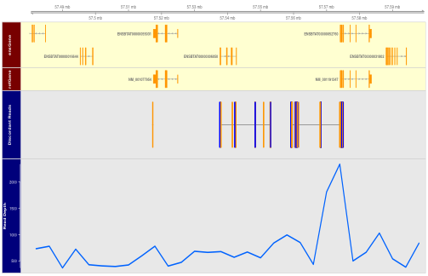
Possible assembly problem on BTA18
This could be a GC-rich region (bias in
Illumina chemistry).
More reads than expected may align
here because repetitive elements were
combined during assembly.

Slide 30
Genome assembly (simplified)
Reads must be assembled into chromosomes
Assembly is a computational process (Liu et al., 2009; Zimin et al., 2009)
This process is imperfect – repetitive regions are hard to assemble correctly!
Sometimes, this…
should be this.

Slide 31
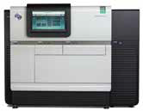
Can it be corrected using long reads?
BTA18 genomic DNA extracted
from CHORI-240 BAC library
(L1 Domino 99375) at AGIL
Sequencing libraries constructed at USDA MARC, pooled, and run on PacBio RS II
Source: Pacific Biosystems
BAC ID | Insert size (bp) | Start | End
CH240-389P14 | 174,682 | 56,954,654 | 57,129,335
CH240-234E12 | 178,618 | 57,058,248 | 57,236,865
CH240-280L6 | 175,831 | 57,092,237 | 57,268,067
CH240-34N7 | 158,841 | 57,129,383 | 57,288,223
Notes:
Transition/explain why PacBio & Illumina are different

Slide 32
Processing of PacBio reads
BAC DNA was pooled at MARC to have enough material to construct a sequencing library
Reads were assembled into contigs using HGAP in SMRTanalysis v2.2.0
44 contigs with an N₅₀ of 31 kb were constructed

Slide 33
Analysis of alignments
PacBio contigs aligned against UMD3.1 contigs using MUMmer 3.0
Short (Illumina) reads aligned against PacBio contigs using BWA 0.7.5a-r405
Paired-end discordancy interrogated using custom scripts (Bickhart, unpublished data)

Slide 34
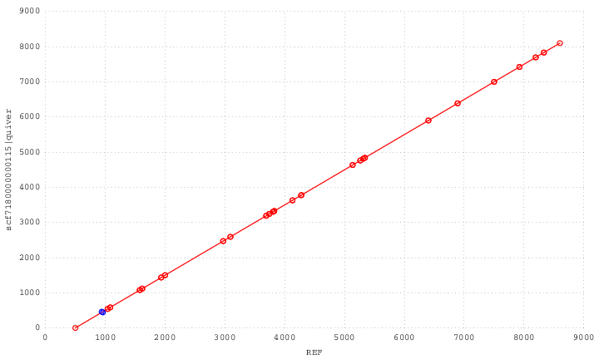
Alignment of BAC contigs with UMD3.1
A line with a slope of 1 indicates that a segment
is conserved between the two sequences – this
contig is almost identical between our PacBio
assembly and the UMD3.1 reference assembly.

Slide 35
Discordancy analysis
Illumina reads aligned w/PacBio contigs
Reads with lengths ±4σ were counted
Discordancies may indicate
  Problems in the PacBio assembly
  The presence of repetitive elements
  Structural differences between the Holstein and Hereford (unlikely)

Slide 36
DNA in PacBio and not in UMD3.1
Reads map to PacBio and UMD3.1 contigs.
Vector DNA – nothing to see here!
~10 kbp of DNA in PacBio contig that doesn’t map to UMD3.1!
Reads map to PacBio and UMD3.1—
ARS-BFGL-NGS-109285 is placed here.

Slide 37
There are clearly assembly problems
PacBio sequence duplicated
on UMD3.1 contig
PacBio sequence duplicated
on UMD3.1 contig

Slide 38
What have we learned?
This is more complex than SNP genotyping, and unsuccessful experiments are expected
You needs lots of high-quality DNA for constructing PacBio libraries
Overlapping BACs should not be pooled (some people already know this)
Data editing and error-correction are critical

Slide 39
Next steps
Re-assemble raw reads following more stringent edits and data cleaning
Re-sequence single BACs or pooled, non-overlapping BACs
Sequence the RPCI-42 Holstein BACs (Monsanto calf)
  Are structural differences between Holstein and Angus in this region

Slide 40
Conclusions
Structural variants in and around the Siglec-12 gene are associated with differences in SCE
SNP are misplaced on the UMD3.1 assembly
A region ~8 kb downstream of ARS-BFGL-NGS-109285 appears to be misassembled
The causal variant on BTA18 has not yet been conclusively identified

Slide 41
Acknowledgments
USDA-ARS appropriated project 1245-31000-101-00
CNPq “Ciência sem Fronteiras” program
Cooperative Dairy DNA Repository and Council on Dairy Cattle Breeding

Slide 42
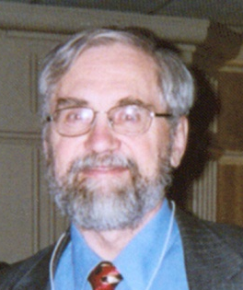
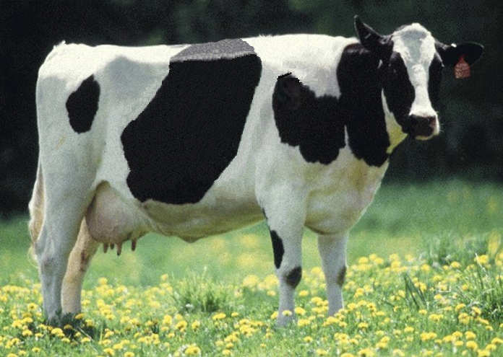
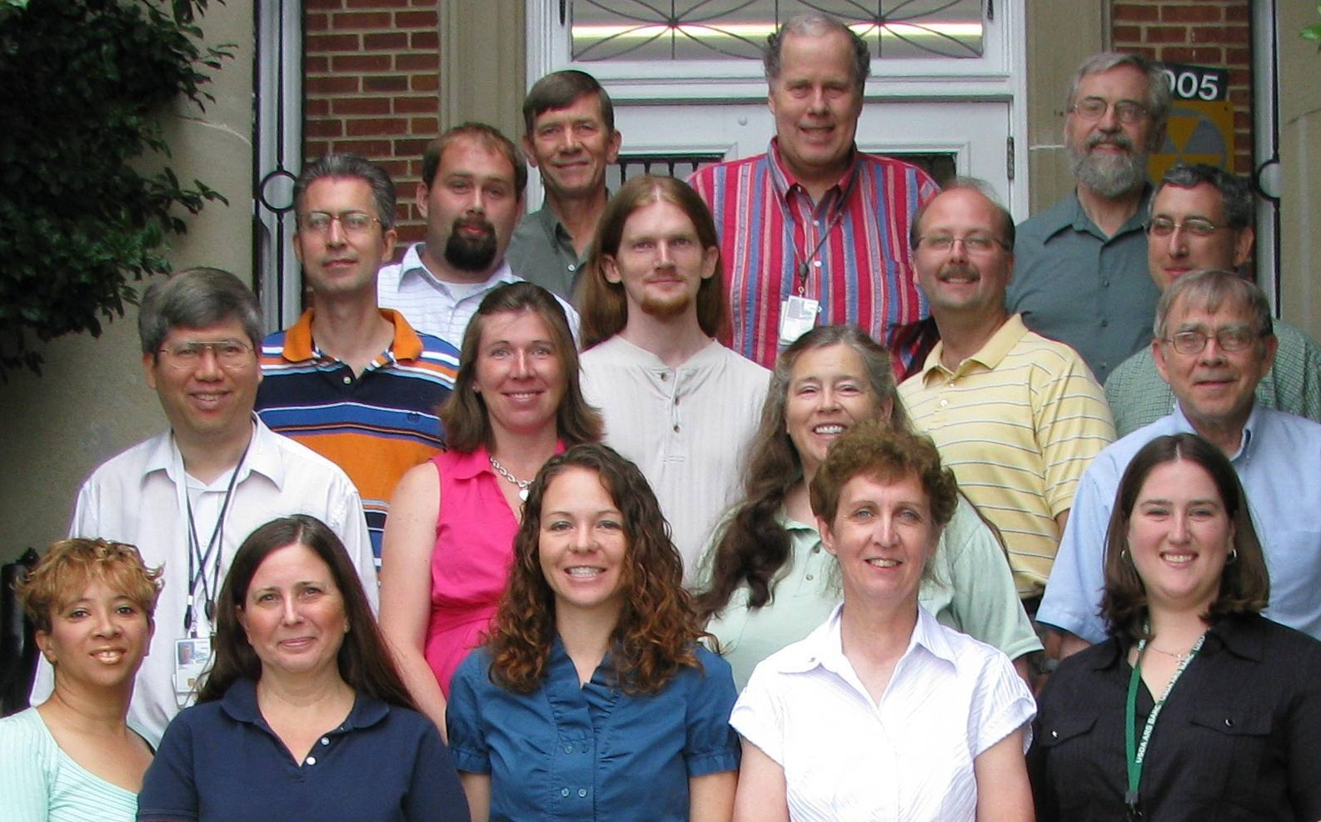
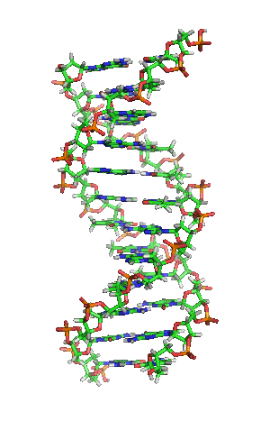
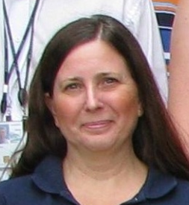
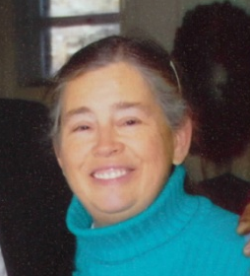

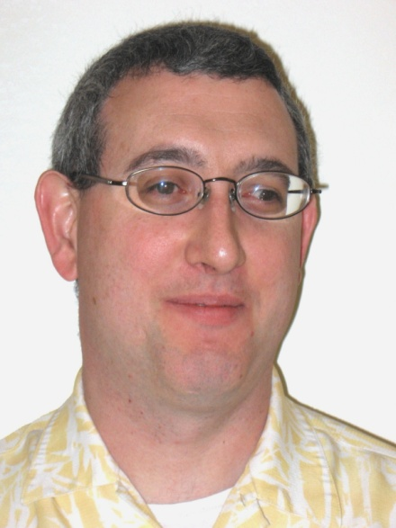
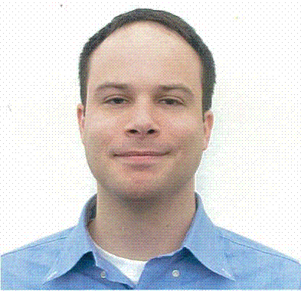
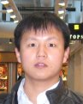
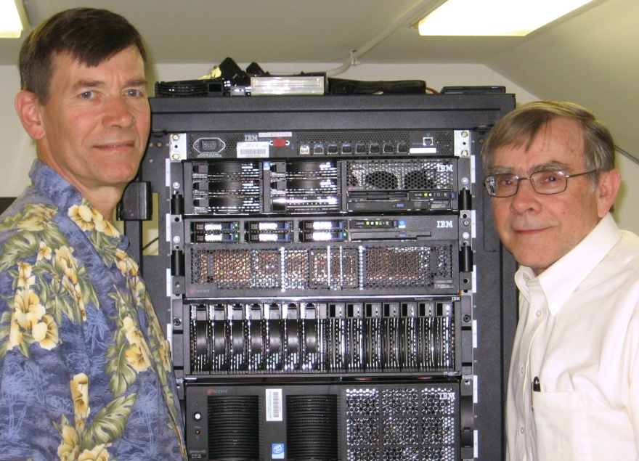
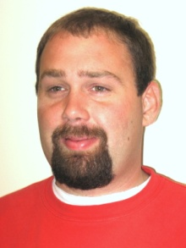
Animal Improvement Program team

Slide 43
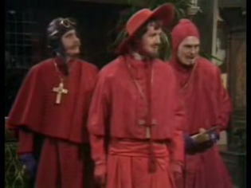
Questions?

