Slide 1
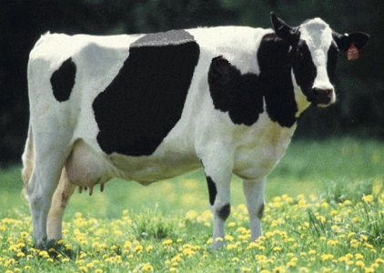
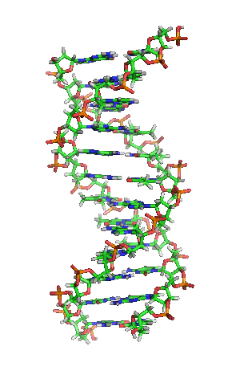
Animal Improvement
Program (AIP)
A “big data” project of the
Animal Genomics and Improvement Laboratory (AGIL)

Slide 2
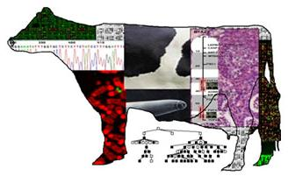
AGIL mission
Discover and develop improved methods for the genetic and genomic evaluation of economically important traits of dairy animals and small ruminants
Conduct fundamental genomics-based research aimed at improving their health and productive efficiency

Slide 3

AGIL staff
Dr. Erin E. Connor, Research Leader
10 senior scientists
2 postdoctoral associates
9 support scientists
2 chemists
5 laboratory technicians
3 information technology specialists
2 administrative assistants
Visiting scientists and students

Slide 4
AGIL appropriated projects
Enhancing genetic merit of ruminants through genome selection and analysis
  Understanding genetic and physiological factors affecting nutrient use efficiency of dairy cattle
  Development of genomic tools to study ruminant resistance to gastrointestinal nematodes
Improving genetic predictions in dairy animals using phenotypic and genomic information
  “Animal Improvement Program” (AIP)

Slide 5




AIP staff
4 senior scientists
6 support scientists
3 information technology specialists
1 administrative assistant
2 visiting scientists
Dr. George Wiggans
Dr. Paul VanRaden
Dr. John Cole
Dr. Derek Bickhart

Slide 6
AIP objectives
Expand national and international collection of phenotypic and genotypic data
Develop a more accurate genomic evaluation system with advanced, efficient methods to combine pedigrees, genotypes, and phenotypes
Use economic analysis to maximize genetic progress and financial benefits from collected data

Slide 7










Genetic evaluation
Improve future performance through selection
Possible data
  Animal’s own measurable traits
  Pedigrees and phenotypes of
  relatives
  Genomic information

Slide 8
Phenotypic data
Records for milk yield, fat percentage, protein percentage, and somatic cell count (1/month)
Appraiser-assigned scores for ∼16 body and udder characteristics related to conformation (e.g., stature)
Breeding records that include indicator for conception success
Calving difficulty scores and stillbirth occurrences

Slide 9
Primary traits evaluated
Yield (milk, fat, and protein)
Conformation (overall and individual traits)
Longevity (productive life)
Fertility (conception and pregnancy rates)
Calving (dystocia and stillbirth)
Disease resistance (somatic cell score)

Slide 10
Data amounts (as of July 2015)
Pedigree records 71,974,045
Animal genotypes 1,035,590
Lactation records (since 1960) 132,629,200
Daily yield records (since 1990) 641,864,015
Reproduction event records 176,559,035
Calving difficulty scores 29,528,607
Stillbirth scores 19,567,198

Slide 11
Value of incoming data
Data
Annual value
Phenotypes (2014)
4 million cows
×
$1.25/cow/month
$60 million
Genotypes (2014)
15,000 medium
-
density
×
$125
$2 million
258,000 low
-
density
×
$45
$12 million
Whole
-
genome sequence (2015)
200+ bulls
×
$1,000
$0.2 million
1,000+ bulls
×
$3,000
$3 million
Total
$77.2 million
Notes:
11

Slide 12
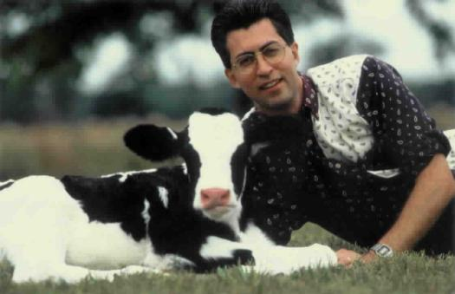
Genomics and SNP
Genomics – Applies DNA technology and bioinformatics to sequence, assemble and analyze the function and structure of genomes
SNP – Single nucleotide polymorphisms; serve as markers to track inheritance
of chromosomal segments
Genomic selection – Selection
using genomic predictions of
economic merit early in life

Slide 13

Benefit of genomics
Determine value of bull at birth
Increase accuracy of selection
Reduce generation interval
Increase selection intensity
Increase rate of genetic gain
Bovine G-Nome
Notes:
13

Slide 14
Why genomics works for dairy cattle
Extensive historical data available
Well-developed genetic evaluation program
Widespread use of artificial-insemination (AI) sires
Progeny-test programs
High-value animals worth the cost of genotyping
Long generation interval that can be reduced substantially by genomics
Notes:
14

Slide 15


Evaluation transition to dairy industry
Council on Dairy Cattle Breeding (CDCB)
  Database maintenance
  Calculation and distribution of genetic merit estimates
  Interface with evaluation users and data suppliers
AGIL
  Research and development using data made available by CDCB

Slide 16
Genomic data flow
Dairy Herd Information (DHI) producer
DNA samples
DNA samples
genomic
evaluations
DNA laboratory
DNA samples
AI organization,
breed association
genotypes
genotypes
nominations,
pedigree data
genotype
quality reports
genomic
evaluations
CDCB
Notes:
16

Slide 17

Evaluation flow
Animal nominated for genomic evaluation by approved nominator
DNA source sent to genotyping lab (2014)
Source | Samples (no.) | Samples (%)
Blood | 10,727 | 4
Hair | 113,455 | 39
Nasal swab | 2,954 | 1
Semen | 3,432 | 1
Tissue | 149,301 | 51
Unknown | 12,301 | 4

Slide 18

Evaluation flow (continued)
DNA extracted and placed on chip
  Marker panels that range from
  2,900 to 777,962 SNPs
  3-day genotyping process
Genotypes sent from genotyping
lab for accuracy review

Slide 19
Animals genotyped (cumulative totals)

Slide 20
Laboratory quality control
Each SNP evaluated for
  Call rate
  Portion heterozygous
  Parent-progeny conflicts
Clustering investigated if SNP exceeds limits
Number of failing SNPs indicates genotype quality
Target of <10 SNPs in each category

Slide 21
Evaluation flow (continued)
Genotype calls modified as necessary
Genotypes loaded into database
Nominators receive reports of parentage and other conflicts
Pedigree or animal assignments corrected
Genotypes extracted and imputed to 61K
SNP effects estimated
Final evaluations calculated

Slide 22

Parentage validation and discovery
Parent-progeny conflicts detected
  Animal checked against all other genotypes
  Reported to breeds and requesters
  Correct sire usually detected
Maternal grandsire checking
  SNP at a time checking
  Haplotype checking more accurate
Who’s your daddy?
Notes:
22

Slide 23
Evaluation flow (continued)
Evaluations released to dairy industry
  Download from FTP site with
  separate files for each nominator
  Weekly release of evaluations of new animals
  Monthly release for females and bulls not marketed
  All genomic evaluations updated 3 times each year with traditional evaluations

Slide 24
Parent ages for marketed Holstein bulls

Slide 25
Genetic merit of marketed Holstein bulls
Average gain:
$87.49/year
Average gain:
$47.95/year
Average gain:
$19.42/year

Slide 26
Improving accuracy
Increase size of predictor population
  Share genotypes across country
  Young bulls receive progeny test
Use more or better SNPs
Account for effect of genomic selection on traditional evaluations
Reduce cost to reach more selection candidates

Slide 27

Growth in bull predictor population
Breed | Jan. 2015 | 12-mo gain
Ayrshire | 711 | 29
Brown Swiss | 6,112 | 336
Holstein | 26,759 | 2,174
Jersey | 4,448 | 245

Slide 28
Haplotypes affecting fertility
Rapid discovery of new recessive defects
  Large numbers of genotyped animals
  Affordable DNA sequencing
Determination of haplotype location
  Significant number of homozygous animals expected, but none observed
  Narrow suspect region with fine mapping
  Use sequence data to find causative mutation

Slide 29

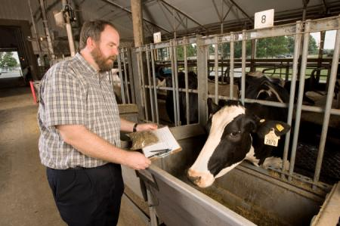
Current research areas
Improve evaluation methodology
Develop applications for sequence data
Acquire data for additional traits
Develop evaluations for new traits

Slide 30


Mating programs
Genomic relationships of genotyped females with available bulls provided
Determination of best mate possible
Dominance effects could be considered

Slide 31
Working with sequence data
Sequence data available from 1000 Bull Genomes Project hosted in Australia
Project funded by industry to sequence over 200 bulls to create a haplotype library
A posteriori granddaughter design to locate chromosomal segments of interest from 71 bulls each with over 100 genotyped and progeny-tested sons

Slide 32


Granddaughter design
Sires with many progeny-tested sons genotyped for genetic markers
Sons of heterozygous sire divided into 2 groups based on paternal allele received
Significant difference in genetic evaluations for 2 son groups indicates sire is segregating for quantitative trait locus (QTL) for trait
M m
+ –
M ?
m ?
+ –
+ –

Slide 33
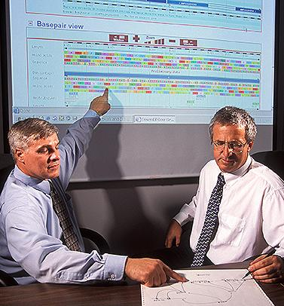
Alignment of sequence data
Alignment – determining location of chromosomal segments provided by sequencer
Findmap – matches segment against library of haplotypes
Preserves low-frequency variants
Does not identify new variants
Uses a hash table to find variant enabling rapid processing

Slide 34
Further use of sequence data
Discovery of causative genetic variants
Refinement of SNPs used in genomic evaluation
  Add discovered causative variants
  Use some SNPs for imputation but not for estimation of SNP effects
Create genotypes for genomic evaluation from sequence data to enable immediate use through imputation of any new SNPs

Slide 35
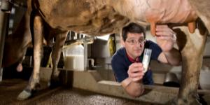
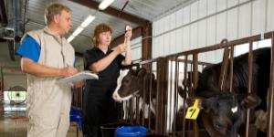
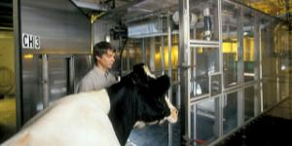
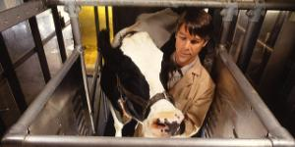
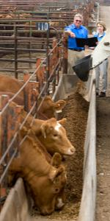
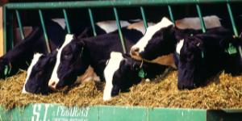
Additional traits requiring data
Clinical mastitis
Displaced abomasum
Ketosis
Hoof health
Immune response
Other health traits
Feed efficiency
Methane production
Milk fatty acid composition from mid‐infrared spectroscopy

Slide 36
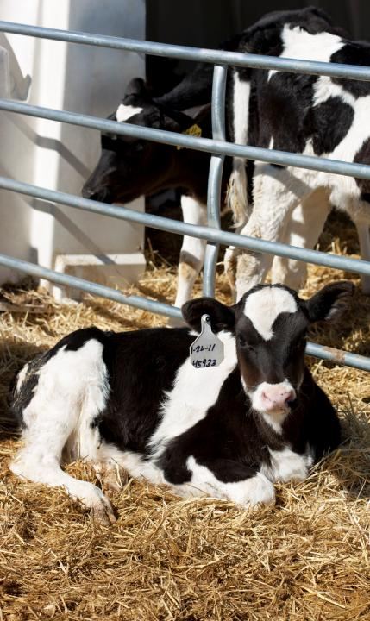
Evaluation of new traits
Mortality
Days to first breeding
Gestation length
Persistency
Resistance to heat stress
  (predicting genotype ×
  environment interactions)

Slide 37
Benefits to dairy industry
Low-cost genotyping tools for genomic predictions of genetic merit
Identification of gene mutations for cow fertility
Genetic evaluations for more than 30 traits of U.S. dairy cows
Genetic-economic indexes to help dairy farmers choose parents of future generations
Genomic mating programs for dairy cattle

Slide 38
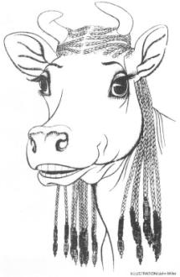
Impact on breeders
Haplotype and gene tests in selection and mating programs
Trend towards a small number of elite breeders that are investing heavily in genomics
About 30% of young males genotyped directly by breeders since April 2013
Prices for top genomic heifers can be very high
(e.g., $265,000 )

Slide 39
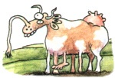
Impact on dairy producers
General
  Reduced generation interval
  Increased rate of genetic gain
  More inbreeding/homozygosity?
Sires
  Higher average genetic merit of available bulls
  More rapid increase in genetic merit for all traits
  Larger choice of bulls for traits and semen price
  Greater use of young bulls

Slide 40
Summary
Highly successful program leading to annual increases in genetic merit for production efficiency
Large database of phenotypic and genomic data provided by industry
Research projects to determine mechanism of genetic control of economically important traits
Data processing techniques developed so that rapid turnaround could be realized

Slide 41




Funding acknowledgments
U.S. taxpayers (USDA appropriated project)
Council on Dairy Cattle Breeding
Binational Agricultural Research & Development
National Institute of Food and Agriculture
Washington State University (NIFA grant)

Slide 42
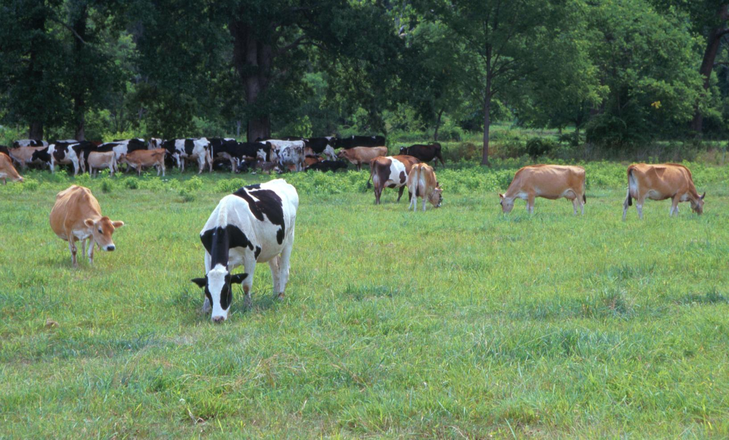
Questions?
AIP web site:
http://aipl.arsusda.gov
Holstein and Jersey crossbreds graze on American Farm Land Trust’s
Cove Mountain Farm in south-central Pennsylvania
Source: ARS Image Gallery, image #K8587-14; photo by Bob Nichols

