Slide 1
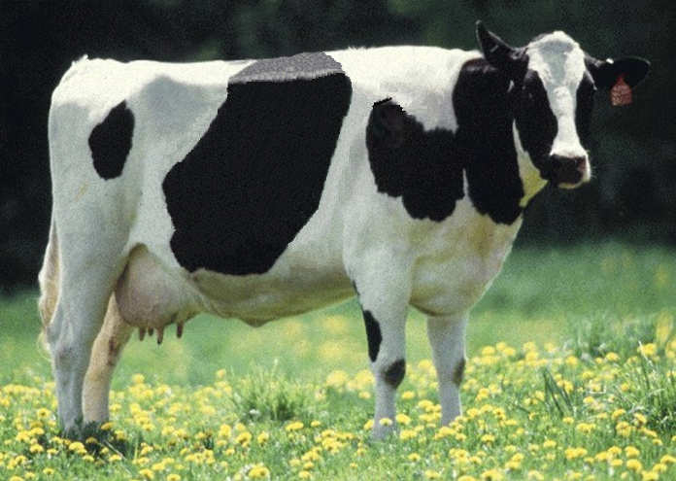
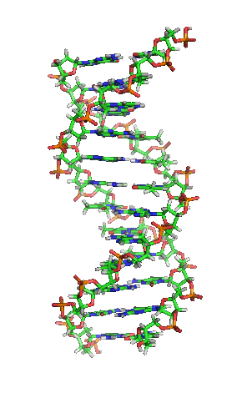
Genomics and where it can take us

Slide 2
Genomics and SNP
Genomics – Applies DNA technology and bioinformatics to sequence, assemble and analyze the function and structure of genomes
SNP – Single nucleotide polymorphisms; serve as markers to track inheritance of chromosomal segments
Genomic selection – Selection using genomic predictions of economic merit early in life

Slide 3
Why genomics works for dairy cattle
Extensive historical data available
Well-developed genetic evaluation program
Widespread use of AI sires
Progeny-test programs
High-value animals worth the cost of genotyping
Long generation interval that can be reduced substantially by genomics
Notes:
3

Slide 4
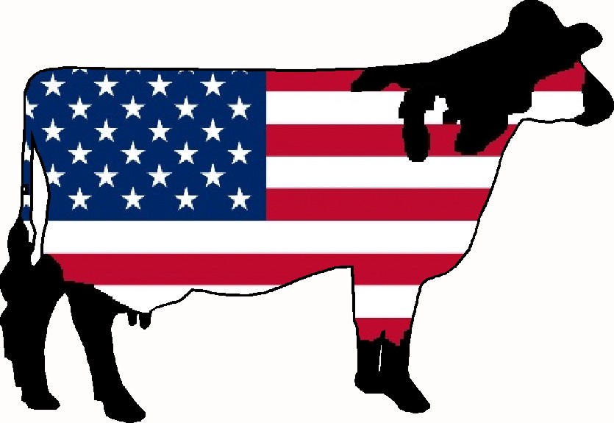
US genomic evaluation system

Slide 5
Collaboration with industry
Council on Dairy Cattle Breeding (CDCB) responsible for receiving data and for computing and delivering US genetic evaluations for dairy cattle
Animal Genomics and Improvement Lab (AGIL) responsible for research and development to improve the evaluation system
CDCB and AGIL employees co-located in Beltsville
Dr. João Dürr is CDCB CEO

Slide 6

Funding
CDCB evaluation calculation and dissemination funded by fee system
  Based on animals genotyped
  87% of revenue from bulls
  Higher fees for herds that
  contribute less information
USDA research on evaluation methodology funded by US Federal Government
$

Slide 7
Council on Dairy Cattle Breeding
CDCB
PDCA
NAAB
DRPC
DHI
Purebred Dairy
Cattle Association
National Association of Animal Breeders
Dairy Records
Processing Centers
Dairy Herd
Information
3 members from each organization
Total of 12 voting members
2 nonvoting industry members

Slide 8
Genomic data flow
Dairy Herd Information (DHI) producer
DNA samples
DNA samples
genomic
evaluations
DNA laboratory
DNA samples
AI organization,
breed association
genotypes
genotypes
nominations,
pedigree data
genotype
quality reports
genomic
evaluations
Council on Dairy Cattle Breeding (CDCB)
Notes:
8

Slide 9
History of genomic evaluations
BovineSNP50 BeadChip available Dec. 2007
First unofficial evaluation released Apr. 2008
Official evaluations for Holsteins and Jerseys Jan. 2009
Official evaluations for Brown Swiss Aug. 2009
Monthly evaluation Jan. 2010
Official 3K evaluations Dec. 2010
BovineLD BeadChip available Sept. 2011
Official evaluations for Ayrshires Apr. 2013
Weekly evaluation Nov. 2014
Notes:
9

Slide 10
Evaluation flow
Animal nominated for genomic evaluation by approved nominator
DNA source sent to genotyping lab (2014)

Source | Samples (no.) | Samples (%)
Blood | 10,727 | 4
Hair | 113,455 | 39
Nasal swab | 2,954 | 1
Semen | 3,432 | 1
Tissue | 149,301 | 51
Unknown | 12,301 | 4

Slide 11

Evaluation flow (continued)

DNA extracted and placed on chip for 3-day genotyping process
Genotypes sent from
genotyping lab to CDCB
for accuracy review


Slide 12
Laboratory quality control
Each SNP evaluated for
  Call rate
  Portion heterozygous
  Parent-progeny conflicts
Clustering investigated if SNP exceeds limits
Number of failing SNP indicates genotype quality
Target of <10 SNP in each category

Slide 13
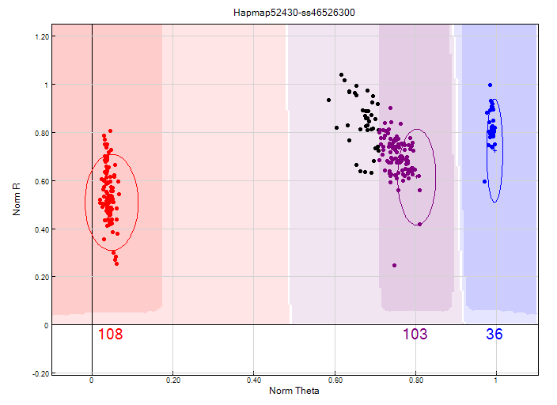
Before clustering adjustment
86% call rate

Slide 14
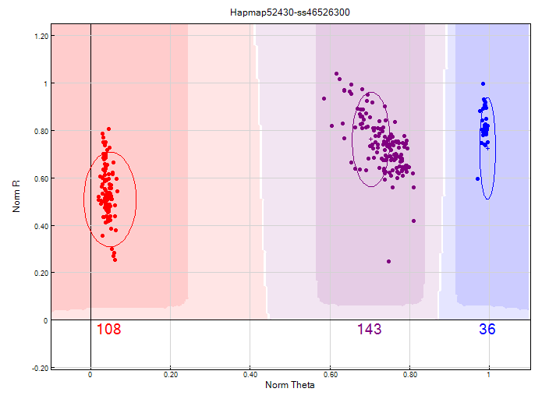
After clustering adjustment
100% call rate

Slide 15
Evaluation flow (continued)


Genotype calls modified as necessary
Genotypes loaded into database
Nominators receive reports of parentage and other conflicts
Pedigree or animal assignments corrected
Genotypes extracted and imputed to 61K
SNP effects estimated
Final evaluations calculated






Slide 16
Evaluation flow (continued)

Evaluations released to dairy industry
  Download from CDCB FTP site with
  separate files for each nominator
  Weekly release of evaluations of new animals
  Monthly release for females and bulls not marketed
  All genomic evaluations updated 3 times each year with traditional evaluations

Slide 17
2014 genotypes by chip SNP density
Chip SNP density | Female | Male | All animals
Low | 239,071 | 29,631 | 268,702
Medium | 9,098 | 14,202 | 23,300
High | 140 | 28 | 168
All | 248,309 | 43,861 | 292,170

Slide 18
2014 genotypes by breed and sex
Breed | Female | Male | All animals | Female: male
Ayrshire | 1,485 | 209 | 1,694 | 88:12
Brown Swiss | 944 | 8,641 | 9,585 | 10:90
Guernsey | 1,777 | 333 | 2,110 | 84:16
Holstein | 212,765 | 30,883 | 243,648 | 87:13
Jersey | 31,323 | 3,793 | 35,116 | 89:11
Milking Shorthorn | 2 | 1 | 3 | 67:33
Normande | 0 | 1 | 0 | 0:100
Crossbred | 13 | 0 | 13 | 100:0
All | 248,309 | 43,861 | 292,170 | 85:15

Slide 19
Growth in bull predictor population
Breed | Jan. 2015 | 12-mo gain
Ayrshire | 711 | 29
Brown Swiss | 6,112 | 336
Holstein | 26,759 | 2,174
Jersey | 4,448 | 245

Slide 20
Holstein prediction accuracy
Trait | Bias* | Reliability (%) | Reliability gain (% points)
Milk (kg) | −80.3 | 69.2 | 30.3
Fat (kg) | −1.4 | 68.4 | 29.5
Protein (kg) | −0.9 | 60.9 | 22.6
Fat (%) | 0.0 | 93.7 | 54.8
Protein (%) | 0.0 | 86.3 | 48.0
Productive life (mo) | −0.7 | 73.7 | 41.6
Somatic cell score | 0.0 | 64.9 | 29.3
Daughter pregnancy rate (%) | 0.2 | 53.5 | 20.9
Sire calving ease | 0.6 | 45.8 | 19.6
Daughter calving ease | −1.8 | 44.2 | 22.4
Sire stillbirth rate | 0.2 | 28.2 | 5.9
Daughter stillbirth rate | 0.1 | 37.6 | 17.9
*2013 deregressed value – 2009 genomic evaluation

Slide 21
Holstein prediction accuracy
Trait | Bias* | Reliability (%) | Reliability gain (% points)
Final score | 0.1 | 58.8 | 22.7
Stature | −0.2 | 68.5 | 30.6
Dairy form | −0.2 | 71.8 | 34.5
Rump angle | 0.0 | 70.2 | 34.7
Rump width | −0.2 | 65.0 | 28.1
Feed and legs | 0.2 | 44.0 | 12.8
Fore udder attachment | −0.2 | 70.4 | 33.1
Rear udder height | −0.1 | 59.4 | 22.2
Udder depth | −0.3 | 75.3 | 37.7
Udder cleft | −0.2 | 62.1 | 25.1
Front teat placement | −0.2 | 69.9 | 32.6
Teat length | −0.1 | 66.7 | 29.4
*2013 deregressed value – 2009 genomic evaluation

Slide 22
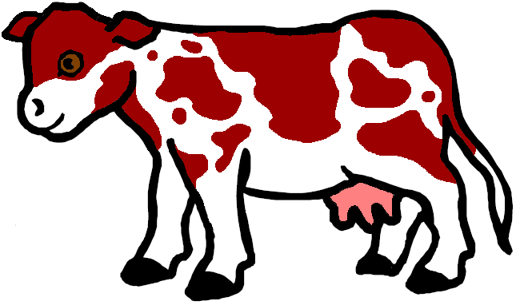
Gene tests (imputed and actual)
Bovine leucocyte adhesion deficiency (BLAD)
Complex vertebral malformation (CVM)
Deficiency of uridine monophosphate synthase (DUMPS)
Syndactyly (mulefoot)
Weaver Syndrome, spinal dismyelination (SDM), spinal muscular atrophy (SMA)
Red coat color
Polledness

Slide 23
New fertility haplotype for Jerseys (JH2)
Chromosome 26 at 8.8–9.4 Mbp
Carrier frequency
  14–28% in decades before 1990
  Only 2.6% now
Estimated effect on conception rate of –4.0% ± 1.5%
Additional sequencing needed to find causative genetic variant

Slide 24
Parent ages for marketed Holstein bulls

Slide 25
Inbreeding for Holstein cows
– Inbreeding
– Expected future inbreeding

Slide 26
Active AI bulls that were genomic bulls

Slide 27
Genetic merit of marketed Holstein bulls
Average gain:
$87.49/year
Average gain:
$47.95/year
Average gain:
$19.42/year

Slide 28
Stability of genomic evaluations
642 Holstein bulls
  Dec. 2012 NM$ compared with Dec. 2014 NM$
  First traditional evaluation in Aug. 2014
  ≥50 daughters by Dec. 2014
Top 100 bulls in 2012
  Average rank change of 9.6
  Maximum drop of 119
  Maximum rise of 56
All 642 bulls
  Correlation of 0.94 between 2012 and 2014
  Regression of 0.92
Notes:
28

Slide 29
Improving accuracy
Increase size of predictor population
  Share genotypes across country
  Include females
Use more or better SNP
Account for effect of genomic selection on traditional evaluations
Reduce cost to reach more selection candidates

Slide 30
New GHD version (in development)
Around 140K SNP expected
Include 16,248 among 60,671 SNP currently used that are not on GHD
Many added SNP have low to moderate MAF
  Research underway to determine if they improve evaluation accuracy

Slide 31
Mating programs
Match genotypes of parents to minimize genomic inbreeding
Avoid mating carriers
Consider nonadditive gene action
May attempt to increases variance to get outliers

Slide 32
Future
Discovery of causative genetic variants
  Do not have linkage decay
  Added to chips as discovered
  Used when enough genotypes exist to support imputation
  Accelerated by availability of sequence data at a lower cost
Evaluation of benefit from larger SNP sets as cost per SNP genotype declines
Application of genomics to more traits
Across-breed evaluation
Accounting for genomic pre-selection

Slide 33
Conclusions
Genomic evaluation has dramatically changed dairy cattle breeding
Rate of gain has increased primarily because of large reduction in generation interval
Genomic research is ongoing
  Detect causative genetic variants
  Find more haplotypes that affect fertility
  Improve accuracy

Slide 34
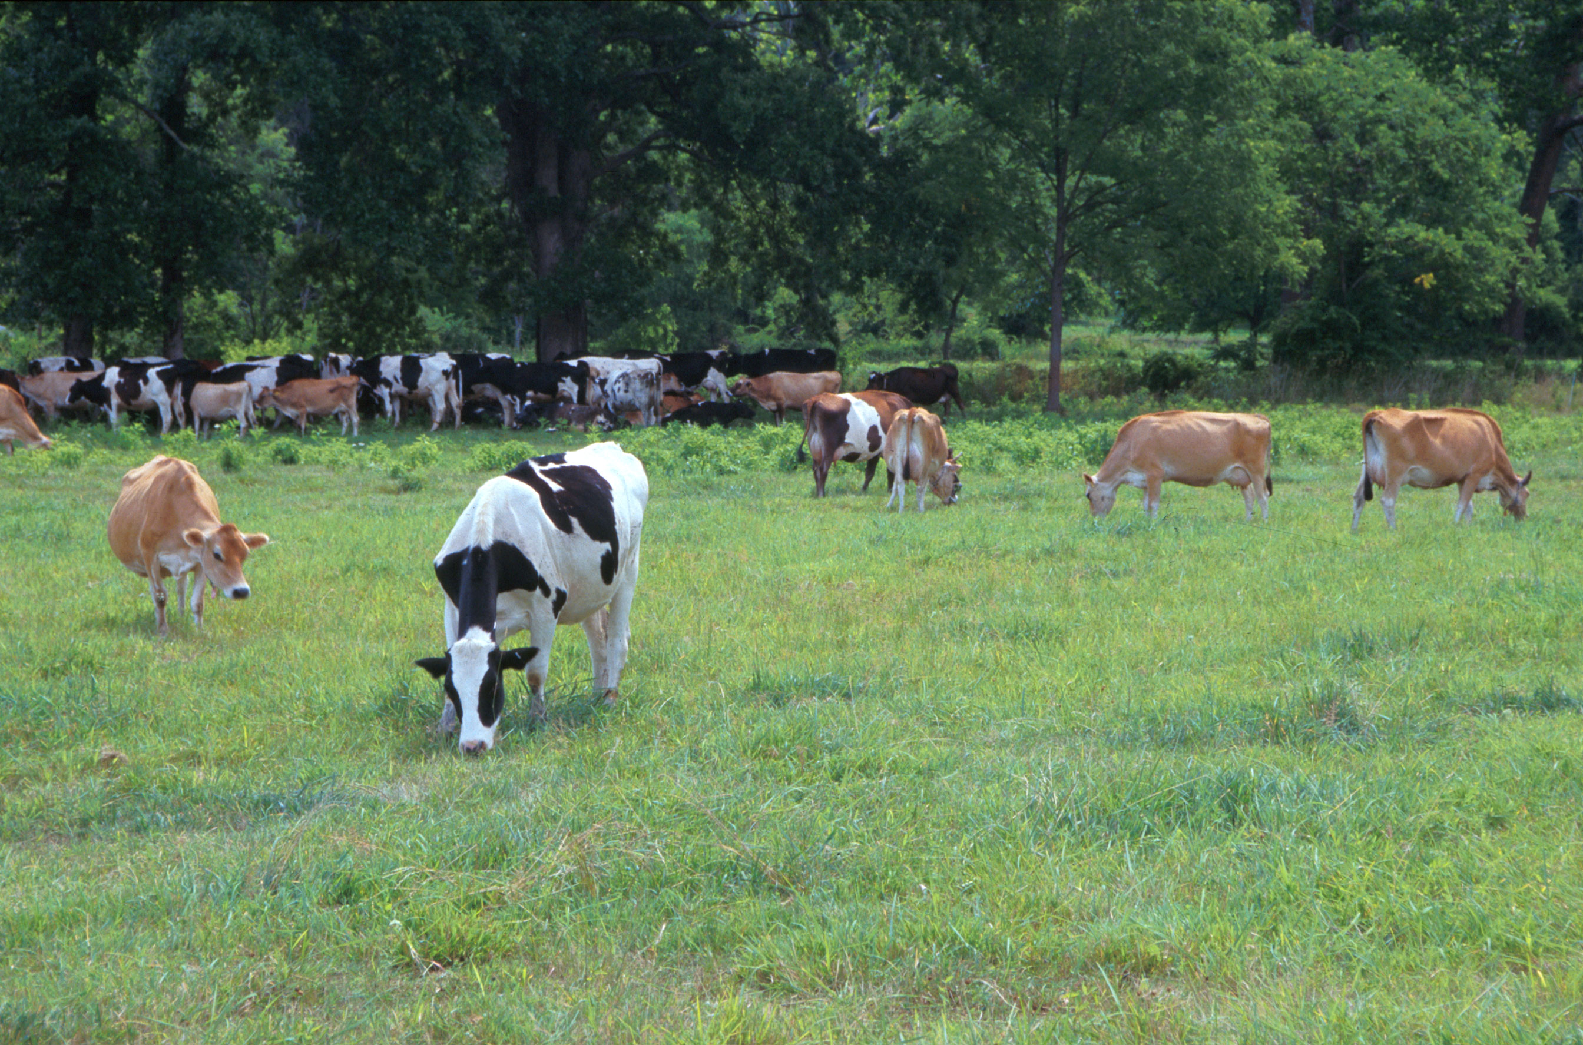
Questions?
AIP web site:
http://aipl.arsusda.gov
Holstein and Jersey crossbreds graze on American Farm Land Trust’s
Cove Mountain Farm in south-central Pennsylvania
Source: ARS Image Gallery, image #K8587-14; photo by Bob Nichols

