Slide 1
Why Genetic Progress Requires Continually Improving Methods

Slide 2
Topics
Breeders and evaluations both adopt new technologies, causing continuous need to redesign breeding and computer programs
Selection index and trait emphasis
Genetic progress
Genetic evaluation and statistical methods
Genotype by environment interaction

Slide 3
Changes in trait selection across time
Trait | Relative emphasis in USDA index (%)
 | PD$ 1971 | MFP$ 1976 | NM$ 1994 | NM$ 2000 | NM$ 2003 | NM$ 2006 | NM$ 2010 | NM$ 2014
Milk | 52 | 27 | 6 | 5 | 0 | 0 | 0 | -1
Fat | 48 | 46 | 25 | 21 | 22 | 23 | 19 | 22
Protein | … | 27 | 43 | 36 | 33 | 23 | 16 | 20
Longevity | … | … | 20 | 14 | 11 | 17 | 22 | 19
SCS | … | … | –6 | –9 | –9 | –9 | –10 | –7
Udder | … | … | … | 7 | 7 | 6 | 7 | 8
Feet/Leg | … | … | … | 4 | 4 | 3 | 4 | 3
Body Size | … | … | … | –4 | –3 | –4 | –6 | –5
Preg Rate | … | … | … | … | 7 | 9 | 11 | 7
Calve Ease | … | … | … | … | 4 | 6 | 5 | 5
Heifer CR | … | … | … | … | … | … | … | 2
Cow CR | … | … | … | … | … | … | … | 1
Notes:
3
3

Slide 4
Genetic Evaluation Advances and increases in genetic progress
Year | Advance | % Gain
1935 | Daughter-dam comparison | 100
1962 | Herdmate comparison | 50
1973 | Records in progress | 10
1974 | Modified cont. comparison | 5
1977 | Protein evaluated | 4
1989 | Animal model | 4
1994 | More traits and Net Merit | 50
2008 | Genomic selection | >50

Slide 5
New evaluation programs: Dec 2014
Replaced animal model programs used since 1989. New options include:
Multi-trait models, multiple class and regress variables, suppress some factors for each trait, random regressions, include foreign data, parallel processing
Developed for transition to single-step model (genotypes, phenotypes, pedigree)
G difficult with 1 million genotypes
Notes:
Renumber factors in same program

Slide 6
Trend in Net Merit $

Slide 7
Expected and realized NM$ progress
Actual progress $80 / year vs. $90 in theory
Female selection has largest genomic benefit
Shorter generation interval and higher REL
Embryo transfer now more valuable
Male selection has reduced age and REL
3% of sons in AI had young sires in 2008 compared to 81% in 2012, >90% in theory

Slide 8
Embryo transfer calves, by year

Slide 9
% ET daughters, % genotyped mates

Slide 10
Previous and future biases
Previous biases have been reduced:
Polygenic effect added (2010), cow PTA adjustments (2010), DGV weight reduced (2012, 2013), PL correlations reduced (2012)
Heritability of yield traits reduced (2014)
Future biases will need to be reduced:
Genomic pre-selection of progeny or mates
Early daughters not from random sampling

Slide 11
Measure genomic pre-selection bias
Mates of proven bulls (current bias)
Top 50 NM$ that now have daughters
Bulls had no daughter records in 2011
Mates of young bulls (future bias)
Top 50 NM$ in Dec 2014, not proven yet
Bulls born in 2010-2012
Did genotyped daughters get phenotypes?

Slide 12
Current bias from mates of proven bulls
Genomic PTA – trad PTA for mates of top 50 NM$ bulls that now have dtr records
Trait | Mean | SD | Min | Max
NM$ | 1 | 2 | -1 | 8
Protein | 0 | 0 | 0 | 0
Prod Life | .0 | .0 | .0 | .2
Dtr Preg Rate | .0 | .0 | .0 | .1
SCS | .00 | .00 | -.01 | .00
Final Score | -.01 | .01 | -.05 | .00
Udder Depth | -.01 | .01 | -.04 | .04

Slide 13
Future bias from mates – young bulls
Genomic PTA – trad PTA of mates of top 50 NM$ bulls born in 2010-2012
Trait | Mean | SD | Min | Max
NM$ | 5 | 3 | 0 | 11
Protein | 0 | 0 | 0 | 1
Prod Life | .1 | .0 | .0 | .1
Dtr Preg Rate | .1 | .0 | .0 | .1
SCS | .00 | .00 | -.01 | .00
Final Score | -.02 | .02 | -.08 | .00
Udder Depth | -.01 | .01 | -.04 | .02

Slide 14
Genetic difference between genotyped daughters with and without records

Slide 15
Percent genotyped daughters with records

Slide 16
Genetic by environment interactions
Tested adding 2 different interactions into US evaluations (random regressions)
Temperature humidity index: state or seasonal differences in heat stress
Herd level: production compared to national averages for year and breed
Very small gains for predicting performance in other countries or for future records

Slide 17
Global Bulls with USA Sires

Slide 18
Conclusions
Selection for some traits causes other traits to become limiting factors
Recent progress is much faster, and emphasis has shifted to different traits
Rapidly growing data and modern breeding programs are challenging evaluation methods
Statistical adjustments have reduced upward biases, but new biases may occur

Slide 19
Acknowledgments
Jan Wright, Mel Tooker, Tabatha Cooper, John Cole, Dan Null, and Jana Hutchison assisted with computation and graphics
Members of the Council on Dairy Cattle Breeding (CDCB) provided data

Slide 20
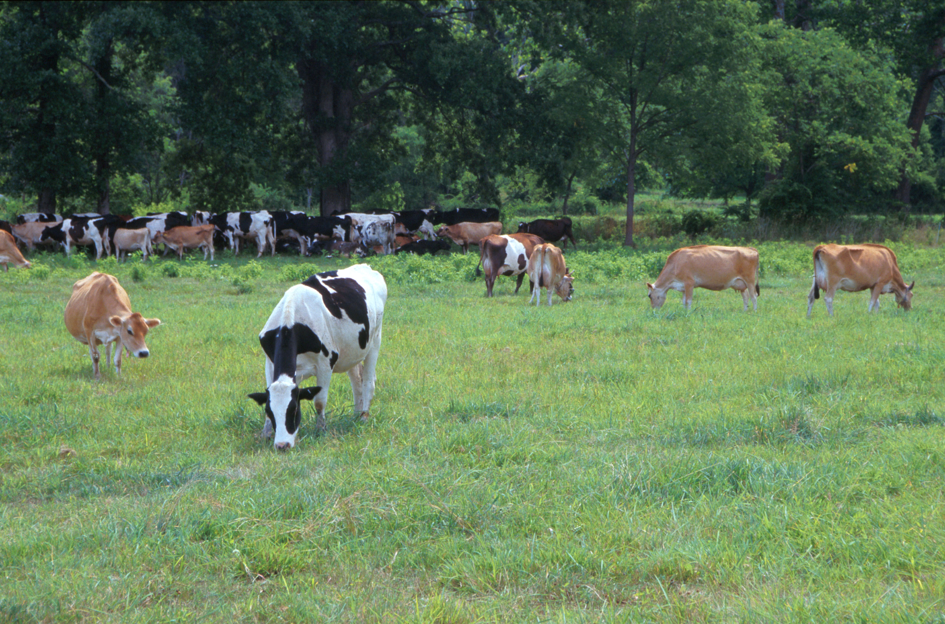
Questions?
AIP web site:
http://aipl.arsusda.gov
Holstein and Jersey crossbreds graze on American Farm Land Trust’s
Cove Mountain Farm in south-central Pennsylvania
Source: ARS Image Gallery, image #K8587-14; photo by Bob Nichols

