Slide 1
Using genotypes to construct phenotypes for dairy cattle breeding programs and beyond

Slide 2
Why do we need new phenotypes?
Changes in production economics
Technology enables collection of new phenotypes
Better understanding of biology
Recent review by Egger-Danner et al. (2015) in Animal

Slide 3
Selection indices now include many traits
Source: Miglior et al. (2012)

Slide 4
New phenotypes should add information
Novel phenotypes
include some
new information
Novel phenotypes
contain little
new information
high
Phenotypic correlation
with existing traits
Novel phenotypes
include much
new information
Novel phenotypes
contain some
new information
low
low
high
Genetic correlation with
existing traits

Slide 5
Cost of measurement vs. value to farmers
high
(milk yield)
(feed intake)
Value of phenotype
low
(conformation)
(greenhouse gas
emissions)
low
high
Cost of measurement

Slide 6
Some novel phenotypes studied recently
Claw health (Van der Linde et al., 2010)
Dairy cattle health (Parker Gaddis et al., 2013)
Embryonic development (Cochran et al., 2013)
Immune response (Thompson-Crispi et al., 2013)
Methane production (de Haas et al., 2011)
Milk fatty acid composition (Soyeurt et al., 2011)
Persistency of lactation (Cole et al., 2009)
Rectal temperature (Dikmen et al., 2013)
Residual feed intake (Connor et al., 2013)

Slide 7
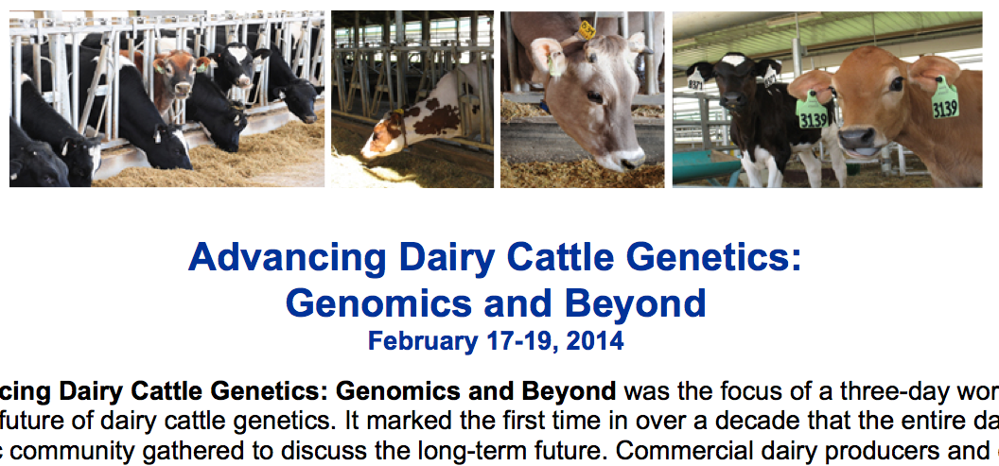
What do US dairy farmers want?
National workshop in Tempe, AZ in February
  Producers, industry, academia, and government
Farmers want new tools
  Additional traits (novel phenotypes)
  Better management tools
Foot health and feed efficiency were of greatest interest

Slide 8
What can farmers do with novel traits?
Put them into a selection index
  Correlated traits are helpful
Apply selection for a long time
  There are no shortcuts
Collect phenotypes on many daughters
  Repeated records of limited value
  Genomics can increase accuracy

Slide 9
Holstein prediction accuracy
Trait | Bias* | Reliability (%) | Reliability gain (% points)
Milk (kg) | −80.3 | 69.2 | 30.3
Fat (kg) | −1.4 | 68.4 | 29.5
Protein (kg) | −0.9 | 60.9 | 22.6
Fat (%) | 0.0 | 93.7 | 54.8
Protein (%) | 0.0 | 86.3 | 48.0
Productive life (mo) | −0.7 | 73.7 | 41.6
Somatic cell score | 0.0 | 64.9 | 29.3
Daughter pregnancy rate (%) | 0.2 | 53.5 | 20.9
Sire calving ease | 0.6 | 45.8 | 19.6
Daughter calving ease | −1.8 | 44.2 | 22.4
Sire stillbirth rate | 0.2 | 28.2 | 5.9
Daughter stillbirth rate | 0.1 | 37.6 | 17.9
*2013 deregressed value – 2009 genomic evaluation

Slide 10
Constructing phenotypes from genotypes
Prediction from correlated traits or phenotypes from reference herds
Haplotypes can be used when causal variants are not known
Causal variants can be used in place of markers
Specific combining abilities can combine additive and dominance effects

Slide 11
Genotypes are abundant

Slide 12
Example: Polled cattle
Polled cattle have improved welfare and increased economic value
polled haplotypes have low frequencies: 0.41% in BS, 0.93% in HO, and 2.22% in JE
Increasing haplotype frequency by index selection requires known status for all animals
Estimate gene content (GC) for all non-genotyped animals.

Slide 13
Prediction of gene content
The densefreq.f90 program (VanRaden) was modified to use the methodology of Gengler et al. (2007)
  Information from all genotyped relatives used
  Gene content is real-valued and continuous in the interval [0,2].

Slide 14
Addition of polled to the Net Merit index
$11.79 (€10.85) and $10.73 (€9.87) for costs of dehorning and polled genetics, respectively (Widmar et al., 2013)
Haplotype count multiplied by $22.52 (€20.72) for genotyped animals
Gene content multiplied by $22.52 (€20.72) for non-genotyped animals
Rank correlations with 2014 NM$ compared for bulls and cows

Slide 15
Validation of Jersey polled gene content
Polled status from recessive codes and animal names compared to GC for 1,615 non-genotyped JE with known status.
97% (n = 675) of pp animals correctly assigned GC near 0
Pp animals had GC near 0 (52%, n = 474) and near 1 (47%; n = 433)
All PP animals (n = 11) assigned GC of ~2.

Slide 16
Reasons for variation in gene content
The expectation for GC is near 1 for heterozygotes
    GC can be <1 if many polled ancestors have unknown status or when pedigree is unknown
    In those cases GC may be set to twice the allele frequency, which is low for polled
    Some animals with -P in the name may actually be PP, not Pp

Slide 17
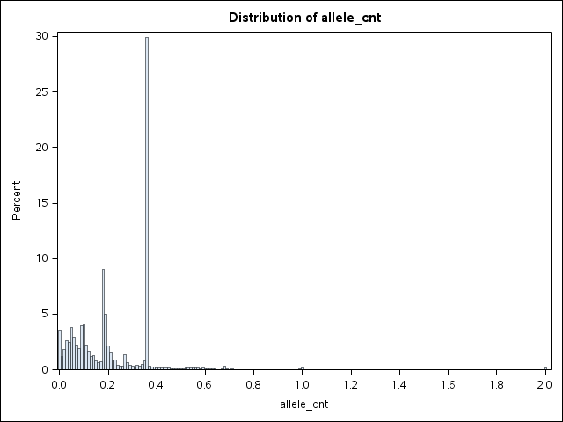
Gene content for polled in Jerseys
MAF = 2.5%
pp
Pp
PP

Slide 18
Jersey polled merit
Group | N | ρ
All animals | 2,471,025 | 0.99997
All cows | 2,436,439 | 0.99997
All bulls | 34,586 | 0.99990
Young bulls (G status) | 380 | 0.99787

Slide 19
Validation of Holstein polled gene content
Polled status from recessive codes and animal names compared to GC for 1,615 non-genotyped JE with known status.
97% (n = 675) of pp animals correctly assigned GC near 0
Pp animals had GC near 0 (52%, n = 474) and near 1 (47%; n = 433)
All PP animals (n = 11) assigned GC of ~2.

Slide 20
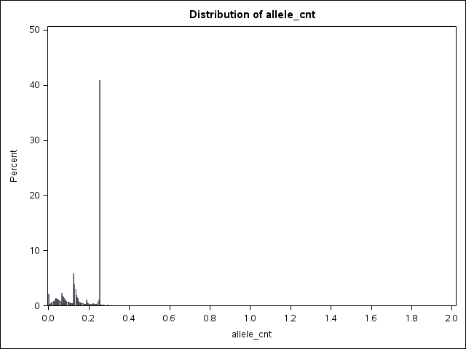
Allele content for polled in Holsteins
MAF = 1.07%
pp
Pp
PP

Slide 21
Holstein polled merit
Group | N | ρ
All animals | 29,010,457 | 0.99999
All cows | 28,769,803 | 0.99999
All bulls | 240,654 | 0.99994
Young bulls (G status) | 1,607 | 0.99966

Slide 22
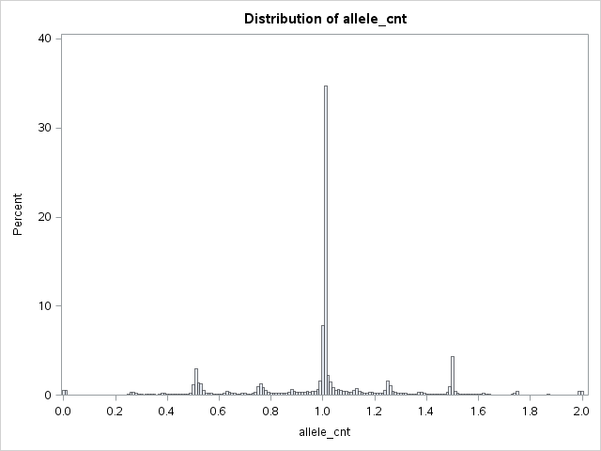
Allele content for DGAT1 in Jerseys
MAF = 47.9%

Slide 23
Other phenotypes may come from genotypes
Name | Chrome | Location (Mbp) | Carrier Freq | Earliest Known Ancestor
HH1 | 5 | 62-68 | 4.5 | Pawnee Farm Arlinda Chief
HH2 | 1 | 93-98 | 4.6 | Willowholme Mark Anthony
HH3 | 8 | 92-97 | 4.7 | Glendell Arlinda Chief, Gray View Skyliner
HH4 | 1 | 1.2-1.3 | 0.37 | Besne Buck
HH5 | 9 | 92-94 | 2.22 | Thornlea Texal Supreme
JH1 | 15 | 11-16 | 23.4 | Observer Chocolate Soldier
BH1 | 7 | 42-47 | 14.0 | West Lawn Stretch Improver
BH2 | 19 | 10-12 | 7.78 | Rancho Rustic My Design
AH1 | 17 | 65.9-66.2 | 26.1 | Selwood Betty’s Commander
For a complete list, see: http://aipl.arsusda.gov/reference/recessive_haplotypes_ARR-G3.html.

Slide 24
Conclusions
New technology is enabling the collection of novel phenotypes
Genotypes are now routinely available for young animals
High-density SNP genotypes can be used to construct phenotypes directly

Slide 25
Acknowledgments
Dan Null and Paul VanRaden, AGIL
Chuanyu Sun, Sexing Technologies
AFRI grant 1245-31000-101-05, “Improving Fertility of Dairy Cattle Using Translational Genomics”

Slide 26

Questions?
http://gigaom.com/2012/05/31/t-mobile-pits-its-math-against-verizons-the-loser-common-sense/shutterstock_76826245/

