Slide 1
Strategies for managing genetic disorders in dairy cattle
John B. Cole
Animal Genomics and Improvement Laboratory
Agricultural Research Service, USDA
Beltsville, MD 20705-2350

Slide 2
Overview
Introduction to genetic disorders
  Definition
  Examples
  Impact on farmers
Management of genetic disorders
  Conventional breeding
  Gene editing
  Desirable alleles

Slide 3
Introduction to genetic disorders

Slide 4
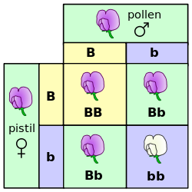
Mendelian recessives
Classical model of inheritance
One locus, typically with two alleles
Often exhibit complete dominance
e.g., Mendel’s experiments
Source: https://commons.wikimedia.org/wiki/File:Punnett_square_mendel_flowers.svg.

Slide 5
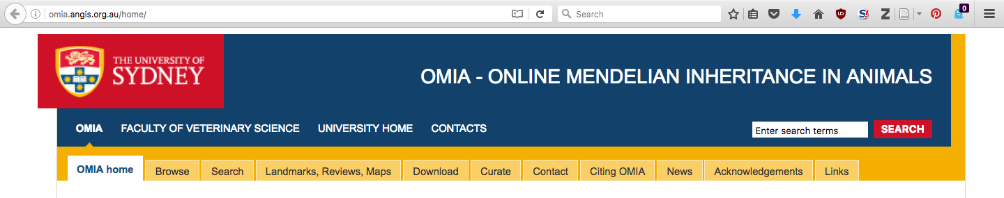
Genetic diseases are common
There are currently 494 genetic traits/disorders of cattle in the Online Mendelian Inheritance in Animals database
  http://omia.angis.org.au/home/
229 of these are Mendelian traits/disorders

Slide 6
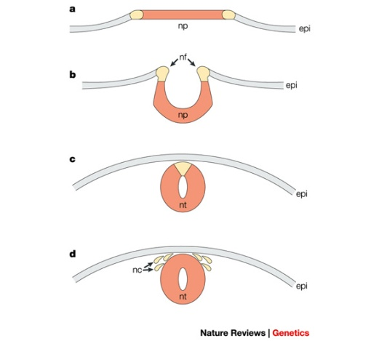
Example – APAF1 (HH1)
Bos taurus apoptotic peptidase activating factor 1 (APAF1; Adams et al., 2016)
Gene expression for APAF1 in murine development begins between 7 and 9 d (Müller et al., 2005)
Gene knockout of APAF1 results in
embryonic death
  Proteins required for this
  pathway/cascade are important
  for neural tube closure in vivo

Slide 7
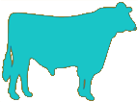

Transmission of APAF1
100% free of recessives | 50% free, 50% carriers
50% free, 50% carriers | 25% free, 50% carriers, 25% die
Source: http://vet.tufts.edu/tas/images/002.png.

Slide 8
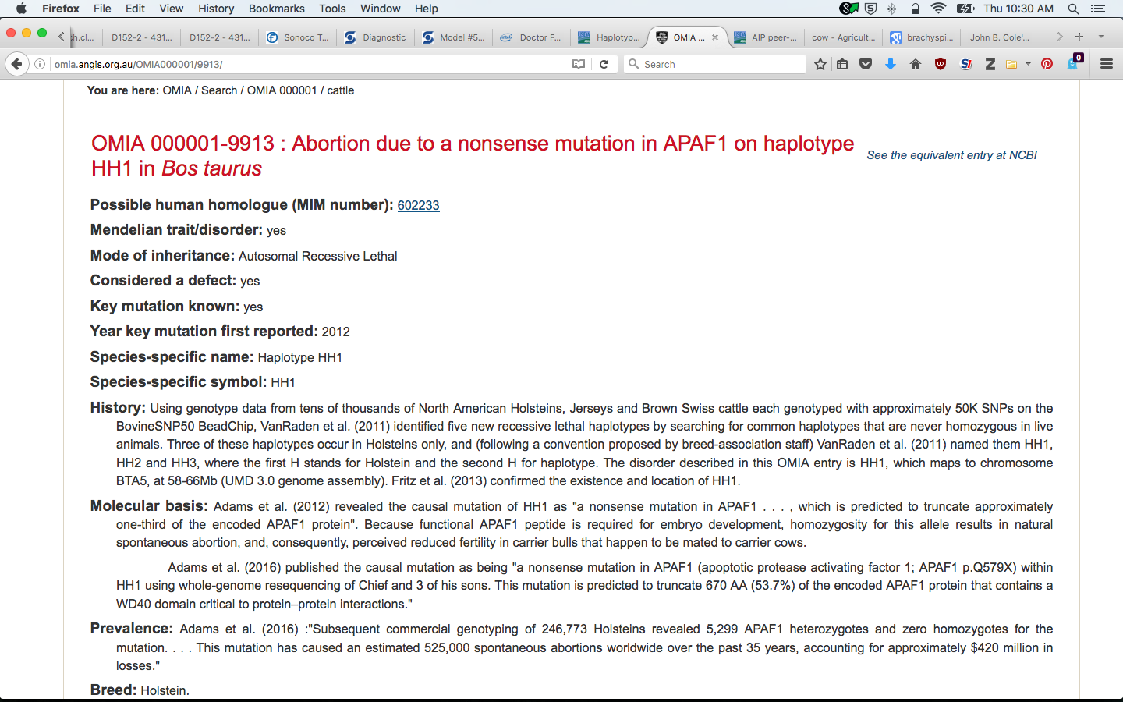
OMIA cards for APAF1
Source: http://omia.angis.org.au/OMIA000001/9913/.

Slide 9
Brachyspina (FANC1)
Source: Agerholm et al. (2006).

Slide 10
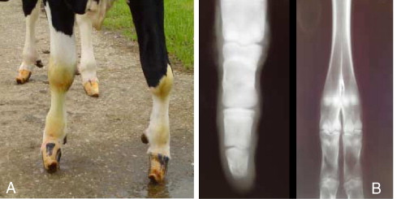
Syndactyly (Mulefoot)
Source: Duchesne et al. (2006).

Slide 11
Timing of recessive effects
Late losses are more costly than early losses
A defect may cause deaths in more than one time period
Embryonic loss or abortion | Death at or near birth | Weeks or months following birth
BH1, HH0, HH1, HH2, HH3, HH4, HH5, CVM, JH1, JH2 | BH2, HH0, CVM, syndactyly (mulefoot) | AH1, BH2, BLAD, cholesterol deficiency, spinal dysmyelination, spinal muscular atrophy, weaver syndrome

Slide 12
Haplotypes affecting fertility
Rapid discovery of new recessive defects
  Large numbers of genotyped animals
  Affordable DNA sequencing
Determination of haplotype location
  Significant number of homozygous animals expected, but none observed
  Narrow suspect region with fine mapping
  Use sequence data to find causative mutation

Slide 13
Genotypes are plentiful
18ª Congresso Estadual de Medicina Veterinária & 1º Encontro de Buiatria do CONESUL, Canela, RS, Brasil, 14 October 2016

Slide 14
Haplotypes affecting fertility
Name | BTA chromo- some | Location* (Mbp) | Carrier frequency (%) | Earliest known ancestor
HH1 | 5 | 63.2* | 3.8 | Pawnee Farm Arlinda Chief
HH2 | 1 | 94.9 – 96.6 | 3.3 | Willowholme Mark Anthony
HH3 | 8 | 95.4* | 5.9 | Glendell Arlinda Chief, Gray View Skyliner
HH4 | 1 | 1.3* | 0.7 | Besne Buck
HH5 | 9 | 92.43– 93.9* | 4.4 | Thornlea Texal Supreme
JH1 | 15 | 15.7* | 24.2 | Observer Chocolate Soldier
JH2 | 26 | 8.8 – 9.4 | 2.6 | Liberators Basilius
BH1 | 7 | 42.8 – 47.0 | 13.3 | West Lawn Stretch Improver
BH2 | 19 | 10.6 – 11.7 | 15.6 | Rancho Rustic My Design
AH1 | 17 | 65.9* | 26.0 | Selwood Betty’s Commander
*Causative mutation known
Source: http://aipl.arsusda.gov/reference/recessive_haplotypes_ARR-G3.html.
18ª Congresso Estadual de Medicina Veterinária & 1º Encontro de Buiatria do CONESUL, Canela, RS, Brasil, 14 October 2016

Slide 15
Haplotypes for known recessives
Recessive | Haplo-type | BTA chromo- some | Tested animals (no.) | Concord- ance (%) | New carriers (no.)
Brachyspina | HH0 | 21 | ? | ? | ?
BLAD | HHB | 1* | 11,782 | 99.9 | 314
CVM | HHC | 3* | 13,226 | — | 2,716
DUMPS | HHD | 1* | 3,242 | 100.0 | 3
Mulefoot | HHM | 15* | 87 | 97.7 | 120
Polled | HHP | 1 | 345 | — | 2,050
Red coat color | HHR | 18* | 4,137 | — | 5,927
SDM | BHD | 11* | 108 | 94.4 | 108
SMA | BHM | 24* | 568 | 98.1 | 111
Weaver | BHW | 4 | 163 | 96.3 | 32
*Causative mutation known
Source: http://aipl.arsusda.gov/reference/recessive_haplotypes_ARR-G3.html.
18ª Congresso Estadual de Medicina Veterinária & 1º Encontro de Buiatria do CONESUL, Canela, RS, Brasil, 14 October 2016

Slide 16
Is the number of defects increasing?
MacArthur et al. (2012) estimated that human genomes contain ~100 loss-of-function mutations, and ~20 completely inactivated genes
The mutations are there even if we have not identified them yet
Our detection methods are improving as our technology improves

Slide 17
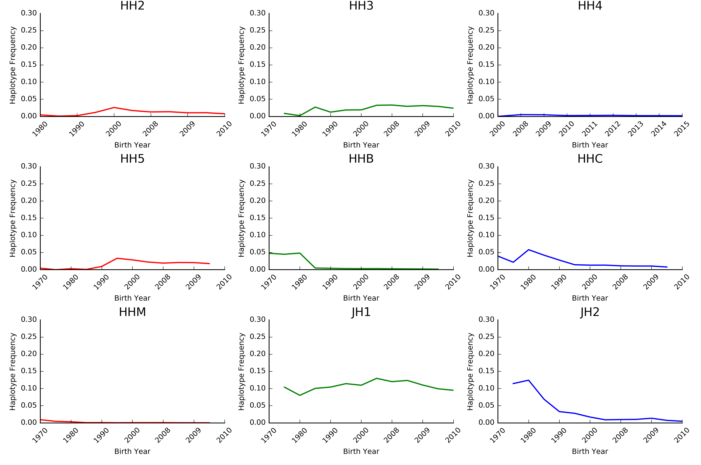
Frequencies change over time
The best way to reduce the frequency of harmful alleles is to not use carrier bulls!
Source: Cole et al. (2016).

Slide 18
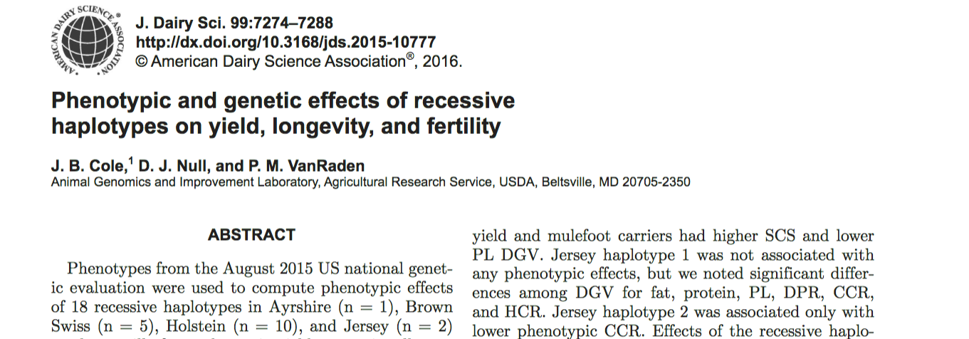
Do recessives affect other traits?
Effects of recessive haplotypes on yield, fertility, and longevity generally were small even when significant

Slide 19
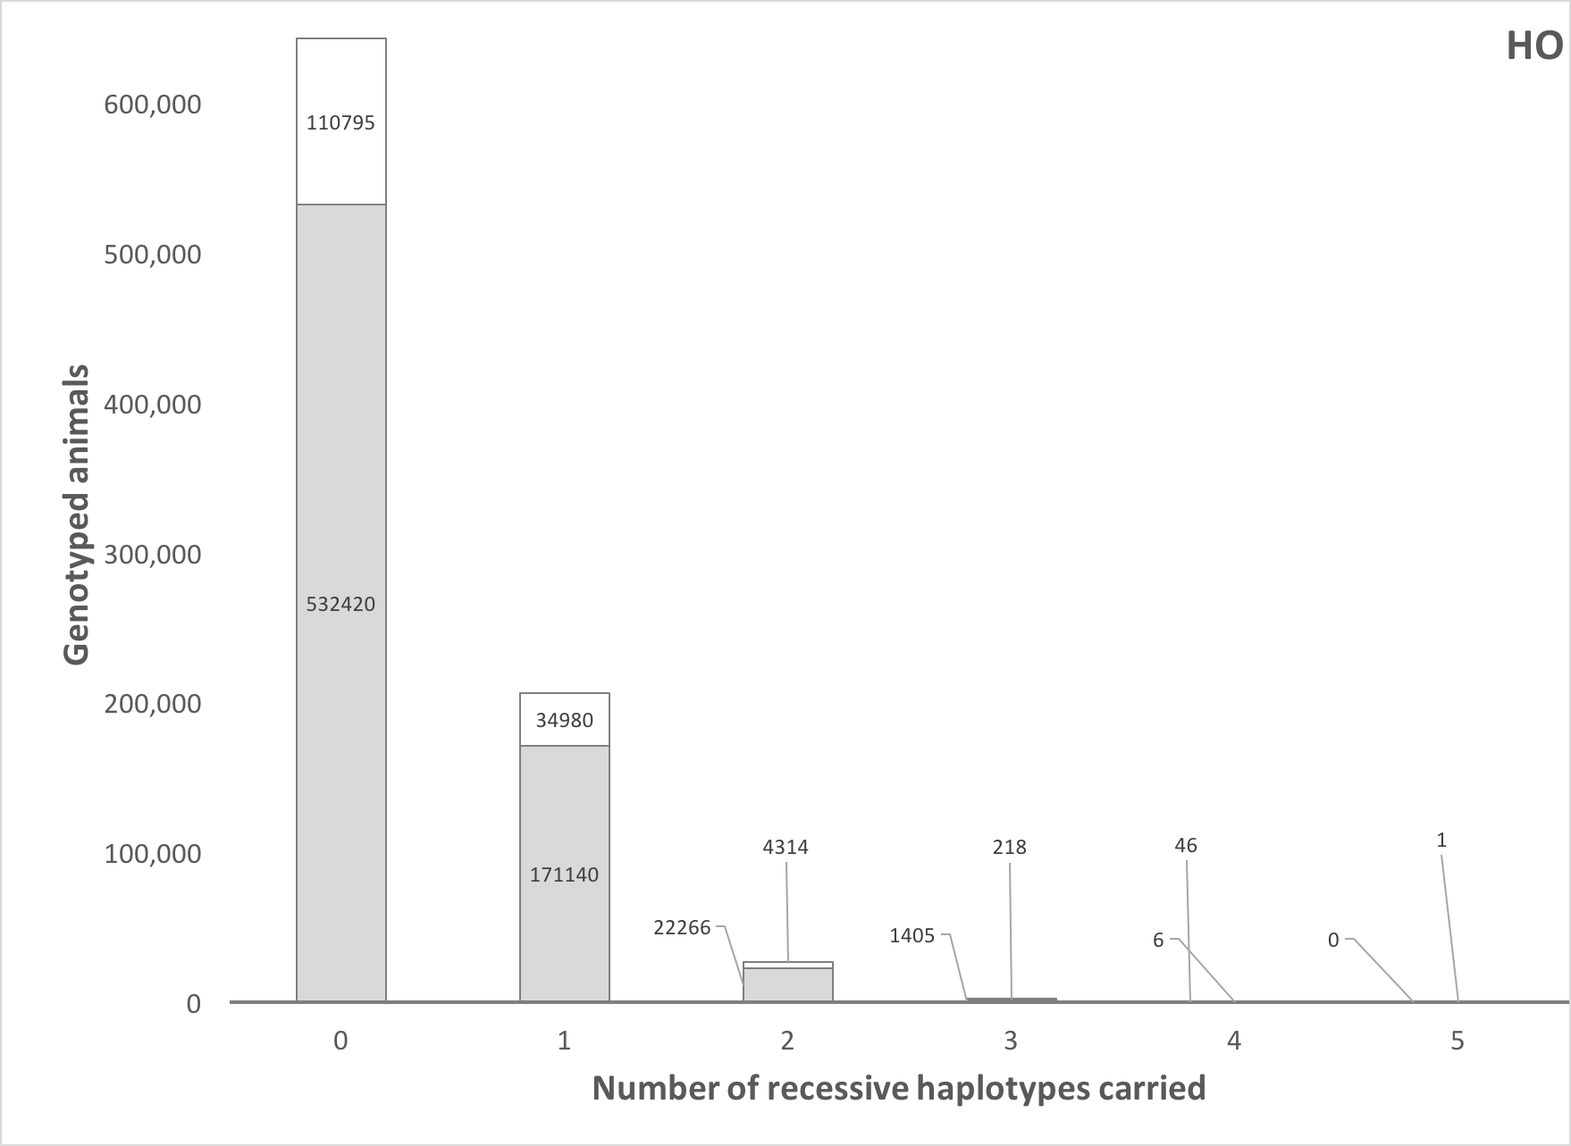
How many defects do animals carry?
Source: Cole et al. (2016).

Slide 20
Estimated cost of genetic load
Cole et al. (2016) estimated losses of at least R$33 million due to known recessives.
Average losses were R$19, R$12, R$3, and R$10 in Ayrshire, Brown Swiss, Holstein, and Jersey, respectively.
This is the economic impact of genetic load as it affects fertility and perinatal mortality.
Actual losses are likely to be higher.

Slide 21
Strategies for management of genetic disorders

Slide 22
Mate selection
The goal of mate selection is to match one bull to one cow for breeding (e.g., Kinghorn, 1987)
1
2
3
3
Semen for AI
4
5
Portfolio (group) of bulls

Slide 23
Previous approaches
Linear programming
  EBV, inbreeding, dominance
Genetic algorithms
  Complex to understand
Sequential mate allocation
  Restrictions often needed
Group mating
  Does not consider merit of cows

Slide 24
Large versus small dairies
In the US, mate allocation is affected by the size of the dairy
Small farms can provide individual attention to each cow in the herd
  Many bulls bred to individual cows
Large farms cannot provide individual attention due to labor constraints
  One bull bred to many cows

Slide 25
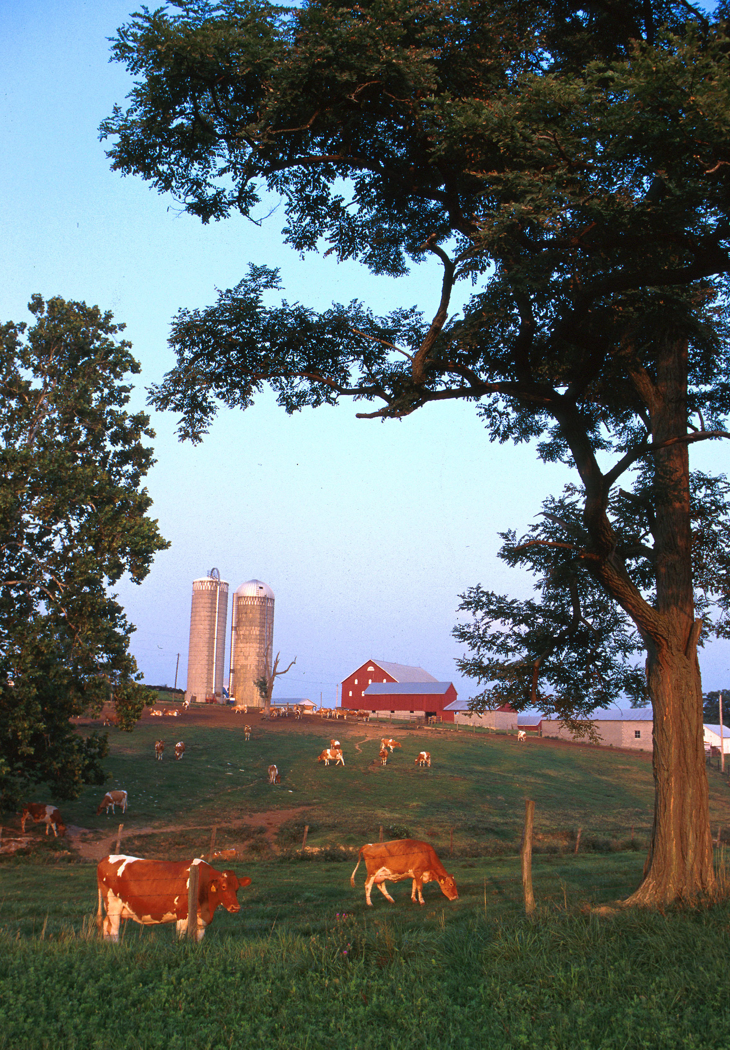
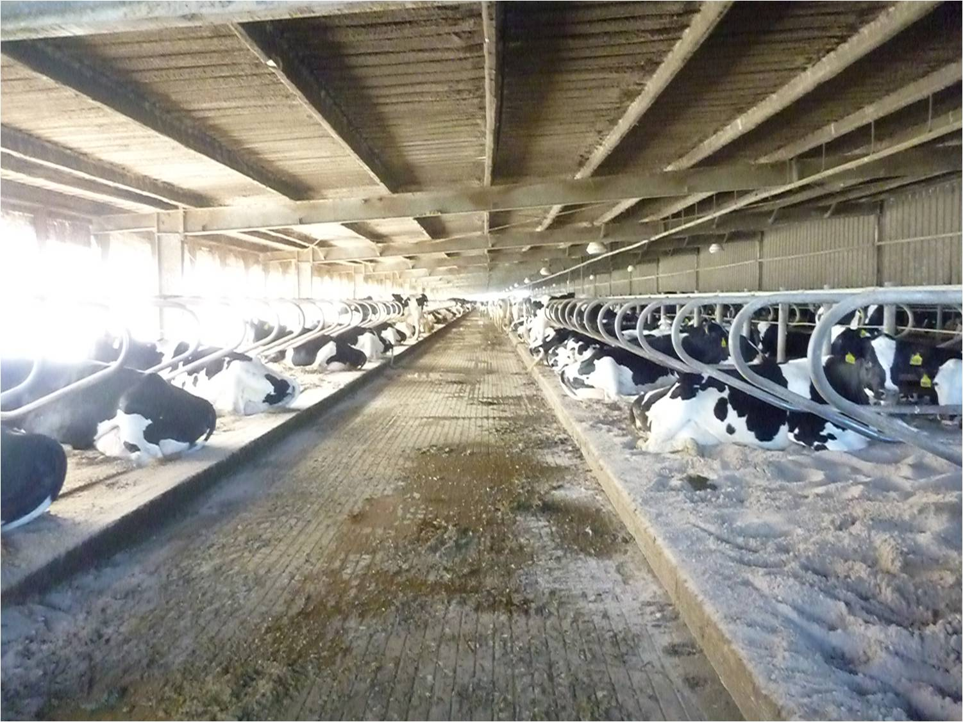
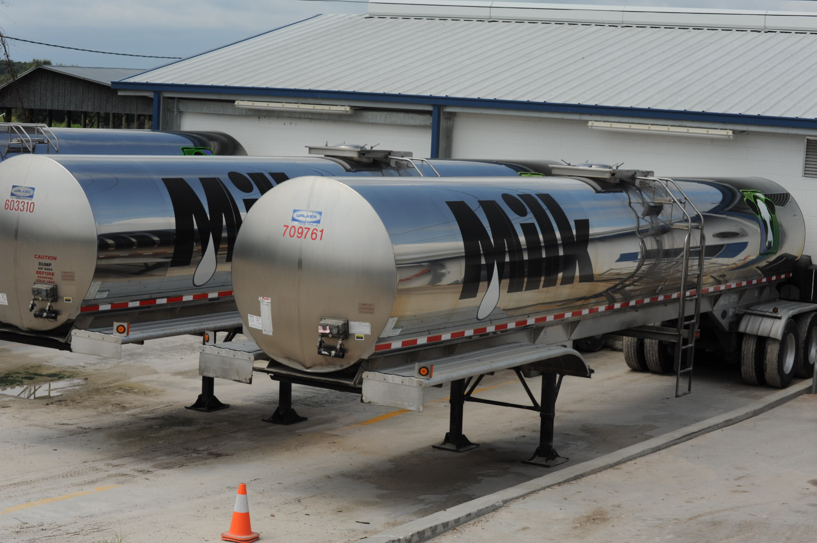
Typical US dairies
Small dairy farm in western Maryland. Photo courtesy of ARS.
Top: Large freestall barn in the state of Florida.
Bottom: 7,000 G (~26,500 l) milk tankers.
Photo courtesy of North Florida Holsteins.

Slide 26
Large herds using timed AI

Slide 27
Selection using marker information
Shepherd and Kinghorn (2001) described a look-ahead mate selection scheme using markers.
Li et al. (2006, 2008) showed QTL genotypes provide more benefit when used in mate selection.
Pryce et al. (2012) found that genotypes can be used to increase genetic gain while limiting inbreeding.
Van Eenennaam and Kinghorn (2014) proposed selection against the total number of lethal alleles and recessive lethal genotypes.
Cole (2015) suggested that parent averages can be adjusted to account for genetic load in sequential mate allocation schemes.

Slide 28
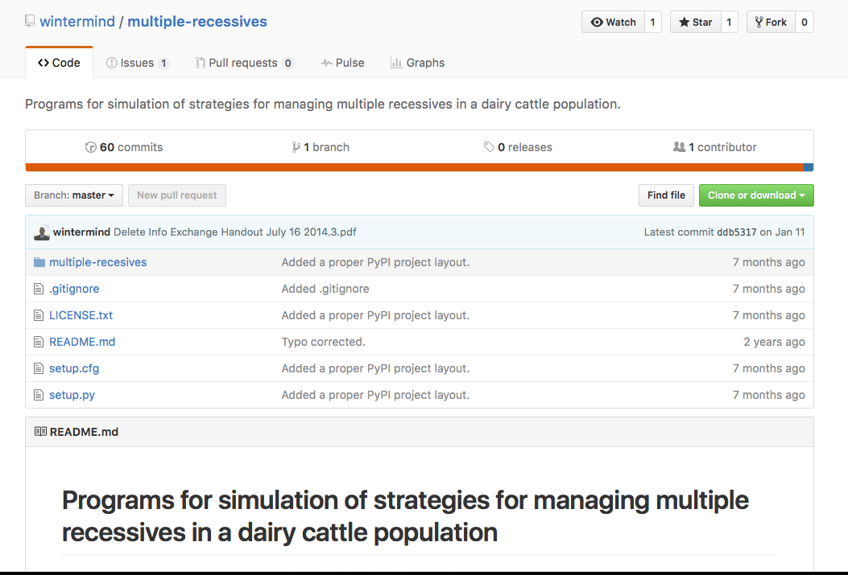
Computer simulation
A computer program was developed to study different mate allocation scenarios
  https://github.com/wintermind/multiple-recessives
Any number or combination of recessives may be simulated
Written in Python 2.7 with Jupyter notebooks for analysis
Has been extended to include gene editing

Slide 29

Sequential mate allocation
Mating parent averages (PA) are adjusted for inbreeding (Pryce et al., 2012) and expected embryonic losses (Cole, 2015):
$$B_{ij}=0.5\left({TBV}_{i}+{TBV}_{j}\right)−λF_{ij}−\sum_{r=1}^{n_{r}}{{P(aa)}_{r}×v_{r}}$$
B_{ij} is a matrix of PA, TBV are true breeding values, λ is the value of a 1% increase in inbreeding, F_{ij} is the inbreeding of the mating, P(aa) is the probability of an affected embryo, and v_{r} is the economic loss associated with an affected embryo.

Slide 30
Mate allocation (cont’d)
A matrix, M, is used to allocate bulls to cows
M_{ij} is set to 1 if B_{ij} is the greatest value in column j (largest PA available for mating to that cow)
If the sum of row i < the maximum number of permitted matings for that bull the mating is allocated
Otherwise, the bull with the next-highest value of B_{ij} is selected, and so on, until each column has one and only one element equal to 1

Slide 31
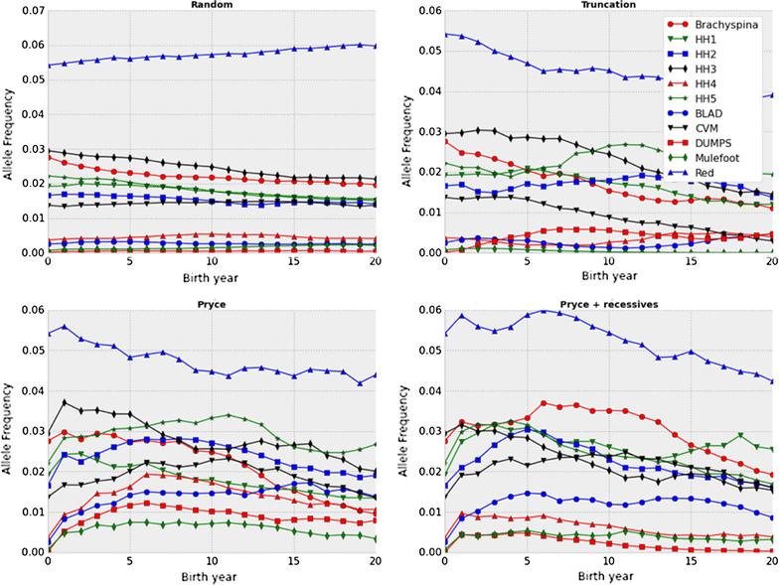
Frequencies change at different rates
Source: Cole (2015).

Slide 32
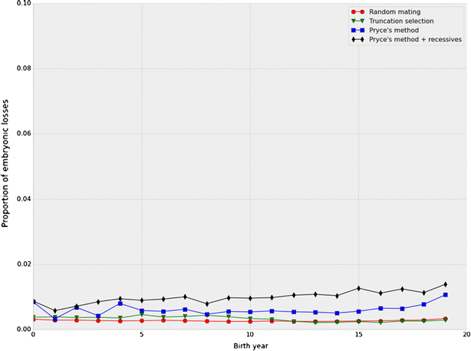
More embryos die when carriers used
Source: Cole (2015).

Slide 33
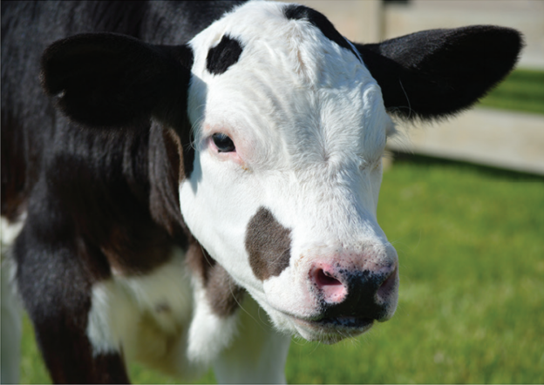
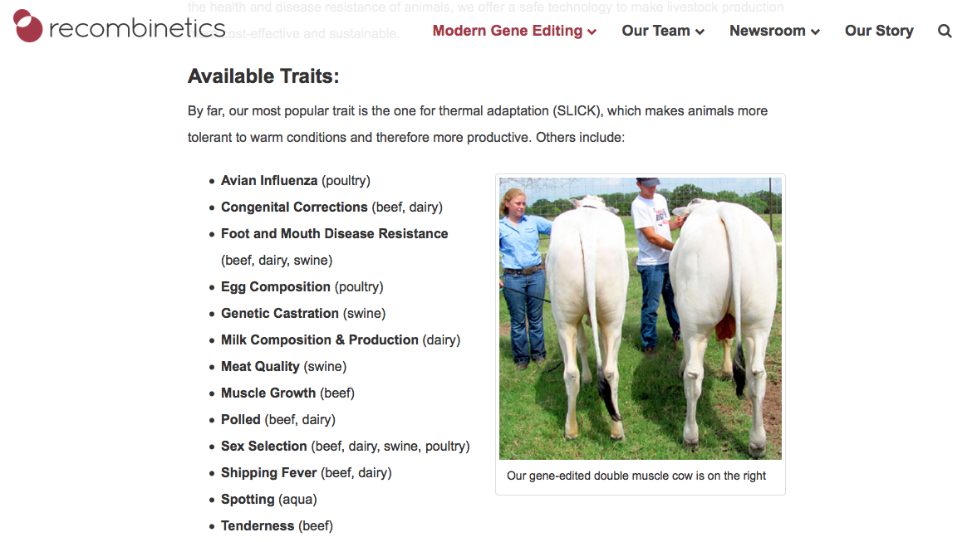
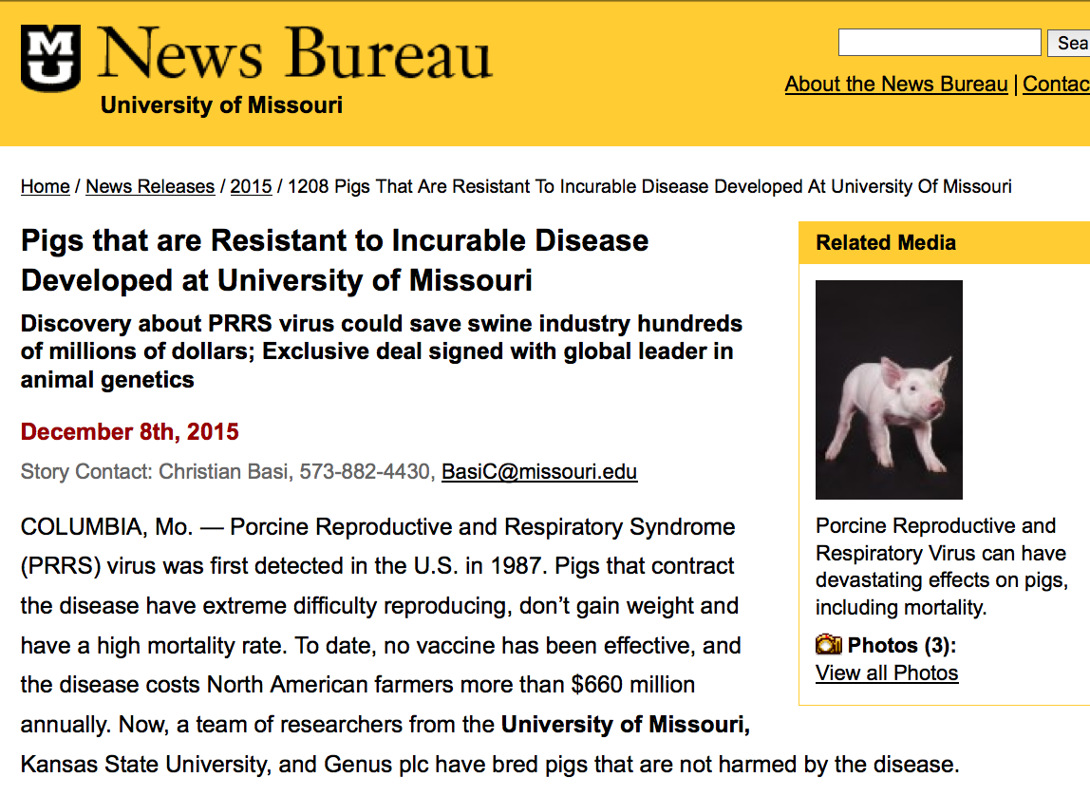
Gene editing in livestock

Slide 34
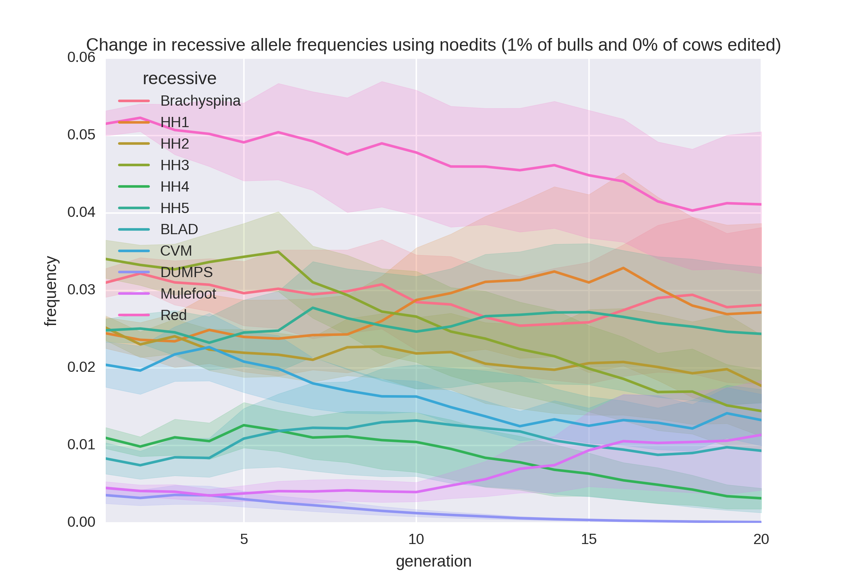
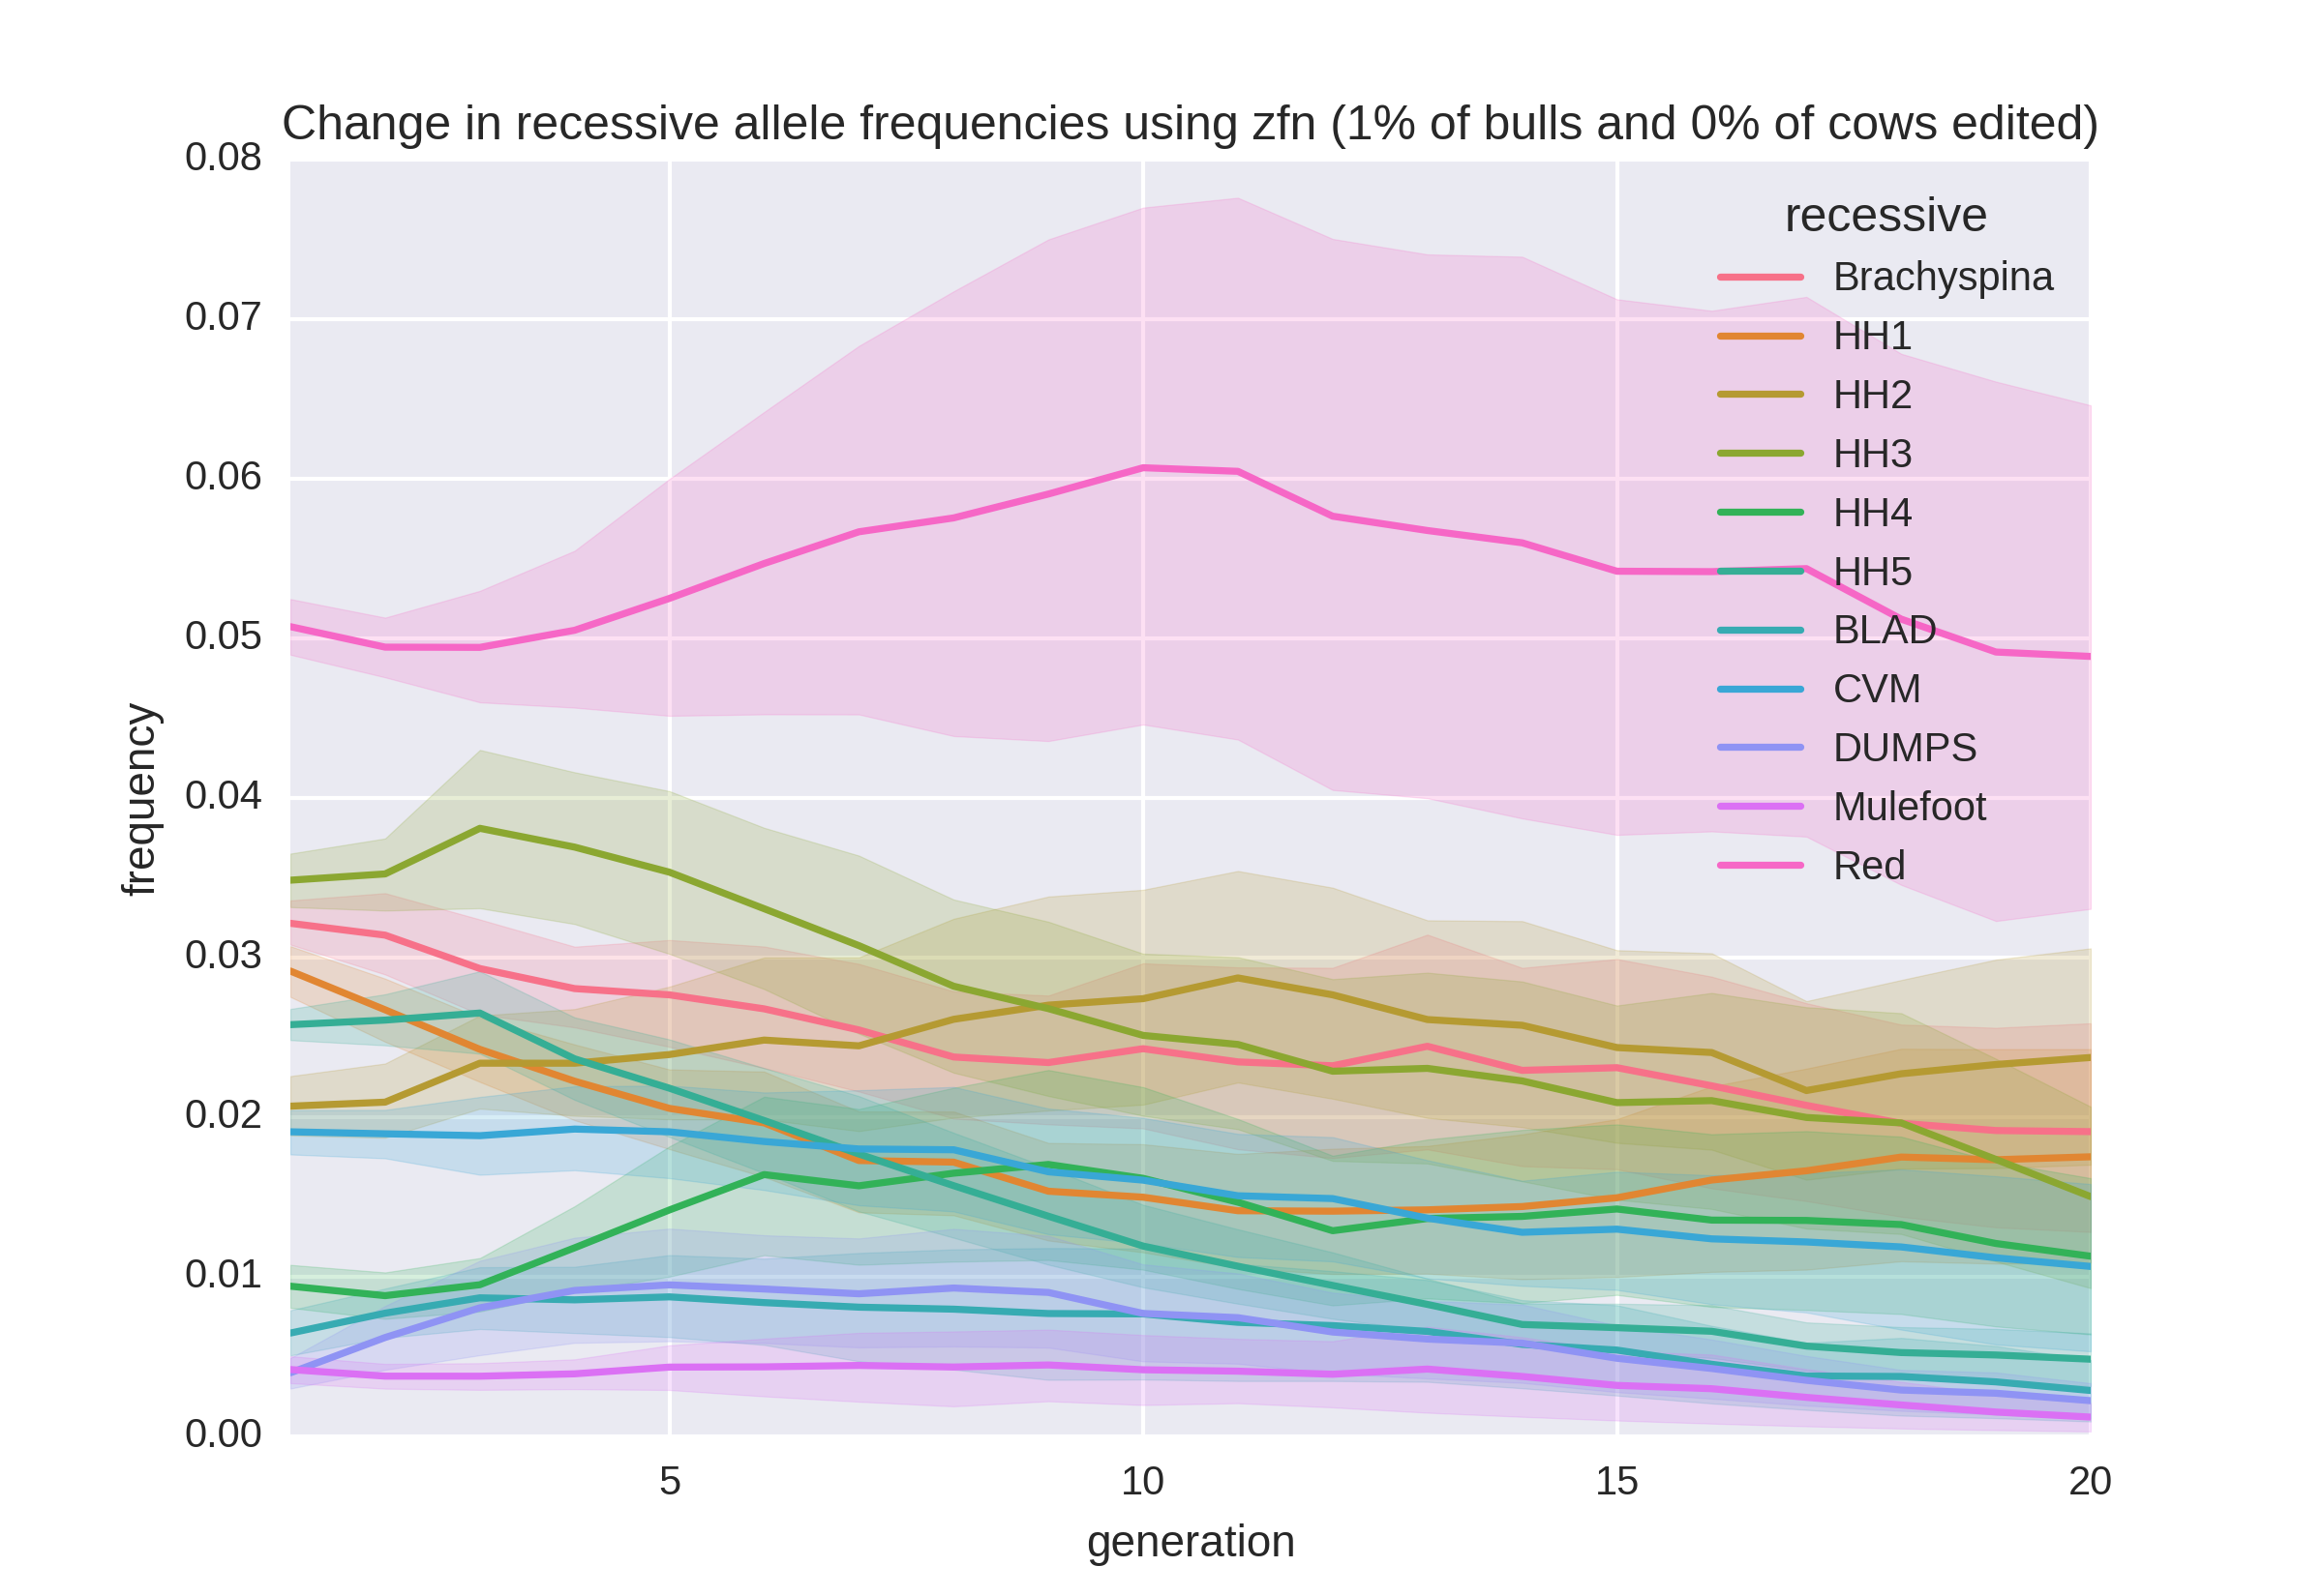
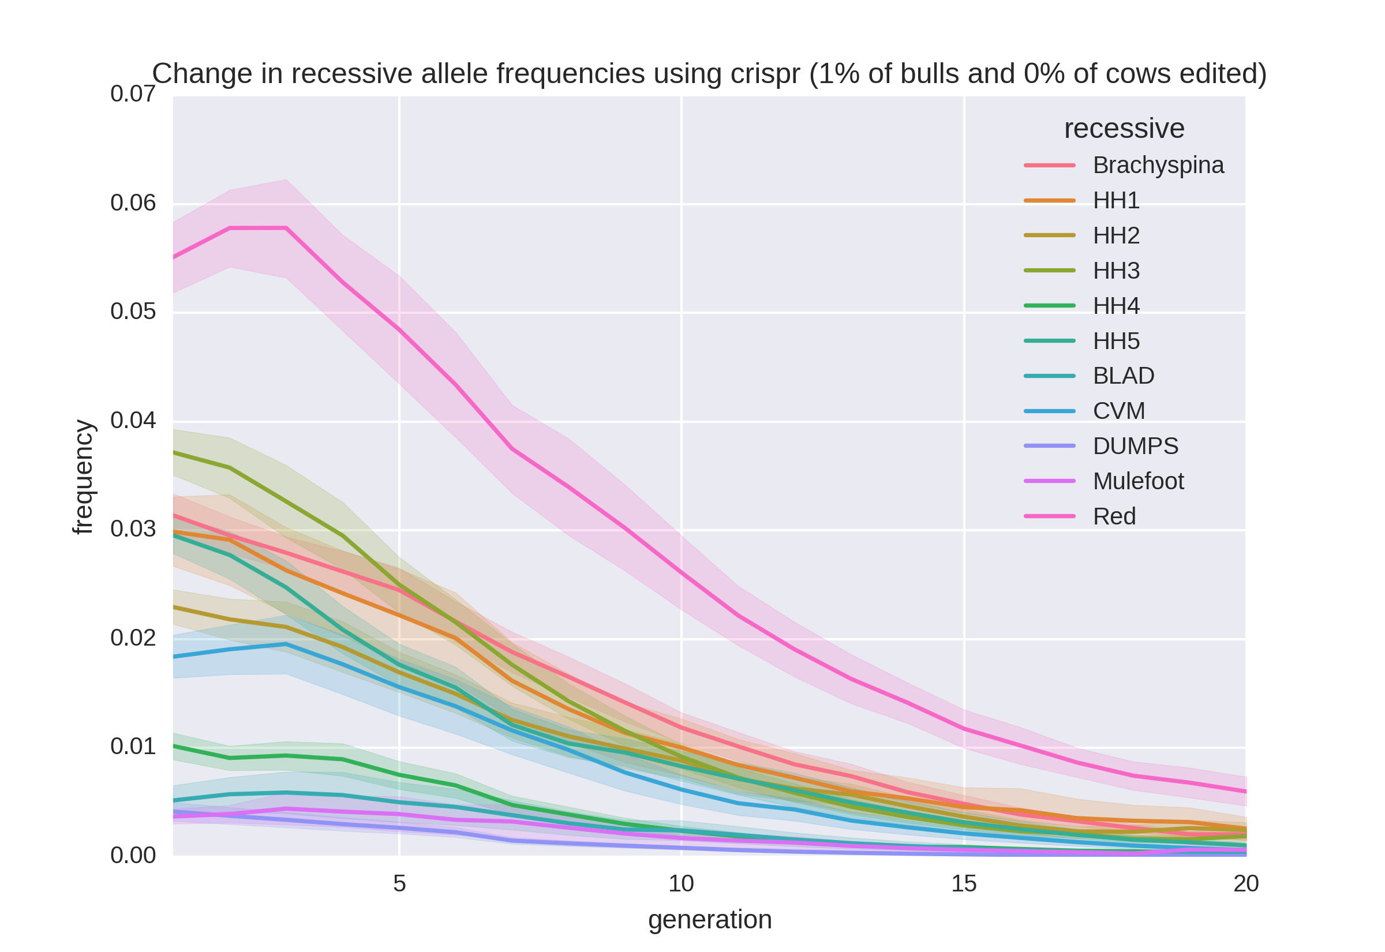
Allele frequency change

Slide 35
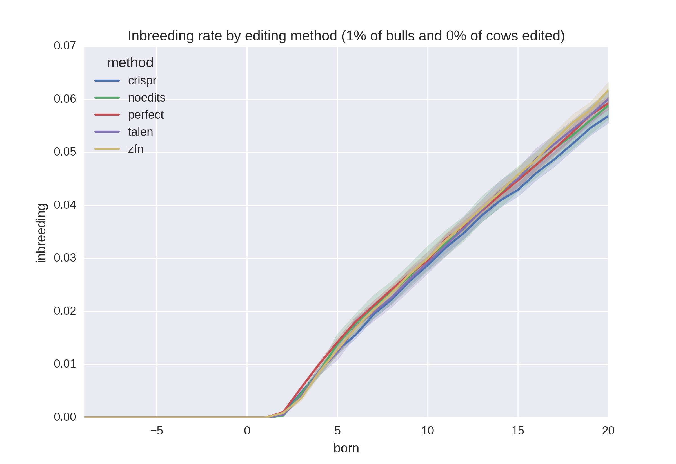
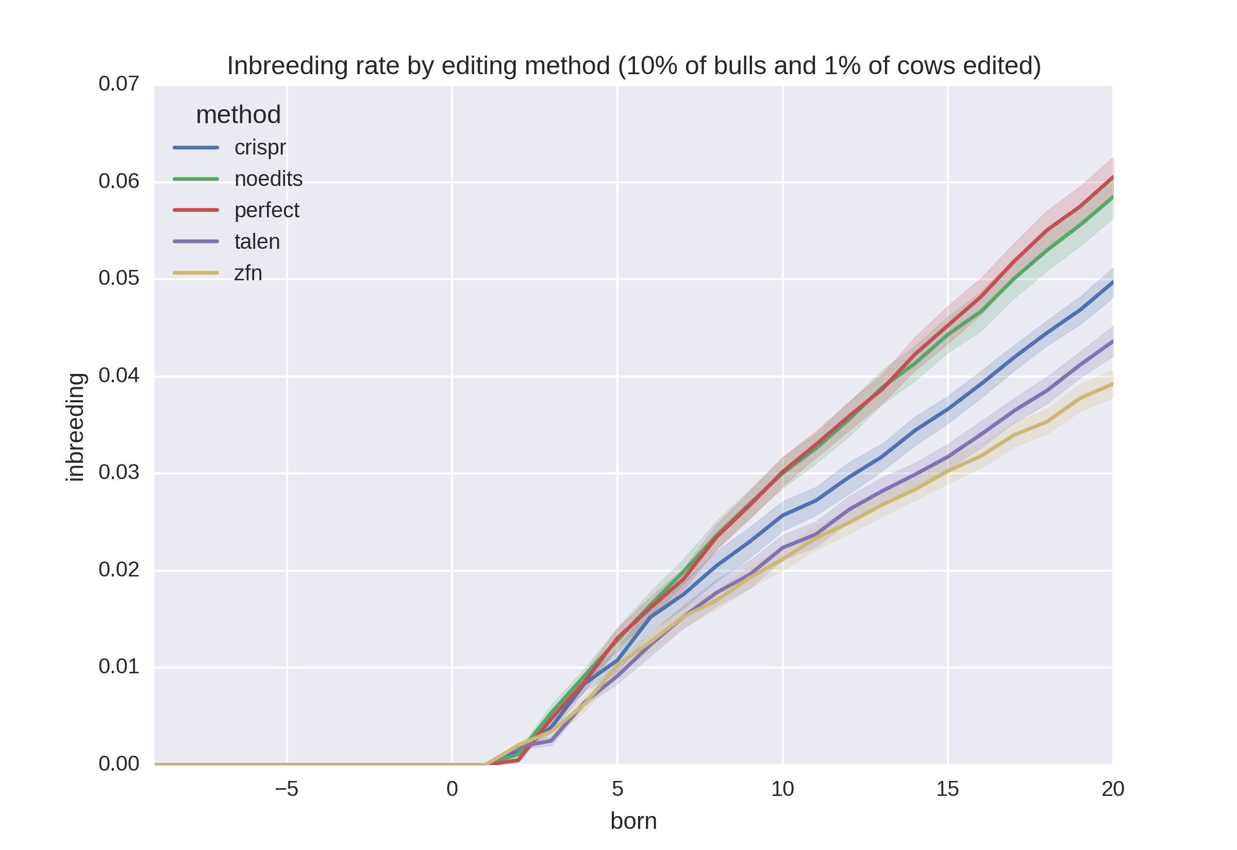
Rates of inbreeding

Slide 36
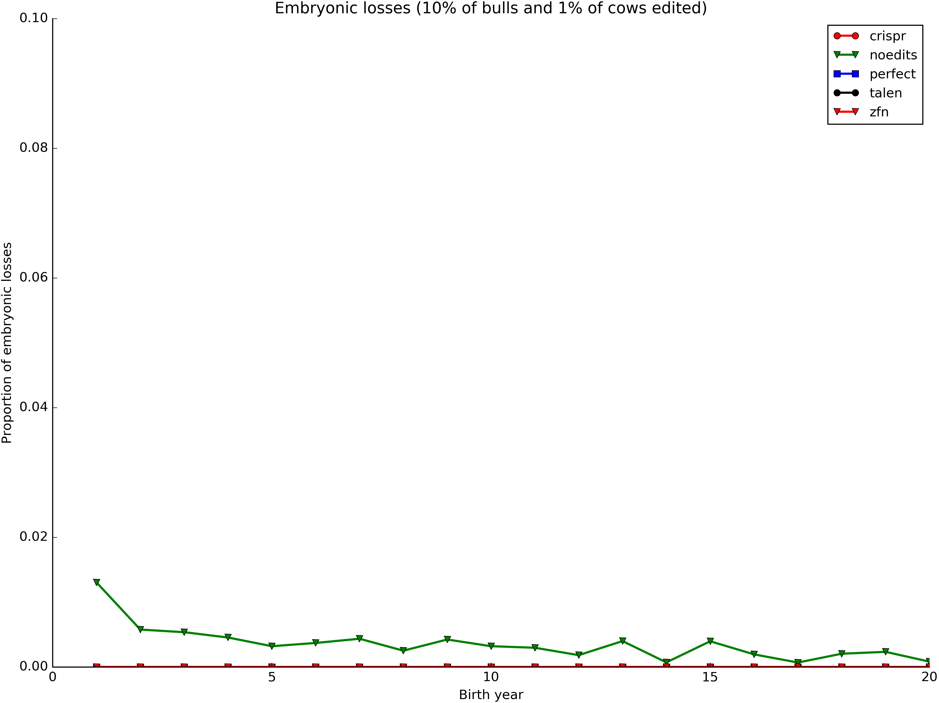
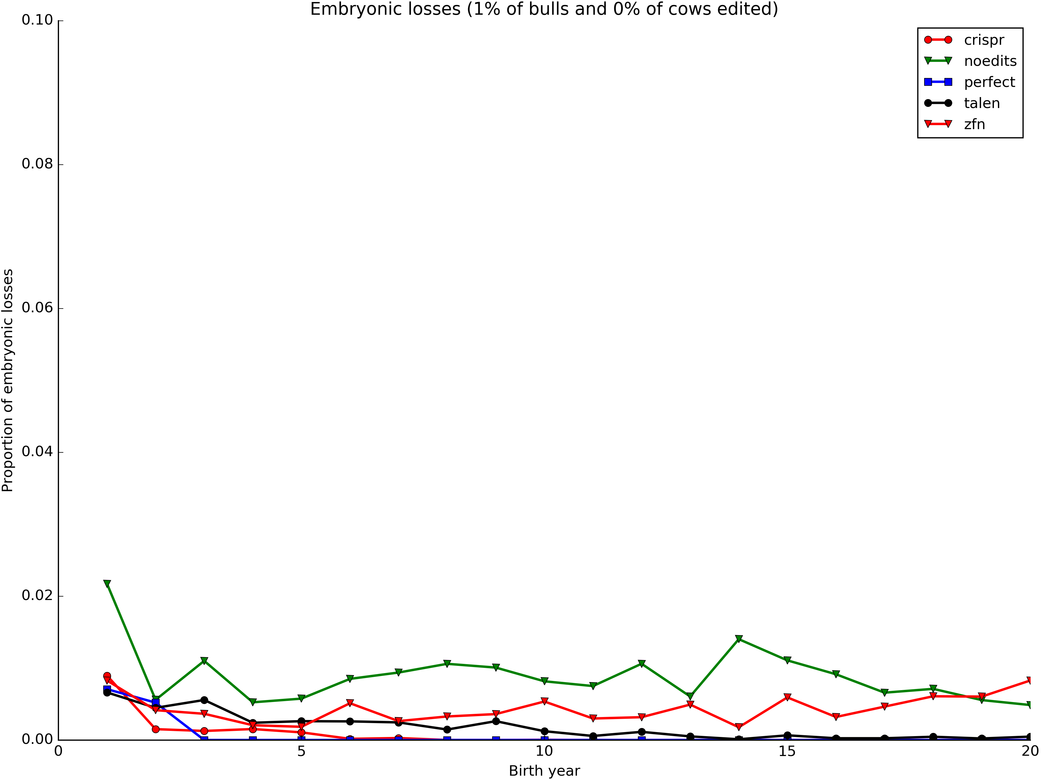
Gene editing reduces embryo loss

Slide 37
What is the best strategy?
Remove carrier bulls from the population
Non-carrier bulls are as good as carrier bulls
 | Carriers |  |  |  | Non-carriers
Breed | N | Mean | SD |  | N | Mean | SD | Difference | P value
AY | 16 | 286.43 | 194.67 |  | 53 | 272.41 | 191.69 | 13.02 | 0.407
BS | 30 | 223.10 | 218.39 |  | 59 | 284.19 | 160.36 | -61.09 | 0.087
HO | 550 | 394.08 | 216.77 |  | 1,765 | 479.49 | 213.89 | -85.41 | <0.001
JE | 99 | 340.51 | 149.00 |  | 378 | 338.82 | 153.99 | 1.69 | 0.460
Source: Cole et al. (2016).

Slide 38
Conclusions
Mendelian genetic disorders are responsible for economic losses to dairy farmers
As technology improves we are identifying more recessive defects
Gene editing should be used to eliminate harmful alleles from the population
Carrier bulls should not be used when non-carrier bulls are of comparable genetic merit

Slide 39
Funding
USDA-ARS project 8042-31000-101-00, “Improving Genetic Predictions in Dairy Animals Using Phenotypic and Genomic Information”
CNPq “Science Without Borders” project 301025/2014-2

Slide 40
Disclaimer
Mention of trade names or commercial products in this presentation is solely for the purpose of providing specific information and does not imply recommendation or endorsement by the US Department of Agriculture.

Slide 41

Questions?

Slide 42
References
Adams, H.A., T.S. Sonstegard, P.M. VanRaden, D.J. Null, C.P. Van Tassell, D.M. Larkin, and H.A. Lewin. 2016. Identification of a nonsense mutation in APAF1 that is likely causal for a decrease in reproductive efficiency in Holstein dairy cattle. J. Dairy Sci. 99:6693-6701.
Agerholm, J.S., F. McEvoy, and J. Arnbjerg. 2006. Brachyspina syndrome in a Holstein calf. J. Vet. Diagn. Invest. 18:418–422.
Cole, J.B. 2015. A simple strategy for managing many recessive disorders in a dairy cattle breeding program. Genet. Sel. Evol. 47:94.
Cole, J.B., D.J. Null, and P.M. VanRaden. 2016. Phenotypic and genetic effects of recessive haplotypes on yield, longevity, and fertility. J. Dairy Sci. 99:7274-7288.
Duchesne, A., M. Gautier, S. Chadi, C. Grohs, S. Floriot, Y. Gallard, G. Caste, A. Ducos, and A. Eggen. 2006. Identification of a doublet missense substitution in the bovine LRP4 gene as a candidate causal mutation for syndactyly in Holstein cattle. Genomics 88:610–621.

Slide 43
References (cont’d)
Gaj, T., C.A. Gersbach, and C.F. Barbas III. 2013. ZFN, TALEN, and CRISPR/Cas-based methods for genome engineering. Trends Biotechnol. 31:398–405.
Kinghorn, B. 1987. On computing strategies for mate allocation. J. Anim. Breed. Genet. 104:12-22.
Li, Y., J.H.J. van der Werf, and B.P. Kinghorn. 2006. Optimisation of crossing system using mate selection. Genet. Sel. Evol. 38:147–65.
Li, Y., J.H.J. van der Werf, and B.P. Kinghorn. 2008. Optimal utilization of non-additive quantitative trait locus in animal breeding programs. J. Anim. Breed. Genet. 125:342–50.
MacArthur, D.G., S. Balasubramanian, A. Frankish, N. Huang N, J. Morris, et al. 2012. A systematic survey of loss-of-function polymorphisms in human protein-coding genes. Science 335:823–828.
Müller, M., J. Berger, N. Gersdorff, F. Cecconi, R. Herken, and F. Quondamatteo. 2005. Localization of Apaf1 gene expression in the early development of the mouse by means of in situ reverse transcriptase‐polymerase chain reaction. Devel. Dynam. 234:215-221.

Slide 44
References (cont’d)
Müller, M., J. Berger, N. Gersdorff, F. Cecconi, R. Herken, and F. Quondamatteo. 2005. Localization of Apaf1 gene expression in the early development of the mouse by means of in situ reverse transcriptase‐polymerase chain reaction. Devel. Dynam. 234:215-221.
Pryce, J.E., B.J. Hayes, and M.E. Goddard. 2012. Novel strategies to minimize progeny inbreeding while maximizing genetic gain using genomic information. J. Dairy Sci. 95:377–388.
Shepherd, R.K., and B.P. Kinghorn. 2001. Designing algorithms for mate selection when major genes or QTL are important. Proc. Assoc. Advmt. Anim. Breed. Genet. 14:377–80.
Van Eenennaam A.L., and B.P. Kinghorn. 2014. Use of mate selection software to manage lethal recessive conditions in livestock populations. In: Proceedings of the 10th WCGALP: 17–22 August 2014; Vancouver.
Widmar, N.J.O., M.M. Schutz, and J.B. Cole. 2013. Breeding for polled dairy cows versus dehorning: Preliminary cost assessments & discussion. J.Dairy Sci. 96(Suppl. 2):602 (abstr. TH373).

