Slide 1

Value of selecting for cow and calf livability

Slide 2
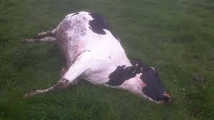
Cow livability (CL) data
Reasons for disposal have been reported and stored in DHI records since 1970
  92 million records on 32 million cows
  About 17% of cows die instead of being sold across all lactations, averaging 6% per lactation, higher for older and lower for younger cows
The lost beef income from cows that die in the U.S. = 17% of 9.2 million cows × $1200/cow ÷ 2.8 lactations = $670 million per year.

Slide 3
Cow livability evaluation
Methods
  Multibreed model including heterosis and inbreeding
  Multitrait model with productive life (PL) by lactation using similar edits and same software as other traits
    Lactation PL not reported, only lifetime PL
  Pre-adjustment for unequal herd-year-parity variance
Heritability of 1.3% (Miller et al., JDS, 2008) reestimated to only 0.6% with more data
Genetic correlation with lactation PL of 0.50

Slide 4
CL reliability and PTA interpretation
Genomic predictions for CL have good reliability in spite of low heritability. Reliability for young genomic tested HOL bulls without daughters averaged 56% compared to 30% for parent average.
If Bull A has a PTA of +2.0, then 83% + 2.0% = 85% of his daughters will remain alive to be sold for beef.
If Bull B has a PTA of –3.0%, then 83% – 3.0% = 80% of his daughters remaining alive to be sold for beef.

Slide 5
PTA correlations of livability with other traits
Bull minimums:
1990 birth year, 50 daughters, 0.50 reliability for PTA livability
Trait | Holstein | Jersey
Milk | 0.09 | –0.08
Fat | 0.21 | 0.01
Protein | 0.16 | –0.01
Productive Life | 0.70 | 0.54
SCS | –0.28 | –0.07
Dtr Pregnancy Rate | 0.40 | 0.54
Cow Concept. Rate | 0.40 | 0.33
Heifer Conc. Rate | 0.28 | 0.32
Bulls (no.) | 45,840 | 3,893

Slide 6
CL, PL, and health traits
Trait | Estimated genetic correlations
 | CL | PL | Diff
Displaced abomasum | -0.66 | -0.62 | 0.04
Ketosis | -0.64 | -0.60 | 0.04
Lameness | -0.46 | -0.31 | 0.15
Mastitis | -0.23 | -0.25 | -0.02
Metritis | -0.21 | -0.15 | 0.06
Retained placenta | -0.30 | -0.33 | -0.03
Health trait PTAs for 5,265 bulls from Parker-Gaddis et al.
Correlations estimated by Kristen using Calo method

Slide 7
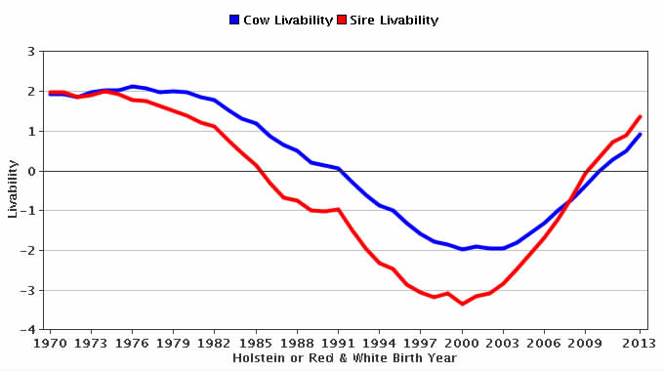
Genetic trend for cow livability - HOL
Source:
CDCB

Slide 8
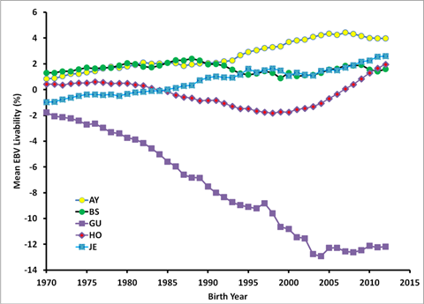
Genetic trend for CL – All breeds

Slide 9
Proposal to include CL in net merit
Trait | Relative emphasis in USDA index (%)
 | PD$ 1971 | MFP$ 1976 | NM$ 1994 | NM$ 2000 | NM$ 2003 | NM$ 2014 | NM$ 20??
Milk | 52 | 27 | 6 | 5 | 0 | –1 | –1
Fat | 48 | 46 | 25 | 21 | 22 | 22 | 24
Protein | … | 27 | 43 | 36 | 33 | 20 | 18
Longevity | … | … | 20 | 14 | 11 | 19 | 13
SCS | … | … | –6 | –9 | –9 | –7 | –7
Udder | … | … | … | 7 | 7 | 8 | 7
Feet/legs | … | … | … | 4 | 4 | 3 | 3
Body size | … | … | … | –4 | –3 | –5 | –6
Pregnancy rate | … | … | … | … | 7 | 7 | 7
Calving traits | … | … | … | … | 4 | 5 | 5
Conception rate | … | … | … | … | … | 3 | 3
Cow livability | … | … | … | … | … | … | 7
Notes:
9
9

Slide 10
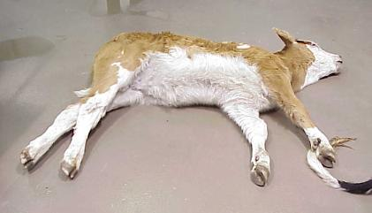
Heifer livability (HL) data
Extract data from CDCB database
  10,976,884 heifer births
  495,282 with “left herd” codes (6 = died)
  2,061,454 with no calving or breeding to confirm that they lived
  6,343,337 calves born 2001–13
  2,826,352 in herds where 2–25% died
>99% of data used from one source (DRMS)

Slide 11
Heifer livability edits
Heifers 2 days not used for HL, used in stillbirth
Heifers > 18 months old set to 18 months
Heifers that have a calf are considered alive, also if sold for infertility (code 4), or sold for any other reason (code 5)
Sold to another dairy (code 2) are not used
Bull calf deaths are not reported
After edits, livability scored as 100 or 0

Slide 12
Heifer livability results
23% of reported calf deaths during first 2 months
33% during month 18 and later but not used because many were near fresh date
Edited calf livability averaged 95%
0.4% heritability estimated by sire model REML (VanRaden, 1986 programs)

Slide 13
HCD haplotype
Holstein haplotype for cholesterol deficiency (HCD)
  Discovered by German researchers in 2015
  Heterozygous animals have reduced cholesterol, but homozygotes have no cholesterol and survive only a few months
Causative mutation discovered in 2016, lab test results now sent by Holstein USA to CDCB

Slide 14
Heifer livability and HCD
For reported heifer livability data:
  4% more death loss from carrier 3,421 sire  carrier MGS matings (significant, P < 0.0001)
  12% expected if carrier  carrier matings are lethal
  Could be under-reporting of death loss, or homozygous HCD sick calves are sold before they die
Genomic PTAs not attempted yet

Slide 15
Conclusions
Cow and heifer livability have low heritability but much data
Economic value of CL is high ($1200) and should receive 7% of emphasis in net merit, but would remove 6% of emphasis from PL (19% vs. 13%)
Database for HL is not national yet, but calf losses from HCD carrier matings were confirmed

Slide 16
Acknowledgements
Data provided by CDCB
Heifer death codes provided by Dairy Records Management Systems, NC and IA

