Slide 1
Selection of Young Animals Using Genomic Evaluations

Slide 2


Genomic prediction
Main idea: improve future traits by selection
  Look at animal’s own measurable traits (used for hundreds or thousands of years)
  Use pedigrees and phenotypes to compute estimates of genetic merit (done officially by USDA 1937-2008)
2009 idea: look directly at the DNA!

Slide 3
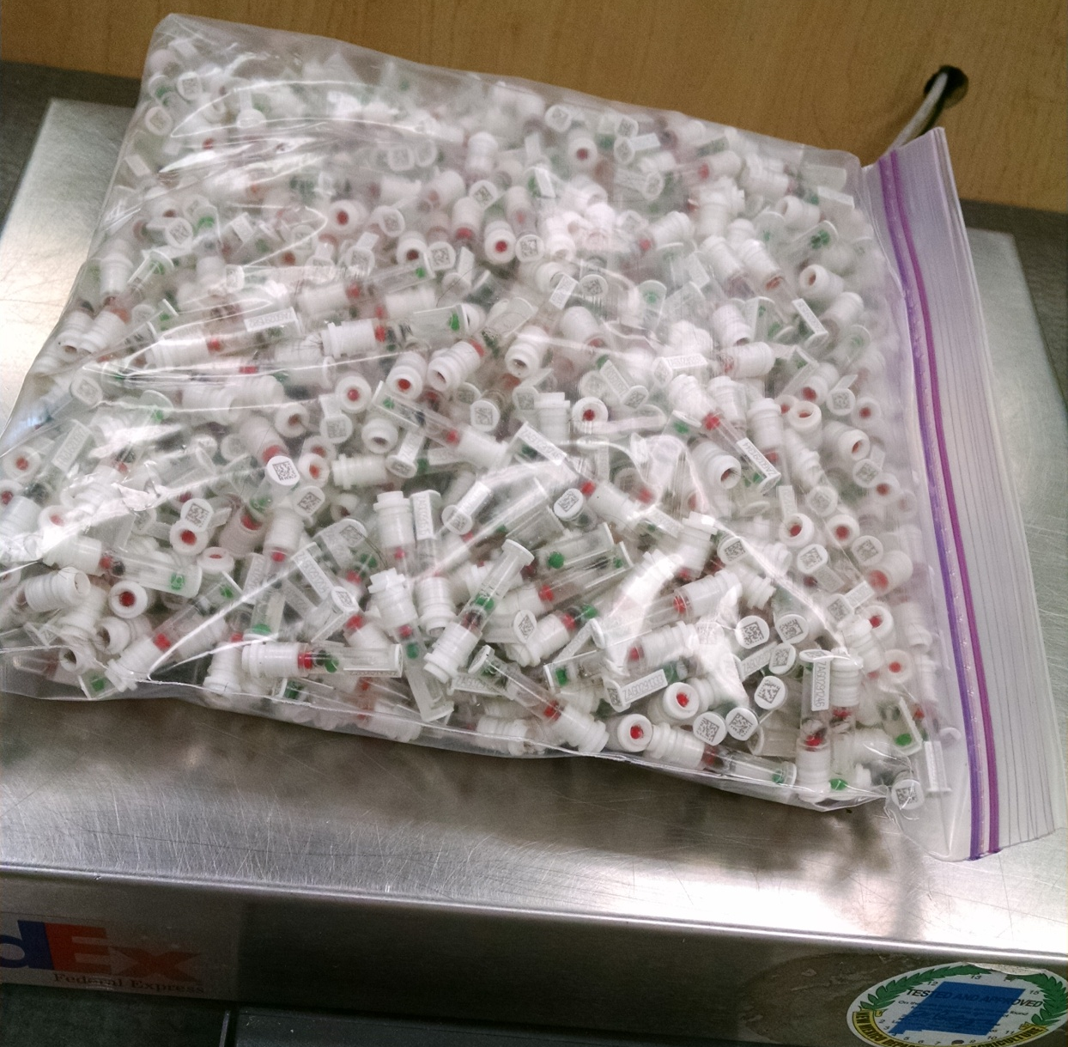
DNA samples from 1 farm, 1 day
Photo provided
by Zoetis

Slide 4
Largest genomic databases
 | 23andMe | Ancestry .com | CDCB / USDA
Genotypes | >1 million | 1.2 million | 1.2 million
Species | Human | Human | Cattle
Countries | 55 |  | >50
Genotyping cost | $199 | $99 | $37-135
Delivery (weeks) | 6-8 | 6-8 | 1-2
DNA generations | Few | Few | Many
EBV reliability | Low | Low | High
Reference: http://genomemag.com/davies-23andme/#.VdY722zosY1
Web sites: https://www.23andme.com/
http://dna.ancestry.com/
https://www.cdcb.us/
http://aipl.arsusda.gov/Main/site_main.htm

Slide 5
Genotype Contributors
by continent
Notes:
5

Slide 6
CDCB genotypes by continent
Continent | Genotypes | Countries
N. America | 1,127,699 | USA, CAN
W. Europe | 107,474 | AUT, BEL, CHE, DEU, DNK, ESP, FIN, FRA, GBR, GRC, IRL, ITA, LUX, NLD, NOR, PRT, SWE
E. Europe | 2,833 | BLR, CZE, HUN, POL, ROU, RUS, SRB, SVK, SVN
Oceania | 9,984 | AUS, NZL
L. America | 11,335 | ARG, BRA, CHL, COL, CRI, ECU, GTM, MEX, PER, URY
Asia | 2,221 | CHN, IND, IRN, JPN, KAZ, SAU, THA, TUR, TWN
Africa | 385 | KEN, ZAF, ZWE

Slide 7
DNA prediction
Prediction equations use data from animals with both genotypes and phenotypes (reference population)
  Genotypes for 60,671 markers
  Phenotypes for 33 traits of 34,072 proven HO bulls and 234,901 cows with records
Includes MACE traits for all bulls from USA, CAN, ITA, GBR, CHE, and JPN(since May 2016)

Slide 8
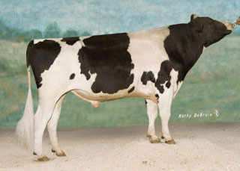
Top proven bulls from Apr 2013
Now with 1,000 daughters
 | Net Merit |  |  | Progeny (2016)
Bull | 2016 | 2013 | PA 2013 | Daus | AI Sons
Observer | 454 | 559 | 380 | 6,874 | 155
Freddie | 470 | 547 | 294 | 22,429 | 186
Awesome | 471 | 524 | 346 | 5,799 | 0
O-Style | 409 | 500 | 369 | 9,715 | 64
Planet | 475 | 494 | 169 | 63,551 | 364
Massey | 513 | 477 | 237 | 9,707 | 82
Levi | 422 | 468 | 181 | 18,800 | 16
Manifold | 589 | 465 | 223 | 39,498 | 5
Domingo | 406 | 452 | 182 | 6,999 | 5
Varsity | 457 | 445 | 92 | 1,597 | 0
Top 10 Avg | 467 | 493 | 247 | 18,497 | 124
(base adjusted values)

Slide 9
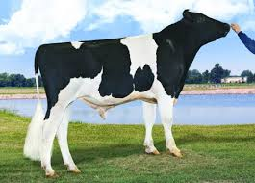
Top young bulls from Apr 2013
Now with > 1,000 daughters
 | Net Merit |  |  | Progeny (2016)
Bull | 2016 | 2013 | PA 2013 | Daus | AI Sons
Supersire | 936 | 694 | 395 | 3,820 | 244
Cabriolet | 852 | 666 | 331 | 1,028 | 6
AltaStacked | 617 | 611 | 439 | 1,308 | 1
Uno | 526 | 600 | 348 | 4,468 | 213
Puzzle | 538 | 584 | 370 | 1,240 | 0
Erdman | 679 | 574 | 362 | 3,351 | 11
Maurice | 642 | 571 | 501 | 1,760 | 26
Indy | 606 | 568 | 385 | 1,375 | 0
Galaxy | 497 | 564 | 501 | 3,146 | 23
Headliner | 701 | 562 | 395 | 1,485 | 26
Top 10 Avg | 721 | 599 | 438 | 2,298 | 80
(base adjusted values)

Slide 10
2013 NM$ vs. PA to predict 2015
Young bulls with 0 daughters in 2013 and > 100 daughters in 2015

Slide 11
Bull reliability comparisons, by breed
Net Merit Reliability (April 2016)
Breed | Proven Bulls | Young Bulls | Parent Average
Holstein | 88 | 75 | 34
Jersey | 86 | 68 | 35
Brown Swiss | 75 | 59 | 33
Ayrshire | 79 | 42 | 33

Slide 12
Proven bull comparisons, by country
Country | Bulls | Daughters / bull | Net Merit | EFI = (relationship to USA cows) / 2
United States | 2,197 | 424 | 168 | 6.6
Germany | 1,492 | 171 | 29 | 5.4
France | 838 | 337 | 85 | 5.1
Italy | 757 | 125 | 30 | 6.4
Canada | 596 | 225 | 41 | 6.5
Netherlands | 536 | 295 | 58 | 5.4
Poland | 535 | 99 | -14 | 5.7
Scandinavia (DFS) | 501 | 325 | 161 | 5.6
Japan | 375 | 54 | 21 | 6.3
New Zealand | 360 | 652 | -75 | 3.2
Korea | 46 | 32 | -19 | 5.9

Slide 13
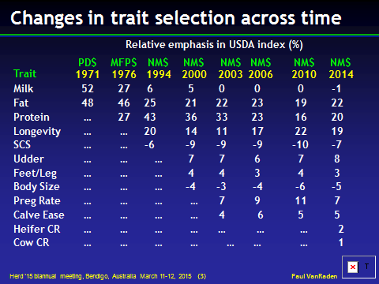

Slide 14
USDA evaluation history
Year | Breeding program | Data sources added
< 1937 | Mass selection | Own phenotype
1937-1962 | Means of relatives | Daughters, dams
1962-1989 | Sire models | Herd-year-season
1989-present | Animal models | Full pedigrees
1995-present | MACE models | Foreign daughters
2009-present | Genomic models | Marker genotypes
2013-future | Biologic models | Causal mutations

Slide 15
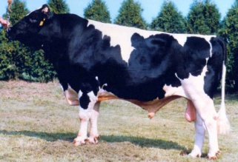
Growth of markers and animals
Year | Markers | Animals | Research partners
1991-2004 | 367 | 1,415 | USDA, Illinois, Israel (DNA from USA, CAN)
2007-2009 | 38,416 | 16,646 | USDA, Missouri, Canada, Illumina
2011-2013 | 636,967 | 161,341 | Added Italy, United Kingdom, high density
2012-2015 | 61,013 | 1,000,000 | Added Interbull (BSW) and Denmark (JER)
2015-future | 39,700,000 | 1,577 | Worldwide exchange in Australia

Slide 16
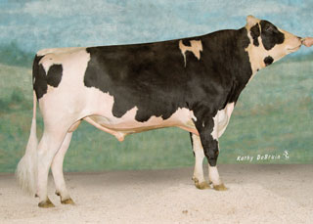
Pedigree: Parents, Grandparents, etc.
 |  | Manfred
 | O-Man
 |  | Jezebel
O-Style
 |  | Teamster
 | Deva
 |  | Dima
Notes:
We are all familiar with a traditional pedigree chart. Animal is expected to be an average of his parents.

Slide 17
O-Style Haplotypes chromosome 15

Slide 18
Expected Relationship Matrix¹
1HO9167 O-Style
 | PGS | PGD | MGS | MGD | Sire | Dam | Bull
Manfred | 1.0 | .0 | .0 | .0 | .5 | .0 | .25
Jezebel | .0 | 1.0 | .0 | .0 | .5 | .0 | .25
Teamster | .0 | .0 | 1.0 | . 0 | .0 | .5 | .25
Dima | .0 | .0 | .0 | 1.0 | .0 | .5 | .25
O-Man | .5 | .5 | .0 | .0 | 1.0 | .0 | .5
Deva | .0 | .0 | .5 | .5 | .0 | 1.0 | .5
O-Style | .25 | .25 | .25 | .25 | .5 | .5 | 1.0
¹Calculated assuming that all grandparents are unrelated

Slide 19
Pedigree Relationship Matrix
1HO9167 O-Style
 | PGS | PGD | MGS | MGD | Sire | Dam | Bull
Manfred | 1.053 | .090 | .090 | .105 | .571 | .098 | .334
Jezebel | .090 | 1.037 | .051 | .099 | .563 | .075 | .319
Teamster | .090 | .051 | 1.035 | .120 | .071 | .578 | .324
Dima | .105 | .099 | .120 | 1.042 | .102 | .581 | .342
O-Man | .571 | .563 | .071 | .102 | 1.045 | .086 | .566
Deva | .098 | .075 | .578 | .581 | .086 | 1.060 | .573
O-Style | .334 | .319 | .324 | .342 | .566 | .573 | 1.043

Slide 20
Genomic Relationship Matrix
1HO9167 O-Style
 | PGS | PGD | MGS | MGD | Sire | Dam | Bull
Manfred | 1.201 | .058 | .050 | .093 | .609 | .054 | .344
Jezebel | .058 | 1.131 | .008 | .135 | .618 | .079 | .357
Teamster | .050 | .008 | 1.110 | .100 | .014 | .613 | .292
Dima | .093 | .135 | .100 | 1.139 | .131 | .610 | .401
O-Man | .609 | .618 | .014 | .131 | 1.166 | .080 | .626
Deva | .054 | .079 | .613 | .610 | .080 | 1.148 | .613
O-Style | .344 | .357 | .292 | .401 | .626 | .613 | 1.157

Slide 21
Difference (Genomic – Pedigree)
1HO9167 O-Style
 | PGS | PGD | MGS | MGD | Sire | Dam | Bull
Manfred | .149 | -.032 | -.040 | -.012 | .038 | -.043 | .010
Jezebel | -.032 | .095 | -.043 | .036 | .055 | .004 | .038
Teamster | -.040 | -.043 | .075 | -.021 | -.057 | .035 | -.032
Dima | -.012 | .036 | -.021 | .097 | .029 | .029 | .059
O-Man | .038 | .055 | -.057 | .029 | .121 | -.006 | .060
Deva | -.043 | .004 | .035 | .029 | -.006 | .087 | .040
O-Style | .010 | .038 | -.032 | .059 | .060 | .040 | .114

Slide 22
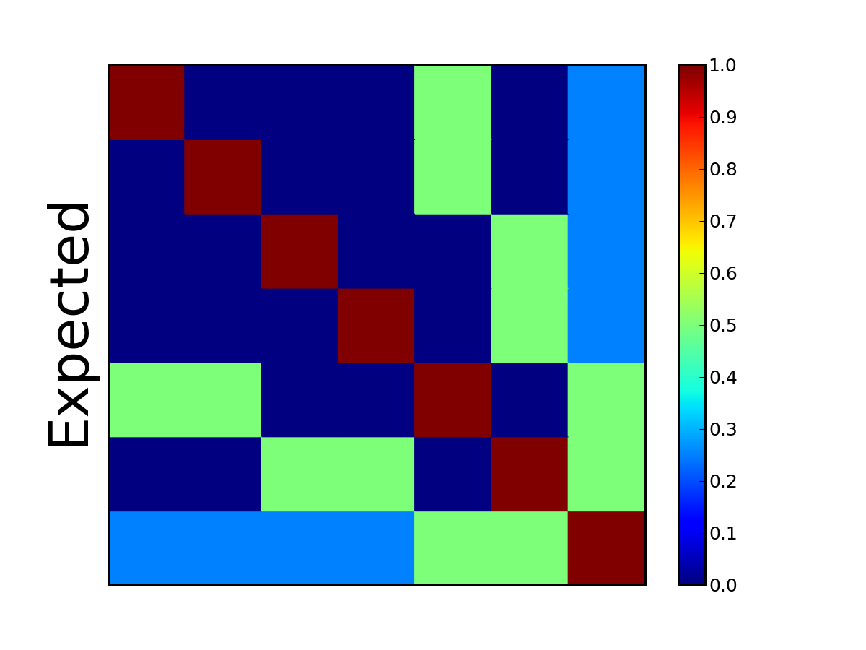
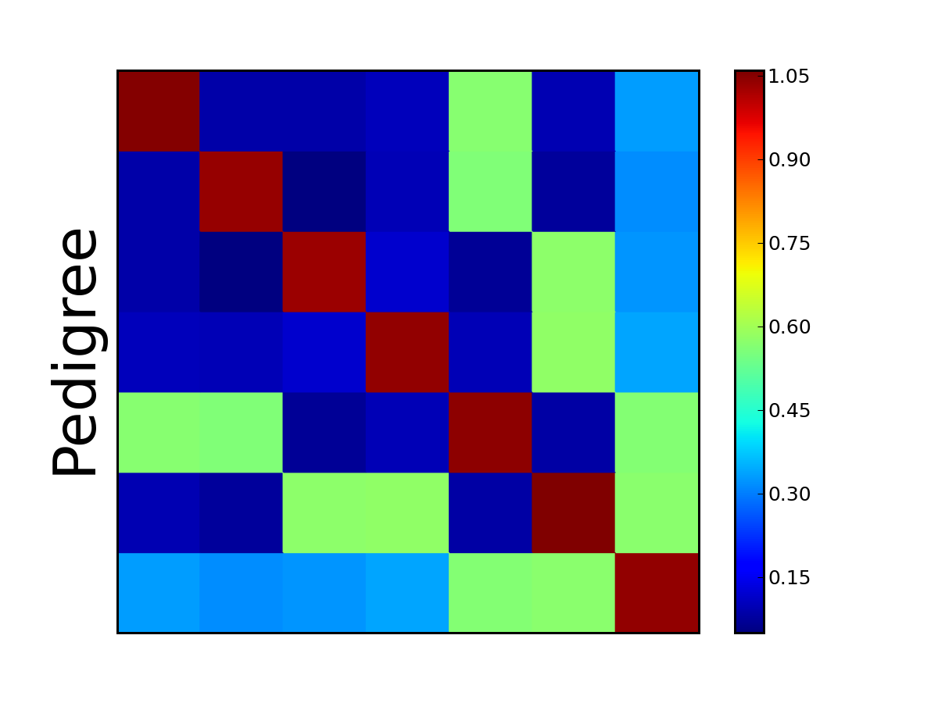

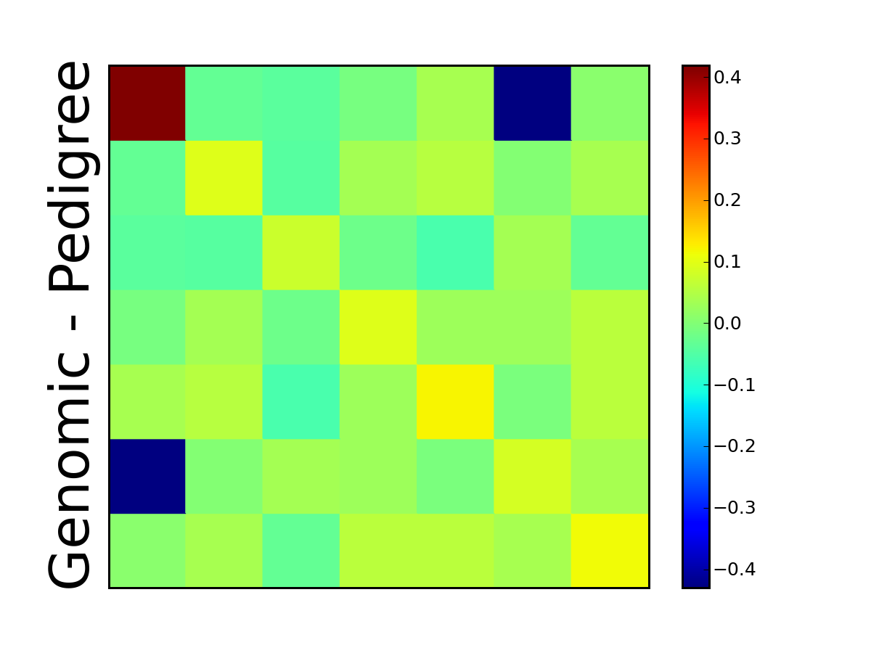
Pseudocolor Plots ― O-Style

Slide 23

Pedigree of sire of embryo (HOUSA73431994)
777K 777K
50K - - -
50K 50K
50K 50K
777K 777K
50K - - -
3K 777K
50K 50K
777K 777K
50K Imputed
Imputed 50K
50K Imputed
50K 777K
50K 50K
50K 777K
77K - - -
777K 777K
50K Imputed
Imputed 50K
50K Imputed
50K 777K
50K 50K
3K 777K
9K 50K
50K 777K
50K 50K
50K 777K
50K Imputed
777K 777K
50K - - -
Imputed 777K
50K

Slide 24
Pedigree of dam of embryo (HOCAN108535184)
777K 50K
50K - - -
50K 777K
50K Imputed
777K 777K
50K 50K
Imputed 777K
50K - - -
777K 50K
777K - - -
Imputed 777K
50K - - -
777K 777K
Imputed Imputed
Imputed 777K
77K 50K
777K 50K
777K - - -
Imputed 777K
50K - - -
777K 777K
Imputed - - -
Imputed 777K
77K 50K
777K 777K
777K 50K
50K 777K
50K - - -
50K 50K
50K 50K
50K 777K
50K

Slide 25
Net Merit by Chromosome
Freddie – was highest Net Merit bull

Slide 26
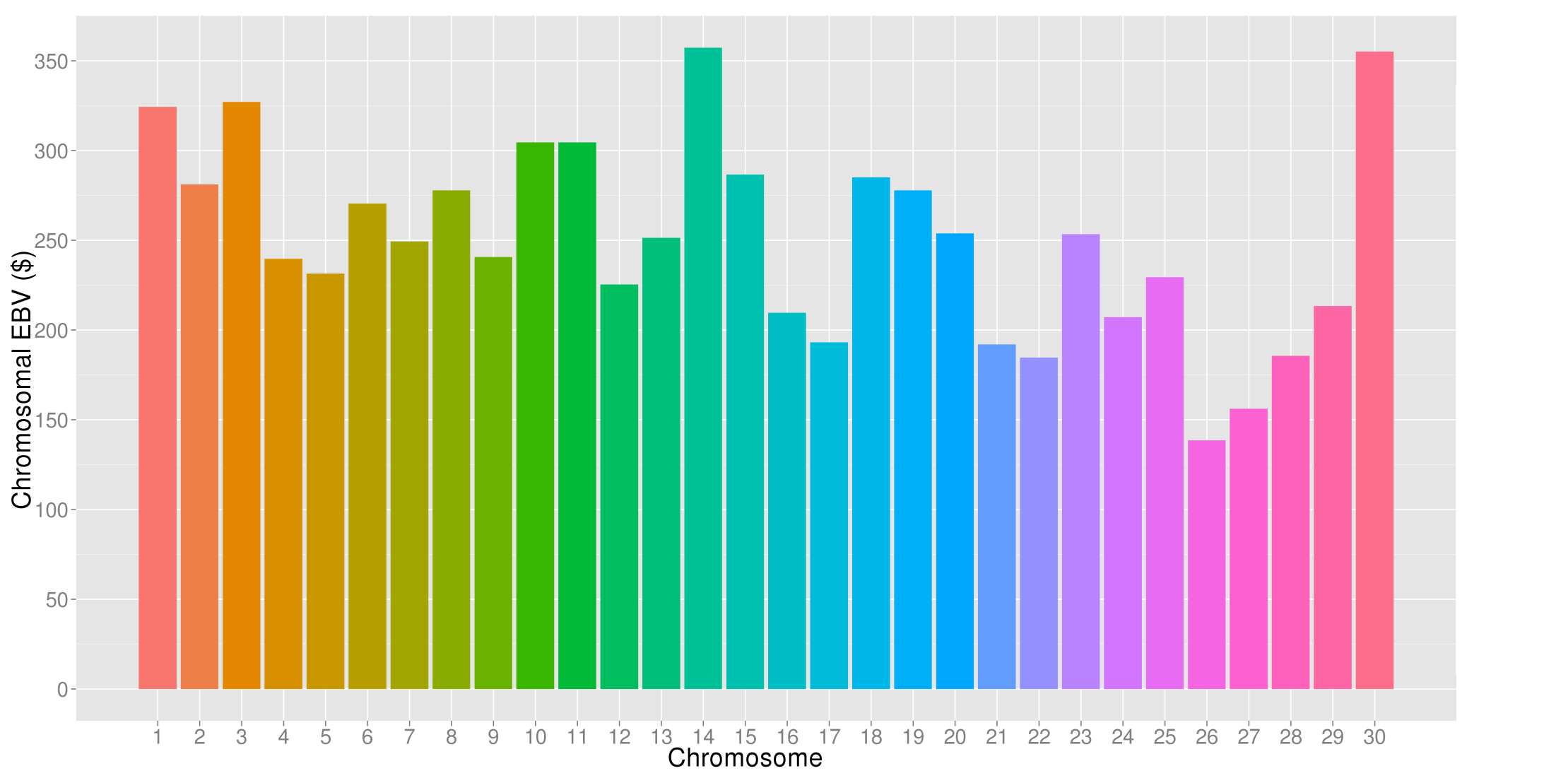
What’s the best cow we can make?
A “Supercow” constructed from the best haplotypes in the Holstein population would have an EBV(NM$) of $7515

Slide 27
Trend in Net Merit $

Slide 28
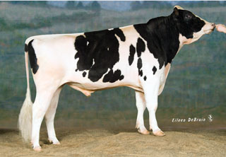
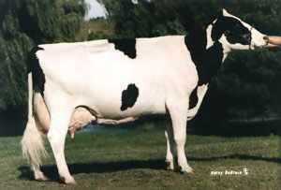
Pedigree or genomic mating?
Computer mating programs assign mates with fewer ancestors in common to reduce pedigree inbreeding
Such programs can instead assign mates with fewer alleles in common to reduce genomic inbreeding
Relationships of each genotyped female to genotyped AI males available since Aug 2014
Dominance effects tested, not yet distributed
Pedigree relationships
Genomic relationships

Slide 29
USA use of 1000 bull genomes
Sequence genotypes from 440 Holsteins
Imputed for 27,000 reference bulls
700,000 candidate loci + 300,000 HD SNPs
Largest 17K added to 60K routinely used
Average gain of 2.7% reliability across traits
Largest 5K added to new chips

Slide 30
Conclusions
Examining DNA is an excellent idea
Selecting young bulls gives much more progress than past selection of proven bulls
More animals and more traits continue to rapidly improve the value and accuracy of genomic predictions
CDCB/USDA database is similar in size to largest human databases, much more useful

Slide 31
Acknowledgments
This research was part of USDA-ARS project 1265-31000-096-00, “Improving Genetic Predictions in Dairy Animals Using Phenotypic and Genomic Information.”
Members of the Council on Dairy Cattle Breeding provided data
Jan Wright, Mel Tooker, Tabatha Cooper, George Wiggans, Derek Bickhart, John Cole, and Jeff O’Connell assisted with computation

Slide 32
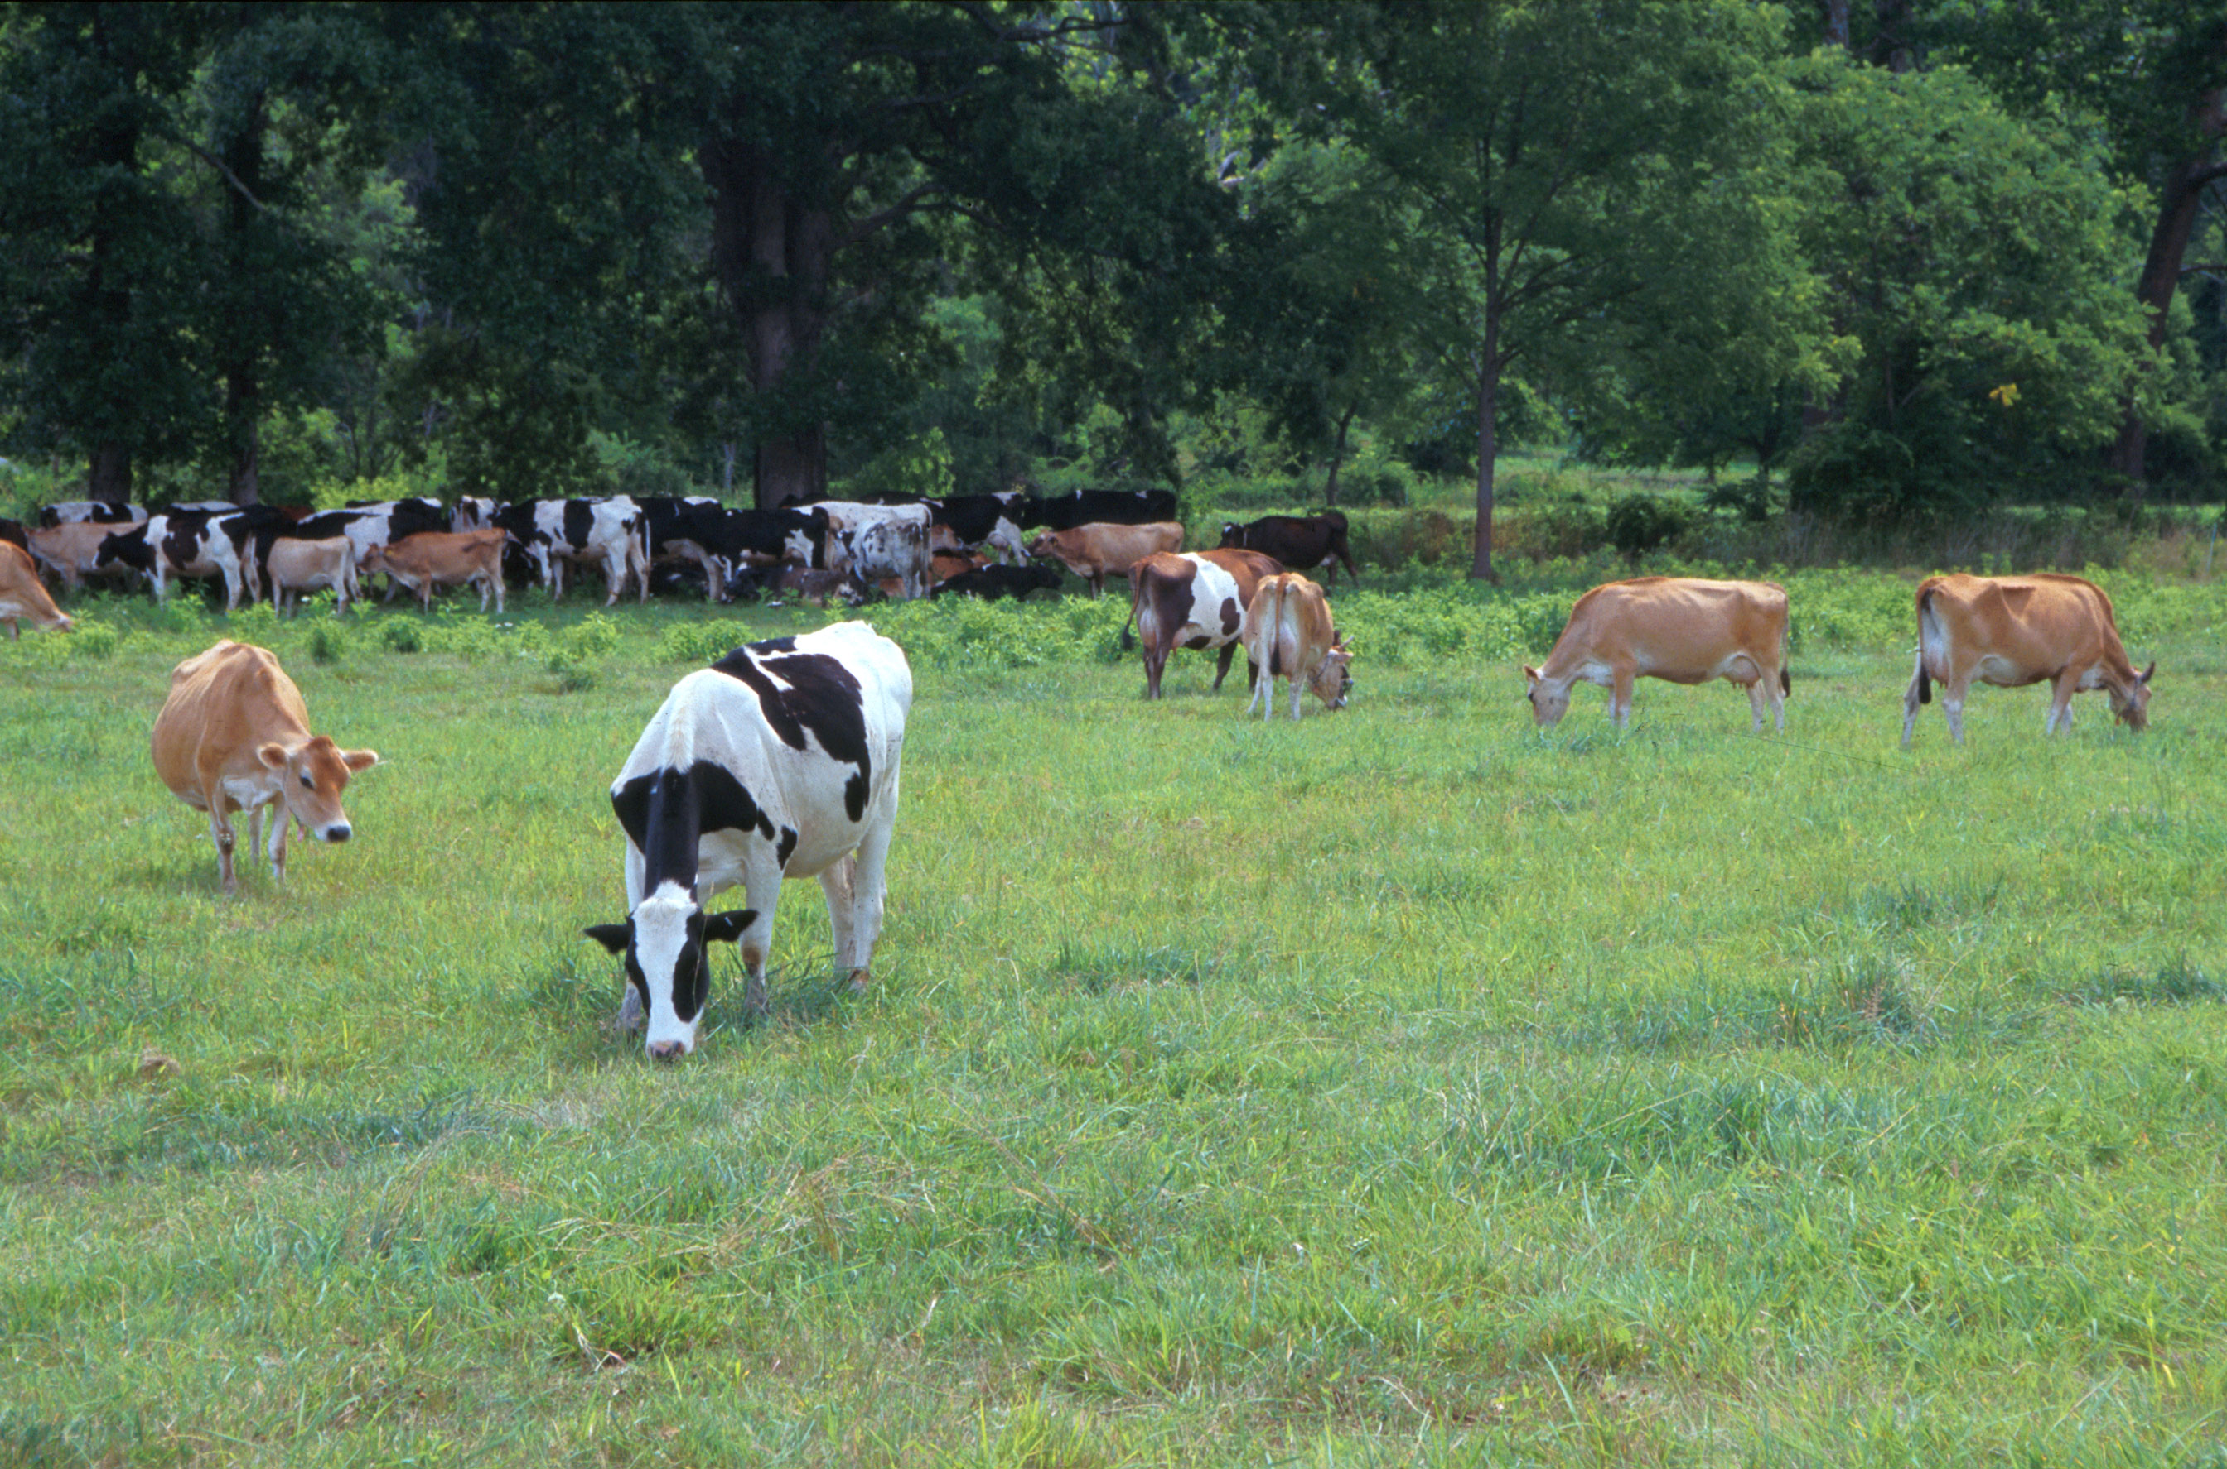
Questions?
AIP web site:
http://aipl.arsusda.gov
Holsteins, Jerseys, and crossbreds graze on American Farm Land Trust’s
Cove Mountain Farm in south-central Pennsylvania
Source: ARS Image Gallery, image #K8587-14; photo by Bob Nichols

