Slide 1
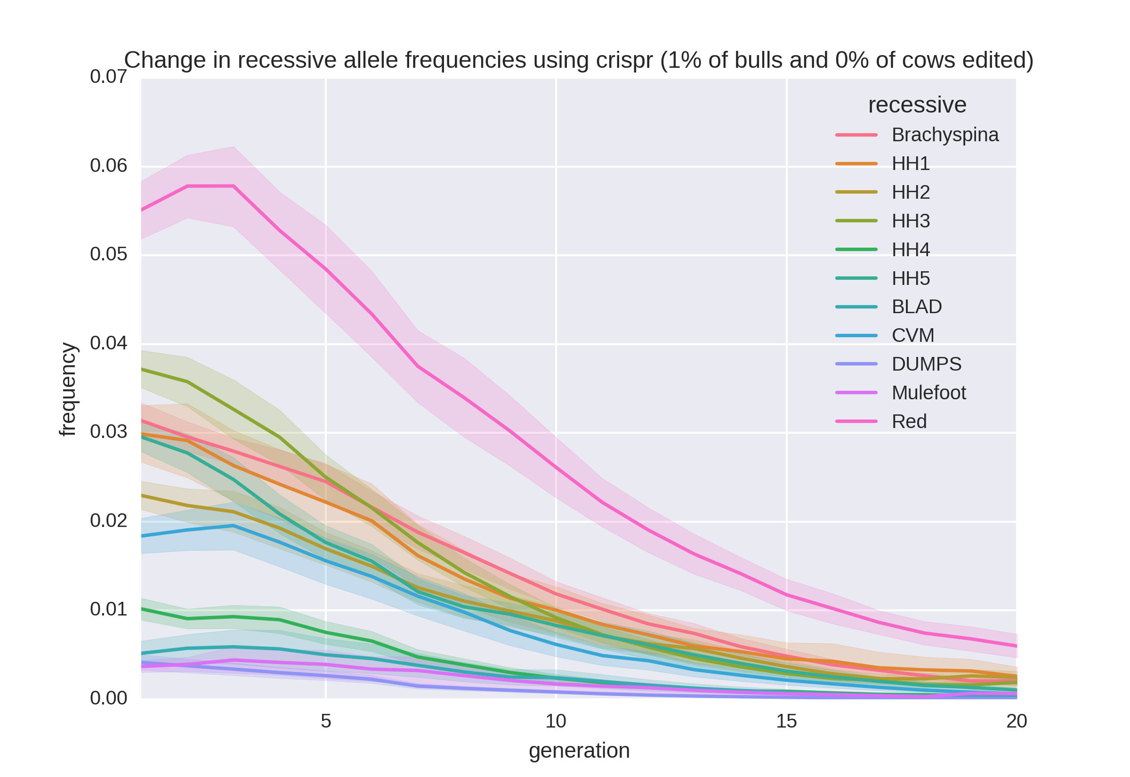
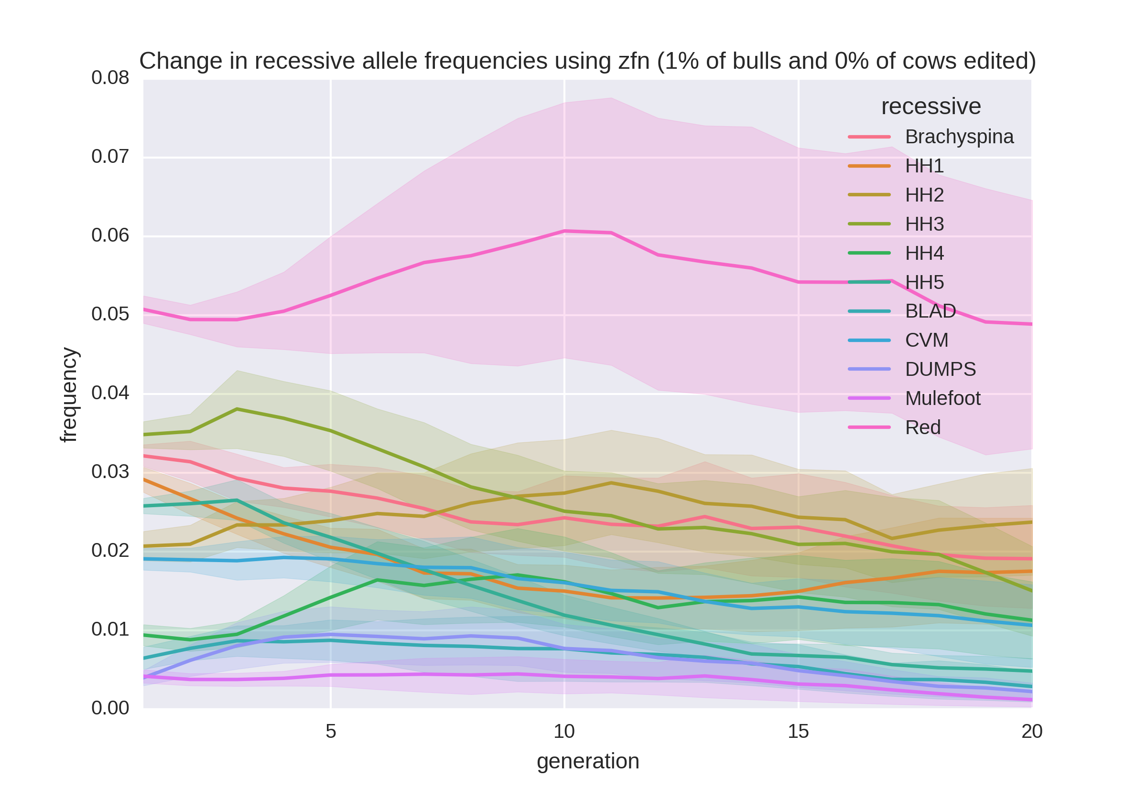
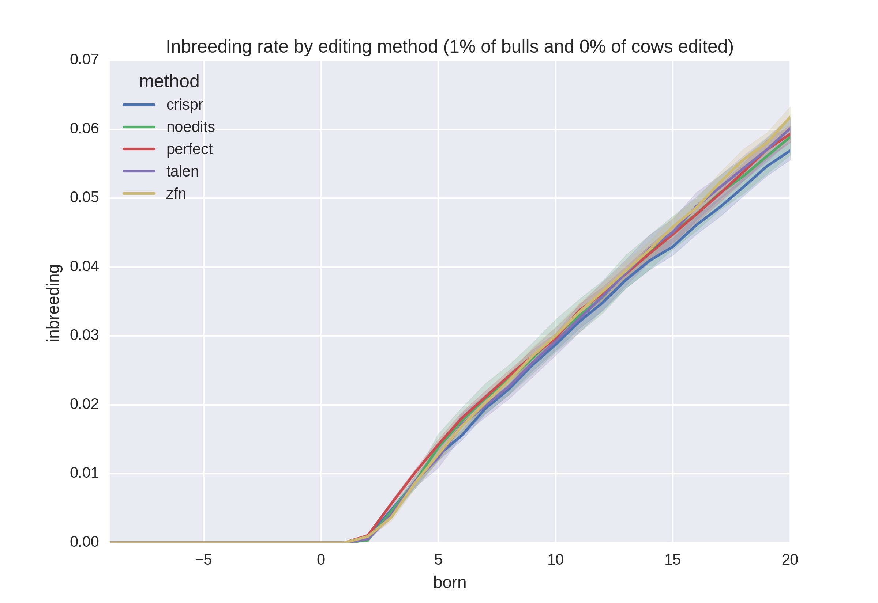
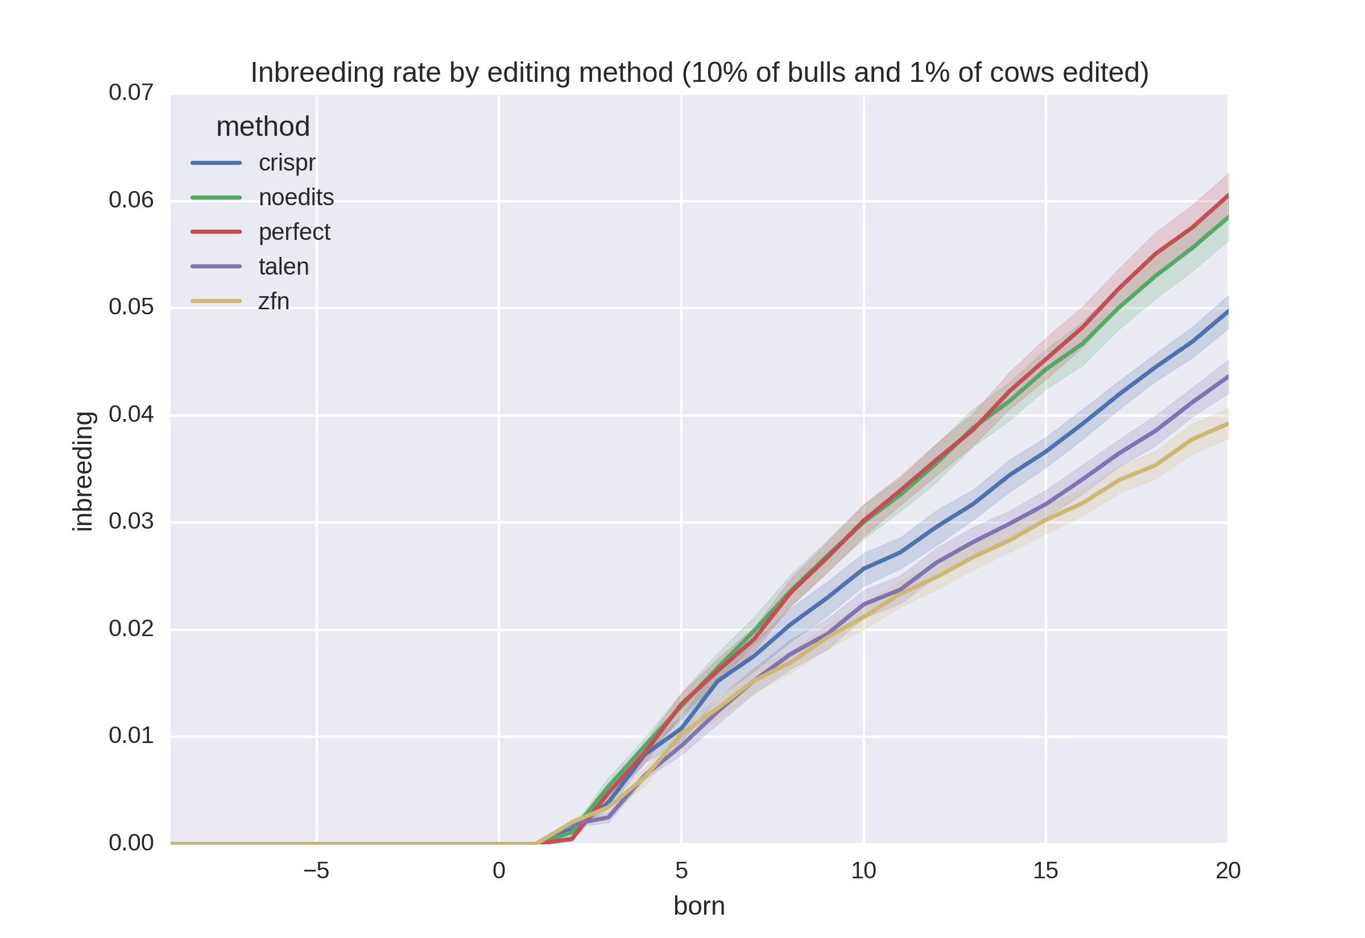
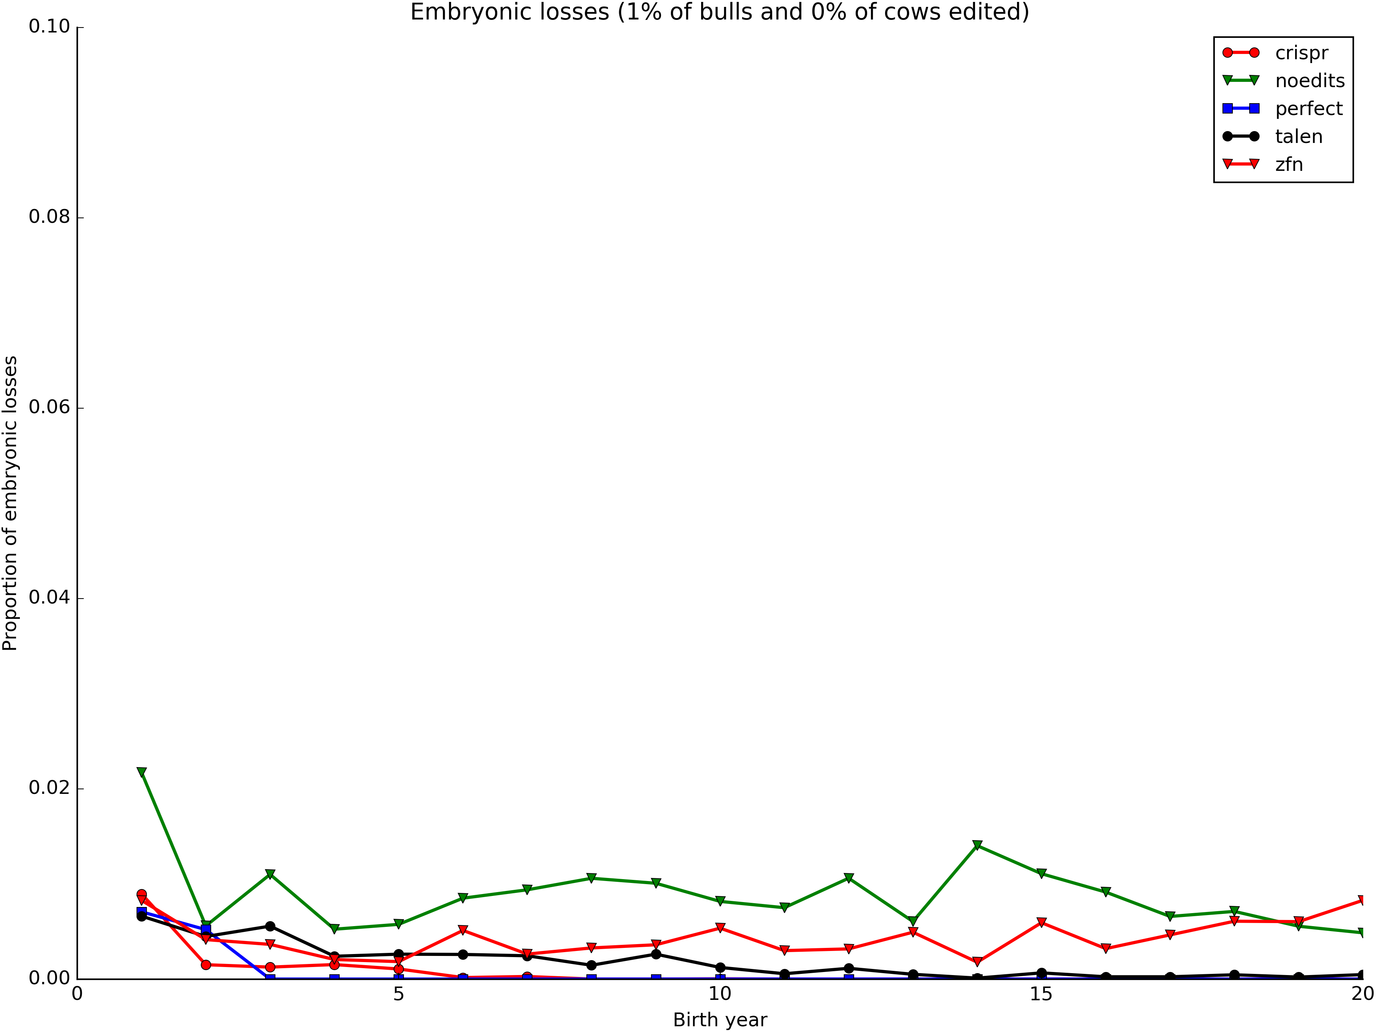
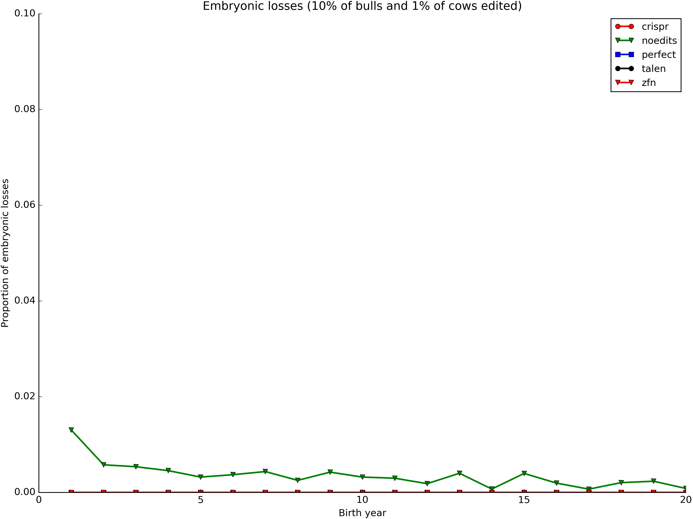
Introduction
Gene editing algorithm
Allele frequencies
High-density SNP genotypes have been used to identify many new recessives that affect fertility in dairy cattle, as well as to track conditions such as polled (Cole et al., 2016).
Sequential mate allocation accounting for increases in genomic inbreeding and the economic impact of affected matings results in faster allele frequency changes than other approaches (Cole, 2015).
Effects of gene editing on selection programs should be considered because it may dramatically change rates of allele frequency change.
Editing occurs when an embryo is created:
  For each recessive edited:
    A random variate is drawn and checked for success
    Failure means that the genotype was not changed
  A uniform random variate is drawn to determine if the embryo produces a live birth
A scenario where many embryos are produced to guarantee some survive is simulated by setting the embryonic death rate to 0.
The editing failure rate can be set to 0 to represent a scenario in which only edited embryos are transferred to recipients.
Genetic load
Inbreeding rates
Cole et al. (2016) estimated losses of at least $10,743,308 due to known recessives.
Losses were $5.77, $3.65, $0.94, and $2.96 per animal in Ayrshire, Brown Swiss, Holstein, and Jersey.
This is the economic impact of genetic load as it affects fertility and perinatal mortality.
Actual losses are likely to be higher.
Editing tools
Technology | Editing failure rate | Embryonic death rate | Probability of success
CRISPR | 0.37 | 0.79 | 0.71
TALEN | 0.79 | 0.88 | 0.30
Perfect | 0.00 | 0.00 | 1.00
ZFN | 0.89 | 0.92 | 0.18
Other parameters
Parameter | Value |  | Parameter | Value
Base bulls | 350 |  | Generations | 20
Base cows | 35,000 |  | Max matings | 5,000
Bulls/herd | 50 |  | Debug flag | True
Base herds | 200 |  | History | ‘end’
Max bulls | 500 |  | RNG seed | time + PID
Max cows | 100,000 |  | Proportion edited | 1 %, 10 % (bulls) 0 %, 1 % (cows)
Trunc point | 0.10 |  | Edit type | ‘C’, ‘P’, ‘T’, 'Z'
Objective
Determine rates of allele frequency change and quantify differences in cumulative genetic gain for several genome editing technologies while considering varying numbers of recessives and different proportions of bulls and cows to be edited.
Key findings
Proportion of bulls edited had only a small effect on allele frequencies
Editing cows had little effect on allele frequencies
More efficient editing results in lower rates of inbreeding
Recessives
Embryonic death rates
Hap | Functional/ gene name | Freq (%) | BTA | Location
HCD | Cholesterol deficiency/ APOB | 2.5 | 11 | 77,953,380–78,040,118
HH0 | Brachyspina/ FANCI | 2.76 | 21 | 21,184,869–21,188,198
HH1 | APAF1 | 1.92 | 5 | 63,150,400
HH2 | — | 1.66 | 1 | 94,860,836–96,553,339
HH3 | SMC2 | 2.95 | 8 | 95,410,507
HH4 | GART | 0.37 | 1 | 1,277,227
HH5 | TFB1M | 2.22 | 9 | 92,350,052–93,910,957
HHB | BLAD/ITGB2 | 0.25 | 1 | 145,119,004
HHC | CVM/SLC35A3 | 1.37 | 3 | 43,412,427
HHM | Mulefoot/LRP4 | 0.07 | 15 | 77,663,790–77,701,209
References
Cole, J.B. 2015. A simple strategy for managing many recessive disorders in a dairy cattle breeding program. Genet. Sel. Evol. 47:94.
Cole, J.B., D.J. Null, and P.M. VanRaden. 2016. Phenotypic and genetic effects of recessive haplotypes on yield, longevity, and fertility. J. Dairy Sci. 99:7274–7288.

