Slide 1
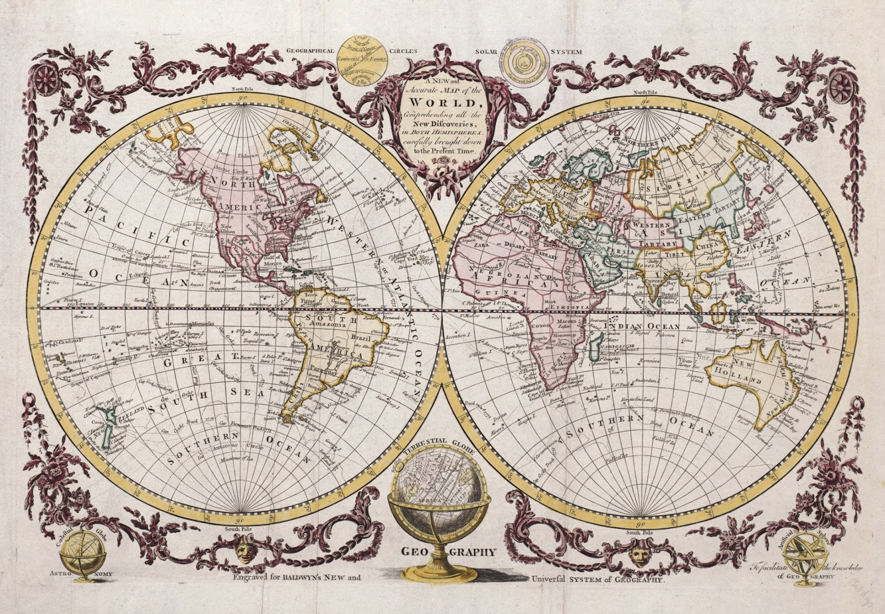
What direction should US dairy research take in the future?

Slide 2
Selection indices include many traits…
Source: Miglior et al. (2012)

Slide 3
…and we keep adding new traits
Trait | Relative emphasis on traits in index (%)
 | PD$ 1971 | MFP$ 1976 | CY$ 1984 | NM$ 1994 | NM$ 2000 | NM$ 2003 | NM$ 2006 | NM$ 2010 | NM$ 2014
Milk | 52 | 27 | –2 | 6 | 5 | 0 | 0 | 0 | -1
Fat | 48 | 46 | 45 | 25 | 21 | 22 | 23 | 19 | 22
Protein | … | 27 | 53 | 43 | 36 | 33 | 23 | 16 | 20
PL | … | … | … | 20 | 14 | 11 | 17 | 22 | 19
SCS | … | … | … | –6 | –9 | –9 | –9 | –10 | -7
UDC | … | … | … | … | 7 | 7 | 6 | 7 | 8
FLC | … | … | … | … | 4 | 4 | 3 | 4 | 3
BDC | … | … | … | … | –4 | –3 | –4 | –6 | -5
DPR | … | … | … | … | … | 7 | 9 | 11 | 7
HCR | … | … | … | … | … | … | … | … | 2
CCR | … | … | … | … | … | … | … | … | 1
SCE | … | … | … | … | … | –2 | … | … | …
DCE | … | … | … | … | … | –2 | … | … | …
CA$ | … | … | … | … | … | … | 6 | 5 | 5
Source: AGIL, ARS, USDA (http://aipl.arsusda.gov/reference/nmcalc-2014.htm).

Slide 4
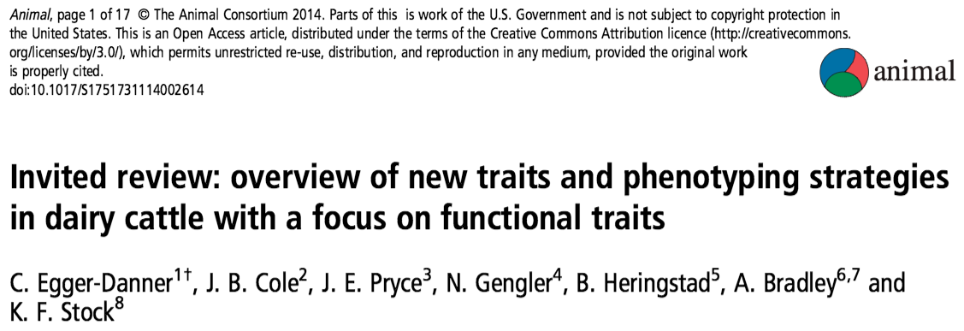
Why do we need new traits?
Changes in production economics
Technology produces new phenotypes
Better understanding of biology
Recent review by Egger-Danner et al.

Slide 5
Some recent novel phenotypes
Claw health (Van der Linde et al., 2010)
Dairy cow health (Parker Gaddis et al., 2013)
Embryonic development (Cochran et al., 2013)
Immune response (Thompson-Crispi et al., 2013)
Methane production (de Haas et al., 2011)
Milk fatty acids (Soyeurt et al., 2011)
Persistency of lactation (Cole et al., 2009)
Rectal temperature (Dikmen et al., 2013)
Residual feed intake (Connor et al., 2013)

Slide 6
New traits should add information
Novel phenotypes
include some
new information
Novel phenotypes
contain little
new information
high
Phenotypic correlation
with existing traits
Novel phenotypes
include much
new information
Novel phenotypes
contain some
new information
low
low
high
Genetic correlation with
existing traits

Slide 7
New traits should have value
high
(milk yield)
(feed intake)
Value of phenotype
(greenhouse gas
emissions)
low
(conformation)
low
high
Cost of measurement

Slide 8
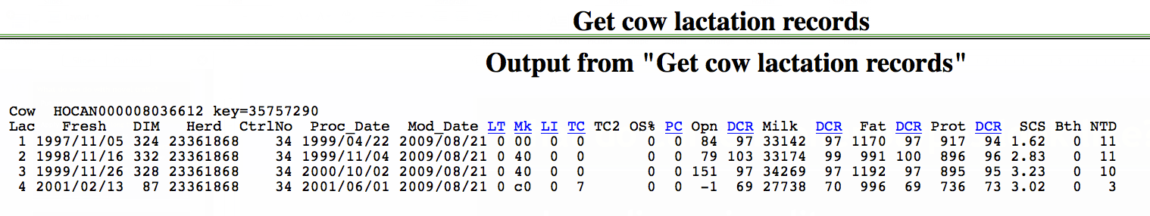
What do current phenotypes look like?
Low-dimensionality
  Usually few observations per lactation
  Close correspondence of phenotypes with values measured
  Easy transmission and storage
Notes:
8
8

Slide 9
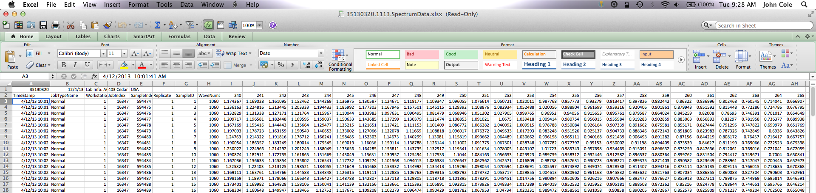
What do new phenotypes look like?
High dimensionality
  Ex.: MIR produces 1,060 points/obs.
  Disconnect between phenotype and measurement
  More resources needed for transmission, storage, and analysis

Slide 10
Genotypes are abundant

Slide 11
Genotypes can be applied to many traits
An animal’s genotype is good for all traits
Traditional evaluations are required for accurate estimates of SNP effects
Traditional evaluations not currently available for heat tolerance or feed efficiency
Research populations could provide data for traits that are expensive to measure
Will resulting evaluations work in target population?

Slide 12
Phenotypes may come from genotypes
Name | Chrome | Location (Mbp) | Freq of minor haplotype |  | Gene Name
HH1 | 5 | 63.15 | 1.92 |  | APAF1
HH2 | 1 | 94.8 to 96.6 | 1.66 |  | unknown
HH3 | 8 | 95.41 | 2.95 |  | SMC2
HH4 | 1 | 1.27 | 0.37 |  | GART
HH5 | 9 | 92 to 94 | 2.22 |  | unknown
JH1 | 15 | 15.70 | 12.10 |  | CWC15
JH2 | 26 | 8.81 to 9.41 | 1.3 |  | unknown
BH1 | 7 | 42.8 to 47.0 | 6.67 |  | unknown
BH2 | 19 | 10.6 to 11.7 | 7.78 |  | unknown
AH1 | 17 | 65.92 | 13.0 |  | UBE3B
For a complete list, see: http://aipl.arsusda.gov/reference/recessive_haplotypes_ARR-G3.html.

Slide 13
What do we do with new traits?
Put them into a selection index
  Correlated traits are helpful
Apply selection for a long time
  There are no shortcuts
Collect many phenotypes
  Repeated records of limited value
  Genomics can increase accuracy

Slide 14
Phenotypes from genotypes
Predict from correlated traits or phenotypes from reference herds
Haplotypes can be used when causal variants are not known
Causal variants can be used in place of markers
Specific combining abilities can combine additive and dominance effects

Slide 15

Some difficult things need to be said…
“I love everybody, but especially you” -- Lyle Lovett

Slide 16
What challenges are on the horizon?
We need more frequent sampling for modern management
  Samples do not need to be evenly spaced across the lactation
Some large farms do not see a value proposition in milk recording
On-farm data are growing, but not collected in a central database
Notes:
16
16

Slide 17

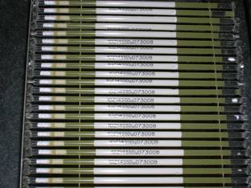
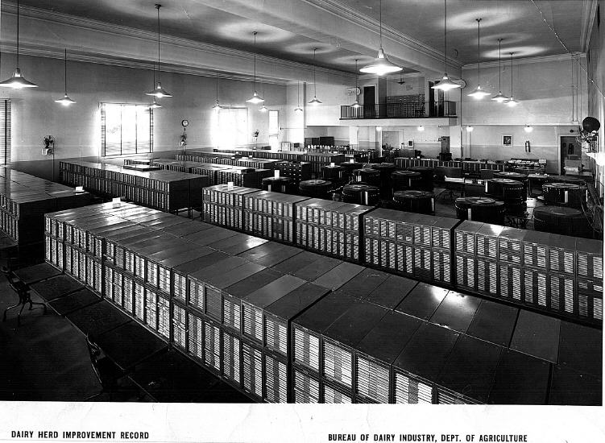
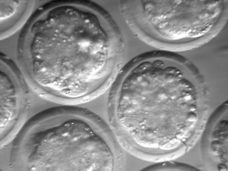
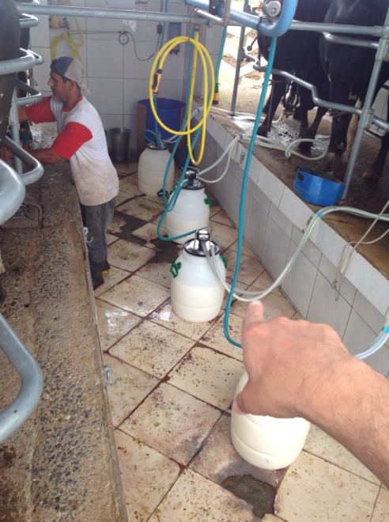
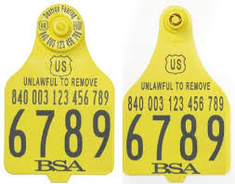
We were technology leaders…
Source: http://vet.tufts.edu/tas/images/002.png.
Source: http//www.shopbrownswiss.com/.

Slide 18
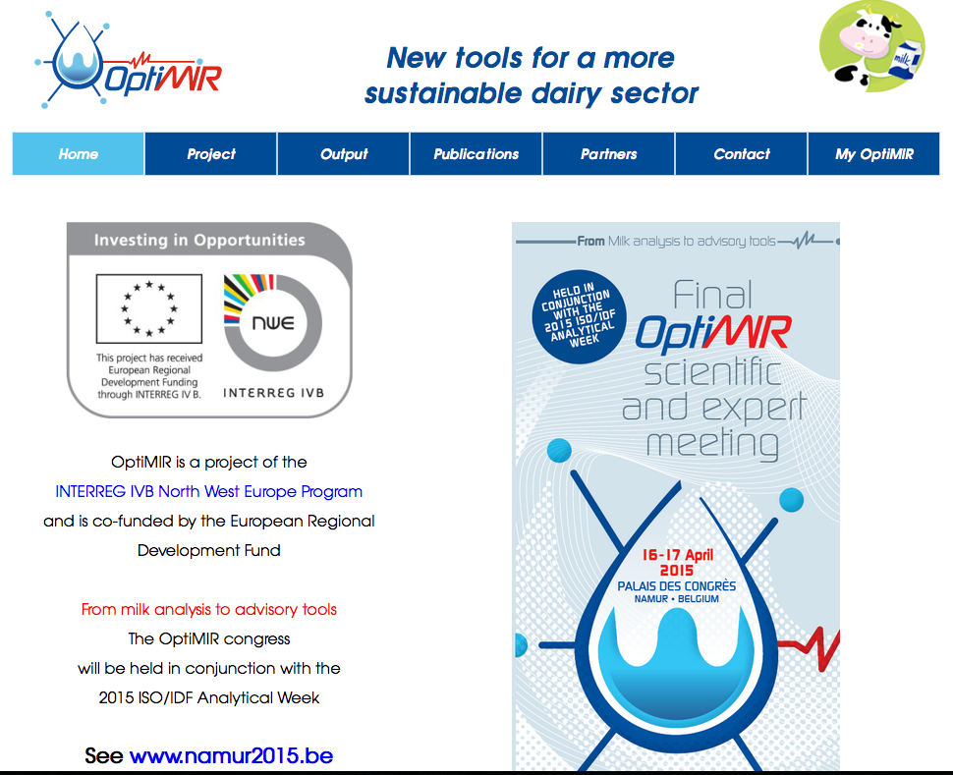
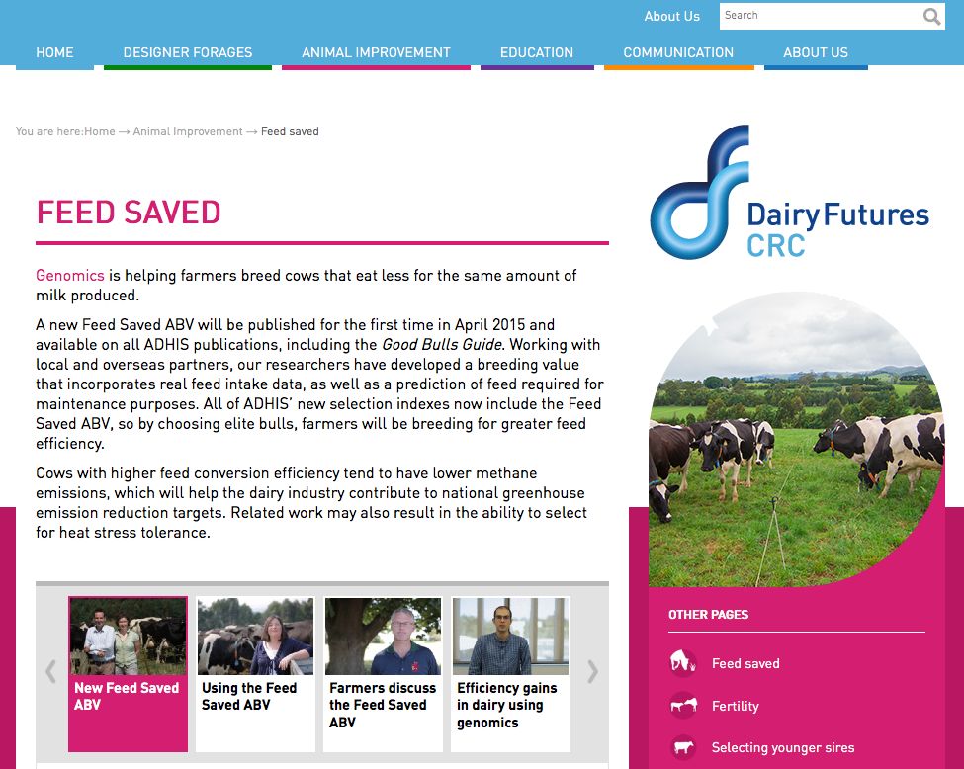

…do we want to retake the lead?

Slide 19
Why have we fallen behind?
Research is being done on new traits
Often not turned into new products
It’s a collective action problem
  Disagreement on objectives
  Lack of commercial incentives
  Infrastructure is not in place
This provides an opportunity for new players to enter the market

Slide 20
How do new players fit into the system?
How do we deal with data collected outside of the DHIA system?
  QC guidelines
  Standards for data analysis
Is lack of independent validation a problem?
How do we combine data from old and new data providers?
  Unified national evaluations?

Slide 21
There are no guarantees…
New technologies often require considerable capital investment
They sometimes fail to work or do not deliver the promised gain
Data are most useful when combined with observations from many farms
This inevitably involves risk

Slide 22
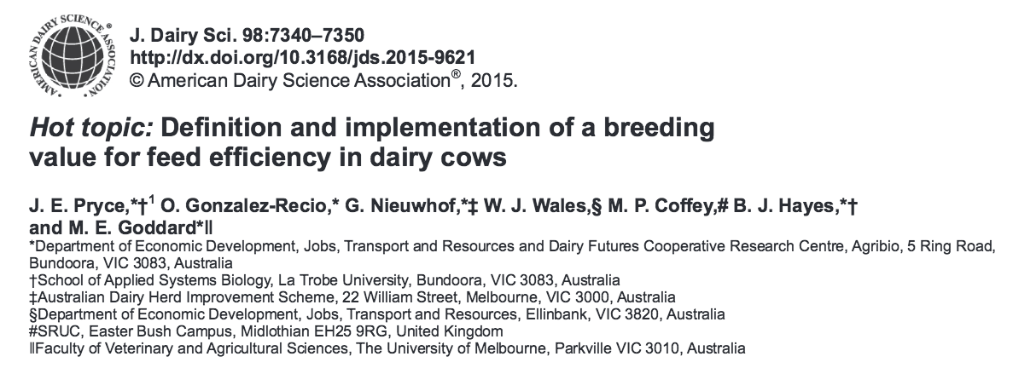
Collaboration is essential
When new traits are expensive, it takes a consortium to collect the data needed for genetic evaluation.
Notes:
22
22

Slide 23
Conclusions
Modern sensor technology produces large amounts of data
Those data can be used to improve herd management and profitability
The DHIA industry needs to rise to the challenge of turning new data into decisions
Why are we doing this?

Slide 24
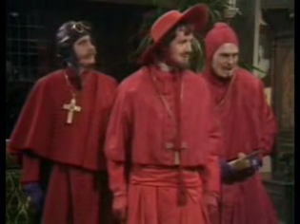
Questions?

