Slide 1
Genetic and genomic improvement of US dairy cattle

Slide 2
Overview
Genetic improvement program
Genomic improvement program
Additional uses of DNA marker information

Slide 3
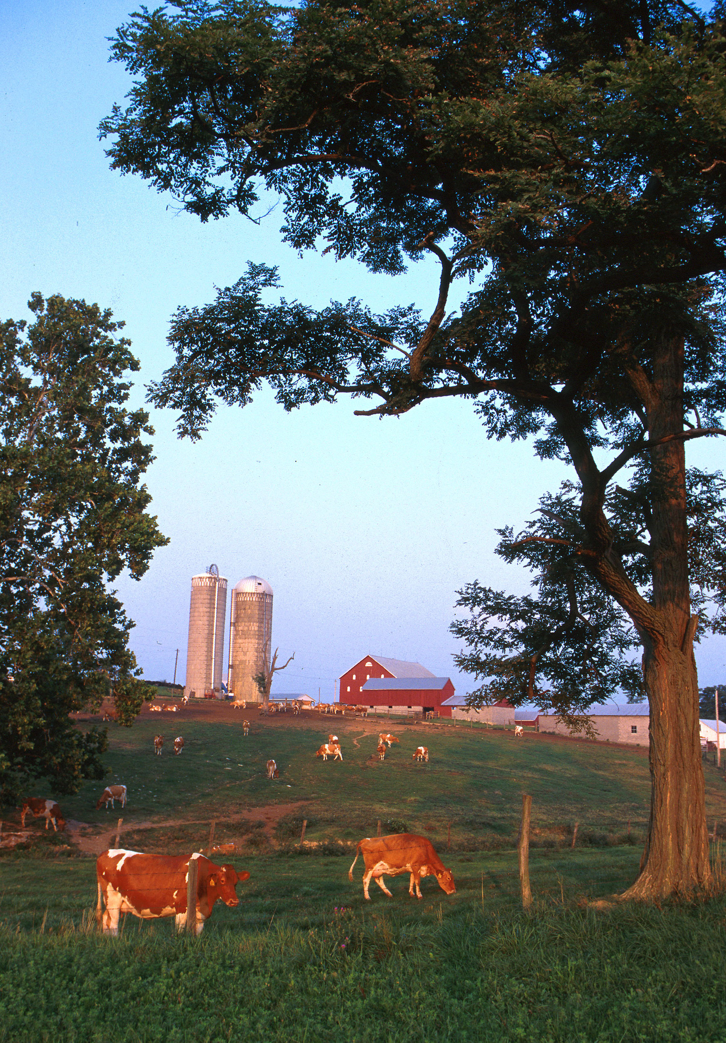
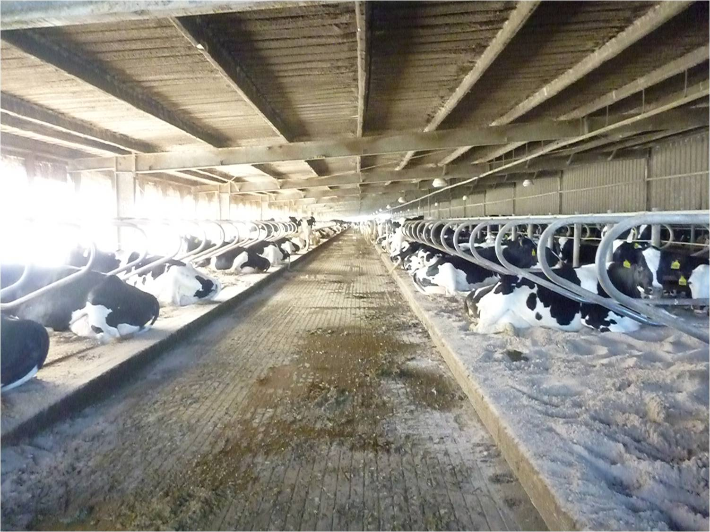
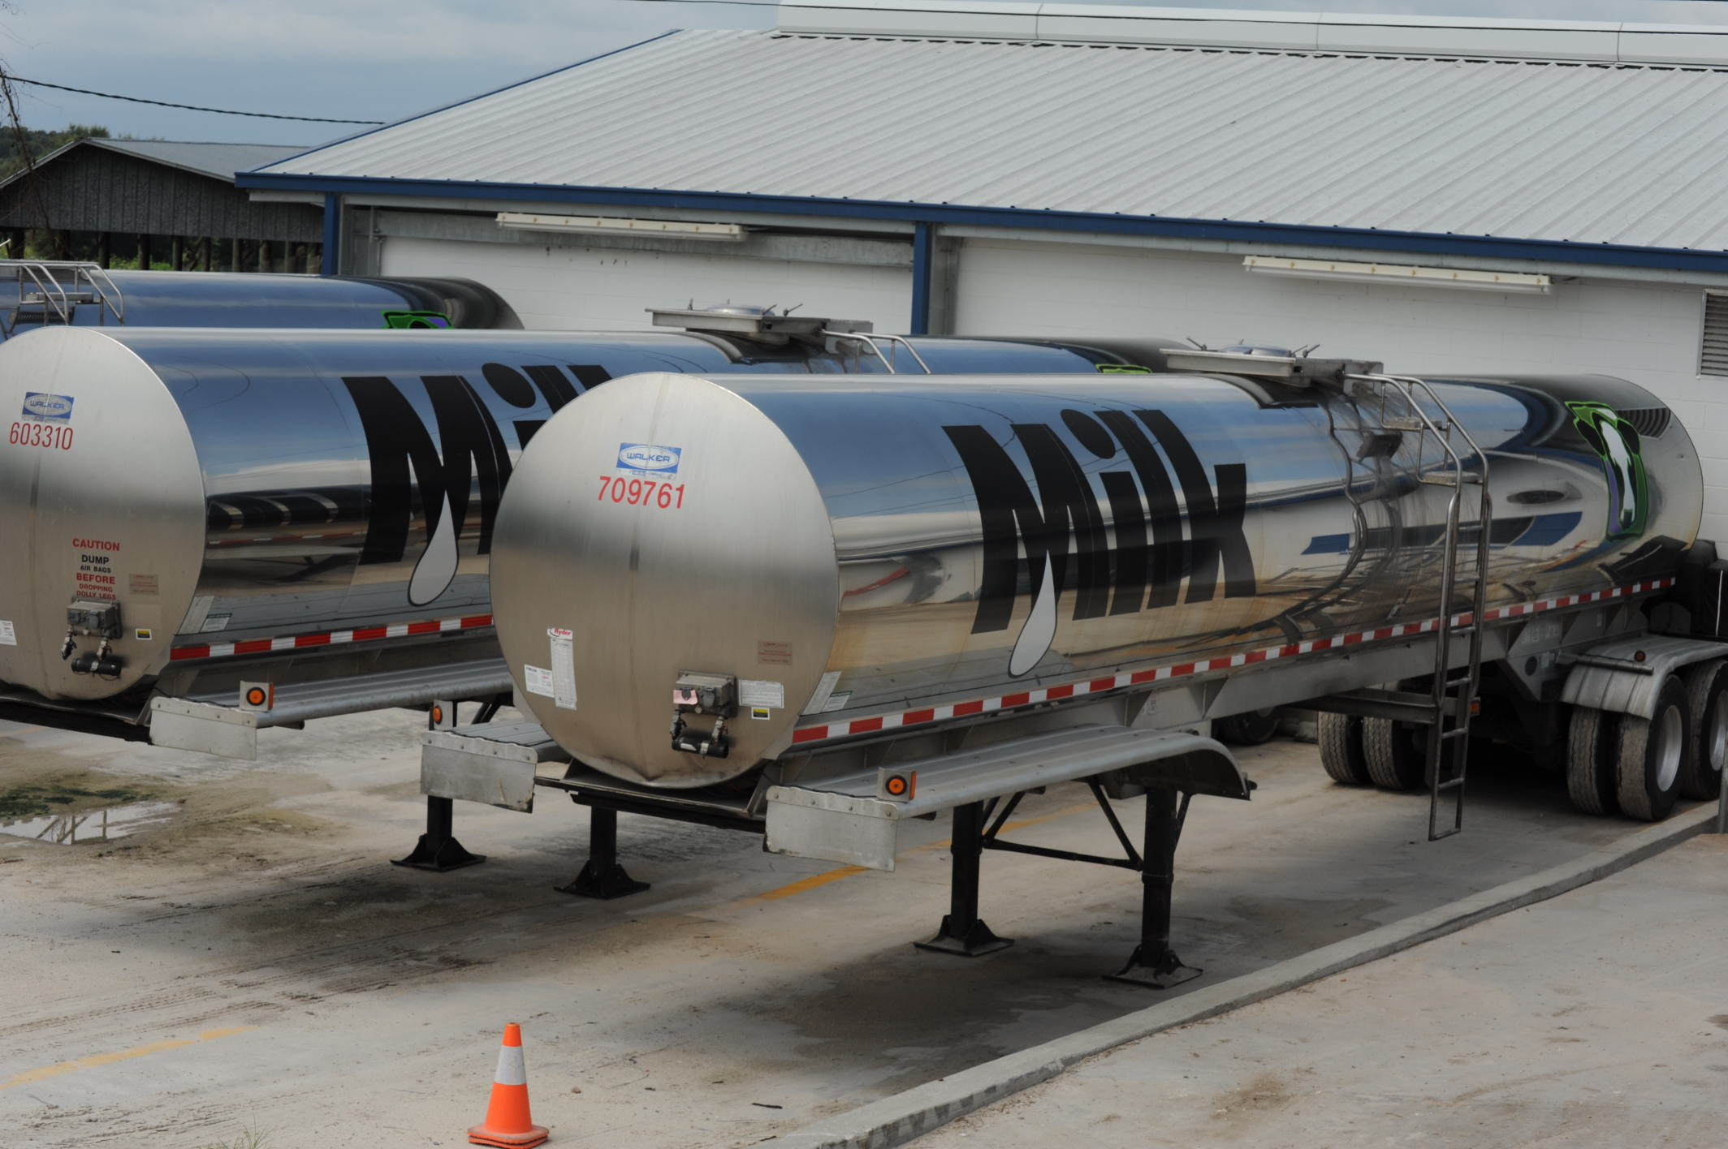
Typical US dairies
Small dairy farm in western Maryland. Photo courtesy of ARS.
Top: Large freestall barn in the state of Florida.
Bottom: 7,000 G (~26,500 l) milk tankers.
Photo courtesy of North Florida Holsteins.

Slide 4
U.S. dairy population and milk yield

Slide 5
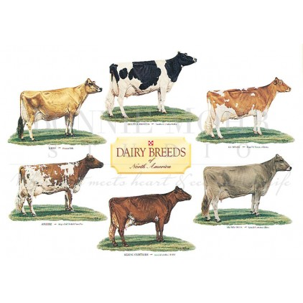
Traditional dairy breeds in the US
The six traditional US dairy breeds. Photo courtesy of Bonnie Mohr.

Slide 6
U.S. DHI dairy statistics (2011)
9.1 million U.S. cows
~75% bred AI
47% milk recorded through Dairy Herd Information (DHI)
4.4 million cows
86% Holstein
8% crossbred
5% Jersey
<1% Ayrshire, Brown Swiss, Guernsey, Milking Shorthorn, Red & White
20,000 herds
220 cows/herd
10,300 kg/cow

Slide 7
Genetics, genomics, and dairy cattle
Bulls do not express traits of interest, so selection must use data from female relatives
Cows are worth R$6,500 each, so owners collect much data for management
Phenotypes, pedigrees for half of US cows
Database and statistical methods developed and maintained by USDA and CDCB since 1908

Slide 8
Genetic evaluation advances
Year | Advance | Gain, %
1862 | USDA established
1895 | USDA begins collecting dairy records
1926 | Daughter-dam comparison | 100
1962 | Herdmate comparison | 50
1973 | Records in progress | 10
1974 | Modified contemporary comparison | 5
1977 | Protein evaluated | 4
1989 | Animal model | 4
1994 | Net merit, productive life, and somatic cell score | 50
2008 | Genomic selection | >50

Slide 9
Animal model
1989 to present
Introduced by Wiggans and VanRaden
Advantages
Information from all relatives
Adjustment for genetic merit of mates
Uniform procedures for males and females
Best prediction (BLUP)
Crossbreds included (2007)
Genomic information added (2008)

Slide 10
Traits evaluated
Year | Trait | Year | Trait
1926 | Milk & fat yields | 2000 | Calving ease¹
1978 | Conformation (type) | 2003 | Daughter pregnancy rate
1978 | Protein yield | 2006 | Stillbirth rate
1994 | Productive life | 2006 | Bull conception rate²
1994 | Somatic cell score (mastitis) | 2009 | Cow and heifer conception rates
 |  | 2016 | Cow livability
¹Sire calving ease evaluated by Iowa State University (1978–99)
²Estimated relative conception rate evaluated by DRMS in Raleigh, NC (1986–2005)

Slide 11
Evaluation methods for traits
Animal model (linear)
Yield (milk, fat, protein)
Type (AY, BS, GU, JE)
Productive life
Somatic cell score
Cow livability
Daughter pregnancy rate
Heifer conception rate
Cow conception rate
Sire–maternal grandsire model (threshold)
Service sire calving ease
Daughter calving ease
Service sire stillbirth rate
Daughter stillbirth rate
Heritability
25 – 40%
7 – 54%
8.5%
12%
1.3%
4%
1%
1.6%
8.6%
3.6%
3.0%
6.5%

Slide 12
Conformation (type) traits
Stature
Strength
Body depth
Dairy form
Rump angle
Thurl width
Rear legs (side)
Rear legs (rear)
Foot angle
Feet and legs score
Fore udder attachment
Rear udder height
Rear udder width
Udder cleft
Udder depth
Front teat placement
Rear teat placement
Teat length

Slide 13
Holstein milk (kg)
Phenotypic base = 11,828 kg
Sires
79 kg/yr
Cows

Slide 14
Holstein daughter pregnancy rate (%)
Cows
Sires
0.1%/yr
Phenotypic base = 22.6%

Slide 15
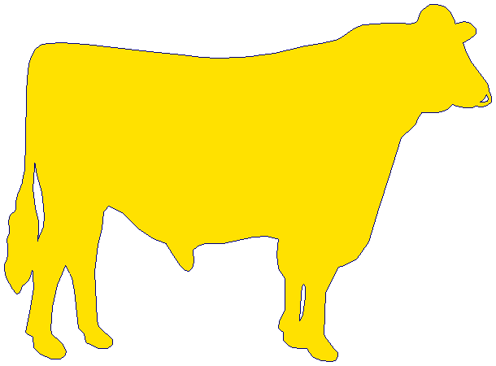
Holstein calving ease (%)
Daughter
0.18%/yr
Service-sire
phenotypic base = 7.9%
Service
sire
Daughter
phenotypic base = 7.5%
0.01%/yr

Slide 16
Economic selection index
Selection index is a tool for combining information about many traits into a single selection criterion.
Net merit (NM$; VanRaden and Cole, 2014) is a measure of cow lifetime profitability.
It is revised periodically to incorporate new traits and reflect changing economic conditions.

Slide 17
Index changes over time
Trait | Relative emphasis in USDA index (%)
 | PD$ 1971 | MFP$ 1976 | NM$ 1994 | NM$ 2000 | NM$ 2003 | NM$ 2014 | NM$ 2016
Milk | 52 | 27 | 6 | 5 | 0 | –1 | –1
Fat | 48 | 46 | 25 | 21 | 22 | 22 | 22
Protein | … | 27 | 43 | 36 | 33 | 20 | 20
Longevity | … | … | 20 | 14 | 11 | 19 | 14
SCS (mastitis) | … | … | –6 | –9 | –9 | –7 | –7
Udder | … | … | … | 7 | 7 | 8 | 8
Feet/legs | … | … | … | 4 | 4 | 3 | 3
Body size | … | … | … | –4 | –3 | –5 | –4
Pregnancy rate | … | … | … | … | 7 | 7 | 7
Calving | … | … | … | … | 4 | 5 | 5
Conception rate | … | … | … | … | … | 3 | 3
Livability | … | … | … | … | … | … | 7
Notes:
17
17

Slide 18
Traditional evaluation summary
Evaluation procedures have improved
Fitness traits have been added
Effective selection has produced substantial annual genetic improvement
Indices enable selection for overall economic merit

Slide 19
Genomic evaluation system
Provides timely evaluations of young bulls for purchasing decisions
Increases accuracy of evaluations of bull dams
Assists in selection of service sires, particularly for low-reliability traits
High demand for semen from genomically evaluated 2-year-old bulls

Slide 20
Collaboration with industry
Council on Dairy Cattle Breeding (CDCB) responsible for receiving data and for computing and delivering US genetic evaluations for dairy cattle
AIP responsible for research and development to improve the evaluation system
CDCB (Bowie) and AIP (Beltsville) are located near one another
Dr. João Dürr is CDCB’s CEO

Slide 21
Council on Dairy Cattle Breeding
CDCB
PDCA
NAAB
DRPC
DHIA
Purebred Dairy
Cattle Association
National Association of Animal Breeders
Dairy Records
Processing Centers
Dairy Herd
Information Association
3 board members from each organization
Total of 12 voting members
2 nonvoting industry members

Slide 22
Genotype Contributors
by continent
Notes:
22

Slide 23
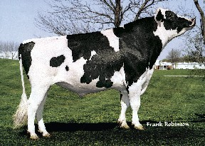
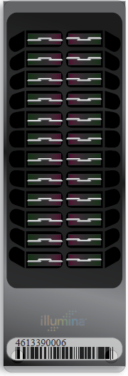
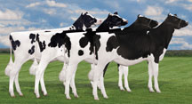
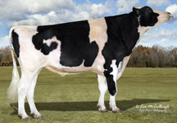
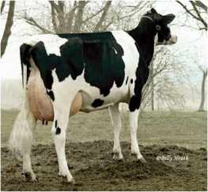
Genomic prediction of progeny test
0
1
2
3
4
5
Select parents, transfer embryos to recipients
Calves born from DNA-selected parents
Bull receives progeny test
Calves born and DNA tested
Reduce generation interval from 5 to 2 years

Slide 24
All generation intervals are decreasing
García-Ruiz et al. (2016)

Slide 25
Evaluation flow
Animal nominated for genomic evaluation by breed association or AI organization
Hair or other DNA source sent to genotyping lab
DNA extracted and placed on chip for 3-day genotyping process
Genotypes sent from genotyping lab to AIPL for accuracy review

Slide 26
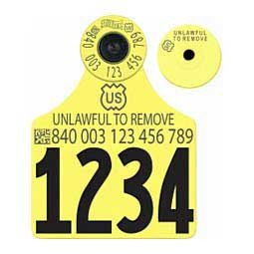
DNA Sources
Calves identified by ear tags and DNA collected at birth
Sources sent to genotyping labs (2015)
Source | Samples (no.) | Samples (%)
Ear tissue | 252,468 | 64
Hair roots | 124,523 | 31
Blood | 6,893 | 2
Nasal swab | 1,903 | <1
Semen | 277 | <1
Unknown | 10,906 | 3

Slide 27
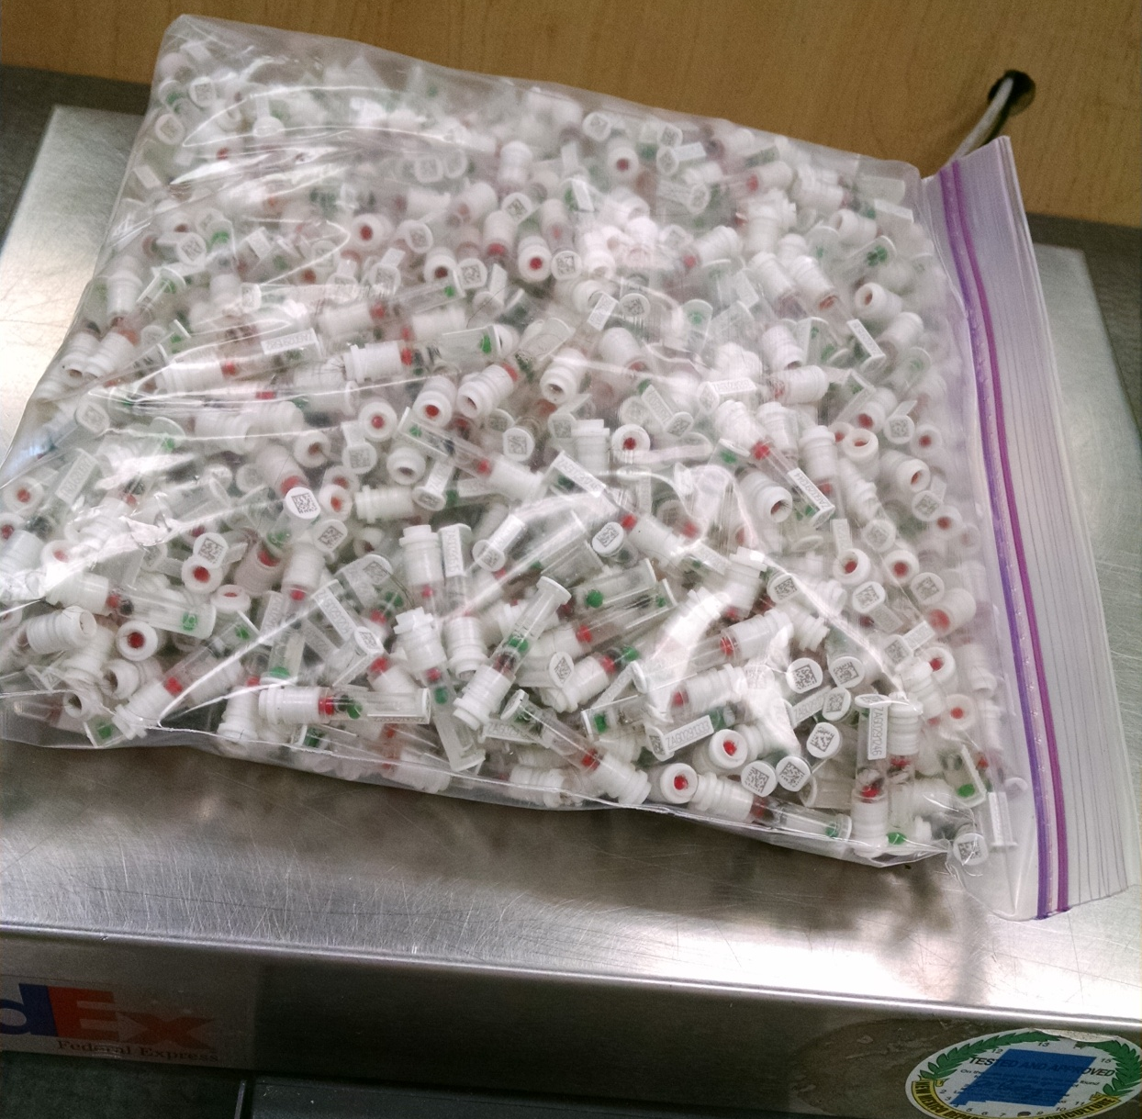
DNA samples from 1 farm, 1 day
Photo provided
by Zoetis

Slide 28
Laboratory quality control
Each SNP evaluated for
Call rate
Portion heterozygous
Parent-progeny conflicts
Clustering investigated if SNP exceeds limits
Number of failing SNPs indicates genotype quality
Target of <10 SNPs in each category

Slide 29
Evaluation flow (continued)
Genotype calls modified as necessary
Genotypes loaded into database
Nominators receive reports of parentage and other conflicts
Pedigree or animal assignments corrected
Genotypes extracted and imputed to 61k
SNP effects estimated

Slide 30
Imputation
Based on splitting genotype into individual chromosomes (maternal and paternal contributions)
Missing SNPs assigned by tracking inheritance from ancestors and descendants
Imputed dams increase predictor population
Genotypes from all chips merged by imputing SNPs not present

Slide 31
Evaluation flow (continued)
Final evaluations calculated
Evaluations released to dairy industry
Download from CDCB FTP site with separate files for each nominator
Weekly release for new animals
All genomic evaluations updated 3 times each year with traditional evaluations

Slide 32
Multistep genomic evaluations
Traditional evaluations (phenotype and pedigree) used as input data for genomic equations
Allele effects estimated for 60,671 markers (Z) by multiple regression, using BayesA prior variance
Polygenic effect for 10% of genetic variation not captured by markers, assuming pedigree covariance
Selection index step combines genomic info with traditional info from nongenotyped parents
Applied to 33 yield, fitness, calving, and type traits

Slide 33
Linear estimates using markers
Selection index equations for EBV
R has diagonals = (1/Reliability)–1
BLUP equations for marker effects, sum to get EBV
k = var(u)/var(m)

Slide 34
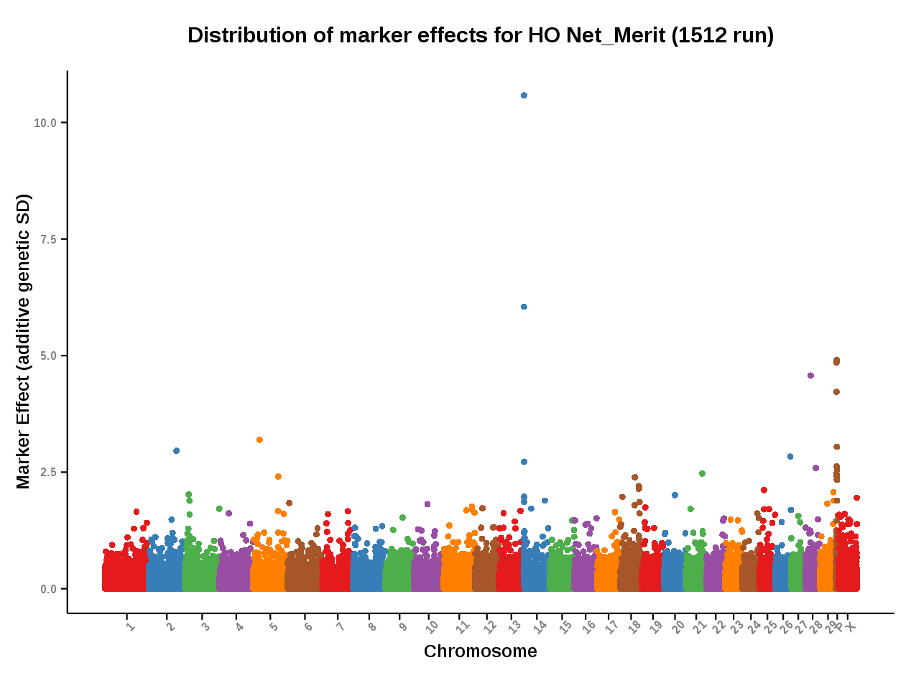
Genomic evaluation results
Source: https://www.cdcb.us/Report_Data/Marker_Effects/marker_effects.cfm?Breed=HO&Trait=Net_Merit

Slide 35
Genetic choices
Before genomics:
Proven bulls with daughter records (PTA)
Young bulls with parent average (PA)
After genomics:
Young animals with DNA test (GPTA)
Reliability of GPTA ~70% compared to PA ~35% and PTA ~85% for Holstein NM$

Slide 36
Genotypes are abundant

Slide 37
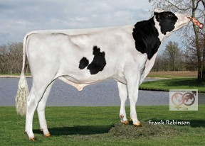
Pedigree of embryosire (HOUSA73431994)
777K
777K
50K
—
50K
50K
50K
50K
777K
777K
50K
—
3K
777K
50K
50K
777K
777K
50K
Imputed
Imputed
50K
50K
Imputed
50K
777K
50K
50K
50K
777K
77K
—
777K
777K
50K
Imputed
Imputed
50K
50K
Imputed
50K
777K
50K
50K
3K
777K
9K
50K
50K
777K
50K
50K
50K
777K
50K
Imputed
777K
777K
50K
—
Imputed
777K
50K

Slide 38
SNP used for genomic evaluations
60,671 SNP used after culling on
Minor allele frequencies
Parent-progeny conflicts
Percentage heterozygous (departure from HWE)
SNP for HH1, BLAD, DUMPS, CVM, polled, red, and mulefoot included
JH1 included for Jerseys
Some SNP eliminated because incorrect location  haplotype non-inheritance

Slide 39
Genetic markers in genomic selection
Notes:
April 2016 CDCB used 60,671 snp. Not an actual SNP chip, but 50K and lower chips imputed up to 60K

Slide 40
2016 genotypes by breed and sex
Breed | Female | Male | All animals | Female: male
Ayrshire | 3,641 | 1,693 | 5,334 | 68:32
Brown Swiss | 4,278 | 16,757 | 21,035 | 20:80
Guernsey | 1,835 | 656 | 2,491 | 74:26
Holstein | 894,471 | 182,866 | 1,077,377 | 83:17
Jersey | 119,689 | 21,031 | 140,720 | 85:15
Milking Shorthorn | 12 | 14 | 26 | 46:54
Crossbred | 38 | 0 | 38 | 100:00
All | 1,023,964 | 223,017 | 1,246,981
Source: Council on Dairy Cattle Breeding (https://www.cdcb.us/Genotype/cur_freq.html).

Slide 41
Growth in US predictor population
 | Bulls |  | Cows^{1,2}
Breed | Jan. 2016 | 12-mo gain | Jan. 2016 | 12-mo gain
Ayrshire | 752 | 41 | 133 | 59
Brown Swiss | 6,363 | 241 | 1,580 | 429
Holstein | 28,922 | 2,163 | 190,021 | 78,917
Jersey | 4,712 | 264 | 42,717 | 16,247
¹Predictor cows must have domestic records.
²Counts include 3k genotypes, which are not included in the predictor population.
Source: Council on Dairy Cattle Breeding (https://www.cdcb.us/Genotype/cur_density.html).

Slide 42
Holstein prediction accuracy
Trait | Bias* | Reliability (%) | Reliability gain (% points)
Milk (kg) | −80.3 | 69.2 | 30.3
Fat (kg) | −1.4 | 68.4 | 29.5
Protein (kg) | −0.9 | 60.9 | 22.6
Fat (%) | 0.0 | 93.7 | 54.8
Protein (%) | 0.0 | 86.3 | 48.0
Productive life (mo) | −0.7 | 73.7 | 41.6
Somatic cell score | 0.0 | 64.9 | 29.3
Daughter pregnancy rate (%) | 0.2 | 53.5 | 20.9
Sire calving ease | 0.6 | 45.8 | 19.6
Daughter calving ease | −1.8 | 44.2 | 22.4
Sire stillbirth rate | 0.2 | 28.2 | 5.9
Daughter stillbirth rate | 0.1 | 37.6 | 17.9
*2013 deregressed value – 2009 genomic evaluation

Slide 43
Holstein prediction accuracy
Trait | Bias* | Reliability (%) | Reliability gain (% points)
Final score | 0.1 | 58.8 | 22.7
Stature | −0.2 | 68.5 | 30.6
Dairy form | −0.2 | 71.8 | 34.5
Rump angle | 0.0 | 70.2 | 34.7
Rump width | −0.2 | 65.0 | 28.1
Feed and legs | 0.2 | 44.0 | 12.8
Fore udder attachment | −0.2 | 70.4 | 33.1
Rear udder height | −0.1 | 59.4 | 22.2
Udder depth | −0.3 | 75.3 | 37.7
Udder cleft | −0.2 | 62.1 | 25.1
Front teat placement | −0.2 | 69.9 | 32.6
Teat length | −0.1 | 66.7 | 29.4
*2013 deregressed value – 2009 genomic evaluation

Slide 44
Bull reliability comparisons by breed
April 2016 NM$
 |  |  | Reliability* (%)
Breed | Reference (n) |  | Proven bulls | Young bulls | PA
Holstein | 30,726 |  | 88 | 75 | 34
Jersey | 4,795 |  | 86 | 68 | 35
Brown Swiss | 6,376 |  | 75 | 59 | 33
Ayrshire | 754 |  | 79 | 42 | 33
Guernsey | 451 |  | 72 | 38 | 31
*Squared correlation (EBV, true BV)

Slide 45
Parent ages of marketed Holstein bulls

Slide 46
Active AI bulls that were genomic bulls

Slide 47
Genetic merit of marketed Holstein bulls
Average gain:
$85.60/year
Average gain:
$52.00/year
Average gain:
$19.77/year

Slide 48
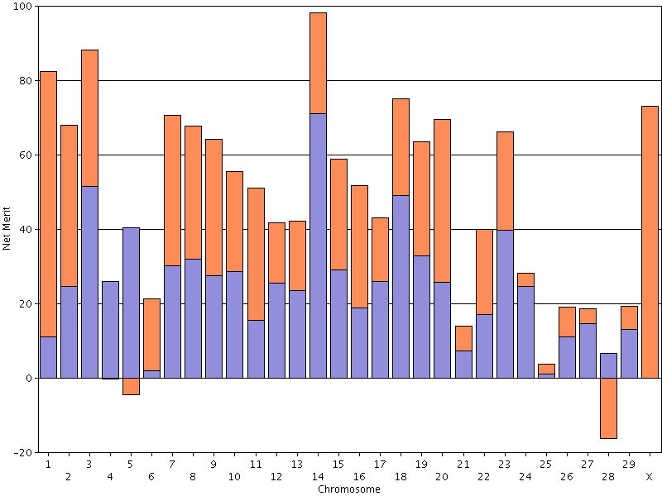
Net merit by chromosome
PINE-TREE 9882 MODES 713-ET (GPTA NM$: +1,036, Rel: 72%)

Slide 49
What’s the best cow we can make?
A “supercow” constructed from the best haplotypes in the Holstein population would have an EBV for NM$ of ~R$25000.

Slide 50
Stability of genomic evaluations
642 Holstein bulls
Dec. 2012 NM$ compared with Dec. 2014 NM$
First traditional evaluation in Aug. 2014
≥50 daughters by Dec. 2014
Top 100 bulls in 2012
Average rank change of 9.6
Maximum drop of 119
Maximum rise of 56
All 642 bulls
Correlation of 0.94 between 2012 and 2014
Regression of 0.92
Notes:
50

Slide 51
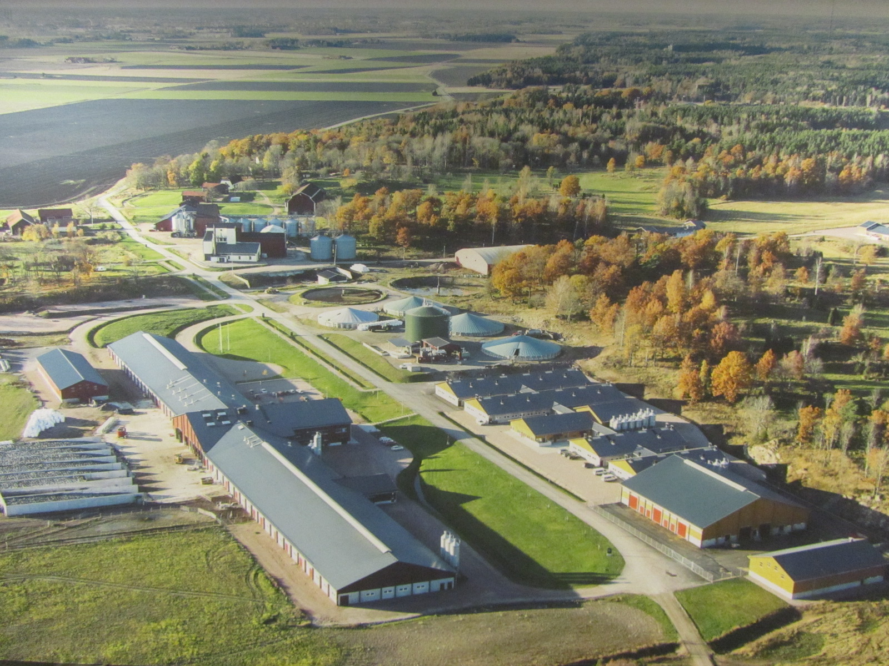
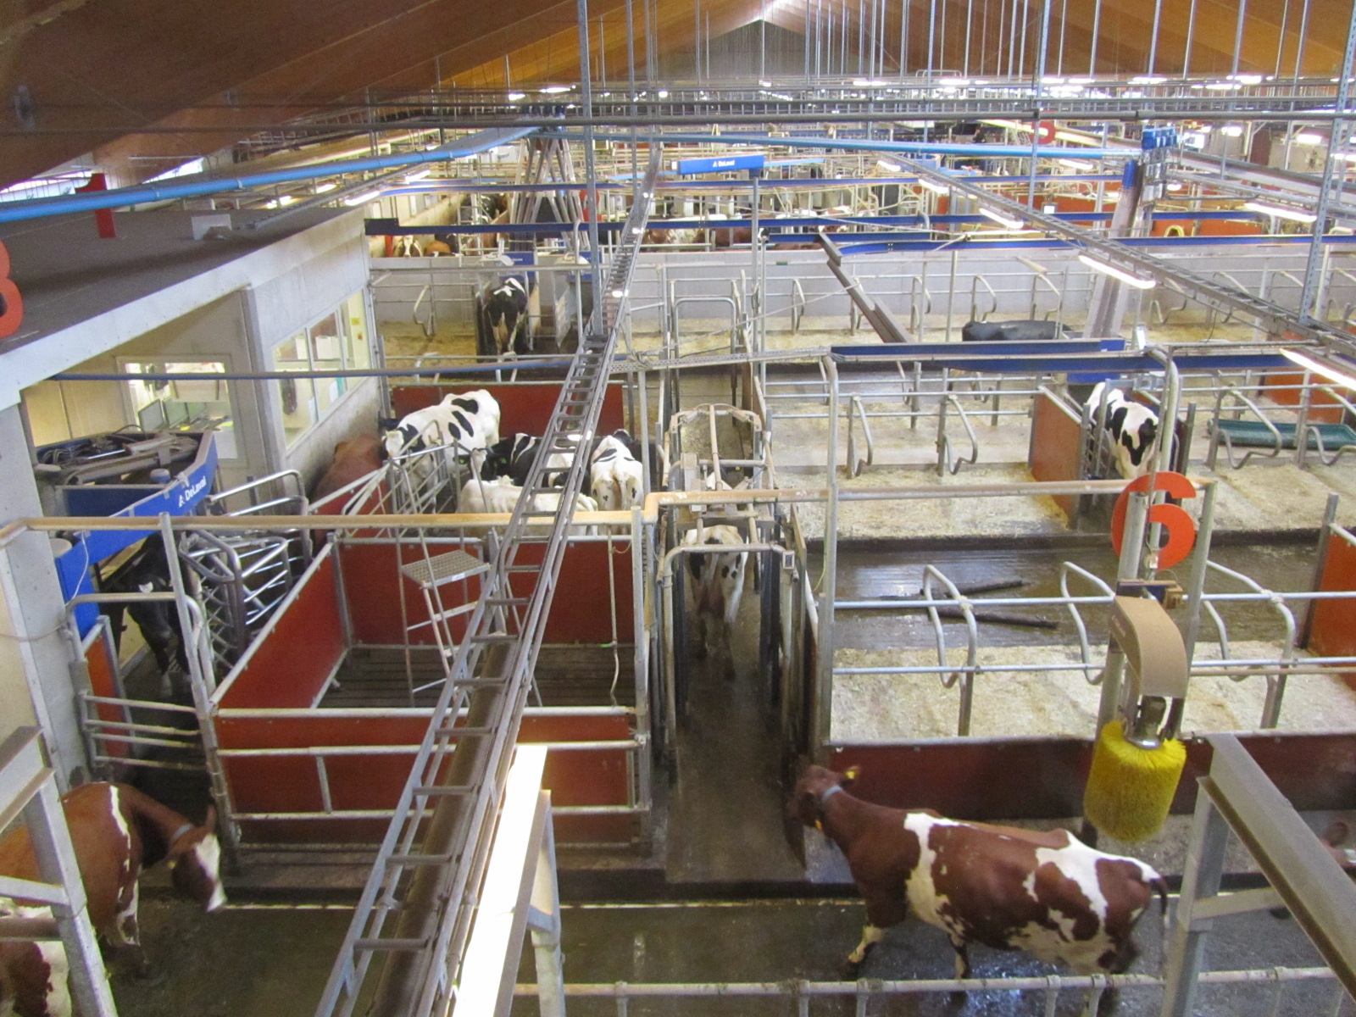
Genomics is not the only innovation
The Swedish Agricultural University dairy research center has a state-of-the-art facility equipped with the latest DeLaval technology.
Photos courtesy of Albert de Vries.

Slide 52
Application to more traits
Animal’s genotype good for all traits
Traditional evaluations required for accurate estimates of SNP effects
Traditional evaluations not currently available for heat tolerance or feed efficiency
Research populations could provide data for traits that are expensive to measure
Will resulting evaluations work in target population?

Slide 53
Parentage validation and discovery
Parent-progeny conflicts detected
Animal checked against all other genotypes
Reported to breeds and requesters
Correct sire usually detected
Maternal grandsire (MGS) checking
SNP at a time checking
Haplotype checking more accurate
Breeds moving to accept SNPs in place of microsatellites
Notes:
53

Slide 54
Some new traits studied recently
Claw health (Van der Linde et al., 2010)
Dairy cattle health (Parker Gaddis et al., 2013)
Embryonic development (Cochran et al., 2013)
Immune response (Thompson-Crispi et al., 2013)
Methane production (de Haas et al., 2011)
Milk fatty acid composition (Soyeurt et al., 2011)
Persistency of lactation (Cole et al., 2009)
Rectal temperature (Dikmen et al., 2013)
Residual feed intake (Connor et al., 2013)

Slide 55
Haplotypes affecting fertility
Rapid discovery of new recessive defects
Large numbers of genotyped animals
Affordable DNA sequencing
Determination of haplotype location
Significant number of homozygous animals expected, but none observed
Narrow suspect region with fine mapping
Use sequence data to find causative mutation

Slide 56
Haplotypes affecting fertility
Name | BTA chromo- some | Location* (Mbp) | Carrier frequency (%) | Earliest known ancestor
HH1 | 5 | 63.2* | 3.8 | Pawnee Farm Arlinda Chief
HH2 | 1 | 94.9 – 96.6 | 3.3 | Willowholme Mark Anthony
HH3 | 8 | 95.4* | 5.9 | Glendell Arlinda Chief, Gray View Skyliner
HH4 | 1 | 1.3* | 0.7 | Besne Buck
HH5 | 9 | 92.43– 93.9* | 4.4 | Thornlea Texal Supreme
JH1 | 15 | 15.7* | 24.2 | Observer Chocolate Soldier
JH2 | 26 | 8.8 – 9.4 | 2.6 | Liberators Basilius
BH1 | 7 | 42.8 – 47.0 | 13.3 | West Lawn Stretch Improver
BH2 | 19 | 10.6 – 11.7 | 15.6 | Rancho Rustic My Design
AH1 | 17 | 65.9* | 26.0 | Selwood Betty’s Commander
*Causative mutation known

Slide 57
Haplotypes tracking known recessives
Recessive | Haplo-type | BTA chromo- some | Tested animals (no.) | Concord- ance (%) | New carriers (no.)
Brachyspina | HH0 | 21 | ? | ? | ?
BLAD | HHB | 1* | 11,782 | 99.9 | 314
CVM | HHC | 3* | 13,226 | — | 2,716
DUMPS | HHD | 1* | 3,242 | 100.0 | 3
Mule foot | HHM | 15* | 87 | 97.7 | 120
Polled | HHP | 1 | 345 | — | 2,050
Red coat color | HHR | 18* | 4,137 | — | 5,927
SDM | BHD | 11* | 108 | 94.4 | 108
SMA | BHM | 24* | 568 | 98.1 | 111
Weaver | BHW | 4 | 163 | 96.3 | 32
*Causative mutation known

Slide 58
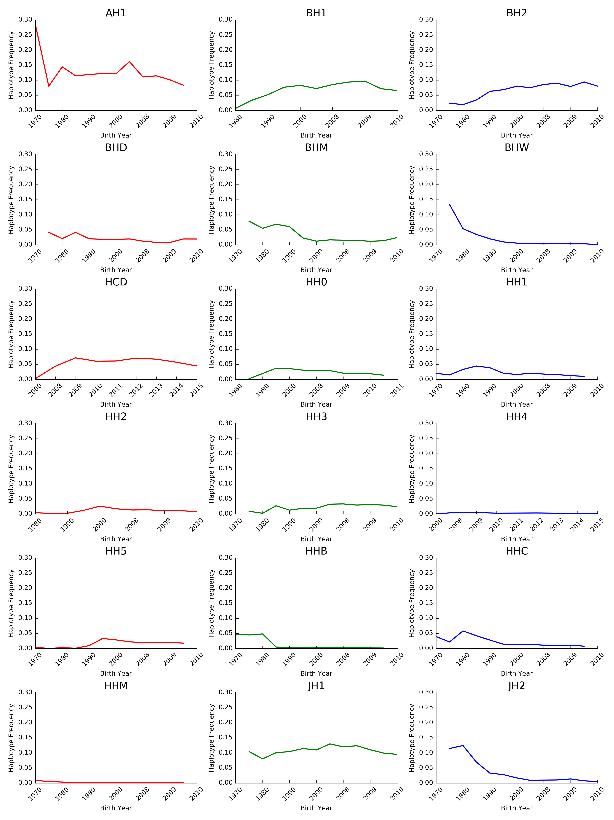
Haplotype frequencies change over time
The best way to reduce the frequency of harmful alleles is to not use carrier bulls!
Cole et al. (2016)

Slide 59
Cost of genetic load
Cole et al. (2016) estimated losses of at least R$33 million from known recessives.
Average losses were R$19, R$12, R$3, and R$10 in Ayrshire, Brown Swiss, Holstein, and Jersey, respectively.
This is the economic impact of genetic load as it affects fertility and perinatal mortality.
Actual losses are likely to be higher.

Slide 60
Economic benefits for breeders
Haplotype and gene tests in selection and mating programs
Trend towards a small number of elite breeders that are investing heavily in genomics
About 30% of young males genotyped
directly by breeders since April 2013
Prices for top genomic heifers can be
very high (e.g., R$874,500)

Slide 61
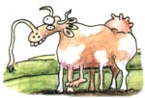
Benefits for dairy producers
Reduced generation interval
Increased rate of genetic gain
More inbreeding/homozygosity?
This can be good and bad at the same time!

Slide 62
Benefits for dairy producers (continued)
Sires
Higher average genetic merit of available bulls
More rapid increase in genetic merit for all traits
Larger choice of bulls in terms of traits and semen price
Greater use of young bulls

Slide 63
Why genomics works for dairy cattle
Extensive historical data available
Well-developed genetic evaluation program
Widespread use of AI sires
Progeny-test programs
High-value animals worth the cost of genotyping
Long generation interval that can be reduced substantially by genomics
Notes:
63

Slide 64
Key issues for the dairy industry
Inbreeding and genetic diversity
(including across breeds)
Sequencing, new genes, and mutations
Novel traits, resource populations
(feed efficiency, health, milk properties)
Cole and VanRaden. (2010)

Slide 65
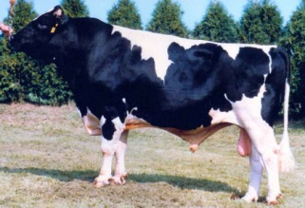
U.S. use of 1,000 bull genomes
Sequence genotypes from 440 Holsteins
Imputed for 27,000 reference bulls
700,000 candidate loci plus 300,000 HD SNPs
Largest 17K added to 60K routinely used
Average gain of 2.7% reliability across traits
Largest 5K added to low-density chips

Slide 66
Conclusions
Genomic evaluation has dramatically changed dairy cattle breeding
Rate of gain is increasing primarily because of a large reduction in generation interval
Genomic research is ongoing
Detect causative genetic variants
Find more haplotypes affecting fertility
Improve accuracy through more SNPs, more predictor animals, and more traits

Slide 67
Acknowledgments
Appropriated project 1265-31000-096-00, "Improving Genetic Predictions in Dairy Animals Using Phenotypic and Genomic Information", ARS, USDA
CNPq “Science Without Borders” project 301025/2014-2
Kristen Gaddis, Dan Null, Paul VanRaden, and George Wiggans
Council on Dairy Cattle Breeding

Slide 68
Disclaimer
Mention of trade names or commercial products in this presentation is solely for the purpose of providing specific information and does not imply recommendation or endorsement by the US Department of Agriculture.

Slide 69
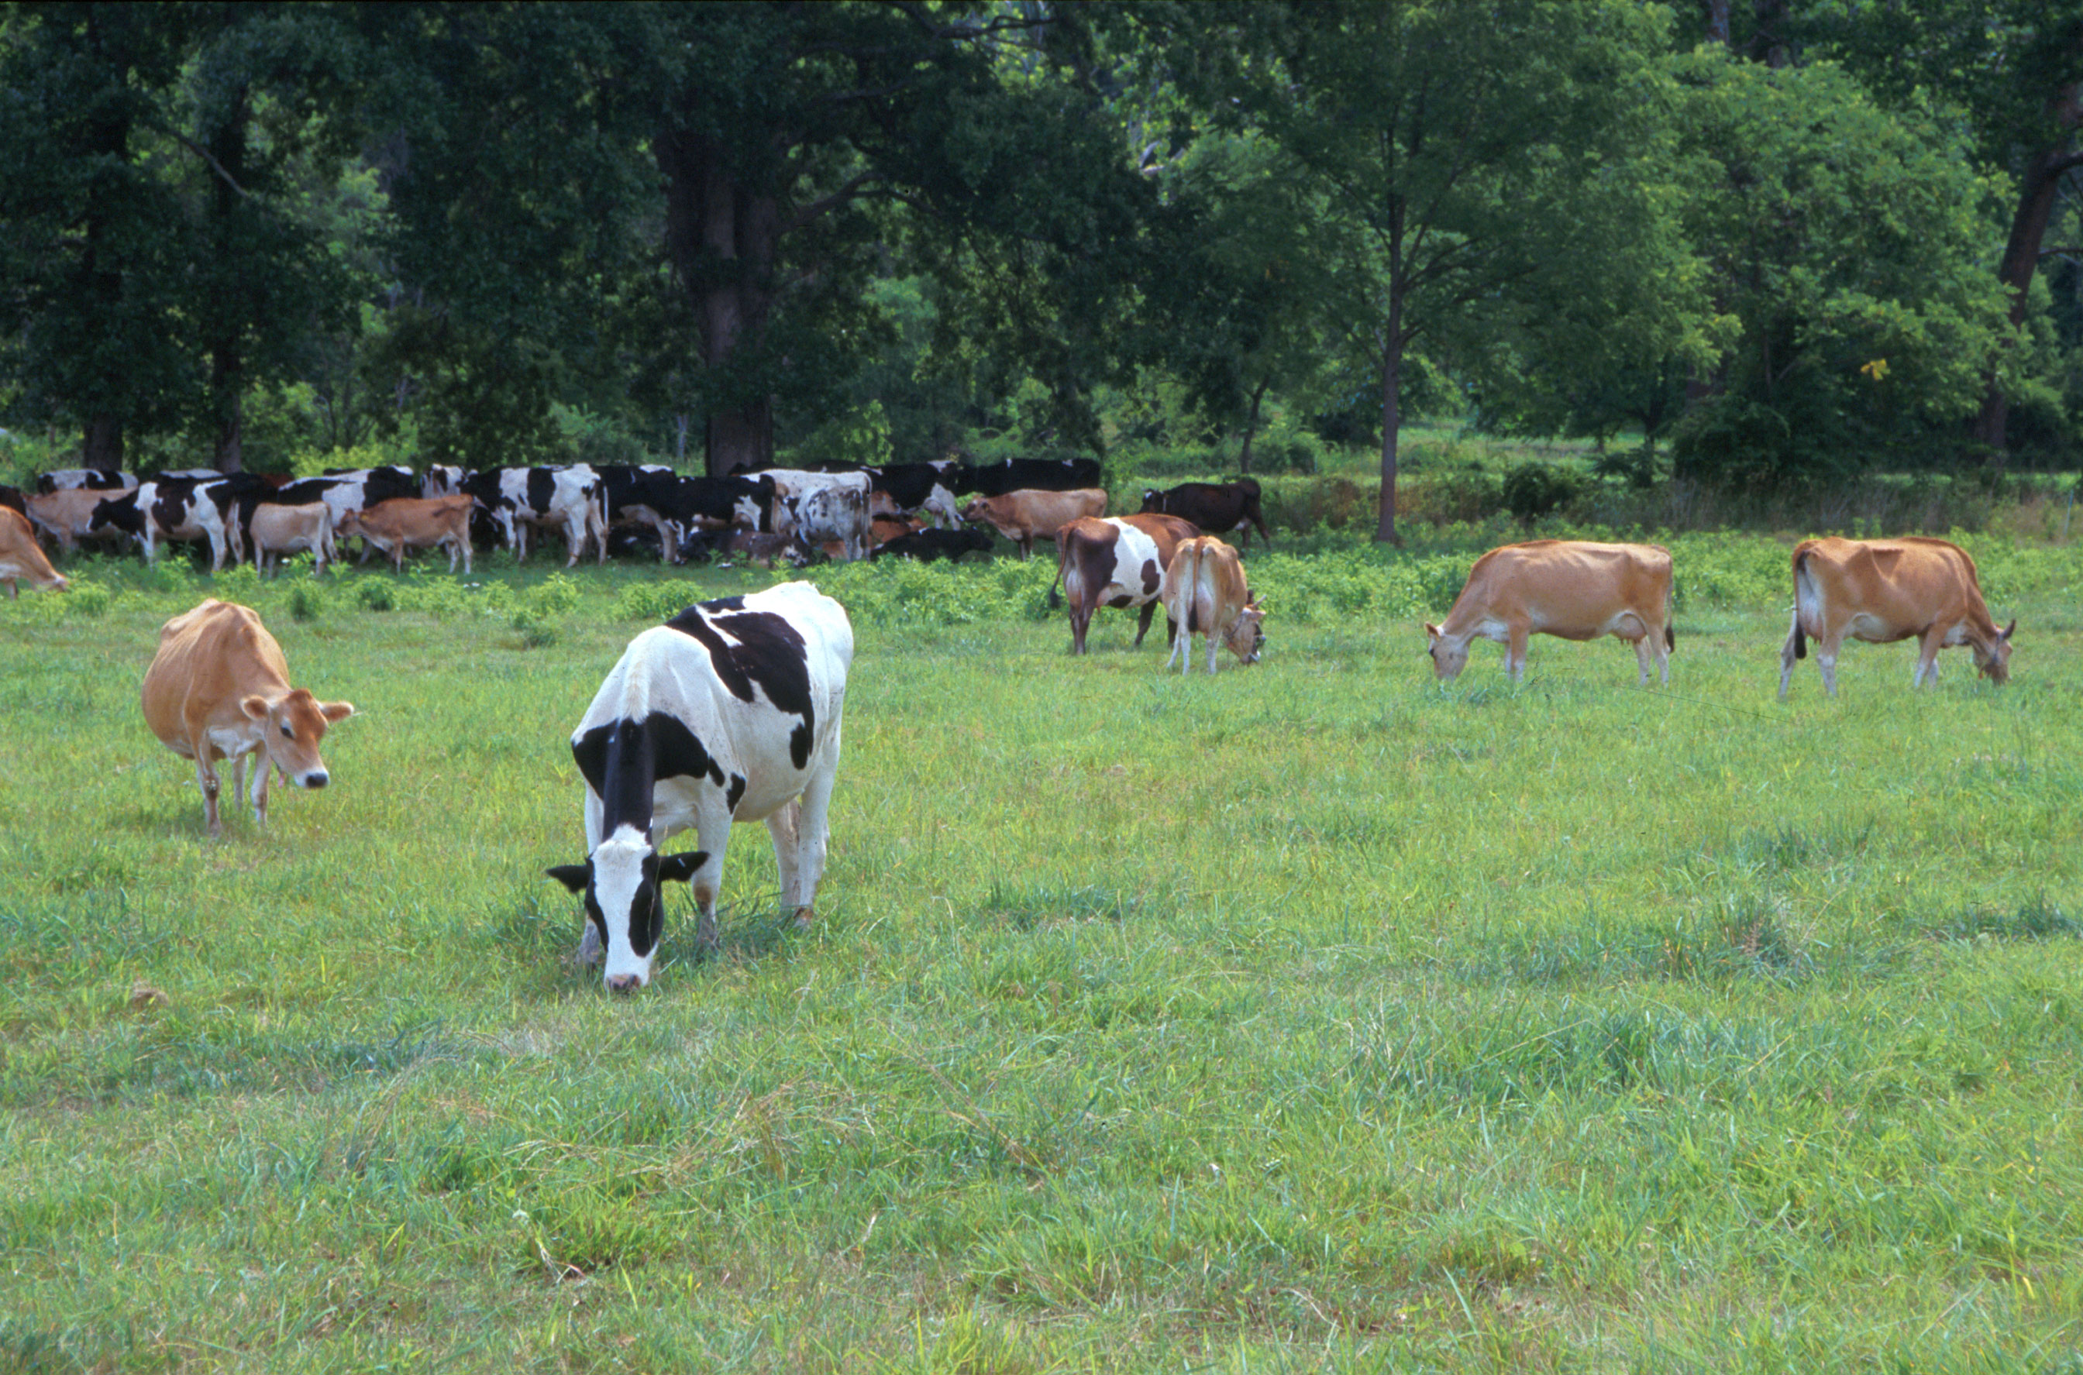
Questions?
AIP web site:
http://aipl.arsusda.gov/
Holsteins, Jerseys, and crossbreds graze on American Farm Land Trust’s
Cove Mountain Farm in south-central Pennsylvania
Source: ARS Image Gallery, image #K8587-14; photo by Bob Nichols

