Slide 1
The Basics of Reference Genomes and Genetic Features

Slide 2
Outline
What is a “reference genome?”
History and examples of reference-building
When is a reference genome useful?

Slide 3
Reference genome assemblies: definition
Database of ordered nucleotides
Ideally Representative

Slide 4
Contents of a successful reference genome
Sequence
Annotation

Slide 5
Why bother making a reference genome?
Identify important features to predict inheritance
Linkage of genes (Gene A and B are on Chromosome 1)
Chromosome counts (Karyotype)
Provide a means of comparing different individuals
Universal nucleotide maps (Gene A is located at X base)
Identify problems quickly (Gene A is missing!)
Speed up many computer algorithms (more in the next lecture)

Slide 6
Genetic and physical maps: our original solution
Genetic maps: trace coinheritance though pedigrees
Markers or phenotypes can be useful here
Often very low resolution of gene/trait placement!
More markers == higher resolution
A
C
B
Genotype 2
A
C
B
Genotype 1
none
ABC
Parent 2
Parent 2

Slide 7
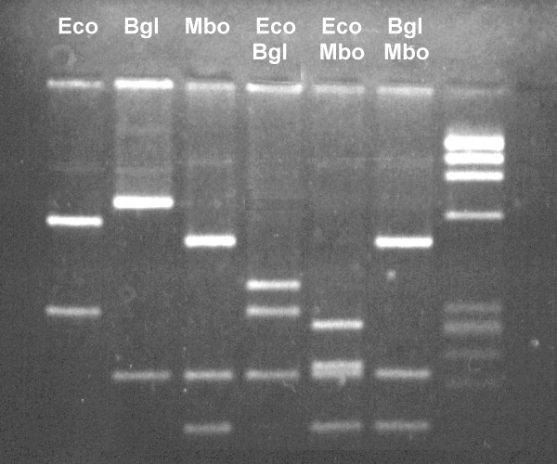
Genetic and physical maps: our original solution
Physical maps use enzymatic (or other) approaches to determine gene order
25 kb
20 kb
17 kb
10 kb
5kb
4kb
3kb
2kb
Bgl
Eco

Slide 8
Which of these approaches…
Requires more data?
Genetic mapping (arguably!)
Requires more lab tech time?
Physical mapping!

Slide 9
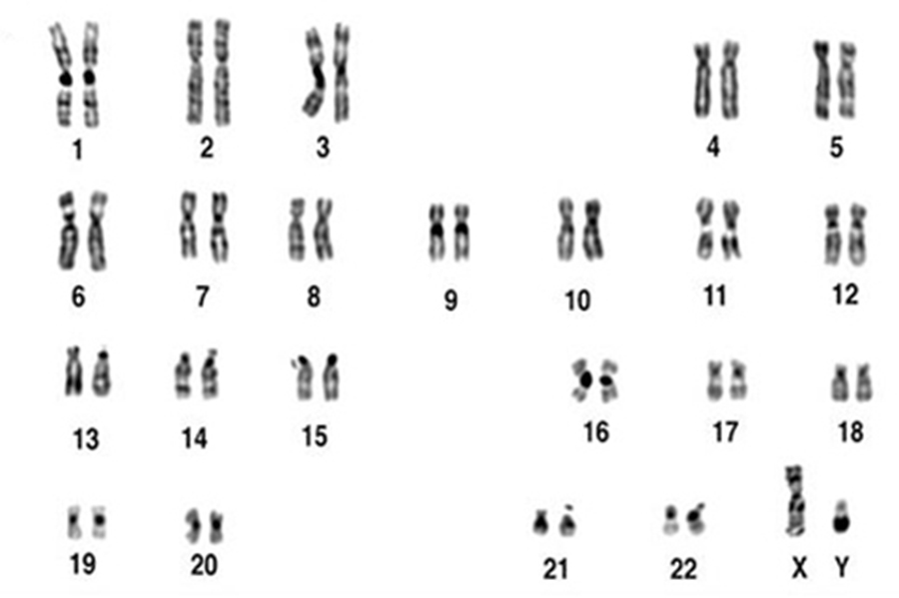
A Case-Study: The Human Reference genome Project
Homo sapiens
3.2 gigabase, haploid genome
24 haploid chromosomes
Gene content
Estimated: >35,000
1.4% of genome is protein coding
Karyotype

Slide 10
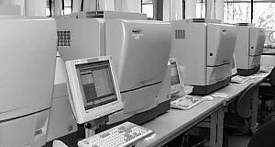
Key pre-HGP scientific advances
Structure of DNA determined (1953)
Watson & Crick
Recombinant DNA created (1972)
P. Berg; Cohen and Boyer
Methods for DNA sequencing developed (1977)
Maxam & Gilbert; F. Sanger
PCR invented (1985)
K. Mullis
Automated DNA sequencer developed (1986)
L. Hood
Slide from University of Colorado Denver lecture: http://www.ucdenver.edu/academics/colleges/medicalschool/departments/biochemistry/GraduatePrograms/genomics/Documents/Human%20Genome%20Lect%20020912abridged.ppt

Slide 11
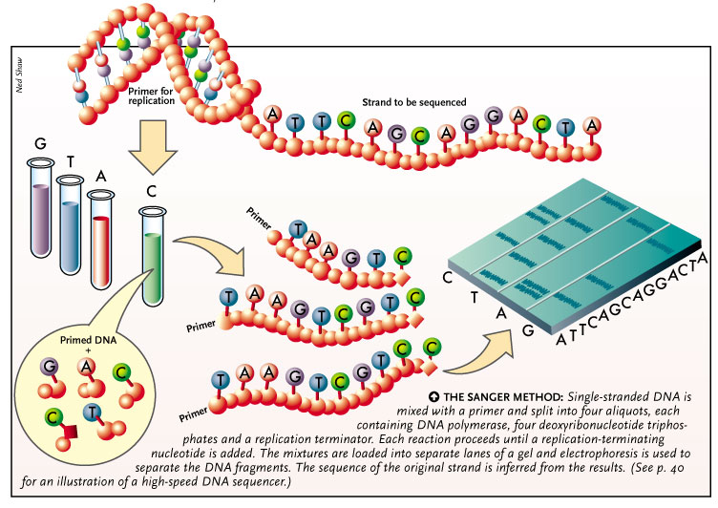
Sanger sequencing

Slide 12
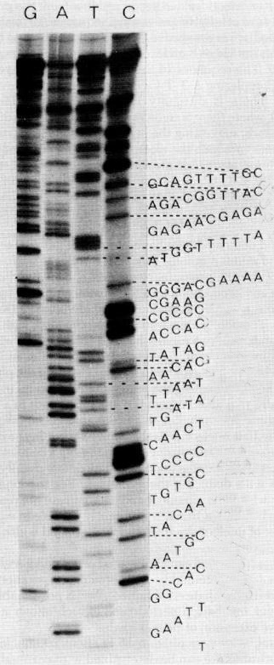
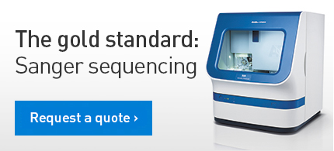
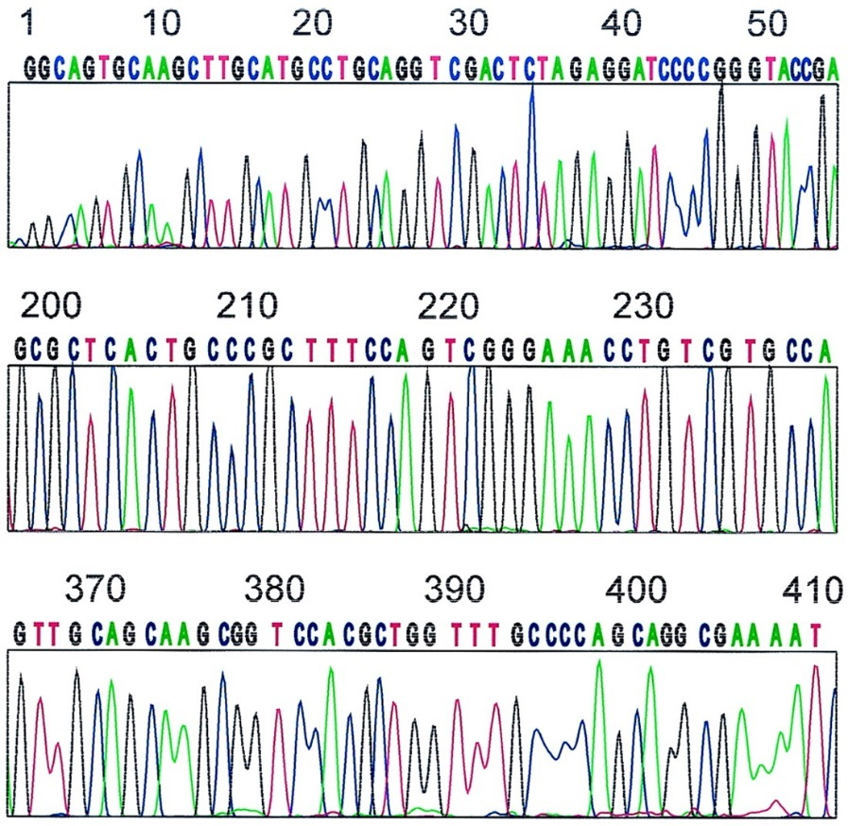
Capillary Sequencing
Leroy Hood
Fluorescently labelled Nucleotides
Could automate the process

Slide 13
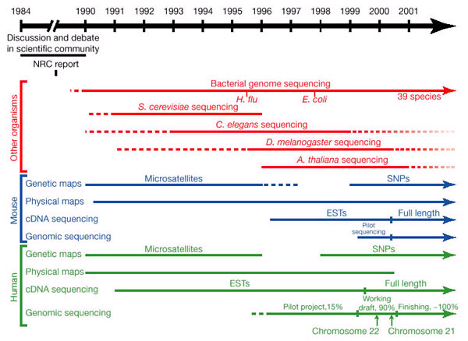
Genomics Timelines
To 2004!
eight years!!
Slide from University of Colorado Denver lecture: http://www.ucdenver.edu/academics/colleges/medicalschool/departments/biochemistry/GraduatePrograms/genomics/Documents/Human%20Genome%20Lect%20020912abridged.ppt

Slide 14
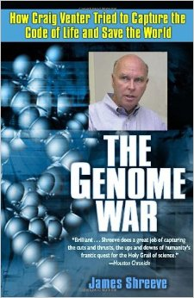
Trouble in paradise: The Genome War
The publically funded Human Genome Project
Francis Collins
Goal: high accurracy
Sought public access
The private industry
Venter – Celera genomics
Goal: faster production
Sought patents and profit
Never really collaborated – only formed a truce

Slide 15
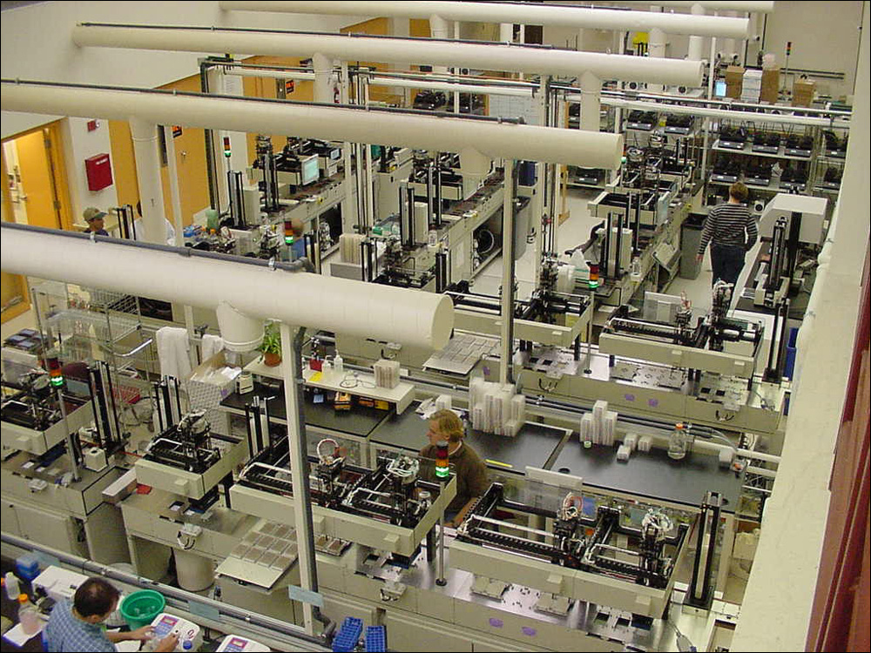
Limits in technology
Huge production scales! 200+ machines
Software not developed to process data

Slide 16
The NCBI approach: Hierarchical shotgun
Genome
BAC = Bacterial
Artificial Chromosome
BAC Library
BAC fragment

Slide 17
The Celera approach: blast it with a shotgun and let someone else pick up the pieces!
Genome
Faster but with disadvantages
No BAC information on fragment origin
Skip lengthy BAC library creation

Slide 18
How long would it take?
If you knew:
The human genome is 3.2 gigabases in size
BAC fragments can be up to 250 kilobases in size
Sanger sequencing could process 500 bases at a time
Whats the minimum Sanger sequencing run count to cover the genome?
6,400,000 minimum, assuming no overlap and perfect conditions
How many years would it take one person if each Sanger run took one day?
~17,534 years, bare minimum

Slide 19
Software hadn’t been developed!
How do you assemble this data?
Celera and UCSC came up with solutions
Celera assembler
GigAssembler

Slide 20
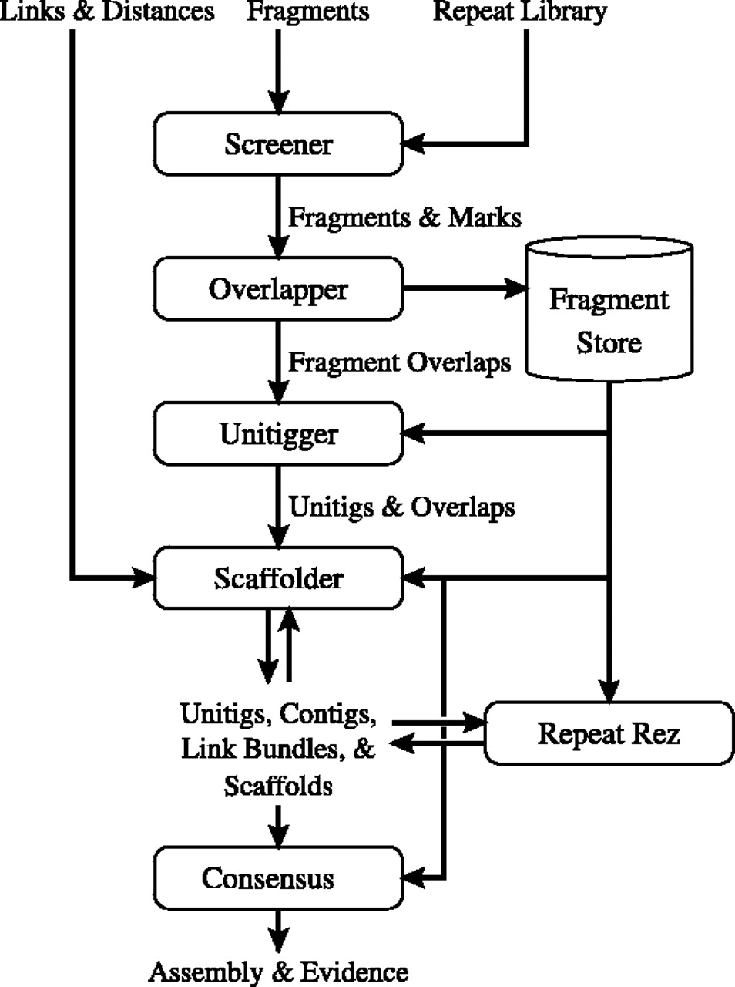
Myers et al. 2000. Drosophila genome
First demonstration of the Celera assembler
Actively removed matches with repetitive elements
Utilized seed-extend algorithms to screen data and create unitigs

Slide 21
Seed-extend: reduce computational complexity
Reduce reads into overlapping “K”mers
Hash the kmers for rapid retrieval
Select identical hash hits, and extend read to find best match
ACGTACGTAGAGGGATAAGATAGAGAGAG
ACGTACGTA
AGGGATAAG
CGTACGTAG
GGGATAAGA
GTACGTAGA
GGATAAGAT
TACGTAGAG
GATAAGATA
for i in kmer_string:
Hash long = (long << 5) + hash + int_value(i)
Read 1
CTACTA
TACGTAGAG
Read 3
GGATAAG
Read 2
TTTAT

Slide 22
Unitig definition
Is a type of “Contig”
Contig = “contiguous sequence” or mapping of sequential DNA bases without interruption
Unitig: Maximal interval sub-graph of the graph of all fragment overlaps with no conflicting overlaps to an interior vertex

Slide 23
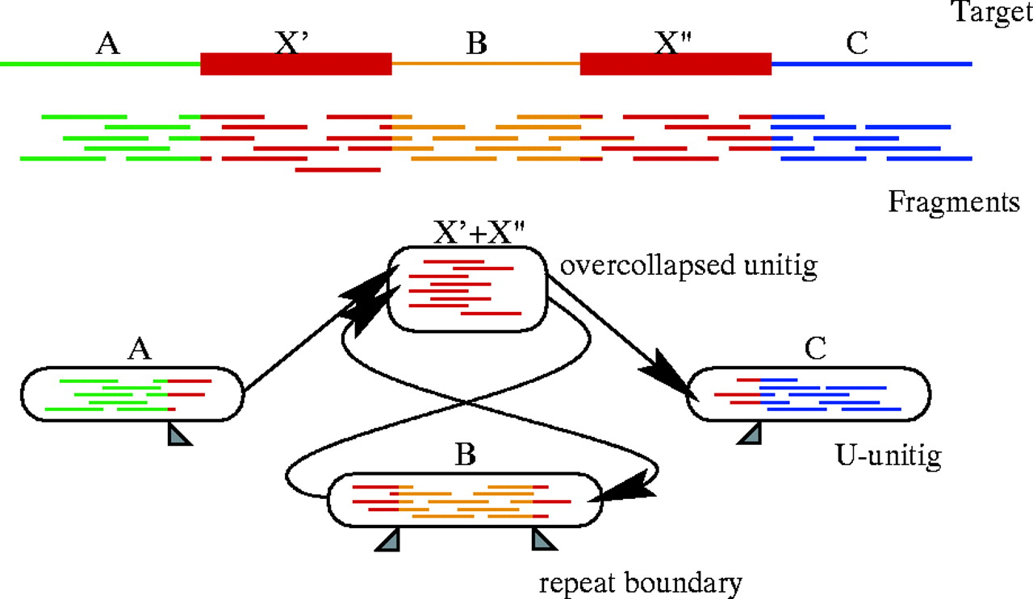
Unitigs do not attempt to resolve repeats

Slide 24
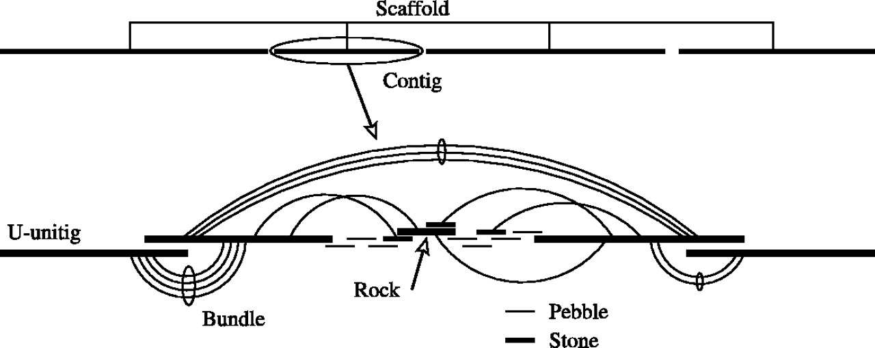
Scaffolding: tying Contigs together
A Scaffold is an ordered arrangement of contigs that does not have direct, confident continuation of nucleotide sequence

Slide 25
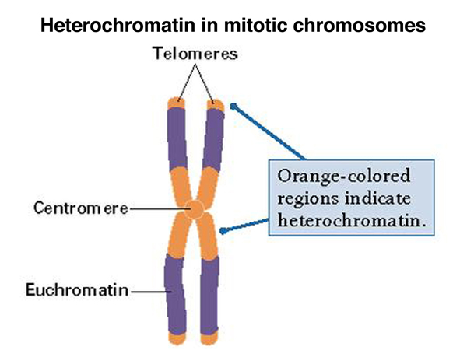
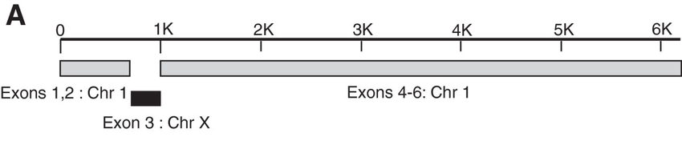
More problems arose!!!
“Dark Matter” of the genome
Long repeats
Heterochromatin
Misassemblies!
Incorrect nucleotide order
3.3 every Megabase

Slide 26
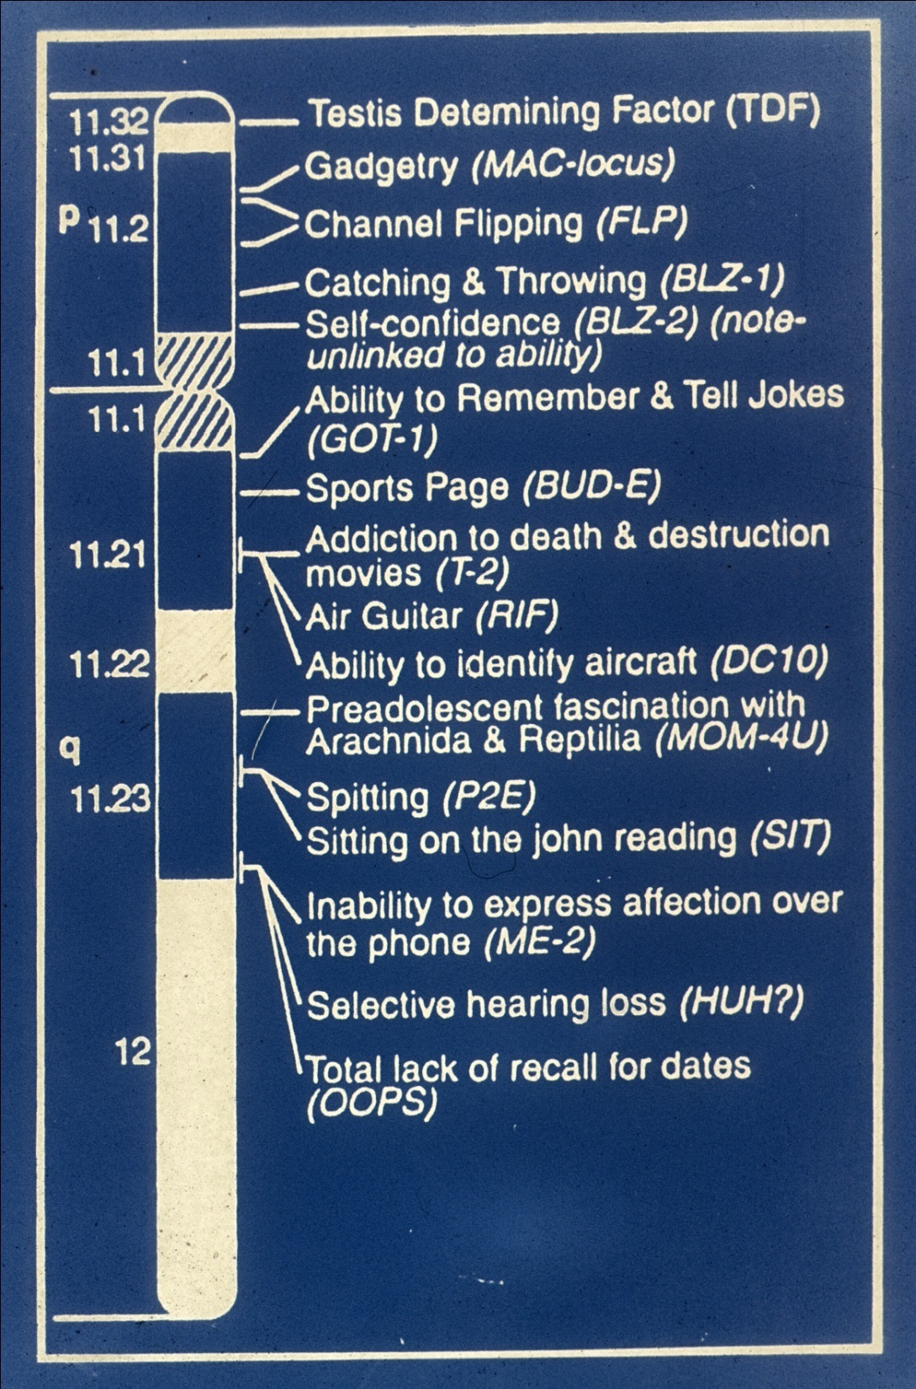
The Y chromosome took quite a while to complete!
Slide from University of Colorado Denver lecture: http://www.ucdenver.edu/academics/colleges/medicalschool/departments/biochemistry/GraduatePrograms/genomics/Documents/Human%20Genome%20Lect%20020912abridged.ppt

Slide 27
What we got out of genome assembly
Dispelling misconceptions about genes
Accurate, high resolution physical map distances of genes
A tool for further genetic analysis

Slide 28
Gene content
Human genome has ~20,000 protein coding genes
Expected > 35,000 genes
Cattle has ~20,000 protein coding genes
Chicken has ~15,000 protein coding genes
Pseudogene content
A gene that has been mutated beyond discernable function
Human: 14,453
Cattle: 797
Chicken: 42

Slide 29
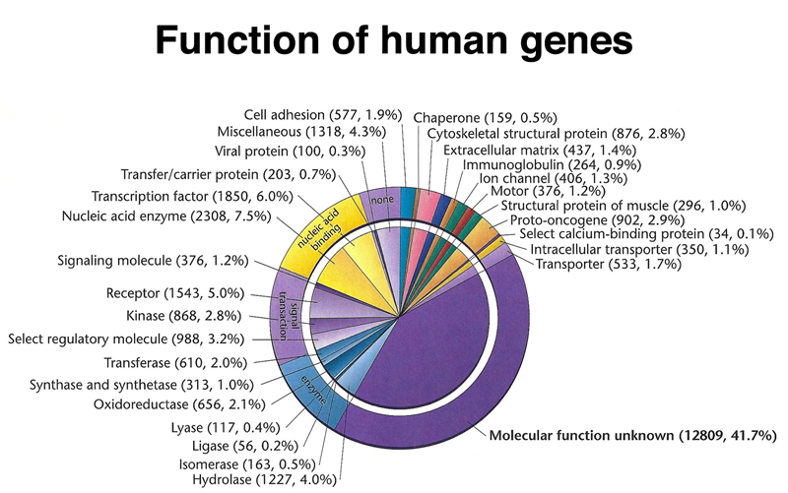
A large proportion of genes have uknown function
Image accessed from: http://www.discoveryandinnovation.com/BIOL202/notes/lecture24.html

Slide 30
Other genetic features: structure and function
Three major classes
Repetitive elements
Segmental duplications
Non-coding, transcribed regions
… and more! (some we haven’t discovered yet)

Slide 31
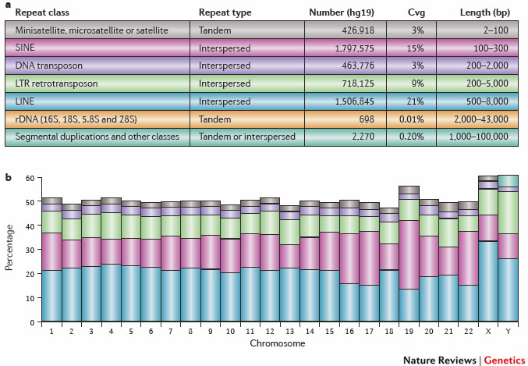
Equates to 51% of the genome!
From Treangen and Salzberg. 2012. Nature Reviews Genetics

Slide 32
Segmental duplications are large, “low copy repeats”
ChrA
Comprise ~5% of the human genome
Encompass 36.8% of pseudogenes
Larger than 1 kb in size
Can cause Non-Allelic Homologous Recombination (NAHR)
A
ChrB
A
B
B
ChrA
A
A

Slide 33
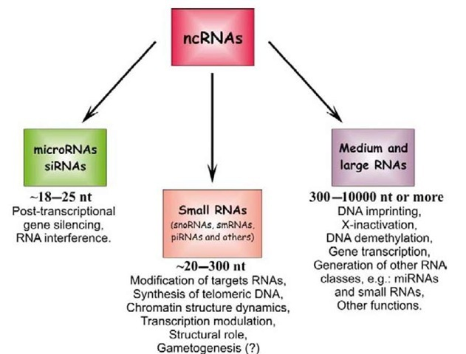
Non-coding RNAs add even more complexity to expression
Numerous classes with different functions
Are not translated to protein
Micro RNAs (miRNA) regulate ~30% of mammalian genes

Slide 34
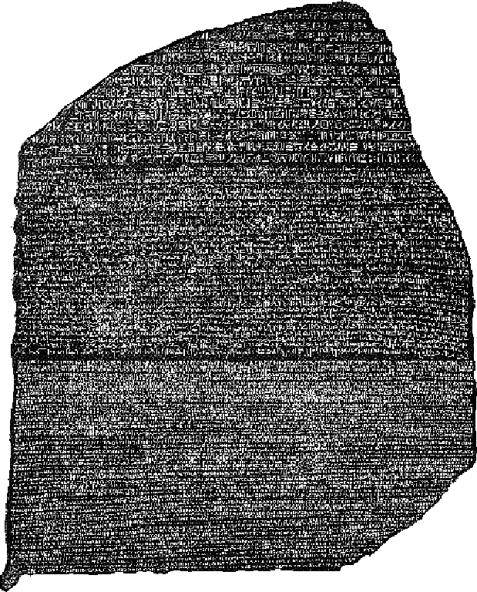
How can we use a reference genome to our advantage?
Useful in analyses that require a common set of coordinates
Quantitative trait loci (QTL) discovery
Comparative genomics

Slide 35
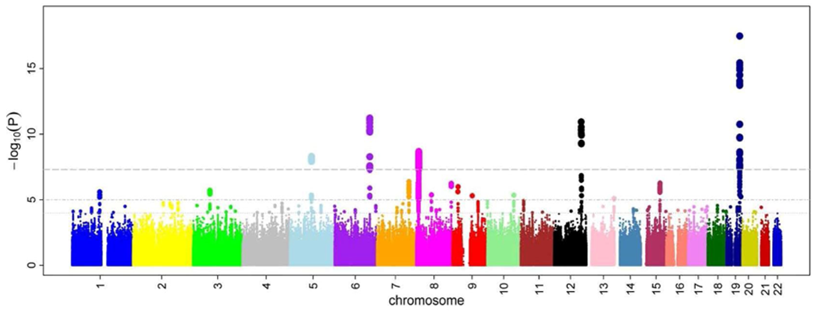
Genome wide association studies
Main benefit: allows ordering of marker alleles
Can assist with imputation from sequencing data

Slide 36
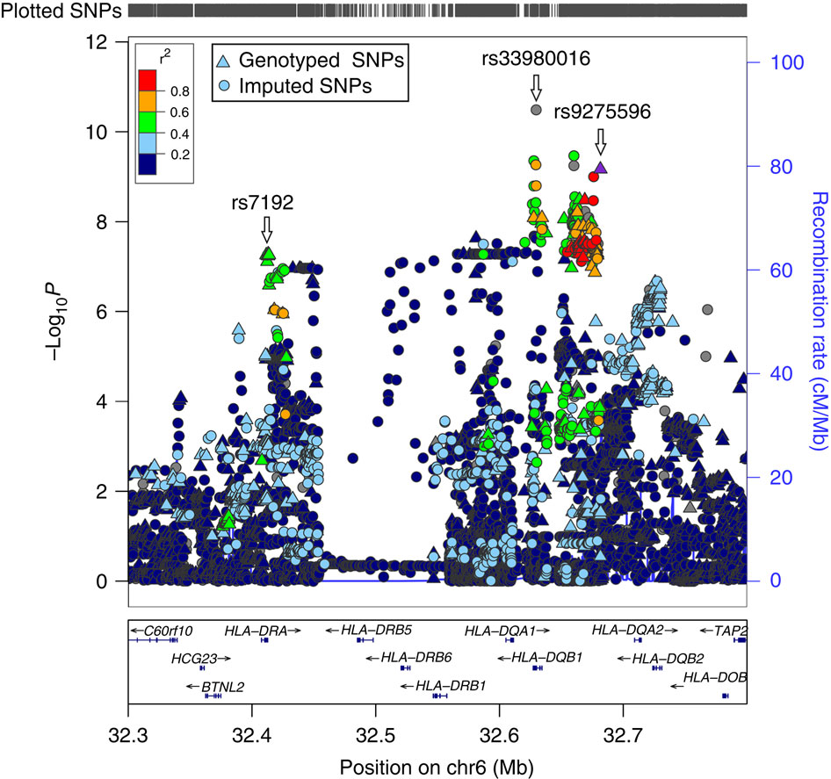
Caution when interpreting results!
Regions of bad SNP coverage
Misassembled regions
Multi-allelic regions!

Slide 37
QTL mapping strategies
Attempt to associate phenotype with genotype
A mixture of heuristics and statistics
Statistics involve pedigree information in order to determine inheritance
Heuristics involve isolating target regions to find variants that may cause the phenotype
Prone to bias!
Confirmation bias (“it has to be my favorite gene!”)
Ascertainment bias (“the reference genome was wrong!”)

Slide 39
Comparative Genomics
Find gene function in related organisms
Find functional sites based on conservation

Slide 40
Take-away points
Reference genomes
Ordered nucleotides
Annotations (genes, features, etc)
History of reference genomes
Originally genetic/physical maps
Human genome was best, first, vertebrate, mammalian genome
Required significant effort (8 years!)

Slide 41
Take-away points
Genetic features
Not just genes! Also non-coding regions
Numerous classes all of which can be identified in the reference
Utility
Provides order and context to association studies
Allows data comparisons

Slide 42
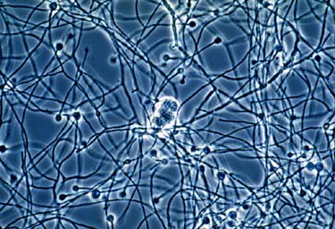
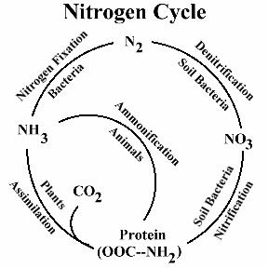
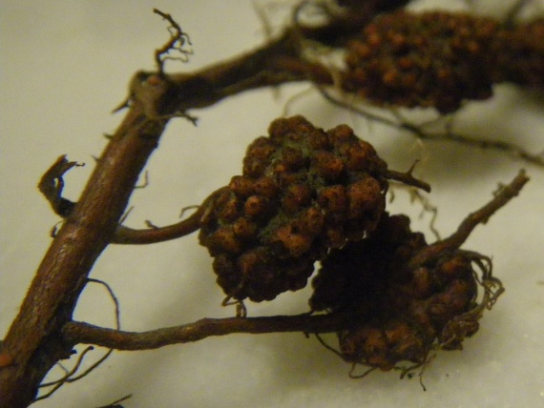
Microbial Genomics in Frankia
N₂ fixing
Enables pioneer plants
Genome
Transcriptome
David R. Benson’s lab
Normand et al. 2007. Genome Res. 17:7-15
Bickhart et al. 2011. BMC Micro. 11:192

Slide 43
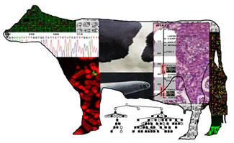
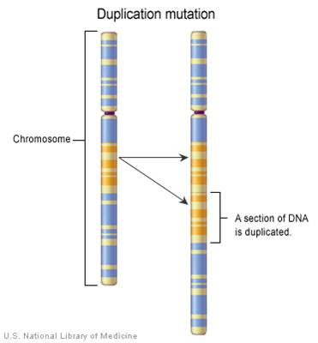
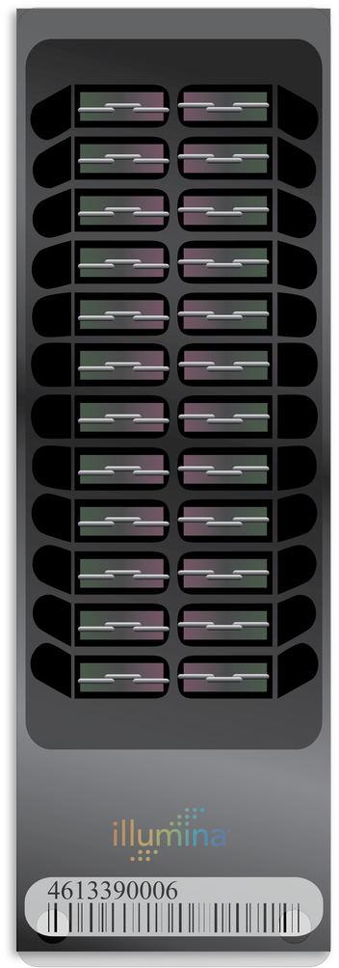
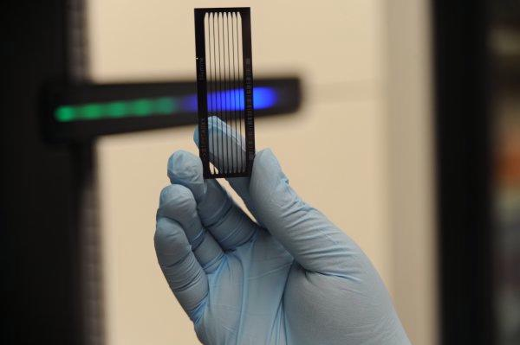
Functional Genomics in Cattle
SNP chips
Sequence data
Transcription Factor Binding sites
Hou, et al. 2011. BMC Genomics. 12:127
Hou, et al. 2012. BMC Genomics. 13:376
George E. Liu’s lab
Bickhart, et al. 2012. Genome Res. 22: 778-790
Liu and Bickhart. 2012. Funct. & Int. Genomics. accepted
Bickhart, et al. 2012. Genomics, Proteomics and Bioinformatics. accepted

Slide 44
Creating Genomics Resources for Agriculture
Genetic Variant detection
Reference genome assembly and annotation
My lab

Slide 45
If you printed the Human reference genome…
… you’d murder quite allot of trees!
Notes:
From the Wellcome collection of the Wellcome trust

Slide 46
What is the easiest way to identify gene function from freshly annotated genes?
Compare the gene and protein sequence to other species’ genes
Use the protein sequence of the gene to identify its function
Look at other genes in the relative vicinity – they usually have similar function

Slide 47
Why were our predictions on gene count so far off?
We overestimated the number of human phenotypes that needed genes
We overestimated our complexity compared to other multicellular organisms
We didn’t account for versatility in expression and protein function

