Slide 1
Reference genome assemblies and the technology behind them
Derek M Bickhart
Animal Genomics and Improvement Laboratory
Research Geneticist (Animal)
derek.bickhart@ars.usda.gov
Phone: (301) 504-8679 Fax: (301) 504-8092

Slide 2
USDA disclaimer
Disclaimers: Mention of trade names, commercial products, or companies in this publication is solely for the purpose of providing specific information and does not imply recommendation or endorsement by the US Department of Agriculture over others not mentioned.
The US Department of Agriculture (USDA) prohibits discrimination in all its programs and activities on the basis of race, color, national origin, age, disability, and where applicable, sex, marital status, familial status, parental status, religion, sexual orientation, genetic information, political beliefs, reprisal, or because all or part of an individual's income is derived from any public assistance program. (Not all prohibited bases apply to all programs.) Persons with disabilities who require alternative means for communication of program information (Braille, large print, audiotape, etc.) should contact USDA's TARGET Center at (202) 720-2600 (voice and TDD). To file a complaint of discrimination, write to USDA, Director, Office of Civil Rights, 1400 Independence Avenue, S.W., Washington, D.C. 20250-9410, or call (800) 795-3272 (voice) or (202) 720-6382 (TDD). USDA is an equal opportunity provider and employer.

Slide 3
Outline
Alignment vs Assembly
Sequencing technologies that contribute to reference genomes
Scaffolding contigs into reference genomes

Slide 4
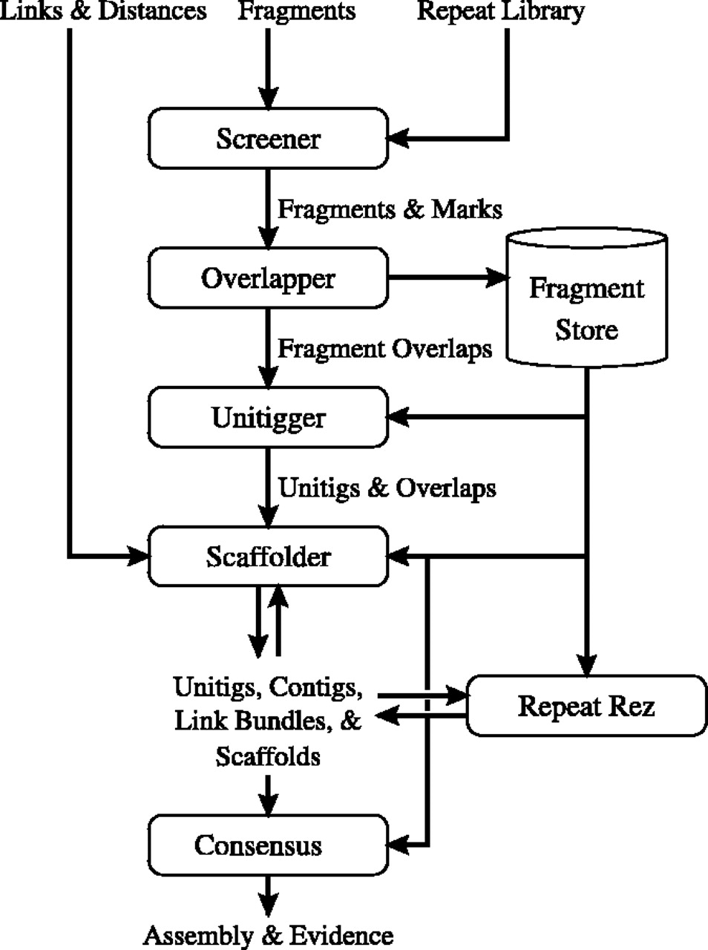
Myers et al. 2000. Drosophila genome
First demonstration of the Celera assembler
Actively removed matches with repetitive elements
Utilized seed-extend algorithms to screen data and create unitigs

Slide 5
Seed-extend: reduce computational complexity
Reduce reads into overlapping “K”mers
Hash the kmers for rapid retrieval
Select identical hash hits, and extend read to find best match
ACGTACGTAGAGGGATAAGATAGAGAGAG
ACGTACGTA
AGGGATAAG
CGTACGTAG
GGGATAAGA
GTACGTAGA
GGATAAGAT
TACGTAGAG
GATAAGATA
for i in kmer_string:
Hash long = (long << 5) + hash + int_value(i)
Read 1
CTACTA
TACGTAGAG
Read 3
GGATAAG
Read 2
TTTAT

Slide 6
The definition of alignment and its benefits
Alignment is a type of algorithm that returns the (probable) position of reads on a reference genome.
Benefits
  Faster than de-novo assembly
  Easy to reference between samples
Disadvantages
  Does not easily give information on Insertions
  Relies heavily on the reference assembly quality

Slide 7
Alignment is NOT Assembly!!!
Alignment | Assembly
Requires Reference Genome | May not need a reference assembly (“de novo”) or may be able to use one (“guided”)
Returns base pair positions of sequence fragments | Returns large stretches of sequence (contigs) from smaller reads
Compression allows for smaller memory overhead | Requires LOTS of memory for hash tables
Certain programs can align quickly with great accurracy | Requires user input to get good results; takes a long time.

Slide 8
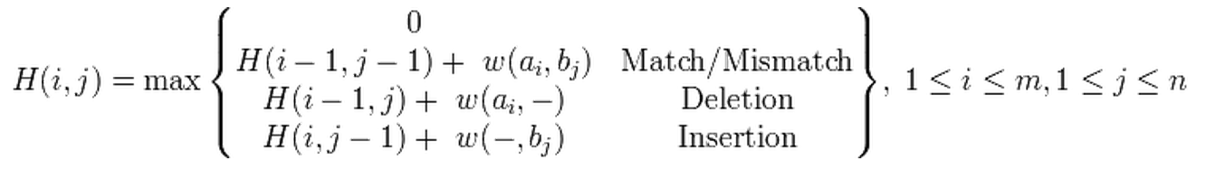
The algorithm behind Smith-Waterman-Gotoh alignment
Matrix H
a = base from sequence 1
b = base from sequence 2
m = length(a)
n = length(b)
H(i,j) = Max similarity score of suffix of a[1..i] and b[1..j]
w(c, d) = penalty from the gap scoring scheme

Slide 9
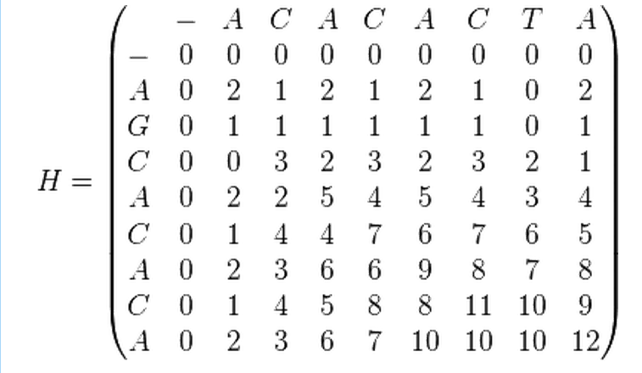
The Alignment Matrix
Legend
or
= Gap
= Match
Sequence A:
A
--
C
A
C
A
C
T
A
Sequence B:
A
G
C
A
C
A
C
--
A

Slide 10
Smith-Waterman-Gotoh is incredibly expensive to calculate!
Needs calculation of an X by Y matrix for query sequence of length X and target sequence of length Y.
Impossibly complex for use with excessively large target sequences (ie. A whole genome!). Hence it is called “local” alignment
We need strategies for finding suitable target sites

Slide 11
Seed-extend is the solution here
Reduce REFERENCE GENOME into overlapping “K”mers
Hash the REFERENCE kmers for rapid retrieval
Compare READ hash to REFERENCE hash, and extend read to find best match
ACGTACGTAGAGGGATAAGATAGAGAGAG
ACGTACGTA
AGGGATAAG
CGTACGTAG
GGGATAAGA
GTACGTAGA
GGATAAGAT
TACGTAGAG
GATAAGATA
for i in kmer_string:
Hash long = (long << 5) + hash + int_value(i)
Reference location 1
CTACTA
TACGTAGAG
Reference 3
GGATAAG
Reference location 2
TTTAT

Slide 12
Alignment requirements vs Assembly requirements for seed-extend
Alignment
  Needs 3.2 billion bases hashed into kmers for subsequent access
  Completely ignores novel information that is not part of the reference
Assembly
  Needs every single read (256+ billion bases) hashed into kmers for subsequent access
  Can account for novel information

Slide 13
Improving de novo assembly: not the algorithm – the chemistry!
Major stumbling blocks for seed-extend:
  Repeats
  Heterochromatin
What is the best way to overcome repetitive DNA?
  High fidelity sequencing – very accurate base calls
  Longer reads – span repetitive elements with single reads

Slide 14
Who do we sequence???
If you had to make a new reference assembly, how would you do it?
  A. Use a panel of individuals to maximize variants represented?
  B. Use a single individual that has lots of heterozygosity?
  C. Use a single individual that has very little heterozygosity?
  D. Make a new reference assembly from each sample?
  E. Use an individual with congenital diseases to get unique regions in the reference?
70% of the draft HGP came from one anonymous donor

Slide 15
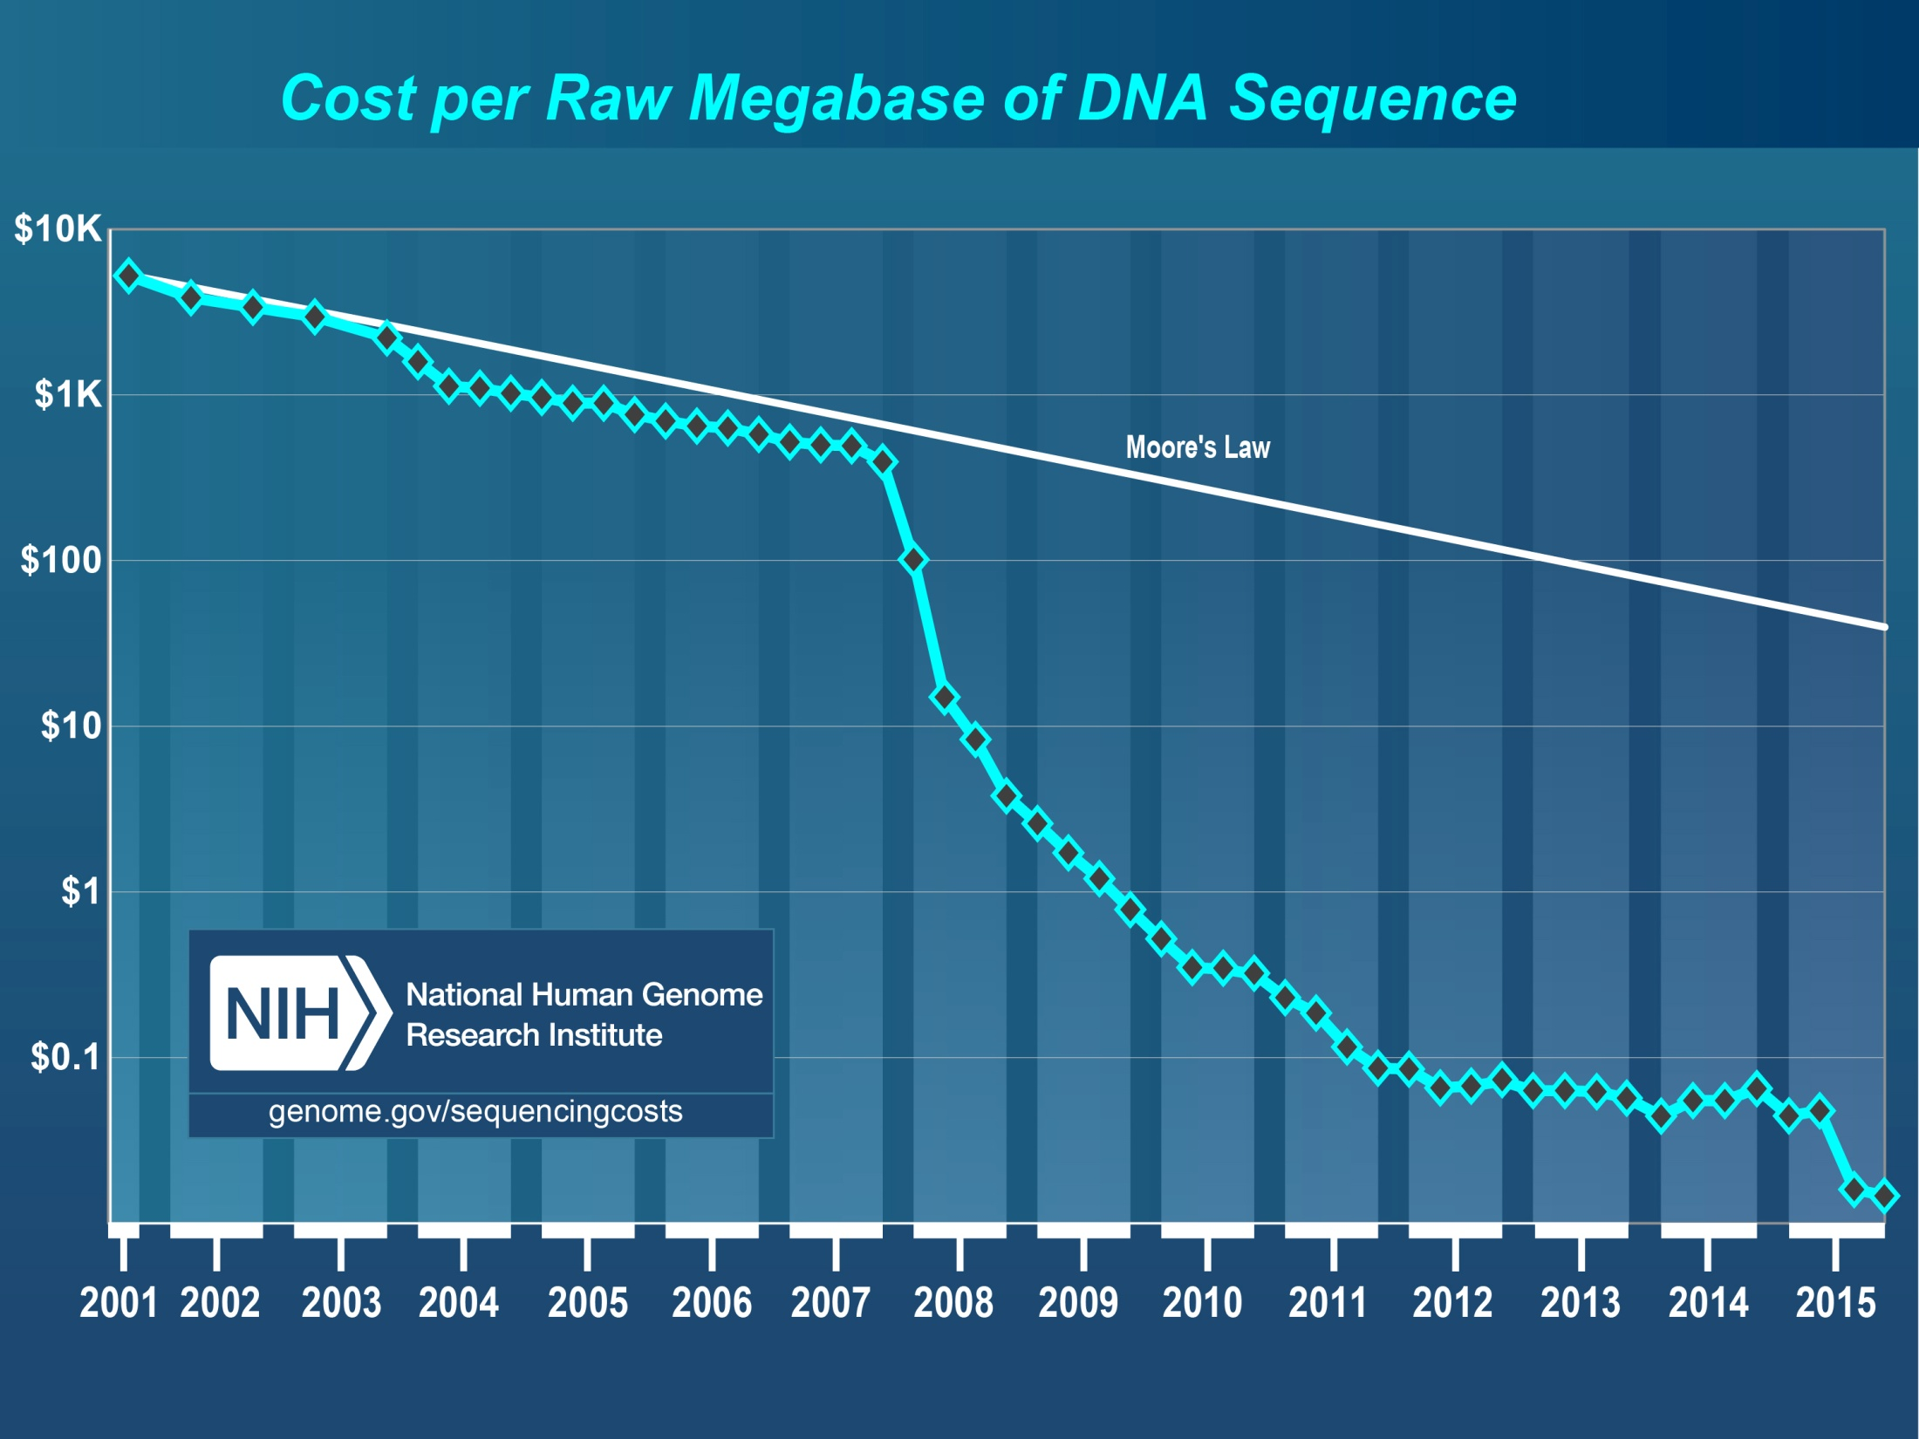
Sequencing read data sources
Human Genome Project Draft
454 sequencing
Illumina Genome Analyzer
Illumina HiSeq X
Illumina
HiSeq

Slide 16
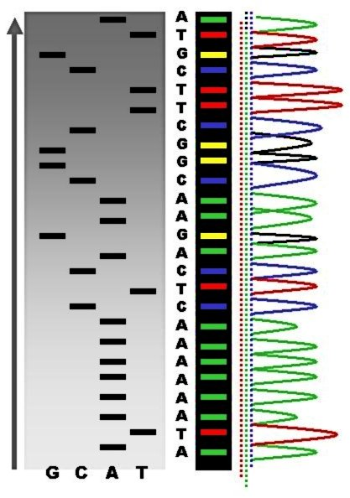
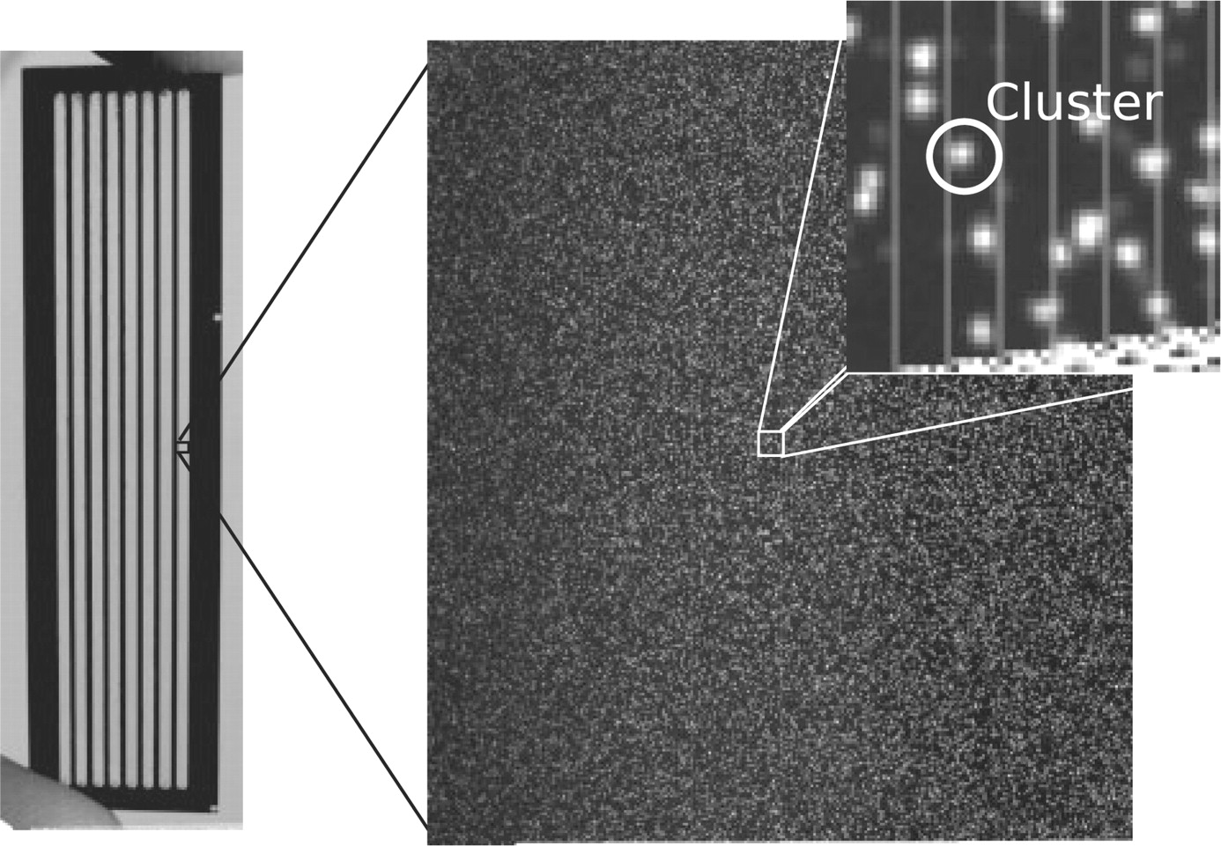
The Biological Big Data Revolution
The scale of sequencing has increased dramatically
1977 - 2004
2008 - Present

Slide 17
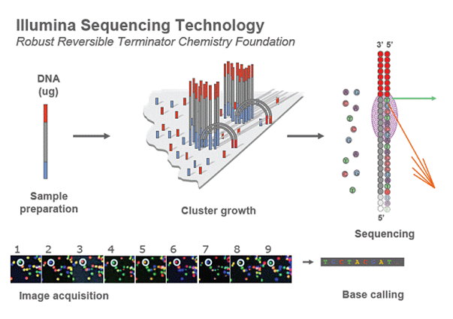

Slide 18
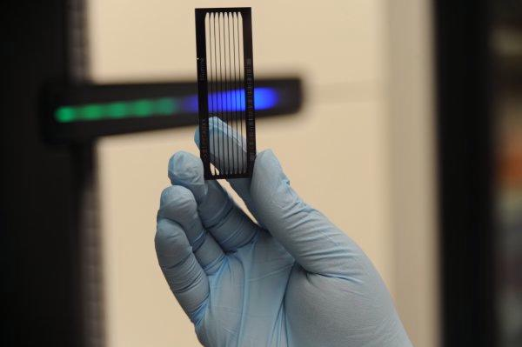

Storage
One run of the NextSeq500
  120 billion DNA bases/letters
  447 times the size of the Encyclopedia Britannica
  … every 29 hours!
Hard drive storage space
  100 gigabytes, compressed
  400 gigabytes as text

Slide 19
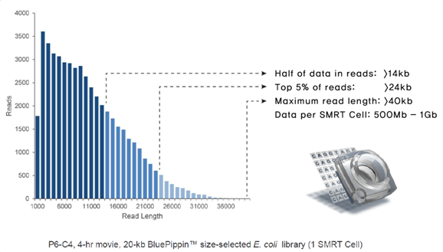
A new paradigm: longer reads
Technology | Read Length
Sanger reads | ~700 bp
Illumina MiSeq | 250 bp
Image from DNA Link website

Slide 20
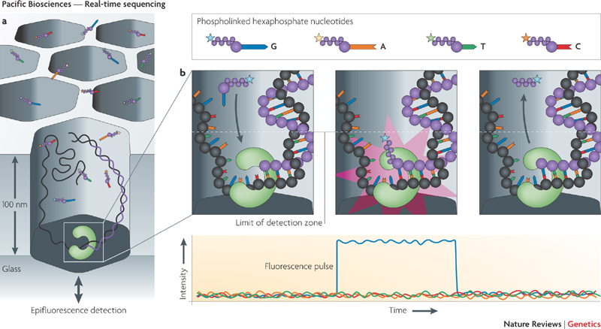
Using physics to sequence DNA

Slide 21
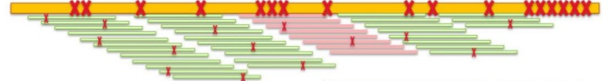
PacBio has a huge problem: errors
High error rates
  Mostly indels
  Randomly distributed
  17%!!! Error incorporation

Slide 22
Contig definition
Contig: “Contiguous sequence.” A single stretch of DNA sequence that is unbroken and represents one haplotype of the reference individual
  A unitig is a type of contig that has no internal kmer references
How do we get around the incredibly high error rate?

Slide 23
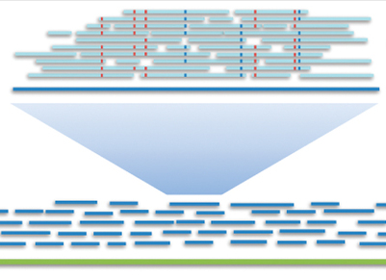
Pacbio error profile and strategies
Use high coverage, higher fidelity reads to correct errors
  Needs fewer pacbio reads, but you need illumina reads to error correct
High coverage and consensus for de novo assembly
  Needs more pacbio reads – is more expensive
From the PacBio blog

Slide 24
Can you get the whole genome into one Contig?
Bacterial genomes?
Vertebrate genomes?

Slide 25
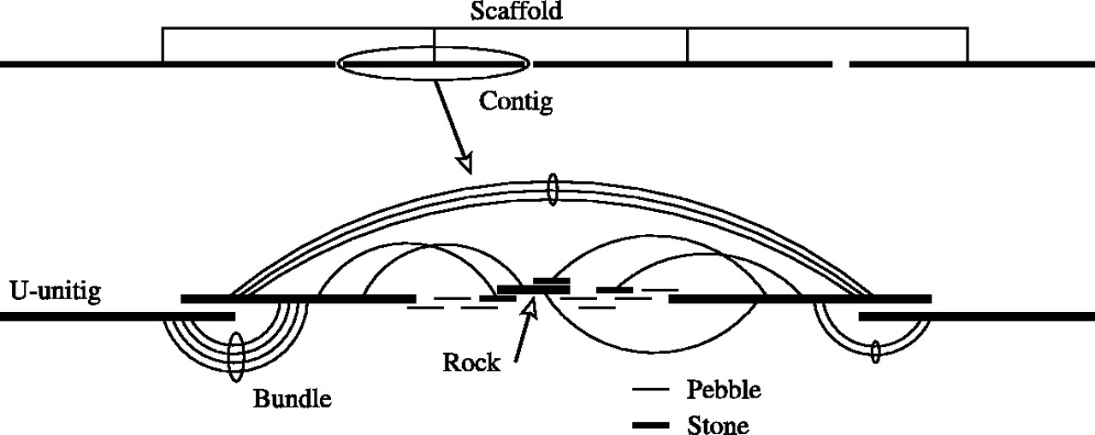
Scaffolding: tying Contigs together
Long distance contig interactions require long-distance data!

Slide 26
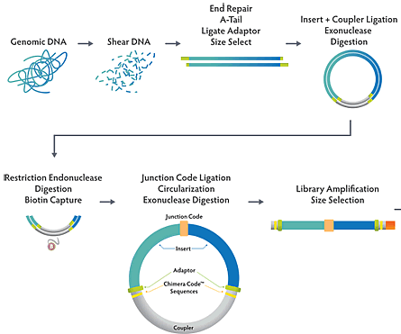
Long range interaction data: mate-pair libraries
Big chunks:
> 2kb in size

Slide 27
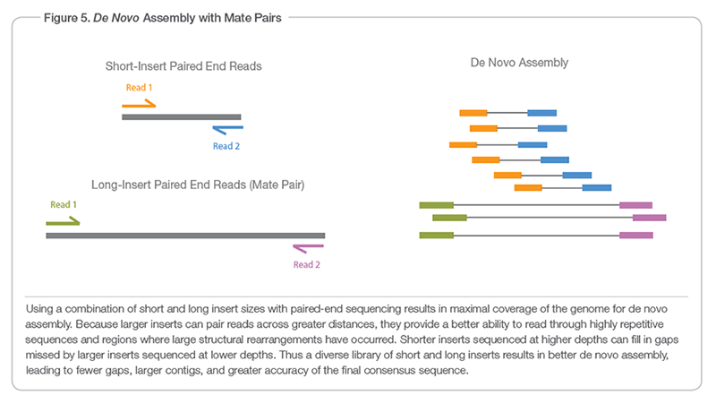
Long range interaction data: mate-pair libraries

Slide 28
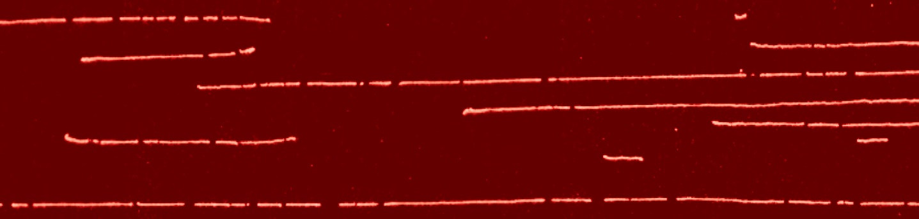
Optical Mapping technologies
Use cameras to image DNA
Identify distance of nuclease sites
Two different types
  Restriction enzyme
  Nickase-labelling

Slide 29
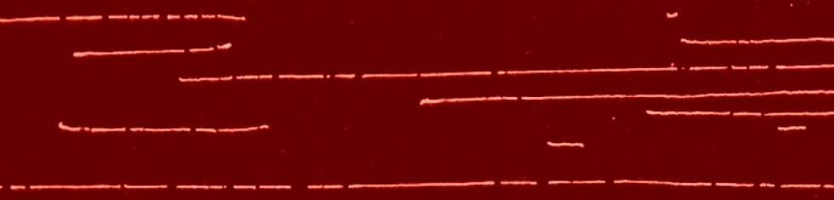
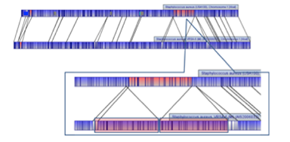
Restriction-based mapping
OpGen
  Anneal DNA to slide
  Digest with Restriction enzyme
  Estimate DNA fragment sizes
  Calculate where restriction sites should be on your genome, and then match them up like a puzzle

Slide 30
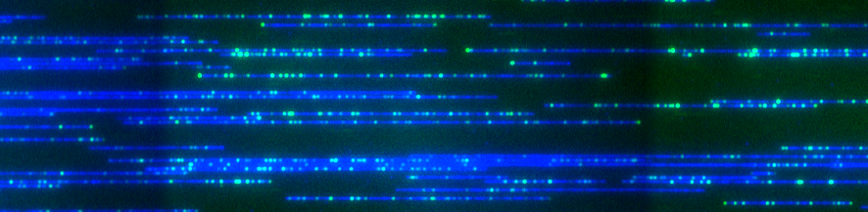
Nickase-labelling (“barcoding”)
David Schwartz + BioNano Genomics
  Strand-specific cutters
  Nicked strand labeled
  Labelled DNA run through nano-channels

Slide 31
Both have problems
Restriction-based methods
  Annealed fragments must fit size range
  Smaller fragments won’t anneal
Barcoding + microfluidics
  Channels clog
  Double-nickase sites are lost
GCTCTTC
GAAGAGC
CGAGAAG
CTTCTCG

Slide 32
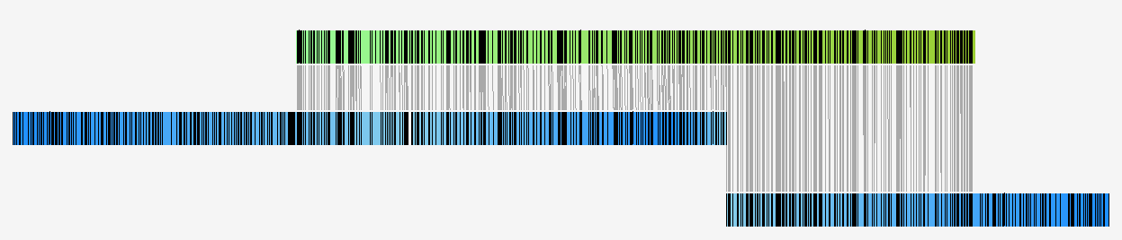
Alignment of Genome Maps to Sequence Contigs
In silico predicted nickase sites
PacBio contig
Genome maps
Barcoded nickase sites

Slide 33
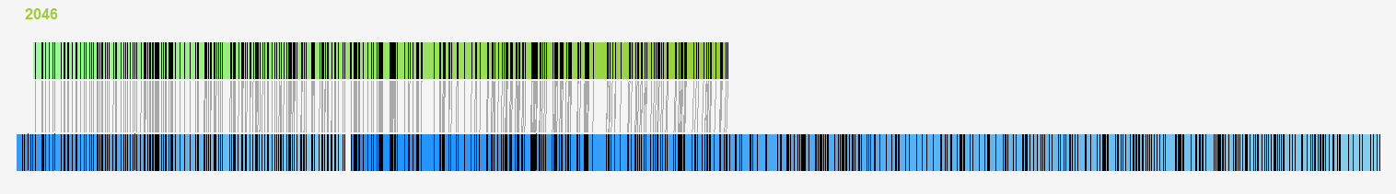
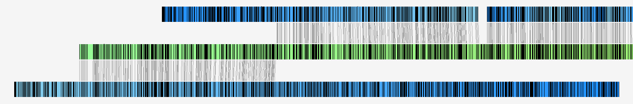


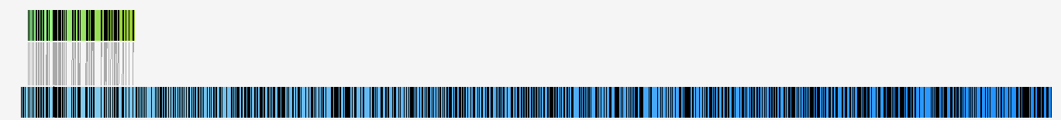
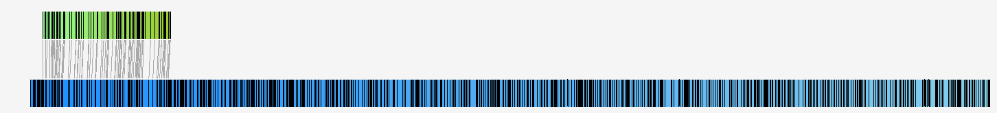
Conflicts Between Genome Map and PB Contigs
102 conflicts flagged
Example, 17.185 Mb PB contig:
BNG108
PBctg 3
BNG1425

Slide 34
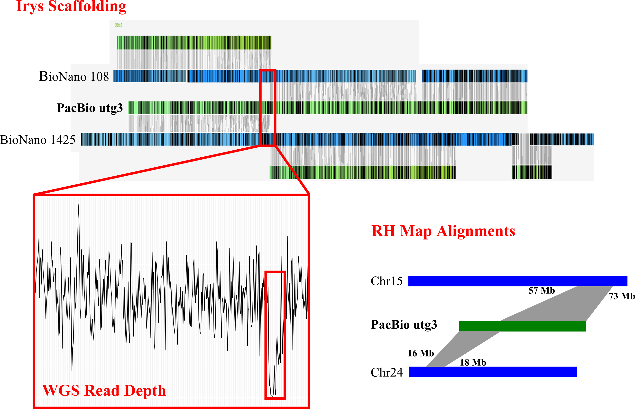
Conflict Resolution

Slide 35
Take-away points
Assembly vs Alignment
  Alignment is NOT assembly, but they can share similar components!
  Alignment is far faster because it takes advantage of the reference genome
Sequencing technologies
  Trend is towards cheaper and longer read technologies!
  Illumina makes the cheapest sequencing
  PacBio (currently) makes the longest reads

Slide 36
Take-away points
Scaffolding ties together contigs
  Relies on long-distance associations of contigs to order them into a map
  Different types of technologies are suitable here
  Optical maps use visual DNA cues to tie together the contigs

Slide 37
Testing retention of knowledge
Describe how you would identify common repetitive elements from the data used in a seed-extend alignment algorithm. Would you accomplish this differently if you were using a seed-extend assembly algorithm?
Reference genomes are extremely useful, but the data must be representative of the population. Can you ever truly finish a reference genome and make it perfectly representative? Why or how?

