Slide 1
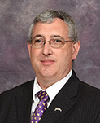
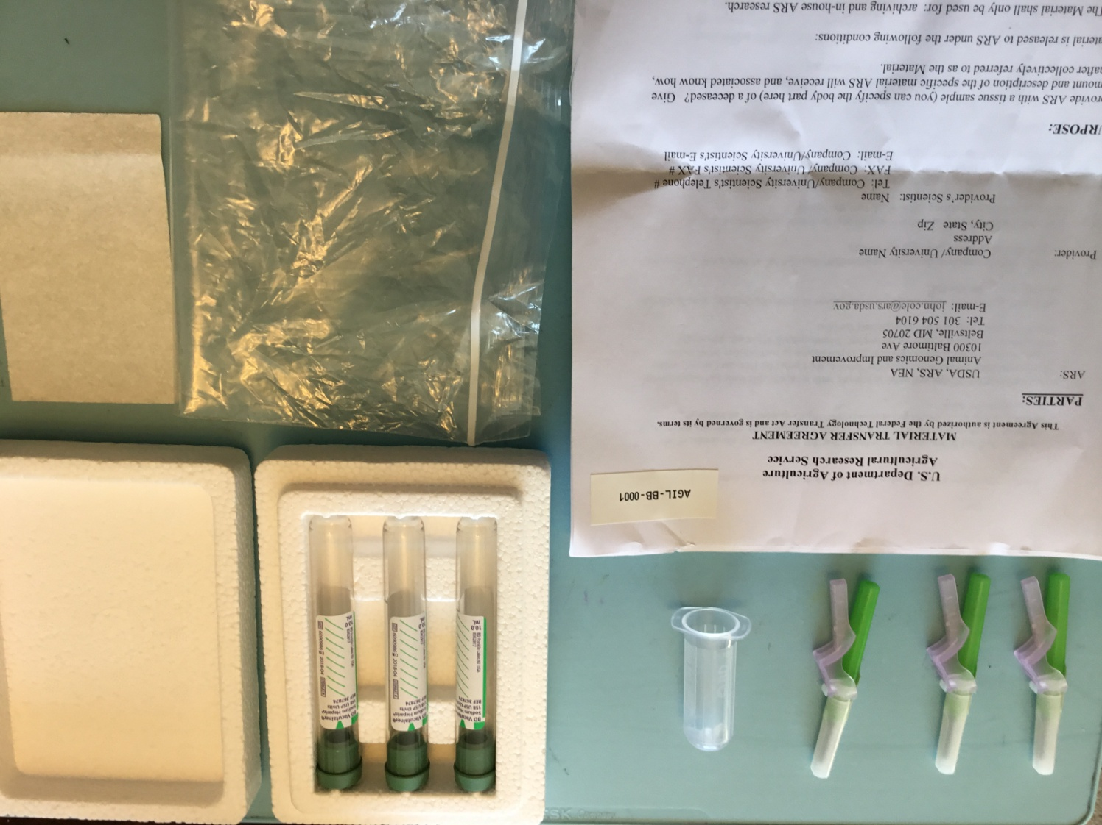
A dairy calf DNA biobank for the discovery of new recessive genetic disorders
John B. Cole
Animal Genomics & Improvement Laboratory, Agricultural Research Service, USDA, Beltsville, MD 20705-2350
Abstract 169
ABSTRACT
High-density SNP genotypes have recently been used to identify a number of novel recessive mutations that adversely affect fertility in dairy cattle, but the lack of standardized procedures for collecting DNA samples and supporting information for those projects underscores the need for a standardized process. The new Dairy Calf DNA BioBank in Beltsville, MD, is a repository for the collection and storage of samples. It complements the automated process of searching for new haplotypes that is part of the national dairy genetic evaluation system. The goal is to collect whole blood from calves that are born dead or that die shortly after birth, particularly if the calf appears to suffer from a congenital defect, as well as DNA from dam and siblings in the herd. Kits that include all sampling materials, return shipping, a material transfer agreement, and a protocol for sample collection are shipped after a request through the website. DNA providers are also able to provide substantial descriptive information about the calves for which they're providing blood. When the samples are received in Beltsville, the DNA is extracted and stored pending future analysis. The material transfer agreement ensures that a clear chain of permission is available for each sample. If a pattern suggests a new recessive genetic disorder within a family, the DNA is available for sequencing and causal variant discovery. Standardized protocols for DNA extraction and whole-genome sequencing will help ensure that data are of high quality. Information on carrier status for new recessives will be distributed through the Council on Dairy Cattle Breeding (Bowie, MD). The URL for the BioBank website is
https://aipl.arsusda.gov/BioBank/.
INTRODUCTION
A number of recessive mutations that adversely affect dairy cow fertility have been identified using high-density SNP genotypes (VanRaden et al., 2011; Cole et al., 2016)
Similar collections (see Supplemental Information)
Procedures for collecting DNA samples and supporting information for new disorders have not been standardized in the United States
OBJECTIVE
Establish a repository for the collection and storage of samples to support discovery of genetic disorders
MATERIALS & METHODS
Collection
  Whole blood from calves born dead or that die shortly after birth (particularly if calf suffers from a congenital defect)
  DNA from calf’s dam and a sibling in the herd
Sampling kits
  Complete inventory (see Supplemental Information)
  Return shipping
  Material transfer agreement (MTA)
  Protocol for sample collection
MATERIALS & METHODS (continued)
Website (https://aipl.arsusda.gov/BioBank/)
  Requests for sampling kits
  Calf descriptions
  Documentation
  Screenshots (see Supplemental Information)
DNA extraction and storage at Henry A. Wallace Beltsville Agricultural Research Center (Beltsville, MD), part of USDA’s Agricultural Research Service
RESULTS
BioBank complements automated process of searching for new haplotypes through national dairy genetic evaluation system
MTA ensures a clear chain of permissions is available for each sample
RESULTS (continued)
If new recessive genetic disorder suggested within a family, DNA is available for sequencing and causal variant discovery
Information on carrier status for new recessives distributed though Council on Dairy Cattle Breeding (Bowie, MD)
CONCLUSIONS
Dairy Calf DNA BioBank established at USDA’s Henry A. Wallace Beltsville Agricultural Research Center in Beltsville, MD
Standardized protocols for DNA extraction and whole-genome sequencing help ensure high-quality data for causal variant discovery
First DNA samples in Dairy Calf DNA BioBank collected from tailless Holstein× Angus calf and its parents
Contents of Dairy Calf DNA BioBank sampling kit
ASAS annual meeting, Baltimore, MD – July 10, 2017 john.cole@ars.usda.gov https://aipl.arsusda.gov

Slide 2

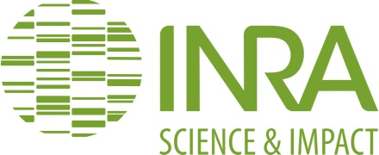

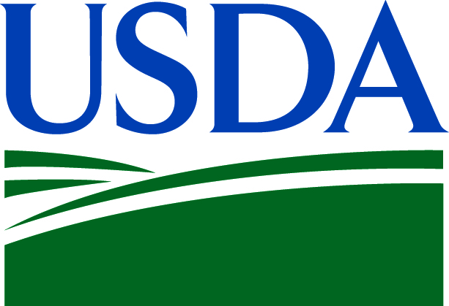

A dairy calf DNA biobank for the discovery of new recessive genetic disorders (J.B. Cole)
SUPPLEMENTAL INFORMATION
Abstract 169
SIMILAR DNA COLLECTIONS
European Gene Bank Network for Animal Genetic Resources (EUGENA)
https://www.rfp-europe.org/
INRA CRB-Anim
https://www.crb-anim.fr/
Irish Cattle Breeding Federation Genetic Defects Survey
https://www.icbf.com/wp/?page_id=2409
USDA-ARS National Animal
Germplasm Project
https://nrrc.ars.usda.gov/
A-GRIN/main_webpage/ars
Swedish University of Agricultural Sciences SLU Biobank
http://www.slu.se/slubiobank
SAMPLING KIT INVENTORY
One cardboard mailer with FedEx shipping and BioBank shipment ID labels affixed
Three 10-mL heparinated (green top) Vacutainers with BioBank shipment ID labels affixed to each
One foam mailing unit
One strip of red tape for sealing foam mailing unit for return shipping
One zip-top plastic bag
One absorbent pad
One needle holder
Three needles
One MTA with recipient’s name and contact information entered under “provider” and BioBank shipment ID affixed to first page
One “What does the BioBank MTA mean?“ flyer
One Dairy Calf DNA BioBank sample collection checklist
One postage-paid return shipping label
WEBSITE SCREENSHOTS
REFERENCES
Cole, J.B., P.M. VanRaden, D.J. Null, J.L. Hutchison, T.A. Cooper, and S.M. Hubbard. 2016. Haplotype tests for recessive disorders that affect fertility and other traits. AIP Res. Rep. GENOMIC3 (09-13) http://aipl.arsusda.gov/reference/recessive_ haplotypes_ARR-G3.html (Accessed July 5, 2017.)
VanRaden, P.M., K.M. Olson, D.J. Null, and J.L. Hutchison. 2011. Harmful recessive effects on fertility detected by absence of homozygous haplotypes. J. Dairy Sci. 94:6153–6161. doi: 10.3168/jds.2011-4624
ASAS annual meeting, Baltimore, MD – July 10, 2017 john.cole@ars.usda.gov https://aipl.arsusda.gov

