Slide 1
AGIL research progress
Paul VanRaden
USDA, Agricultural Research Service, Animal Genomics and Improvement Laboratory, Beltsville, MD, USA
paul.vanraden@ars.usda.gov

Slide 2
Topics
Gestation length
Adjustments for expected future inbreeding (EFI) used since 2005 and heterosis used since 2007: Examples
Genomic evaluations for crossbred animals
Residual feed intake (RFI) as a new trait for Holsteins
Data included, models, and parameters
Reliability of predictions
Economic value of feed saved
Reporting of feed intake evaluations

Slide 3
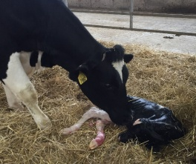
Gestation length for cows
Photo courtesy of GENEX
Gestation length PTAs released for bulls and genotyped cows in August 2017
Cow PTAs will be added to format 105, similar to bull PTAs in format 38
Calf gestation length = service sire PTA + cow PTA + service sire breed effect + cow breed effect
Breed averages:
277 HO, 278 JE, 281 AY, 284 GU, and 286 BS

Slide 4
U.S. PTAs are adjusted for inbreeding
Trait | Inbreeding depression/1% | Trait value in NM$ | $ Value /1% F
Milk | –63.9 | –0.004 | 0.3
Fat | –2.37 | 3.56 | –8.4
Protein | –1.89 | 3.81 | –7.2
Productive life | –0.26 | 21 | –5.5
Somatic cell score | 0.004 | –117 | –0.5
Daughter pregnancy rate | –0.13 | 11 | –1.4
Cow conception rate | –0.16 | 2.2 | –0.4
Heifer conception rate | –0.08 | 2.2 | –0.2
Cow livability | –0.08 | 12 | –1.0
Net merit $ | –25 | 1 | –25

Slide 5
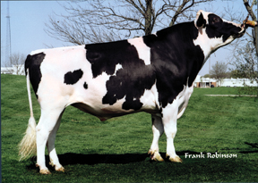
Example EFI adjustment for OMan
Difference of EFI – daughter F = 9.0 – 5.4 = 3.6%
Economic loss (future – past daughters) = 3.6 ($25/1%F) = $90
OMan’s initial NM$ = +$426 before adjustment
OMan’s official NM$ = +$336 after adjustment
As the population becomes more related to an animal, its evaluations decrease
Progeny, grandprogeny, etc., also adjusted because their EFIs tend to be higher than breed average

Slide 6
U.S. PTAs are adjusted for heterosis
Trait | Heterosis /100% | Trait value in NM$ | $ Value /100%
Milk | 48. | –0.004 | –0.2
Fat | 20. | 3.56 | 71.2
Protein | 9. | 3.81 | 34.3
Productive life | 0.67 | 21 | 14.1
Somatic cell score | 0.03 | –117 | –3.5
Daughter pregnancy rate | 2.55 | 11 | 28.1
Cow conception rate | 1.78 | 2.2 | 3.9
Heifer conception rate | 2.63 | 2.2 | 5.8
Cow livability | 0.02 | 12 | 0.2
Net merit $ | 154 | 1 | 154

Slide 7
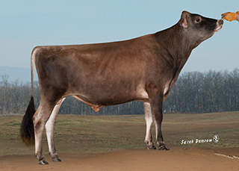
Top young Jersey bulls
Name | Breed composition¹ |  |  |  |  |  |  | % Unknown Ped
 | % Jersey |  |  |  | % Holstein
 | BBR |  | Ped |  | BBR |  | Ped |  | NM$
Cespedes | 92 |  | 91 |  | 8 |  | 8 | 1 | 777
Familia | 93 |  | 94 |  | 7 |  | 6 | 0 | 759
Marlo | 89 |  | 87 |  | 11 |  | 13 | 0 | 744
Bauer | 92 |  | 88 |  | 7 |  | 9 | 3 | 737
Tyrion | 92 |  | 87 |  | 7 |  | 13 | 0 | 736
¹BBR = Genomic breed base representation, Ped = Pedigree breed composition
After filling missing ancestors/breed codes in pedigree to match reported BBR
Ranking based on April 2017 NM$

Slide 8
Example heterosis adjustments
100% Jersey bull with EFI = 8.2% gets
No heterosis and -$205 penalty for EFI on JE scale
Would get $154 credit for heterosis, no penalty for EFI, and breed additive effect if mated to HO cows
89% Jersey bull with EFI = 7.6% gets
$38 credit for heterosis and -$170 penalty for EFI on JE scale
Would get $116 credit for 75% heterosis, $20 penalty for 0.8% EFI, and breed effect if mated to HO cows
Second bull NM$ would be -$73 lower as mate for HO

Slide 9
Additive breed PTA differences from HO
Trait | Trait value in NM$ | AY | BS | GU | JE
Milk | -0.004 | -2572 | -2040 | -3002 | -2749
Fat | 3.56 | -75 | -48 | -46 | -27
Protein | 3.81 | -68 | -38 | -74 | -47
PL | 21 | -0.1 | -0.3 | -4.1 | +1.2
SCS | -117 | -0.04 | +0.01 | +0.13 | +0.15
DPR | 11 | +1.4 | 0.0 | +0.1 | +3.2
CCR | 2.2 | +0.4 | -2.2 | -4.0 | +2.8
HCR | 2.2 | -3.5 | -4.5 | -5.7 | -0.6
LIV | 12 | +2.0 | +0.5 | -5.8 | +0.7
Net Merit $ | 1 | -481 | -324 | -625 | -208
(excluding type and calving traits)

Slide 10
Genotypes (August 2017)
Breed | Reference population |  |  |  | Total genotypes
 | Bulls |  | Cows
Holstein | 36,933 |  | 409,593 |  | 1,656,430
Jersey | 5,260 |  | 77,714 |  | 200,070
Brown Swiss | 6,729 |  | 2,633 |  | 31,488
Ayrshire | 796 |  | 295 |  | 7,692
Guernsey | 470 |  | 748 |  | 3,235
Crossbred |  |  |  |  | 59,905

Slide 11
Crossbreds excluded from evaluation
Category | Limits | Number
F₁ Jersey × Holstein | >40% (both breeds) | 2,153
F₁ Brown Swiss × Holstein | >40% (both breeds) | 12
Holstein backcrosses | >67% and <94% | 8,679
Jersey backcrosses | >67% and <94% | 21,239
Brown Swiss backcrosses | >67% and <94% | 158
Other crosses | Various mixtures | 3,748
Total excluded crossbreds |  | 35,989
As of April 2017
Notes:
3,471 crossbreds currently have evaluations under the current system.

Slide 12
Crossbred genotypes
Previously identified using breed check SNPs
Since 2016, genomic breed composition is reported for all genotypes as breed base representation (BBR)
59,905 genotypes of crossbreds as of August 2016 had <94% BBR from any pure breed
>35,000 animals had no previous GPTAs because they failed breed check edits
$1.4 million genotyping cost for excluded animals

Slide 13
Crossbred genomic evaluations
Compute GPTAs for each of the 5 genomic breeds (HO, JE, BS, AY, and GU) on all-breed instead of current within-breed scales
Compute GPTAs for crossbreds by blending marker effects for each breed weighted by BBR
Example crossbred has BBR = 77% HO + 23% JE
Crossbred GPTA = 0.77 HO GPTA + 0.23 JE GPTA
Convert GPTAs from across- to within-breed scales
Notes:
5 directories for production, PL, SCS, fertility etc.; one for each breed. In the XX directory, there are YLD subdirectories for each breed, but only using the allele frequencies for that breed. i.e. yldHO, yldJE etc.

Slide 14
Comparison of official and all-breed (yield)
Breed | Correlation
 | Milk |  |  |  | Fat |  |  |  | Protein
 | Old |  | Young |  | Old |  | Young |  | Old |  | Young
Holstein | 0.99 |  | 0.99 |  | 0.99 |  | 0.99 |  | 0.99 |  | 0.99
Jersey | 0.99 |  | 0.98 |  | 0.99 |  | 0.99 |  | 0.99 |  | 0.99
Brown Swiss | 0.99 |  | 0.98 |  | 0.99 |  | 0.97 |  | 0.99 |  | 0.98
Ayrshire | 0.99 |  | 0.92 |  | 0.99 |  | 0.95 |  | 0.99 |  | 0.96
Guernsey | 0.99 |  | 0.97 |  | 0.99 |  | 0.99 |  | 0.99 |  | 0.98
Official within-breed predictions vs. new all-breed predictions
Notes:
Bulls from official dataset from 1704

Slide 15
Comparison of official and all-breed (nonyield)
Breed | Correlation
 | PL |  |  |  | SCS |  |  |  | DPR
 | Old |  | Young |  | Old |  | Young |  | Old |  | Young
Holstein | 0.99 |  | 0.99 |  | 0.99 |  | 0.98 |  | 0.99 |  | 0.97
Jersey | 0.98 |  | 0.95 |  | 0.99 |  | 0.98 |  | 0.99 |  | 0.98
Brown Swiss | 0.94 |  | 0.93 |  | 0.99 |  | 0.99 |  | 0.96 |  | 0.96
Ayrshire | 0.98 |  | 0.94 |  | 0.99 |  | 0.98 |  | 0.99 |  | 0.98
Guernsey | 0.99 |  | 0.96 |  | 0.99 |  | 0.99 |  | 0.99 |  | 0.99
Notes:
Bulls from official dataset from 1704

Slide 16
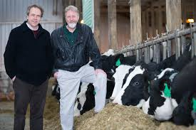
Feed intake data
Research herd | Cows | Records | Researchers
Univ. of Wisconsin and US Dairy Forage Res. Ctr. | 1,390 | 1,597 | Weigel, Armentano
Iowa State Univ. | 953 | 1,006 | Spurlock
ARS, USDA (Beltsville, MD) | 534 | 834 | Connor
Univ. of Florida | 491 | 582 | Staples
Michigan State Univ. | 273 | 315 | VandeHaar, Tempelman
Purina Anim. Nutr. Ctr. (MO) | 151 | 184 | Davidson
Virginia Tech | 93 | 93 | Hanigan
Miner Agric. Res. Inst. (NY) | 58 | 58 | Dann
All | 3,947 | 4,621 | $5 million AFRI grant

Slide 17
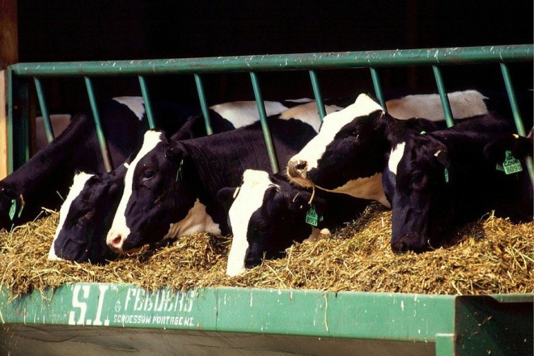
National RFI genomic evaluation
Feed intakes from research cows already adjusted for phenotypic correlations with milk net energy, metabolic body weight (BW), and weight change to get RFI
Genetic evaluation model:
RFI = breeding value + permanent environment + herd × sire + management group + age-parity + b₁(inbreeding) + b₂(GPTA_{milk net energy} ) + b₃(GPTA_{BW composite})
Remove remaining genetic correlations and include 60 million nongenotyped Holsteins
Genomic model:
Predict 1.4 million genotyped Holsteins

Slide 18
Variance estimates for RFI (and SCS)
Parameter | RFI | SCS
Heritability (%) | 14 | 16
Repeatability (%) | 24 | 35
Phenotypic correlation with yield | 0.00 | –0.10
Genetic correlation with yield | 0.00 | –0.03
SCS provided a 2nd trait with similar properties, which allowed genomic predictions from research cows to be compared with national SCS predictions

Slide 19
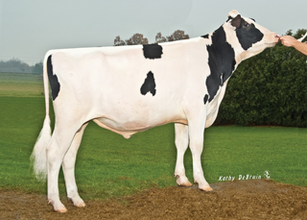
Feed data vs. other trait data
Top 100 progeny-tested Holstein bulls for NM$
Average 739 milk daughters, <0.1 RFI daughters
GREL averages 94% milk, 89% NM$, 16% RFI
Top 100 young Holstein bulls for NM$
GREL averages 75% milk, 71% NM$, 12% RFI
REL_{PA} averages 35% milk, 33% NM$, 3% RFI

Slide 20
Computed vs. actual GREL for SCS
Expected genomic reliability (GREL) was 19% for both RFI and SCS
SCS GPTA was correlated by only 0.39 for national vs. research-cow reference data
Observed GREL of SCS was (0.39)² × 72% = 11%
RFI GREL was discounted to agree with Var(PTA) for RFI and observed GREL of SCS

Slide 21
Economic values
Statistic | Milk production (3.5% F, 3.0% P) | Dry matter intake | Residual feed intake
Lactation mean (lb/lactation) | 25,000 | 16,600 | 0
Lactation SD (lb/lactation) | 2,900 | 2,750 | 1,130
Price/lb | $0.17 | $0.12 | $0.12
Mean income or cost/lactation | $4,250 | –$1,992 | 0
Lifetime value/lb (2.8 lactations) | $0.253 | –$0.336 | –$0.336
Relative value (% of NM$) | 36% |  | –16%
Economic values for milk and BW continue to subtract correlated feed consumption
Subtraction of expected feed intake from milk yield is the “net” in NM$

Slide 22
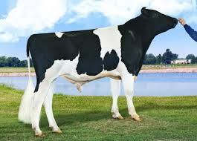
Economic progress
Higher reliability for other traits than for RFI because of more records
REL_{NM$} averages 75% for young and 91% for proven bulls
REL_{RFI} averages ~12% for young and 16% for proven bulls
Progress for lifetime profit may be only 1.01 times or 1% faster than current NM$ progress, but the extra gain is worth $4.5 million per year to the U.S. dairy industry

Slide 23
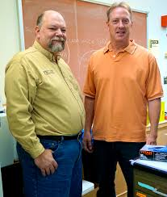
Reporting feed efficiency
Feed efficiency expected from yield and weight
FE$ = (1 – 0.45) MFP$ – $0.31 × 40 × BWC
Current definition used in TPI
New FE$ = FE$ – $0.12 × 2.8 lactations × 305 × RFI lb/d
Feed saved (used in AUS)
FS lb/lactation = –305 × RFI lb/d – 0.20 × 40 × BWC
FS$ = –$0.12 × 2.8 lactations × FS lb/lactation

Slide 24
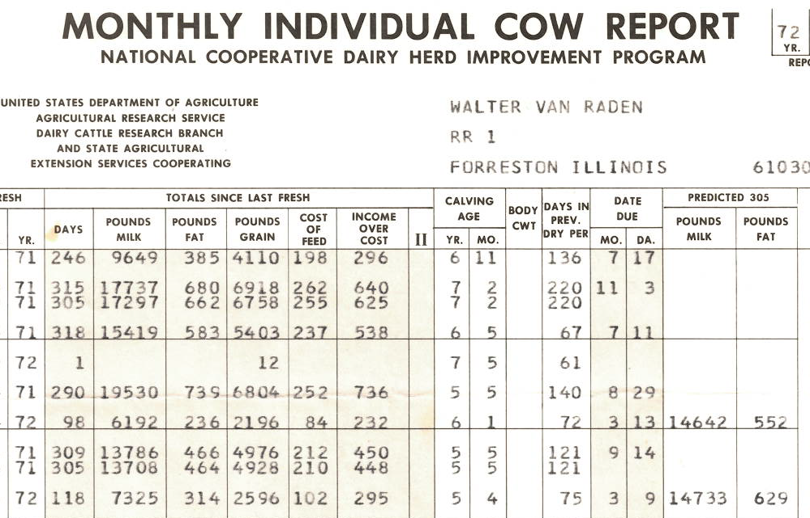
VanRaden DHI feed costs (1972)

Slide 25
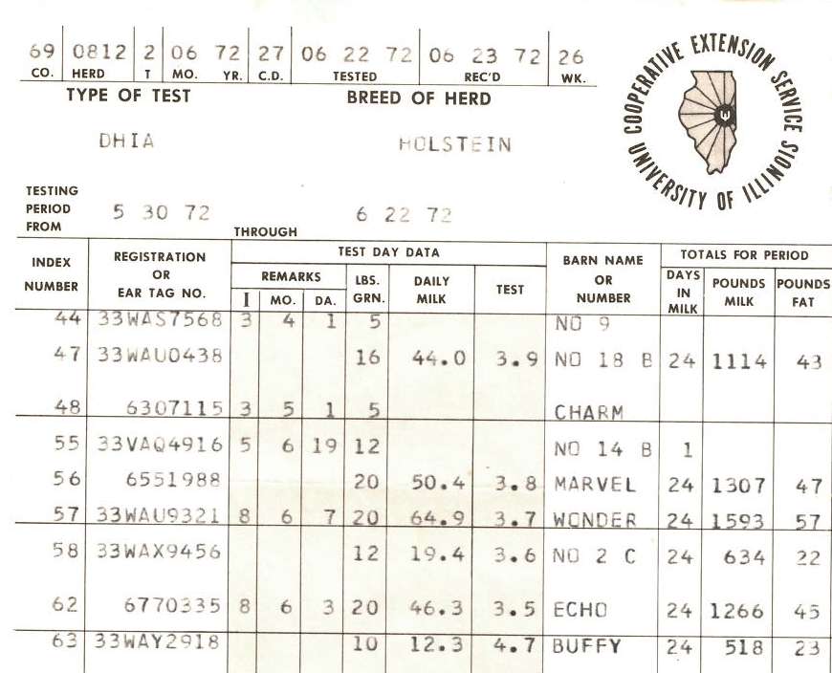
Paul’s DHI feed intake records (1972)

Slide 26
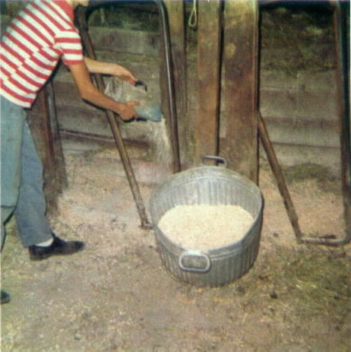
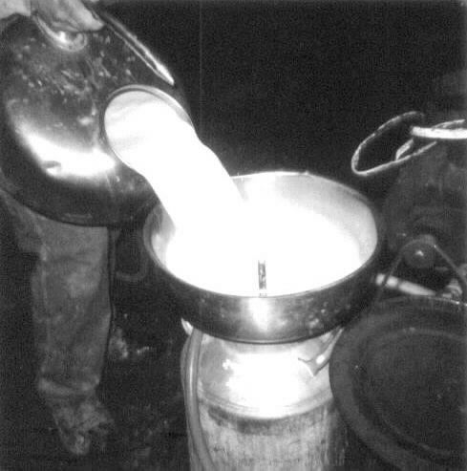
Paul feeding cows (1974)

Slide 27
Summary
US genetic evaluations have adjusted for inbreeding since 2005 and heterosis since 2007.
Genomic evaluations for crossbreds have been developed and automated
Residual feed intake could get ~16% of relative emphasis in net merit, but low REL of ~12% for young animals will limit progress

Slide 28
Acknowledgments (1)
Mel Tooker and Gary Fok (AGIL) for development of crossbred genomic evaluations
Mike VandeHaar, Rob Tempelman, Jim Liesman, Kent Weigel, Lou Armentano, Erin Connor, and others for managing feed intake data collection
Jeff O’Connell for estimating RFI variance components
George Wiggans for managing genotypes
Last research project of Jan Wright 1958–2017

Slide 29
Acknowledgments (2)
Agriculture and Food Research Initiative Competitive Grant #2011-68004-30340 from USDA National Institute of Food and Agriculture (feed intake funding)
USDA-ARS project 1265-31000-101-00, “Improving Genetic Predictions in Dairy Animals Using Phenotypic and Genomic Information” (AGIL funding)
Council on Dairy Cattle Breeding and its industry suppliers for data

