Slide 1
Development of genomic evaluations for direct measures of health in U.S. Holsteins and their correlations with fitness traits
K.L. Parker Gaddis,¹ M.E. Tooker,² J.R. Wright,² J.H. Megonigal, Jr.,¹ J.S. Clay,³ J.B. Cole,² and P.M. VanRaden²
¹ Council on Dairy Cattle Breeding, Bowie, Maryland, USA
² Animal Genomics and Improvement Laboratory, Agricultural Research Service, USDA, Beltsville, Maryland, USA
³ Dairy Records Management Systems, Raleigh, North Carolina, USA
Notes:
1

Slide 2
Introduction
Increasing demand for health evaluations
  Consumer demand
  Improve profitability → decreasing management costs
Health trait | Direct cost estimate*
Hypocalcemia | $38
Displaced abomasum | $178
Ketosis | $28
Mastitis | $72
Metritis | $105
Retained placenta | $64
*Liang et al., 2017; Donnelly et al.
Notes:
2

Slide 3
Objectives
Estimate variance components for 6 common health events recorded by producers on U.S. dairy farms
Compute traditional and genomic evaluations
Estimate correlations with fitness traits currently used for selection

Slide 4

Phenotypic data
Health event data available from DRMS (Raleigh, NC) for 6 common health traits
  Hypocalcemia/milk fever
  Displaced abomasum
  Ketosis
  Mastitis
  Metritis
  Retained placenta

Slide 5
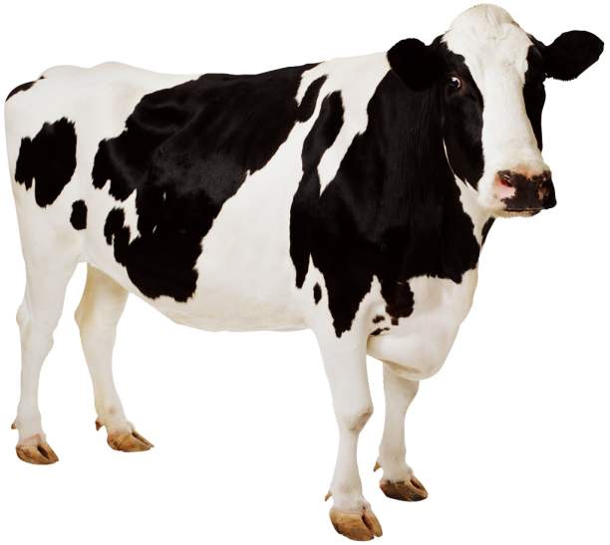
Standardization & editing
Account for different acronyms used in herds
Inclusion of Holstein animals with acceptable ID
Parities 1 to 5
Events must occur within specified time frame after calving (e.g., retained placenta must be reported within 10 days of calving)
Minimum/maximum constraints for herd-year reporting

Slide 6
Variance component estimation
Univariate linear animal models (AIREMLF90; Misztal et al., 2002):
  Fixed effects
    Overall mean
    Parity
    Year-season
  Random effects
    Herd-year
    Additive genetic
    Permanent environmental
    Residual
Notes:
Describe the scale of the trait
6

Slide 7
Traditional evaluation
Univariate BLUP repeatability animal model
Similar to routine national genetic evaluations
Fixed effects included
  Year-season
  Age at calving by parity
  Regression on inbreeding
Random effects the same

Slide 8
Genomic evaluation
SNP effects estimated using model similar to BayesA
Same fixed and random effects as traditional model
Used 60,671 markers currently included in U.S. routine genomic evaluations

Slide 9
Summary statistics
Health event | Records (no.) | Cows (no.) | Herds (no.) | Mean incidence rate (%)
Hypocalcemia | 1,232,071 | 720,091 | 671 | 1.3
Displaced abomasum | 1,880,042 | 1,054,244 | 980 | 2.1
Ketosis | 1,288,144 | 741,520 | 671 | 3.9
Mastitis | 2,541,411 | 1,428,312 | 1,825 | 10.2
Metritis | 2,032,644 | 1,171,957 | 1,315 | 6.2
Retained placenta | 1,964,950 | 1,120,772 | 1,319 | 3.6
Notes:
- Specify that this is after editing
9

Slide 10
Variance components
Observed scale (standard error)
Health trait | Heritability | Repeatability
Hypocalcemia | 0.006 (0.59 × 10^{–3}) | 0.031 (0.10 × 10^{–2})
Displaced abomasum | 0.011 (0.46 × 10^{–3}) | 0.012 (0.48 × 10^{–3})
Ketosis | 0.012 (0.77 × 10^{–3}) | 0.045 (0.11 × 10^{–2})
Mastitis | 0.031 (0.95 × 10^{–3}) | 0.086 (0.75 × 10^{–3})
Metritis | 0.014 (0.76 × 10^{–3}) | 0.053 (0.86 × 10^{–3})
Retained placenta | 0.010 (0.62 × 10^{–3}) | 0.036 (0.86 × 10^{–3})

Slide 11
Reliability Progeny-tested animals
Health trait | Mean reliability (%) |  | Improvement
 | Traditional | Genomic
Hypocalcemia | 20.0 | 44.2 | 24.2
Displaced abomasum | 25.7 | 47.1 | 21.4
Ketosis | 24.0 | 46.2 | 22.2
Mastitis | 33.3 | 56.3 | 23.0
Metritis | 27.6 | 48.1 | 20.5
Retained placenta | 25.6 | 46.7 | 21.1

Slide 12
Reliability Young animals
Health trait | Mean reliability (%) |  | Improvement
 | Traditional | Genomic
Hypocalcemia | 10.9 | 40.0 | 29.1
Displaced abomasum | 14.6 | 41.8 | 27.2
Ketosis | 13.4 | 41.2 | 27.8
Mastitis | 18.3 | 49.4 | 31.1
Metritis | 15.4 | 42.2 | 26.8
Retained placenta | 14.2 | 41.6 | 27.4

Slide 13
Correlations with other traits
Health trait | Protein | Productive life | Livability | Somatic cell score | Daughter pregnancy rate | Cow conception rate | Heifer conception rate
Hypocalcemia | 0.18 | 0.15 | 0.19 | –0.29 | 0.003 | 0.01 | 0.02
Displaced abomasum | 0.23 | 0.35 | 0.47 | –0.13 | 0.32 | 0.28 | 0.24
Ketosis | 0.03 | 0.33 | 0.27 | –0.19 | 0.59 | 0.49 | 0.07
Mastitis | 0.06 | 0.39 | 0.22 | –0.68 | 0.20 | 0.21 | 0.06
Metritis | 0.05 | 0.32 | 0.26 | –0.09 | 0.46 | 0.41 | 0.23
Retained placenta | –0.03 | 0.17 | 0.13 | –0.10 | 0.14 | 0.13 | 0.12
Hypocalcemia & retained placenta calculated for bulls born since 1990 with reliability of ≥75%
All other traits calculated for bulls born since 1990 with reliability of ≥90%
Values in red are different from 0
Notes:
- Explain the difference between productive life and livability
13

Slide 14
Health merit index
Incorporate 6 health traits into a single measure of health
Health merit = economically weighted sum of 6 health traits
Ensure appropriate weighting of each trait

Slide 15
Correlations with health merit index
Trait | Correlation with health merit
Protein | 0.09
Productive life | 0.56
Livability | 0.55
Somatic cell score | –0.45
Daughter pregnancy rate | 0.51
Cow conception rate | 0.46
Heifer conception rate | 0.34
Calculated for bulls born since 1990 with reliability of ≥90%

Slide 16
Conclusions
Genomic reliabilities
  40 – 49% for young animals
  44 – 56% for progeny-tested animals
Correlations with current traits as expected
Health traits will add no more than 4% improvement to lifetime net merit index (NM$)
Preparing pipeline to be ready for implementation

Slide 17

Acknowledgments
Dairy Records Management Systems
Animal Genomics & Improvement Laboratory, ARS, USDA
Thank you!

