Slide 1
Genetic improvement programs for U.S. dairy cattle
John B. Cole
Animal Genomics and Improvement Laboratory
Agricultural Research Service, USDA, Beltsville, MD
john.cole@ars.usda.gov

Slide 2
U.S. dairy population & milk yield

Slide 3
U.S. DHI statistics (2016)
9.3 million U.S. cows
~75% bred AI
47% milk recorded through Dairy Herd Information (DHI)
  4.38 million cows
    83% Holstein
    10% crossbred
    6% Jersey
    <1% Ayrshire, Brown Swiss, Guernsey, Milking Shorthorn, Red & White
  17,339 herds
  253 cows/herd
  11,302 kg/cow

Slide 4
States with >200,000 DHI cows (Jan. 2017)
Idaho
232,571
Minnesota
246,649
New York
365,326
Wisconsin
761,978
Pennsylvania
337,951
California
919,136

Slide 5
DHI enrollment by breed (Jan. 2017)
Breed | Herds | Cows
Ayrshire | 63 | 3,205
Brown Swiss | 142 | 10,079
Guernsey | 84 | 3,948
Holstein | 13,348 | 3,595,206
Jersey | 838 | 321,706
Milking Shorthorn | 24 | 1,170
Crossbred | 1,873 | 466,995
All | 16,372 | 4,402,309

Slide 6
Phenotypic data
Records for milk yield, fat percentage, protein percentage, and somatic cell count (1/month)
Appraiser-assigned scores for ∼16 body and udder characteristics related to conformation (e.g., stature)
Breeding records that include indicator for conception success
Calving difficulty scores and stillbirth occurrences

Slide 7
Conformation (type) traits
Stature
Strength
Body depth
(Ayrshire, Guernsey, Holstein)
Dairy form
Rump angle
Thurl/rump width
Rear legs (side view)
Rear legs (rear view)
(Brown Swiss, Guernsey, Holstein, Milking Shorthorn)
Foot angle
Feet and legs score (Holstein)
Mobility
(Brown Swiss, Milking Shorthorn)
Fore udder attachment
Rear udder height
Rear udder width
Udder cleft
Udder depth
Front teat placement
Rear teat placement
(Holstein, Jersey)
Teat length
Milking speed
(Brown Swiss, Milking Shorthorn)
Final score

Slide 8
Data sources for genetic evaluations
Data collected
on farms
Dairy records
processing centers
Analytical laboratories
National database
Genetic evaluation
center
Milk processing
plants
On-farm
system only
Non-milk
recording farms

Slide 9
Data amounts (as of Sept. 2016)
Pedigree records 75,538,654
Animal genotypes 1,589,202
Lactation records (since 1960) 139,134,191
Daily yield records (since 1990) 684,182,260
Reproduction event records 196,505,574
Calving difficulty scores 27,991,336
Stillbirth scores 18,470,886

Slide 10
Primary traits evaluated
Yield
  Milk, fat, and protein
Conformation
  Overall and individual traits
Longevity
  Productive life, cow livability
Fertility
  Conception and pregnancy rates
Calving
  Dystocia and stillbirth
Disease resistance
  Somatic cell score

Slide 11
U.S. trait evaluation history
Year | Trait | Year | Trait
1926 | Milk, fat yields | 2000 | Calving ease¹
1978 | Conformation (type) | 2003 | Daughter pregnancy rate
1978 | Protein yield | 2006 | Stillbirth rate
1994 | Productive life | 2006 | Sire conception rate²
1994 | Somatic cell score (mastitis) | 2009 | Cow and heifer conception rates
 |  | 2017 | Cow livability
¹Sire calving ease evaluated by Iowa State University (1978–99)
²Estimated relative conception rate evaluated by DRMS, Raleigh, NC (1986–2005)

Slide 12
Evaluation methods for traits
Animal model (linear) Heritability
  Yield (milk, fat, protein) 15–29%
  Type (AY, BS, GU, JE) 8–51%
  Longevity (productive life, cow livability) 1.3–8%
  Somatic cell score 12%
  Daughter pregnancy rate 1.4%
  Heifer conception rate 1%
  Cow conception rate 1.6%
Sire–maternal grandsire model (threshold)
  Service sire calving ease 8.6%
  Daughter calving ease 4.8%
  Service sire stillbirth rate 0.8%
  Daughter stillbirth rate 2.1%

Slide 13
U.S. genetic-economic indices (2017)
Trait | Relative value (%)
 | Net merit | Cheese merit | Fluid merit | Grazingmerit
Milk yield | –0.7 | –7.9 | 20.4 | –0.5
Fat yield | 23.7 | 20.1 | 24.3 | 20.7
Protein yield | 18.3 | 22.0 | 0.0 | 16.0
Productive life (PL) | 13.4 | 11.4 | 13.8 | 7.8
Somatic cell score (SCS) | –6.5 | –7.0 | –3.2 | –5.5
Udder composite (UC) | 7.4 | 6.3 | 7.6 | 7.5
Feet/legs composite (FLC) | 2.7 | 2.3 | 2.8 | 2.8
Body weight composite (BWC) | –5.9 | –5.0 | –6.0 | –6.1
Daughter pregnancy rate (DPR) | 6.7 | 5.7 | 6.9 | 17.9
Heifer conception rate (HCR) | 1.4 | 1.2 | 1.4 | 2.5
Cow conception rate (CCR) | 1.6 | 1.4 | 1.7 | 4.4
Calving ability index (CA$) | 4.8 | 4.1 | 4.9 | 4.5
Cow livability (LIV) | 7.4 | 6.2 | 7.5 | 5.0

Slide 14
U.S. selection index changes
Trait | Relative emphasis on traits (%)
 | PD$ 1971 | MFP$ 1976 | CY$ 1984 | NM$ 1994 | NM$ 2000 | NM$ 2003 | NM$ 2006 | NM$ 2010 | NM$ 2014 | NM$ 2017
Milk | 52 | 27 | –2 | 6 | 5 | 0 | 0 | 0 | –1 | –1
Fat | 48 | 46 | 45 | 25 | 21 | 22 | 23 | 19 | 22 | 24
Protein | … | 27 | 53 | 43 | 36 | 33 | 23 | 16 | 20 | 18
PL | … | … | … | 20 | 14 | 11 | 17 | 22 | 19 | 13
SCS | … | … | … | –6 | –9 | –9 | –9 | –10 | –7 | –7
UC | … | … | … | … | 7 | 7 | 6 | 7 | 8 | 7
FLC | … | … | … | … | 4 | 4 | 3 | 4 | 3 | 3
BWC | … | … | … | … | –4 | –3 | –4 | –6 | –5 | –6
DPR | … | … | … | … | … | 7 | 9 | 11 | 7 | 7
SCE | … | … | … | … | … | –2 | … | … | … | …
DCE | … | … | … | … | … | –2 | … | … | … | …
CA$ | … | … | … | … | … | … | 6 | 5 | 5 | 5
HCR | … | … | … | … | … | … | … | … | 1 | 1
CCR | … | … | … | … | … | … | … | … | 2 | 2
LIV | … | … | … | … | … | … | … | … | … | 7

Slide 15
Genetic trend – net merit

Slide 16
Traditional evaluation summary
Evaluation procedures have improved
Fitness traits have been added
Effective selection has produced substantial annual genetic improvement
Indexes enable selection for overall economic merit
Fertility evaluations prevent continued decline

Slide 17
Genomic evaluation system
Provides timely evaluations of young bulls for purchasing decisions
Increases accuracy of evaluations of bull dams
Assists in selection of service sires
  Particularly for traits with low reliability
High demand for semen from genomically evaluated 2-year-old bulls

Slide 18
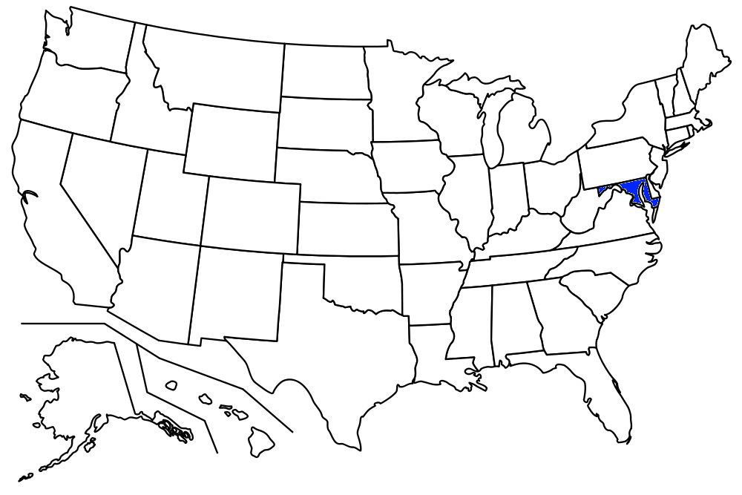
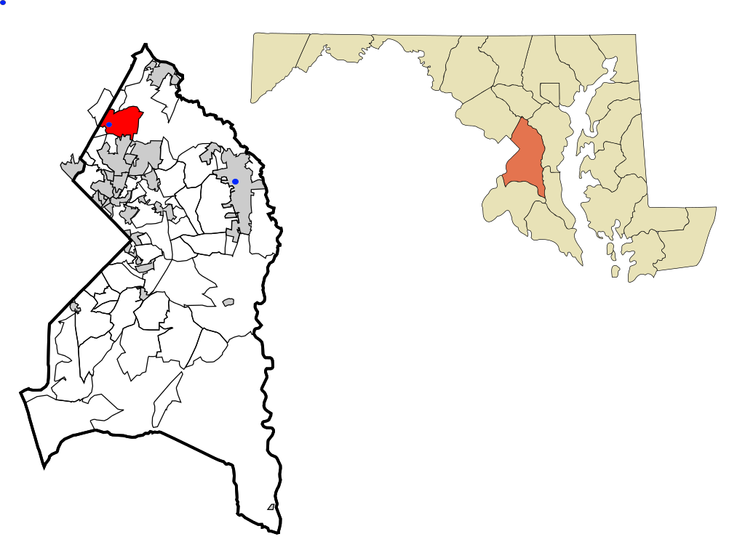
Government–industry collaboration
Animal Genomics and Improvement Laboratory (AGIL) , Agricultural Research Service, USDA
  Responsible for research and development to improve the evaluation system
  Located in Beltsville, Maryland
  Dr. John Cole, Acting Research Leader
Council on Dairy Cattle Breeding (CDCB)
  Responsible for approving changes,
  receiving data, and computing and
  delivering U.S. genetic evaluations for
  dairy cattle
  Located in Bowie, Maryland
  Dr. João Dürr, CEO

Slide 19
Council on Dairy Cattle Breeding
CDCB
PDCA
NAAB
DRPC
DHI
Purebred Dairy
Cattle Association
National Association of Animal Breeders
Dairy Records
Processing Centers
Dairy Herd
Information
3 members from each organization
Total of 12 voting members
2 nonvoting industry members

Slide 20
Genomic data flow
Animal manager/owner
DNA samples
DNA samples
genomic
evaluations
DNA laboratory
DNA samples
AI organization,
breed association
genotypes
genotypes
nominations,
pedigree data
genotype
quality reports
genomic
evaluations
Council on Dairy
Cattle Breeding (CDCB)

Slide 21
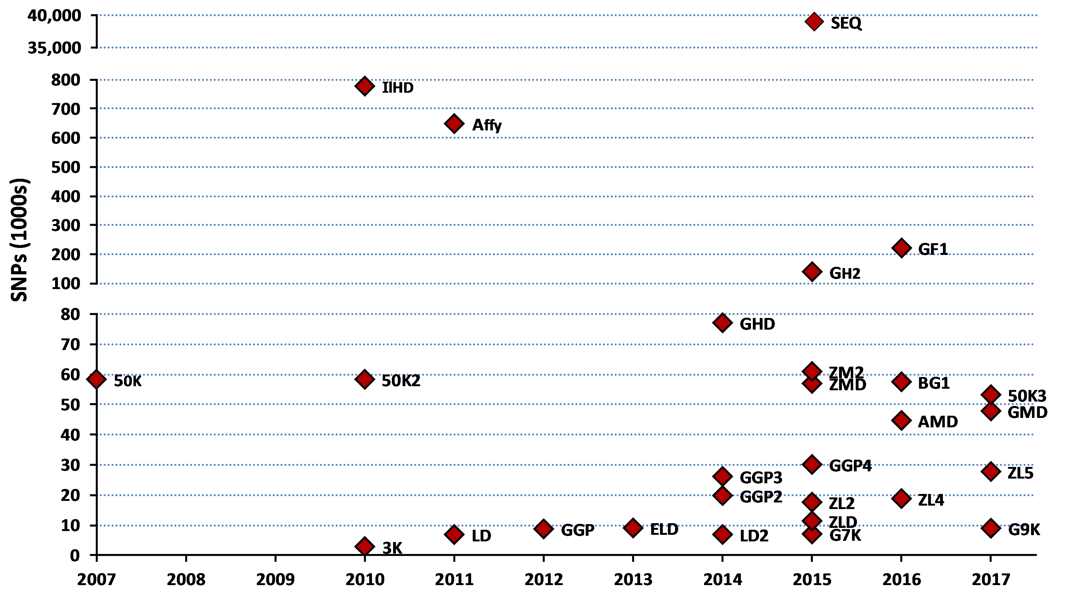
Genotyping chip history

Slide 22
Evaluation flow
Animal nominated for genomic evaluation by approved nominator
DNA source sent to genotyping lab (2015)
Source | Samples (no.) | Samples (%)
Blood | 6,893 | 2
Hair | 124,523 | 31
Nasal swab | 1,903 | <1
Semen | 277 | <1
Tissue | 252,468 | 64
Unknown | 10,906 | 3

Slide 23

Evaluation flow (continued)
DNA extracted and placed on chip for 3-day genotyping process
Genotypes sent from genotyping lab
to CDCB for accuracy review
  60,671 SNPs used in
  genomic evaluation

Slide 24
2015 genotypes by breed and sex
Breed | Female | Male | All animals | Female: male
Ayrshire | 5,663 | 1,962 | 7,625 | 74:26
Brown Swiss | 6,214 | 26,242 | 32,456 | 19:81
Guernsey | 2,468 | 793 | 3,261 | 76:24
Holstein | 1,361,770 | 237,636 | 1,599,406 | 85:15
Jersey | 174,238 | 26,724 | 200,962 | 87:13
All | 1,550,353 | 293,357 | 1,843,710 | 84:16

Slide 25
Laboratory quality control
Each SNP evaluated for
  Call rate
  Portion heterozygous
  Parent-progeny conflicts
Clustering investigated if SNP exceeds limits
Number of failing SNPs indicates quality of submission
Target of <10 SNPs in each category

Slide 26
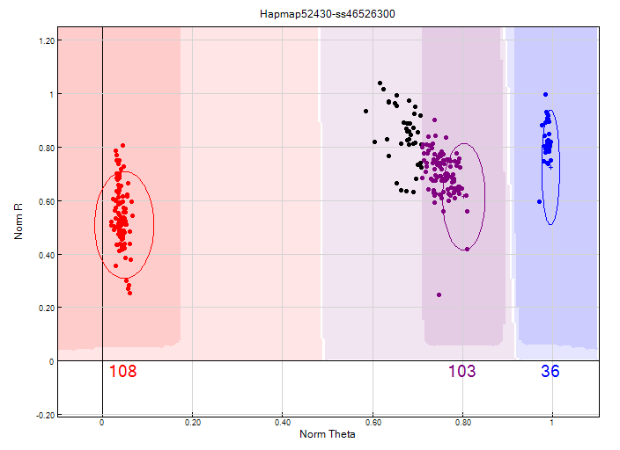
Before clustering adjustment
86% call rate

Slide 27
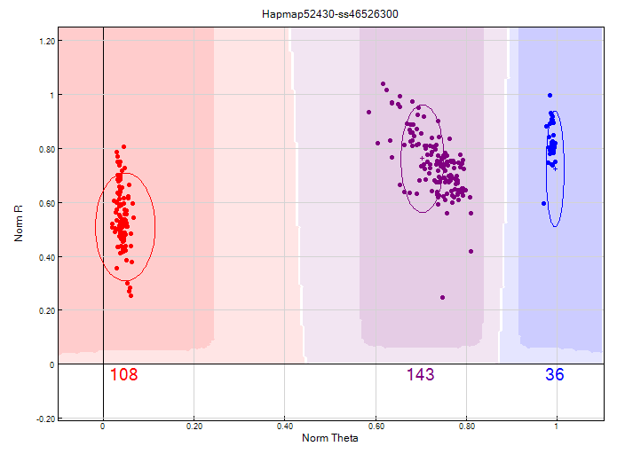
After clustering adjustment
100% call rate

Slide 28
Evaluation flow (continued)
Genotype calls modified as necessary
Genotypes loaded into database
Nominators receive reports of parentage and other conflicts
Pedigree or animal assignments corrected
Genotypes extracted and imputed to 61K
SNP effects estimated

Slide 29
Imputation
Based on splitting genotype into individual chromosomes (maternal and paternal contributions)
Missing SNPs assigned by tracking inheritance from ancestors and descendants
Imputed dams increase predictor population
Genotypes from all chips merged by imputing SNPs not present

Slide 30
findhap
Developed by Dr. Paul VanRaden, ARS, USDA
Divides chromosomes into segments
Allows for successively shorter segments (usually 3 runs)
  Long segments lock in identical by descent
  Shorter segments fill in missing SNPs
Separates genotype into maternal and paternal contribution, haplotypes (phasing)
Builds haplotype library sequenced by frequency

Slide 31
Evaluation flow (continued)
Final evaluations calculated
Evaluations released to dairy industry
  Download from CDCB FTP site with
  separate files for each nominator
  Weekly release of evaluations of new animals
  Monthly release for females and bulls not marketed
  All genomic evaluations updated 3 times each year with traditional evaluations

Slide 32

Weekly evaluations
Released to nominators, breed associations, and dairy records processing centers at 8 a.m. each Tuesday
Calculations restricted to genotypes that first became usable during the previous week
8 AM
8 AM
8 AM
8 AM
8 AM

Slide 33
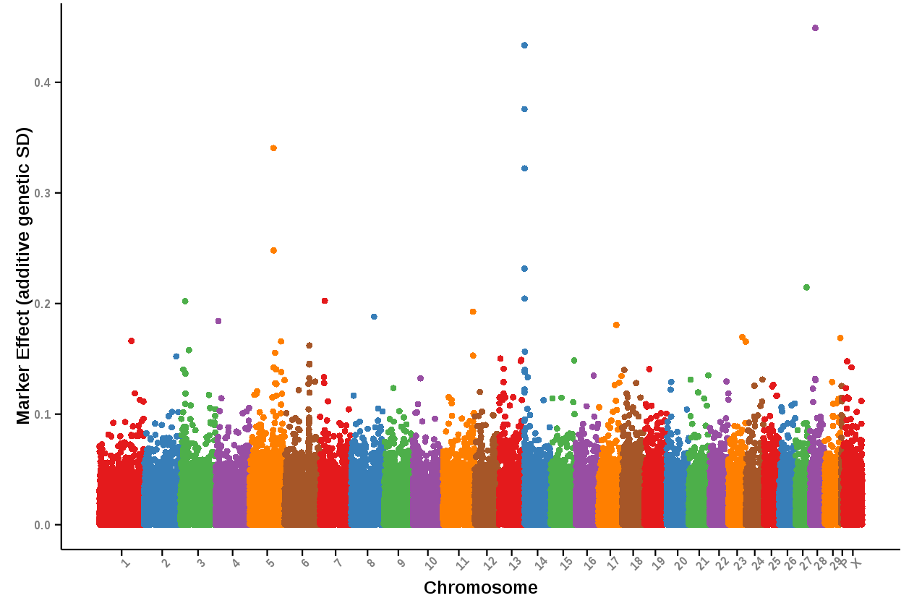
Holstein protein SNP effects
December 2015
Source: Council on Dairy Cattle Breeding, https://www.uscdcb.com/Report_Data/Marker_Effects/marker_effects.cfm?Breed=HO&Trait=Protein

Slide 34
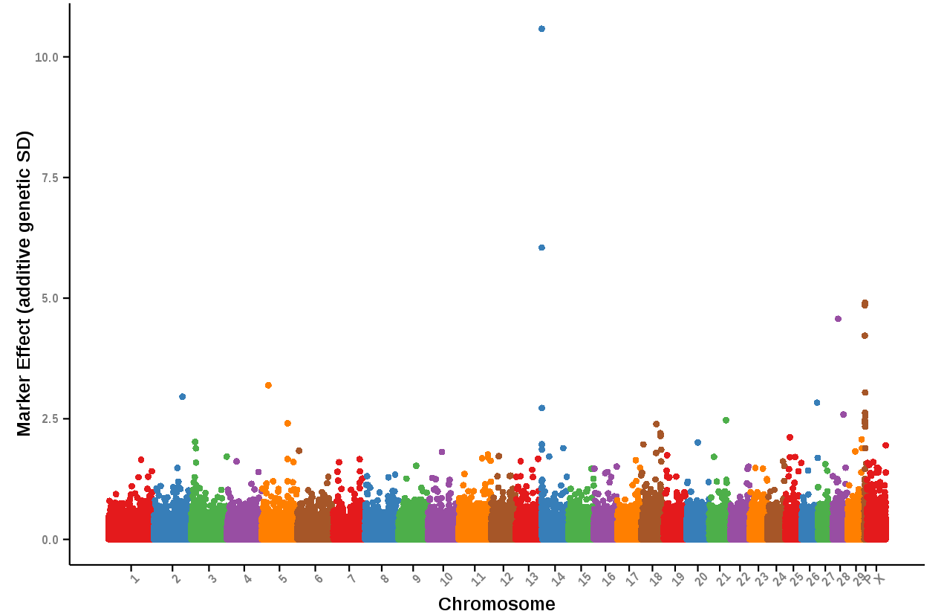
Holstein net merit SNP effects
December 2015
Source: Council on Dairy Cattle Breeding, https://www.uscdcb.com/Report_Data/Marker_Effects/marker_effects.cfm?Breed=HO&Trait=Net_Merit

Slide 35
Information sources for evaluations
Traditional evaluations of genotyped bulls and cows used to estimate SNP effects
Combined final evaluation
  Sum of SNP effects for an animal’s alleles
  Polygenetic effect
  Traditional evaluation
Pedigree data used and validated by genotypes

Slide 36
Genotypes evaluated
Imputed, young
Imputed, old (young cows included before March 2012)
<50K, young, female
<50K, young, male
<50K, old, female
<50K, old, male (≤ 20 bulls)
≥50K, young, female
≥50K, young, male
≥50K, old, female
≥50K, old, male
2009
2010
2011
2012
2013
2014
2015
2016
2017

Slide 37
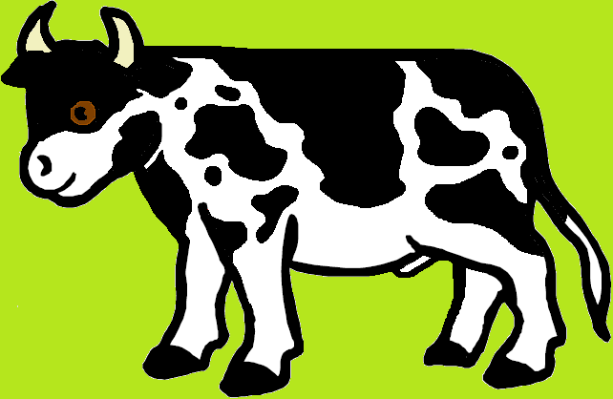
Growth in bull predictor population
Breed | January 2016 | 12-month gain
Ayrshire | 752 | 42
Brown Swiss | 6,363 | 271
Holstein | 28,917 | 2,168
Jersey | 4,712 | 265

Slide 38
Reliabilities (young* Holsteins)
9,000
8,000
7,000
50K genotypes
6,000
3K genotypes
5,000
Animals (no.)
4,000
3,000
2,000
1,000
0
40
45
50
55
60
65
70
75
80
Reliability for PTA protein (%)
*Animals with no traditional PTA in April 2011

Slide 39
Holstein prediction accuracy
Trait | Bias* | Reliability (%) | Reliability gain (% points)
Milk (kg) | −80.3 | 69.2 | 30.3
Fat (kg) | −1.4 | 68.4 | 29.5
Protein (kg) | −0.9 | 60.9 | 22.6
Fat (%) | 0.0 | 93.7 | 54.8
Protein (%) | 0.0 | 86.3 | 48.0
Productive life (months) | −0.7 | 73.7 | 41.6
Somatic cell score | 0.0 | 64.9 | 29.3
Daughter pregnancy rate (%) | 0.2 | 53.5 | 20.9
Sire calving ease | 0.6 | 45.8 | 19.6
Daughter calving ease | −1.8 | 44.2 | 22.4
Sire stillbirth rate | 0.2 | 28.2 | 5.9
Daughter stillbirth rate | 0.1 | 37.6 | 17.9
*2013 deregressed value – 2009 genomic evaluation

Slide 40
Holstein prediction accuracy
Trait | Bias* | Reliability (%) | Reliability gain (% points)
Final score | 0.1 | 58.8 | 22.7
Stature | −0.2 | 68.5 | 30.6
Dairy form | −0.2 | 71.8 | 34.5
Rump angle | 0.0 | 70.2 | 34.7
Rump width | −0.2 | 65.0 | 28.1
Feet and legs | 0.2 | 44.0 | 12.8
Fore udder attachment | −0.2 | 70.4 | 33.1
Rear udder height | −0.1 | 59.4 | 22.2
Udder depth | −0.3 | 75.3 | 37.7
Udder cleft | −0.2 | 62.1 | 25.1
Front teat placement | −0.2 | 69.9 | 32.6
Teat length | −0.1 | 66.7 | 29.4
*2013 deregressed value – 2009 genomic evaluation

Slide 41
Marketed Holstein bulls
Year entered AI | Traditional progeny- tested | Genomic marketed | All bulls
2008 | 1,778 | 170 | 1,948
2009 | 1,508 | 346 | 1,854
2010 | 1,414 | 393 | 1,807
2011 | 1,279 | 648 | 1,927
2012 | 1,254 | 711 | 1,965
2013 | 913 | 771 | 1,684
2014 | 679 | 929 | 1,608
2015 | 645 | 918 | 1,563

Slide 42
Parent ages (marketed Holstein bulls)

Slide 43
Genetic merit (marketed Holstein bulls)

Slide 44
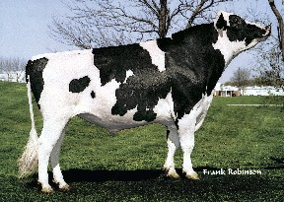
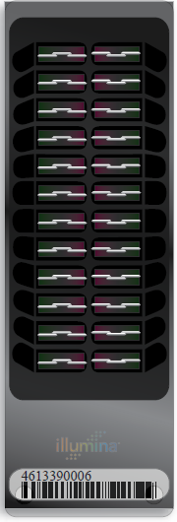
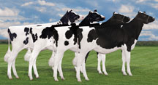
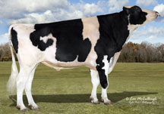
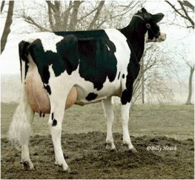
Genomic prediction of progeny test
0
1
2
3
4
5
  Select parents, transfer embryos to recipients
Calves born from DNA-selected parents
Bull receives progeny test
  Calves born and DNA tested
Reduce generation interval from 5 to 2 years

Slide 45
Genetic choices
Before genomics:
  Progeny-tested bulls with daughter records (PTA)
  Young bulls with parent average (PA)
After genomics:
  Young animals with DNA test (GPTA)
  GPTA reliability of ~70% for Holstein NM$ compared with ~35% for PA and ~85% for PTA

Slide 46
Young bulls (2013 NM$ vs. 2010 PA)

Slide 47
Progeny-tested bulls (2013 vs. 2010 NMS)

Slide 48
Genotyped mates of top young bulls

Slide 49
Why genomics works for dairy cattle
Extensive historical data available
Well-developed genetic evaluation program
Widespread use of AI sires
Progeny-test programs
High-value animals worth the cost of genotyping
Long generation interval that can be reduced substantially by genomics

Slide 50
Key issues for the dairy industry
Inbreeding and genetic diversity
  including across breeds
Sequencing, new genes, and mutations
Novel traits, resource populations
  feed efficiency, health, milk properties

Slide 51
Application to more traits
Animal’s genotype good for all traits
Traditional evaluations required for accurate estimates of SNP effects
Traditional evaluations not currently available for heat tolerance or feed efficiency
Research populations could provide data for traits that are expensive to measure
Will resulting evaluations work in target population?

Slide 52
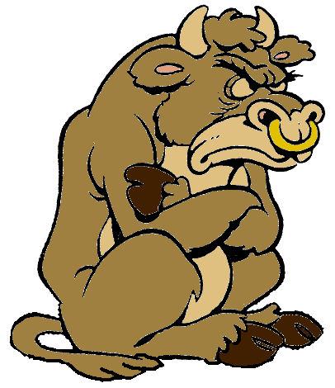
Parentage validation and discovery
Parent-progeny conflicts detected
  Animal checked against all other genotypes
  Reported to breeds and requesters
  Correct sire usually detected
Maternal grandsire checking
  SNP at a time checking
  Haplotype checking more accurate
Breeds accept SNPs along with
microsatellites

Slide 53
Haplotypes affecting fertility
Rapid discovery of new recessive defects
  Large numbers of genotyped animals
  Affordable DNA sequencing
Determination of haplotype location
  Significant number of homozygous animals expected, but none observed
  Narrow suspect region with fine mapping
  Use sequence data to find causative mutation

Slide 54
Haplotypes affecting fertility
Name | Chromo- some* | Location** (Mbp) | Carrier frequency (%) | Earliest known ancestor
HH1 | 5 | 63.2** | 3.8 | Pawnee Farm Arlinda Chief
HH2 | 1 | 94.9 – 96.6 | 3.3 | Willowholme Mark Anthony
HH3 | 8 | 95.4** | 5.9 | Glendell Arlinda Chief, Gray View Skyliner
HH4 | 1 | 1.3** | 0.7 | Besne Buck
HH5 | 9 | 93.2 – 93.4 | 4.4 | Thornlea Texal Supreme
JH1 | 15 | 15.7** | 24.2 | Observer Chocolate Soldier
JH2 | 26 | 8.8 – 9.4 | 2.6 | Liberators Basilius
BH1 | 7 | 42.8 – 47.0 | 13.3 | West Lawn Stretch Improver
BH2 | 19 | 11.1** | 15.6 | Rancho Rustic My Design
AH1 | 17 | 65.9** | 26.0 | Selwood Betty’s Commander
*Bos taurus autosome (BTA) **Causative mutation known; Mbp = megabase pairs

Slide 55
Haplotypes for known recessives (Holstein)
Recessive | Haplo- type | BTA chromo- some | Location* (Mbp) | Carrier frequency (%)
Brachyspina | HH0 | 21 | 21.2 | 5.5
BLAD | HHB | 1 | 145.1* | 0.5
CVM | HHC | 3 | 43.4* | 2.7
DUMPS | HHD | 1 | 69.8* | <0.1
Mule foot | HHM | 15 | 77.7 | 0.1
Polled (dominant) | HHP | 1 | 1.7 – 2.0 | 1.4
Coat color
Red | HHR | 18 | 14.8* | 10.8
Black/red | HBR | 18 | 14.8 | 1.6
Dominant red | HDR | 3 | 9.5* | 0.1
Cholesterol deficiency | HCD | 11 | 78.0* | 5.0
*Causative mutation known

Slide 56
Haplotypes for known recessives (other breeds)
Recessive | Haplo- type | BTA chromo- some | Location* (Mbp) | Carrier frequency (%)
Polled (dominant) | JHP | 1 | 1.7 – 2.0 | 4.4
 | BHP | 1 | 1.7 – 2.0 | 0.8
SDM | BHD | 11 | 14.7* | 4.4
SMA | BHM | 24 | 62.1 – 62.2 | 7.2
Weaver | BHW | 4 | 49.9* | 3.1
*Causative mutation known

Slide 57

International dairy breeding
Genotype alliances
  North America (US, Canada, UK, Italy)
  Ireland, New Zealand
  Netherlands, Australia
  Eurogenomics (Denmark/Sweden/Finland, France, Germany, Netherlands/Belgium, Spain, Poland)
Interbull genomic multitrait across-country evaluation (GMACE)
  Proposed exchange of SNP effects (SNPMACE)

Slide 58
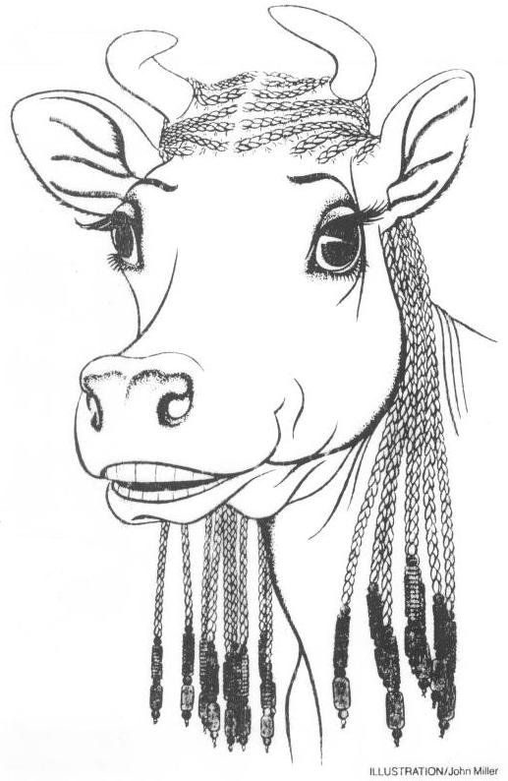
Impact on breeders
Haplotype and gene tests used in selection and mating programs
Trend towards a small number of elite breeders that are investing heavily in genomics
About 30% of young males genotyped directly by breeders since April 2013
Over 65% of breedings to genomic bulls
Prices for top genomic heifers can be very high
(e.g., $265,000)

Slide 59
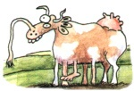
Impact on dairy producers
General
  Reduced generation interval
  Increased rate of genetic gain
  More inbreeding/homozygosity?
Sires
  Higher average genetic merit of available bulls
  More rapid increase in genetic merit for all traits
  Larger choice of bulls for traits and semen price
  Greater use of young bulls

Slide 60
Conclusions
Genomic evaluation has dramatically changed dairy cattle breeding
Rate of gain is increasing primarily because of a large reduction in generation interval
Genomic research is ongoing
  Detect causative genetic variants
  Find more haplotypes affecting fertility
  Improve accuracy through more SNPs, more predictor animals, and more traits

Slide 61
Acknowledgments
Appropriated project 8042-31000-101-00, “Improving Genetic Predictions in Dairy Animals Using Phenotypic and Genomic Information,” Agricultural Research Service, USDA
Kristen Gaddis, Dan Null, Paul VanRaden, and George Wiggans
Council on Dairy Cattle Breeding

Slide 62
Acknowledgments (cont’d)
Dr. Kirill Plemyashov and Dr. Andrei Kudinov
Department of Animal Husbandry and Breeding of Ministry of Agriculture of the Russian Federation
Committee on Agriculture and Fisheries of the Leningrad Region
St. Petersburg State Academy of Veterinary Medicine
JSC "Neva for breeding"

Slide 63
Disclaimer
Mention of trade names or commercial products in this presentation is solely for the purpose of providing specific information and does not imply recommendation or endorsement by the United States Department of Agriculture.

Slide 64
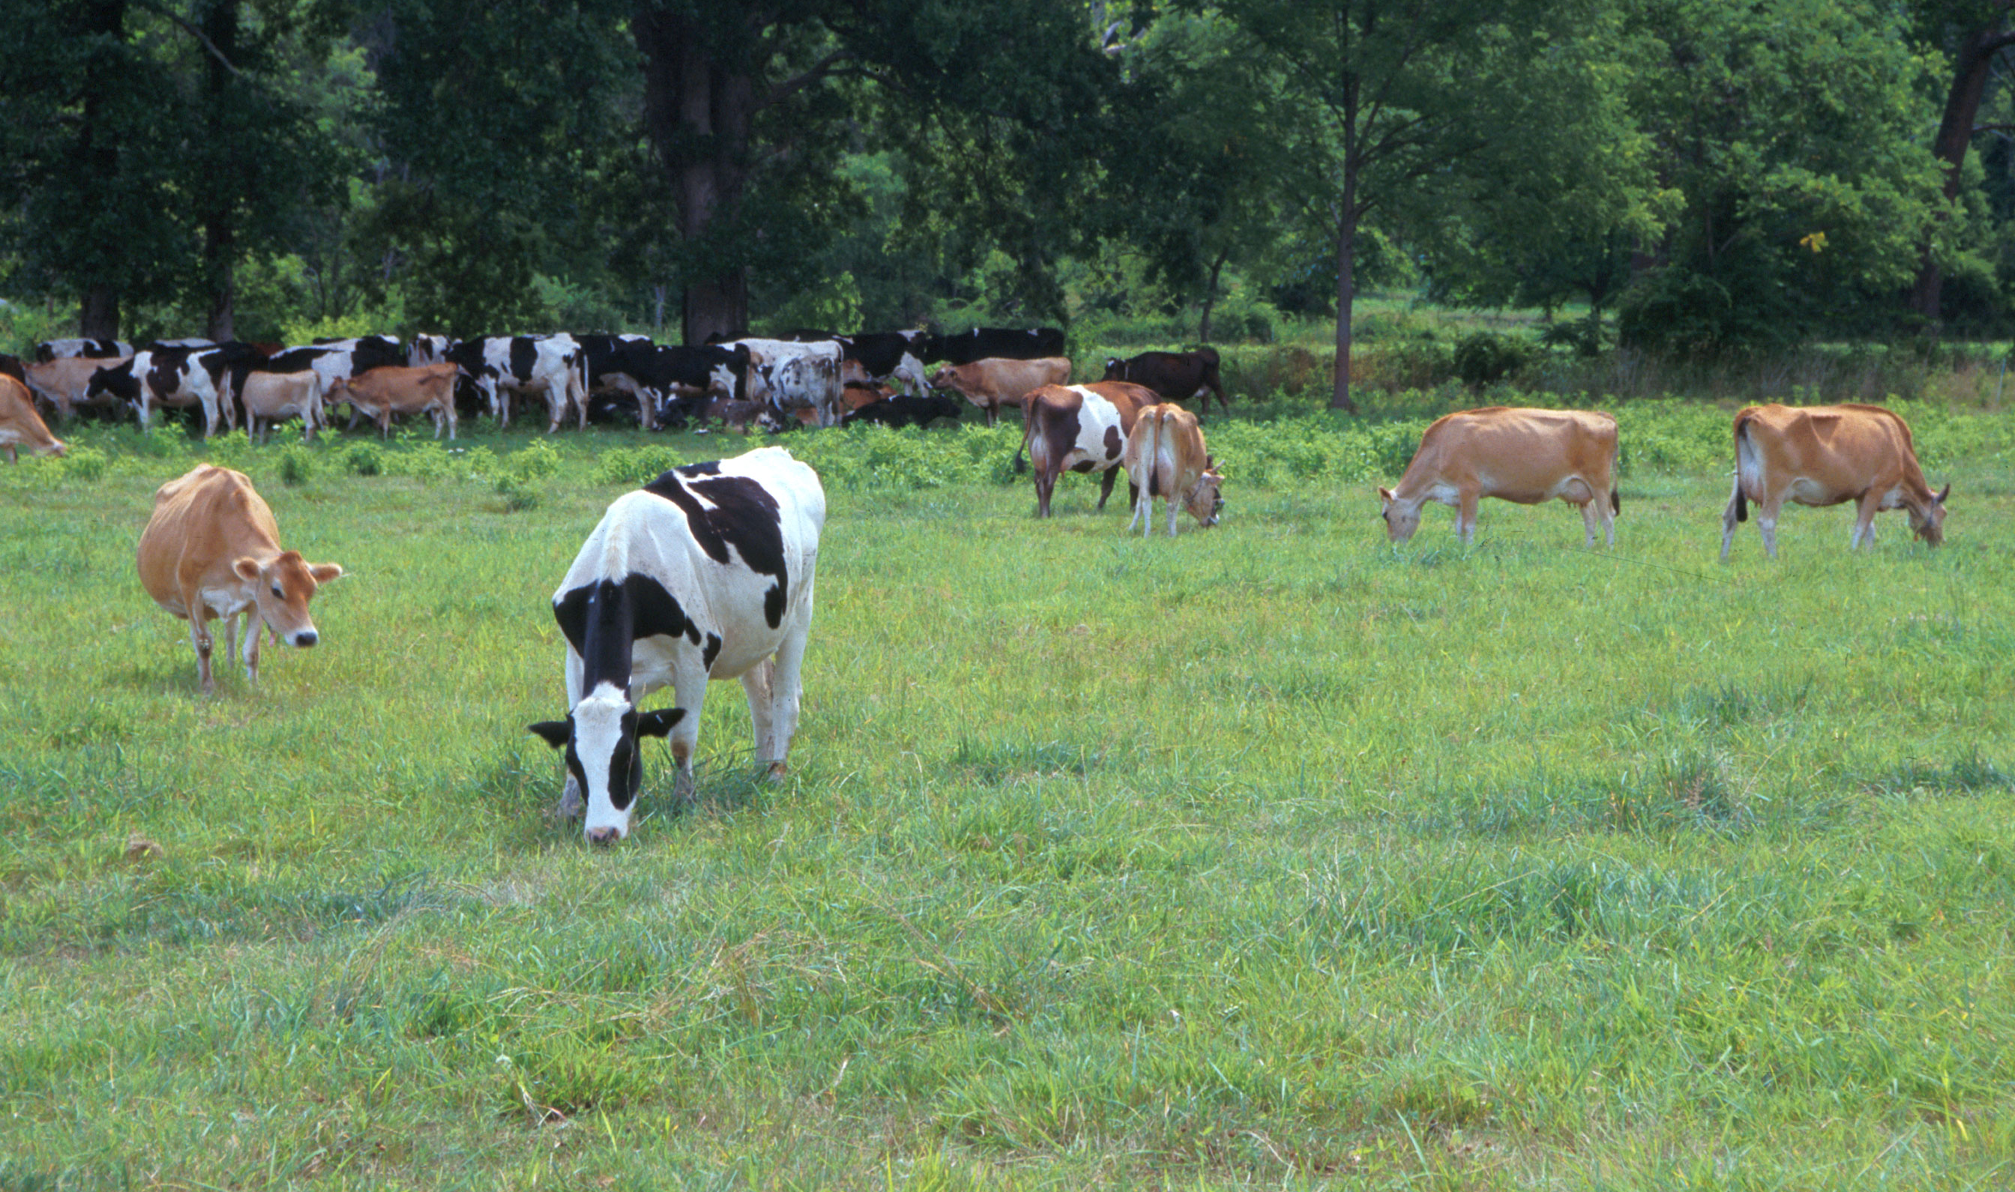
Questions?
AIP web site:
http://aipl.arsusda.gov
Holstein and Jersey crossbreds graze on American Farm Land Trust’s
Cove Mountain Farm in south-central Pennsylvania
Source: ARS Image Gallery, image #K8587-14; photo by Bob Nichols

