Slide 1
The role of phenotyping in dairy cattle improvement in the genomic era
John B. Cole
Animal Genomics and Improvement Laboratory
Agricultural Research Service, USDA, Beltsville, MD
john.cole@ars.usda.gov

Slide 2
What is a phenotype?
Any characteristic or property of an animal that we can observe and measure
Early selection probably was based on coat color and pattern
Later, milk and butterfat were used
Now we measure many things

Slide 3
What do we routinely measure today?
Trait Heritability
Yield (milk, fat, protein) 15–29%
Conformation (type) (~17 traits) 8–51%
Longevity (productive life, cow livability) 1.3–8%
Somatic cell score 12%
Daughter pregnancy rate 1.4%
Heifer conception rate 1%
Cow conception rate 1.6%
Service sire (direct) calving ease 8.6%
Daughter (maternal) calving ease 4.8%
Service sire (direct) stillbirth rate 0.8%
Daughter (maternal) stillbirth rate 2.1%

Slide 4
Why do scientists measure things?
Because we can?
  “That’s funny...” are the most interesting words in science
To better understand a phenomenon
  How does it work?
  Is it predictable?
  Can we change it?
My advisor told me to do it, and I want to graduate

Slide 5
Why do farmers measure things?
To make better decisions
  Must be perceived value
  Not everyone agrees on value (e.g., animal ID)
Direct financial incentive
  E.g., progeny-test herds
Because scientists ask them to
  May be narrow limits on what farmers will do out of generosity

Slide 6
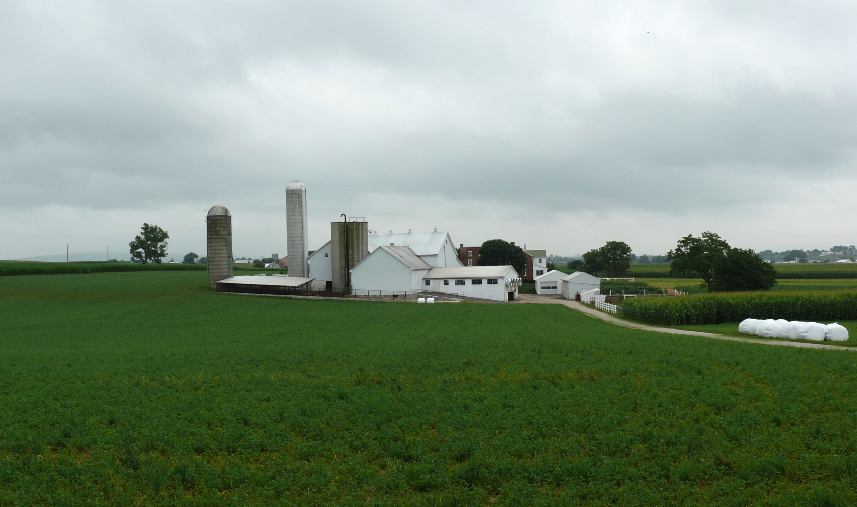
Sources of new phenotypes
Barn: Flooring type, bedding materials, density, weather data
Cow: Body temperature, activity, rumination time, feed & water intake
Herdsmen/consultants: Health events, foot/claw health, veterinary treatments
Parlor: yield, composition, milking speed, conductivity, progesterone, temperature
Silo/bunker: ration composition, nutrient profiles
Pasture: soil type/composition, nutrient composition
Source: http://commons.wikimedia.org/wiki/File:Amish_dairy_farm_3.jpg

Slide 7
What influences a phenotype?
P = G + E
Percentage of total variation attributable to genetics is small
CA$: 0.07
DPR: 0.04
PL: 0.08
SCS: 0.12
Percentage of total variation attributable to environmental factors is large
Feeding/nutrition
Housing
Reproductive management

Slide 8
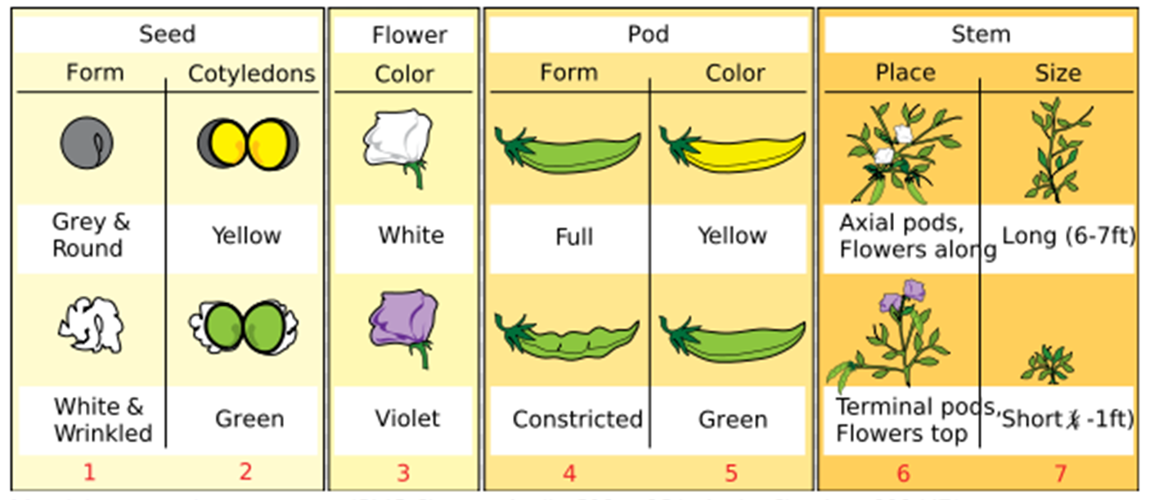
Mendel wanted to understand
Source: https://adapaproject.org/bbk_temp/tiki-index.php?page=Leaf%3A+Who+was+Gregor+Mendel%3F

Slide 9
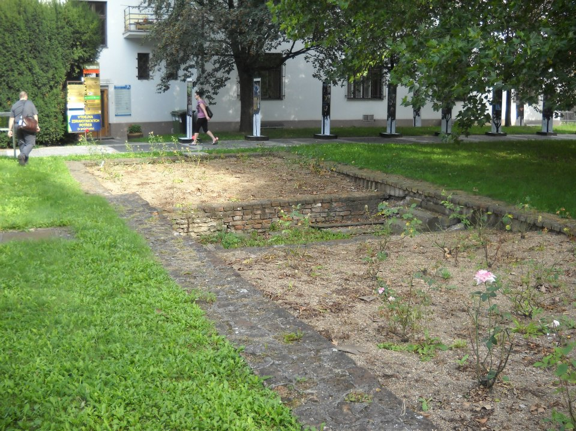

Slide 10
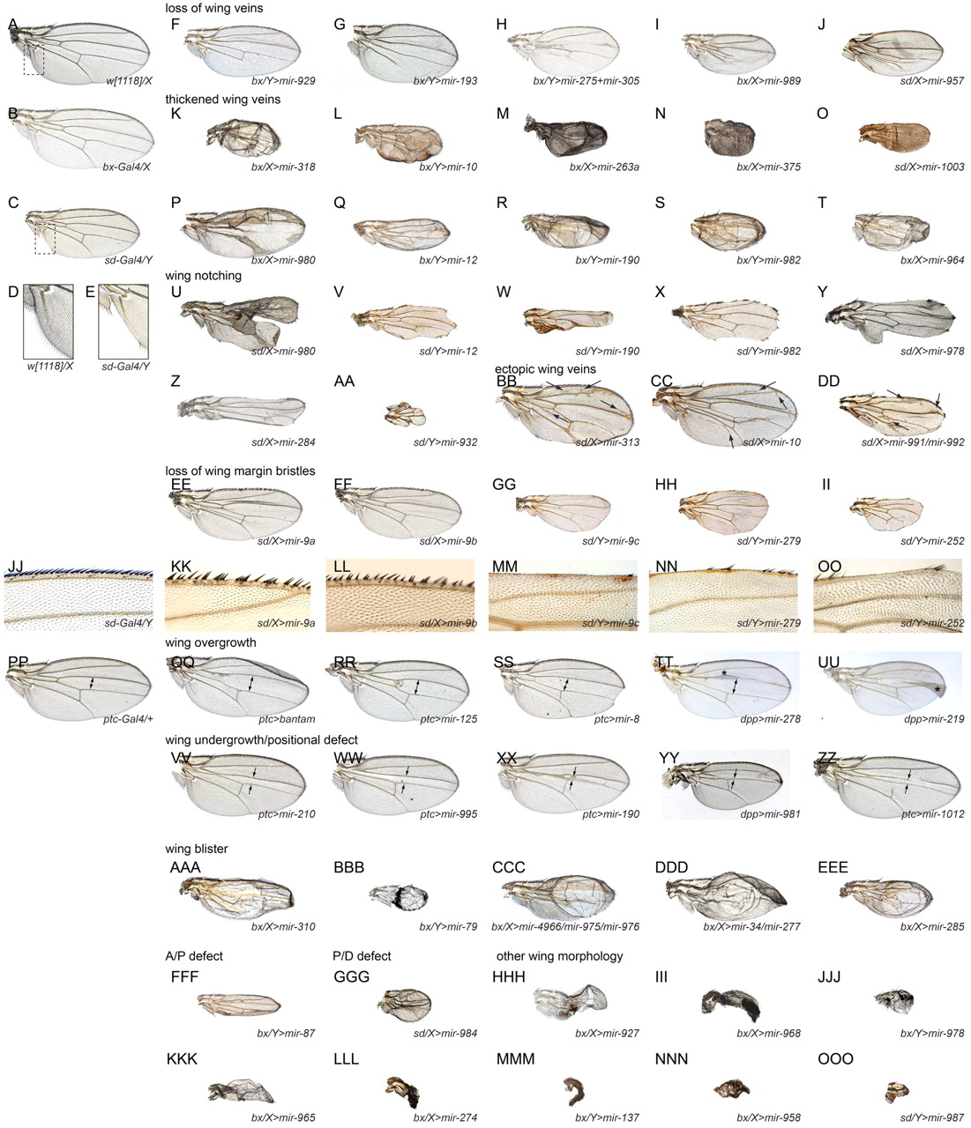
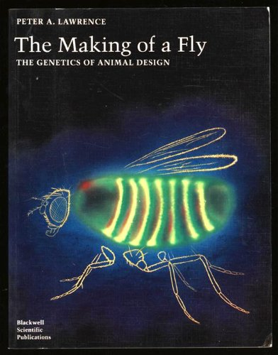
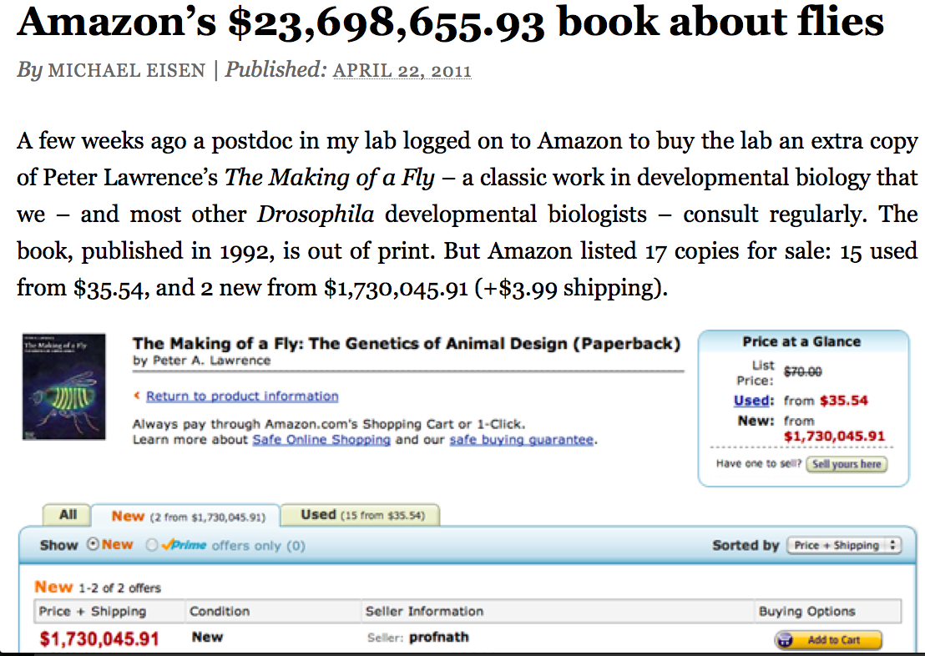
Morgan et al. said, “That’s interesting …”
Source: http://dev.biologists.org/content/139/15/2821

Slide 11
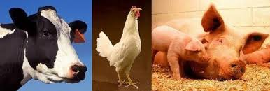
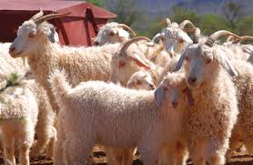
Genetic diversity in livestock species
Tremendous phenotypic variation among livestock species
Several contributing mechanisms (Andersson, COGD, 2013)
  Directional selection for adaptive mutations
  Directional selection for phenotypic apperance
  Natural selection for human environment
  Genetic drift
Source: Agricultural Research Service, USDA

Slide 12
Mendelian recessives are not unusual
Name | Chr | Location (Mbp) | Minor haplotype frequency |  | Gene name
HH1 | 5 | 63.2 | 1.92 |  | APAF1
HH2 | 1 | 94.9–96.6 | 1.66 |  | Unknown
HH3 | 8 | 95.4 | 2.95 |  | SMC2
HH4 | 1 | 1.3 | 0.37 |  | GART
HH5 | 9 | 93.2–93.4 | 2.22 |  | TFB1M
JH1 | 15 | 15.7 | 12.10 |  | CWC15
JH2 | 26 | 8.8–9.4 | 1.3 |  | Unknown
BH1 | 7 | 42.8–47.0 | 6.67 |  | Unknown
BH2 | 19 | 11.1 | 7.78 |  | TUBD1
AH1 | 17 | 65.9 | 13.0 |  | UBE3B
For complete list, see:
http://aipl.arsusda.gov/reference/recessive_haplotypes_ARR-G3.html

Slide 13
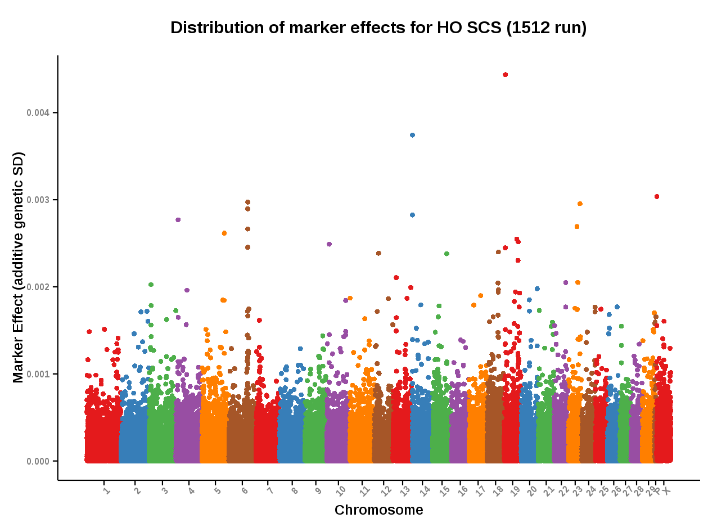
Many genes affect quantitative traits
Source: Council on Dairy Cattle Breeding, https://www.uscdcb.com/Report_Data/Marker_Effects/marker_effects.cfm?Breed=HO&Trait=SCS

Slide 14
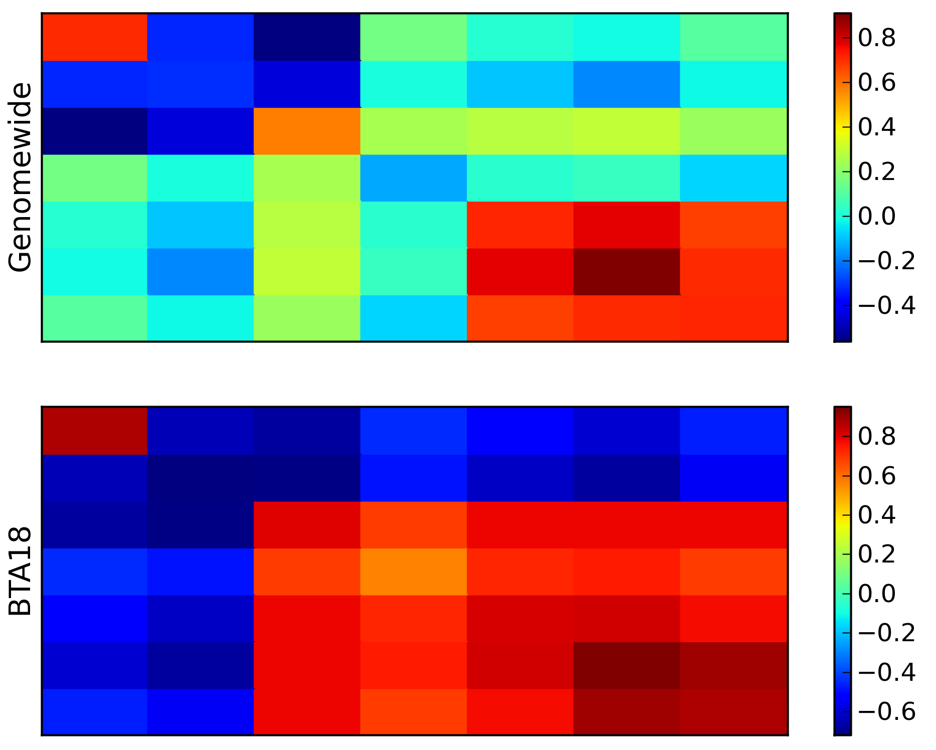
Pleiotropy is not unusual

Slide 15
How do we choose what to measure?
Opportunity
  Phenotype is easily measured using available labor and materials
Necessity
  Measurement is needed to solve a problem
Novelty
  Most of us like to work on new problems

Slide 16
How carefully should we measure?
Precise definitions are important (e.g., Seidenspinner et al., AG, 2009)...
  ...except when they’re not (Waurich et al., EAAP, 2011)
How many values do discrete scales really need?
Beware false precision on continuous scales!
Remember P = G + E!

Slide 17
Are we talking about the same thing?
What do commonly used terms mean?
  “Efficiency,” “health,” “sustainability,” “welfare”
Unlike things may be grouped together
  “Lameness” vs. “locomotion”
Some computer formats can support general as well as detailed reports
  e.g., AGIL format 6

Slide 18
Context matters
Information often lacking about environments in which phenotypes are expressed
  Where? When? How?
Qualitative vs. quantitative descriptions
Phenotypes often change over time
  Sometimes desirable, sometimes not
Who records the phenotypes?

Slide 19
Selection indices include many traits …
Source: Miglior et al. (2012)

Slide 20
… and we keep adding new ones
Trait | Relative emphasis on traits (%)
 | PD$ 1971 | MFP$ 1976 | CY$ 1984 | NM$ 1994 | NM$ 2000 | NM$ 2003 | NM$ 2006 | NM$ 2010 | NM$ 2014 | NM$ 2017
Milk | 52 | 27 | –2 | 6 | 5 | 0 | 0 | 0 | –1 | –1
Fat | 48 | 46 | 45 | 25 | 21 | 22 | 23 | 19 | 22 | 24
Protein | … | 27 | 53 | 43 | 36 | 33 | 23 | 16 | 20 | 18
PL | … | … | … | 20 | 14 | 11 | 17 | 22 | 19 | 13
SCS | … | … | … | –6 | –9 | –9 | –9 | –10 | –7 | –7
UC | … | … | … | … | 7 | 7 | 6 | 7 | 8 | 7
FLC | … | … | … | … | 4 | 4 | 3 | 4 | 3 | 3
BWC | … | … | … | … | –4 | –3 | –4 | –6 | –5 | –6
DPR | … | … | … | … | … | 7 | 9 | 11 | 7 | 7
SCE | … | … | … | … | … | –2 | … | … | … | …
DCE | … | … | … | … | … | –2 | … | … | … | …
CA$ | … | … | … | … | … | … | 6 | 5 | 5 | 5
HCR | … | … | … | … | … | … | … | … | 1 | 1
CCR | … | … | … | … | … | … | … | … | 2 | 2
LIV | … | … | … | … | … | … | … | … | … | 7

Slide 21
Some recent new dairy phenotypes
Lactation persistency (Cole et al., JDS, 2009)
Claw health (Van der Linde et al., JDS, 2010)
Methane production (de Haas et al., JDS, 2011)
Milk fatty acids (Soyeurt et al., JDS, 2011)
Embryonic development (Cochran et al., BR, 2013)
Immune response (Thompson-Crispi et al., JDS, 2013)
Rectal temperature (Dikmen et al., PLoS1, 2013)
Residual feed intake (Connor et al., JAS, 2013)
Dairy cow health (Parker Gaddis et al., JDS, 2014)
Cow livability (VanRaden et al., IB, 2017)

Slide 22
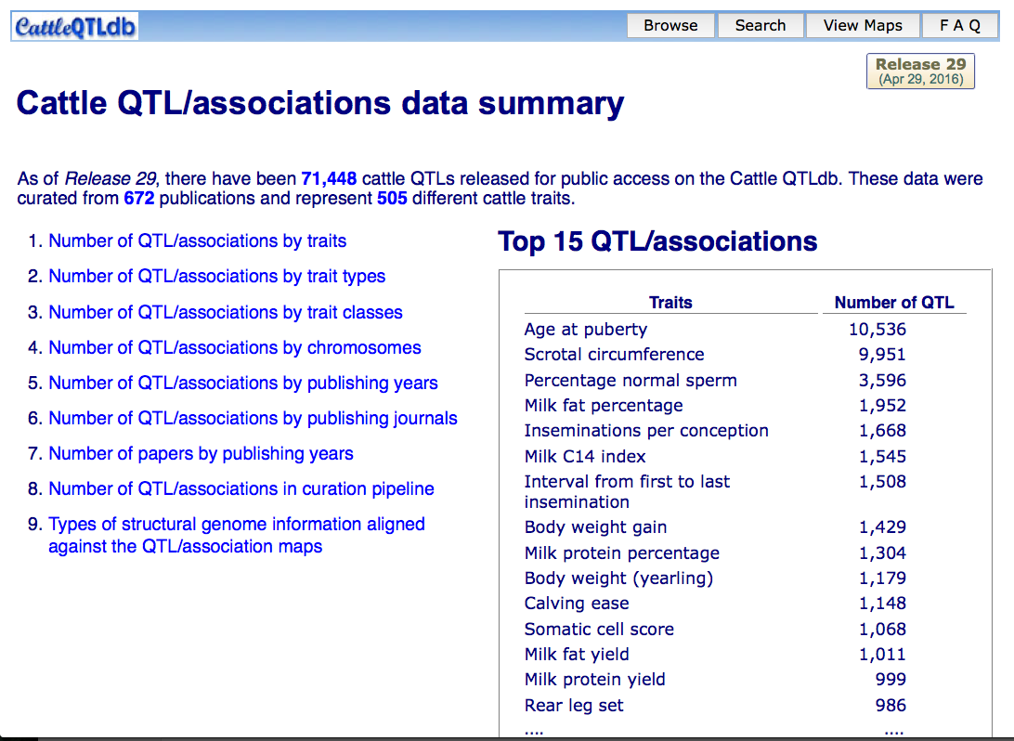
When is enough enough?
505
phenotypes!
Source: CattleQTLdb: http://www.animalgenome.org/cgi-bin/QTLdb/BT/summary

Slide 23
Digression – how many QTLs, did you say?
If there really are 1,148 calving ease QTLs, then
What really is a QTL?
Is Bayes B actually so objectionable after all?
What should we really be selecting for?

Slide 24
Making sense of 505 cattle traits
Ontologies organize traits by their meaning and relationship(s) to one another
Hughes et al. (ISU PhD thesis, 2008) reported on the Animal Trait Ontology Project
  Livestock product trait ontology includes 473 terms
Who uses these structures?
  Should ontology IDs be used to identify phenotypes in manuscripts?

Slide 25
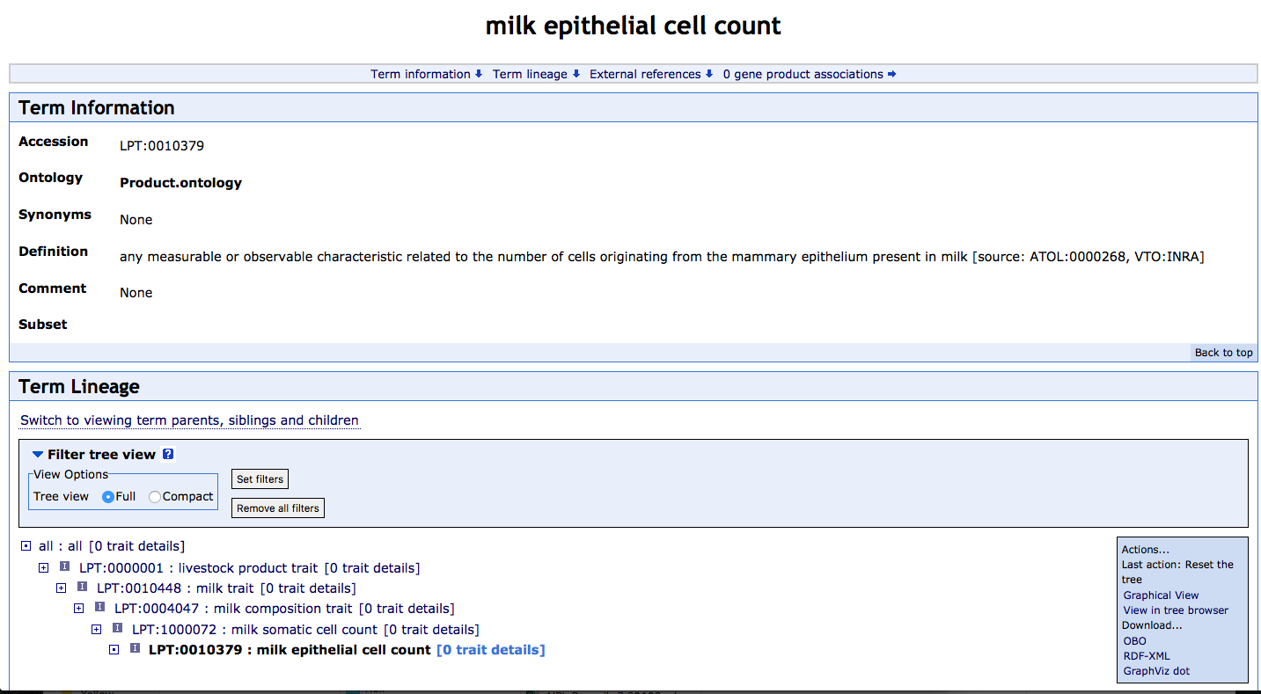
Example ontology (milk SCC)
Source: Livestock Production Trait Ontology

Slide 26
Who gets to define phenotypes?
Anyone willing to take the time?
  Just because you define it does not mean people will use it
International standards bodies
  ICAR Working Group on Functional Traits
Are we comfortable with proprietary phenotypes?
  Does it matter?

Slide 27
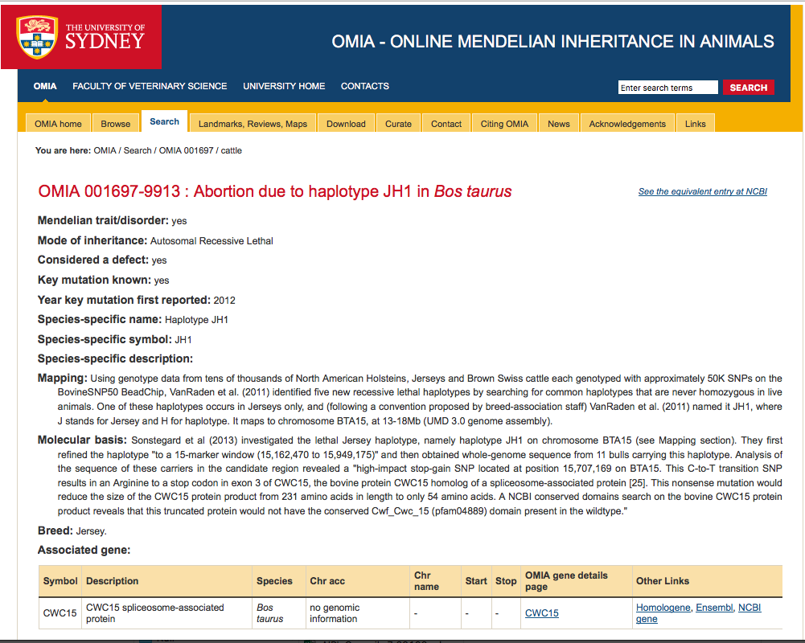
Formal definitions exist for recessives
Source: OMIA – Online Mendelian Inheritance in Animals, http://omia.angis.org.au/OMIA1697/9913/

Slide 28
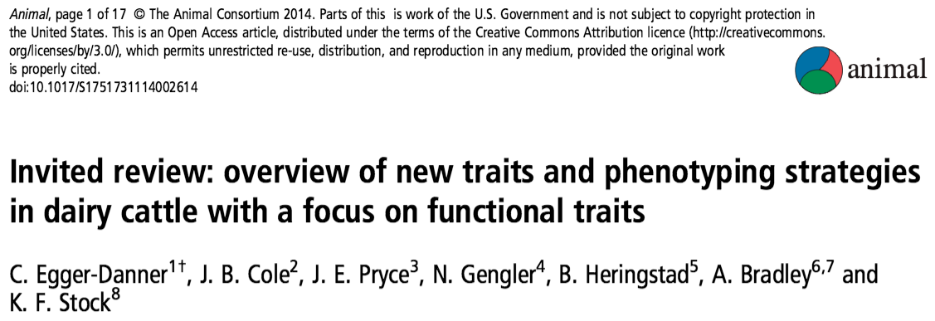
Why do we need new traits?
Changes in production economics
Technology produces new phenotypes
Better understanding of biology
Recent review by Egger-Danner et al. (Animal, 2015)
This is a fancy way
of saying that
selection objectives
change!

Slide 29
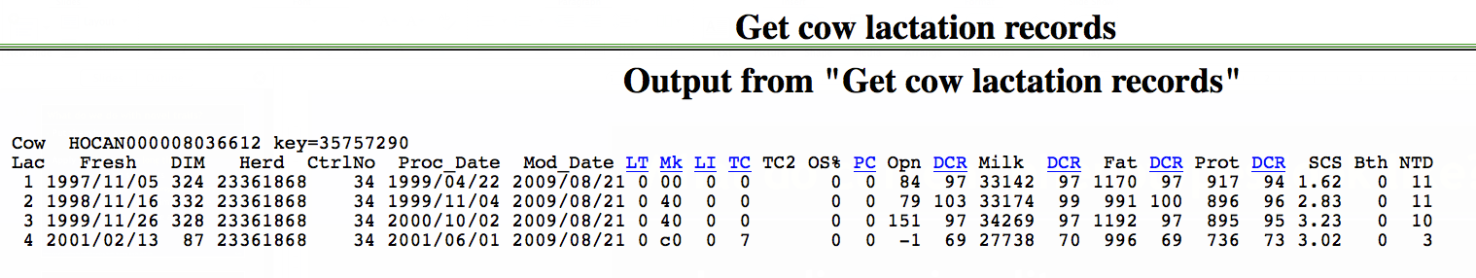
What do current phenotypes look like?
Low dimensionality
  Usually few observations per lactation
  Close correspondence of phenotypes with values measured
  Easy transmission and storage

Slide 30
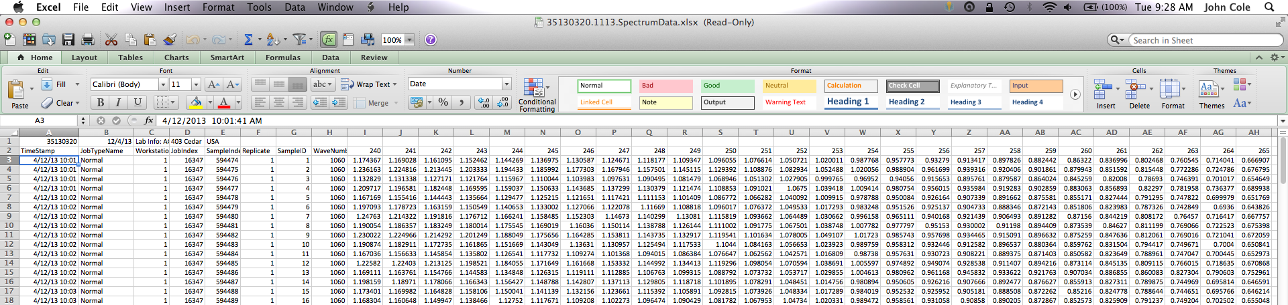
What do new phenotypes look like?
High dimensionality
  Example: MIR produces 1,060 points/observation
  Disconnect between phenotype and measurement
  More resources needed for transmission, storage, and analysis

Slide 31
New traits should add information
Novel phenotypes include some new information | Novel phenotypes contain little new information
Novel phenotypes include much new information | Novel phenotypes include some new information
High
Phenotypic correlation
with existing traits
Low
Low
High
Genetic correlation with existing traits

Slide 32
New traits should have value
Milk yield | Feed intake
Conformation | Greenhouse gas emissions
High
Phenotype value
Low
Low
High
Measurement cost

Slide 33
Does P matter in the genomics era?
An animal’s genotype is good for all traits
Traditional evaluations are required for accurate estimates of SNP effects…
But evaluations are not currently available for many new traits (e.g., feed efficiency)
Research populations could provide data for traits that are expensive to measure
Will resulting evaluations work in target population?

Slide 34
Genotypes are abundant
Imputed, young
Imputed, old (young cows included before March 2012)
<50K, young, female
<50K, young, male
<50K, old, female
<50K, old, male (≤ 20 bulls)
≥50K, young, female
≥50K, young, male
≥50K, old, female
≥50K, old, male
2009
2010
2011
2012
2013
2014
2015
2016
2017

Slide 35
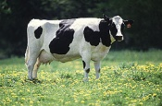
What’s a SNP genotype worth?
Pedigree is equivalent to information on ~7 daughters
For protein yield (h² = 0.30), the SNP genotype provides information equivalent to an additional 34 daughters

Slide 36

What’s a SNP genotype worth?
And for daughter pregnancy rate (h² = 0.04), SNP = 131 daughters

Slide 37
We can construct P from G
Predict from correlated traits or phenotypes from reference herds
Causal variants can be used in place of markers
Haplotypes can be used when causal variants are not known
Specific combining abilities can combine additive and dominance effects (e.g., Sun et al., PLoS1, 2014)

Slide 38
What do we do with new traits?
Put them into a selection index
  Correlated traits are helpful
Apply selection for a long time
  No shortcuts
Collect many phenotypes
  Repeated records of limited value
  Genomics can increase accuracy
Weigh cost vs. benefit

Slide 39
What challenges are on the horizon?
We need more frequent sampling for modern management
  Samples do not need to be evenly spaced across the lactation
Some large farms do not see a value proposition in milk recording
On-farm data are growing but not collected in a central database

Slide 40
Has the DHI system fallen behind?
Research is being done on new traits
Often not turned into new products
Collective action problem
  Disagreement on objectives
  Lack of commercial incentives
  Infrastructure is not in place
Opportunity for new players to enter the market

Slide 41
How do new players fit into the system?
How do we deal with data collected outside of the DHI system?
  QC guidelines
  Standards for data analysis
Is lack of independent validation a problem?
How do we combine data from old and new data providers?
  Unified national evaluations?

Slide 42
No guarantees with new technologies
New technologies often require considerable capital investment
They sometimes fail to work or do not deliver the promised gain
Data are most useful when combined with observations from many farms
This inevitably involves risk

Slide 43
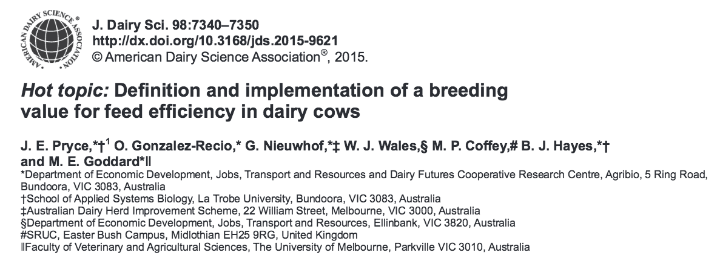
Collaboration is essential
When new traits are expensive, it takes a consortium to collect the data needed for genetic evaluation

Slide 44
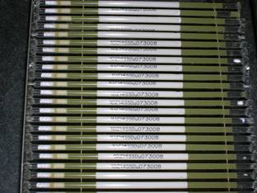
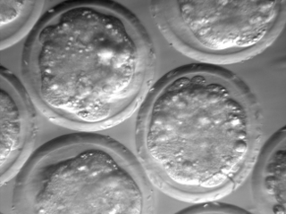
Preservation of unique resources
Many unique resources have been lost (e.g., selection experiments)
We need to preserve phenotypes as well as genotypes
Whose job is this?
  Perhaps ARS’s National Center for Genetic Resources Preservation? (Ft. Collins, CO)
Source: NAGP, PAGRP, ARS, USDA
Source: Cummings Veterinary Medical Center, Tufts University

Slide 45
Conclusions
Phenotypes are the foundation of genetic improvement programs
Modern tools produce lots of data
Those data can be used to improve herd management and profitability
We need to rise to the challenge of turning new data into decisions

Slide 46
Acknowledgments
Appropriated project 8042-31000-101-00, “Improving Genetic Predictions in Dairy Animals Using Phenotypic and Genomic Information,” Agricultural Research Service, USDA
Kristen Gaddis, Dan Null, Paul VanRaden, and George Wiggans
Council on Dairy Cattle Breeding

Slide 47
Acknowledgments (cont’d)
Dr. Kirill Plemyashov and Dr. Andrei Kudinov
Department of Animal Husbandry and Breeding of Ministry of Agriculture of the Russian Federation
Committee on Agriculture and Fisheries of the Leningrad Region
St. Petersburg State Academy of Veterinary Medicine
JSC "Neva for breeding"

Slide 48
Disclaimer
Mention of trade names or commercial products in this presentation is solely for the purpose of providing specific information and does not imply recommendation or endorsement by the United States Department of Agriculture.

Slide 49
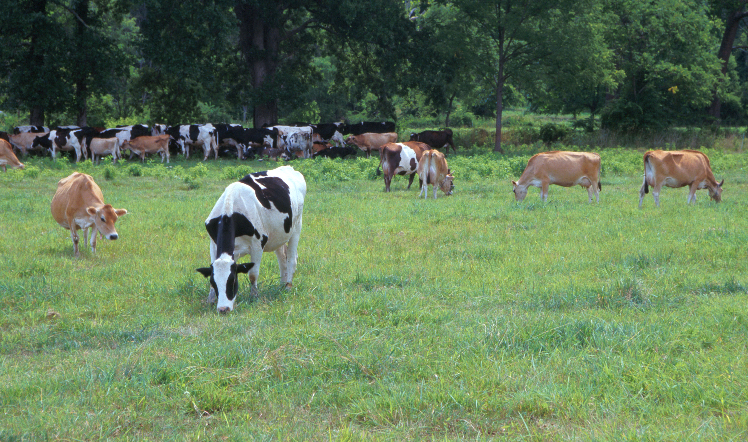
Questions?
AIP web site:
http://aipl.arsusda.gov
Holstein and Jersey crossbreds graze on American Farm Land Trust’s
Cove Mountain Farm in south-central Pennsylvania
Source: ARS Image Gallery, image #K8587-14; photo by Bob Nichols

