Slide 1
  What is cooking at AGIL?
Dr Paul VanRaden and chef Dan Null
USDA Animal Genomics and Improvement Lab,
Beltsville, MD 20705
Email: paul.vanraden@ars.usda.gov
Web site: https://aipl.arsusda.gov/

Slide 2
Menu for the talk
Course | Selections | Price
Appetizer | Discovering maternal grandsires and maternal great grandsires | Free
Soup and salad | Modeling the accuracy of pedigree data | Free
Main course | New cattle DNA reference map, SNP list, and haplotypes | Free
Drinks | Age at first calving as a new trait | Free
Dessert | Feed intake reliabilities | Free
After dinner | What’s cooking at Paul’s house? | $2.18 / day

Slide 3
Appetizer: Discovering pedigrees (parents, grandparents, etc.)
 | Sire
Calf
 |  | MGSire
 | Dam | MGGSire
 |  | MGDam
Notes:
We are all familiar with a traditional pedigree chart. Animal is expected to be an average of his parents.

Slide 4
Accuracy of ancestor discovery
If the true ancestor is genotyped, accuracy of discovery is very high
If the reported pedigree is wrong, accuracy of detection also high
With lower density chips, accuracy is slightly reduced
Methods published and used since 2013: https://aipl.arsusda.gov/publish/jds/2013/96_1874.pdf
Ancestor | Correctly discovered
SIRE | ~100%
MGS | 97%
MGGS | 92%

Slide 5
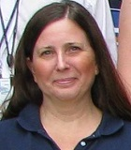
Filling in pedigrees
>200,000 discovered MGS not yet used because no Dam ID available
>200,000 discovered MGGS not yet used because no MGDam ID available
Procedures developed to fill the missing IDs to link to ancestors
  HO999DAM000000001 for example
  Similar system used for several years in CAN, ID’s not released to public
  Should evaluations and / or public use the discovered pedigrees?
First check if true dam can be discovered in same herd (20,000 found)
  Match birth and fresh dates, only 1 dam’s pedigree matches calf’s

Slide 6
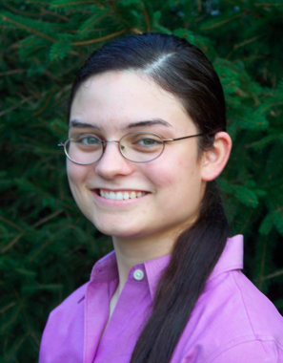
Accounting for pedigree accuracy
Bulls differ in accuracy of daughter pedigree
  Most bulls have about 90% of ‘daughters’ correctly coded
  Some bulls now have 100% correct because all are genotyped
New methods were tested to remove biases from reporting accuracy
  Genes assumed 90% from reported sire, 10% from unknown sire group
  Biases in Holstein PTAs were smaller than expected
  Changes in rank from new model were also small
Project completed by AGIL postdoc Heather Bradford (now at VPI)

Slide 7
Chromosome Pedigree (O-Style) chromosome 15

Slide 8
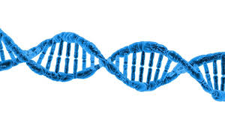
Main course: Cattle DNA reference map
Why do researchers use the same map?
  Lets everyone track genetic differences using a common language
  Shows where genes are, and how the DNA encodes proteins (annotation)
Why switch to a new map?
  Many sections of the previous map were on wrong chromosome
  Improve imputation of missing SNPs by large-scale rearrangements
  Improve annotation and alignment by small-scale refinements
  1000 Bull Genomes Project will switch from UMD3 to ARS-UCD

Slide 9
Two assemblies: UMD3 and ARS-UCD
UMD3: Zimin et al. 2009 Genome Biology 10:R42
  University of Maryland and USDA-ARS research
  Used by most cattle genotyping and sequencing studies since 2009
  ‘Corrected’ version was used by AGIL after mismapped sections removed
ARS-UCD: Rosen et al. 2018 WCGALP, vol. Molecular Genetics 3, p. 802
  USDA-ARS-AGIL, U. California-Davis, and several other researchers
  Used long reads to bridge across repeats, then short reads for polishing
  Annotation (gene structure) released by NCBI in May 2018

Slide 10
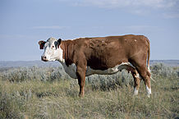
New cattle genome reference map
New and old maps both about 2.7 billion bases long
ACGTGTCATCGATCCTAGGCTTAGCTACGATCCGATCGATTTCGATCGATCGAATCG
Compare previous UMD3 map to new ARS-UCD map
  Both maps assembled the genome using only Dominette DNA
  Inheritance and consistency of haplotypes across generations
  Imputation and alignment tests
Implement the ARS-UCD map during a full release, hopefully December 2018

Slide 11
Converting locations to a different map
Convert SNP locations (liftover)
  Use probe from chip manifest or flanking sequence, align to new map
  Or simulate paired end reads from old map, align to new map
  Help from Bob Schnabel, U MO
Each chromosome may be longer or shorter than previous assembly
  Many insertions, deletions, inversions, translocations vs. UMD3
  Autosomes range from -4.3% shorter (chr12) to 0.6% longer (chr26)
  X chromosome 6.6% longer than UMD3, with more distinct PAR

Slide 12
X and Y chromosomes
DNA differs on X and Y,
but pseudo-autosomal
region is the same DNA
on both chromosomes

Slide 13
Compare pseudo-autosomal region (PAR) of X
X
PAR
UMD3
X
ARS-UCD
PAR
New SNPs were selected to fill the gaps in the longer X
Notes:
142 SNP changed chromosome (.24%)

Slide 14
Liftover of SNP locations
Probes used for genotyping SNPs on arrays
  A 50-base sequence extended to the right or left of SNP, such as
  [C/T]AGTCAGCTCTGTGGCCTGGGCAGGTTCCCAGGATATTCCAGCCAGAC
  Where was this located on the old map?
  Where is this located on the new map?
Difficulties
  Could have multiple locations in map or other SNPs within the probe
  Some read errors, or maternal vs. paternal chromosome of Dominette

Slide 15
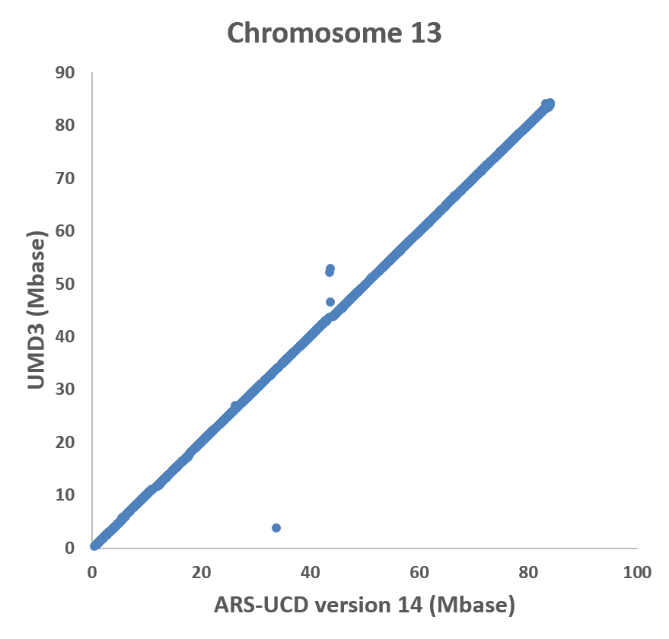
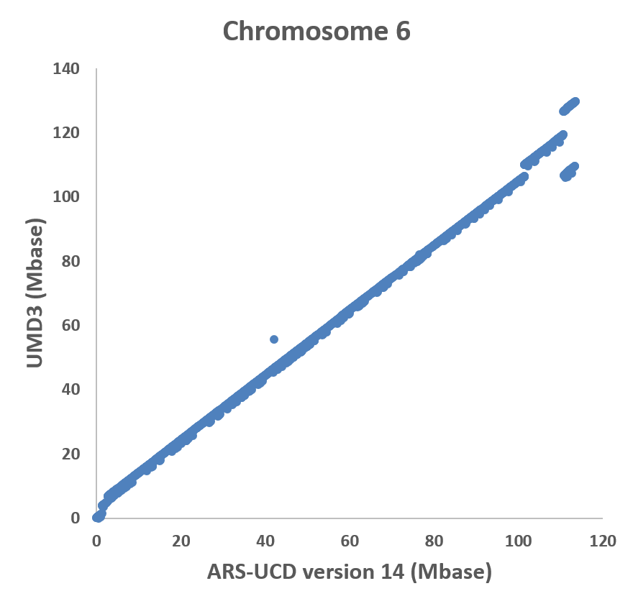
Best and worst chromosome matches (other than X)
Notes:
Chrome 13 143 kb average change
Chrome 6 5 mb average change

Slide 16
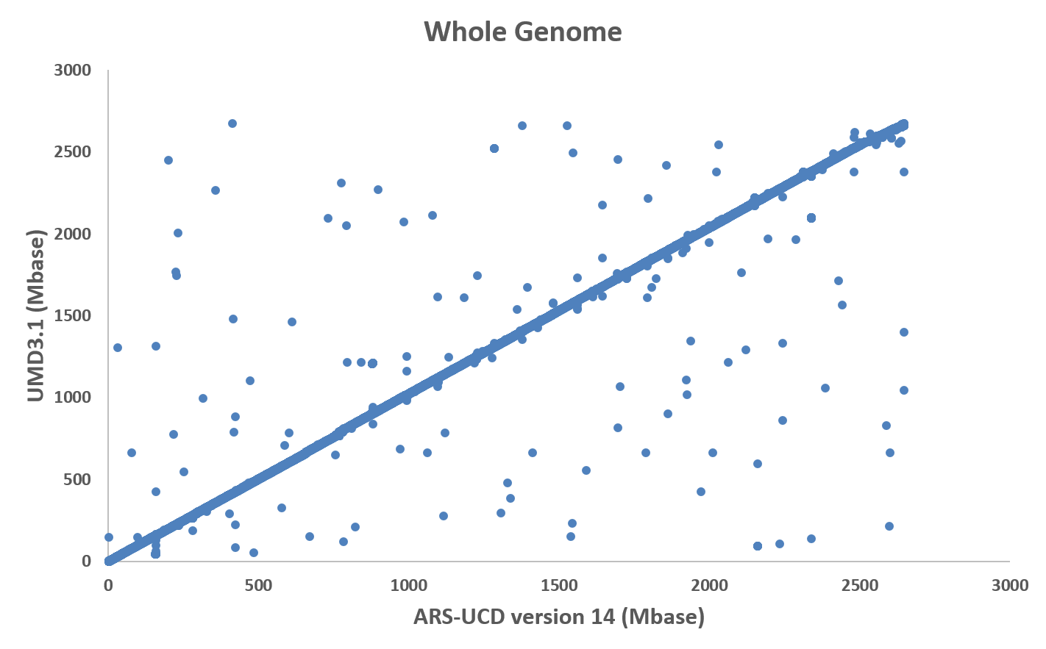
SNPs now located on different chromosomes
60K on same
chromosome,
200 on different
Notes:
142 SNP changed chromosome (.24%)

Slide 17

Imputation tests
Locations for the 60,367 usable SNPs were converted to ARS-UCD1
Genotypes were imputed to 60K from 30 chips of differing density
Genotypes from 5 breeds were imputed separately:
  1,748,453 Holsteins (HO)
  215,800 Jerseys (JE)
  32,724 Brown Swiss (BS)
  4,834 Ayrshires (AY)
  3,517 Guernseys (GU)

Slide 18
Haplotype noninheritance rate (smaller is better)
Haplotypes with parent-progeny noninheritance (%)
Breed | UMD3 | ARS-UCD
HO | 1.6 | 1.1
JE | 4.3 | 3.8
BS | 1.5 | 1.2
AY | 1.8 | 1.4
GU | 1.6 | 1.3
Maximum number of haplotypes per segment
Breed | UMD3 | ARS-UCD
HO | 47,978 | 36,690
JE | 39,628 | 29,732
BS | 11,602 | 9,447
AY | 2,030 | 1,606
GU | 1,970 | 1,427
SNPs used 60,671 60,474

Slide 19
Imputation and alignment: Other properties
Average numbers of distinct haplotypes per segment decreased for all breeds.
Many previous problem areas no longer have excess numbers of haplotypes, particularly on the X chromosome and the pseudoautosomal region of X.
Truly lethal haplotypes were more cleanly separated from false candidate haplotypes.
To test alignment of sequence data, paired-end reads from a HO bull were aligned to both maps
  2.3% more read pairs of Holstein DNA aligned correctly to the new Hereford reference map
Notes:
30% in AY

Slide 20
Implementing new map with more SNPs
New list of 79,239 instead of 60,671 SNPs
  SNPs from high density and sequence data with biggest NM$ effects
  More gene tests (DGAT1, ABCG2, casein, leptin) from recent chips
  Improved SNP editing system and improved prediction reliability (~2%)
Impute genotypes for all breeds and crossbreds
Obtain prior allele effect estimates for all traits, breeds, and BBR
Check published haplotypes to ensure proper inheritance

Slide 21
Fertility haplotype research
Changes to genetic recessives and haplotypes
  More gene tests incorporated (HCD, HH4, HH5, HH6, BH2, AH1, AH2)
  New Holstein haplotype HH6 discovered in France (0.4% frequency in USA)
  JH2 difficult to track with new map, probably will be discontinued
  BH1 fertility effect has greatly decreased, probably will be discontinued
New map and added gene tests should improve imputation from low density
  Some chips provide gene tests, many do not

Slide 22
Drinks: Age at first calving
Heifers eat feed but produce no milk until calving
  Earlier calving is worth $2.50 per day
  Economic emphasis could be 3% of Net Merit $
  Removes some emphasis from heifer conception rate
Large database (23 million records) available for AFC
  Heritability is 2.7%
  PTA standard deviation only about 3 days
  Reliability of genomic predictions of 66% for HO

Slide 23
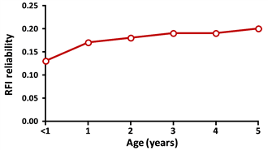
Dessert: Residual feed intake
Tested potential gains from additional feed intake data
Estimated young bull reliabilities by exact inversion of single-step genomic equations
Bulls further from reference cows have lower theoretical REL for RFI
Measure feed intake on cows more closely related to next generation
Research of Bingjie Li (AGIL postdoc) and Elif Gunal (CDCB intern)

Slide 24

What’s cooking at Paul’s house?
Least cost ration, every day for 31 years.
Costs $2.18 / day for food, drink, and snacks
  Breakfast: 2-day rotation of corn flakes or raisin bran plus whole milk
  Lunch: every day a bologna sandwich
  Dinner: 4-day rotation of macaroni, spaghetti, rice, noodles
  Dessert: every day ice cream
Invented by me in 1987 at Kohl’s food store, Madison, WI
Guaranteed to prevent both starvation and obesity (100% successful so far)

Slide 25
Main points to ruminate on
Many non-pedigreed herds could get accurate pedigrees
The ARS-UCD sequence map will soon replace the UMD3 map
  Better marker locations, genotype imputation, haplotype inheritance, sequence alignment, and gene annotation
  30% more SNPs to improve reliabilities and carrier status
More new traits such as age at first calving could be evaluated
Feed intake research cows should be related to top new bulls
Paul’s cookbook http://www.paulvanraden.com/Nutrition.htm

Slide 26
Acknowledgments
USDA-ARS project 1265-31000-101-00, “Improving Genetic Predictions in Dairy Animals Using Phenotypic and Genomic Information” (AGIL funding)
Council on Dairy Cattle Breeding (CDCB) and its industry suppliers for data
Agriculture and Food Research Initiative Competitive Grant #2011-68004-30340 from USDA National Institute of Food and Agriculture (feed intake funding)
Genotyping labs have added many important SNPs to their chips

