Slide 1
Landscape of Breeding in Food and Agriculture - From Conventional to Gene Editing
John B. Cole
USDA, Agricultural Research Service
Henry A. Wallace Beltsville Agricultural Research Center
Animal Genomics and Improvement Laboratory
Beltsville, MD 20705-2350
john.cole@ars.usda.gov

Slide 2
US dairy population and milk yield

Slide 3
Genetics, genomics, and dairy cattle
Bulls do not express traits of interest, so selection must use data from female relatives
Cows are worth about $1,200 each, so owners collect much data for management
  Phenotypes, pedigrees for half of US cows
Database and statistical methods developed and maintained by USDA and the Council on Dairy Cattle Breeding (CDCB) since 1908

Slide 4
U.S. DHI dairy statistics, 2017
9.1 million U.S. cows
~75% bred AI
47% milk recorded through Dairy Herd Information (DHI)
  4.4 million cows
    80% Holstein
    10% crossbred
    8% Jersey
    <2% Ayrshire, Brown Swiss, Guernsey, Milking Shorthorn, Red & White
  15,500 herds
  280 cows/herd
  24,400 lb milk/cow
  939 lb fat/cow
  771 lb protein/cow

Slide 5
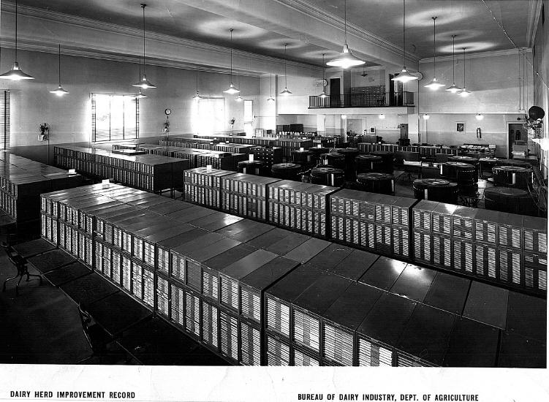
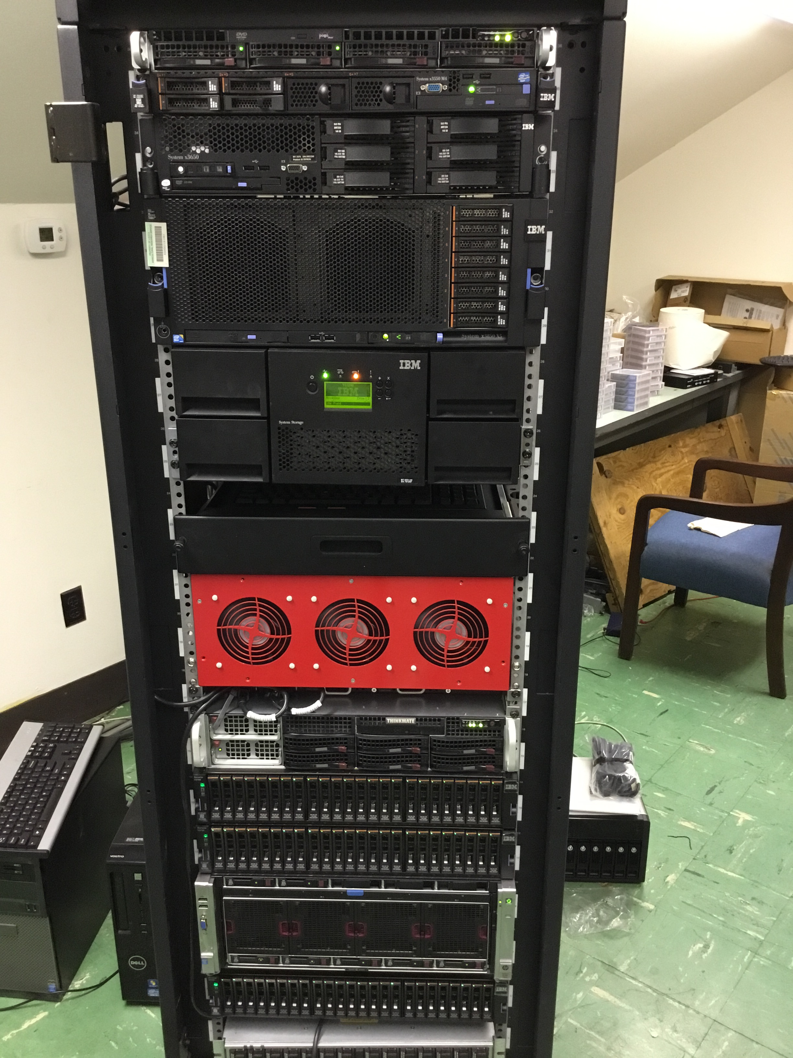
DHI Records Database
1935
2015

Slide 6
What influences a phenotype?
P = G + E
The percentage of total variation attributable to genetics varies:
Female fertility: 0.04
Working life: 0.08
Udder health: 0.12
Milk production: 0.35
The percentage of total variation attributable to environmental factors is large:
Feeding/nutrition
Housing
Reproductive management
Notes:
6
6

Slide 7

How does genetic selection work?
ΔG = genetic gain each year
reliability = how certain we are about our estimate of an animal’s genetic merit (genomics ⬆)
selection intensity = how selective we are when making mating decisions (management can ⬆)
genetic variance = variation in the population due to genetics (we can’t really change this)
generation interval = time between generations (genomics ⬇)

Slide 8
What is the value of genetic selection?
Source: https://queries.uscdcb.com/eval/summary/trend.cfm?R_Menu=JE.f#StartBody
In 2015: 1957 base was 44% of total fat,
management was 28% of gains, and
genetics was 28% of gains

Slide 9
Advances in genetic theory
Theory | Author | Year | Species
Single-gene inheritance | Mendel | 1865 | Peas
Multiple-gene inheritance | Fisher | 1918 | Humans
Pedigree relationship matrix | Wright | 1922 | Cattle
Selection index | Hazel & Lush | 1943 | Plants, cattle
Mixed linear models | Henderson | 1963 | Cattle
Genomic prediction | Meuwissen | 2001 | Animals
Genomic relationship matrix | VanRaden | 2008 | Cattle
Also application
First database with 1 million genotyped individuals was
USDA/Council on Dairy Cattle Breeding in July 2015

Slide 10
USDA evaluation history
Year | Breeding program | Data sources added
<1937 | Mass selection | Own phenotype
1937–62 | Means of relatives | Daughters, dams
1962–89 | Sire models | Herd-year-season
1989–present | Animal models | Full pedigrees
1995–present | MACE* models | Foreign daughters
2009–present | Genomic models | Marker genotypes
2013–future | Biological models | Causal mutations
*MACE = multi-trait across-country evaluation

Slide 11
Genetic improvement works in all species
Source: University of Nebraska-Lincoln (http://passel.unl.edu/pages/informationmodule.php?idinformationmodule=1075412493&topicorder=10&maxto=12)

Slide 12
Traits routinely evaluated in the US
Year | Trait | Year | Trait
1926 | Milk & fat yields | 2006 | Stillbirth rate
1978 | Conformation (type) | 2006 | Bull conception rate²
1978 | Protein yield | 2009 | Cow & heifer conception rates
1994 | Productive life | 2016 | Cow livability
1994 | SCS (udder health) | 2017 | Gestation length (research)³
2000 | Calving ease (dystocia)¹ | 2017 | Residual feed intake (research)³
2003 | Daughter pregnancy rate | 2018 | Cow health
¹Sire calving ease evaluated by Iowa State University (1978–99)
²Estimated relative conception rate evaluated by DRMS in Raleigh, NC (1986–2005)
³Research trait … no official evaluations yet

Slide 13
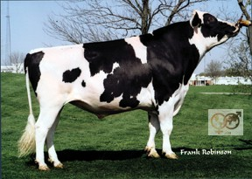
Progeny-tested bulls
O-Bee Manfred Justice
  >100,000 daughters with milk yield records
    60,000 in U.S. plus 40,000 in 25 other countries
  1 million units of semen sold worth $30 million
About 10,000 dairy bulls/year progeny tested
  Best 10–20% selected for global use

Slide 14
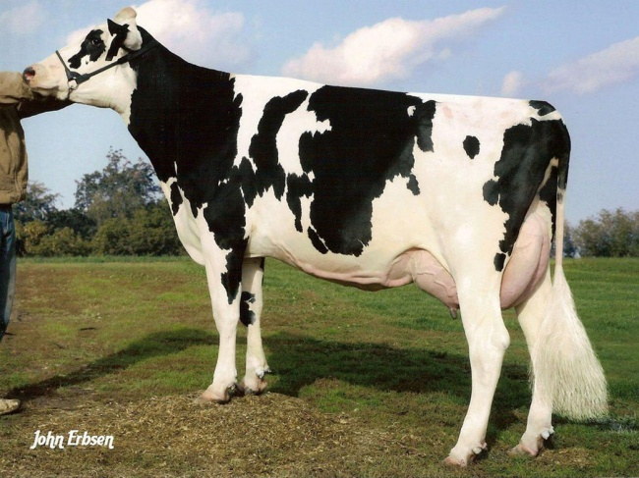
Example daughter traits
O-Bee Manfred Justice daughter
  Average 6% more milk, protein, butterfat
  Average 17% longer productive life
  Average 10% more fertile
  Average 50% fewer difficult births
$700 more lifetime profit than average cow

Slide 15
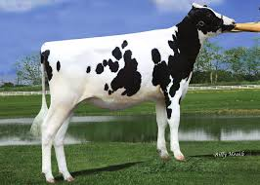
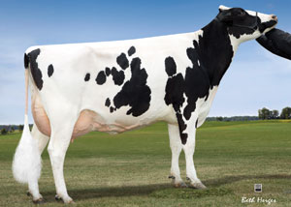
Genomic prediction
Main idea: improve future traits by selection
  Look at animal’s own measurable traits (used for hundreds or thousands of years)
  Use pedigrees and phenotypes to compute estimates of genetic merit (done officially by USDA 1937–2008)
2008 idea: Why not look directly at the DNA?

Slide 16

Growth of markers and animals
Year | Markers | Animals | Research partners
1991–2004 | 367 | 1,415 | USDA, Illinois, Israel (DNA from USA, CAN)
2007–09 | 38,416 | 16,646 | USDA, Missouri, Canada, Illumina
2011–13 | 636,967 | 161,341 | Italy, United Kingdom, and high-density added
2012–15 | 61,013 | 1,000,000 | Interbull and Denmark added
2015–future | 39,700,000 | 1,577 | Australia worldwide exchange

Slide 17
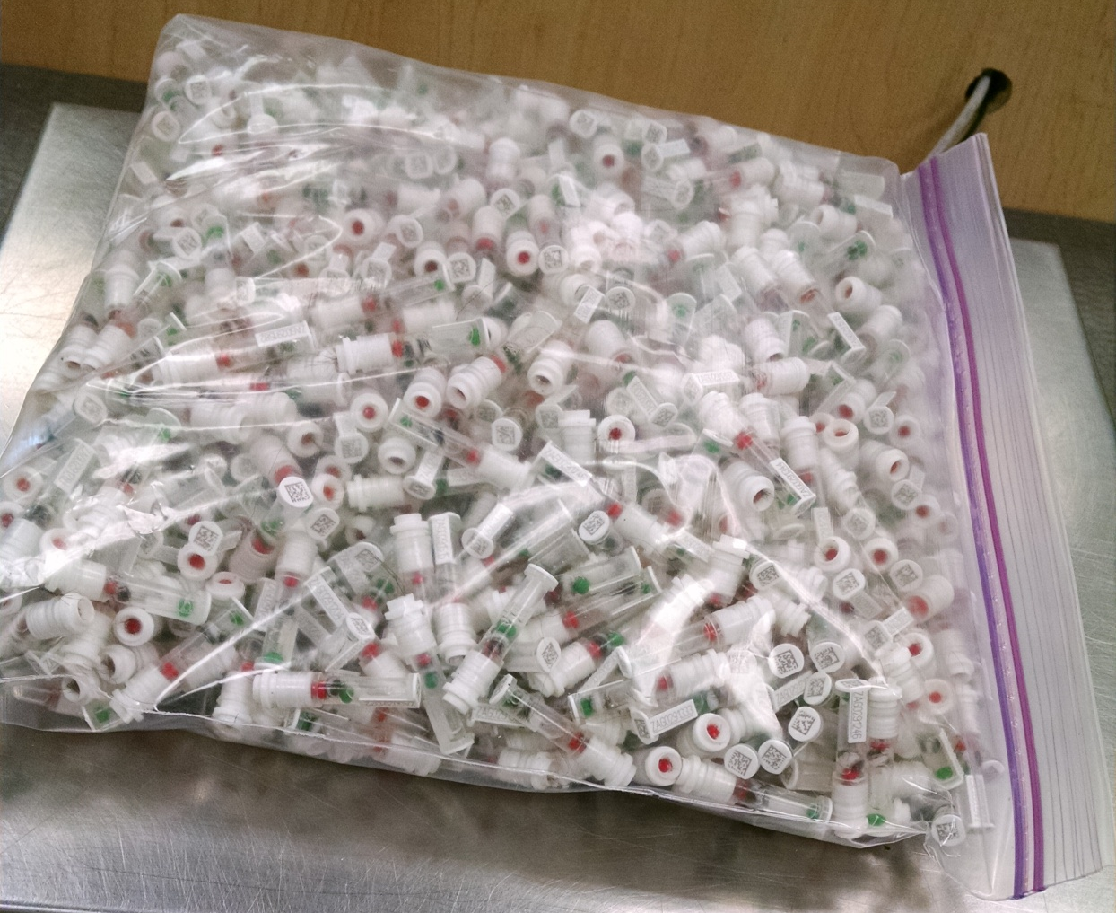
DNA samples from 1 farm, 1 day
Source: Zoetis

Slide 18
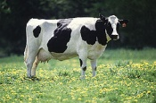
What’s a SNP genotype worth for production?
Pedigree is equivalent to information on about 7 daughters
For protein yield (h² = 0.30), the SNP genotype provides information equivalent to an additional 34 daughters
Notes:
18

Slide 19

What’s a SNP genotype worth for fertility?
For daughter pregnancy rate (h² = 0.04), SNP = 131 daughters
Notes:
19

Slide 20
Largest genomic databases
 | Ancestry.com | 23andMe | CDCB/USDA
Genotypes | >4 million | >5 million | >2.5 million
Species | Human | Human | Cattle
Countries | ? | >55 | 57
Genotyping cost | $99 | $69 | $37–135
Delivery (weeks) | 6–8 | 6–8 | 1–2
DNA generations | Few | Few | >10
EBV reliability | None | Low | High
Reference: http://genomemag.com/davies-23andme/#.VdY722zosY1
Web sites: https://www.23andme.com/; http://dna.ancestry.com/; https://www.cdcb.us/; http://aipl.arsusda.gov/Main/site_main.htm

Slide 21
Genomic selection works!
Source: García-Ruiz et al., 2016

Slide 22
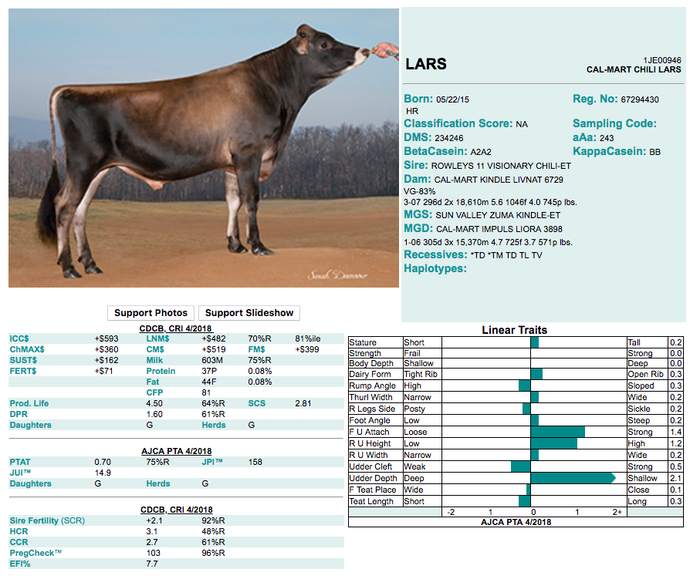
What is a breeding index?
A single number based on information about many traits used for making selection decisions
ICC$ = Ideal commercial
cow index
LNM$ = Lifetime net merit
FM$ = Fluid merit
CM$ = Cheese merit
JPI = Breed-specific index
Source: Genex (http://genex.crinet.com/dairy/index.php?action=DETAIL&code=1JE00946&lang=&Breed=JE)

Slide 23
Why select for more than one trait?
To make use of more information
  Correlations among traits are rarely 0
Several traits may have economic value
  Farmers may receive a quality premium
Some traits need to be improved and others maintained
  Selection for only yield would reduce fertility
Balanced selection improves traits according to their economic values

Slide 24
Index changes over time
Trait | Relative emphasis on traits (%)
 | PD$ 1971 | MFP$ 1976 | CY$ 1984 | NM$ 1994 | NM$ 2000 | NM$ 2003 | NM$ 2006 | NM$ 2010 | NM$ 2014 | NM$ 2017 | NM$ 2018
Milk | 52 | 27 | –2 | 6 | 5 | 0 | 0 | 0 | –1 | –1 | –1
Fat | 48 | 46 | 45 | 25 | 21 | 22 | 23 | 19 | 22 | 24 | 27
Protein | … | 27 | 53 | 43 | 36 | 33 | 23 | 16 | 20 | 18 | 17
PL | … | … | … | 20 | 14 | 11 | 17 | 22 | 19 | 13 | 12
SCS | … | … | … | –6 | –9 | –9 | –9 | –10 | –7 | –7 | –4
UC | … | … | … | … | 7 | 7 | 6 | 7 | 8 | 7 | 7
FLC | … | … | … | … | 4 | 4 | 3 | 4 | 3 | 3 | 3
BWC | … | … | … | … | –4 | –3 | –4 | –6 | –5 | –6 | –5
DPR | … | … | … | … | … | 7 | 9 | 11 | 7 | 7 | 7
SCE | … | … | … | … | … | –2 | … | … | … | … | …
DCE | … | … | … | … | … | –2 | … | … | … | … | …
CA$ | … | … | … | … | … | … | 6 | 5 | 5 | 5 | 5
HCR | … | … | … | … | … | … | … | … | 1 | 1 | 1
CCR | … | … | … | … | … | … | … | … | 2 | 2 | 2
LIV | … | … | … | … | … | … | … | … | … | 7 | 7
HTH$ | … | … | … | … | … | … | … | … | … | … | 2
Source: https://aipl.arsusda.gov/reference/nmcalc-2018.htm

Slide 25
What if we put the best DNA together in one animal?
EBV(NM$) = $7,304
After Cole and VanRaden (2011).

Slide 26
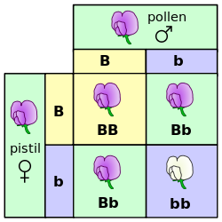
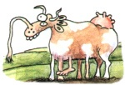
Mendelian recessives
Classical model of inheritance
One locus, typically with two alleles
Often exhibit complete dominance
e.g., Mendel’s experiments
Source: https://commons.wikimedia.org/wiki/File:Punnett_square_mendel_flowers.svg.

Slide 27
Estimated cost of genetic load
Cole et al. (2016) estimated annual losses of at least $10,743,308 due to known recessives.
Average losses were $5.77, $3.65, $0.94, and $2.96 in Ayrshire, Brown Swiss, Holstein, and Jersey, respectively.
This is the economic impact of genetic load as it affects fertility and perinatal mortality.
Actual losses are likely to be higher.

Slide 28
Recessives in U.S. Holsteins
Haplo- type | Functional/Gene name | BTA chromosome | Location (Mbp) | Haplotype frequency (%) | Timing¹
HBR | Black/red coat color/MC1R(MSHR) | 18 | 14.8 | 0.80 | —
HCD | Cholesterol deficiency/APOB | 11 | 78.0* | 2.50 | W
HDR | Dominant red color/MC1R(MSHR) | 3 | 9.5* | 0.04 | —
HH0 | Brachyspina/FANCI | 21 | 21.2 | 2.76 | E,B
HH1 | APAF1 | 5 | 63.2* | 1.92 | E
HH2 | — | 1 | 94.9 – 96.6 | 1.66 | E
HH3 | SMC2 | 8 | 95.4* | 2.95 | E
HH4 | GART | 1 | 1.3* | 0.37 | E
HH5 | TFB1M | 9 | 93.2 – 93.4 | 2.22 | E
HHB | BLAD/ITGB2 | 1 | 145.1* | 0.25 | W
HHC | CVM/SLC35A3 | 3 | 43.4* | 1.37 | E,B
HHD | DUMPS/UMPS | 1 | 69.8* | 0.01 | E
HHM | Mule foot/LRP4 | 15 | 77.7 | 0.07 | B
HHP | Polledness (dominant)/POLLED | 1 | 1.7 – 2.0 | 0.71 | —
HHR | Red coat color/MC1R(MSHR) | 18 | 14.8* | 5.42 | —
*Causative mutation known
¹Timing of embryonic loss/calf death for homozygous animals: B = calf death at/shortly after birth,
E = embryonic loss/abortion, W = calf death weeks/months after birth
Source: Cole et al. (2016)

Slide 29
Is gene editing the solution to the recessives problem?
Much speculation about application of gene editing in livestock populations
  Rapid introgression of desirable Mendelian traits, such as the Slick locus (Loi et al., 2016)
  Improvement of quantitative traits (Jenko et al., 2015)
  Development of animal models of complex human disease (e.g., Tu et al., 2015)
What about editing carriers to rapidly eliminate harmful alleles from the population?

Slide 30
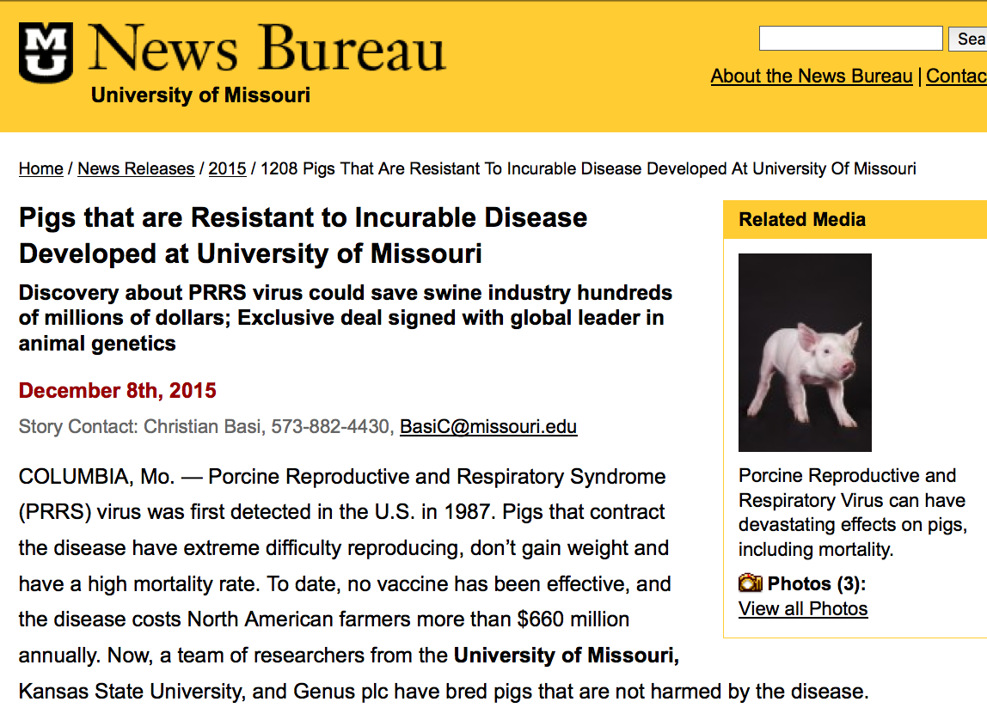
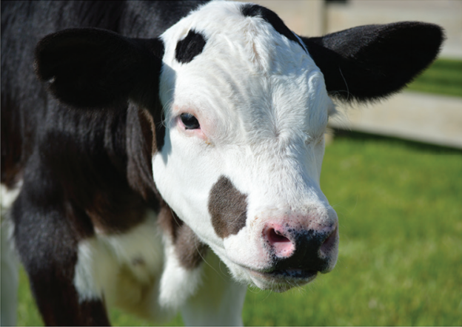
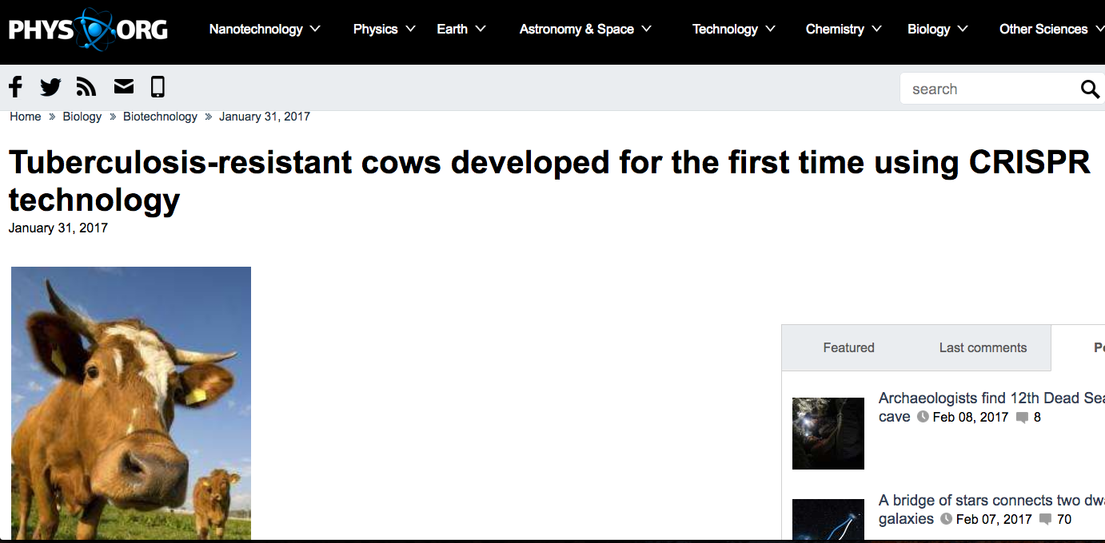
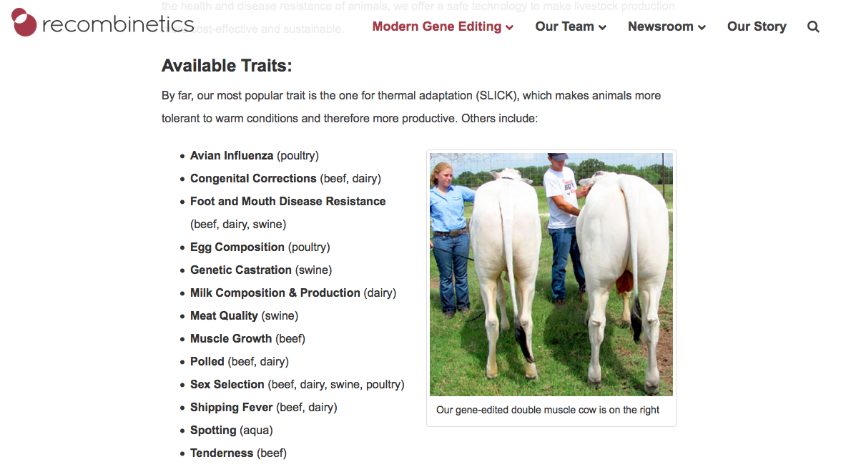
Examples of gene editing in livestock

Slide 31
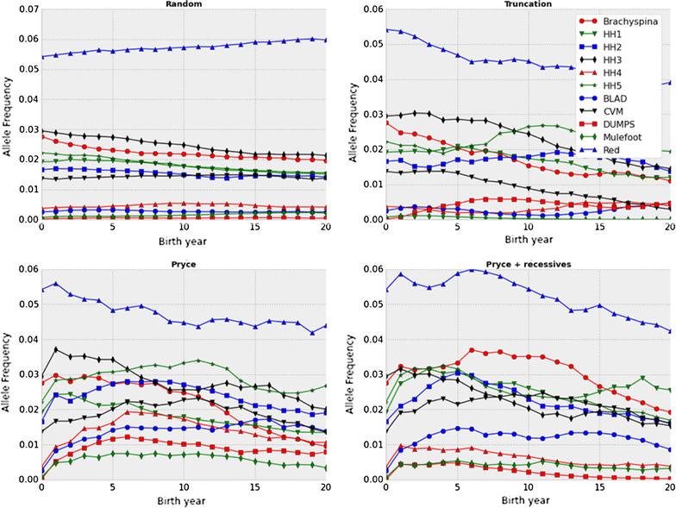
Selection may not be fast enough!
Source: Cole (2015)

Slide 32
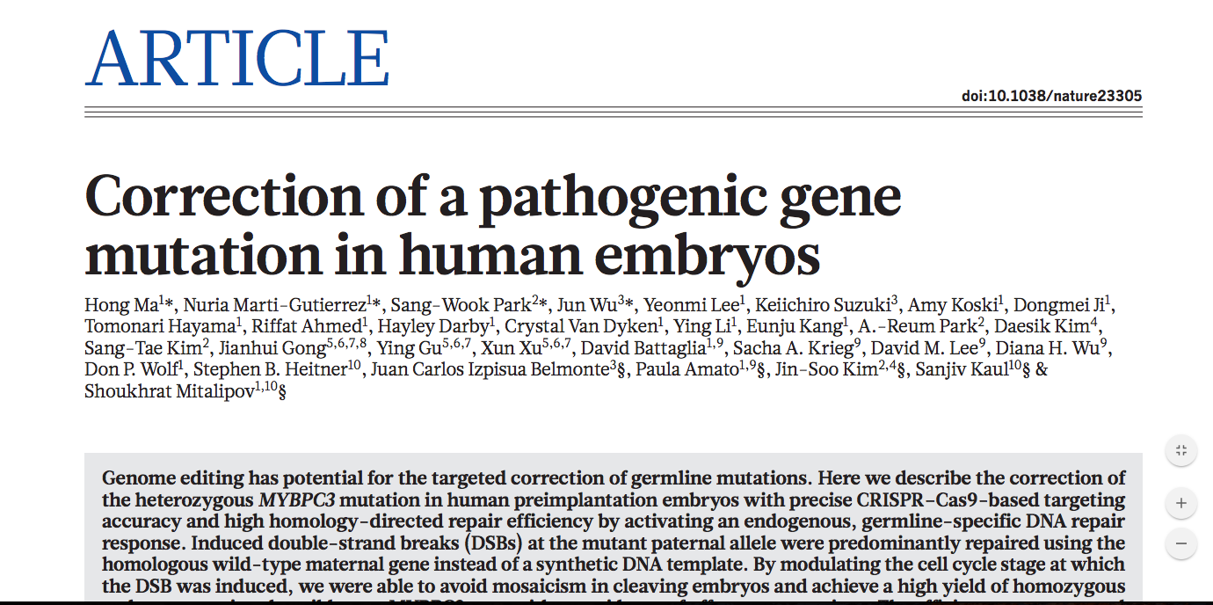
This is no longer a speculative use of the technology!
Source: Ma et al. (2017).

Slide 33
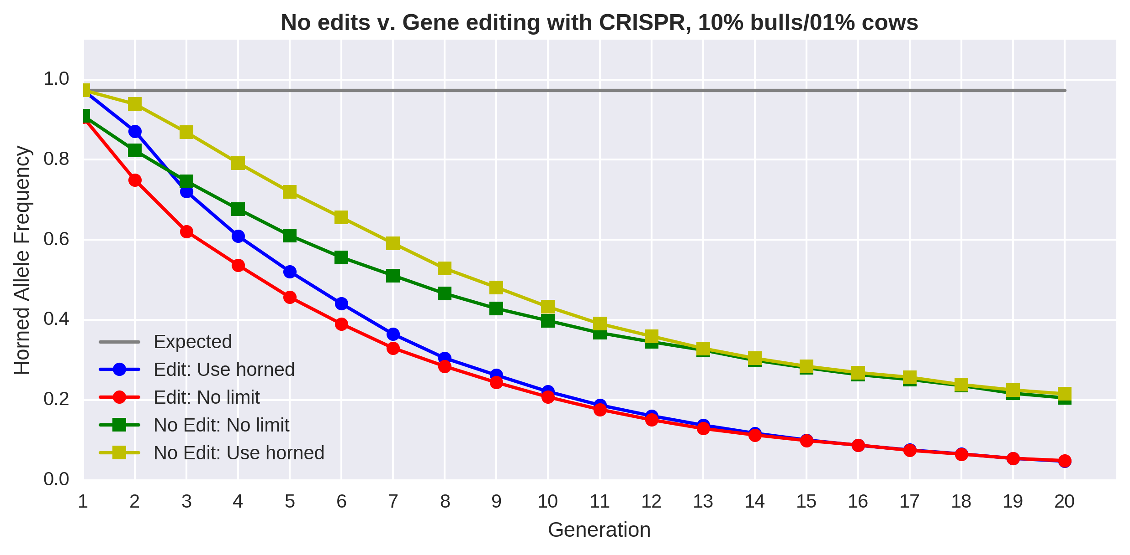
Change is faster with editing and few restrictions
Source: Mueller et al. (2018).

Slide 34
Editing many alleles can increase rate of genetic gain
a) 125 alleles edited
b) 250 alleles edited
c) 500 alleles edited
Rates of genetic gain for quantitative traits are faster each generation when gene
editing is used in concert with genomic selection than using genomic selection alone.
Source: Gorjanc et al. (2015).

Slide 35
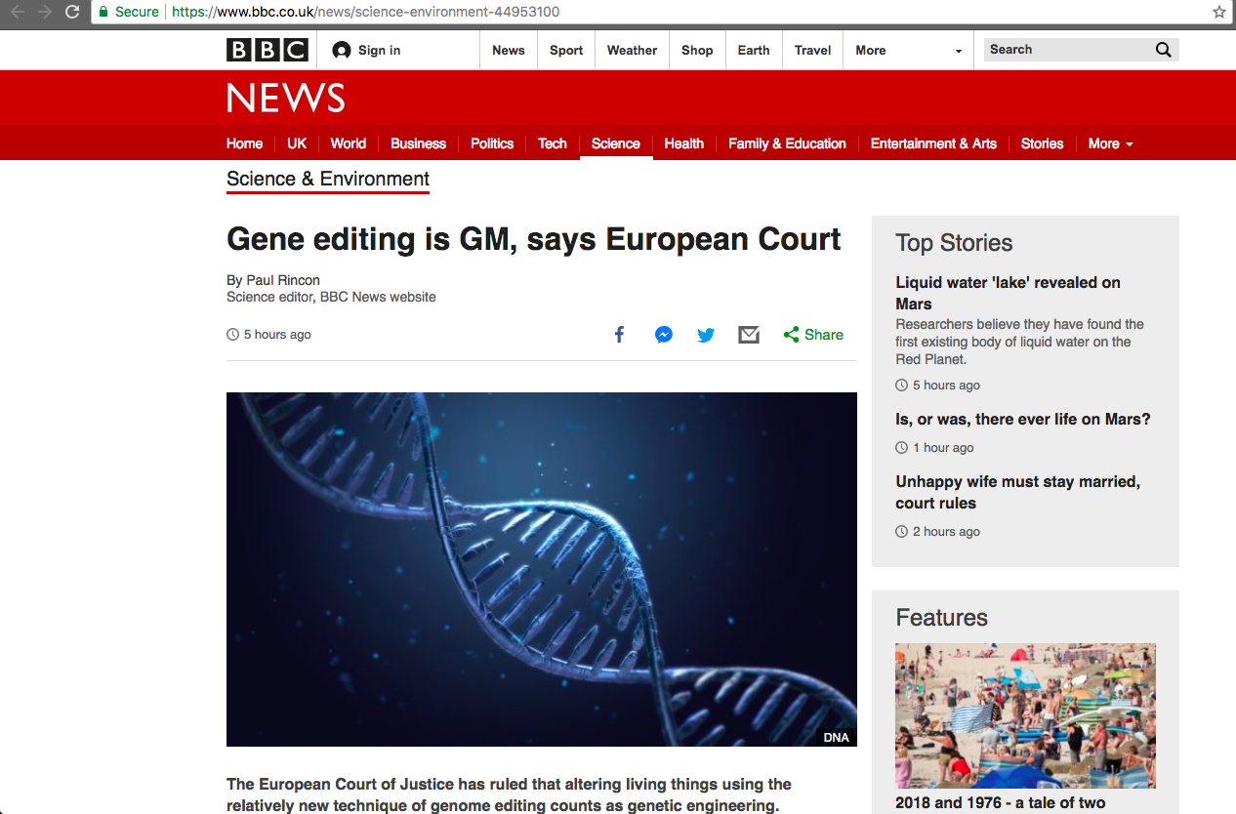
Breaking news from Europe…
Source: https://www.bbc.co.uk/news/science-environment-44953100.

Slide 36
Conclusions
Traditional genetic selection based on pedigree and performance information has been very successful
Genomic selection programs including DNA genotype information have further increased rates of genetic gain
Gene editing has clear value for monogenic traits associated with animal welfare (polled), adaptation (slick), and health (PRRS, tuberculosis)
Consumer acceptance and regulatory barriers are more substantial than technological issues

Slide 37
Acknowledgments and disclaimers
USDA-ARS project ARS 8042-31000-002-00, “Improving dairy animals by increasing accuracy of genomic prediction, evaluating new traits, and redefining selection goals”
Mention of trade names or commercial products in this presentation is solely for the purpose of providing specific information and does not imply recommendation or endorsement by USDA

Slide 38
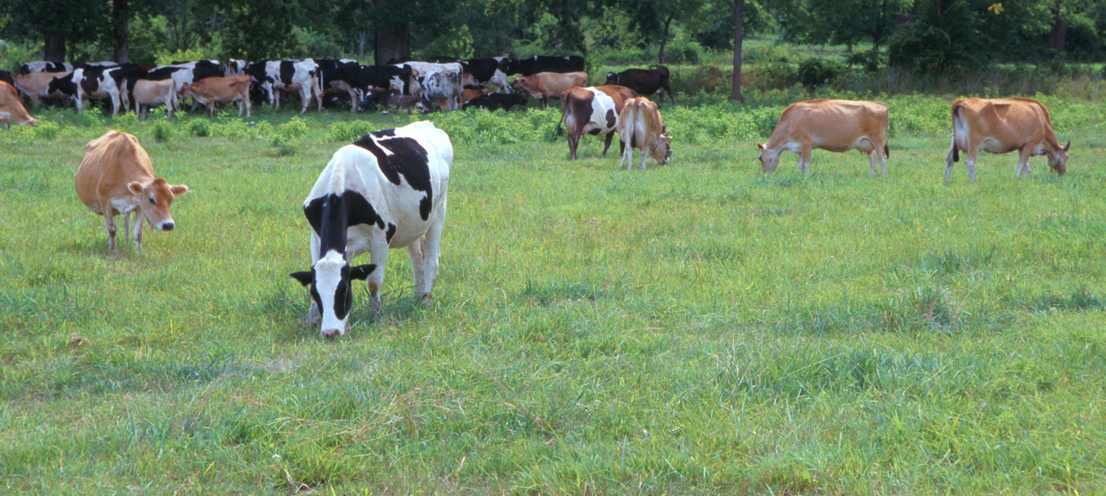
Questions?
AIP web site:
http://aipl.arsusda.gov/
Holstein and Jersey crossbreds graze on American Farm Land Trust’s
Cove Mountain Farm in south-central Pennsylvania
Source: ARS Image Gallery, image #K8587-14; photo by Bob Nichols

Slide 39
References
Cole, J.B. 2015. A simple strategy for managing many recessive disorders in a dairy cattle breeding program. Genet. Sel. Evol. 47:94.
Cole, J.B., D.J. Null, and P.M. VanRaden. 2016. Phenotypic and genetic effects of recessive haplotypes on yield, longevity, and fertility. J. Dairy Sci. 99:7274-7288.
Cole, J.B., and P.M. VanRaden. 2011. Use of haplotypes to estimate Mendelian sampling effects and selection limits. J. Anim. Breed. Genet. 128:446-455.
García-Ruiz, A., J.B. Cole, P.M. VanRaden, G.R. Wiggans, F.J. Ruiz-López, and C.P. Van Tassell. 2016. Changes in genetic selection differentials and generation intervals in US Holstein dairy cattle as a result of genomic selection. PNAS USA. 113:E3995-4004.
Jenko, J., G. Gorjanc, M.A. Cleveland, R.K. Varshney, C.B.A. Whitelaw, J.A. Woolliams, and J.M. Hickey. 2015. Potential of promotion of alleles by genome editing to improve quantitative traits in livestock breeding programs. Genet. Sel. Evol. 47:55.

Slide 40
References
Loi, P., P. Toschi, F. Zacchini, G. Ptak, P.A. Scapolo, E. Capra, A. Stella, P. Ajmone Marsan, and J.L. Williams. 2016. Synergies between assisted reproduction technologies and functional genomics. Genet. Sel. Evol. 48:53.
Ma, H., N. Marti-Gutierrez, S.-W. Park, J. Wu, Y. Lee, K. Suzuki, A. Koski et al. 2017. Correction of a pathogenic gene mutation in human embryos. Nature 548:413-419.
Tu, Z., W. Yang, S. Yan, X. Guo, and X.-J. Li. 2015. CRISPR/Cas9: a powerful genetic engineering tool for establishing large animal models of neurodegenerative diseases. Mol. Neurodegen. 10:35.
Wall, R. J., D. E. Kerr, and K. R. Bondioli. 1997. Transgenic dairy cattle: genetic engineering on a large scale. J. Dairy Sci. 80:2213-2224.

