Slide 1
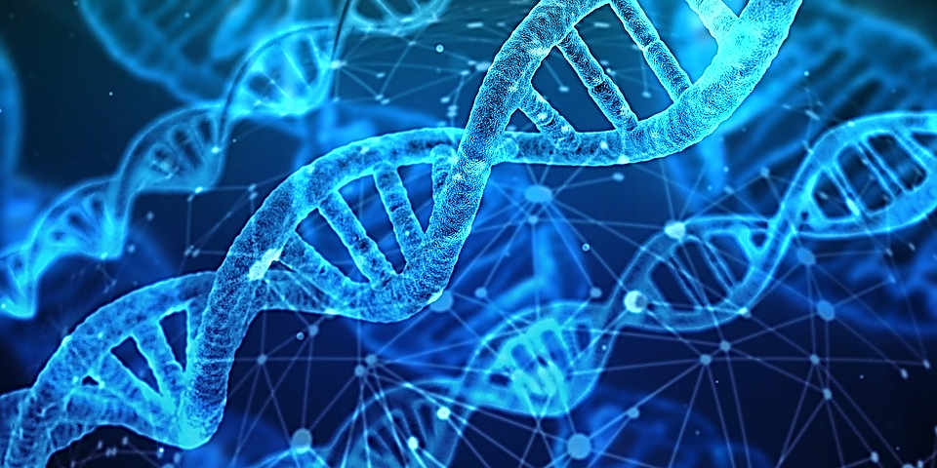
Genomic selection:
Achievements in the last decade
and plans for the next
Paul VanRaden
USDA, Agricultural Research Service, Animal Genomics and Improvement Laboratory, Beltsville, MD
Email: paul.vanraden@ars.usda.gov
Project web site: https://aipl.arsusda.gov/

Slide 2
Genetic and genomic milestones
Year | Researchers | Discovery/Development
1865 | Mendel | Inherited traits of peas
1900 | Bateson and others | Rediscovery of Mendel’s laws
1905 | Spillman (USDA) | Horned/polled (Mendelian trait in cattle)
1922 | Wright (USDA) | Pedigree relationship matrix
1953 | Watson, Crick | Structure of DNA
1976 | Henderson (also Norman, USDA) | Use of pedigree relationships in PTAs
2001 | Lander | Sequence of human genome
2007 | Illumina, USDA, and others | Development of SNP chip for cattle
2009 | Elsik (NIH and USDA funding) | Sequence of cattle genome
2009 | USDA | Genomic methods, official predictions

Slide 3
Progress in past decade and next decades
Progress in reliability of predictions
Expansion in number of variants tested
Additional traits tested and new uses for genotyping
Growth in numbers genotyped worldwide and in other species
Genetic progress

Slide 4
Worldwide dairy genotyping (January 2009)
Countries | Animals
United States and Canada | 22,344
France | 8,500
Netherlands and New Zealand* | 6,000
New Zealand and Ireland | 4,500
Germany | 3,000
Australia | 2,000
Denmark, Finland, and Sweden | 2,000
Source:
“Dairy Cattle Breeders Have Adopted Genomic Selection” (Gordon Conference on Quantitative Genetics and Genomics, February 2009)
*Used customized Illumina 50K chip
(different markers)

Slide 5
Worldwide livestock genotyping (January 2019)
Species | Countries/Companies | Animals
Dairy | United States and Canada | 3,020,000
 | France | 550,000
 | Netherlands | 465,000
 | New Zealand | 140,000
 | Germany | 785,000
Beef (Angus) | United States | 550,000
Beef and dairy | Ireland | 1,500,000
Poultry | Aviagen | 1,000,000/year

Slide 6
CDCB usable genotype counts/year by animal sex
*Through December 13

Slide 7
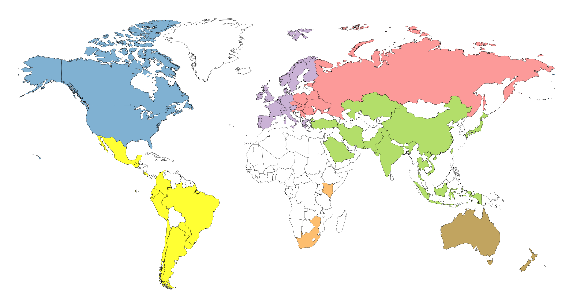
Genotyped animals in database by region (2018)
7,749
2,585,255
200,002
23,408
27,356
1,943
18,513

Slide 8
Top 10 NM$ genotyped Holsteins by country
Country | NM$ | Country | NM$ | Country | NM$ | Country | NM$
USA | 1114 | JPN | 854 | CHE | 763 | NZL | 595
CAN | 1040 | HUN | 850 | ZAF | 724 | RUS | 555
GBR | 1006 | ESP | 837 | ROU | 698 | NOR | 532
NLD | 996 | ARG | 823 | SWE | 696 | SVN | 508
DEU | 973 | POL | 799 | FIN | 684 | URY | 492
ITA | 930 | DNK | 789 | TUR | 672 | GRC | 443
CZE | 908 | LUX | 780 | TWN | 656 | PKS | 443
FRA | 904 | VNM | 780 | BRA | 652 | UKR | 384
CHN | 879 | CHL | 776 | BLR | 615 | IDN | 333
AUS | 864 | IRL | 765 | SAU | 615
BEL | 858 | MEX | 763 | PRT | 614

Slide 9

Formal international genotype exchanges
Country exchanges with U.S. | Breed | Sex | Since
Canada | All | All | 2009
United Kingdom, Italy | Holstein | Bulls | 2011
All Europe via Interbull | Brown Swiss | Bulls | 2012
Denmark | Jersey | Bulls | 2014
United Kingdom | Guernsey | All | 2016
Japan, Switzerland, Germany | Holstein | Bulls | 2016

Slide 10
Numbers of variants tested in cattle
Year | Variants | Data source
<1995 | 0 | Only pedigrees and phenotypes
2003 | 367 | RFLP markers, not implemented
2008 | 50,000 | 50K SNP chip
2010 | 777,000 | High-density chip
2015 | 39,700,000 | Whole genome sequencing (1000 Bull Genomes Project)
Future | New mutations (e.g., HCD) | Sequence each new AI bull
Future | Epigenetic | External control of gene function

Slide 11

Many new chips have been added

Slide 12
Predictions now use more SNPs
New list of 79,239 instead of 60,671 SNPs
  SNPs from high density and sequence data with biggest NM$ effects
  More gene tests (DGAT1, ABCG2, casein, leptin) from recent chips
  More gene tests (HH0, HH3, HH4, BH2, AH1, AH2) in fertility haplotypes
  Improved SNP editing system and improved prediction reliability (1–3%)
Implemented by CDCB in December 2018
Most other countries still use 50,000 SNPs from 2009

Slide 13
Human genotyping and sequencing (January 2019)
Technology | Database | People genotyped | Variants genotyped
High-density (HD) SNP chip | Ancestry.com | >10 million | 700,000
 | 23andMe | Millions | 700,000
 | UK Biobank | 483,000 | 826,000
Whole genome sequence | TopMed (U. Michigan) | 135,000 | 500 million
 | Illumina | 600,000 | 500 million
HD imputed to sequence | U. Michigan | >25 million | 500 million
Total raw data = 600,000 people × 40× coverage × 2.7 billion genome length) = 65 million GB

Slide 14
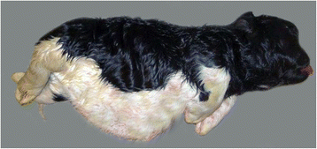
Detect new mutations by sequencing new AI bulls?
Normal DNA in both parents, but progeny has new mutation
New dominant mutation examples
  NZL: Half of Halcyon daughters had thick hair and gave no milk
  CAN: Rosabel had new dominant mutation for red hair color
  Europe: Bulldog calves from Igale Masc (1%), Captivo (12%), Energy (20%)
New recessive mutation examples
  CAN: Maughlin Storm with HCD mutation causing calf death
  USA: 118 animals with large new chromosome deletions; 252 with XXY

Slide 15
Relative weighting in 2018 net merit (NM$)
UC Udder composite
BWC Body weight composite
FLC Feet-legs composite
DPR Daughter pregnancy rate
CCR Cow conception rate
HCR Heifer conception rate
CA$ Calving ability (calving ease & stillbirth rate)
PL Productive life
LIV Livability
SCS Somatic cell score
MAST Mastitis
METR Metritis
DA Displaced abomasum
RETP Retained placenta
KETO Ketosis
MFEV Milk fever

Slide 16
New traits and evaluations expected
April 2019
  Genomic predictions for crossbreds
  Earlier first calving age (heifer maturity rate)
Future: More traits already tested in USDA research
  Individual feed intakes measured for 5,000 cows
  Heat stress: Cows adapted to southern vs. northern climate
  Persistency: Productivity in late vs. peak lactation
Other new traits require local data be combined with national data

Slide 17
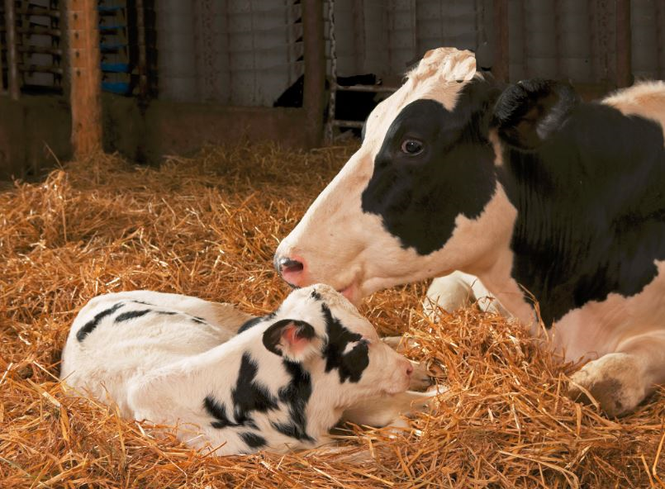
Earlier first calving age (EFC)
Heifers eat feed but produce no milk until calving
  Earlier calving is worth $2.50 per day
  Economic emphasis could be 3% of NM$
  Removes some emphasis from heifer conception rate
Large database (23 million records) available for EFC
  Heritability of 2.7%
  PTA standard deviation only about 3 days
  Reliability of genomic predictions of 66% for Holsteins

Slide 18
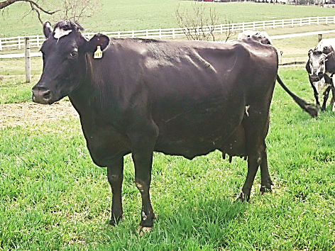
Genomic predictions for crossbreds
Genomic predictions computed within-breed since 2009
More crossbreds will receive predictions in April 2019
  Weighted combination of purebred predictions
  Breed base representation (BBR): Genetic contribution of each breed
Currently about 60,000 animals with >10% BBR from another breed
About 17,000 animals with 6–10% BBR from another breed
  Will no longer contribute to purebred reference
  Will be predicted using only purebred data

Slide 19
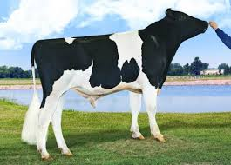

Genomic mating programs
Reduce inbreeding using genomic instead of pedigree relationships
  Genomic relationship of each live female to each marketed bull
  File contains 1 million females × 5,000 males
Genomic mating increases heifer calf value by
  +$33 compared with pedigree mating (1.3% lower inbreeding)
  +$78 compared with random mating (3.1% lower inbreeding)
Also improves conception rates by avoiding recessive carrier matings
Also reduces inbreeding of bull calves, promoting faster growth

Slide 20
Bull’s chromosome pedigree (O-Style)
Chromosome 15

Slide 21
Ancestor discovery
If true ancestor genotyped, accuracy of discovery very high
If reported pedigree wrong, accuracy of detection also high
With lower density chips, accuracy slightly reduced
Methods published and used since 2013 (VanRaden et al.)
Ancestor | Correctly discovered
Sire | ~100%
MGS | 97%
MGGS | 92%

Slide 22
Discovering pedigrees (parents, grandparents, etc.)
 |  |  | Sire
Calf
 |  |  |  |  |  | Maternal grandsire (MGS)
 |  |  | Dam |  |  |  |  |  | Maternal great-grandsire (MGGS)
 |  |  |  |  |  | Maternal granddam (MGD)
Notes:
We are all familiar with a traditional pedigree chart. Animal is expected to be an average of his parents.

Slide 23
Filling in pedigrees
>200,000 discovered MGS not yet used because no dam ID available
>200,000 discovered MGGS not yet used because no MGD ID available
Procedures developed to fill missing IDs to link to ancestors
  HO999DAM000000001, for example
  Should predictions use and public see the discovered pedigrees?
First check if true dam can be discovered in same herd (20,000 found)
  Match birth and fresh dates (only 1 dam’s pedigree matches calf’s)

Slide 24
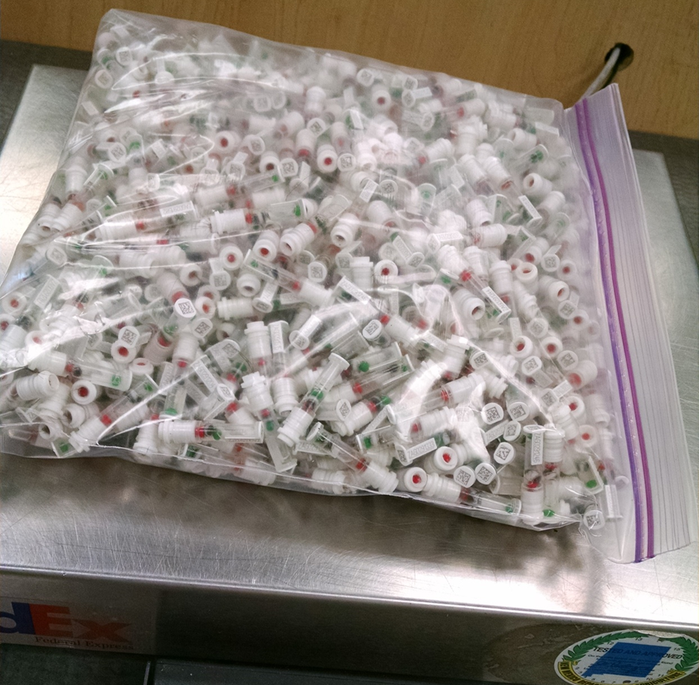
Genotyping is easy
DNA source sent to genotyping lab (2018)
Source | Samples (no.) | Samples (%)
Tissue (ear) | 579,255 | 81
Hair | 102,229 | 14
Blood | 14,656 | 2
Nasal swab | 656 | <1
Semen | 319 | <1
Unknown | 17,048 | 2
Photo source: Zoetis

Slide 25
Potential for embryo genotyping
13,000 embryos already genotyped
Genomic predictions sent only to breeder via nominator
Change selection strategies if technology improves and costs decline
  Genotype before instead of after pregnancy
  Demand for embryo genotyping could be more than for calves
  Could genotype 20 million embryos/year instead of 4 million calves
May be difficult to automate … requires switching to ET instead of AI

Slide 26
Generation interval – Holstein

Slide 27

Genetic progress (Holstein)

Slide 28
Predict 50 years of genetic progress (Cole, 2018)
Trait | 50-year progress | 2017 mean | 2067 mean
Milk (pounds) | +9,329 | 27,055 | 36,384
Fat (pounds) | +531 | 1,008 | 1,539
Protein (pounds) | +342 | 825 | 1,167
Productive life (months) | +65 | 26 | 91
Body size (pounds) | –230 | 1,500 | 1,230
Udder composite | +2.65 | 0 | 2.65
Daughter pregnancy rate (%) | +26 | 29 | 55
Cow conception rate (%) | +42 | 35 | 77
Heifer conception rate (%) | +21 | 57 | 78

Slide 29
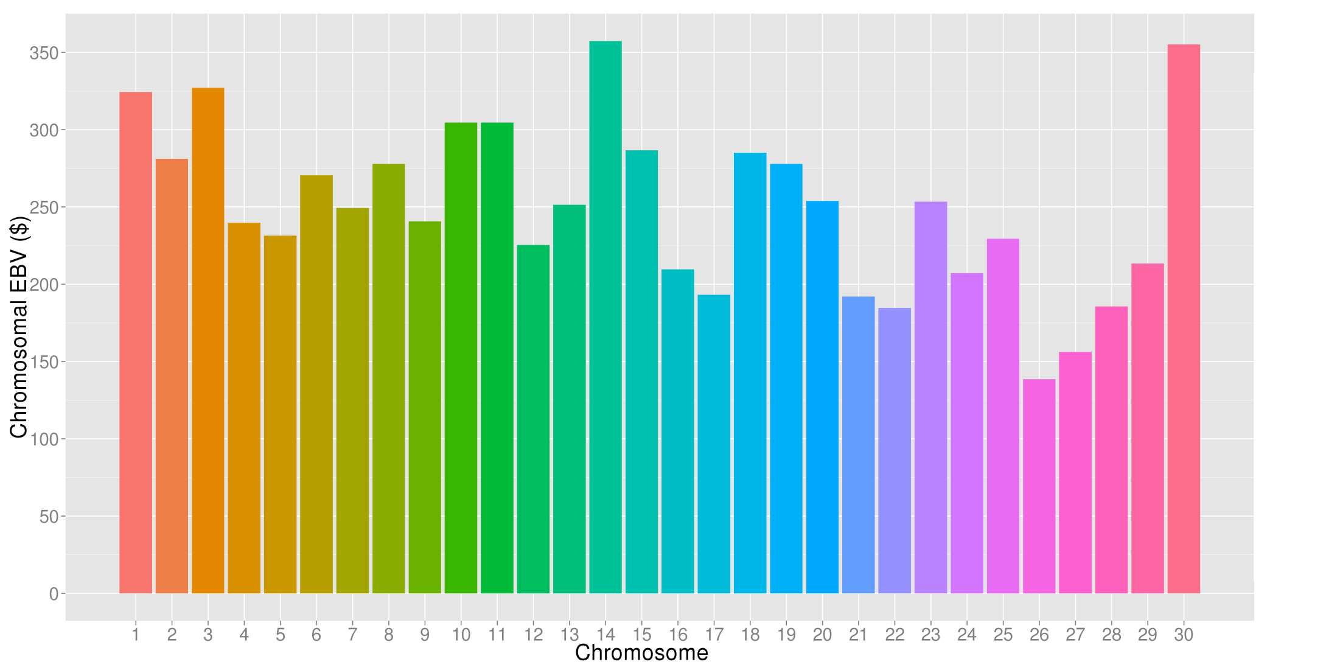
What’s the best cow we can make?
A “supercow” constructed from the best haplotypes in the Holstein population would have an EBV for NM$ of +$7,515 !

Slide 30
USDA-AGIL 5-year plan
Objective 1: Expand genomic data used in prediction by selecting new variants that more precisely track the true gene mutations that cause phenotypic differences
Objective 2: Evaluate new traits that can all be predicted at birth from the same inexpensive DNA sample
Objective 3: Improve efficiency of genomic prediction and computation by developing faster algorithms, testing new adjustments and models, and accounting for genomic pre-selection in evaluation
Full research plan: https://aipl.arsusda.gov/AboutUs/AboutUs.htm

Slide 31
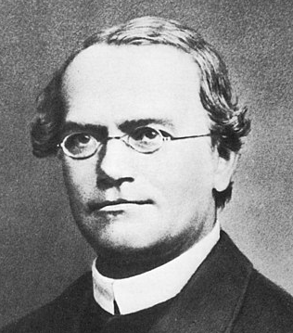
Summary
The DNA predictions adopted 10 years ago have improved rapidly
  Accuracy improves as datasets expand and more traits are included
  Many new uses such as pedigree discovery and genomic mating
  New predictions for crossbreds and early first calving coming in April
Future predictions will use more gene tests discovered from sequence data and more international genotypes
Methods developed for dairy cattle are now used for beef, swine, poultry, humans, corn, alfalfa, soybeans, and even peas
Mendel would be pleased

Slide 32
Acknowledgments and Disclaimers
Council on Dairy Cattle Breeding (CDCB) and its industry suppliers for data
Genotyping labs for adding many important SNPs to their chips
Taxpayers for funding USDA-ARS-AGIL project 8042-31000-002-00, “Improving dairy animals by increasing accuracy of genomic prediction, evaluating new traits, and redefining selection goals”
Mention of trade names or commercial products in this presentation is solely for the purpose of providing specific information and does not imply recommendation or endorsement by USDA; USDA is an equal opportunity provider and employer

