Slide 1
Preview of genetic evaluations for feed efficiency (and other traits)
Paul VanRaden,¹ Mike VandeHaar,² Rob Tempelman,² and Kent Weigel³
¹USDA, Agricultural Research Service, Animal Genomics and Improvement Laboratory, Beltsville, MD, USA
²Michigan State University, East Lansing, MI, USA
³University of Wisconsin, Madison, WI, USA
paul.vanraden@usda.gov

Slide 2
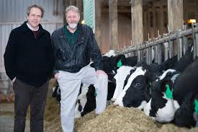
Feed intake data
Research herd | Cows | Records | Researchers
Univ. of Wisconsin & U.S. Dairy Forage Res. Ctr. | 1,390 | 1,678 | Weigel, Armentano
Iowa State Univ. | 953 | 1,006 | Spurlock
ARS, USDA (Beltsville, MD) | 534 | 834 | Connor
Univ. of Florida | 491 | 582 | Staples
Michigan State Univ. | 273 | 315 | VandeHaar, Tempelman
Purina Anim. Nutr. Ctr. (MO) | 151 | 184 | Davidson
Virginia Tech | 93 | 93 | Hanigan
Miner Agric. Res. Inst. (NY) | 58 | 58 | Dann
All | 3,965 | 4,823 | $5 million AFRI grant

Slide 3

Economic values
Statistic | Milk production (3.5% F, 3.0% P) | Dry matter intake | Residual feed intake
Price/pound | $0.17 | $0.12 | $0.12
Mean income or cost/lactation | $4,250 | –$1,992 | 0
Lifetime value/pound (2.8 lactations) | $0.253 | ‒$0.336 | –$0.336
Relative value (% of NM$) | 36% | … | –16%
Since 2000, NM$ has selected for smaller cows using type traits (body weight composite) to reduce expected feed intake (‒5% of NM$)
Economic values for yield and BWC already account for correlated feed intake; RFI measures uncorrelated intake

Slide 4
Economic indexes accounting for feed costs
PTA definitions for columns on next slide
  MFP$gross Gross income from lifetime milk, fat, protein
  MFP$net Net income (correlated feed cost removed)
  BWC$ Body weight composite (lifetime value)
  RFI$ Residual feed intake (lifetime value)
  FeedSaved$ BWC$ + RFI$
  NM$ Lifetime net merit $ (current official)
  NM$_RFI NM$ + RFI$

Slide 5
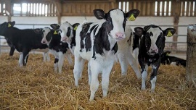
PTAs for top NM$ calves in research herds
MFP$gross | MFP$net | BWC$ | FeedSave$ | RFI$ | NM$ | NM_RFI$
931 | 510 | 6 | 39 | 23 | 898 | 921
949 | 524 | 1 | 18 | 17 | 897 | 914
1027 | 574 | ‒4 | 7 | 11 | 888 | 899
909 | 488 | 5 | 25 | 20 | 886 | 906
909 | 476 | 19 | 20 | 1 | 858 | 859
884 | 470 | 8 | 29 | 21 | 840 | 861
846 | 466 | 3 | 6 | 3 | 827 | 830
955 | 557 | ‒8 | ‒44 | ‒36 | 815 | 779
891 | 474 | 15 | 45 | 30 | 807 | 837

Slide 6
NM$ before and after including feed intake data
Correlation = 0.990

Slide 7
Reliabilities of economic indexes
REL definitions for research calves (same as previous slide)
  MFP$ Official REL average of 79%
  BWC$ Official REL average of 77%
  RFI$ REL average of 12%
  FeedSaved$ (REL_{BWC} × 67² + REL_{RFI} × 209²)/(67² + 209²)
  NM$ REL average 76% for current official
  NM$_noRFI REL_{NM$} including REL_{RFI} = 0% (no info)
  NM$_RFI (REL_{NM$} × 193² + REL_{RFI} × 70²)/(193² + 70²)

Slide 8
RELs for top NM$ calves in research herds
MFP$gross | BWC$ | FeedSave$ | RFI$ | NM$ | NM_noRFI$ | NM_RFI$
77 | 76 | 16 | 10 | 74 | 65 | 67
76 | 76 | 17 | 11 | 73 | 65 | 66
78 | 78 | 17 | 10 | 75 | 66 | 67
76 | 74 | 17 | 11 | 73 | 65 | 66
79 | 78 | 20 | 14 | 76 | 67 | 69
77 | 74 | 18 | 13 | 74 | 65 | 67
76 | 77 | 18 | 12 | 74 | 65 | 67
76 | 73 | 17 | 11 | 73 | 65 | 66
76 | 76 | 16 | 10 | 73 | 65 | 66

Slide 9
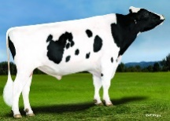
Daughters and RELs of top proven bulls (April 2019)
Bull | Dtrs_Milk | Dtrs_PL | Dtrs_RFI | REL_RFI | REL_NM | REL_NM_RFI
Rowdy | 243 | 0 | 0 | 13 | 90 | 81
Raiden | 65 | 0 | 0 | 13 | 87 | 78
Josuper | 9,362 | 5,073 | 0 | 15 | 97 | 88
Rubicon | 4,108 | 1,980 | 0 | 17 | 97 | 88
Frazzled | 21 | 0 | 0 | 12 | 84 | 76
Dante | 840 | 187 | 0 | 15 | 94 | 85
Delta | 6,054 | 1,817 | 0 | 17 | 97 | 88
Coleman | 77 | 0 | 0 | 13 | 86 | 77
Passat | 158 | 0 | 0 | 13 | 89 | 80
Duke | 614 | 30 | 0 | 13 | 92 | 83

Slide 10
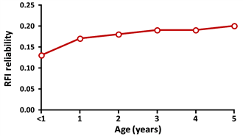
Declining REL by distance from reference cows
Young bull reliabilities estimated by exact inversion of single-step genomic equations
Bulls further from reference cows had lower theoretical REL for RFI
Conclusion: Measure feed intake on cows more closely related to elite animals in next generation
Research of Bingjie Li (AGIL postdoc) and Elif Gunal (CDCB intern)
REL by age of bull

Slide 11
Expected RFI REL with more reference cows

Slide 12
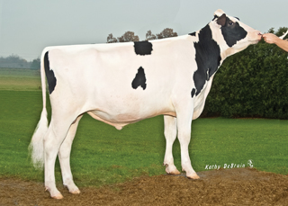
RFI reliability by animal group
Animal group from national data | RFI Reliability (%)
 | Pedigree | Genomic
3,965 cows with RFI phenotypes | 30 | 34
Top 10 sires with most RFI daughters | 78 | 85
Top 100 Net Merit progeny tested sires | 8 | 16
Top 100 Net Merit young bulls | 3 | 12
1.5 million genotyped Holsteins | 5 | 13
60 million non-genotyped Holsteins | 3 | 3

Slide 13
Multi- vs. Single-Step REL of RFI
Mean REL | Pedigree | Genomic
Multi-step | 24% | 31%
Single-step (exact inversion) | 26% | 31%
Results based on 5,981 animals with 60k genotypes;
Multi-step analysis was from national RFI evaluation;
Single-step analysis was from research cows plus ancestors.
(Slight differences in multi- and single-step data modeling).
Research by postdoc Bingjie Li now published in J. Dairy Sci.

Slide 14
Multi- vs. Single-Step evaluation of RFI
Correlations | Pedigree | Genomic
EBV (multi- vs. single-step) | 0.997 | 0.939
REL (multi- vs. single-step) | 0.989 | 0.916
Results based on 5,981 animals with 60k genotypes;
Multi-step analysis was from national RFI evaluation;
Single-step analysis was from research cows plus ancestors.
(Slight differences in multi- and single-step data modeling).
Research by postdoc Bingjie Li now published in J. Dairy Sci.

Slide 15
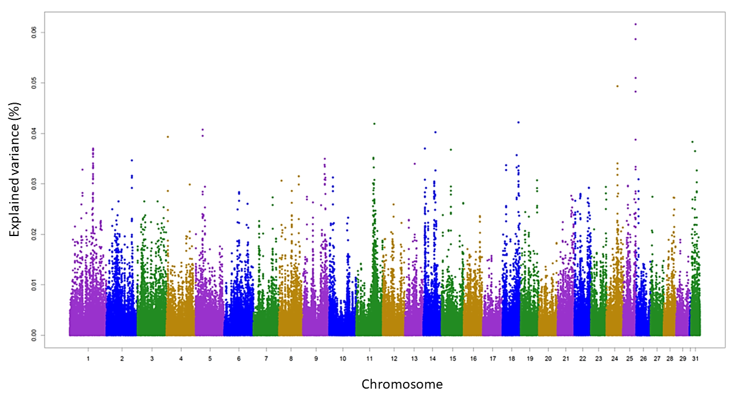
Largest effects for RFI from high-density genotypes
SNP variance explained by 5-SNP windows
Top 350 RFI SNPs provided to labs to design better future chips

Slide 16
Selection for feed efficiency (why now?)
Before genomics
  Measurement for 1 cow = $500
  Young bulls per year = 1,500
  Daughters per bull = 100
  Annual cost = $75 million
After genomics
  Measurement for 1 cow = $500
  Cost per genomic test = $40
  No. of reference cows = 25,000
  Young bulls per year = 5,000
  One-time cost = $13.5 million
  Annual update cost = $200,000
$50,000 per AI bull
$310 per AI bull

Slide 17
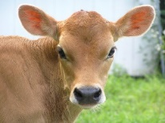
Heifer livability (HLIV) data
Extracted data from CDCB database (birth years 2001–16)
  4,428,896 dairy heifer data records
  Herds with death loss of 2–25%
  Heifers <2 days old not evaluated (used in stillbirth)
  Heifers up to 18 months old used
  Total number of deaths = 142,6202 (3.2%)
Livability scored as 100 (alive) or 0 (dead)
Heritability estimate of 0.4% by sire model REML

Slide 18
HLIV evaluation
Genomic PTAs (GPTAs) for proven bulls
  Holstein: ‒1.5% to +1.5% (SD of 0.5%)
  Jersey: ‒0.8% to +0.8% (SD of 0.2%)
RELs for young animals
  Holstein: 49% REL for GPTA
  19% REL for traditional PA
  Jersey: 31% REL for GPTA
  13% REL for traditional PA

Slide 19
Correlation of HLIV with other traits (Holstein)
Correlations for HLIV GPTA of recent proven bulls
  0.47 with PL and 0.20 with cow livability
  0.36 with calving trait dollars (calving ease, stillbirth)
  0.32 with early first calving (EFC)
  0.30 to 0.32 with yield traits
Correlation of HLIV GPTA with NM$ is very high (0.55)
Genetic trend for HLIV already favorable in recent years because of selection for correlated traits and NM$
Notes:
The Jersey correlations and trends are not as high, perhaps due to fewer genotypic records (311,576 records for Jersey population as compared to 2,505,753 for Holsteins).

Slide 20
Economic values for EFC and HLIV
EFC has value of $2.50 per day (SD of 2.5 days)
  Relative emphasis on EFC could be about 3% of NM$
  Emphasis on HCR would decline from 2.1% to about 1.5%
  Evaluation and derivation in Hutchison et al. (2017 JDS)
HLIV has value of <$5.00 per 1% (SD of 0.5%)
  Relative emphasis on HLIV could be <1% of NM$
  Contributions to NM$ will be very small (less than ±$5)
  Evaluation being developed by postdoc Mahesh Neupane

Slide 21
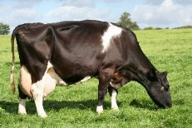
Economic value of PL
Faster genetic gain makes young cows more valuable than old
NM$ has not accounted for genetic trend of replacements
PL may have only half the economic value currently assumed
Based on University of Florida research by Michael Schmitt and Albert De Vries
  Ranking sires using genetic selection indices based on financial investment methods versus lifetime net merit. J. Dairy Sci. 102:9060–9075. 2019. https://doi.org/10.3168/jds.2018-16081

Slide 22
Economic value of BWC in NM$
BW pounds = 40 * BWC from Manzanilla-Pech et al., 2016
BWC$ = BW * [cull price * (1 – cow death loss) – heifer growth cost – cow maintenance cost * 2.8 lactations – cow growth cost]
Maintenance = $3.28 / pound BW / lactation from NRC values
Now about twice as high as previously used in NM$ because:
  $ value was constant using lower feed costs from 1990s
  Modern cows require more energy for maintenance (NRC)
The BWC$ contribution to FeedSaved$ and NM$ should double

Slide 23
August 2020 NM$ revision options
RFI could get 16% of total emphasis but Var(PTA) and REL are low
BWC should double negative emphasis from ‒5% to ‒10% because maintenance cost used since 2000 was too low
EFC could get 3% of emphasis with reduced emphasis on HCR
HLIV could get 1% of emphasis depending on calf value
PL should get less value because faster progress makes younger cows more profitable than older (Schmitt et al., 2019, JDS)

Slide 24
Extra progress from each proposed revision
Index revisions | Old emphasis | New emphasis | Progress (% of NM$ gain) | Value/year (million $)
Add feed intake data (RFI) | … | 16% | 0.85 | 4.25
Add early first calving (EFC) | … | 3% | 0.04 | 0.20
Add heifer livability (HLIV) | … | <1% | 0.01 | 0.05
Revise maintenance cost (BWC) | ‒5% | ‒10% | 0.62 | 3.10
Revise opportunity cost (PL) | 12% | 7% | 0.42 | 2.10
Total for all revisions | … | … | 1.94 | 9.70

Slide 25
Extra progress from adding more traits to NM$
Year | Traits (no.) | Traits included | Correlation with previous index | Extra progress
1977 | 3 | Milk, fat, protein | … | …
1994 | 5 | PL, SCS | 0.84 | 19%
2000 | 18 | Linear type | 0.94 | 6%
2003 | 21 | DPR, calving ease | 0.98 | 2%
2006 | 23 | Stillbirth | 0.975 | 3%
2014 | 25 | HCR, CCR | 0.965 | 4%
2017 | 26 | LIV | 0.989 | 1%
2018 | 32 | Health traits | 0.994 | 0.6%
2020 | 35 | RFI, EFC, HLIV, revisions | 0.981 | 1.9%

Slide 26
Reporting feed saved, feed efficiency, or RFI
Feed saved is already reported in AUS and proposed for USA
  FeedSaved$ combines RFI$ and BWC$ (value of BWC) but not yield traits
Feed efficiency is already reported by Holstein USA:
  FE$ combines MFP$net and BWC$ to get milk income – expected feed cost
  Current definition receives 8% of emphasis in TPI
  New FE$ could be FE$ + RFI$, then deserves more emphasis
Multiple choice: FeedSaved$, RFI$, FE$? Or report pounds or kg of DMI?

Slide 27
Conclusions
RFI could get ~16% of relative emphasis in net merit, but low REL of ~12% for young animals will limit progress
HLIV could have genomic evaluations in 2020
NM$ should
  Include RFI, EFC, and HLIV
  Put more emphasis on smaller BWC
  Reduce emphasis on PL and HCR
REL of NM$ is lower when feed intake or other traits with low REL (such as fertility) are included in selection goal, but progress is faster

Slide 28
Acknowledgments & disclaimers
USDA-ARS project 8042-31000-002-00-D, “Improving Dairy Animals by Increasing Accuracy of Genomic Prediction, Evaluating New Traits, and Redefining Selection Goals” (AGIL funding)
CDCB and its industry suppliers for data
Agriculture and Food Research Initiative Competitive Grant #2011-68004-30340 from USDA National Institute of Food and Agriculture (feed intake funding)
USDA is an equal opportunity provider and employer
Mention of trade names or commercial products in this presentation is solely for the purpose of providing specific information and does not imply recommendation or endorsement by USDA

