Slide 1
  The future of genomic evaluations of Holstein cattle
John B. Cole
USDA, Agricultural Research Service
Henry A. Wallace Beltsville Agricultural Research Center
Animal Genomics and Improvement Laboratory
Beltsville, MD 20705-2350

Slide 2
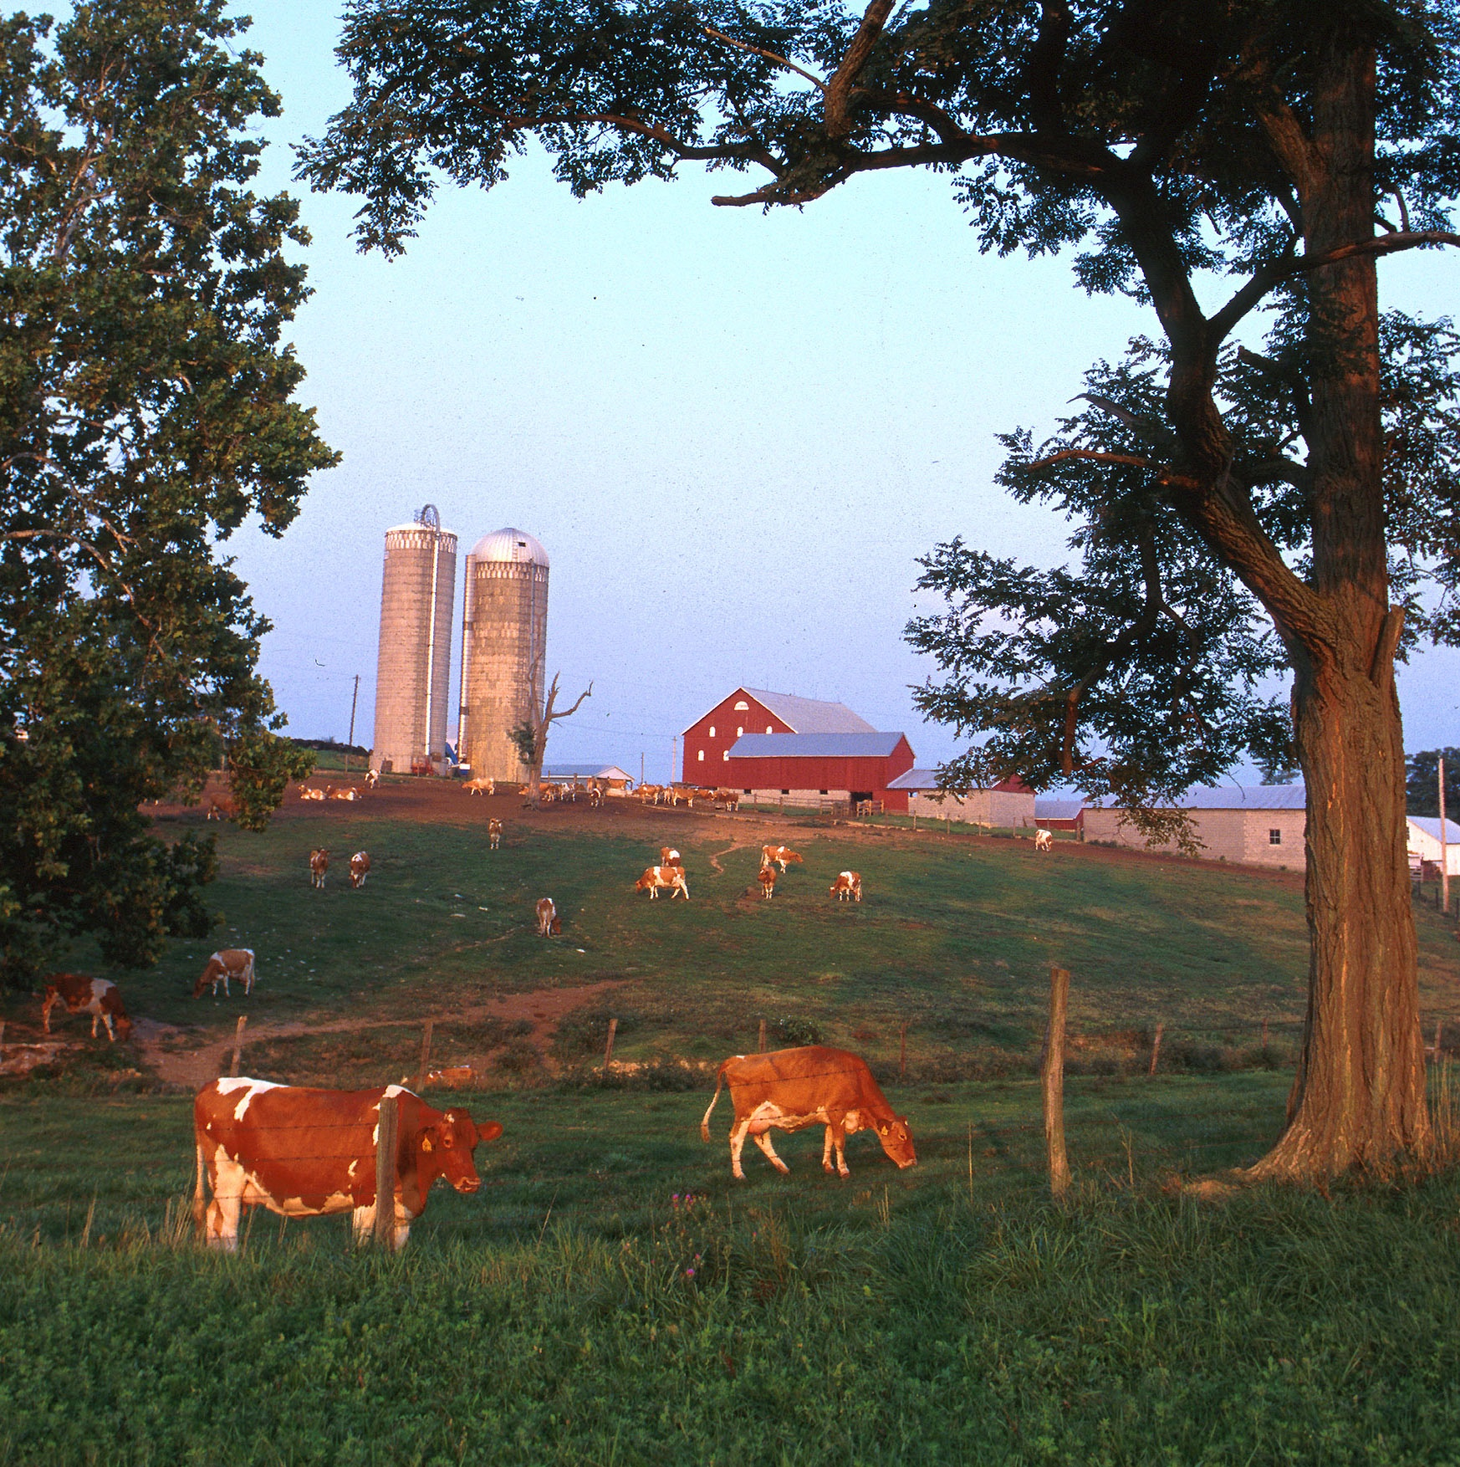
Topics for discussion
Where have we been?
  Genetic selection has provided high benefits at low prices
Where are we today?
  Genomics a big success
  Challenging business climate
Where are we going tomorrow?
  Data
  Decisions
  Diversity

Slide 3
Where have we been?

Slide 4
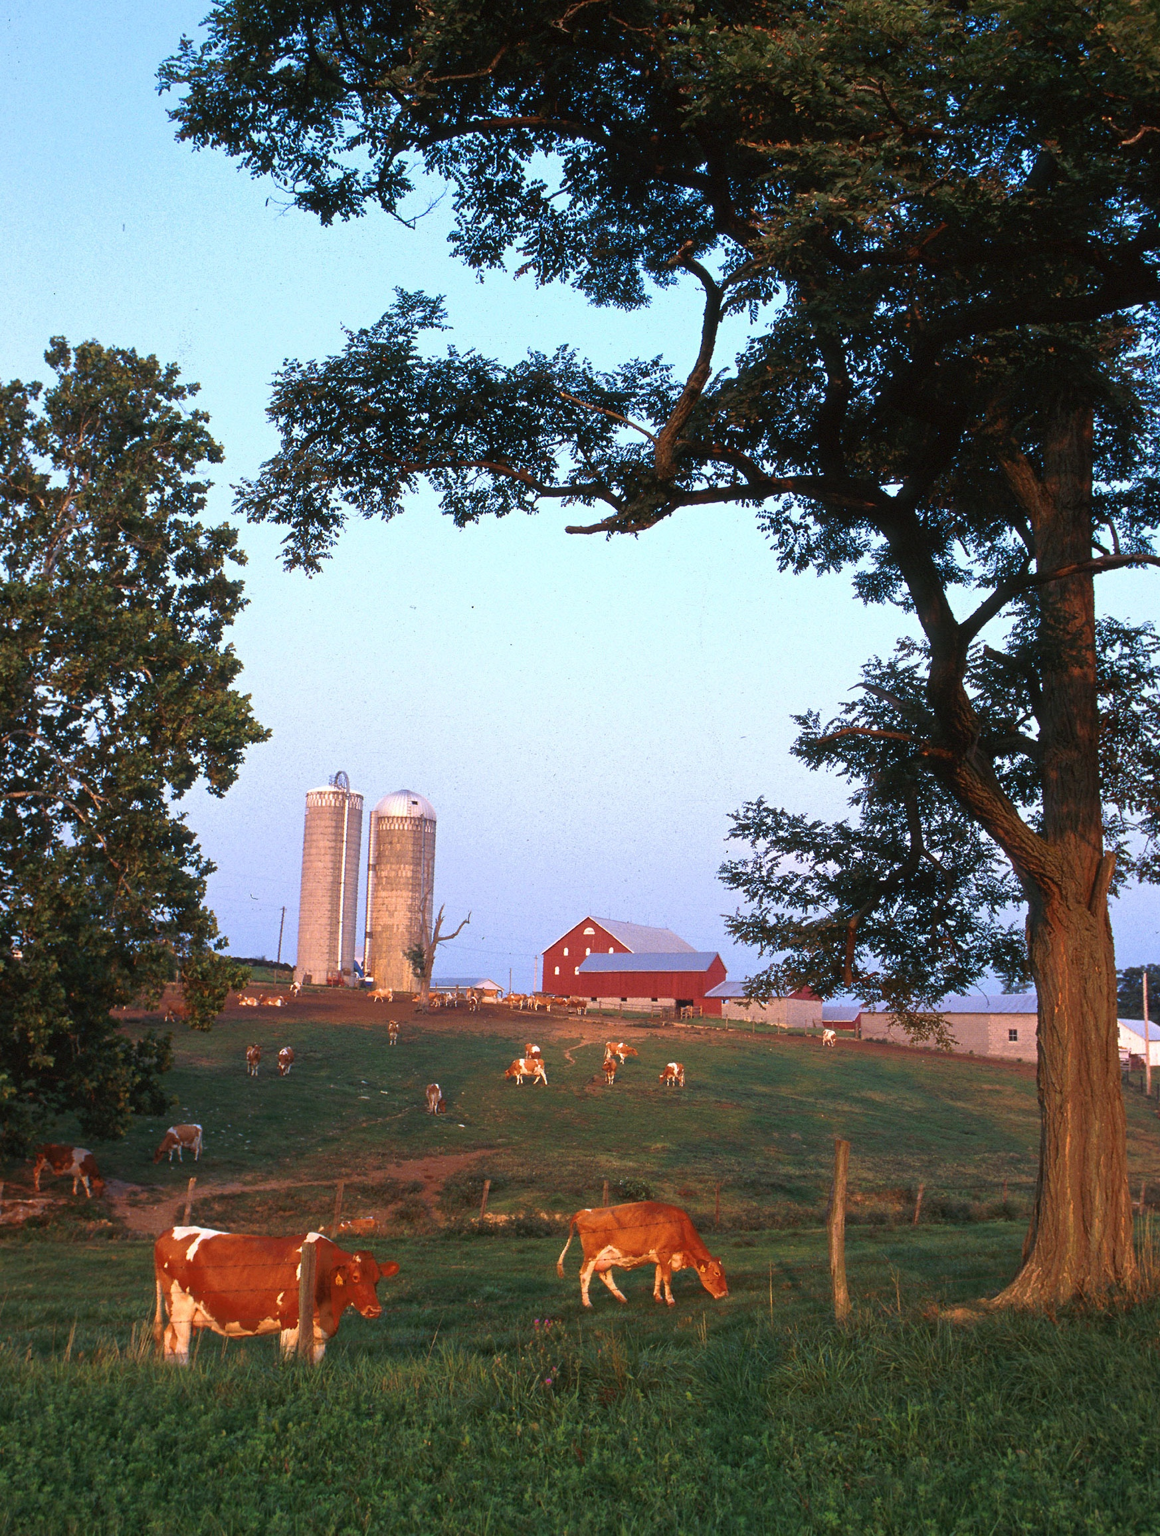
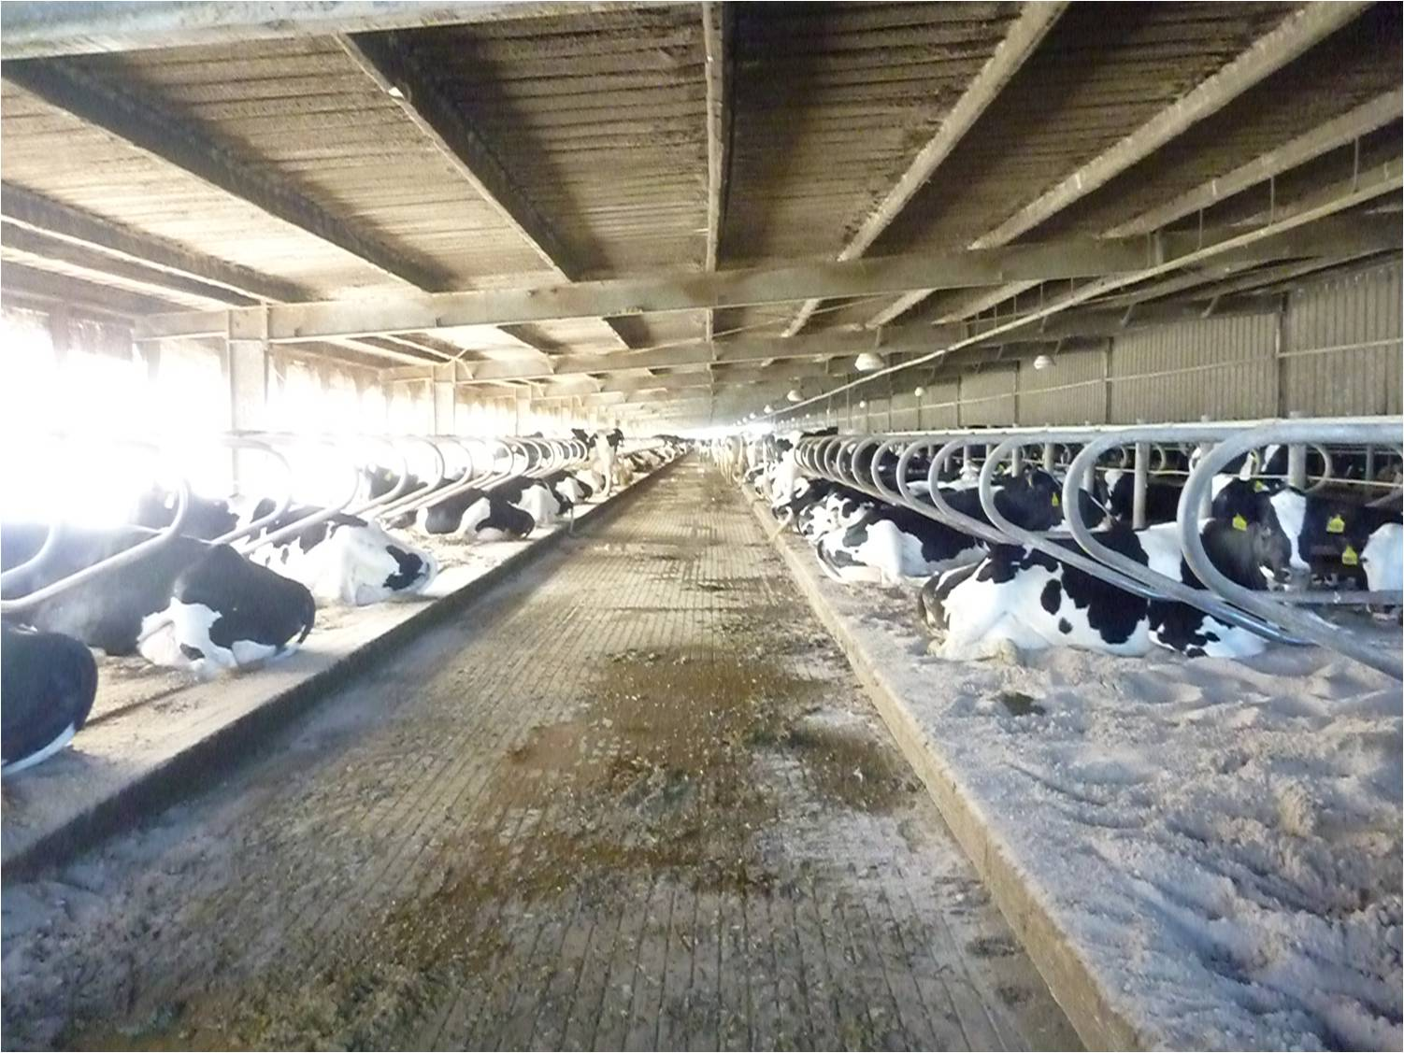
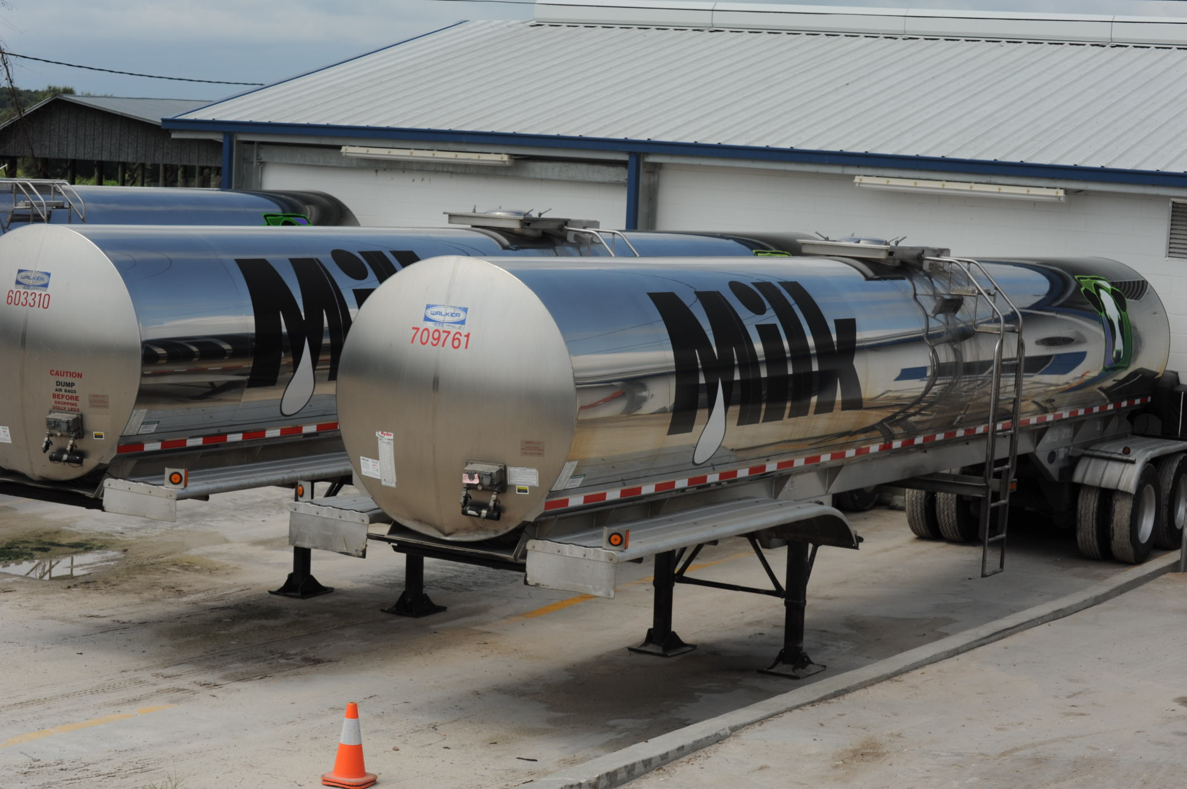
Typical US dairies
Top: Large freestall barn in the state of Florida.
Bottom: 7,000 G (~26,500 l) milk tankers.
Photo courtesy of North Florida Holsteins.
Small dairy farm in western Maryland. Photo courtesy of ARS.

Slide 5

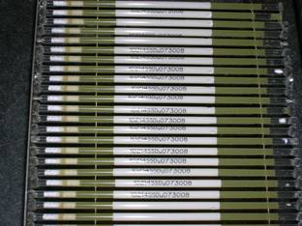
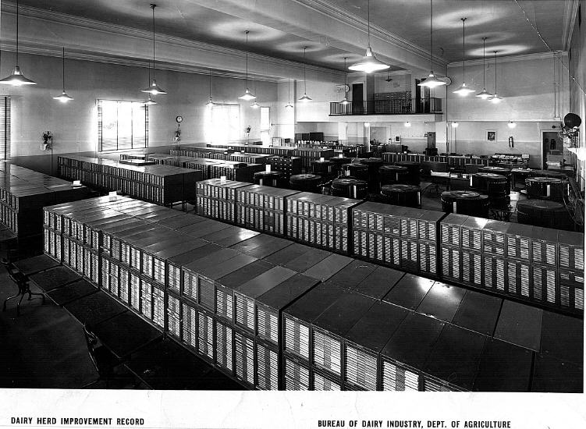
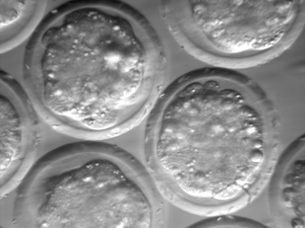
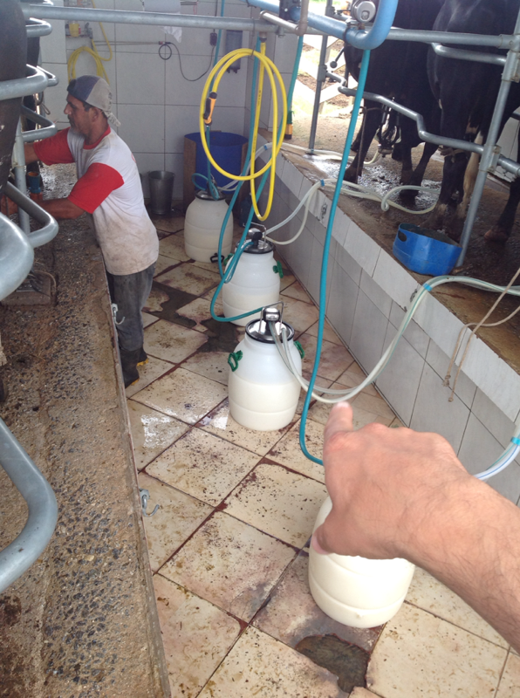
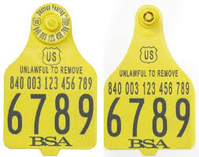
Dairy farmers have always adopted new technologies

Slide 6
Productivity has greatly increased over time

Slide 7
What influences a phenotype?
P = G + E
The percentage of total variation attributable to genetics varies:
Female fertility: 0.04
Working life: 0.08
Udder health: 0.12
Milk production: 0.35
The percentage of total variation attributable to environmental factors is large:
Feeding/nutrition
Housing
Reproductive management
Notes:
7
7

Slide 8
What is the value of genetic selection?
In 2015: 1957 base was 44% of total fat,
management was 28% of gains, and
genetics was 28% of gains
Source: https://queries.uscdcb.com/eval/summary/trend.cfm?R_Menu=JE.f#StartBody

Slide 9
Where are we today?

Slide 10
Genotypes are plentiful
Source: Council on Dairy Cattle Breeding

Slide 11
Genomic selection has increased rates of gain
Source: García-Ruiz et al. (2016)

Slide 12
Genotypes can be applied to many traits
An animal’s genotype is good for all traits
Traditional evaluations are required for accurate estimates of SNP effects
Traditional evaluations not currently available for heat tolerance or feed efficiency
Research populations could provide data for traits that are expensive to measure
Will resulting evaluations work in target population?

Slide 13
Impact of genomics on dairy producers
General
  Reduced generation interval
  Increased rates of genetic gain
  Better reliabilities for low-heritability traits
  More inbreeding/homozygosity
    This is not inevitable!
Bulls
  Higher average genetic merit of available bulls
  More rapid increase in genetic merit for all traits
  Larger choice of bulls for traits and semen price
  Greater use of young bulls
    69% of all US matings are to young bulls

Slide 14
What if we put the best DNA together in one animal?
EBV(NM$) = US$7,304
= Mex$138,641
After Cole and VanRaden (2011).

Slide 15
Where are we going tomorrow?

Slide 16
What do countries include in their index?

Slide 17
Why do we need new phenotypes?
Changes in production economics
Technology produces new phenotypes or reduces costs of collecting them
  New traits can be predicted on all genotyped animals without collecting progeny records
  Phenotyping costs are shared among millions of animals
  Biotechnology supports improved sensors
To better understand cow biology
Recent review by Egger-Danner et al. (Animal, 2015)

Slide 18
Selection goals have always changed over time
Trait | Relative emphasis on traits (%)
 | PD$ 1971 | MFP$ 1976 | CY$ 1984 | NM$ 1994 | NM$ 2000 | NM$ 2003 | NM$ 2006 | NM$ 2010 | NM$ 2014 | NM$ 2017 | NM$ 2018
Milk | 52 | 27 | –2 | 6 | 5 | 0 | 0 | 0 | –1 | –1 | –1
Fat | 48 | 46 | 45 | 25 | 21 | 22 | 23 | 19 | 22 | 24 | 27
Protein | … | 27 | 53 | 43 | 36 | 33 | 23 | 16 | 20 | 18 | 17
PL | … | … | … | 20 | 14 | 11 | 17 | 22 | 19 | 13 | 12
SCS | … | … | … | –6 | –9 | –9 | –9 | –10 | –7 | –7 | –4
UC | … | … | … | … | 7 | 7 | 6 | 7 | 8 | 7 | 7
FLC | … | … | … | … | 4 | 4 | 3 | 4 | 3 | 3 | 3
BWC | … | … | … | … | –4 | –3 | –4 | –6 | –5 | –6 | –5
DPR | … | … | … | … | … | 7 | 9 | 11 | 7 | 7 | 7
SCE | … | … | … | … | … | –2 | … | … | … | … | …
DCE | … | … | … | … | … | –2 | … | … | … | … | …
CA$ | … | … | … | … | … | … | 6 | 5 | 5 | 5 | 5
HCR | … | … | … | … | … | … | … | … | 1 | 1 | 1
CCR | … | … | … | … | … | … | … | … | 2 | 2 | 2
LIV | … | … | … | … | … | … | … | … | … | 7 | 7
HTH$ | … | … | … | … | … | … | … | … | … | … | 2
Source: https://aipl.arsusda.gov/reference/nmcalc-2018.htm

Slide 19
Traits routinely evaluated in the US
Year | Trait | Year | Trait
1926 | Milk & fat yields | 2006 | Bull conception rate²
1978 | Conformation (type) | 2009 | Cow & heifer conception rates
1978 | Protein yield | 2016 | Cow livability
1994 | Productive life | 2017 | Gestation length
1994 | SCS (udder health) | 2017 | Residual feed intake (research)³
2000 | Calving ease (dystocia)¹ | 2018 | Cow health
2003 | Daughter pregnancy rate | 2019 | Age at first calving (early first pregnancy)
2006 | Stillbirth rate
¹Sire calving ease evaluated by Iowa State University (1978–99)
²Estimated relative conception rate evaluated by DRMS in Raleigh, NC (1986–2005)
³Research trait … no official evaluations yet

Slide 20
Examples of other traits
Claw health
(Van der Linde et al., 2010)
Cow health
(Parker Gaddis et al., 2013)
Embryonic development
(Cochran et al., 2013)
Immune response
(Thompson-Crispi et al., 2013)
Methane production
(de Haas et al., 2011)
Milk fatty acid composition (Soyeurt et al., 2011)
Persistency of lactation
(Cole et al., 2009)
Thermoregulation (Dikmen et al., 2013)
Susceptibility to bovine respiratory disease
(Neibergs et al., 2014)
Residual feed intake
(Connor et al., 2013)
Cheesemaking properties
(De Marchi et al., 2009)
Superovulation & embryo transfer
(Parker Gaddis et al., 2017)
Adaptation to automated (robotic) milking (Vosman et al., 2014)
Metabolic diseases
(Pryce et al., 2016)
Udder health
(Soyeurt et al., 2012)
Cow temperament
(Kramer et al., 2013)
Milking efficiency
(Lovendahl et al., 2012)

Slide 21
New traits should add more information
Novel phenotypes include some new information | Novel phenotypes contain little new information
Novel phenotypes include much new information | Novel phenotypes include some new information
High
Phenotypic correlation
with existing traits
Low
Low
High
Genetic correlation with existing traits

Slide 22
New traits should have value to farmers
Milk yield | Feed intake
Conformation | Greenhouse gas emissions
High
Phenotype value
Low
Low
High
Measurement cost

Slide 23
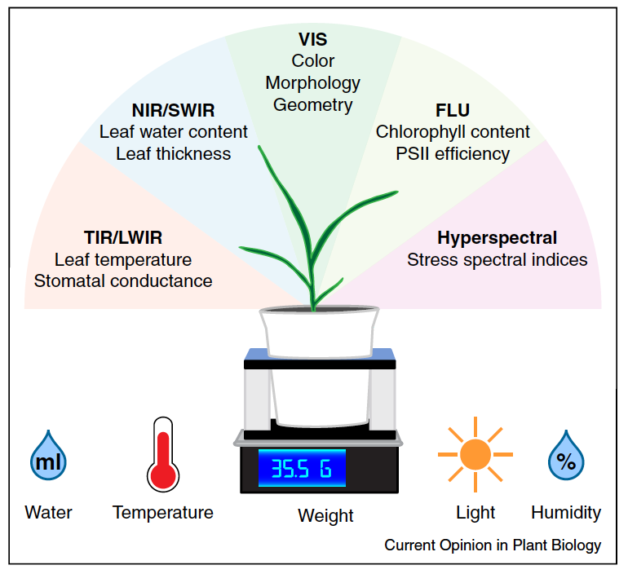
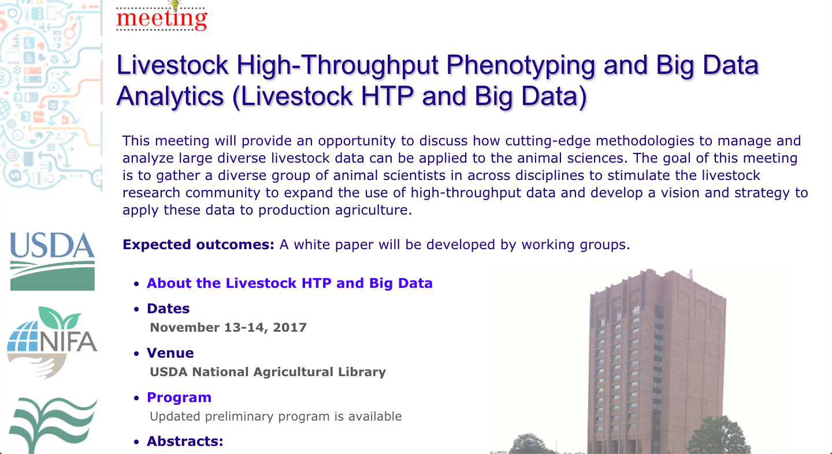
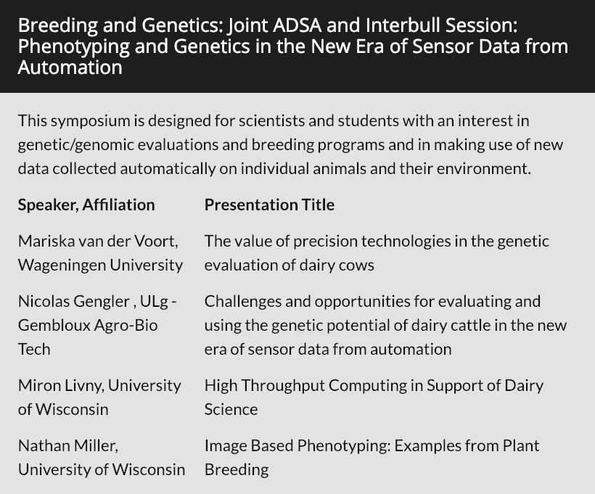
High-throughput phenotyping
Source: Fahlgren et al. (2015; https://doi.org/10.1016/j.pbi.2015.02.006).

Slide 24
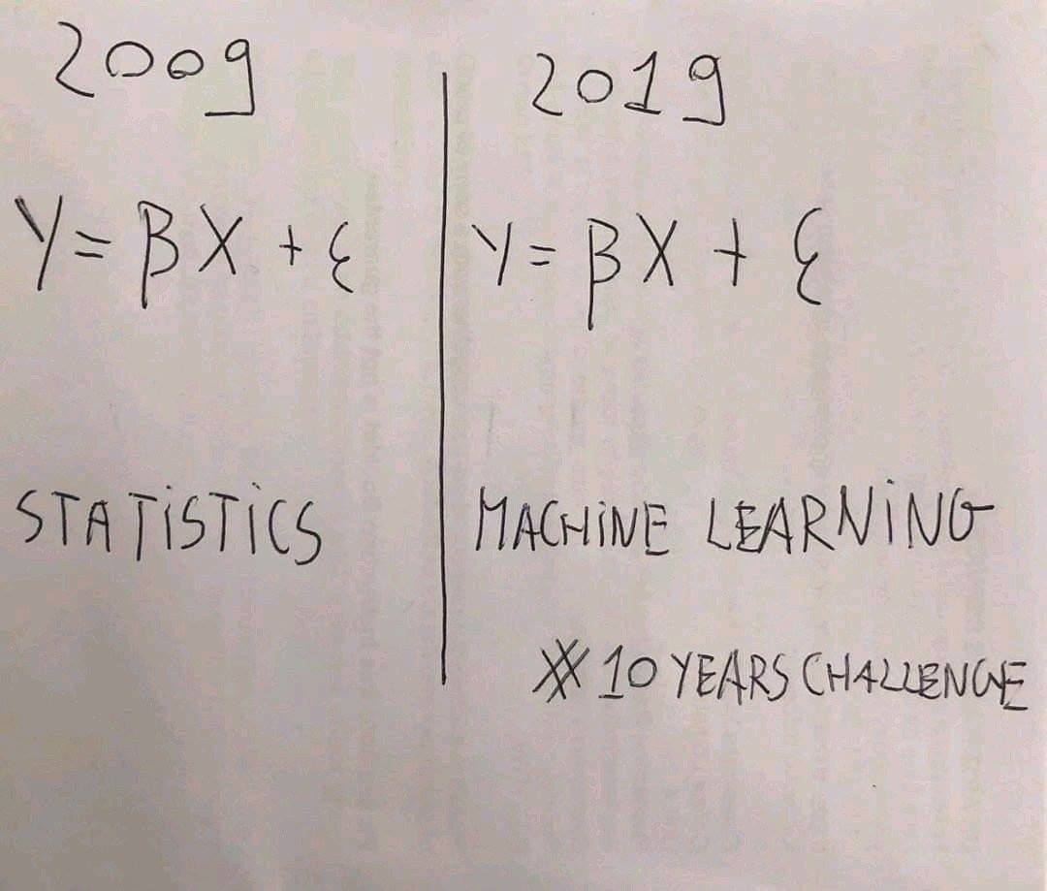
Machine learning and phenotypic prediction
Many data now available to farmers
Underutilized for predicting future performance
Can also be used to assign animals to management groups or schedule treatments
Source: Twitter.

Slide 25
Inbreeding is increasing faster than in the past
GFI = genomic future inbreeding, PB = proven bulls, YB = young bulls
Source: CDCB (2019)

Slide 26
Why do we worry about inbreeding?
Change in phenotypic performance per 1% increase in inbreeding
Milk (kg) | Fat (kg) | Protein (kg) | PL (mo) | SCS | DPR | HCR | CCR | Livability
-28.6 | -1.08 | -0.85 | -0.25 | 0.00 | -0.14 | -0.05 | -0.18 | -0.08
Source: CDCB (https://queries.uscdcb.com/eval/summary/Bmean_bases_het.cfm).
Change in genetic potential per year when selecting on NM$
Milk (kg) | Fat (kg) | Protein (kg) | PL (mo) | SCS | DPR | HCR | CCR | Livability
+47.2 | +2.67 | +1.72 | +0. 51 | -0.38 | +0.16 | +0.20 | +0.42 | +0.38
Source: AGIL, ARS, USDA (https://aipl.arsusda.gov/reference/nmcalc-2018.htm).
Be careful!
Interviewer: “How did you go bankrupt?”
Ernest Hemingway: “Two ways. Gradually, then suddenly.”

Slide 27
Known recessives in U.S. Holsteins
Haplotype | Functional/Gene name | Chromosome | Location (Mbp) | Haplotype frequency (%) | Timing¹
HBR | Black/red coat color/MC1R (MSHR) | 18 | 14.71 | 0.75 | —
HCD | Cholesterol deficiency/APOB | 11 | 77.87 | 2.28 | W
HDR | Dominant red color/MC1R (MSHR) | 3 | 9.36 | 0.03 | —
HH0 | Brachyspina/FANCI | 21 | 20.77 | 1.65 | E,B
HH1 | APAF1 | 5 | 62.81 | 1.28 | E
HH2 | — | 1 | 93.50-95.58 | 1.21 | E
HH3 | SMC2 | 8 | 93.75 | 2.64 | E
HH4 | GART | 1 | 1.99 | 0.23 | E
HH5 | TFB1M | 9 | 91.85-91.94 | 2.39 | E
HH6 | SDE2 | 16 | 29.01-29.05 | 0.44 | Old age
HHB | BLAD/ITGB2 | 1 | 144.77 | 0.21 | W
HHC | CVM/SLC35A3 | 3 | 43.26 | 1.10 | E,B
HHD | DUMPS/UMPS | 1 | 69.15 | 0.01 | E
HHM | Mulefoot/LRP4 | 15 | 76.81 | 0.05 | B
HHP | Polledness (dominant)/POLLED | 1 | 2.57 | 0.88 | —
HHR | Red coat color/MC1R (MSHR) | 18 | 14.71 | 3.29 | —
¹Timing of embryonic loss/calf death for homozygous animals: B = calf death at/shortly after birth, E = embryonic loss/abortion, W = calf death weeks/months after birth, — = non-lethal (Cole et al., 2016; Cole et al., 2018).

Slide 28
Is the number of genetic defects increasing?
MacArthur et al. (2012) estimated that human genomes contain ~100 loss-of-function mutations, and ~20 completely inactivated genes
The mutations are there even if we have not identified them yet
  Example: HH6, mutation in SDE2 (Fritz et al., 2018)
Our detection methods are improving as our technology improves

Slide 29
Opportunities and Conclusions

Slide 30
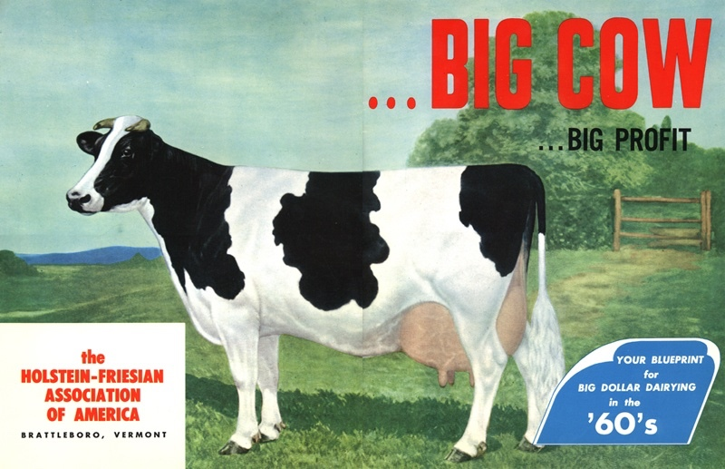
U.S. Ideal Holstein – 1960s
Source: Dr. L.B. Hansen, University of Minnesota.

Slide 31
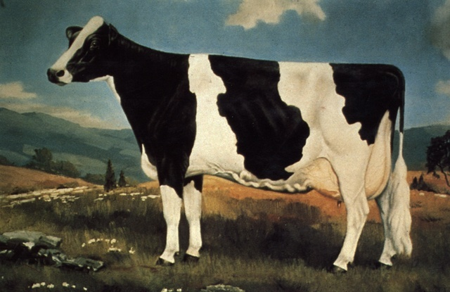
U.S. Ideal Holstein – 1970s
Source: Dr. L.B. Hansen, University of Minnesota.

Slide 32
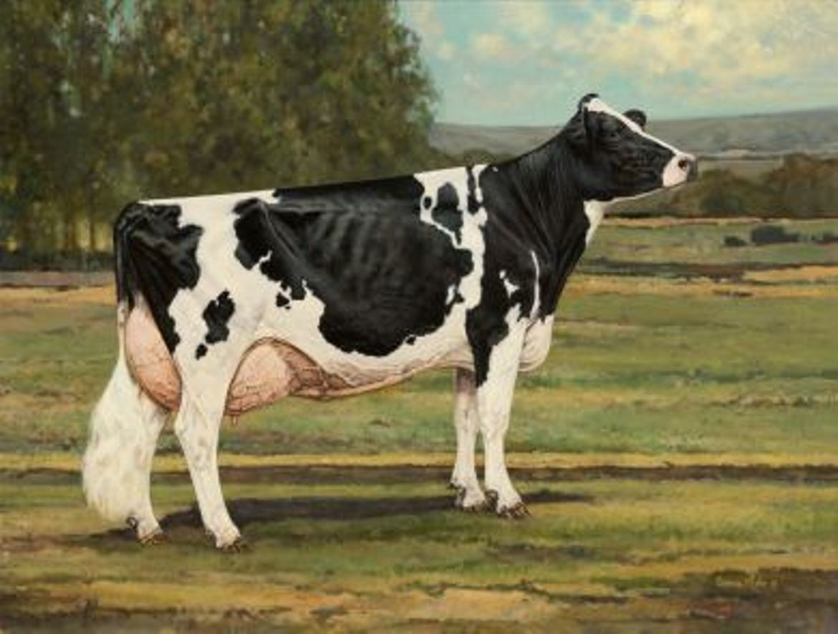
U.S. Ideal Holstein – 2012
Source: Dr. L.B. Hansen, University of Minnesota.

Slide 33
Conclusions
Genetic gains are cumulative and permanent, but genetic evaluations depend on a constant flow of data
The number of traits measured is growing but affordable data recording is challenging in some cases
Diversity must be monitored to avoid long-term problems
The Holstein breed is large enough to support many different breeding objectives and production systems
Holstein breeders have never been afraid of change, but they are not willing to adopt changes without reason

Slide 34
Acknowledgments
Travel funding from Holstein de México, A.G., is gratefully acknowledged.
USDA-ARS project 8042-31000-002-00-D, “Improving Dairy Animals by Increasing Accuracy of Genomic Prediction, Evaluating New Traits, and Redefining Selection Goals”.
USDA is an equal opportunity provider and employer.
Mention of trade names or commercial products in this presentation is solely for the purpose of providing specific information and does not imply recommendation or endorsement by the US Department of Agriculture.

Slide 35
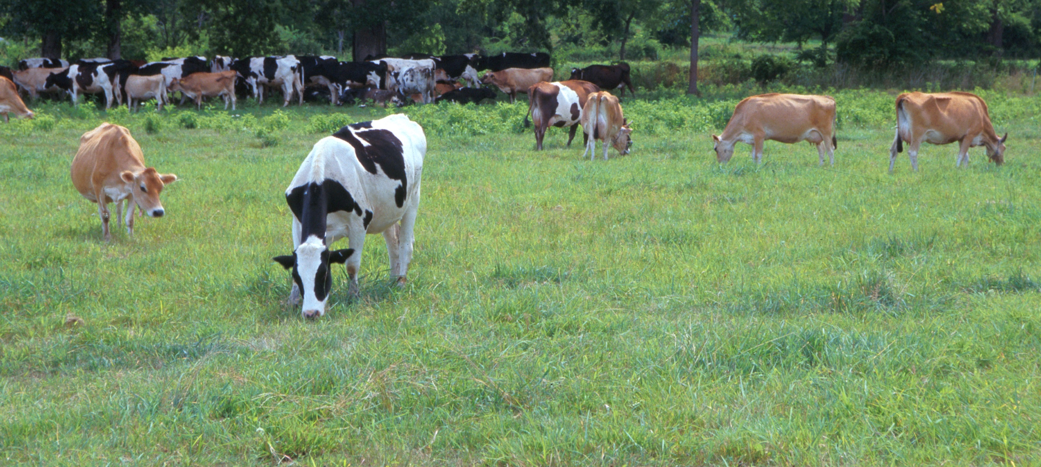
Questions?
AIP web site:
http://aipl.arsusda.gov/
Holstein and Jersey crossbreds graze on American Farm Land Trust’s
Cove Mountain Farm in south-central Pennsylvania
Source: ARS Image Gallery, image #K8587-14; photo by Bob Nichols

