Slide 1
  How does biotechnology drive change in the dairy sector?
John B. Cole
USDA, Agricultural Research Service
Henry A. Wallace Beltsville Agricultural Research Center
Animal Genomics and Improvement Laboratory
Beltsville, MD 20705-2350

Slide 2
Introduction and the Need for Change

Slide 3
What do we mean when we talk about change?
A technological change is an increase in the efficiency of a product or process that results in an increase in output, without an increase in input. (study.com).
Biotechnology is the exploitation of biological processes for industrial and other purposes (google.com).

Slide 4
Is improvement over time guaranteed?
We have become accustomed to steady improvements over time
  There is no guarantee of continuous gains (e.g., fertility)
All improvements are the result of deliberate decisions
  Bulls are selected to breed cows
  New equipment is purchased
Decisions must be based on data
  When? Where? How much?

Slide 5
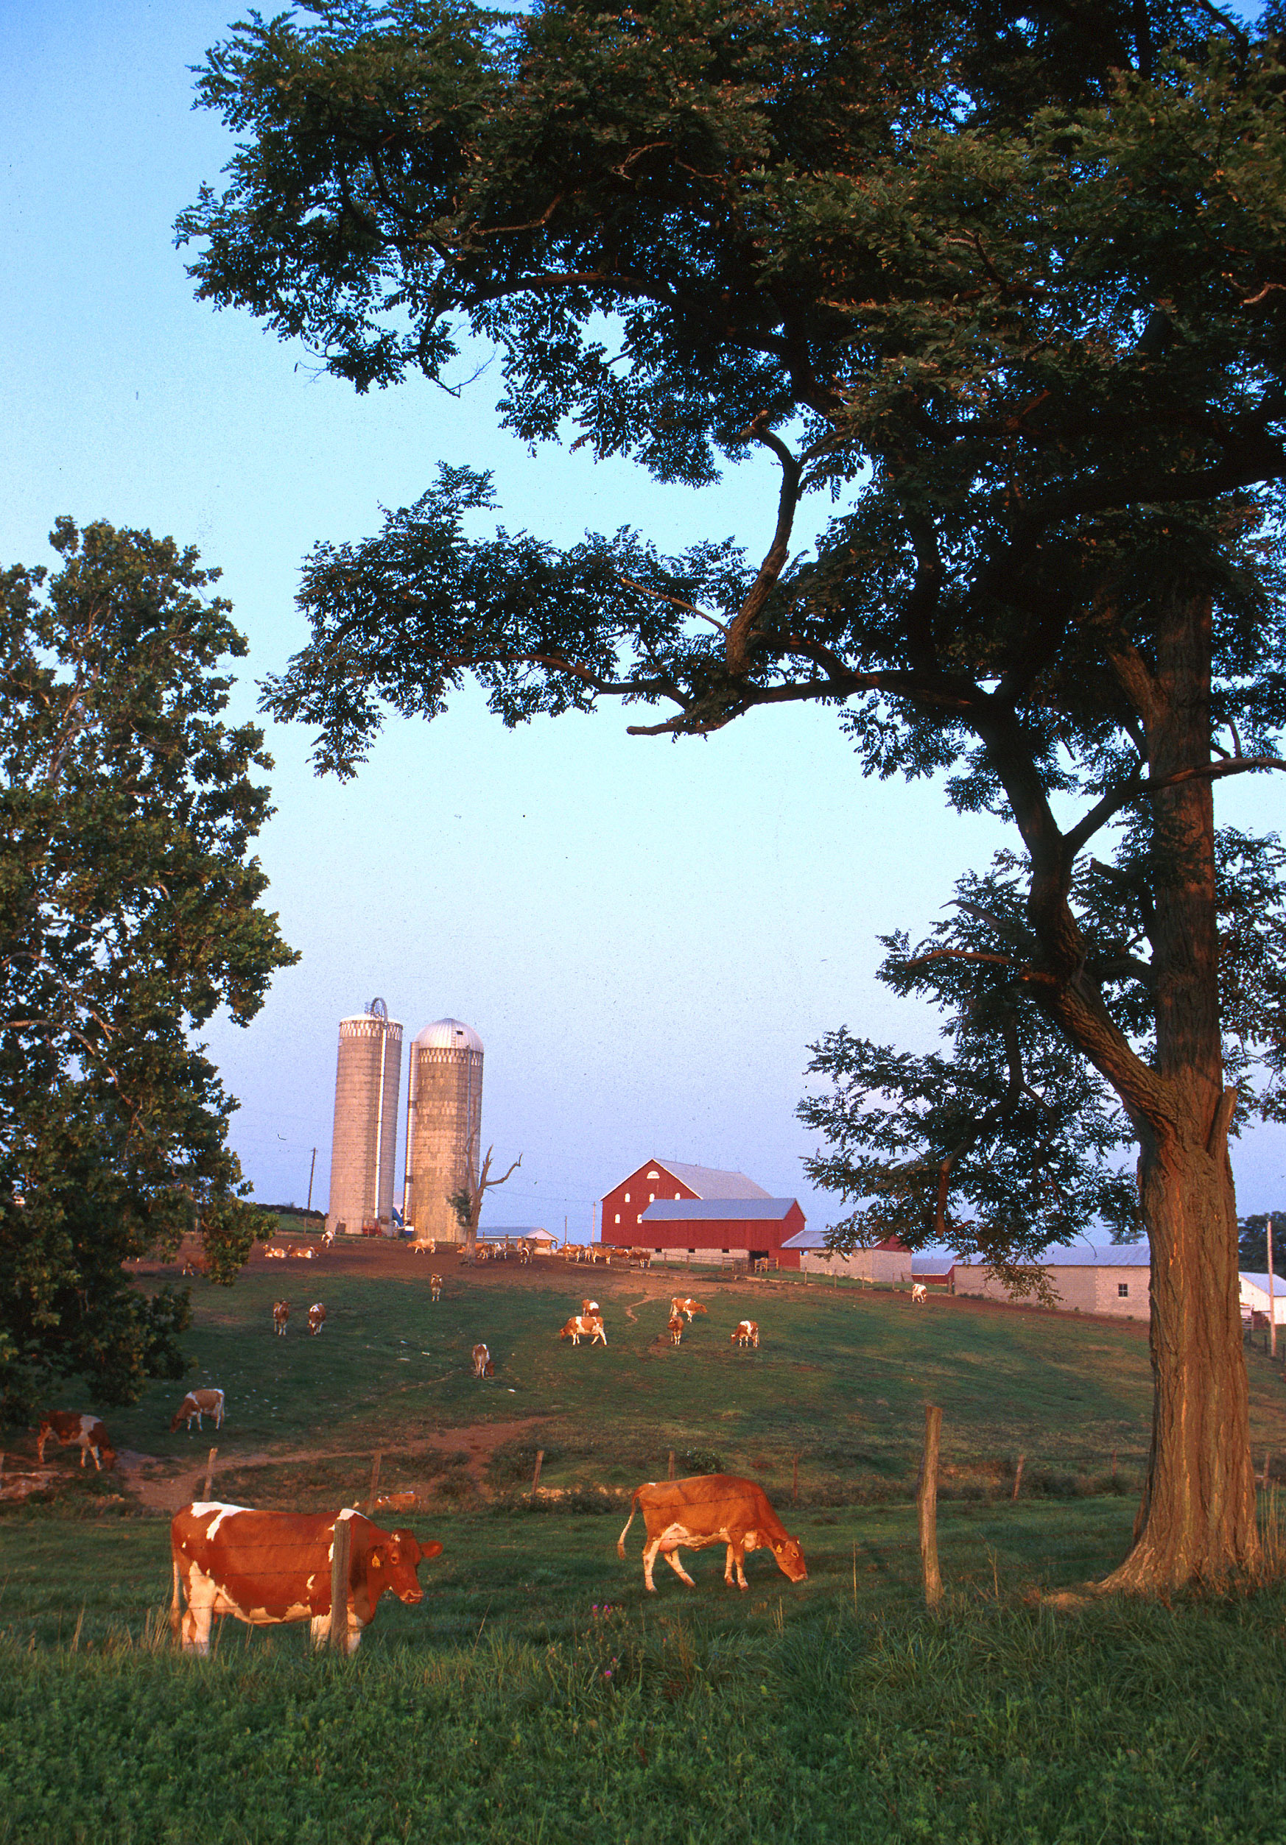
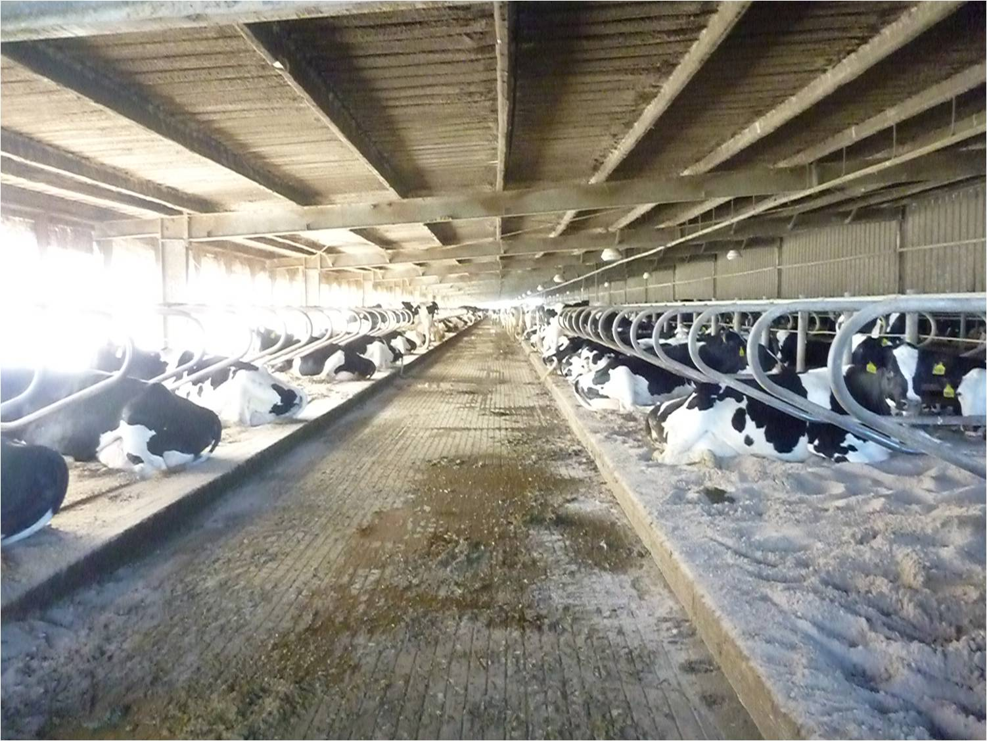
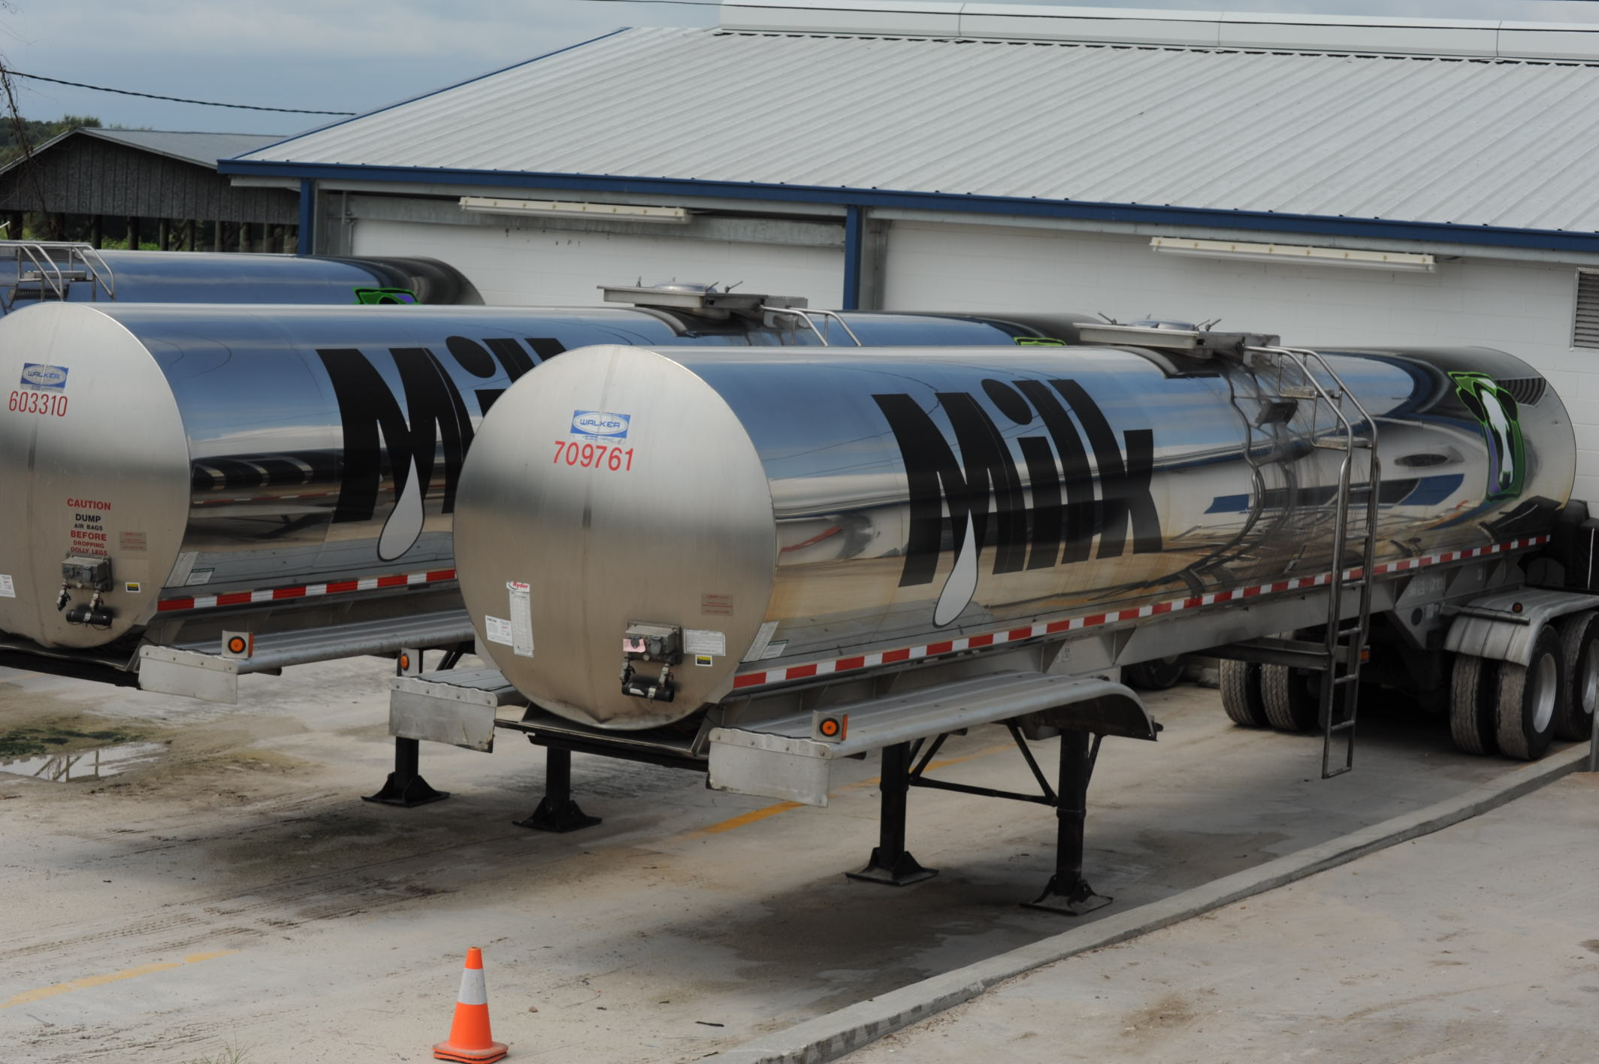
Typical US dairies
Top: Large freestall barn in the state of Florida.
Bottom: 7,000 G (~26,500 l) milk tankers.
Photo courtesy of North Florida Holsteins.
Small dairy farm in western Maryland. Photo courtesy of ARS.

Slide 6

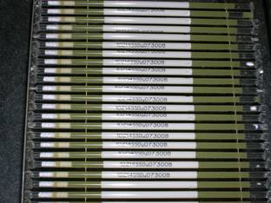
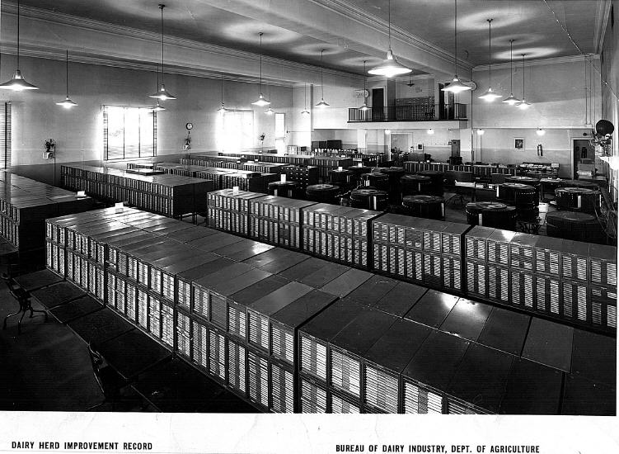
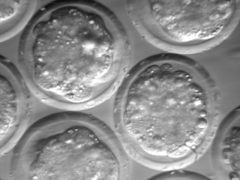
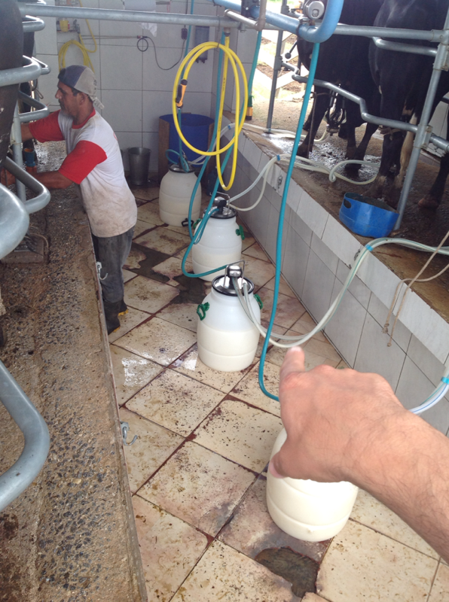
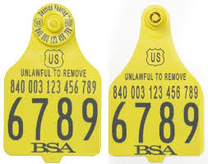
Dairy farmers are strong adopters of technology
Source: http://vet.tufts.edu/tas/images/002.png.
Source: http//www.shopbrownswiss.com/.

Slide 7
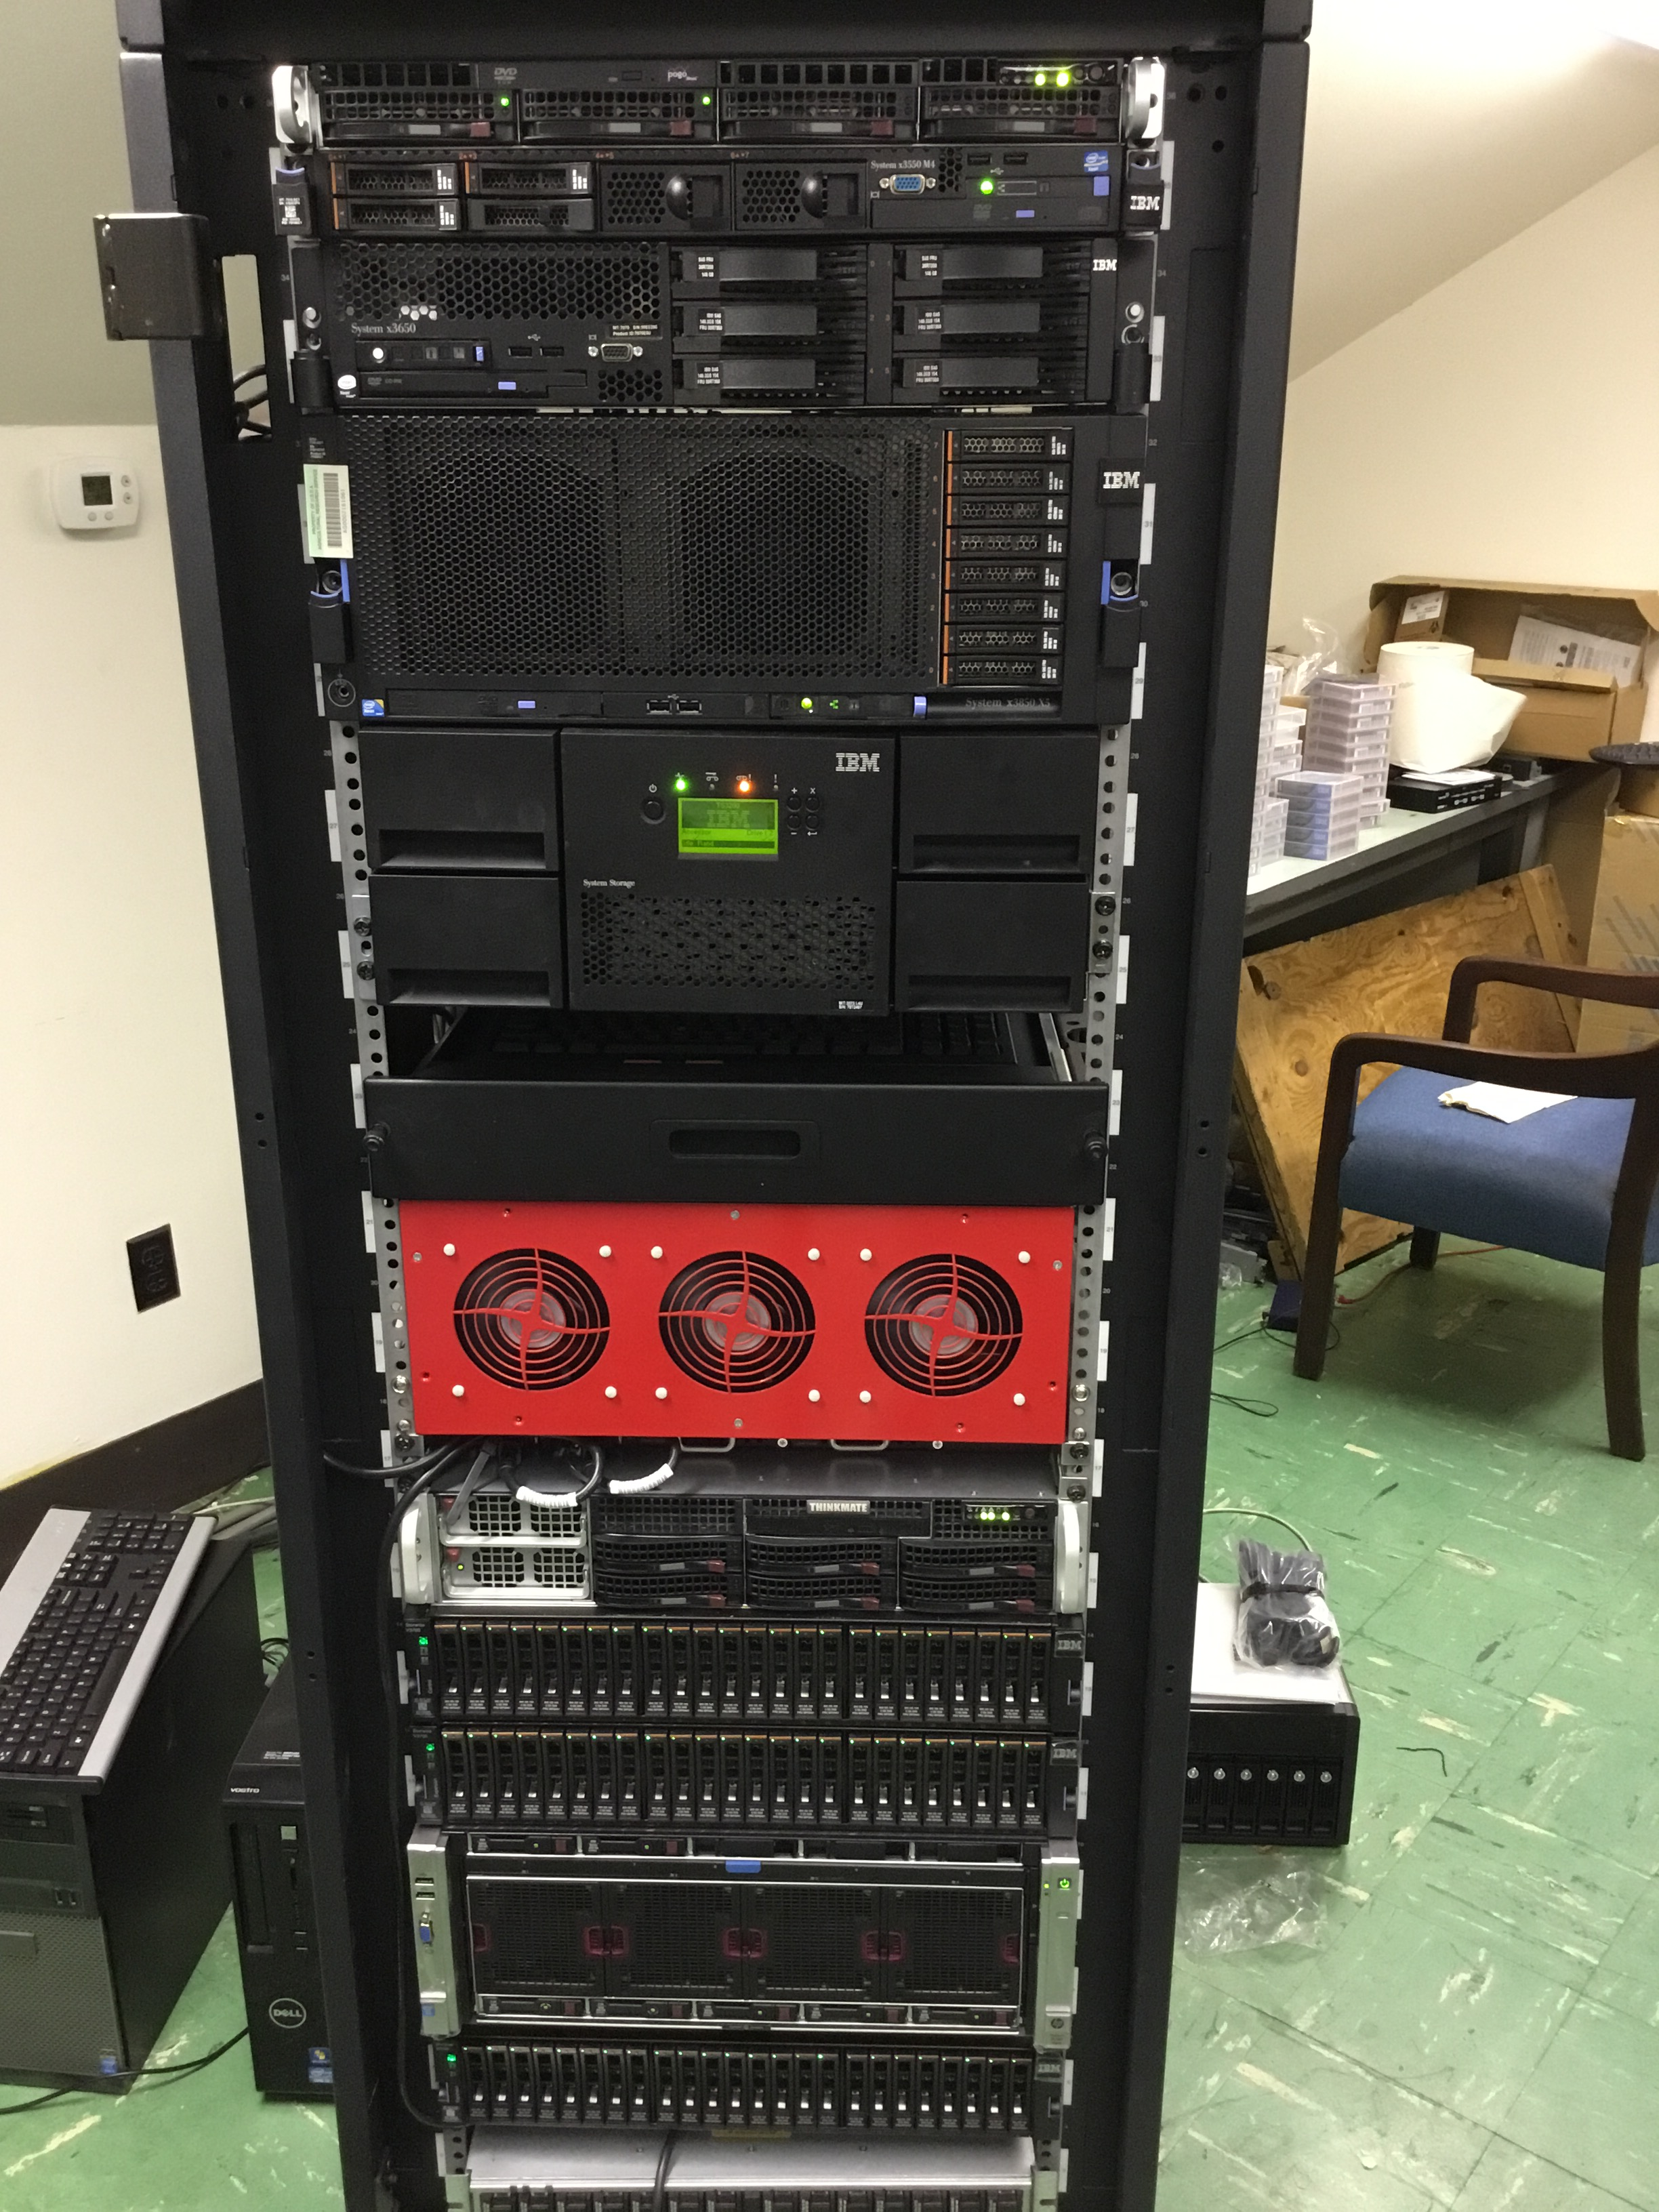
Dairy records databases, then and now
1935
2015

Slide 8
Advances in genetic theory
Theory | Author | Year | Species
Single-gene inheritance | Mendel | 1865 | Peas
Multiple-gene inheritance | Fisher | 1918 | Humans
Pedigree relationship matrix | Wright | 1922 | Cattle
Selection index | Hazel & Lush | 1943 | Plants, cattle
Mixed linear models | Henderson | 1963 | Cattle
Genomic prediction | Meuwissen | 2001 | Animals
Genomic relationship matrix | VanRaden | 2008 | Cattle
Also application
First database with 1 million genotyped individuals was
USDA/Council on Dairy Cattle Breeding in July 2015

Slide 9
Those changes greatly increased efficiency

Slide 10
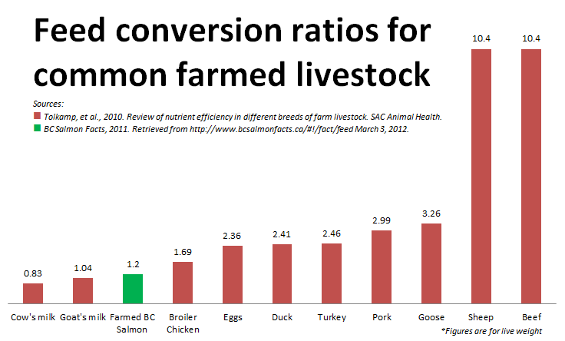
Dairy production is an efficient use of resources
Source: https://johnkutensky.wordpress.com/2014/08/28/eating-on-other-planets/.

Slide 11
The industry is still under great pressure to change
Source: https://www.ers.usda.gov/amber-waves/2014/december/milk-production-continues-shifting-to-large-scale-farms/.

Slide 12
Phenotype is King

Slide 13
Cow-centric model of inputs and outputs
Milk
Fat
Protein
Lactose
Urine
Feces
Calves
Gases
Feed
Minerals
Water
Sensors
Drugs
Hormones
Semen
Embryos
Source: https://pixabay.com/vectors/cow-milk-dairy-cows-animal-bauer-1595259/.

Slide 14
What influences a phenotype?
P = G + E
The percentage of total variation attributable to genetics varies:
Female fertility: 0.04
Working life: 0.08
Udder health: 0.12
Milk production: 0.35
The percentage of total variation attributable to environmental factors is large:
Feeding/nutrition
Housing
Reproductive management
Notes:
14
14

Slide 15
What is the value of genetic selection?
Source: https://queries.uscdcb.com/eval/summary/trend.cfm?R_Menu=JE.f#StartBody
In 2015: 1957 base was 44% of total fat,
management was 28% of gains, and
genetics was 28% of gains

Slide 16
5 generations of cows at the Beltsville Dairy
Source: ARS Image K7964-1.

Slide 17
Traits routinely evaluated in the US
Year | Trait | Year | Trait
1926 | Milk & fat yields | 2006 | Bull conception rate²
1978 | Conformation (type) | 2009 | Cow & heifer conception rates
1978 | Protein yield | 2016 | Cow livability
1994 | Productive life | 2017 | Gestation length
1994 | SCS (udder health) | 2017 | Residual feed intake (research)³
2000 | Calving ease (dystocia)¹ | 2018 | Cow health
2003 | Daughter pregnancy rate | 2019 | Age at first calving
2006 | Stillbirth rate
¹Sire calving ease evaluated by Iowa State University (1978–99)
²Estimated relative conception rate evaluated by DRMS in Raleigh, NC (1986–2005)
³Research trait … no official evaluations yet

Slide 18
Examples of other phenotypes
Claw health
(Van der Linde et al., 2010)
Cow health
(Parker Gaddis et al., 2013)
Embryonic development
(Cochran et al., 2013)
Immune response
(Thompson-Crispi et al., 2013)
Methane production
(de Haas et al., 2011)
Milk fatty acid composition (Soyeurt et al., 2011)
Persistency of lactation
(Cole et al., 2009)
Thermoregulation (Dikmen et al., 2013)
Susceptibility to bovine respiratory disease
(Neibergs et al., 2014)
Residual feed intake
(Connor et al., 2013)
Cheesemaking properties
(De Marchi et al., 2009)
Superovulation & embryo transfer
(Parker Gaddis et al., 2017)
Adaptation to automated (robotic) milking (Vosman et al., 2014)
Metabolic diseases
(Pryce et al., 2016)
Udder health
(Soyeurt et al., 2012)
Cow temperament
(Kramer et al., 2013)
Milking efficiency
(Lovendahl et al., 2012)

Slide 19
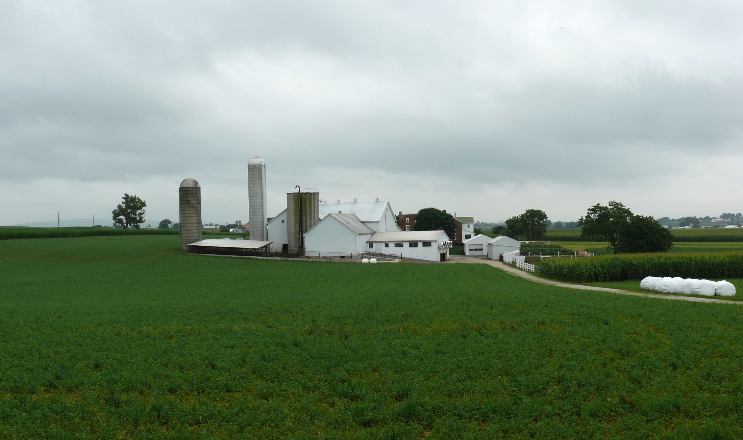
Where do new phenotypes come from?
Barn: Flooring type, bedding materials, density, weather data
Cow: Body temperature, activity, rumination time, feed & water intake
Herdsmen/consultants: Health events, foot/claw health, veterinary treatments
Parlor: yield, composition, milking speed, conductivity, progesterone, temperature
Source: http://commons.wikimedia.org/wiki/File:Amish_dairy_farm_3.jpg
Silo/bunker: ration composition, nutrient profiles
Pasture: soil type/composition, nutrient composition
Laboratory/milk plant: detailed milk composition, mid-infrared spectral data

Slide 20
Why do we need new phenotypes?
Changes in production economics
Technology produces new phenotypes or reduces costs of collecting them
  New traits can be predicted on all genotyped animals without collecting progeny records
  Phenotyping costs are shared among millions of animals
  Biotechnology supports improved sensors
To better understand cow biology
Recent review by Egger-Danner et al. (Animal, 2015)

Slide 21
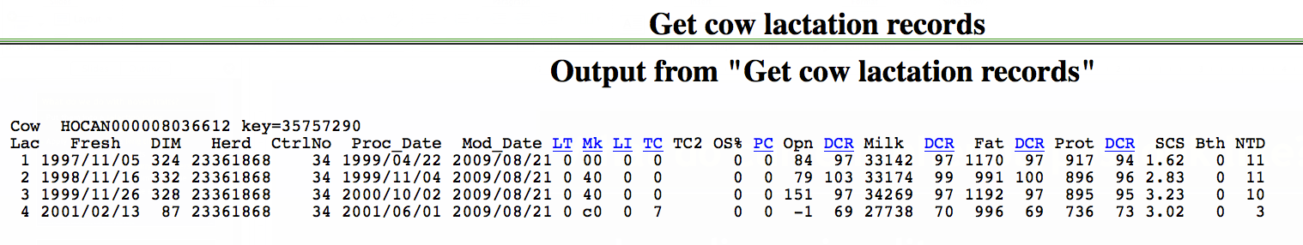
What do current phenotypes look like?
Low dimensionality
  Usually few observations per lactation
  Close correspondence of phenotypes with values measured
  Easy transmission and storage
  Costs of data recording are relatively low

Slide 22
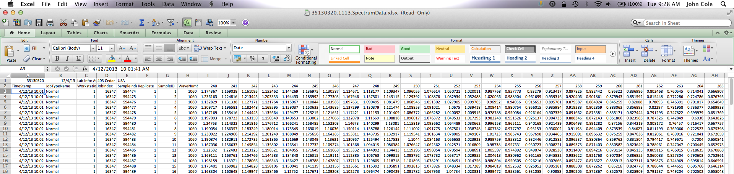
What do new phenotypes look like?
High dimensionality
  Example: MIR produces 1,060 points/observation
  Disconnect between trait and measurement
  More resources needed for transmission, storage, and analysis
  Phenotyping costs can be high (e.g., feed intake)

Slide 23
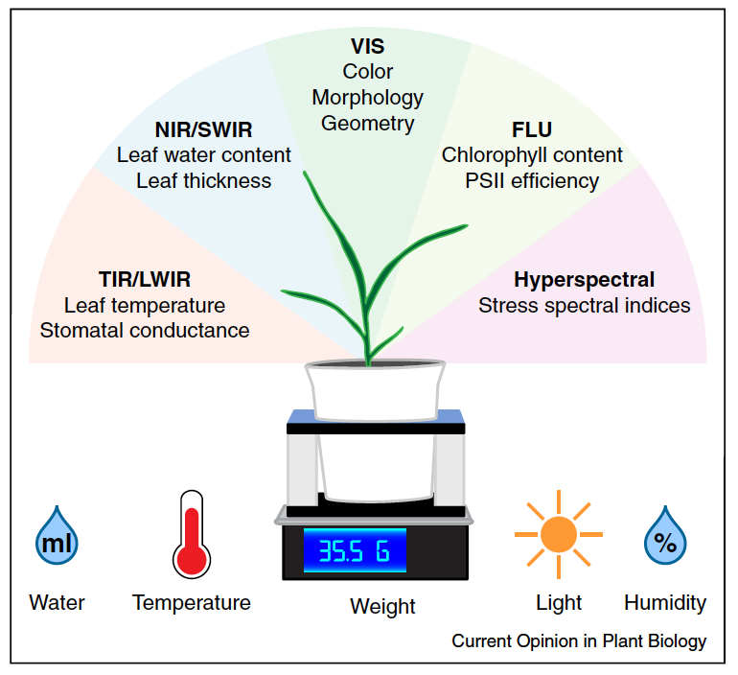
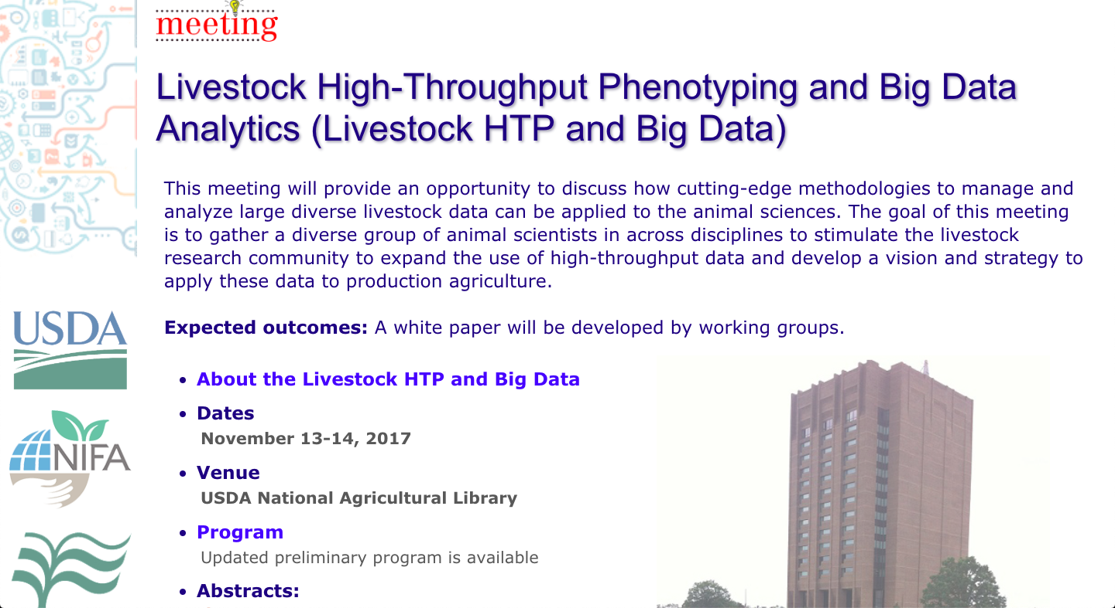
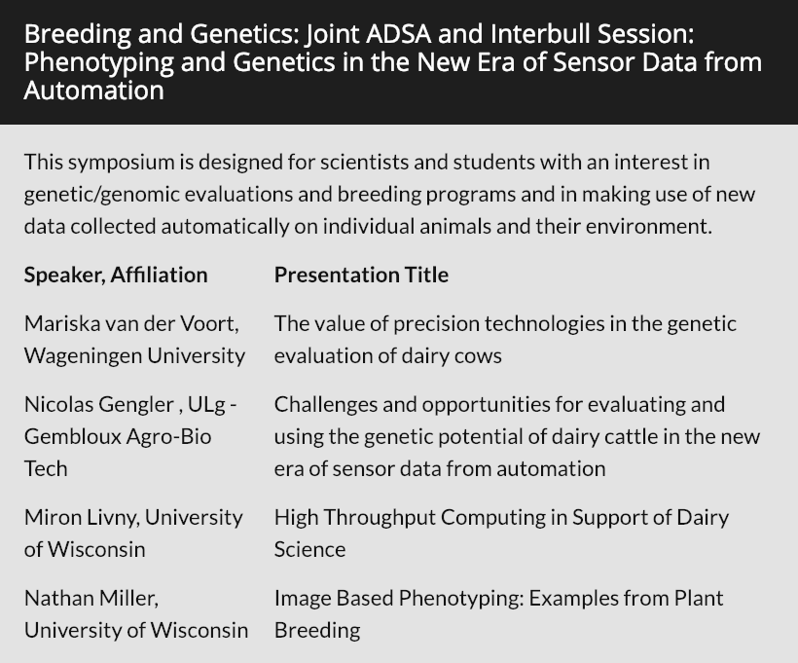
High-throughput phenotyping
Source: Fahlgren et al. (2015; https://doi.org/10.1016/j.pbi.2015.02.006).

Slide 24
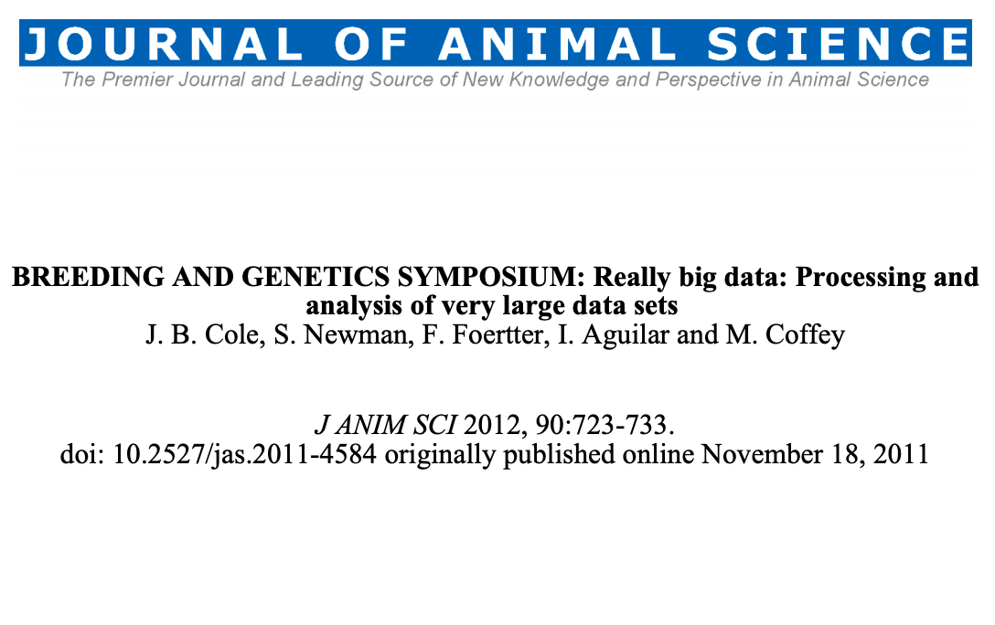
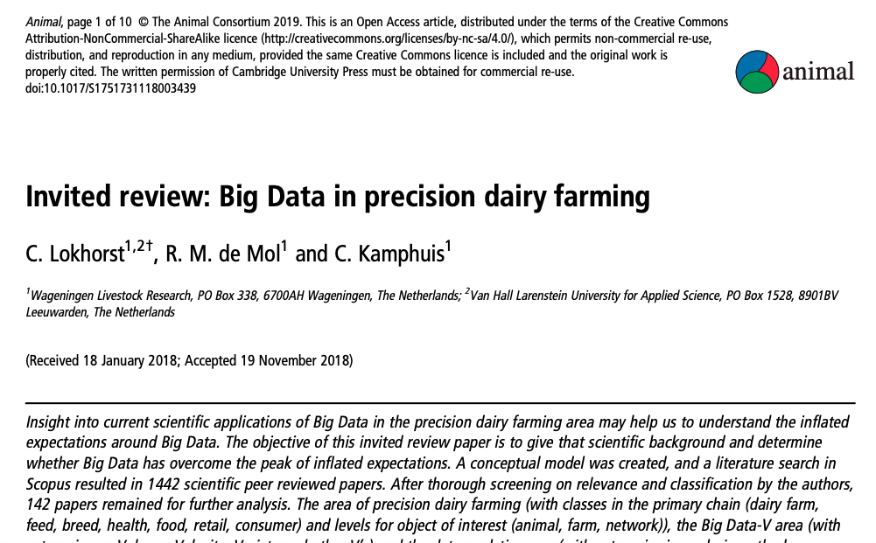
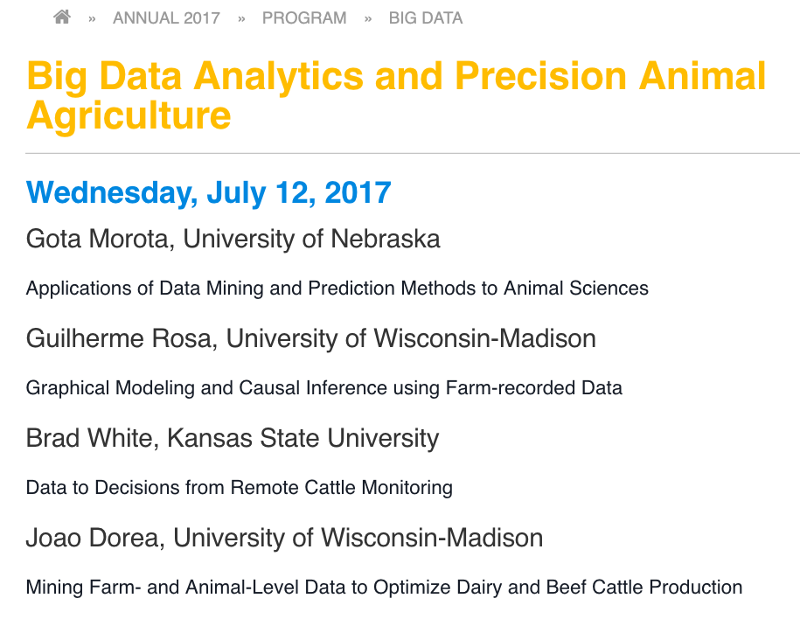
Big data
Source: MicroStrategy.

Slide 25
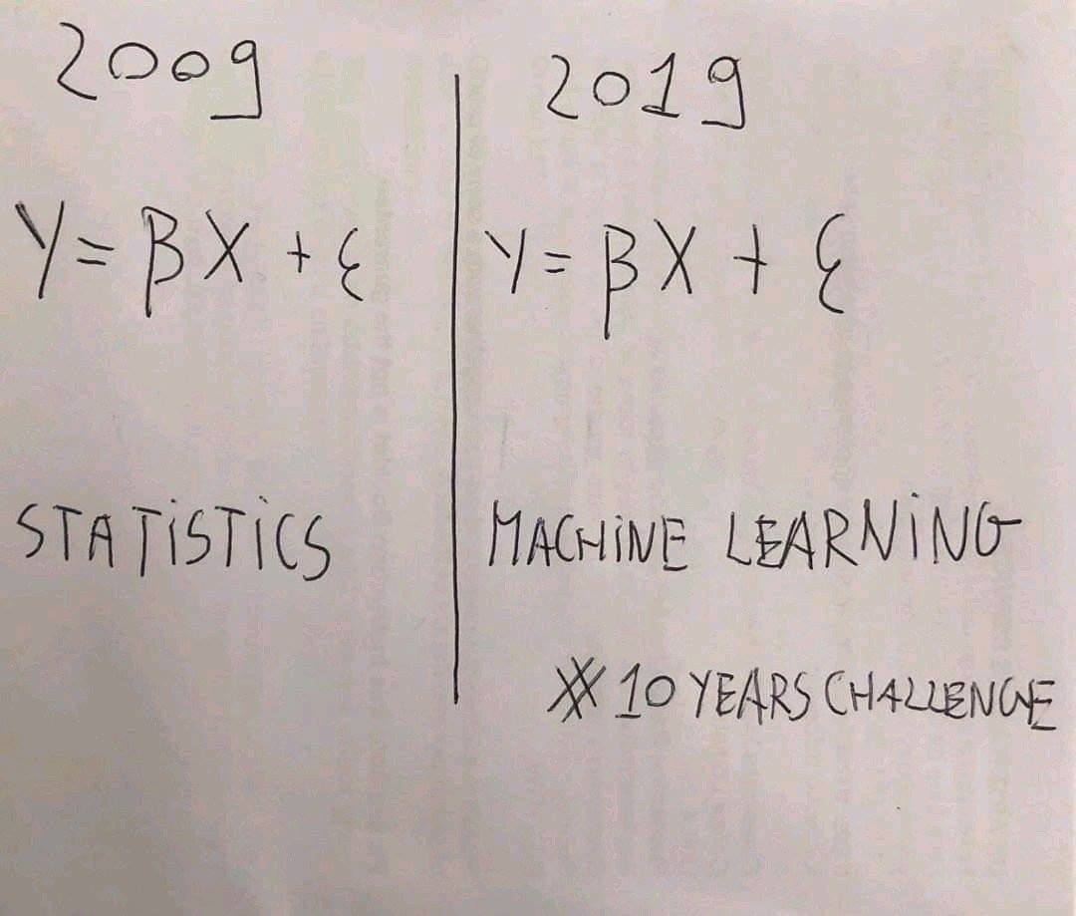
Machine learning and phenotypic prediction
Many data now available to farmers
Underutilized for predicting future performance
Can also be used to assign animals to management groups or schedule treatments
Source: Twitter.

Slide 26
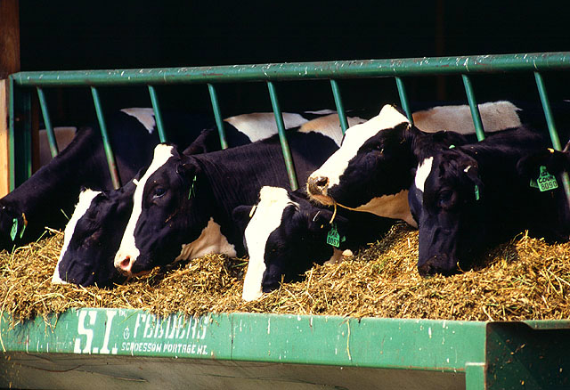

Traditional phenotyping scheme
Current milk recording
Many farms participate
Low-intensity phenotyping (few measurements per cow)
Well-suited to traits with low recording costs
Source: ARS, USDA
Source: North Florida Holsteins
Source: J.B. Cole

Slide 27
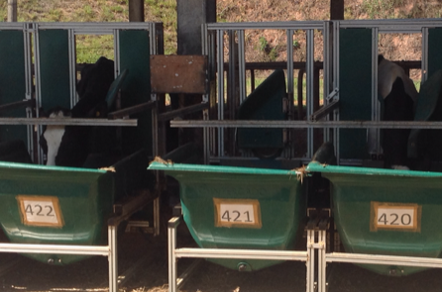
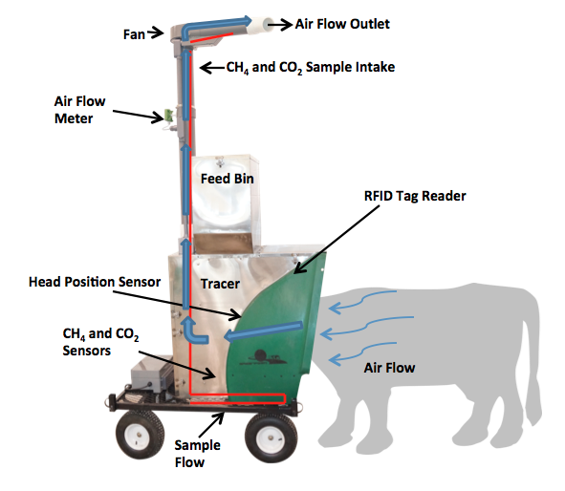
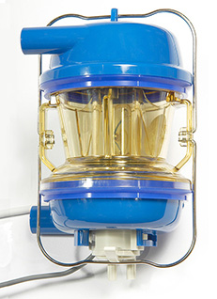
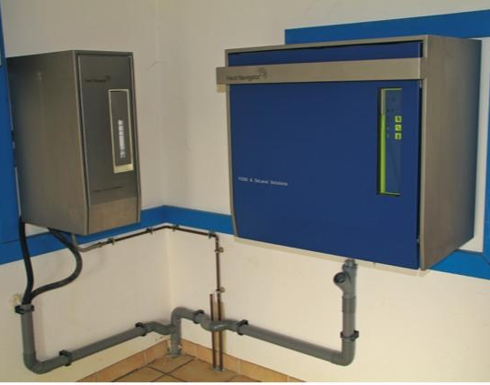
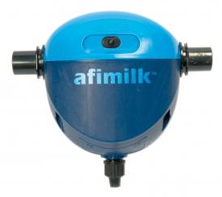
Alternative phenotyping scheme
Few farms
Intensive phenotyping (many measurements per cow)
Use cases
  Expensive-to-measure traits
  Developing countries
Source: J.B. Cole
Source: http://c-lockinc.com/
Source: http://www.afimilk.com/
Source: http://goo.gl/wu8YtR

Slide 28
Potential uses of biotechnology
Inside of the cow
  Manipulation of rumen microbiome
    Reduced methane emissions
  Alteration of milk nutrient profile
    Little good – credible – research on topics such as A2
  Reduction of N and P excreted in urine and feces
  Body temperature
    Disease status
Outside of the cow
  Improved sensors for measuring phenotypes
    Ear flicking, mucus, etc.
  Better varieties of grain and forage
  Inoculants/feed additives to improve efficiency of feed conversion
  Improved flavor profiles or nutrient properties of manufactured products

Slide 29
Genomic Selection and Faster Rates of Gain

Slide 30
Genotypes are plentiful
Source: Council on Dairy Cattle Breeding

Slide 31
Growth of markers and animals
Year | Markers | Animals | Research partners
1991–2004 | 367 | 1,415 | USDA, Illinois, Israel (DNA from USA, CAN)
2007–09 | 38,416 | 16,646 | USDA, Missouri, Canada, Illumina
2011–13 | 636,967 | 161,341 | Italy, United Kingdom, and high-density added
2012–15 | 61,013 | 1,000,000 | Interbull and Denmark added
2015–future | 39,700,000 | 1,577 | Australia worldwide exchange

Slide 32
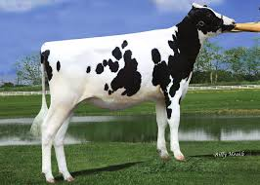
Largest genomic databases
 | Ancestry.com | 23andMe | CDCB/USDA
Genotypes | >4 million | >5 million | >3 million
Species | Human | Human | Cattle
Countries | ? | >55 | 57
Genotyping cost | $99 | $69 | $37–135
Delivery (weeks) | 6–8 | 6–8 | 1–2
DNA generations | Few | Few | >10
EBV reliability | None | Low | High
Reference: http://genomemag.com/davies-23andme/#.VdY722zosY1
Web sites: https://www.23andme.com/; http://dna.ancestry.com/; https://www.cdcb.us/; http://aipl.arsusda.gov/Main/site_main.htm

Slide 33
Genotypes can be applied to many traits
An animal’s genotype is good for all traits
Traditional evaluations are required for accurate estimates of SNP effects
Traditional evaluations not currently available for heat tolerance or feed efficiency
Research populations could provide data for traits that are expensive to measure
Will resulting evaluations work in target population?

Slide 34
Impact of genomics on dairy producers
General
  Reduced generation interval
  Increased rates of genetic gain
  Better reliabilities for low-heritability traits
  More inbreeding/homozygosity
    This is not inevitable!
Bulls
  Higher average genetic merit of available bulls
  More rapid increase in genetic merit for all traits
  Larger choice of bulls for traits and semen price
  Greater use of young bulls
    69% of all US matings are to young bulls

Slide 35
Genomic selection increases rates of gain
Source: García-Ruiz et al. (2016)

Slide 36
What if we put the best DNA together in one animal?
EBV(NM$) = $7,304
= R$28,277
After Cole and VanRaden (2011).

Slide 37
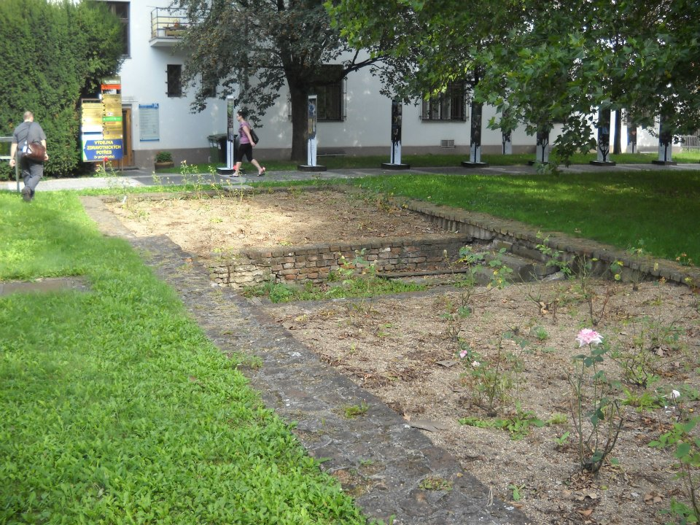
The original biotechnology lab – Mendel’s greenhouse

Slide 38
Inbreeding is increasing faster than in the past
Source: CDCB (2019)

Slide 39
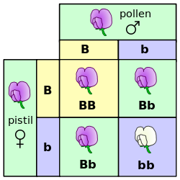
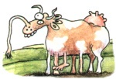
Mendelian recessives
Classical model of inheritance
One locus, typically with two alleles
Often exhibit complete dominance
e.g., Mendel’s experiments
Source: https://commons.wikimedia.org/wiki/File:Punnett_square_mendel_flowers.svg.

Slide 40
Recessives in U.S. Holsteins
Haplotype | Functional/Gene name | Chromosome | Location (Mbp) | Haplotype frequency (%) | Timing¹
HBR | Black/red coat color/MC1R (MSHR) | 18 | 14.71 | 0.75 | —
HCD | Cholesterol deficiency/APOB | 11 | 77.87 | 2.28 | W
HDR | Dominant red color/MC1R (MSHR) | 3 | 9.36 | 0.03 | —
HH0 | Brachyspina/FANCI | 21 | 20.77 | 1.65 | E,B
HH1 | APAF1 | 5 | 62.81 | 1.28 | E
HH2 | — | 1 | 93.50-95.58 | 1.21 | E
HH3 | SMC2 | 8 | 93.75 | 2.64 | E
HH4 | GART | 1 | 1.99 | 0.23 | E
HH5 | TFB1M | 9 | 91.85-91.94 | 2.39 | E
HH6 | SDE2 | 16 | 29.01-29.05 | 0.44 | Old age
HHB | BLAD/ITGB2 | 1 | 144.77 | 0.21 | W
HHC | CVM/SLC35A3 | 3 | 43.26 | 1.10 | E,B
HHD | DUMPS/UMPS | 1 | 69.15 | 0.01 | E
HHM | Mulefoot/LRP4 | 15 | 76.81 | 0.05 | B
HHP | Polledness (dominant)/POLLED | 1 | 2.57 | 0.88 | —
HHR | Red coat color/MC1R (MSHR) | 18 | 14.71 | 3.29 | —
¹Timing of embryonic loss/calf death for homozygous animals: B = calf death at/shortly after birth,
E = embryonic loss/abortion, W = calf death weeks/months after birth (Cole et al., 2016; Cole et al., 2018).

Slide 41
Is the number of defects increasing?
MacArthur et al. (2012) estimated that human genomes contain ~100 loss-of-function mutations, and ~20 completely inactivated genes
The mutations are there even if we have not identified them yet
  Example: HH6, mutation in SDE2 (Fritz et al., 2018)
Our detection methods are improving as our technology improves

Slide 42
Estimated cost of genetic load
Cole et al. (2016) estimated annual losses of at least $10.7 million due to known recessives.
Average losses were $5.77, $3.65, $0.94, and $2.96 in Ayrshire, Brown Swiss, Holstein, and Jersey, respectively.
This is the economic impact of genetic load as it affects fertility and perinatal mortality.
Actual losses are likely to be higher.

Slide 43
Is gene editing the solution to the recessives problem?
Much speculation about application of gene editing in livestock populations
  Rapid introgression of desirable Mendelian traits, such as the Slick locus (Loi et al., 2016)
  Improvement of quantitative traits (Jenko et al., 2015)
  Development of animal models of complex human disease (e.g., Tu et al., 2015)
What about editing carriers to rapidly eliminate harmful alleles from the population?

Slide 44
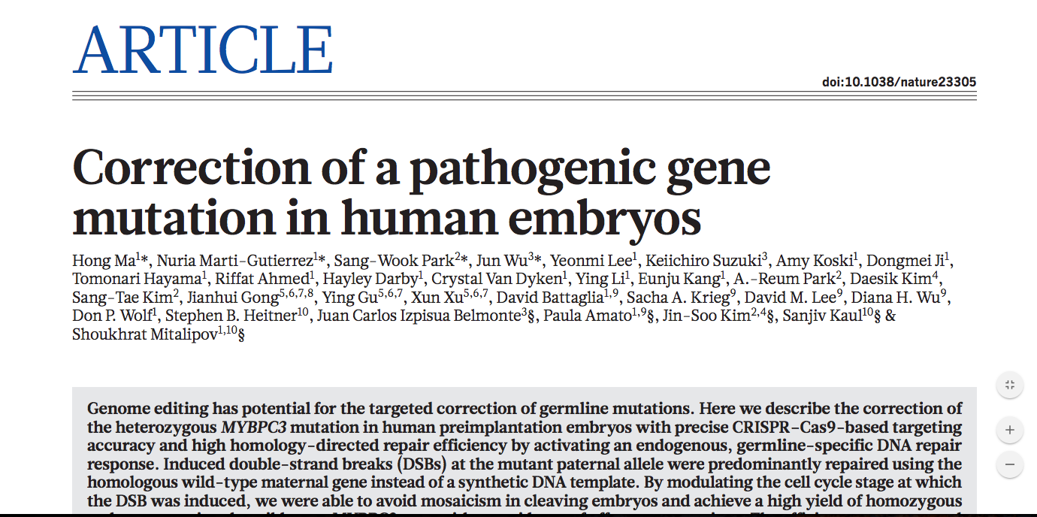
This is no longer a speculative use of the technology!
Source: Ma et al. (2017).

Slide 45
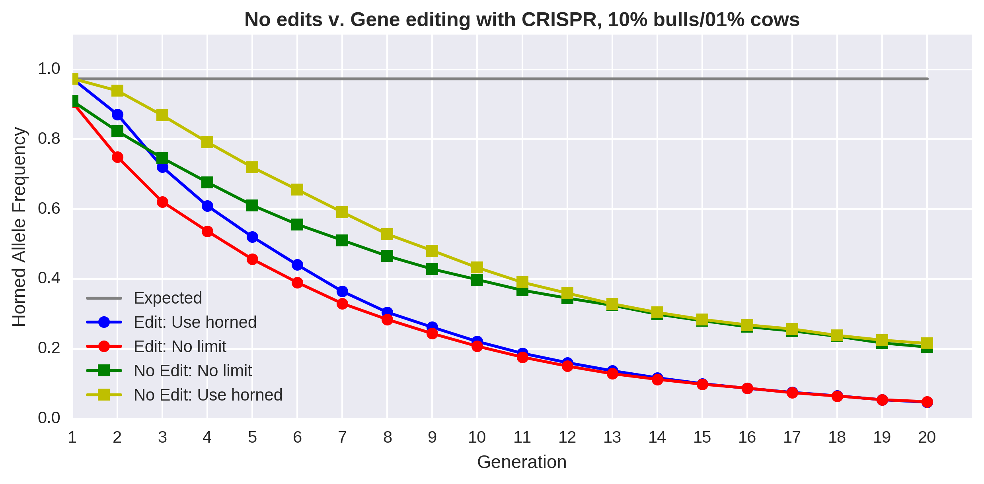
Change is fastest with editing and few restrictions
Source: Mueller et al. (2019).

Slide 46
What about gene editing for quantitative traits?
Can gene editing be used to fix many desirable alleles simultaneously?
  There are few major genes in cattle (e.g., Cole et al., 2009)
  This implies that many loci must be edited to influence quantitative traits
The success rate of individual edits varies by technology
  Multiplexed edits are possible (e.g., Kurata et al., 2018)
Jenko et al. (2015) have studied the problem using simulation
  So-called promotion of alleles by gene editing

Slide 47
Editing many alleles can increase rate of genetic gain
a) 125 alleles edited
b) 250 alleles edited
c) 500 alleles edited
Rates of genetic gain for quantitative traits are faster each generation when gene
editing is used in concert with genomic selection than using genomic selection alone.
Source: Gorjanc et al. (2015).

Slide 48
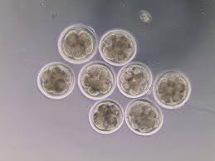
Gene editing as a tool for validation
Candidate genes for early embryonic losses not always validated
Targeted knockouts can be used to validate candidates for early embryonic losses
Relatively fast and cost-effective
Source: University of Florida (2013).

Slide 49
Opportunities and Conclusion

Slide 50

Biotechnology is applied across the life of the cow
birth
breeding
transition
birth
heifer
calving
lactation
breeding
culling
dry-cow therapy
decision
dry-off

Slide 51
Biotechnology is applied from farm to fork
Better technology results in better decision-making throughout the production chain!
consumers
advocacy groups
influence
food & other products
lobby
government bodies
influence
manufacturers
milk & components
regulate
farmers
modify
manage environment
produce milk & calves
cows
outputs
constrained by environment
inputs

Slide 52
Conclusions
Biotechnology has been an important driver of changes in the dairy industry
Genetic gains are cumulative and permanent, but evaluations depend on a constant flow of data
The array of measurable phenotypes is growing but affordable recording remains challenging
Gene editing has potential to increase rates of gain and eliminate harmful alleles from the population, if regulators permit its use

Slide 53
Acknowledgments
The author was supported by USDA-ARS project 8042-31000-002-00-D, “Improving Dairy Animals by Increasing Accuracy of Genomic Prediction, Evaluating New Traits, and Redefining Selection Goals”.
USDA is an equal opportunity provider and employer.
Mention of trade names or commercial products in this presentation is solely for the purpose of providing specific information and does not imply recommendation or endorsement by the US Department of Agriculture.

Slide 54

Questions?

