Slide 1
  Pros and cons of hitchhiking: The truth about inbreeding in dairy cattle
John B. Cole
USDA, Agricultural Research Service
Henry A. Wallace Beltsville Agricultural Research Center
Animal Genomics and Improvement Laboratory
Beltsville, MD 20705-2350

Slide 2
Topics for discussion
What is inbreeding, and what causes it?
(Why) is it bad?
How do we measure it?
Is it changing in the Holstein breed?
Can we do anything about it?
Take-home messages

Slide 3
What is inbreeding, and what causes it?

Slide 4
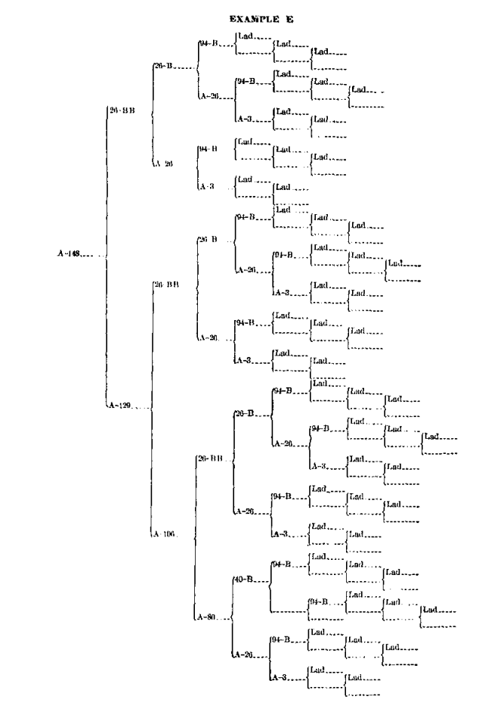
Inbreeding results from the mating of related animals
It’s the proportion of the genome that is identical because it came from the same ancestor
Inbreeding results when related animals are mated to one another
Inbreeding is inevitable in a finite population
  It can be managed, but not stopped
Cow A-148
f_{P} = 0.646
Source: Swett et al. (1949)

Slide 5
More efficient selection, more inbreeding
Theory | Author | Year | Species
Single-gene inheritance | Mendel | 1865 | Peas
Multiple-gene inheritance | Fisher | 1918 | Humans
Pedigree relationship matrix | Wright | 1922 | Cattle
Selection index | Hazel & Lush | 1943 | Plants, cattle
Mixed linear models | Henderson | 1963 | Cattle
Genomic prediction | Meuwissen | 2001 | Animals
Genomic relationship matrix | VanRaden | 2008 | Cattle
Also application
First database with 1 million genotyped individuals was
USDA/Council on Dairy Cattle Breeding in July 2015

Slide 6
Genotypes are plentiful
Source: Council on Dairy Cattle Breeding (2019).

Slide 7
We want to get the best DNA together in one animal
EBV(NM$) = $7,304
After Cole and VanRaden (2011).

Slide 8
Genomic selection lets us go really fast
Source: García-Ruiz et al. (2016).

Slide 9
We’re in an endless race to find the highest index bull
INDUSTRY:
AI breeds bulls to meet market demands
High-genetic-merit bulls have high marketability
Lower inbreeding rates result in slower genetic gains
Who is willing to go slower to better manage inbreeding?
Source: Wikimedia Commons.

Slide 10
(Why) is it bad?

Slide 11
Inbreeding often has undesirable effects
Harmful loci increase in frequency and are more likely to be paired-up
  e.g., Haplotypes such as HH1
  This is thought to account for most inbreeding depression
Slow inbreeding more effective at selecting against harmful loci
Undesirable loci travel along with desirable loci if they’re close together (“hitchhiking”)
Trait | Effect/1% gain
Milk yield | -50 lb
Fat yield | -1.5 lb
Birth weight | -0.24 lb
Yearling weight | -1.5 lb
Weight at 4 years | -5.0 lb
Height | Slight decrease
Survival to 1st calf | -2 %
Services to conception | +0.05
Days to first service | +3.0
Age at puberty | Delayed
Source: Schmidt et al. (1988).

Slide 12
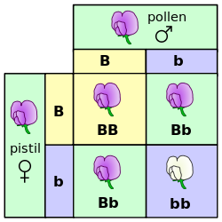
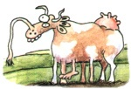
Mendelian recessives are exposed by inbreeding
Classical model of inheritance
One locus, typically with two alleles
Often exhibit complete dominance
e.g., Mendel’s experiments
Source: The Far Side.
Source: Wikimedia.

Slide 13
There are many known recessives in U.S. Holsteins
Haplotype | Functional/Gene name | Chromosome | Location (Mbp) | Haplotype frequency (%) | Timing¹
HBR | Black/red coat color/MC1R (MSHR) | 18 | 14.71 | 0.75 | —
HCD | Cholesterol deficiency/APOB | 11 | 77.87 | 2.28 | W
HDR | Dominant red color/MC1R (MSHR) | 3 | 9.36 | 0.03 | —
HH0 | Brachyspina/FANCI | 21 | 20.77 | 1.65 | E,B
HH1 | APAF1 | 5 | 62.81 | 1.28 | E
HH2 | — | 1 | 93.50-95.58 | 1.21 | E
HH3 | SMC2 | 8 | 93.75 | 2.64 | E
HH4 | GART | 1 | 1.99 | 0.23 | E
HH5 | TFB1M | 9 | 91.85-91.94 | 2.39 | E
HH6 | SDE2 | 16 | 29.01-29.05 | 0.44 | Old age
HHB | BLAD/ITGB2 | 1 | 144.77 | 0.21 | W
HHC | CVM/SLC35A3 | 3 | 43.26 | 1.10 | E,B
HHD | DUMPS/UMPS | 1 | 69.15 | 0.01 | E
HHM | Mulefoot/LRP4 | 15 | 76.81 | 0.05 | B
HHP | Polledness (dominant)/POLLED | 1 | 2.57 | 0.88 | —
HHR | Red coat color/MC1R (MSHR) | 18 | 14.71 | 3.29 | —
¹Timing of embryonic loss/calf death for homozygous animals: B = calf death at/shortly after birth,
E = embryonic loss/abortion, W = calf death weeks/months after birth (Cole et al., 2016; Cole et al., 2018).

Slide 14
Is the number of defects increasing?
MacArthur et al. (2012) estimated that human genomes contain ~100 loss-of-function mutations, and ~20 completely inactivated genes
The mutations are there even if we have not identified them yet
  Example: HH6, mutation in SDE2 (Fritz et al., 2018)
Our detection methods are improving as our technology improves
New mutations do occur, but they are very rare

Slide 15
Estimated cost of genetic load
Cole et al. (2016) estimated annual losses of at least $10.7 million due to known recessives.
Average losses were $5.77, $3.65, $0.94, and $2.96 in Ayrshire, Brown Swiss, Holstein, and Jersey, respectively.
This is the economic impact of genetic load as it affects fertility and perinatal mortality.
Actual losses are likely to be higher.

Slide 16
We don’t really know how much is too much
Correlation: -0.23.
Selection is now on indices that include health and fitness data
This avoids past mistakes from focusing on only one or a few traits
Will we see genetic merit gradually fade away, or will we cross a threshold and suddenly crash?
Interviewer: “How did you go bankrupt?”
Ernest Hemingway: “Two ways. Gradually, then suddenly.”
Source: CCDCB (2019).

Slide 17
How do we measure it?

Slide 18
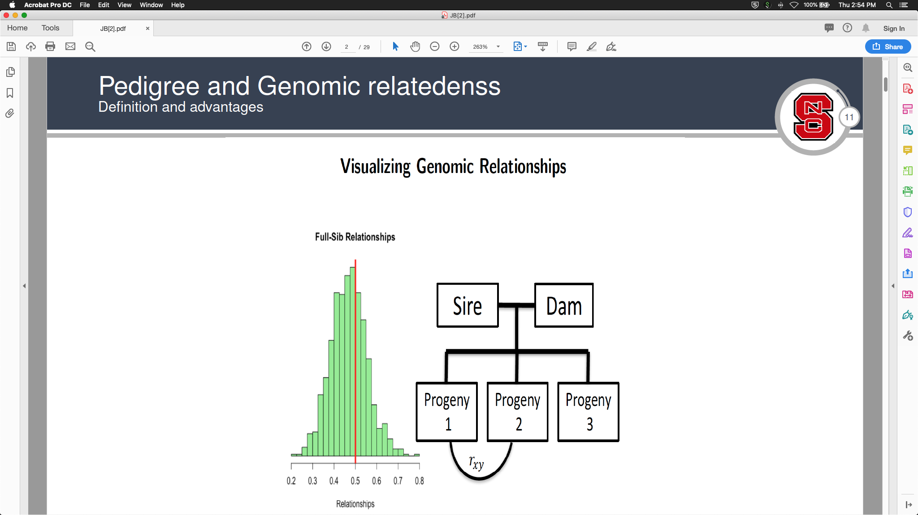
Pedigree and genomic inbreeding
Pedigree inbreeding is based on the passing of chromosomes from parents to offspring over many generations
Genomic inbreeding is based on the actual pieces of chromosomes passed from parents to offspring over many generations
Inbreeding increases as pedigrees get deeper
However, the age of inbreeding may matter, too
Source: Christian Maltecca (2019).

Slide 19


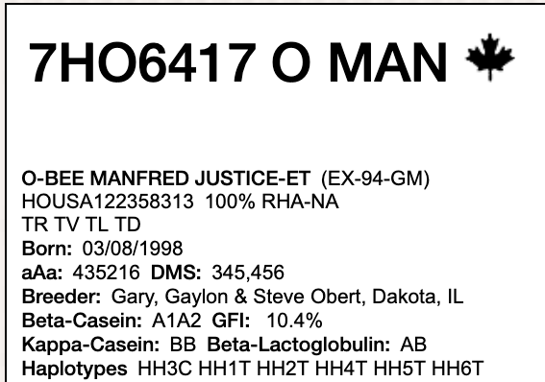
Expected future inbreeding (EFI)
Inbreeding is a property of an individual animal
Expected future inbreeding is the average inbreeding expected when a bull is mated to a random sample of cows from the population
The more related a bull is to the population, the higher the EFI
Genomic future inbreeding (GFI) is based on the same concept
mated to
Bull
Random sample of cows from population
Expected Future Inbreeding (%)
Source: Select Sires.

Slide 20
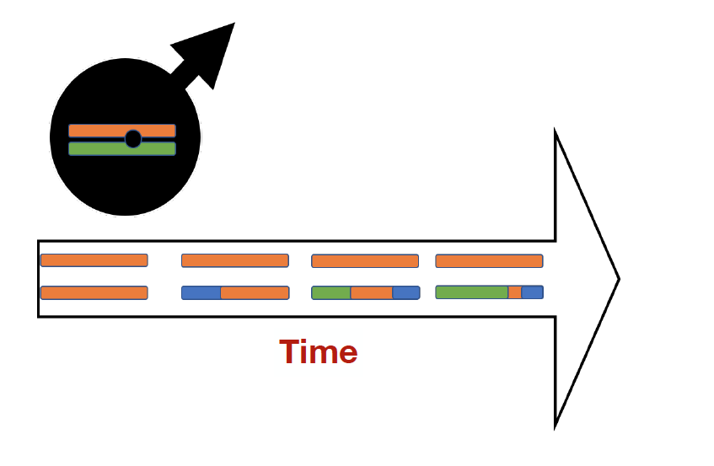
Runs of homozygosity (ROH)
Recent inbreeding produces long stretches of DNA shared in common
Old inbreeding is represented by much shorter pieces of shared DNA
ROH provide information about specific places in the genome
Old stretches of inbreeding may have been purged of harmful loci
Source: Christian Maltecca (2019).

Slide 21
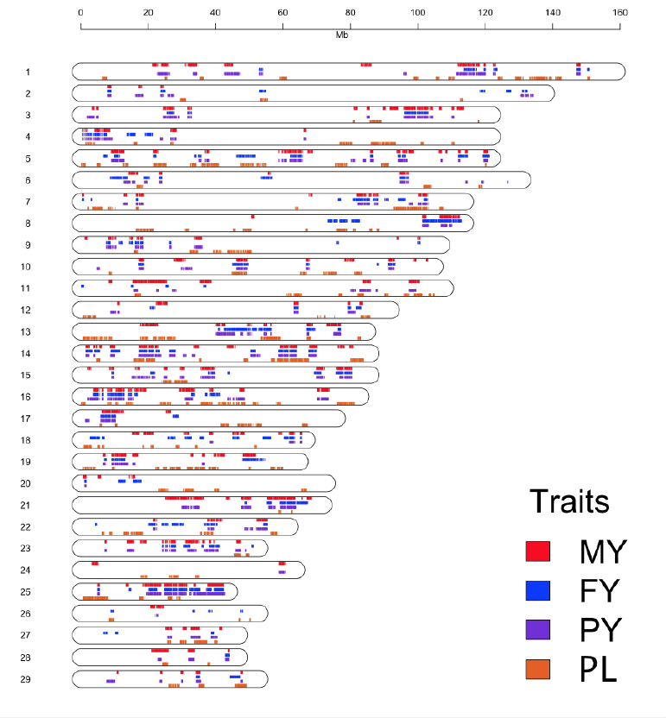
ROH used to find undesirable, but not lethal, regions
Some mutations in the population are sub-lethal: they harm performance but don’t kill animals
They are more difficult to find than lethal haplotypes
May appear in ROH
Source: Christian Maltecca (2019).

Slide 22
Is it changing in the Holstein breed?

Slide 23
Pedigree and genomic inbreeding of Holsteins
Source: CDCB (April 2019)

Slide 24
ROUND OAK RAG APPLE ELEVATION (007HO00058)
-----------------
HOUSA000000933122 1944-03-28 WIS IDEAL
-----------------
HOUSA000001013415 1947-03-28 Wis Burke
-----------------
HOUSA000002454577 1944-03-28
-----------------
HOUSA000001271810 1955-03-23 TIDY BURKE ELEVATION 1 58k
HOUSA000000933122 1944-03-28 WIS IDEAL
HOUSA000001013415 1947-03-28 Wis Burke
HOUSA000002454577 1944-03-28
HOUSA000003348181 1950-09-18 CARINE MERCEDES BURKE IDEAL
-----------------
HOUSA000002948518 1947-09-19
-----------------
HOUSA000001491007 1965-08-30 ROUND OAK RAG APPLE ELEVATION 4 778k
-----------------
HOUSA000000848777 1947-01-04 OSBORNDALE TY VIC
-----------------
HOUSA000001189870 1952-04-26 OSBORNDALE IVANHOE 1 58k
-----------------
HOUSA000002471271 1947-11-29
-----------------
HOUSA000005749758 1962-07-14 ROUND OAK IVANHOE EVE
HOCAN000000239301 1951-11-30 ROSAFE CENTURION
HOUSA000001294924 1954-02-15 GLENAFTON GAIETY
HO---------------
HOUSA000004855614 1959-01-07
HOUSA000001064446 1947-09-23 ROUND OAK MONTVIC P F GENERAL
HOUSA000003757944 1953-11-16
HOUSA000002292061 1949-02-17
f_{P} | 0.0
f_{G} | -3.3
NM$ | -567
TPI | 843

Slide 25
MARA-THON BW MARSHALL-ET (007HO05375)
HOUSA000001556373 1968-11-19 GLENDELL ARLINDA CHIEF 4 778k
HOUSA000001697572 1975-11-20 ARLINDA ROTATE 4 778k
HOUSA000007370146 1969-08-14
HOUSA000001879149 1982-03-06 ARLINDA MELWOOD-ET 4 778k
HOUSA000001531866 1968-01-27 PACLAMAR COMBINATION
HOUSA000009311697 1976-12-10 ARLINDA COMBI MELODY
HOUSA000008155956 1972-05-04 ARLINDA CARLIN MELODY
HOUSA000002103297 1989-05-19 MAIZEFIELD BELLWOOD-ET 1 58k
HOUSA000001441440 1963-01-20 PENSTATE IVANHOE STAR 1 58k
HOUSA000001667366 1974-05-16 CARLIN-M IVANHOE BELL 4 778k
HOUSA000007832117 1970-10-18 B & W HEILO CREAMELLE
HOUSA000012052401 1984-10-13 BREN-WAY BELL BETSY
HOUSA000001626813 1972-08-06 MARSHFIELD ELEVATION TONY 1 58k
HOUSA000011302033 1982-09-15 BREN-WAY TONY BESSIE
HOUSA000010533152 1980-07-01
HOUSA000002290977 1995-03-24 MARA-THON BW MARSHALL-ET 4 778k
HOUSA000001441440 1963-01-20 PENSTATE IVANHOE STAR 1 58k
HOUSA000001667366 1974-05-16 CARLIN-M IVANHOE BELL 4 778k
HOUSA000007832117 1970-10-18 B & W HEILO CREAMELLE
HOUSA000001912270 1983-01-25 EMPRISE BELL ELTON 4 778k
HOUSA000001556373 1968-11-19 GLENDELL ARLINDA CHIEF 4 778k
HOUSA000010248397 1979-06-02 MONARCHIAL GLENDELL EFFIE
HOUSA000008786528 1974-07-23
HOUSA000014840387 1990-05-02 MORGAN-VALLEY ELTON MARA
HOUSA000001650414 1973-06-28 S-W-D VALIANT 4 778k
HOUSA000001818972 1980-02-02 MEL-EST VALIANT IROS MELVIN 1 58k
HOUSA000008560247 1973-11-02 MEL-EST ELEVATION IROSE ROSITA
HOUSA000012936456 1986-05-26 MORGAN-VALLEY MARCIS MARY
HOUSA000001682467 1975-01-22 WAGNERSCREST IVANHOE ASTRONAUT 1 58k
HOUSA000011021502 1982-03-01
HOUSA000008510667 1973-08-09
f_{P} | 5.8
f_{G} | 8.9
NM$ | -78
TPI | 1548

Slide 26
PINE-TREE ACURA-ET (029HO18960)
HOUSA000139005002 2007-09-17 COYNE-FARMS DORCY-ET 1 58k
HO840003006972816 2010-06-22 MOUNTFIELD SSI DCY MOGUL-ET 1 58k
HOUSA000062784081 2006-04-23 MOUNTFIELD MARSH MAXINE-ET 1 58k
HOUSA000072254526 2013-01-05 WOODCREST MOGUL YODER-ET 8 77k
HOUSA000060597003 2003-03-03 ENSENADA TABOO PLANET-ET 4 778k
HO840003008363689 2011-03-21 WOODCREST PLANET YAKARA-ET 3 3k
HOUSA000066893887 2009-05-18 COYNE-FARMS BKEYE YVONNE-ET 1 58k
HO840003128557482 2015-11-15 ABS ACHIEVER-ET 17 140k
HOUSA000060996956 2004-10-31 BADGER-BLUFF FANNY FREDDIE 1 58k
HONLD000543756297 2011-06-16 APINA ALTAEMBASSY-ET 2 58k
HOUSA000064969166 2008-12-01 STRAUSSDALE PLANET ELLA 1 58k
HO840003013177242 2013-09-30 COMPASS-TRT AMRC AE J925-ET 8 77k
HOUSA000064966739 2008-12-23 ROYLANE SOCRA ROBUST-ET 1 58k
HOUSA000070640281 2011-07-26 SEAGULL-BAY MISS AMERICA-ET 2 58k
HOUSA000066228178 2009-04-16 AMMON-PEACHEY SHAUNA-ET 1 58k
HO840003142332520 2017-11-25 PINE-TREE ACURA-ET 17 140k
HOUSA000069398748 2010-06-30 MOUNTFIELD MSY MAURICE-ET 2 58k
HO840003009554583 2012-05-22 S-S-I MAURICE PARTYROCK-ET 2 58k
HO840003006972817 2010-06-22 JK-GOLD SSI DORCYPIE7042-ET 1 58k
HO840003014334961 2014-01-01 S-S-I PARTYROCK PROFIT-ET 8 77k
HO840003006972816 2010-06-22 MOUNTFIELD SSI DCY MOGUL-ET 1 58k
HO840003009554577 2012-05-17 S-S-I MOGUL MAHO 8054-ET 7 9k
HO840003004672693 2010-08-26 S-S-I ROBUST MAHO 7083-ET 2 58k
HO840003132116871 2016-03-13 PINE-TREE 9882 PROF 7019-ET 20 19k
HOUSA000064966739 2008-12-23 ROYLANE SOCRA ROBUST-ET 1 58k
HOUSA000069981349 2010-12-28 SEAGULL-BAY SUPERSIRE-ET 2 58k
HOUSA000066228178 2009-04-16 AMMON-PEACHEY SHAUNA-ET 1 58k
HO840003011890130 2013-12-02 OCD SUPERSIRE 9882-ET 17 140k
HOUSA000064966739 2008-12-23 ROYLANE SOCRA ROBUST-ET 1 58k
HO840003008315320 2011-03-08 OCD ROBUST SHIMMER-ET 2 58k
HOUSA000066228180 2009-04-18 AMMON-PEACHEY SHANA-ET 1 58k
f_{P} | 12.8
f_{G} | 17.1
NM$ | 1,065
TPI | 2,895

Slide 27
Can we do anything about it?

Slide 28
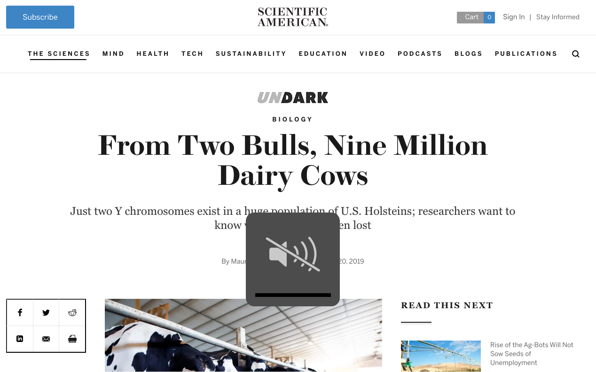
Scientists are trying to understand what’s been lost
Almost all Y chromosomes in the Holstein bull population are from Elevation and Chief
It’s unclear what might have been lost along the way
A small genetic base may translate to a fragile population that can’t respond well to changes
Source: O’Hagan (2019), Scientific American, 20 June 2019.

Slide 29
AI companies were trying to identify new bloodlines
Source: Miglior and Beavers, Progressive Dairyman, 18 July 2014.

Slide 30
There are many theoretically satisfying ideas…
…but nobody uses them
Geneticists don’t breed cows, farmers do
Many cows now mated at random to a portfolio of bulls
Everyone thinks their neighbor should use different bulls
Some methods for avoiding inbreeding
Optimal contribution theory
Minimization of progeny inbreeding
Linear programming
Look-ahead mate selection
Selection against lethal alleles
Index selection including Mendelian sampling variance
Genomic selection including dominance

Slide 31
U.S. PTAs are adjusted for inbreeding
Trait | Inbreeding depression/1% | Trait value in NM$ | $ Value /1% F
Milk | –63.9 | –0.004 | 0.3
Fat | –2.37 | 3.56 | –8.4
Protein | –1.89 | 3.81 | –7.2
Productive life | –0.26 | 21 | –5.5
Somatic cell score | 0.004 | –117 | –0.5
Daughter pregnancy rate | –0.13 | 11 | –1.4
Cow conception rate | –0.16 | 2.2 | –0.4
Heifer conception rate | –0.08 | 2.2 | –0.2
Cow livability | –0.08 | 12 | –1.0
Net merit $ | –25 | 1 | –25

Slide 32
Example EFI adjustment for Acura
Difference of EFI – daughter F = 8.7 – 0.0 = 8.7%
Economic loss (future – past daughters) = 8.7 × $25/1%F = $217
Acura’s initial NM$ = +$1,282 before adjustment
Acura’s official NM$ = +$1,065 after adjustment
As the population becomes more related to an animal, its evaluations decrease
Progeny, grandprogeny, etc., also adjusted because their EFIs tend to be higher than breed average

Slide 33
Opportunities and Conclusion

Slide 34
Conclusions
Male genetic diversity is very limited in the Holstein population
It’s important to conserve female genetic variation
Inbreeding depression may be responsible for some of the decrease in fitness traits, such as fertility
If stacking of pedigrees continues dairy breeding will come to resemble pig and chicken breeding – without the controlled environments

Slide 35
Acknowledgments
The author was supported by USDA-ARS project 8042-31000-002-00-D, “Improving Dairy Animals by Increasing Accuracy of Genomic Prediction, Evaluating New Traits, and Redefining Selection Goals”.
The conference organizers funded the author’s travel.
USDA is an equal opportunity provider and employer.
Mention of trade names or commercial products in this presentation is solely for the purpose of providing specific information and does not imply recommendation or endorsement by the US Department of Agriculture.

Slide 36

Questions?

