Slide 1
A Labor of Love: Making the Calving Traits Easier to Bear
John B. Cole
Acting Research Leader
Animal Genomics and Improvement Laboratory
ARS, USDA, Beltsville, MD
john.cole@usda.gov

Slide 2
Topics for discussion
We have improved traits that were problematic for many farmers using better genetics and management.
Holstein PTAs will average 2.2% and 2.7% for sire and daughter calving ease, which means that selection thresholds such as “no bull over 8” are no longer necessary.
Sire and daughter stillbirth will now be expressed in terms of percent stillbirths to heifers to match the calving ease traits.

Slide 3
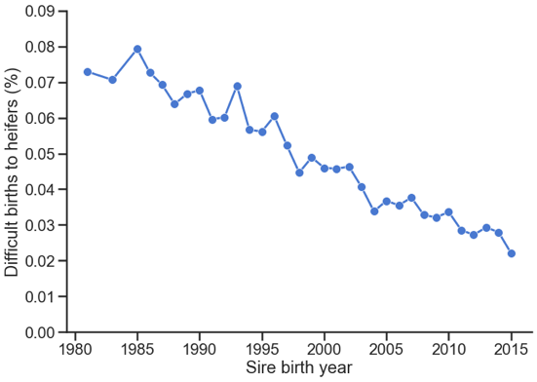
Calving ease has improved over time
The rate of difficult births in Holsteins has decreased substantially over time.
Selection for better genetics and improvements in calving management practices have resulted in less dystocia and fewer stillbirths!
We are adjusting the phenotypic base to match observed incidence rates.

Slide 4
New phenotypic bases in August 2020
Breed | Trait¹ | Current base (%) | New base (%) | Change | New base year
Holstein | SCE | 7.9 | 2.2 | -5.7 | 2015
 | DCE | 8.5 | 2.7 | -5.8 | 2010
 | SSB | 8.0 | 5.7 | -2.3 | 2015
 | DSB | 8.0 | 6.6 | -1.4 | 2010
Brown Swiss | SCE | 5.2 | 3.0 | -2.2 | 2015
 | DCE | 5.2 | 2.8 | -2.4 | 2010
Phenotypic bases for all traits will match the lower observed incidence rates.
In the future, phenotypic and genetic bases will be automatically updated.

Slide 5
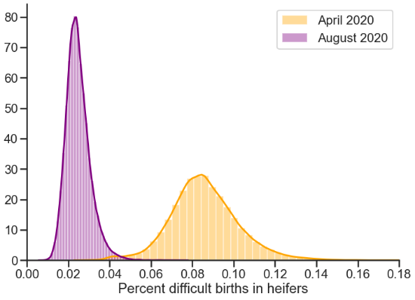
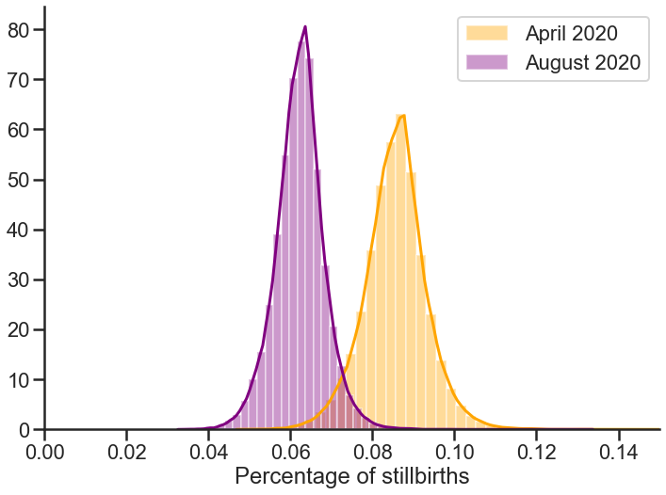
The range of evaluations will change
 |  | 2004 official |  |  | 2004 proposed
Breed | Trait | Minimum | Maximum |  | Minimum | Maximum
Holstein | SCE | 3.4 | 20.5 |  | 0.7 | 7.6
 | DCE | 3.8 | 20.7 |  | 1.0 | 8.6
 | SSB | 4.9 | 17.1 |  | 3.0 | 13.0
 | DSB | 3.5 | 19.2 |  | 3.0 | 17.0
Brown Swiss | SCE | 2.8 | 9.5 |  | 1.5 | 5.9
 | DCE | 2.9 | 8.9 |  | 1.5 | 5.2

Slide 6
How will this affect individual bulls?
Bulls were always ranked correctly!
 |  | Sire CE (%) |  |  | Daughter CE (%) |  |  | Sire SB (%) |  |  | Daughter SB (%)
NAAB Code | Name | Old Base | New Base |  | Old Base | New Base |  | Old Base | New Base |  | Old Base | New Base
001HO12786 | Piledriver | 6.1 | 1.6 |  | 7.1 | 2.2 |  | 6.7 | 4.8 |  | 5.8 | 4.9
011HO11779 | AltaTopshot | 6.5 | 1.7 |  | 6.7 | 2.0 |  | 5.8 | 4.1 |  | 4.3 | 3.6
007HO13250 | Jedi | 7.2 | 1.9 |  | 5.6 | 1.6 |  | 7.6 | 5.5 |  | 5.1 | 4.3
029HO17553 | Josuper | 8.2 | 2.3 |  | 6.9 | 2.1 |  | 7.0 | 5.0 |  | 5.2 | 4.4
014HO14220 | Riveting | 10.4 | 3.1 |  | 8.9 | 2.9 |  | 7.8 | 5.6 |  | 5.2 | 4.4
014HO14226 | Rome | 12.2 | 3.8 |  | 10.2 | 3.4 |  | 8.4 | 6.1 |  | 5.9 | 5.1
151HO00690 | Denver | 13.4 | 4.3 |  | 8.9 | 2.9 |  | 7.9 | 5.7 |  | 7.6 | 6.5
1.8
0.7

Slide 7
How will Net Merit change?
Trait | April 2020 | August 2020 | Change in emphasis
Milk | -0.7 | -0.7 | 0.0
Fat | 26.8 | 27.0 | +0.2
Protein | 16.9 | 17.1 | +0.2
Productive life | 12.1 | 12.2 | +0.1
Somatic cell score | -4.0 | -4.1 | +0.1
Body weight composite | -5.3 | -5.3 | 0.0
Udder composite | 7.4 | 7.5 | +0.1
Feet & legs composite | 2.7 | 2.8 | +0.1
Daughter pregnancy rate | 6.7 | 6.8 | +0.1
Calving ability (CA$) | 4.8 | 3.8 | -1.0
Heifer conception rate | 1.4 | 1.4 | 0.0
Cow conception rate | 1.6 | 1.7 | +0.1
Livability | 7.3 | 7.4 | +0.1
Health (HTH$) | 2.3 | 2.3 | 0.0

Slide 8
Other Net Merit considerations
There will be some bull reranking of bulls for NM$ because of the new weights.
Some foreign bulls will have changes in correlated traits for when they have some missing PTA, especially as it affects PL.

Slide 9
Are calving difficulty and stillbirth solved problems?
No! The United States has worked for many years to successfully reduce the levels of difficult calvings and stillbirths.
It’s important to keep an eye on these traits when making bull selection decisions.
If you use an index, such as NM$ or TPI, calving traits will already be properly accounted for.

Slide 10
Take-home messages
Calving traits have improved over time.
In August, Holstein PTAs will average 2.2% for SCE and 2.7% for DCE.
The range of all calving traits will significantly decrease - most Holstein bulls will range from 1% to 4% SCE.
Selection thresholds such as “no bull over 8%” are no longer necessary.
The stillbirth traits will now be expressed as percent stillbirths to heifers, similar to the calving ease traits.

Slide 11






Spreading the News
Calving evaluations shifted in April
May 25, 2020 print
A reset on calving ease
July 2020 print
August calving trait improvements
August 10 Hoard’s Intel
What’s Going on with Calving Ease?
July 1, 2020 print / digital
August 2020 calving traits will reflect lower breed averages
August 8, 2020 print / digital
What’s Going on with Calving Ease?
May 15, 2020 digital
August 2020 Calving Traits Will Reflect Lower Breed Averages
July 6, 2020 digital
August Holstein Calving Traits will be Vastly Different
July 1 e-newsletter
August 2020 calving traits will reflect lower breed averages
The Pulse, Summer 2020
What is going on with calving ease?
August 2020 Calving Traits Will Reflect Lower Breed Averages

Slide 12
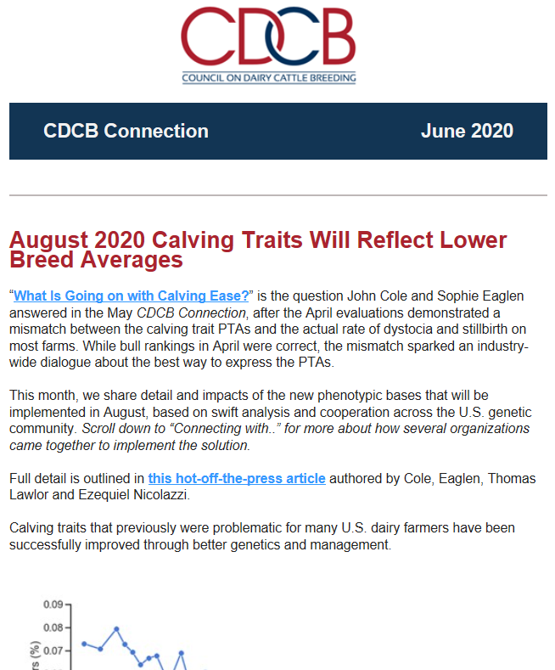
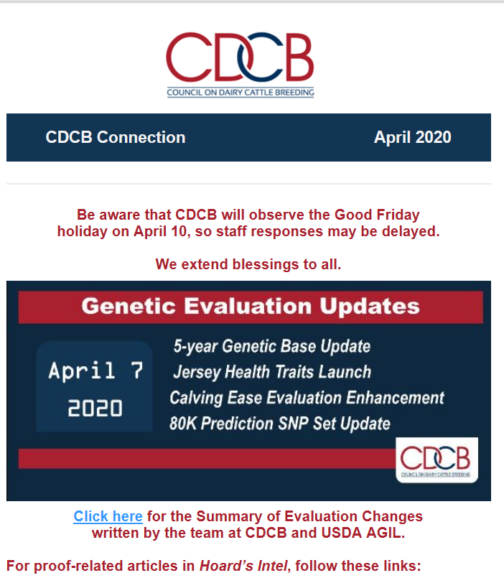
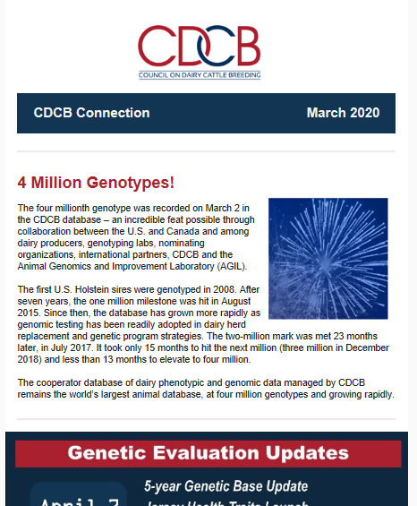
Stay Connected to CDCB
Receive CDCB Connection monthly newsletter by emailing cindy.ferrier@uscdcb.com
View at https://www.uscdcb.com/whats-new/newsletter/

Slide 13
Disclaimer
The author was supported by USDA-ARS project 8042-31000-002-00-D, “Improving Dairy Animals by Increasing Accuracy of Genomic Prediction, Evaluating New Traits, and Redefining Selection Goals”.
USDA is an equal opportunity provider and employer.
Mention of trade names or commercial products in this presentation is solely for the purpose of providing specific information and does not imply recommendation or endorsement by the US Department of Agriculture.

Slide 14
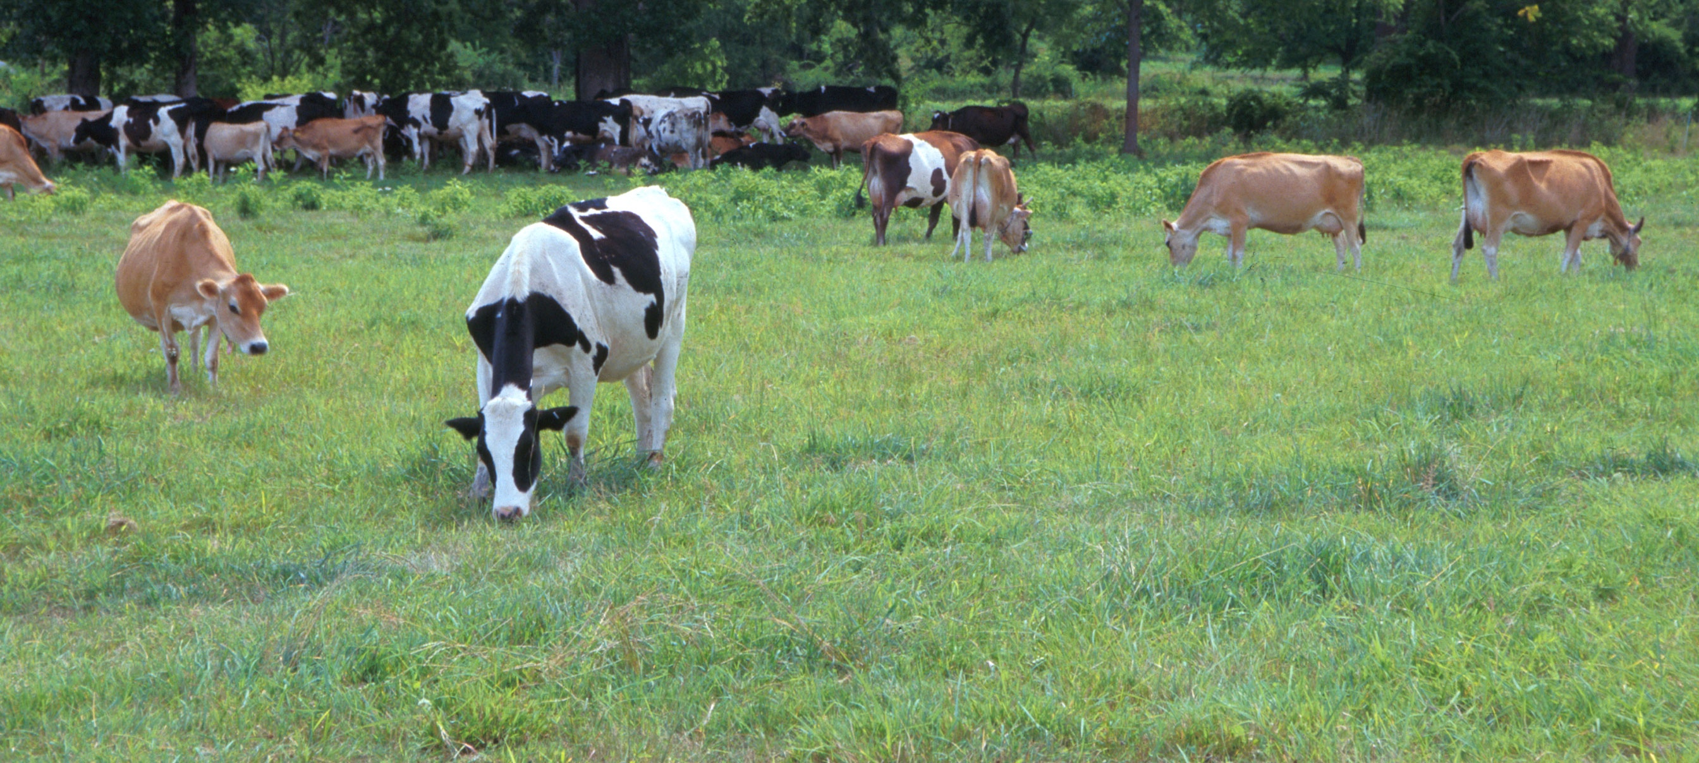
Questions?
AIP web site:
http://aipl.arsusda.gov/
Holstein and Jersey crossbreds graze on American Farm Land Trust’s
Cove Mountain Farm in south-central Pennsylvania
Source: ARS Image Gallery, image #K8587-14; photo by Bob Nichols

