Slide 1
Calculation and use of genetic evaluations for feed saved
Paul VanRaden,¹ Mike VandeHaar,² Rob Tempelman,² Sajjad Toghiani,¹ and Kristen Gaddis³
¹USDA, Agricultural Research Service, Animal Genomics and Improvement Laboratory, Beltsville, MD, USA
²Michigan State University, East Lansing, MI, USA
³Council on Dairy Cattle Breeding, Bowie, MD, USA
paul.vanraden@usda.gov

Slide 2
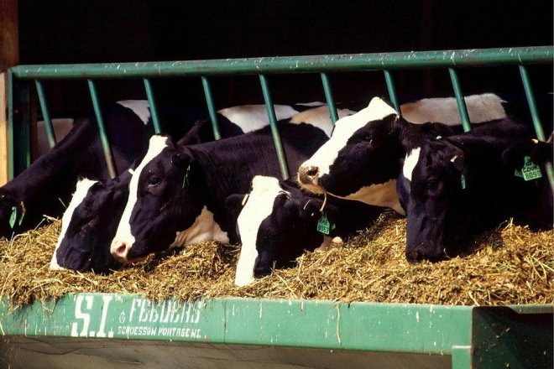
Topics
Revision of cow maintenance cost
Economics for Feed Saved (FSAV)
Reliability for residual feed intake (RFI) and FSAV
Formulas to combine RFI and BWC into FSAV
Feed costs for each pound of milk, fat, or protein
Future national impact of FSAV

Slide 3
Body weight (BW) and body weight composite (BWC)
Since 2000, Net Merit (NM$) has deducted for higher feed costs of larger cows by including a penalty on BWC.
Since 2017, the previous composite formula from U Minnesota was replaced by new BWC formulas based on HAUSA research and AJCA research to better predict actual cow BW.
  Dairy form included to predict weight instead of frame size.
More data from university research herds and genomic regressions now indicate 35 instead of 40 pounds increase in BW for each unit of HO BWC.

Slide 4
Body weight and maintenance feed (dry matter intake)
National Research Council publishes nutrients required
Estimate is increasing
Estimates from CDCB data are much higher
Phenotypic, cow genomic, and sire regressions give similar, high estimates
NM$ should put 2.3 X more emphasis on small body size
Maintenance estimate: | DMI lb / BW lb / year
NM$ 2018 assumed | 1.7
NRC 2001 | 2.7
NRC 2021 | 3.4
Phenotypic | 5.8
Genomic | 5.5
Sire genomic | 5.9
NM$ 2021 proposed | 4.5

Slide 5
Other incomes and costs for BWC already in NM$
+$0.75 Income from cull cows / pound BW
+$0.17 Income from larger calves / pound cow BW
-$0.75 Heifer growth cost up to 1200 pounds
-$0.50 Cow growth cost from 1200 to 1500 pounds
-$0.10 Extra housing costs for cows
Incomes and expenses all converted to feed pounds / lactation
Maintenance + other items = 138 pounds DMI / unit BWC

Slide 6
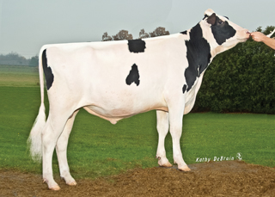
FSAV formulas and reliability averages
Combining BWC and RFI into FSAV
  PTA_{FSAV} –138 * PTA_{BWC} – 1 * PTA_{RFI} pounds / lactation
  REL_{FSAV} 0.35 * REL_{BWC} + 0.65 * REL_{RFI}
Reversing these formulas can give PTA_{RFI} and REL_{RFI} if interested
REL averages for calf predictions
  BWC and RFI 77% and 15%
  Feed Saved 37%
Low REL will reduce REL of NM$ but increase genetic progress

Slide 7
Including Feed Saved PTA and REL in NM$
Lifetime value of FSAV = $0.12/lb DMI * 2.6 lactations = $0.31
Reliability of NM$ with FSAV (or RFI) included
  NM$ with FSAV REL_{NM$} × 0.89 + REL_{RFI} × 0.11
  NM$ current 76%
  NM$ with FSAV 69%
Correlation of NM$ with and without FSAV included = 0.984
Extra progress from FSAV is worth ~$8 million/ year nationally

Slide 8
Milk component prices and feed costs (proposed $)
Few researchers estimated costs for milk components.
New data indicates that milk fluid and protein may require less feed and fat more feed than previously assumed.
Feed cost for fat still poorly estimated because body fat loss during feeding trials not accounted for, only body weight change (next slide).
Income – cost $ | Milk | Fat | Protein
2021 base milk price $ / lb | 0.014 | 2.10 | 2.60
2018 feed cost | 0.027 | 0.65 | 0.90
2021 feed cost | 0.007 | 0.96 | 0.84
2018 profit / lb | -0.013 | 1.45 | 1.70
2021 profit / lb | +0.007 | 1.14 | 1.76

Slide 9
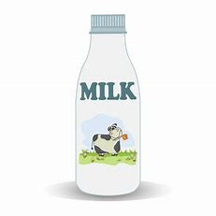
Feed consumed to produce milk, fat, or protein
 | Description | Marginal feed $ | DMI (lb) for component yields
Model |  | / 100 pounds milk | Milk | Fat | Protein
1 | Phenotypic | 3.32 | 0.008 | 2.82 | 5.32
2 | Genomic | 8.93 | 0.087 | 11.41 | 8.05
3 | Sire genomic | 6.08 | 0.040 | 6.58 | 7.38
NM$ | Assumed 2018 | 7.68 | 0.225 | 5.42 | 7.50
NM$ | Proposed 2021 | 6.96 | 0.060 | 8.00 | 7.00
ECM | Energy corrected milk | - | 0.327 | 12.95 | 7.65

Slide 10
Relative emphasis in NM$ and progress (proposed)
Trait | Relative emphasis |  | Correlation with index
 | 2018 | 2021 | 2018 | 2021
Milk | -0.7 | 7.1 | .51 | .62
Fat | 26.8 | 16.3 | .78 | .71
Protein | 16.9 | 13.7 | .68 | .73
BWC | -5.3 | -10.4 | -.23 | -.37
RFI | 0.0 | -14.2 | .00 | .14
[Feed Saved] |  | 24.6 |  | .39
Many other proposed changes will affect the 2021 emphasis and progress.

Slide 11

Proposed NM$ revisions for April 2021
Revise maintenance cost for BWC for all breeds
Include RFI and BWC feed reductions in FSAV for Holsteins
Adjust feed costs for milk components
Include heifer livability (HLIV) and early first calving (EFC)
Revise opportunity and maturity costs in productive life (PL)
Adjust price forecasts and other economic assumptions

Slide 12
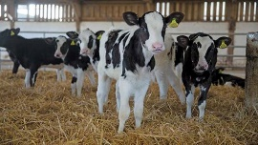
Conclusions
Selection for Feed Saved should improve US profit by $8 million / year
  $4.3 million extra progress from DMI data via residual feed intake
  $4.0 million from more penalty on BWC via more maintenance cost
RFI could get ~14% of relative emphasis in net merit, but low REL of ~15% for RFI and ~37% for FSAV of young animals will limit progress
REL of NM$ is lower when feed intake or other traits with low REL (such as fertility) are included in selection goal, but progress is faster

Slide 13
Acknowledgments
US taxpayers for funding our USDA-ARS project 8042-31000-002-00-D, “Improving Dairy Animals by Increasing Accuracy of Genomic Prediction, Evaluating New Traits, and Redefining Selection Goals”
CDCB and its industry suppliers for data
Agriculture and Food Research Initiative Competitive Grant #2011-68004-30340 from USDA National Institute of Food and Agriculture (feed intake funding)
Foundation for Food and Agriculture Research (FFAR) (additional feed intake funding)

