Slide 1
Current Research at AGIL, January 2020
John B. Cole
USDA, Agricultural Research Service
Henry A. Wallace Beltsville Agricultural Research Center
Animal Genomics and Improvement Laboratory
Beltsville, MD 20705-2350
john.cole@usda.gov

Slide 2
80K SNP: Choosing which SNP to include
Large effect HD and sequence SNP from 2 previous studies
Wiggans et al., 2016, J. Dairy Sci. 99:4504–4511 (HD SNP)
VanRaden et al., 2017, Genet. Sel. Evol. 49:32 (sequence)
Gene tests added to recent chips
Causal alleles within lethal haplotypes
Remove previous SNP with high parent-progeny conflict rates, missing genotypes, Hardy-Weinberg within breeds, etc.
Set SNP to missing on individual chips with poor properties

Slide 3
80K SNP: Gene tests & sequence SNP w/large effects
Gene tests for DGAT1, ABCG2, β-casein, and β-lactoglobulin had large effects on yield traits and net merit
Gene tests for Holstein cholesterol deficiency, complex vertebral malformation, brachyspina, and calpain had large effects on somatic cell score, udder cleft, protein yield, and gestation length, respectively
New sequence marker on chromosome 3 had largest effect on Holstein final score, foot angle, feet-and-legs score, and rear legs (rear view)
For Jerseys, bGHR had large effect on productive life

Slide 4
80K SNP: Comparison of 80K & 60K predictions
Genomic predictions improved more for breeds with larger reference populations (Holsteins and Jerseys)
Individual predictions changed most for animals less related to US population, with less complete pedigrees, or genotyped with lowest density chips (such as 3K)
Correlations of 80K with 60K predictions for young animals
About 0.99 for Jersey, Holstein, and Guernsey yield traits
Higher for Ayrshire and Brown Swiss yield traits
Lower for many other traits (~0.98)

Slide 5
RFI evaluations: Reliabilities (Li et al., 2020, JDS)
Animal group from national data | RFI Reliability (%)
 | Pedigree | Genomic
3,965 cows with RFI phenotypes | 30 | 34
Top 10 sires with most RFI daughters | 78 | 85
Top 100 Net Merit progeny tested sires | 8 | 16
Top 100 Net Merit young bulls | 3 | 12
1.5 million genotyped Holsteins | 5 | 13
60 million non-genotyped Holsteins | 3 | 3

Slide 6
RFI evaluations: Largest effects for RFI from HD genotypes
SNP variance explained by 5-SNP windows
Top 350 RFI SNPs provided to labs to design better future chips

Slide 7
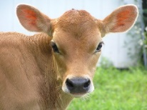
Heifer livability: Data
Extracted data from CDCB database (birth years 2001–16)
4,428,896 dairy heifer data records
Herds with death loss of 2–25%
Heifers <2 days old not evaluated (used in stillbirth)
Heifers up to 18 months old used
Total number of deaths = 142,6202 (3.2%)
Livability scored as 100 (alive) or 0 (dead)
Heritability estimate of 0.4% by sire model REML

Slide 8
Heifer livability: Evaluation
Genomic PTAs (GPTAs) for proven bulls
Holstein: ‒1.5% to +1.5% (SD of 0.5%)
Jersey: ‒0.8% to +0.8% (SD of 0.2%)
RELs for young animals
Holstein: 49% REL for GPTA
19% REL for traditional PA
Jersey: 31% REL for GPTA
13% REL for traditional PA

Slide 9
Heifer livability: Correlation with other traits
Correlations for HLIV GPTA of recent proven bulls
0.47 with PL and 0.20 with cow livability
0.36 with calving trait dollars (calving ease, stillbirth)
0.32 with early first calving (EFC)
0.30 to 0.32 with yield traits
Correlation of HLIV GPTA with NM$ is very high (0.55)
Genetic trend for HLIV already favorable in recent years because of selection for correlated traits and NM$
Notes:
The Jersey correlations and trends are not as high, perhaps due to fewer genotypic records (311,576 records for Jersey population as compared to 2,505,753 for Holsteins).

Slide 10
August 2020 NM$ revision options
RFI could get 16% of total emphasis but Var(PTA) and REL are low
BWC should double negative emphasis from ‒5% to ‒10% because maintenance cost used since 2000 was too low
EFC could get 3% of emphasis with reduced emphasis on HCR
HLIV could get 1% of emphasis depending on calf value
PL should get less value because faster progress makes younger cows more profitable than older (Schmitt et al., 2019, JDS)

Slide 11
Ancestor discovery (Nani et al., 2020, JDS)
In June 2019, more than 11% of genotyped animals in the CDCB database had no dam pedigree information
An automated procedure to discover and fill missing maternal ID numbers based on discovered MGS and MGGS was developed
Pedigree EBV for milk, fat, and protein yields increased by 116 kg for milk, 4.5 kg for fat, and 3.6 kg for protein
Reliabilities for pedigree EBV increased by 6 percentage points for milk yield, 7 percentage points for fat yield, and 6 percentage points for protein yield

Slide 12
GWAS for health (Freebern et al., 2020, BMC Genomics)

Slide 13
HH2: Identification of candidate variant
HH2 identified from a deficiency-of-homozygotes approach and undesirable effects on conception rate and stillbirths confirmed
5 carriers were present in a group of 183 sequenced Holstein bulls selected to maximize the coverage of unique haplotypes
3 variants concordant with the haplotype calls were found in the HH2 region
A high-impact frameshift in intraflagellar protein 80 (IFT80) was confirmed in Holsteins from the 1000 Bull Genomes Project that shared no animals with the discovery set

Slide 14
HH2: Validation of candidate variant
IFT80-null embryos generated by truncation at exon 2 with guide-RNAs annealed to Cas9 mRNA
Abattoir-derived oocytes fertilized in vitro with high-fertility semen
Embryos injected at the one-cell stage with CRISPR-Cas9 complex (treatment) or Cas9 mRNA (control) before return to culture
IFT80-null embryos arrested at the 8-cell stage of development, consistent with data from mouse hypomorphs and HH2 carrier-to-carrier matings

Slide 15
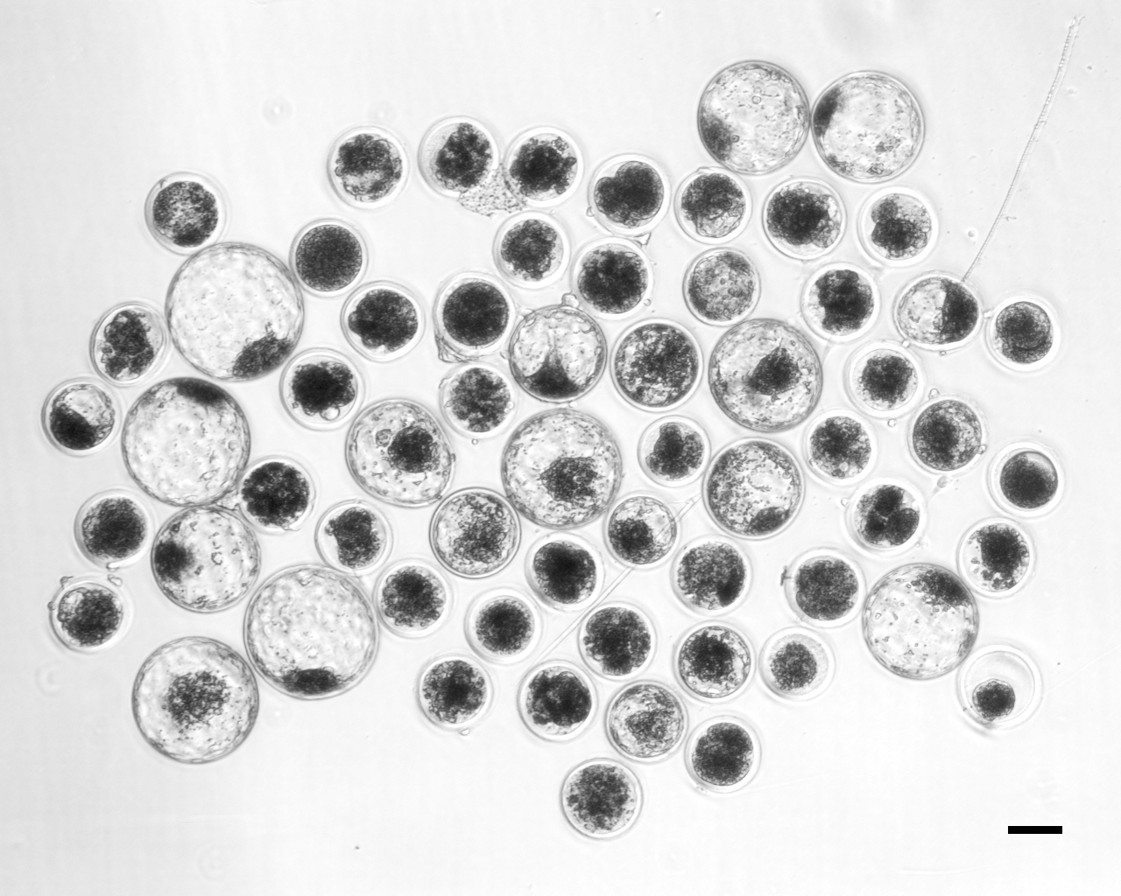
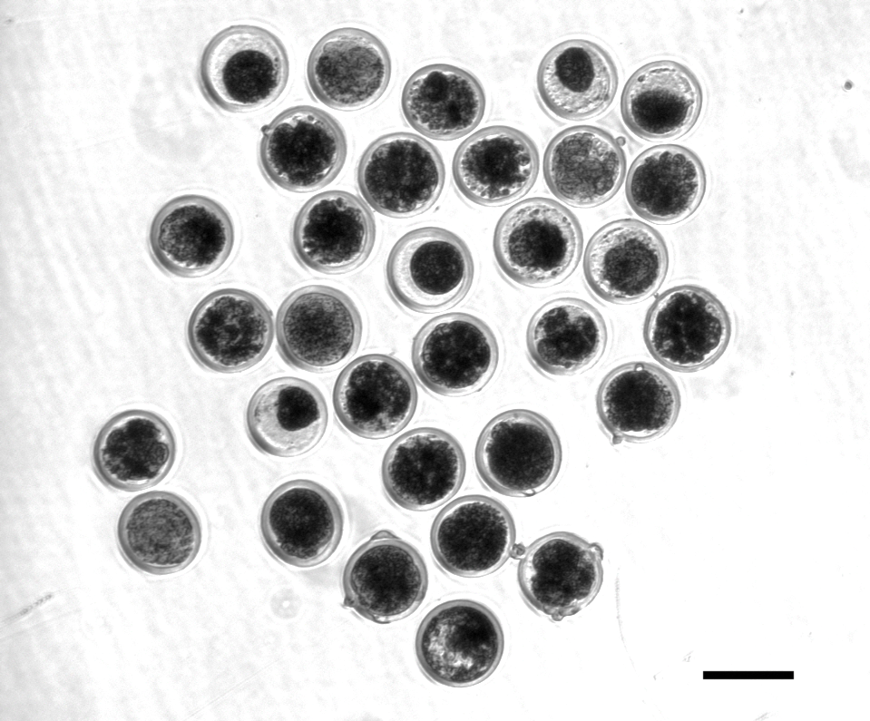
HH2: Candidate confirmed with functional validation
A frameshift in IFT80 at 107,172,615 bp (p.Leu381fs) disrupts wnt and hedgehog signaling, and is responsible for the death of homozygous embryos
A tag SNP will be used to track the causal mutation
Proven sires could be genotyped to confirm concordance
Control embryos injected with only Cas-9 (left)
Treatment embryos injected with Cas-9 and IFT80 exon 2 guide RNA (right)

Slide 16
Disclaimer
The author was supported by USDA-ARS project 8042-31000-002-00-D, “Improving Dairy Animals by Increasing Accuracy of Genomic Prediction, Evaluating New Traits, and Redefining Selection Goals”.
USDA is an equal opportunity provider and employer.
Mention of trade names or commercial products in this presentation is solely for the purpose of providing specific information and does not imply recommendation or endorsement by the US Department of Agriculture.

Slide 17
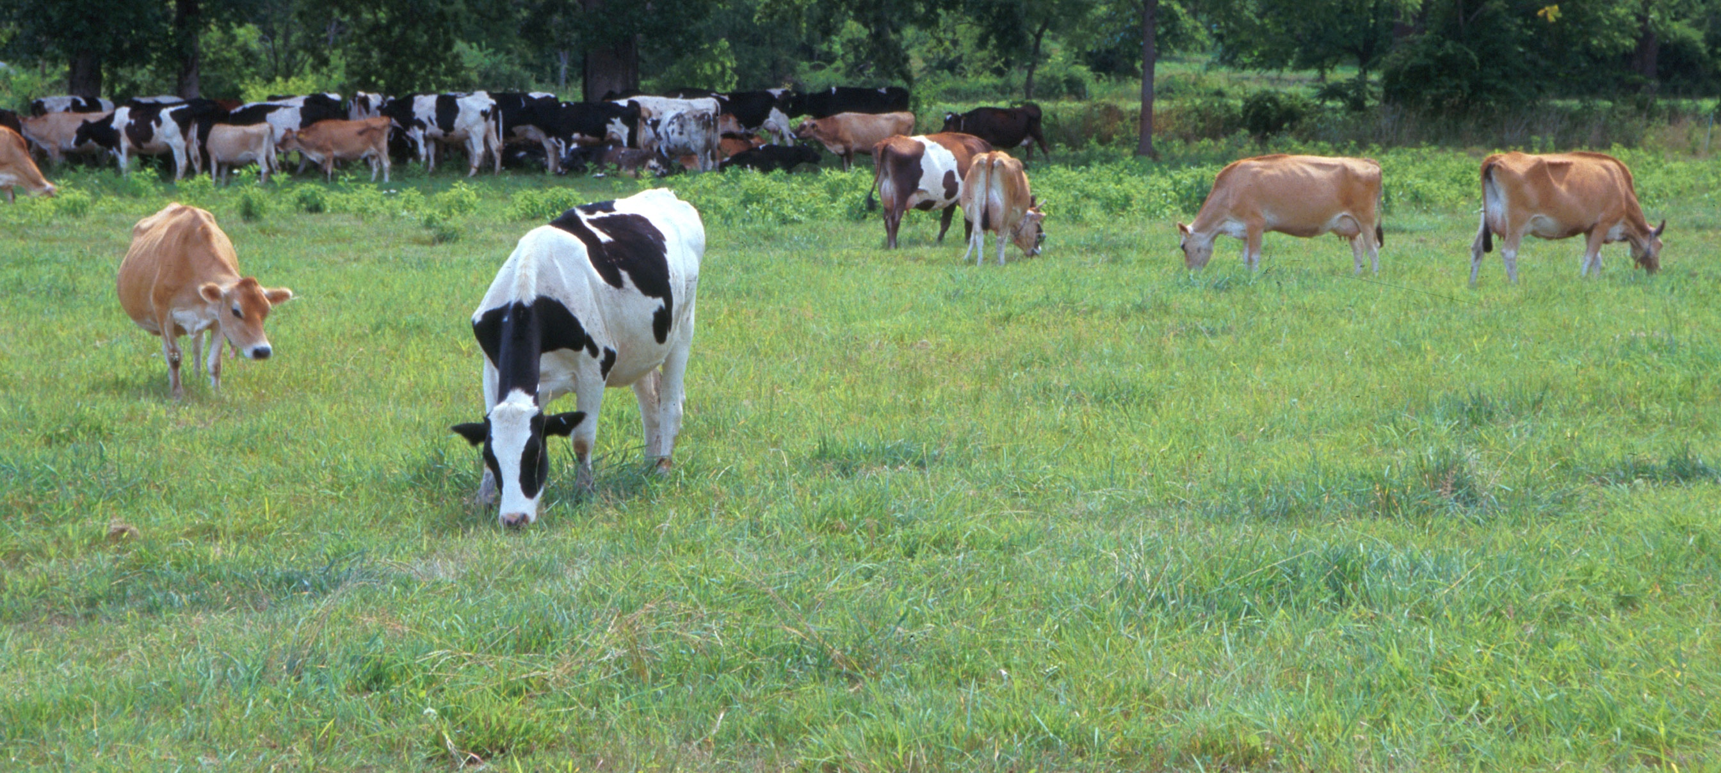
Questions?
AIP web site:
http://aipl.arsusda.gov/
Holstein and Jersey crossbreds graze on American Farm Land Trust’s
Cove Mountain Farm in south-central Pennsylvania
Source: ARS Image Gallery, image #K8587-14; photo by Bob Nichols

