Slide 1
Identification, Validation, and Management of Mendelian Traits in Livestock Breeding Programs
John B. Cole
Acting Research Leader
Animal Genomics and Improvement Laboratory
ARS, USDA, Beltsville, MD
john.cole@usda.gov

Slide 2
Collaborators
Derek M. Bickhart,² Jana L. Hutchison,¹ Daniel J. Null,¹ M. Sofia Ortega,³ Christine F. Baes,⁴ and Christian Maltecca⁵
¹Animal Genomics and Improvement Laboratory, ARS, USDA, Beltsville, MD
²Cell Wall Biology and Utilization Research Laboratory, U.S. Dairy Forage Research Center, ARS, USDA, Madison, WI
³Division of Animal Sciences, College of Agriculture, Food, & Natural Resources, University of Missouri, Columbia, MO
⁴Department of Animal BioSciences, University of Guelph, Ontario
⁵Department of Animal Science, North Carolina State University, Raleigh, NC

Slide 3
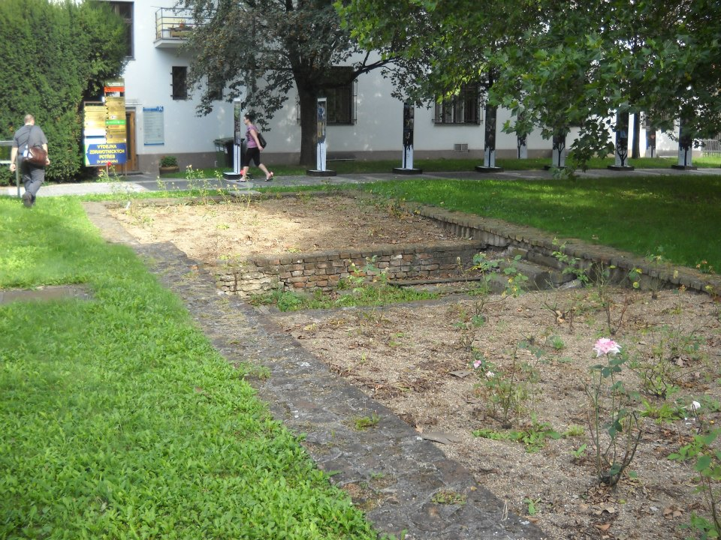
Overview
How do we detect new genetic disorders?
Are incidence rates increasing?
How do we validate causal variants?
How do we manage genetic
disorders in our populations?
Where do we go from here?

Slide 4
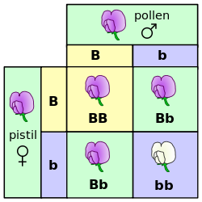
Mendelian traits
One locus, typically with two alleles
Often exhibit complete dominance
Autosomal recessive
  Many loci in cattle (Cole et al.,
  2018; https://bit.ly/2utjPbT)
Autosomal dominant
  Polled (Medugorac et al., 2011;
  PMID: 22737241), MITF (Philipp
  et al., 2011; PMID: 22174915)
Source: https://commons.wikimedia.org/wiki/File:Punnett_square_mendel_flowers.svg.

Slide 5

Genetic diseases are common
There currently are 532 genetic traits/disorders of cattle in the Online Mendelian Inheritance in Animals database
  https://omia.org/home/
249 of these are Mendelian traits/disorders

Slide 6
This not a dairy-specific problem!
Beef cattle
  Jenko et al. (2019) reported 1 new lethal and 2 new semi-lethal haplotypes
Poultry
  Youngworth and Delany (2019) identified the causal variant for the Wingless-2 developmental syndrome
Pigs
  Derks et al. (2019) found 5 common recessive lethal haplotypes in 2 commercial populations
Dogs
  Oh, lord, dogs have all the genetic defects

Slide 7
Haplotyping in US dairy cattle
Parental Haplotypes
Paternal and maternal chromosomes phased
Chromosomes divided into 100-SNP blocks
List of unique blocks in the population computed
What haplotypes never appear as homozygotes?
Automated part of genomic evaluation workflow
Progeny Haplotypes
!

Slide 8
How are haplotypes affecting fertility detected?
Lethal haplotypes found by searching for blocks that never appear as homozygotes even though a substantial number are expected
Fertility data used to determine if carrier × carrier matings have reduced fertility
  Identifies recessives with effects early in gestation
Dystocia data can be used to check for effects on stillbirth rates
  Identifies recessives with effects late in gestations
Methodology described in VanRaden et al. (2011)

Slide 9
Effects confirmed using fertility data
Carrier-to- carrier matings are tested for effects on conception rate and stillbirth
  Early embryonic losses show conception rate effects (e.g., HH2 and JH1)
  Some variants show stillbirth effects (e.g., BH2 and HCD)
For example, matings of AH1 carrier sires to cows with AH1 carrier maternal grandsires had 6.1% lower sire conception rate
Bioinformatics used to identify putative causal variants

Slide 10
Known recessives in U.S. Holsteins (February 2020)
Haplo- type | Functional/Gene name | BTA chromosome | Location (Mbp) | Haplotype frequency (%) | Timing¹
HBR | Black/red coat color/MC1R(MSHR) | 18 | 14.8 | 0.75 | —
HCD | Cholesterol deficiency/APOB | 11 | 78.0 | 2.28 | W
HDR | Dominant red color/MC1R(MSHR) | 3 | 9.5 | 0.03 | —
HH0 | Brachyspina/FANCI | 21 | 21.2 | 1.65 | E,B
HH1 | APAF1 | 5 | 63.2 | 1.28 | E
HH2 | — | 1 | 94.9 – 96.6 | 1.21 | E
HH3 | SMC2 | 8 | 95.4 | 2.64 | E
HH4 | GART | 1 | 1.3 | 0.23 | E
HH5 | TFB1M | 9 | 93.2 – 93.4 | 2.39 | E
HH6 | SDE2 | 16 | 29.0–29.1 | 0.44 | W
HHB | BLAD/ITGB2 | 1 | 145.1 | 0.21 | W
HHC | CVM/SLC35A3 | 3 | 43.4 | 1.10 | E,B
HHD | DUMPS/UMPS | 1 | 69.8 | 0.01 | E
HHM | Mule foot/LRP4 | 15 | 77.7 | 0.05 | B
HHP | Polledness (dominant)/POLLED | 1 | 1.7 – 2.0 | 0.88 | —
HHR | Red coat color/MC1R(MSHR) | 18 | 14.8 | 3.29 | —
¹Timing of embryonic loss/calf death for homozygous animals: B = calf death at/shortly after birth,
E = embryonic loss/abortion, W = calf death weeks/months after birth (Cole et al., 2018; https://bit.ly/2utjPbT).

Slide 11
Timing of recessive effects
Late losses are more costly than early losses (Cole et al., 2016)
  Jenko et al. (2019) found a similar pattern
A defect may cause deaths in more than one time period
Embryonic loss or abortion | Death at or near birth | Weeks or months following birth
BH1, HH0, HH1, HH2, HH3, HH4, HH5, CVM, JH1, JH2 | BH2, HH0, CVM, syndactyly (mulefoot) | AH1, BH2, HH6, BLAD, cholesterol deficiency, spinal dysmyelination, spinal muscular atrophy, weaver syndrome

Slide 12
Estimated cost of genetic load
Cole et al. (2016) estimated annual losses of at least $10.7 million due to known recessives.
Average losses were $5.77, $3.65, $0.94, and $2.96 in Ayrshire, Brown Swiss, Holstein, and Jersey, respectively.
This is the economic impact of genetic load as it affects fertility and perinatal mortality.
Actual losses are likely to be higher.

Slide 13
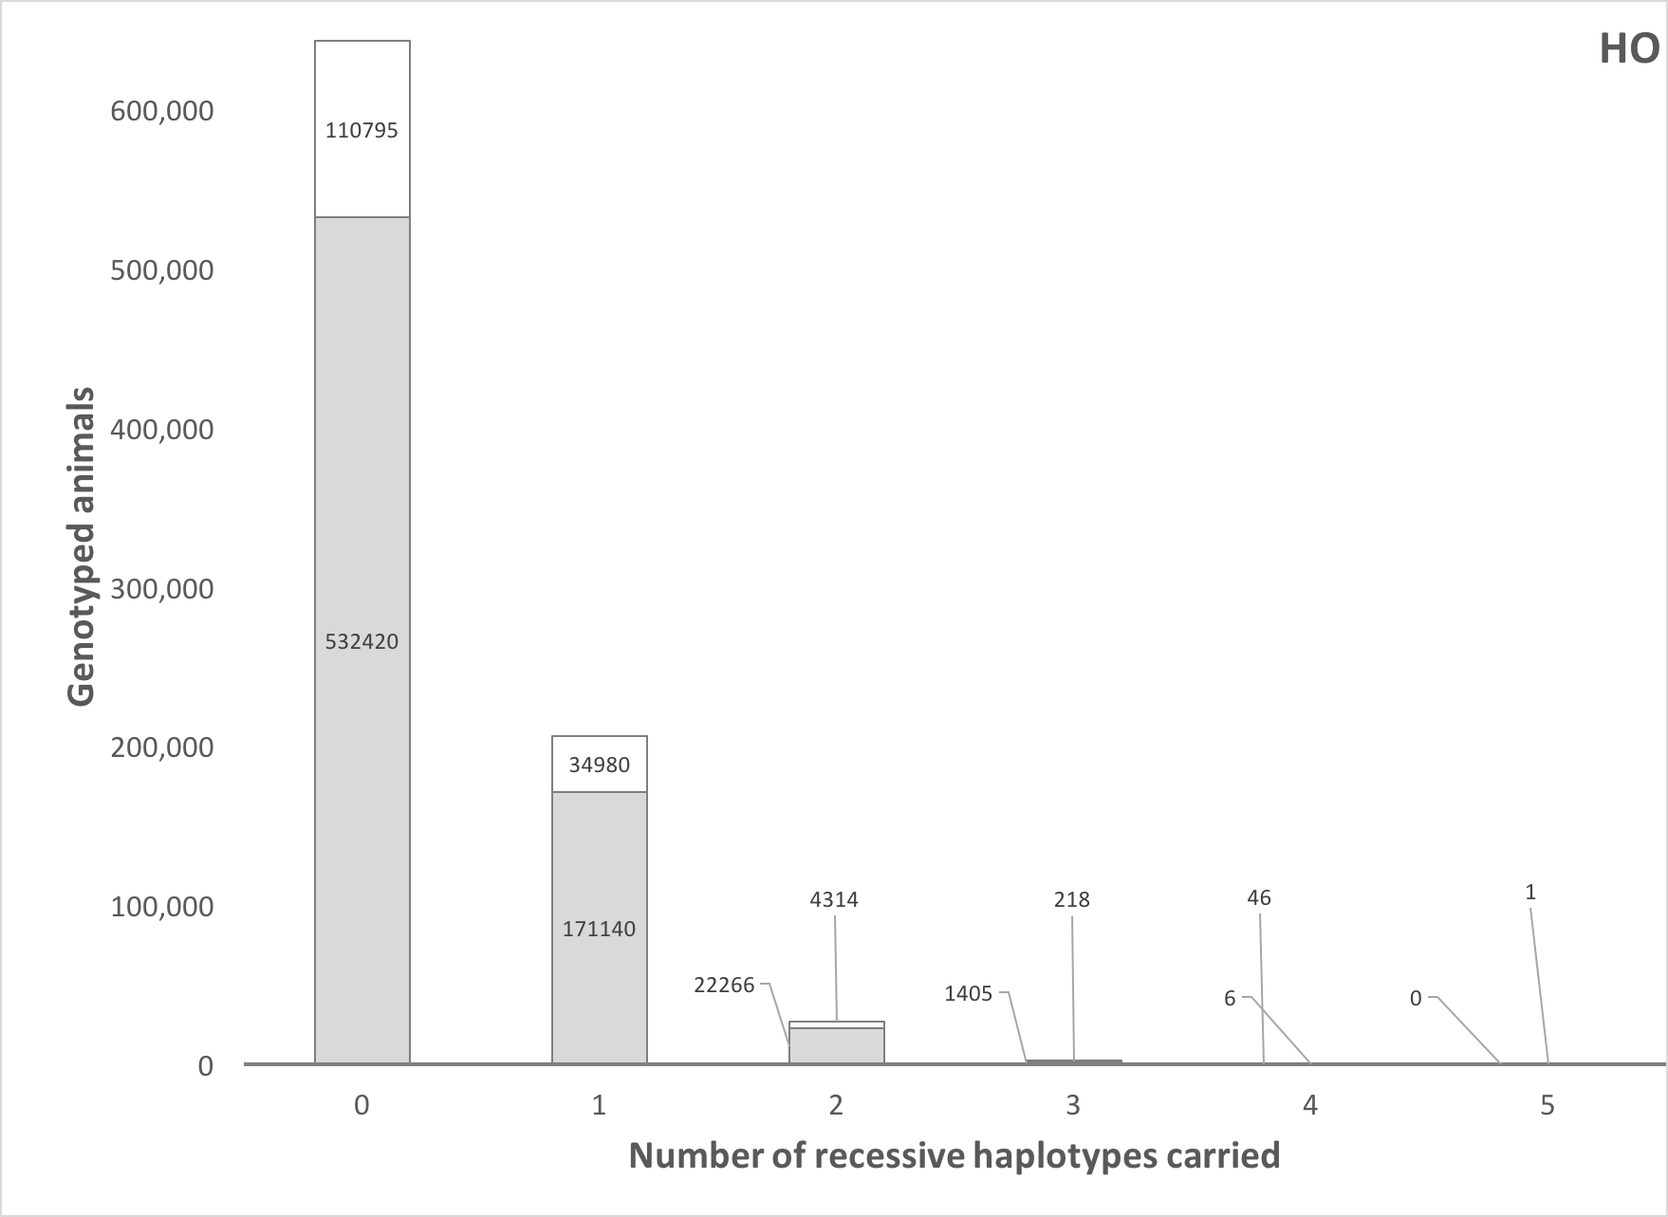
How many defects do animals carry?
Source: Cole et al. (2016).

Slide 14
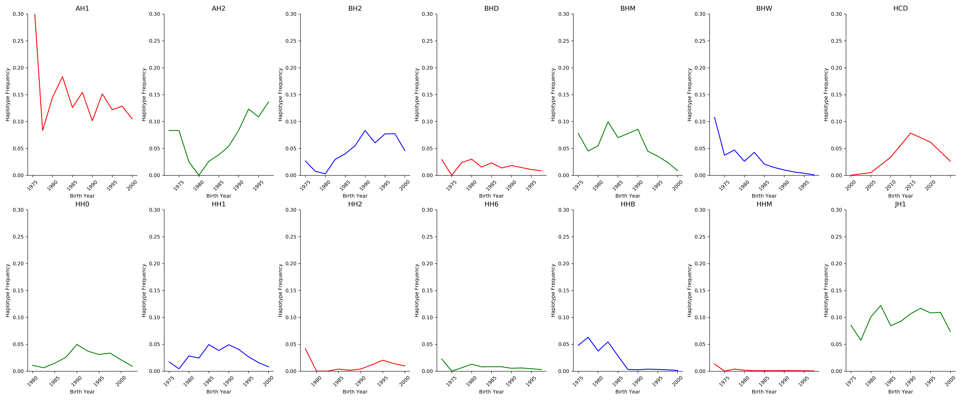
Frequencies change over time
The best way to reduce the frequency of harmful alleles is to not use carrier bulls!

Slide 15
Is the number of defects increasing?
MacArthur et al. (2012) estimated that human genomes contain ~100 loss-of-function mutations, and ~20 completely inactivated genes
The mutations are there even if we have not identified them yet
  Example: HH6, mutation in SDE2 (Fritz et al., 2018)
Our detection methods are improving as our technology improves
We continue to make many copies of haplotypes from a small number of bulls, uncovering existing genetic load

Slide 16
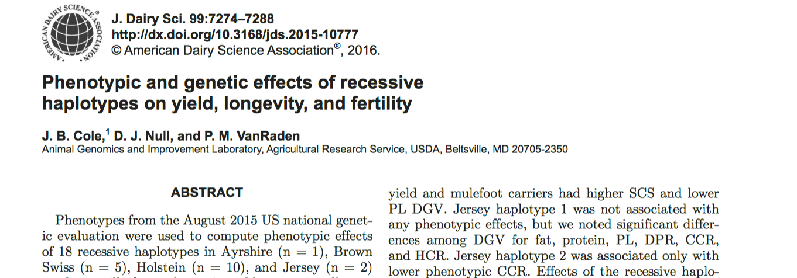
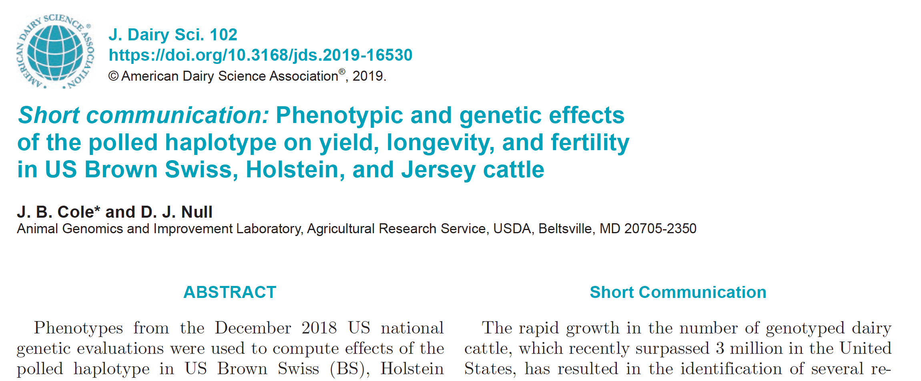
Does pleiotropy affect traits of economic importance?
Effects of recessive haplotypes on yield, fertility, and longevity generally were small even when different from 0

Slide 17
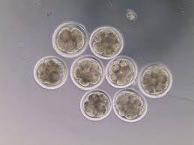
Validation of candidate variants
Candidate genes for early embryonic losses not always validated in the laboratory
Targeted knockouts can be used to validate candidates for early embryonic losses
Relatively fast and cost-effective
Source: University of Florida (2013).

Slide 18
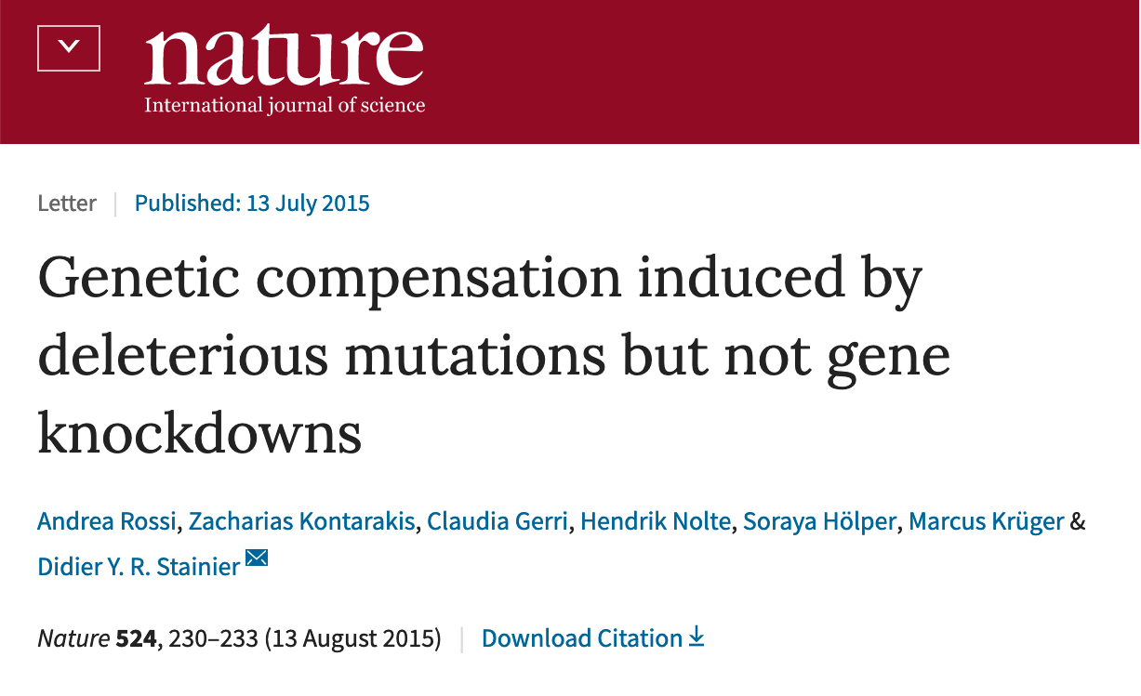
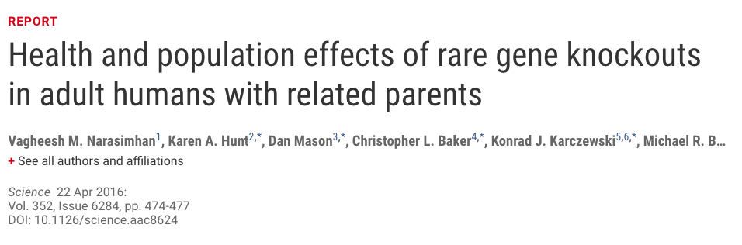
Why is functional validation desirable?
Not all mutations produce phenotypic change
  Compensatory networks can buffer against deleterious mutations (Rossi et al., 2015)
  Many homozygous loss-of-function alleles produce no deleterious phenotypes, including some expected to result in genetic disease (Narasimhan et al., 2016)

Slide 19
Identification of candidate HH2 variant
HH2 identified from a deficiency-of-homozygotes approach and undesirable effects on conception rate and stillbirths confirmed
5 carriers were present in a group of 183 sequenced Holstein bulls selected to maximize the coverage of unique haplotypes
3 variants concordant with the haplotype calls were found in the HH2 region
A high-impact frameshift in intraflagellar protein 80 (IFT80) was confirmed in Holsteins from the 1000 Bull Genomes Project that shared no animals with the discovery set

Slide 20
Validation of candidate HH2 variant
IFT80-null embryos generated by truncation at exon 2 with guide-RNAs annealed to Cas9 mRNA
Abattoir-derived oocytes fertilized in vitro with high-fertility semen
Embryos injected at the one-cell stage with CRISPR-Cas9 complex (treatment) or Cas9 mRNA (control) before return to culture
IFT80-null embryos arrested at the 8-cell stage of development, consistent with data from mouse hypomorphs and HH2 carrier-to-carrier matings

Slide 21
Efficiency of editing
Procedures similar to Ortega
et al. (2019)

Slide 22
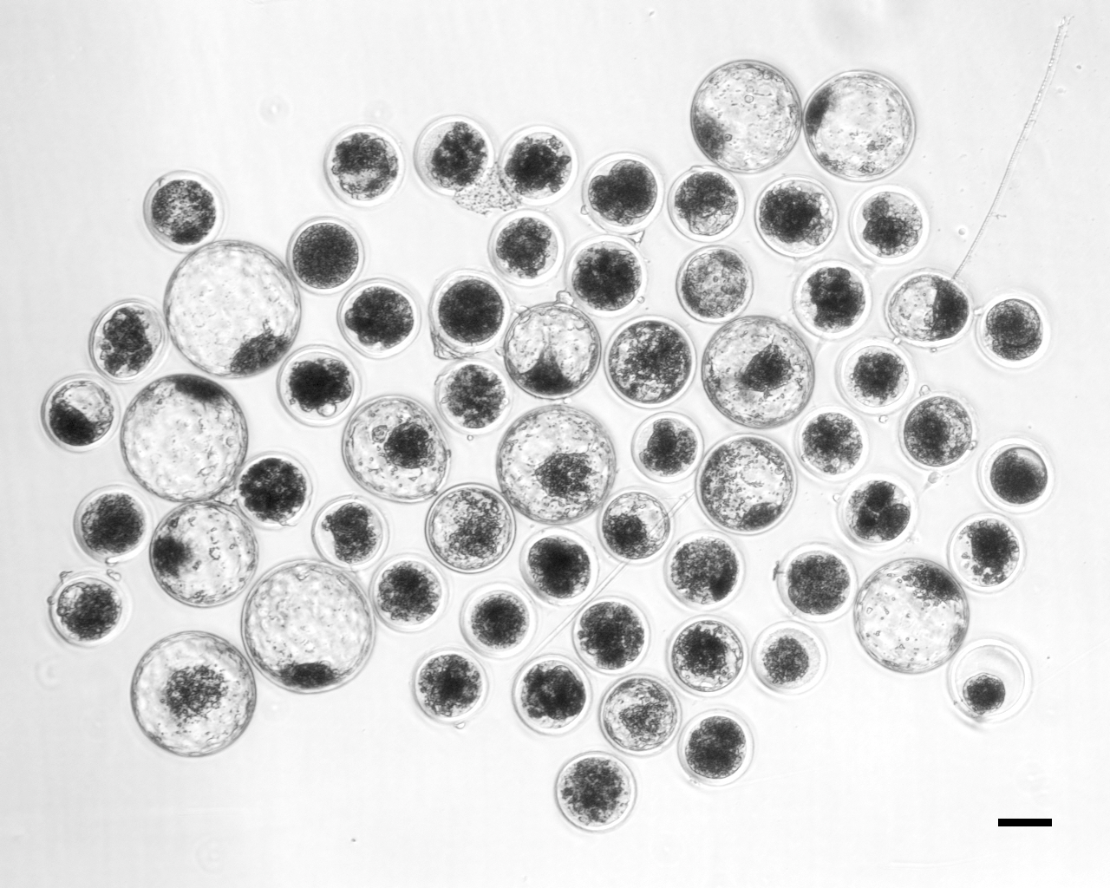
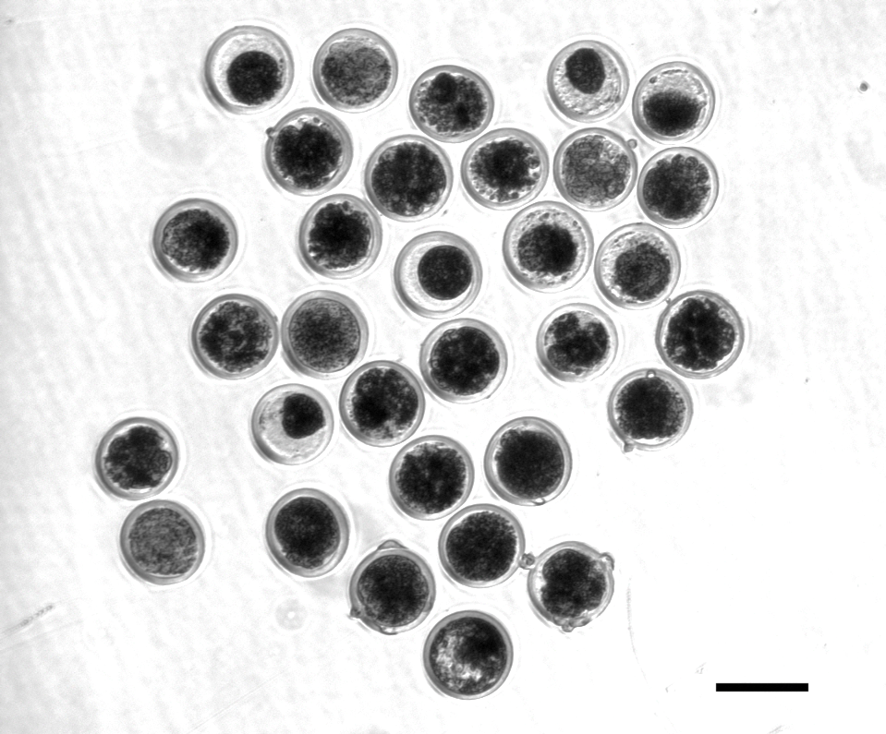
HH2 candidate confirmed with functional validation
A frameshift in IFT80 at 107,172,615 bp (p.Leu381fs) disrupts wnt and hedgehog signaling, and is responsible for the death of homozygous embryos
A tag SNP will be used to track the causal mutation
Proven sires could be genotyped to confirm concordance
Control embryos injected with only Cas-9 (left)
Treatment embryos injected with Cas-9 and IFT80 exon 2 guide RNA (right)

Slide 23
Should carrier bulls be culled?
Remove carrier bulls from the population if population is large enough and non-carrier bulls are available
Non-carrier bulls are as good as carrier bulls, on average
 | Carriers |  |  |  | Non-carriers
Breed | N | Mean | SD |  | N | Mean | SD | Difference | P value
AY | 16 | 286.43 | 194.67 |  | 53 | 272.41 | 191.69 | 13.02 | 0.407
BS | 30 | 223.10 | 218.39 |  | 59 | 284.19 | 160.36 | -61.09 | 0.087
HO | 550 | 394.08 | 216.77 |  | 1,765 | 479.49 | 213.89 | -85.41 | <0.001
JE | 99 | 340.51 | 149.00 |  | 378 | 338.82 | 153.99 | 1.69 | 0.460
Source: Cole et al. (2016).

Slide 24
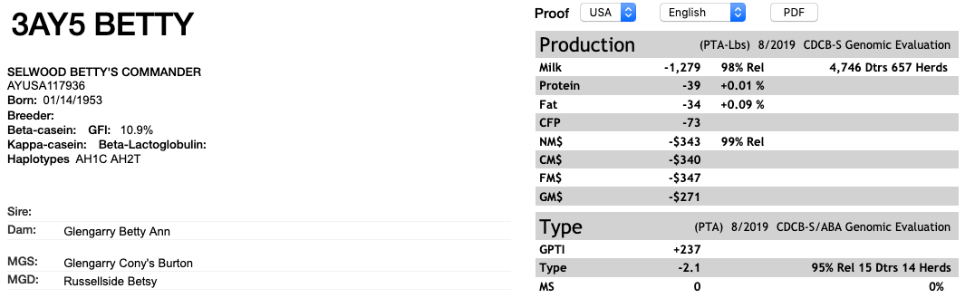
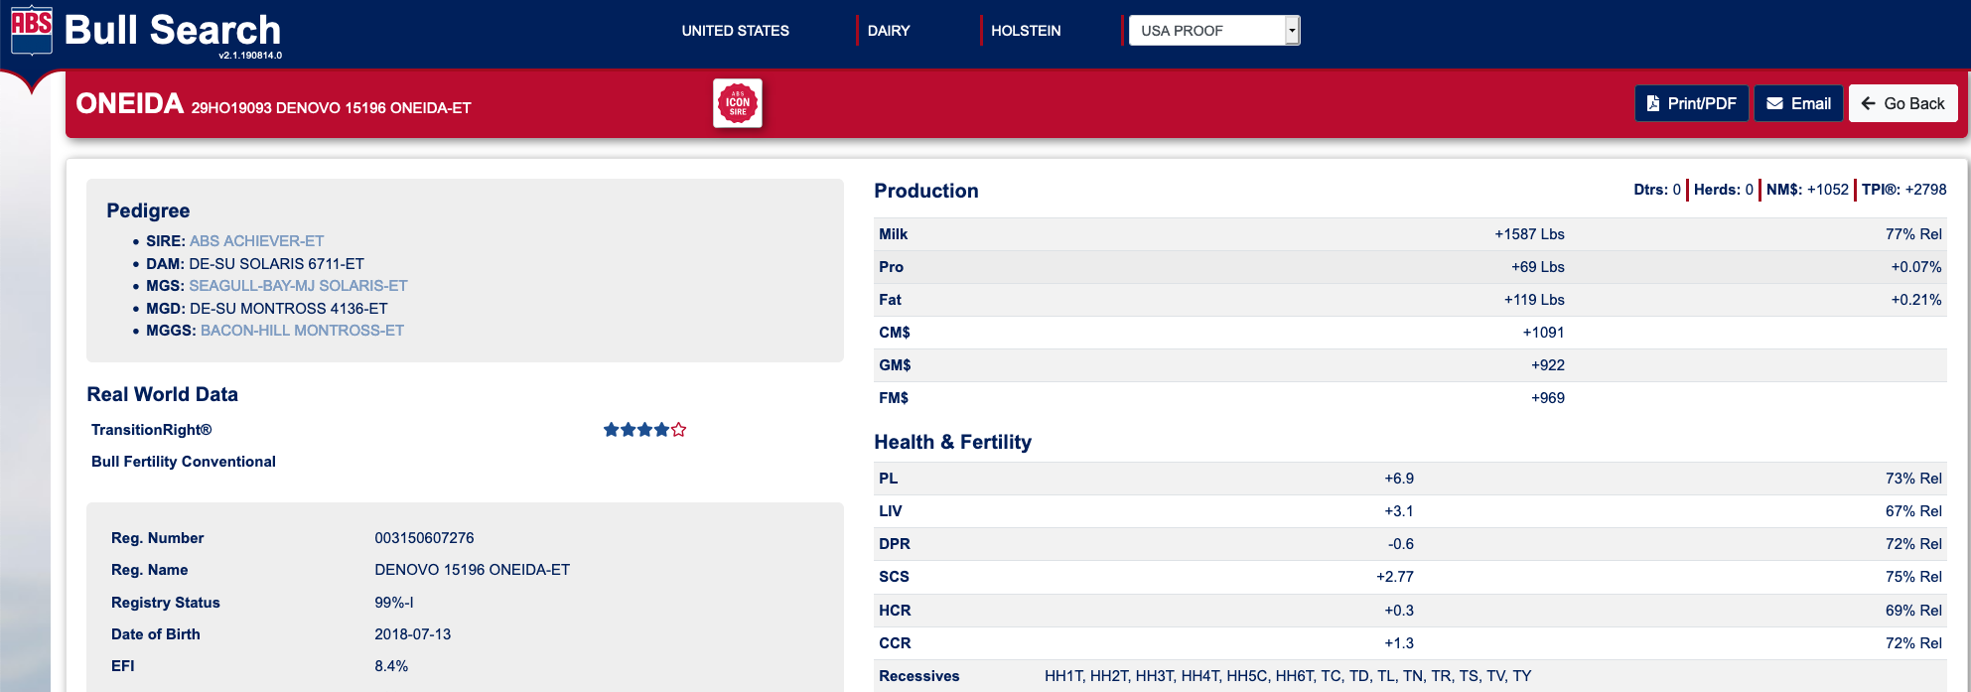
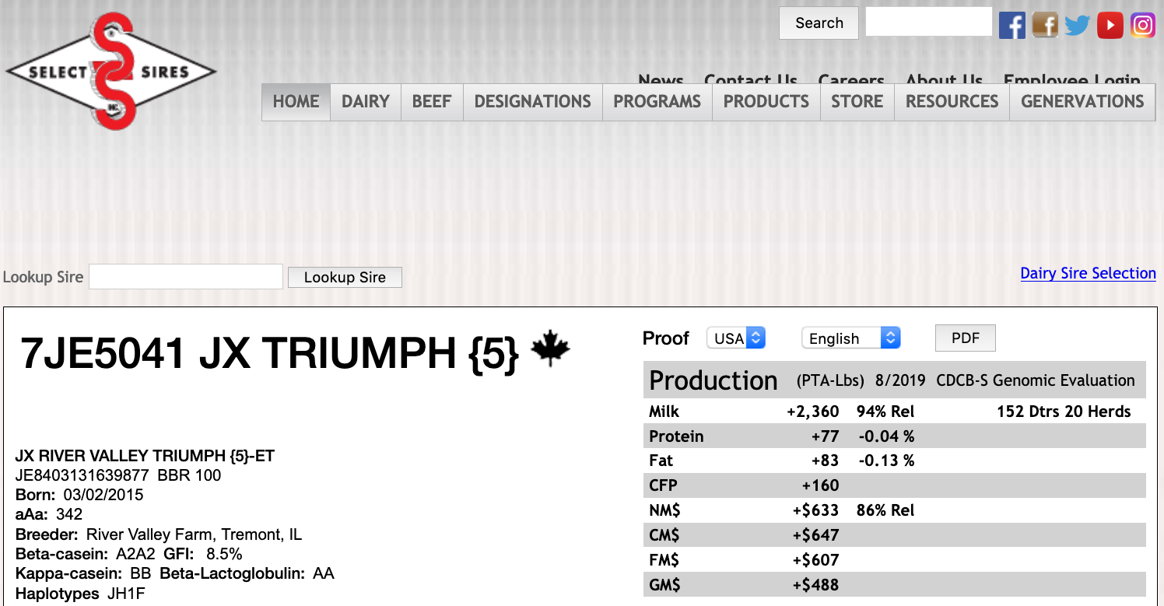
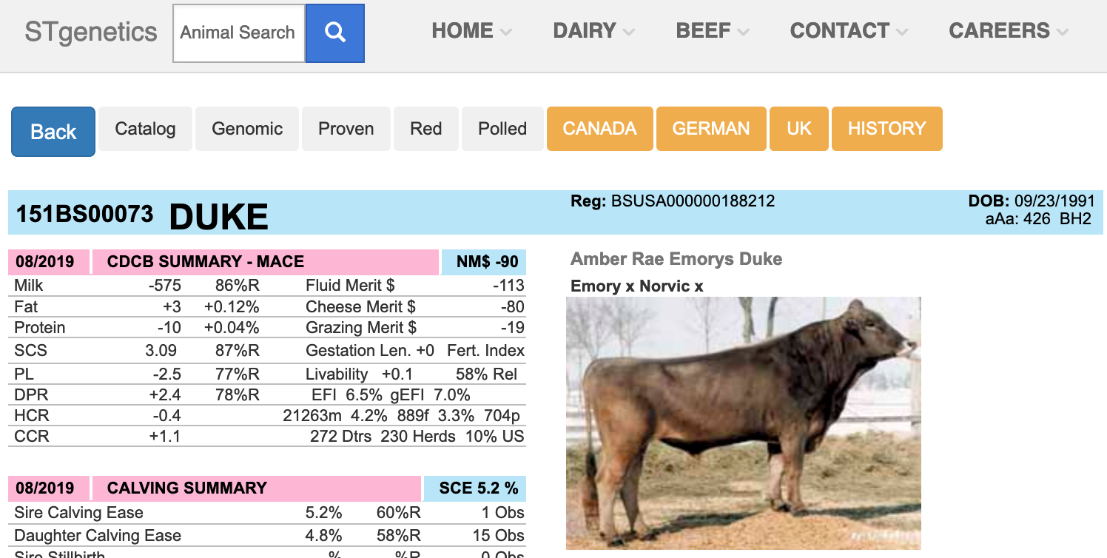
Bull carrier status should be published

Slide 25
Include marker information when selecting mates
Shepherd and Kinghorn (2001) described a look-ahead mate selection scheme using markers.
Li et al. (2006, 2008) showed QTL provide more benefit when used in mate selection rather than in index selection.
Van Eenennaam and Kinghorn (2014) proposed selection against the total number of lethal alleles and recessive lethal genotypes.
Cole (2015) suggested that parent averages can be adjusted to account for genetic load in sequential mate allocation schemes.

Slide 26
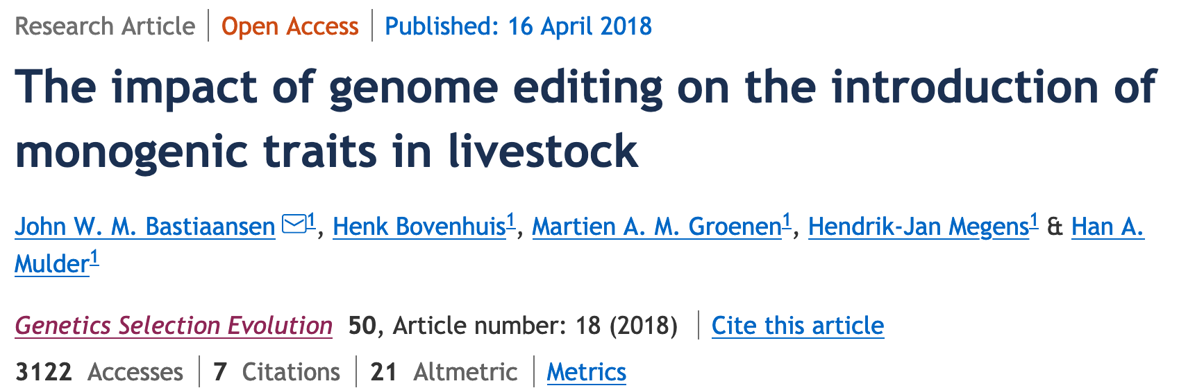
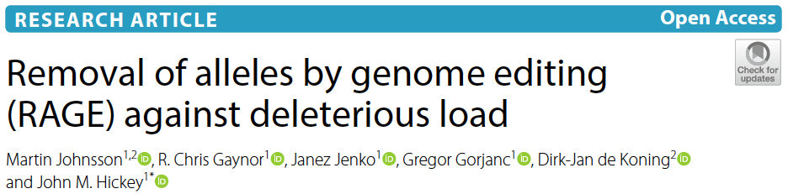
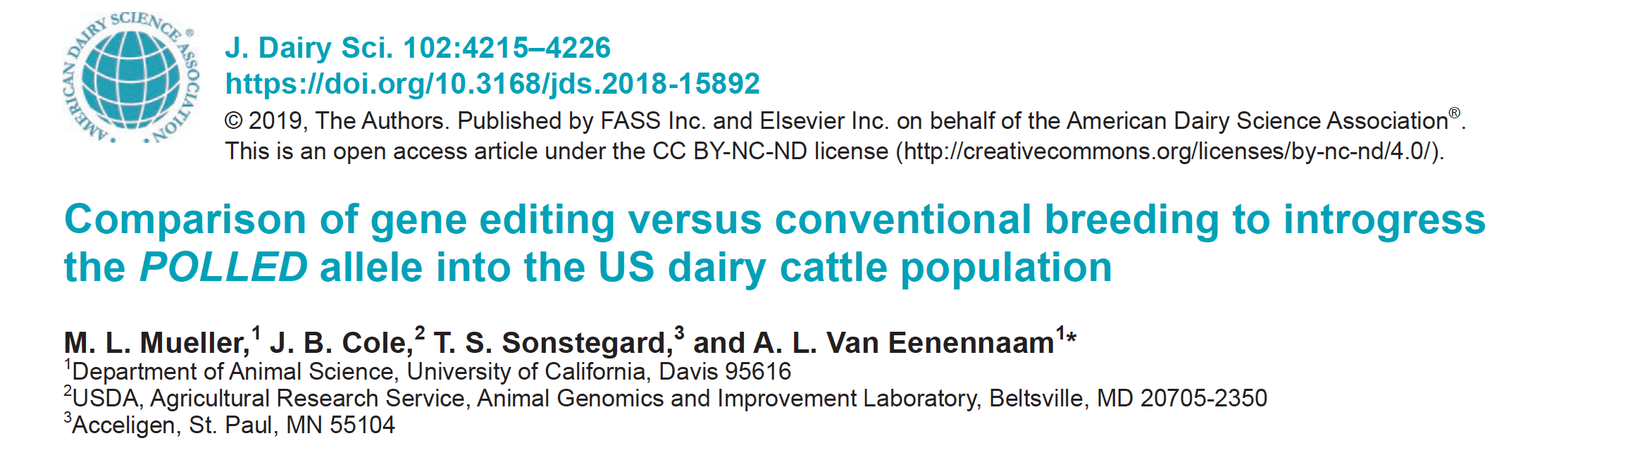
Can we edit our way around the problem?
Bastiaansen et al. (2018)
Johnsson et al. (2019)
Mueller et al. (2019)

Slide 27
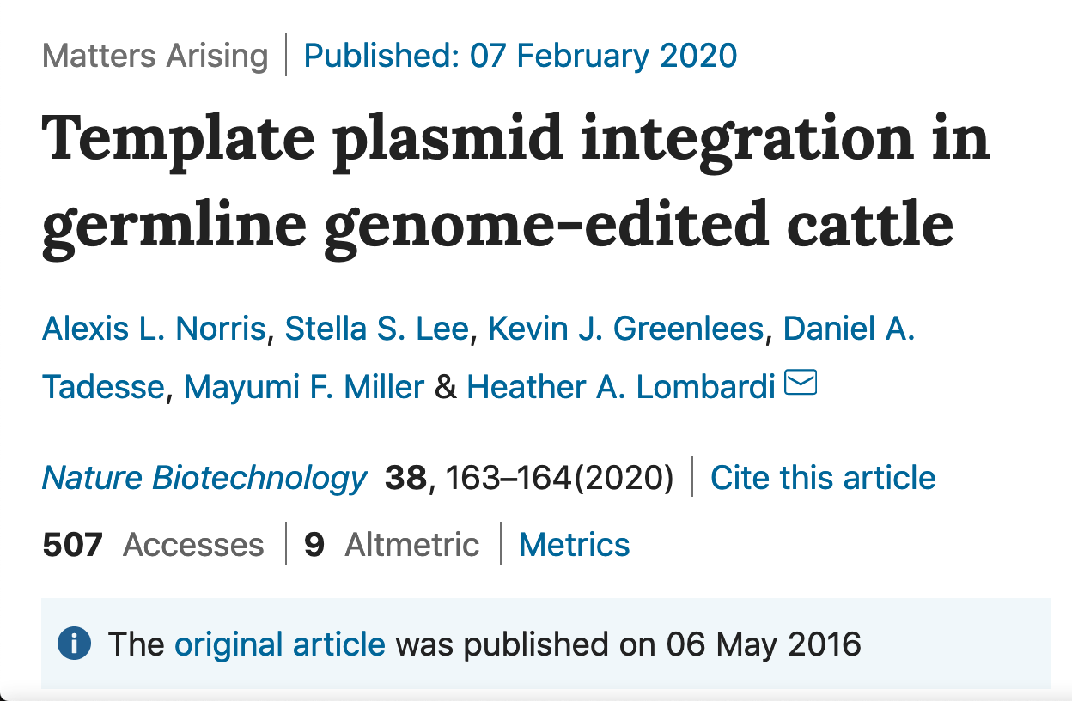
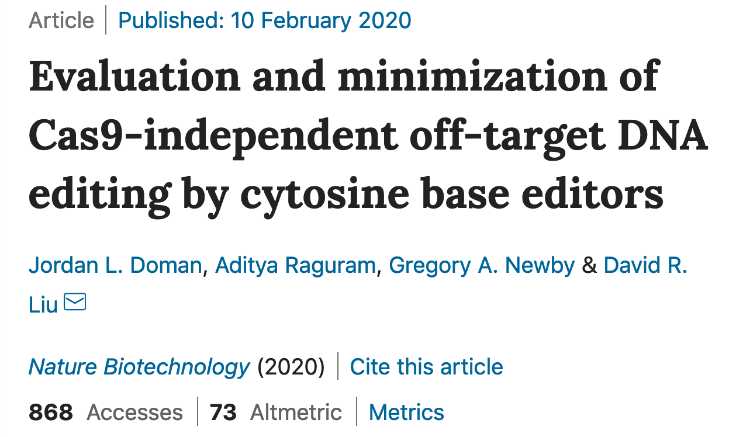
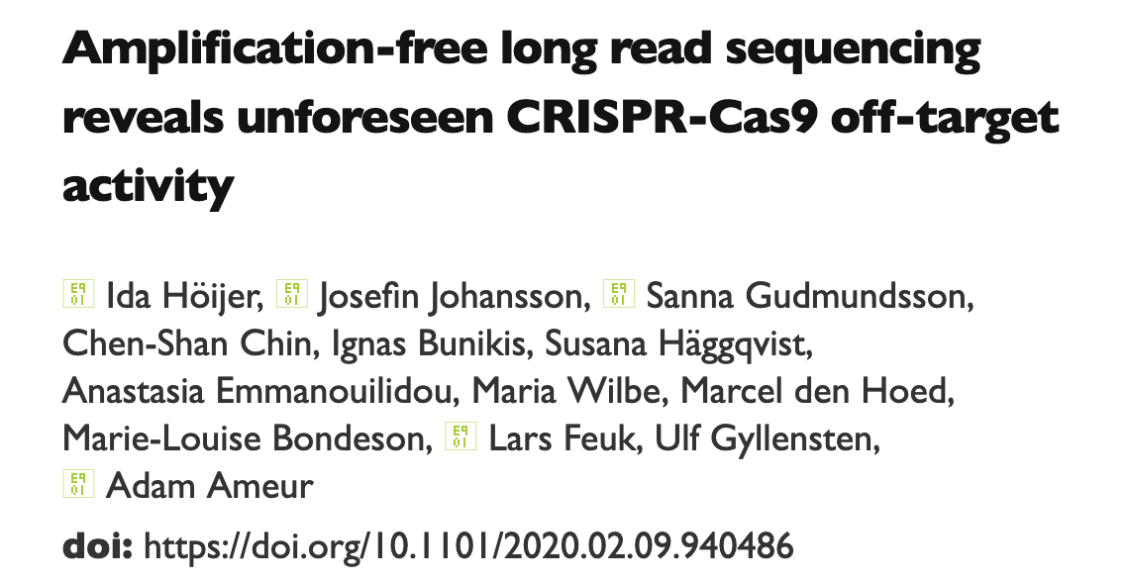
More edits, more problems?

Slide 28
Conclusions
Mendelian genetic disorders are responsible for economic losses to dairy farmers
As technology improves we are identifying more recessive defects
CRISPR-Cas9 knockouts can be use for functional validation of candidate mutations
Gene editing should be used to eliminate harmful alleles from the population
Carrier bulls should not be used when non-carrier bulls are of comparable genetic merit and bottlenecks may be avoided

Slide 29
Acknowledgments
Mr. Kenneth Shallop, and Dr. Steve Schroeder of AGIL assisted with DNA extraction, sequencing, and alignment of resulting reads.
The Council on Dairy Cattle Breeding (Bowie, MD) provided access to the National Dairy Database for testing fertility effects and identifying candidate HH2 regions.
Access to SNP genotypes and DNA for sequencing was provided by the Collaborative Dairy DNA Repository (Verona, WI).
Data from Run 7 of the the 1000 Bull Genomes Project were used for independent validation of HH2.

Slide 30
Support
Bickhart: ARS project 5090-31000-026-00-D
Bickhart and Cole: AFRI Grant 2016-67015-24886
Cole, Hutchison, and Null: ARS project 8042-31000-002-00-D
Cole and Ortega: NIH and USDA-NIFA Dual-Purpose R01 Grant 4097656
USDA is an equal opportunity provider and employer.
Mention of trade names or commercial products in this presentation is solely for the purpose of providing specific information and does not imply recommendation or endorsement by the US Department of Agriculture.

Slide 31
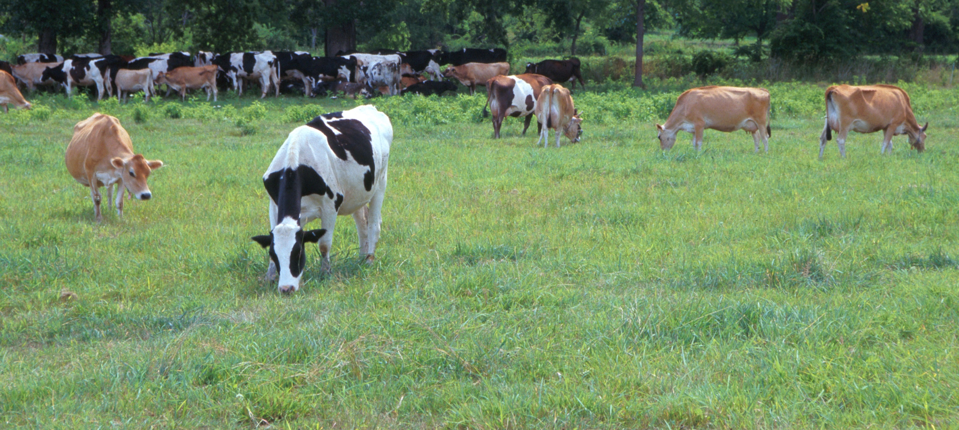
Questions?
AIP web site:
http://aipl.arsusda.gov/
Holstein and Jersey crossbreds graze on American Farm Land Trust’s
Cove Mountain Farm in south-central Pennsylvania
Source: ARS Image Gallery, image #K8587-14; photo by Bob Nichols

Slide 32
References
Bastiaansen et al., 2018; PMID: 29661133
Cole, 2015; PMID: 26620491
Cole and Null, 2019; PMID: 31255269
Cole et al., 2016; PMID: 27394947
Cole et al., 2018; https://bit.ly/2utjPbT
Derks et al., 2019; PMID: 30875370
Doman et al., 2020; https://doi.org/10.1038/s41587-020-0414-6
Fritz et al., 2018; PMID: 29680649
Höijer et al., 2020, bioRxiv
Jenko et al., 2019; PMID: 30836944
Johnsson et al., 2019; PMID: 30995904
Li et al., 2006; PMID: 16492372, 18803790

Slide 33
References (cont’d)
MacArthur et al., 2012; PMID: 22344438
Medugorac et al., 2011; PMID: 22737241
Mueller et al., 2019; PMID: 30852022
Narasimhan et al., 2016; PMID: 26940866
Norris et al., 2020; PMID: 32034391
Ortega et al., 2019; PMID: 31803983
Philipp et al., 2011; PMID: 22174915
Rossi et al., 2015; PMID: 26168398
Shepherd and Kinghorn, 2001; AAABG
Van Eenennaam and Kinghorn, 2014; WCGALP

Slide 34
References (cont’d)
VanRaden et al., 2011; PMID: 22118103
Youngworth and Delany, 2019; PMID: 31075853

