Slide 1
Current Research at AGIL,
February 2020
John B. Cole
USDA, Agricultural Research Service
Henry A. Wallace Beltsville Agricultural Research Center
Animal Genomics and Improvement Laboratory
Beltsville, MD 20705-2350
john.cole@usda.gov

Slide 2
Topics for discussion
60K to 80K SNP list
RFI
Heifer livability
Ancestor discovery
More health studies
Possible NM$ updates
HH2 mutation identified
Personnel changes at AGIL
Hiring of new geneticists
Hiring of Permanent Research Leader
Extramural funding

Slide 3
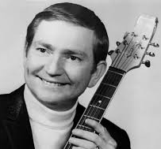
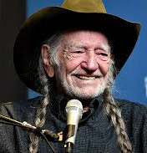
What’s the deal with the hair?

Slide 4
Moving from 60K SNP to 80K SNP
Gene tests added to recent chips
Causal alleles within lethal haplotypes
Remove previous SNP with high parent-progeny conflict rates, missing genotypes, Hardy-Weinberg within breeds, etc.
Gene tests for DGAT1, ABCG2, β-casein, and β-lactoglobulin had large effects on yield traits and net merit
Correlations of 80K with 60K predictions for young animals
  About 0.99 for Jersey, Holstein, and Guernsey yield traits
  Higher for Ayrshire and Brown Swiss yield traits
  Lower for many other traits (~0.98)

Slide 5
RFI evaluations: Reliabilities (Li et al., 2020, JDS)
Animal group from national data | RFI Reliability (%)
 | Pedigree | Genomic
3,965 cows with RFI phenotypes | 30 | 34
Top 10 sires with most RFI daughters | 78 | 85
Top 100 Net Merit progeny tested sires | 8 | 16
Top 100 Net Merit young bulls | 3 | 12
1.5 million genotyped Holsteins | 5 | 13
60 million non-genotyped Holsteins | 3 | 3

Slide 6
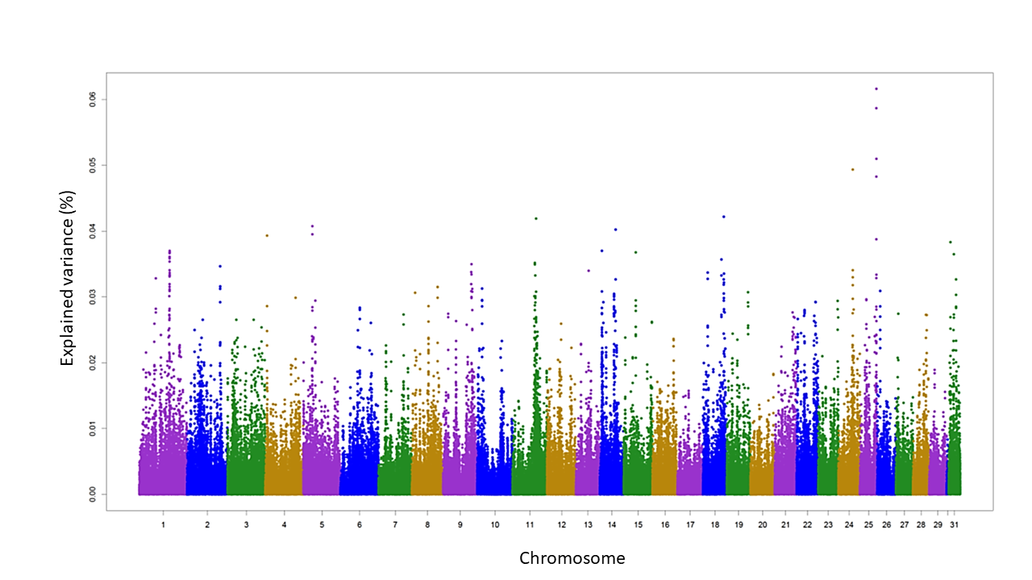
RFI evaluations: Largest effects for RFI from HD genotypes
SNP variance explained by 5-SNP windows
Top 350 RFI SNPs provided to labs to design better future chips

Slide 7
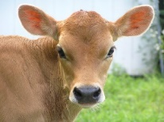
Heifer livability: Data
Extracted data from CDCB database (birth years 2001–16)
  4,428,896 dairy heifer data records
  Herds with death loss of 2–25%
  Heifers <2 days old not evaluated (used in stillbirth)
  Heifers up to 18 months old used
  Total number of deaths = 142,6202 (3.2%)
Livability scored as 100 (alive) or 0 (dead)
Heritability estimate of 0.4% by sire model REML

Slide 8
Heifer livability: Evaluation
Genomic PTAs (GPTAs) for proven bulls
  Holstein: ‒1.5% to +1.5% (SD of 0.5%)
  Jersey: ‒0.8% to +0.8% (SD of 0.2%)
RELs for young animals
  Holstein: 49% REL for GPTA
  19% REL for traditional PA
  Jersey: 31% REL for GPTA
  13% REL for traditional PA

Slide 9
Heifer livability: Correlation with other traits
Correlations for HLIV GPTA of recent proven bulls
  0.47 with PL and 0.20 with cow livability
  0.36 with calving trait dollars (calving ease, stillbirth)
  0.32 with early first calving (EFC)
  0.30 to 0.32 with yield traits
Correlation of HLIV GPTA with NM$ is very high (0.55)
Genetic trend for HLIV already favorable in recent years because of selection for correlated traits and NM$
Notes:
The Jersey correlations and trends are not as high, perhaps due to fewer genotypic records (311,576 records for Jersey population as compared to 2,505,753 for Holsteins).

Slide 10
Ancestor discovery (Nani et al., 2020, JDS)
In June 2019, more than 11% of genotyped animals in the CDCB database had no dam pedigree information
An automated procedure to discover and fill missing maternal ID numbers based on discovered MGS and MGGS was developed
Pedigree EBV for milk, fat, and protein yields increased by 116 kg for milk, 4.5 kg for fat, and 3.6 kg for protein
Reliabilities for pedigree EBV increased by 6 percentage points for milk yield, 7 percentage points for fat yield, and 6 percentage points for protein yield

Slide 11
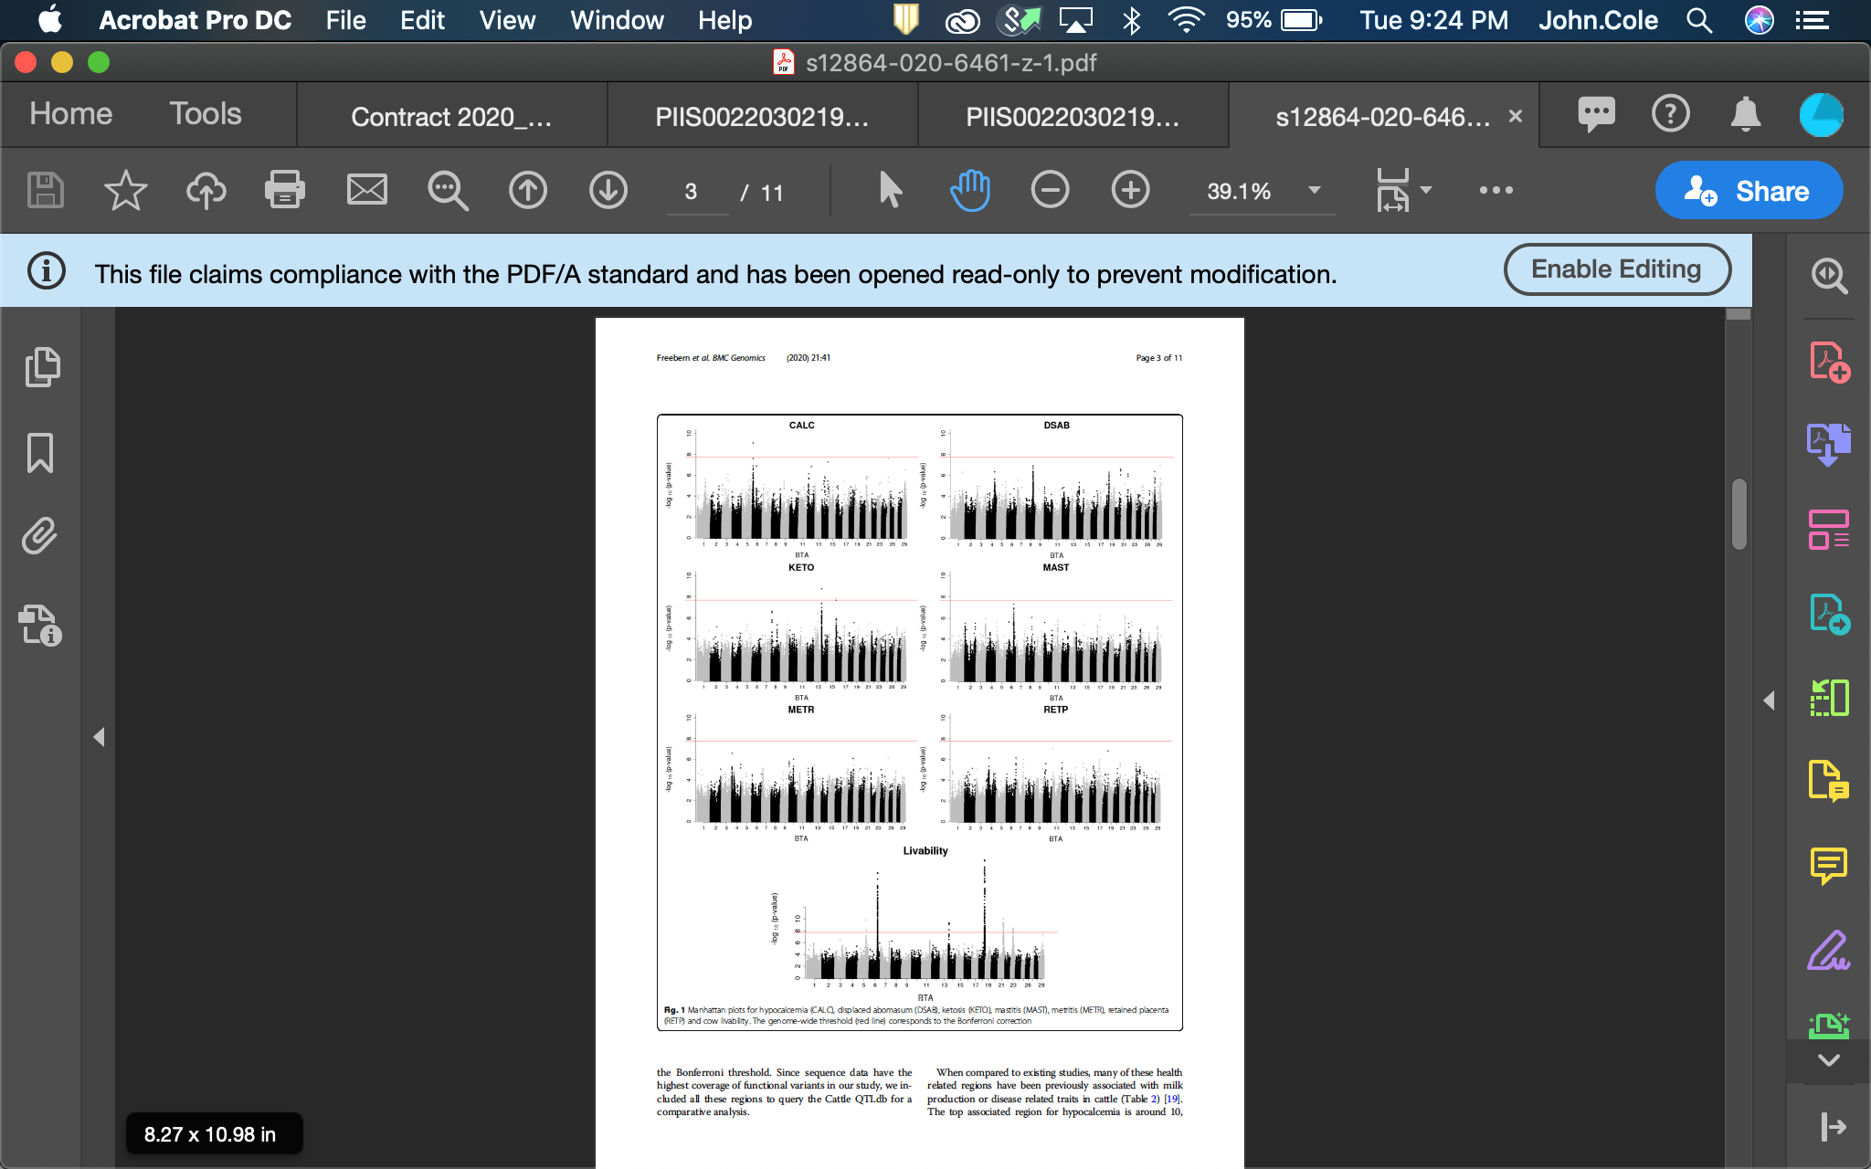
GWAS for health (Freebern et al., 2020, BMC Genomics)

Slide 12
August 2020 NM$ revision options
RFI could get 16% of total emphasis but V(PTA) and REL are low
BWC should double negative emphasis from ‒5% to ‒10% because maintenance cost used since 2000 was too low
EFC could get 3% of emphasis with reduced emphasis on HCR
HLIV could get 1% of emphasis depending on calf value
PL should get less value because faster progress makes younger cows more profitable than older (Schmitt et al., 2019, JDS)

Slide 13
HH2: Known recessives in US Holsteins (Feb. 2020)
Haplo- type | Functional/Gene name | BTA chromosome | Location (Mbp) | Haplotype frequency (%) | Timing¹
HBR | Black/red coat color/MC1R(MSHR) | 18 | 14.8 | 0.75 | —
HCD | Cholesterol deficiency/APOB | 11 | 78.0 | 2.28 | W
HDR | Dominant red color/MC1R(MSHR) | 3 | 9.5 | 0.03 | —
HH0 | Brachyspina/FANCI | 21 | 21.2 | 1.65 | E,B
HH1 | APAF1 | 5 | 63.2 | 1.28 | E
HH2 | — | 1 | 94.9 – 96.6 | 1.21 | E
HH3 | SMC2 | 8 | 95.4 | 2.64 | E
HH4 | GART | 1 | 1.3 | 0.23 | E
HH5 | TFB1M | 9 | 93.2 – 93.4 | 2.39 | E
HH6 | SDE2 | 16 | 29.0–29.1 | 0.44 | W
HHB | BLAD/ITGB2 | 1 | 145.1 | 0.21 | W
HHC | CVM/SLC35A3 | 3 | 43.4 | 1.10 | E,B
HHD | DUMPS/UMPS | 1 | 69.8 | 0.01 | E
HHM | Mule foot/LRP4 | 15 | 77.7 | 0.05 | B
HHP | Polledness (dominant)/POLLED | 1 | 1.7 – 2.0 | 0.88 | —
HHR | Red coat color/MC1R(MSHR) | 18 | 14.8 | 3.29 | —
¹Timing of embryonic loss/calf death for homozygous animals: B = calf death at/shortly after birth,
E = embryonic loss/abortion, W = calf death weeks/months after birth (Cole et al., 2018; https://bit.ly/2utjPbT).

Slide 14
HH2: Identification of candidate variant
HH2 identified from a deficiency-of-homozygotes approach and undesirable effects on conception rate and stillbirths confirmed
5 carriers were present in a group of 183 sequenced Holstein bulls selected to maximize the coverage of unique haplotypes
3 variants concordant with the haplotype calls were found in the HH2 region
A high-impact frameshift in intraflagellar protein 80 (IFT80) was confirmed in Holsteins from the 1000 Bull Genomes Project that shared no animals with the discovery set

Slide 15
HH2: Validation of candidate variant
IFT80-null embryos generated by truncation at exon 2 with guide-RNAs annealed to Cas9 mRNA
Abattoir-derived oocytes fertilized in vitro with high-fertility semen
Embryos injected at the one-cell stage with CRISPR-Cas9 complex (treatment) or Cas9 mRNA (control) before return to culture
IFT80-null embryos arrested at the 8-cell stage of development, consistent with data from mouse hypomorphs and HH2 carrier-to-carrier matings

Slide 16
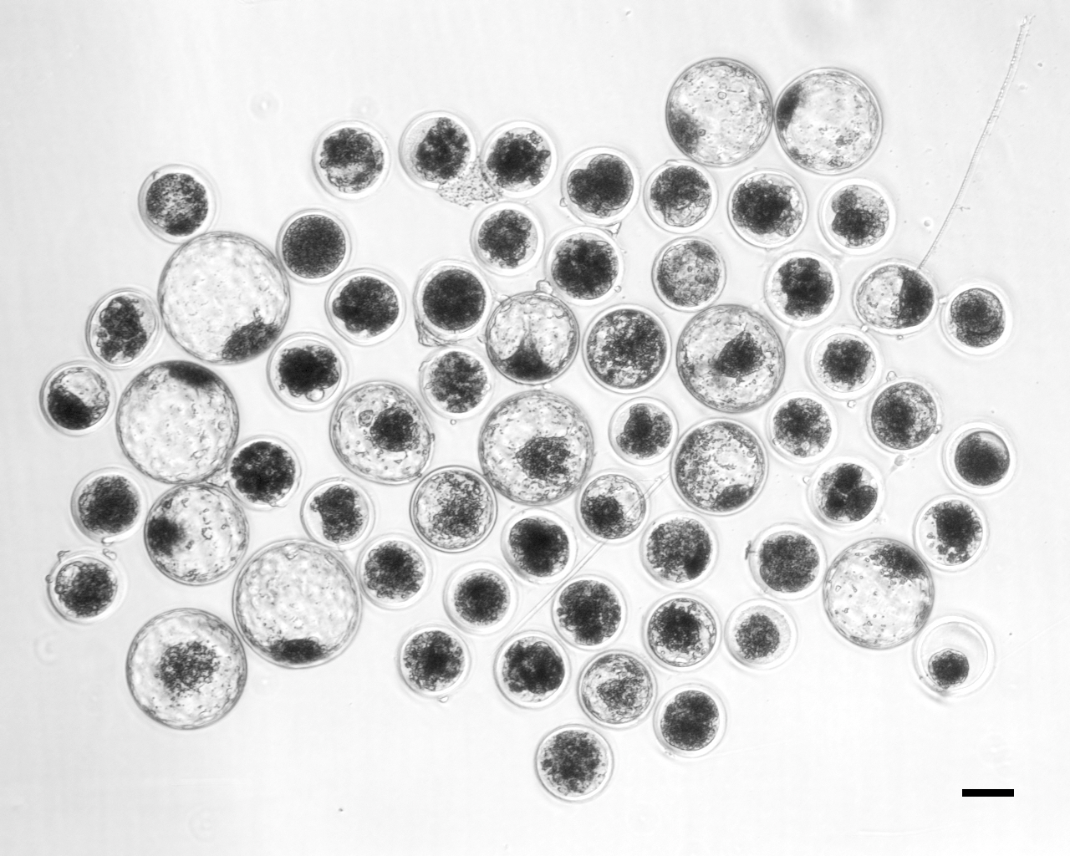
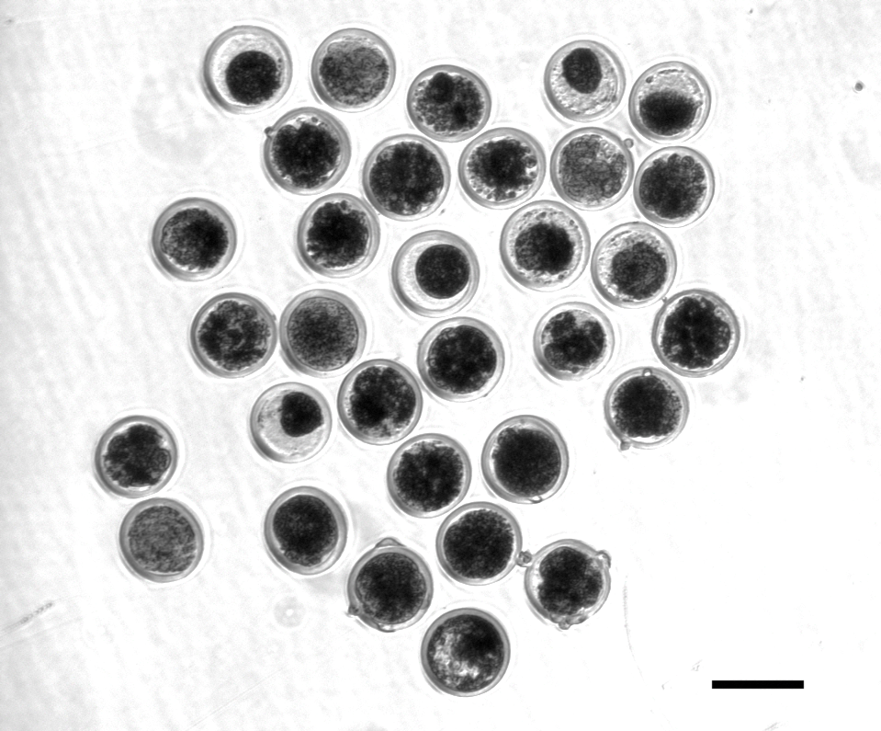
HH2: Candidate confirmed with functional validation
A frameshift in IFT80 at 107,172,615 bp (p.Leu381fs) disrupts wnt and hedgehog signaling, and is responsible for the death of homozygous embryos
A tag SNP will be used to track the causal mutation
Proven sires could be genotyped to confirm concordance
Control embryos injected with only Cas-9 (left)
Treatment embryos injected with Cas-9 and IFT80 exon 2 guide RNA (right)

Slide 17

AGIL Staffing: New Animal Scientist
Dr. Sajjad Toghiani
Will work with Paul VanRaden
PhD in Animal Breeding and Genetics from University of Georgia

Slide 18

AGIL Staffing: New Postdoctoral Scientist
Dr. Ahmed Al-Khudhair
Working with Paul VanRaden
PhD in Genetics and Bioinformatics from University of Toledo

Slide 19
AGIL Staffing: New Postdoctoral Scientist
Dr. Shuli Liu
Working with John Cole
PhD in Animal Genetics and Breeding, China Agricultural University
Current project focuses on immune gene diversity in US Holsteins

Slide 20
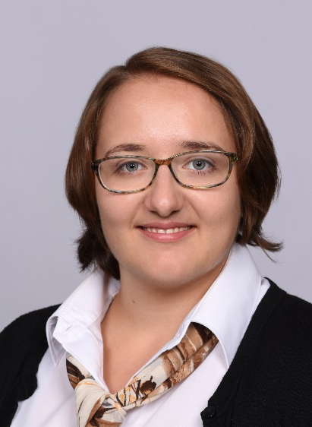
AGIL Staffing: New Visiting Scientist
Ms. Irene Häfliger
Working with John Cole
PhD candidate, Institute of Genetics, Vetsuisse Faculty, University of Bern
Will work on identification of genetic defects and other topics of mutual interest

Slide 21

AGIL Staffing: Permanent Research Leader
Fall search was canceled due to funding concerns
Position description is being revised to cover a broader range of expertise
New RL will be hired into Erin Connor’s position rather than George Wiggans’s

Slide 22
AGIL Staffing: Research Geneticists
Refining position description with Office of National Programs
Hope to advertise this spring
Are the applicants there?

Slide 23
Current extramural (grant) funding
NIFA, “Genetic Mechanism of Reproductive Heterosis in Dairy Cattle” (Y. Da et al.)
NIFA, “Big-data Genomic Investigation to Improve Dairy Cattle Health” (L. Ma et al.)
Minnesota Agricultural Experiment Station, “Reducing Mastitis in the Dairy Cow by Increasing the Prevalence of Beneficial Polymorphisms in Genes Associated with Mastitis Resistance” (Crooker et al.)

Slide 24
Current extramural (grant) funding (cont’d)
NIFA, “Enhanced Prediction of Dairy Cattle Performance Combined with a Tool to Improve Replacement and Breeding Decisions” (De Vries et al.)
NIFA, “Enabling Tools for Microbiome-Based Trait Selection in Dairy Cows” (Suen et al.)
NIH and NIFA R01, “Physiological and Genetic Insights into Pregnancy Loss” (Spencer et al.)

Slide 25


Conclusion – You get what you pay for!

Slide 26
Disclaimer
The author was supported by USDA-ARS project 8042-31000-002-00-D, “Improving Dairy Animals by Increasing Accuracy of Genomic Prediction, Evaluating New Traits, and Redefining Selection Goals”.
USDA is an equal opportunity provider and employer.
Mention of trade names or commercial products in this presentation is solely for the purpose of providing specific information and does not imply recommendation or endorsement by the US Department of Agriculture.

Slide 27
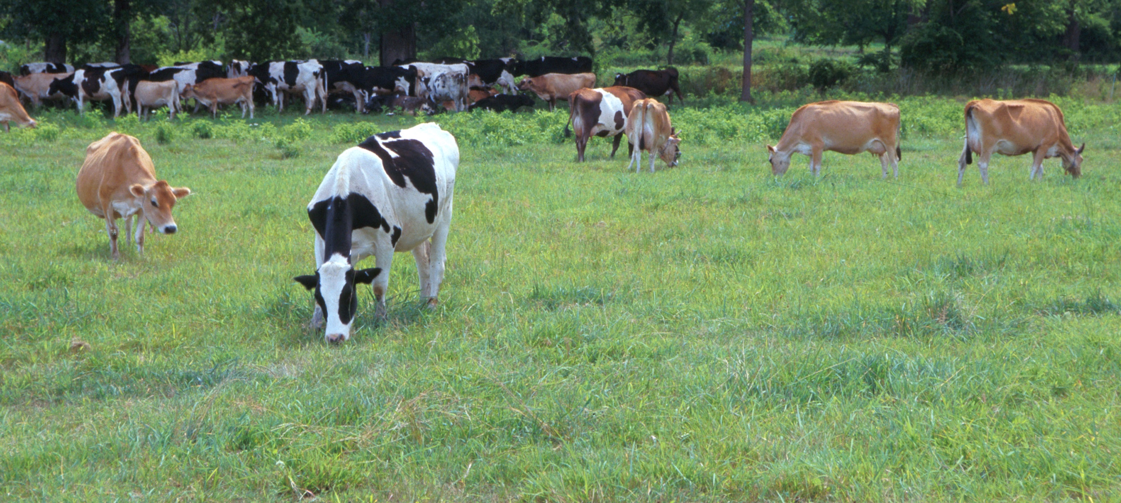
Questions?
AIP web site:
http://aipl.arsusda.gov/
Holstein and Jersey crossbreds graze on American Farm Land Trust’s
Cove Mountain Farm in south-central Pennsylvania
Source: ARS Image Gallery, image #K8587-14; photo by Bob Nichols

