Slide 1
2021 revision of the net merit index
Paul VanRaden,*¹ John Cole,¹ Mahesh Neupane,¹ Sajjad Toghiani,¹ Kristen Gaddis,² and Rob Tempelman³
¹USDA, Agricultural Research Service, Animal Genomics and Improvement Laboratory, Beltsville, MD, USA
²Council on Dairy Cattle Breeding, Bowie, MD, USA
³Michigan State University, East Lansing, MI, USA
paul.vanraden@usda.gov
Topics:
Net merit revision in August 2021
Economic values, added traits, and progress
Relative values, relative emphasis, SD, and reliability

Slide 2
Relative values in 2018 net merit (NM$)
UC Udder composite
BWC Body weight composite
FLC Feet-legs composite
DPR Daughter pregnancy rate
CCR Cow conception rate
HCR Heifer conception rate
CA$ Calving ability (calving ease & stillbirth rate)
PL Productive life
LIV Livability
SCS Somatic cell score
MAST Mastitis
METR Metritis
DA Displaced abomasum
RETP Retained placenta
KETO Ketosis
MFEV Milk fever

Slide 3
NM$ revisions
August 2021
Include heifer livability (HLIV) and early first calving (EFC)
Include feed saved (FS) and report residual feed intake (RFI) of cows
Revise maintenance cost of body weight composite (BWC)
Revise opportunity and maturity costs in productive life (PL)
Adjust price forecasts and other economic assumptions
Calving trait (CT) scale affected NM$ emphasis since August 2020
Genetic base (means and SD) from April 2020 now affect NM$

Slide 4
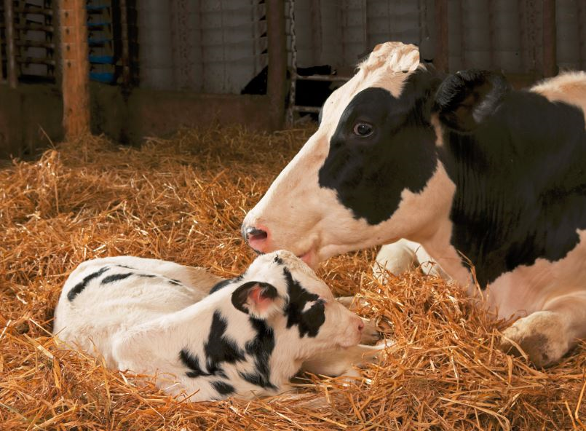
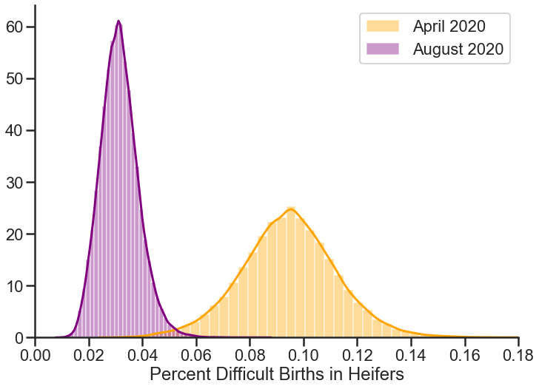
Reduced genetic SD for calving traits (2020)
PTA included phenotypic means for Holstein calvings of 8%
Incidence now only 2–4% from genetic progress and changes in management
PTA SD and means were reduced 33–64% when converting from underlying to observed scale
Emphasis in NM$ now reduced proportionally (about half)

Slide 5
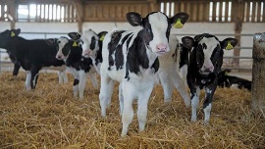
Economic values for EFC and HLIV
EFC has value of $2.05 per day (SD of 2.8 days)
Relative emphasis on EFC is about 1% of NM$
Emphasis on HCR declined from 1% to 0.5% because HCR previously took some credit for EFC
HLIV has value of <$5.00 per 1% (SD of 0.8%)
Relative emphasis on HLIV is 0.5% of NM$
Contributions to NM$ will be small (less than $5)
Evaluation developed by postdoc Mahesh Neupane (2021 JDS)

Slide 6
Relative value and relative emphasis
Both report percentage of selection from economic value and SD
Relative value uses genetic SD, ignoring reliability
Relative emphasis uses PTA SD, less emphasis if less REL
Compared by Zhang and Amer (2021 J. Dairy Sci.)
Does not affect animal ranking or genetic progress
Relative value reflects potential for selection
Relative emphasis also reflects amount of data

Slide 7
Reliability of NM$
REL of an index is a weighted average of the traits included
REL appears less when new traits with lower REL are added
Actual REL of NM$ increases compared to previous index with REL = 0% for the new traits
See example Holstein bulls
Example: | Proven | Young
Daughters with milk | 25,329 | 0
Daughters with feed | 2 | 0
REL of milk | 99% | 78%
REL of feed saved | 60% | 38%
REL of RFI | 40% | 17%
NM$ previous REL | 99% | 76%
NM$ with RFI, 0% REL | 92% | 70%
NM$ with feed intake | 95% | 71%

Slide 8
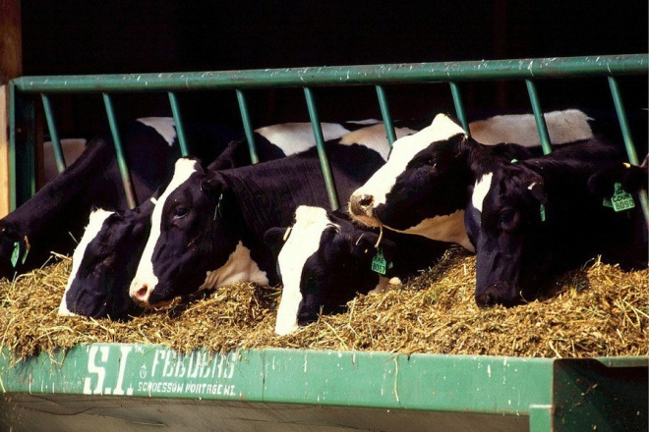
Economic value for feed intake
Economic values for yield traits and BWC already accounted for correlated feed intake
RFI measures intake uncorrelated with yield and body weight and gets -12% of relative value in NM$ but -4% of relative emphasis due to low REL
Feed saved combines reduced feed intake estimated from RFI and from BWC of smaller cows
The 5-year FFAR-CDCB project has added ∼1,800 US lactations to the previous 4,800-lactation USDA-funded study
Use of RFI in NM$ requires continuing data collection; 650 records from Canada added in April 2021; 2,200 records from Europe could be added

Slide 9
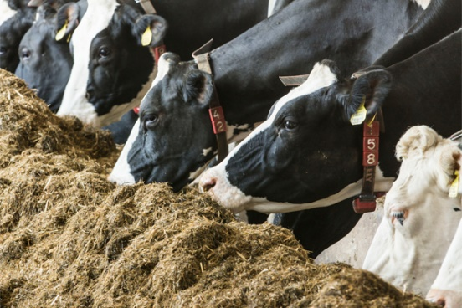
Mixed models to predict dry matter intake (DMI)
DMI records used from 6,338 lactations of 5,094 U.S. Holstein cows
Implementing mixed models through SAS PROC MIXED
Common fixed effects
Overall mean
Days in milk
Age-Parity
Body weight change
Common random effects
Herd-year
Experimental trial
Residual effect
Phenotypic model
Phenotypic regression (Kg)
Milk yield
Fat yield
Protein yield
Metabolic body weight
Genomic model
Genomic regression (GEBV)
Milk yield
Fat yield
Protein yield
BWC
Sire’s genomic model (x2)
Sire’s genomic regression (GEBV)
Milk yield
Fat yield
Protein yield
BWC
Extended genomic model
Genomic regression (GEBV)
Milk yield
Fat yield
Protein yield
Stature
Strength
Body depth
Dairy form
Rump width

Slide 10
Maintenance feed required per year per pound of body weight
Estimate | Maintenance (pounds DMI/pound BW) | Standard error
NM$ 2018 value | 1.7 | …
NRC 2001 value | 2.7 | …
NRC 2021 value | 3.4 | …
Phenotypic regression | 5.8 | ±0.18
Genomic regression | 6.3 | ±0.42
Sire genomic regression | 5.9 | ±0.72
NM$ 2021 value | 4.5 | …
Maintenance estimates from research herds much higher than NRC values
When regressing DMI on phenotypic, genomic, and sire’s genomic body size predictors
Direct emphasis assigned against BWC in NM$ 2021 (- 9.4%) vs. NM$ 2018 (-5.3%)

Slide 11
Feed intake for yield components
Method | Marginal feed cost ($)/ 100 pounds standardized milk | DMI (pounds) required per unit of component output
 |  | Milk | S.E. | Fat | S.E. | Protein | S.E.
Phenotypic regression | 2.93 | 0.007 | ±0.008 | 2.82 | ±0.13 | 5.32 | ±0.31
Genomic regression | 7.60 | 0.076 | ±0.03 | 10.82 | ±0.60 | 7.88 | ±1.34
Sire Genomic regression × 2 | 5.15 | 0.043 | ±0.05 | 6.43 | ±1.14 | 6.66 | ±2.35
NM$ 2018 | 7.68 | 0.225 | -- | 5.42 | -- | 7.50 | --
NM$ 2021 | 5.22 | 0.120 | -- | 5.00 | -- | 6.00 | --
Theoretical (Dado et al. 1994) | 5.63 | 0.112 | -- | 4.42 | -- | 8.17 | --
ECM (National Research Council, 2001) | 4.14 | 0.122 | -- | 4.82 | -- | 2.85 | --
Each method gave differing feed cost for milk components, especially for fat yield.
Phenotypic regression indicates much more feed required to produce protein than fat.
Genomic and sire regressions indicate that fat required the same or more feed than protein.
Marginal feed costs for milk fluid and protein are less in NM$ 2021 than previously assumed in NM$ 2018.

Slide 12
Predicting feed intake from the type traits in BWC
Strength was the most significant predictor of DMI, agreeing with the current BWC formula.
Body depth was removed from the set of 5 type traits due to high multi-collinearity.
Including the 4 type traits gave a slightly better fit than simply using current BWC.
Dairy form was not significant after removing yield traits.
DMI (kg/day) required per unit of each type trait
Type traits | Multicollinearity Diagnostic
 | Before | After
 | Estimates (S.E.)
Stature | 0.04 (±0.07) | 0.04 (±0.07)
Strength | 0.75 (±0.24) | 0.60 (±0.07)
Body depth | -0.17 (±0.26) | --
Dairy form | 0.02 (±0.12) | -0.05 (±0.05)
Rump width | 0.03 (±0.06) | 0.04 (±0.06)

Slide 13
Predicting body weight from the type trait PTAs in BWC
The 5 type traits in BWC were significant predictors of body weight, similar to current BWC.
Body depth was removed from the model after detecting high multicollinearity. Strength and dairy form (negative) were then the most important traits associated with BW, as in official BWC.
Estimated regression of BW on genomic BWC was 35 pounds compared to 40 pounds previously estimated by HAUSA by phenotypic regression.
BW (kg) change per unit of each type trait
Type traits | Multicollinearity Diagnostic
 | Before | After
 | Estimates (S.E.)
Stature | 7.96 (±1.12) | 7.82 (±1.12)
Strength | 46.91 (±3.79) | 29.30 (±1.19)
Body depth | -20.52 (±4.19) | --
Dairy form | -4.16 (±1.86) | -12.34 (±0.82)
Rump width | 2.05 (± 1.01) | 3.40 (±0.98)

Slide 14
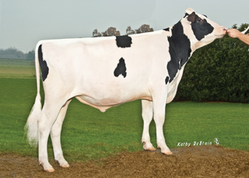
Feed saved and feed intake formulas
Combining BWC and RFI into FSAV
PTA_{FSAV} –151.8 * PTA_{BWC} – 1 * PTA_{RFI} pounds / lactation
REL_{FSAV} 0.367 * REL_{BWC} + 0.633 * REL_{RFI}
PTA_{RFI} and REL_{RFI} now also provided in formats along with Feed Saved
PTA for dry matter intake can also be obtained as
PTA_{DMI} 0.12 * PTA_{milk} + 6 * PTA_{fat} + 7 * PTA_{protein} – FSAV

Slide 15
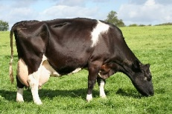
Economic value of Productive Life
NM$ previously assumed equal profit for each additional lactation but should account for differing profit in younger vs.
older cows
Faster genetic gain makes young replacements cows more valuable; higher mature yields make older cows more profitable
Current PL relative value of 12% – 6% for genetic progress + 9% for maturity
Economic research by Michael Schmitt and Albert De Vries (University of Florida)
Ranking sires using genetic selection indices based on financial investment methods versus lifetime net merit. J. Dairy Sci. 102:9060–9075. 2019. https://doi.org/10.3168/jds.2018-16081

Slide 16
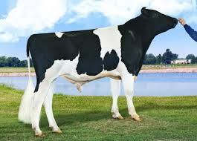
Extra progress from each proposed revision
Index revisions | Old value | New value | Progress (% of NM$ gain) | Value/year (million $)
Add RFI | … | ‒12% | 0.85 | 4.25
Add EFC | … | 1% | 0.04 | 0.20
Add HLIV | … | <1% | 0.01 | 0.05
Revise SD of CT | 5% | 2.5% | 0.10 | 0.50
Revise maintenance costs (BWC) | ‒5% | ‒9% | 0.62 | 3.10
Revise lactation profits (PL) | 12% | 15% | 0.28 | 1.35
Total for all revisions | … | … | 2.18 | 9.45
Advantages are nearly double if selecting proven bulls with higher REL for the new traits.

Slide 17
Extra progress from adding more traits to NM$
Year | Traits (no.) | Traits included | Correlation with previous index | Extra progress
1977 | 3 | Milk, fat, protein | … | …
1994 | 5 | PL, SCS | 0.84 | 19%
2000 | 18 | Linear type | 0.94 | 6%
2003 | 21 | DPR, calving ease | 0.98 | 2%
2006 | 23 | Stillbirth | 0.975 | 3%
2014 | 25 | HCR, CCR | 0.965 | 4%
2017 | 26 | LIV | 0.989 | 1%
2018 | 32 | Health traits | 0.994 | 0.6%
2021 | 35 | RFI, EFC, HLIV, revisions | 0.981 | 2.2%

Slide 18
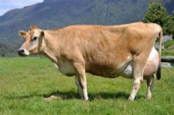
Type composites for non-HO breeds
New genetic SD from April 2020 base change were not included in NM2021 document (yet)
Composites could be updated to better match new definitions and new traits from JE, BS, GU, and MS breeds
Breed association estimates of SD often differ from those used in NM$, causing differences in relative values or emphasis

Slide 19
Conclusions
Net merit revision in August 2021
Includes Feed Saved, Early First Calving, and Heifer Livability
Puts more emphasis on smaller BWC and longer PL
Revises other economic values using recent and next year prices
Increased SD of NM$ mainly from reduced marginal feed cost for yield
Reported REL of NM$ is lower because new traits have lower REL
Progress is faster if all traits are in selection goal with correct weight

Slide 20
Acknowledgments & disclaimers
USDA-ARS project 8042-31000-002-00-D, “Improving Dairy Animals by Increasing Accuracy of Genomic Prediction, Evaluating New Traits, and Redefining Selection Goals” (AGIL funding)
CDCB and its industry suppliers for data
Agriculture and Food Research Initiative competitive grant #2011-68004-30340 from USDA National Institute of Food and Agriculture (feed intake funding)
USDA is an equal opportunity provider and employer
Mention of trade names or commercial products in this presentation is solely for the purpose of providing specific information and does not imply recommendation or endorsement by USDA

