Slide 1
Using the whole read: Structural Variation detection with RPSR
Presented by Derek Bickhart

Slide 2
Presentation Outline
Variant classification and detection
Theory on read structure and bias
Simulations and real data

Slide 3
Nuc
Genetic Variation
How genomes change over time
Single nucleotide variations – SNP (human millions of variants)
Indels – Insertions/Deletions (1 bp – 1000 bp)
Mobile Elements – SINE, LINE Transposition (300bp - 6 kb)
Genomic structural variation (1 kb – 5 Mb)
Large-scale Insertions/Deletions (Copy Number Variation: CNV)
Segmental Duplications (> 1kb, > 90% sequence similarity)
Chromosomal Inversions, Translocations, Fusions.
Chr
Notes:
Variation of genetic sequence between two individuals can encompass smaller sequence-based events or larger scale, cytogenetic events.
Starting on the small scale, SNPs comprise a significant variation of sequence between individuals. On the human side, dbSNP has over 60 million recorded SNPs.
Insertions and deletions that range in size from 1bp to 50bp are a larger form of variation, though these are less frequent than SNPs
SINE, LINE transpositions and duplications are larger events still, ranging in size from 300 bp to 6 kb
The largest genetic variants are called Structural variants due to their massive size. The intra-chromosome insertions and deletions that range in size from 1kb to 5 Mb are termed copy number variations. Duplications of sequential sequence are termed segmental duplications (SDs). Data from the 1000 genomes project pilot study suggests that CNVs and SDs are predicted to generate the largest size of variable DNA among individuals, even more so than SNPs. Currently, 60,000 CNVs have been identified in humans, with more unique and infrequent events to be discovered in the near future.
CNVs = younger, still segregating
SDs = ancient, fixed events
George’s
As a biologist, we really think about genome differences or variations in term of understanding the relationship between the genotype and phenotype. For last several decades, our perspectives at the global level have being one of the cytogenetics. Looking at the big things moving along the genome. Such as the most common type of Robertsonian translocation in cattle is the t(1;29), which is a fusion of chr1 with 29. With the human, cow or other genome available, we have an opportunity now to look at the other direction: from the sequence up.
One of the important things to remember is that not all differences are single nucleotide variations or SNP. There are a lot of other types of mutation that occurred in the genome over the evolutionary time. Here are some of them which is larger than SNP in size: small insertion/deletion events, movement of mobile repetitive elements and many large-scale events.
We term those large-scale events as genomic structural variations (ranging from 1 kb to 5Mb). By structural, we do not mean the 2-d or 3d structure, but instead a 1-D segment of DNA sequences. They include larger-scale insertion/deletion (CNV), segmental duplication of sequences, inversion and translocation and so on. We defined: The copy number of a piece of DNA segment is the number of times this piece occurs in the genome.
Human studies have discovered ~66,000 CNV and majority of them are innocent. They are associated with 17% of phenotypic changes in gene expression and a subset of them contributed to individual health and disease. We are the first to report the existence, frequency and impact of such CNV in cattle (1%).
SegDup: Segmental duplications exist in many species and are defined as stretches of DNA sequence >=1-5 kb in length with >= 90% sequence conservation that are present in more than one location in a genome. These sequences make up 5.5%, 2.9%, 1.2% and 0.6% of the human, rat, mouse and dog genomes, respectively. The extent of segmental duplication in the bovine genome is 3%.
*Human studies: 66,741 CNVs, 18% phenotype, health & disease-related

Slide 4
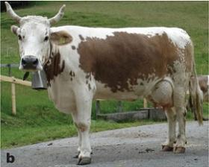
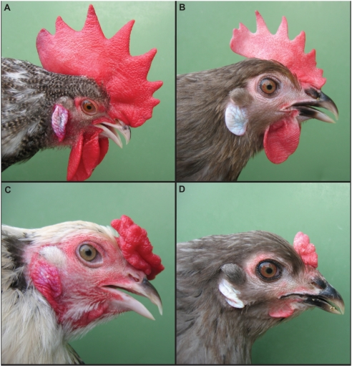
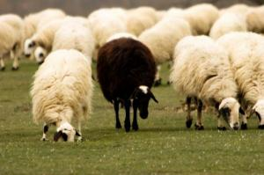
SVs contribute to phenotype
Nuc
KIT
KIT
Picture from Seo et al. 2007. BMC Genetics
SOX5
ASIP
Chr
Picture from Wright et al. 2009. PLoS Genet.
Notes:
While the majority of discovered CNVs appear to be silent events, some CNVs have been implicated in several human diseases including autism, crohn’s disease and schizophrenia.
Traits caused by CNVs are not unique to humans and such events can be identified in agriculturally important species.
For example, the peacomb phenotype in chickens, a trait that prevents heat-loss in colder climates, is caused by a CNV within the first intron of the SOX5 gene.
A duplication of the KIT gene causes a white coat color in domestic pigs and a similar duplication of the ASIP gene causes white coat color in sheep as well; the latter is an economically important trait.

Slide 5
Tracking variants with LD
Nuc
In Linkage
Disequilibrium
Form a
Haplotype
A causative variant?
Chr

Slide 6
Underestimating the number of genetic variants
Mostly impute these
Still some issues:
Relatively new mutations
Ref. assembly errors
Difficult to sequence locations
Can we get biological function from imputation?
Disease variants
Or
New high productive QTV

Slide 7
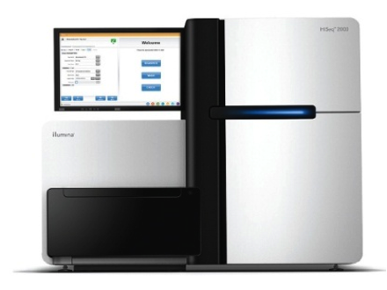
Sequencing to find novel variants
Raw Data
REF:
ACGTAAAGGTACGACGATCGACG
REF:
ACGTAAAGGTACGACGATCGACG
ACGTAAAGGGACG
ACGTAAAGGGACG
GTAAAGGTACGAC
GTAAAGGTACGAC
GTAAAGGTACGAC
GTAAAGGTACGAC
GGGACGACGATCGA
GGGACGACGATCGA

Slide 8
Making use of new variants
What do you do after variant calling?
Check for functional impact
Check for frequency
Variants can be placed on chips
Deletions can be tracked
WildType:
ACGACTAGACGATGGACGA
ACGACTAG
Deletion:
ACGACTA TGGACGA
ACGACTA
TGGACGA
ACGACTAT

Slide 9
Presentation Outline
Variant classification and detection
Theory on read structure and bias
Simulations and real data

Slide 10
Structural variant detection still proves to be a challenge
No Perfect Calls
Most datasets have high FDR
A majority of variants are missed
Good Performance
Pretty conservative
Moderate Performance
Too many False Positives
Poor performance

Slide 11
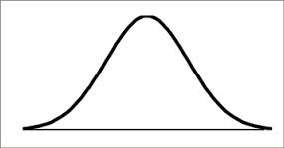
Understanding the sequencing process
DNA sheared to fragments
Fragments follow a size distribution
Fragments sequenced from both sides
We don’t know the middle, but we know the size!

Slide 12
Using information from alignments
What the
Alignment
should look like:
Reference Genome
Deletions
Insertions
Reference Genome
3bp
3bp
ACGAGATAGT ACCATAGACG
ACGAGATAGGGCCATAGACG
7bp
1bp
ACGAGATAGTAGATACCATAGACG
ACGAGATAGCCATAGACG

Slide 13
Using information from alignments
What the
Alignment
should look like:
Reference Genome
Tandem Duplication
Reference Genome
CGATAGACGAC GGAGAGAGATAG GGAGAGAGATAG ACCCAGATAA
CGATAGACGAC GGAGAGAGATAG ACCCAGATAA

Slide 14
Getting more from your reads
Unaligned
Aligned
Reference Genome
Split Read
Deletion call
Unaligned Read
Aligned Read
TTGCGA
TTG
CGA
CGACGA
ACGACGAGGGTGTGATTGACGATCGATA
ACGACGAGGGTGTGATTG CGATA

Slide 15
Overcoming read biases and creating useful information
Chemistry problems confuse detection
Alignment issues occur
Use clustering algorithm
Chimeric
Read
Repeat
Repeat

Slide 16
Ease of Use
Designed to process BWA-aligned BAM files
Scalable to system resources
Multi-threaded
Tunable to reduce false positives

Slide 17
RPSR: Read Pair, Split Read
Written in Java (version 8)
Currently two modes:
Preprocess
Cluster
Uses map-reduce paradigms for easy threading

Slide 18
Presentation Outline
Variant classification and detection
Theory on read structure and bias
Simulations and real data

Slide 19
Simulation dataset
Started with Cattle chr29
51 megabases
Acrocentric
Synthetic 10X coverage
Variants per simulated chromosome
Variant Type | Avg. Count | Avg. size
Deletion | 12.3 | 350 bp
Tandem Dup | 11.8 | 350 bp

Slide 20
Comparison Program
Delly / Duppy
Rausch et al. 2012. Bioinformatics
Combined read pair, split read caller
Discovers discordant reads, then uses split reads to validate
Run with default settings and in “split read” mode

Slide 21
Program results: Simulation
True
Positives
Total
Calls
Actual
Positives
Deletions
Duplications

Slide 22
Program results: Simulation
RPSR vs Delly/Duppy precision
RPSR is far more precise than Delly/Duppy
Program | Precision
RPSR Dels | 8.7%
Delly Dels | 0.9%
RPSR Tandem | 73.7%
Duppy Duplications | 1.8%

Slide 23
Real Dataset: Angus Individual
Provided by Jerry Taylor and Bob Schnabel
Sequence statistics
20 X coverage of Illumina reads
Reads quality trimmed
Aligned with BWA to UMD3.1

Slide 24
Program results: Angus
RPSR
Variant type | Total Calls | Avg. Size (bp) | Total Length | Largest call
Deletions | 4171 | 237 | 991 kb | 43.7 kb
Duplications | 9617 | 554 | 5,335 kb | 152.0 kb
Delly/Duppy
Variant type | Total Calls | Avg. Size (bp) | Total Length | Largest call
Deletions | 1867 | 1,304,683 | 2.4 gb | 149 Mb
Duplications | 10263 | 232,472 | 2.38 gb | 150 Mb

Slide 25
Conclusions
Structural variants are a type of mutation we can track inexpensively
Accurate assessment of SVs is needed
Future developments for RPSR
Smaller resource footprint
Automatic threshold detection

Slide 26
Acknowledgements
Colleagues at the USDA
George Liu
Tad Sonstegard
Curt Van Tassell
AGIL
Jerry Taylor
Bob Schnabel
The Reecy Lab
Projects mentioned in this presentation were funded in part by NRI grant numbers 2007-35205-17869 and 2011-67015-30183, and by USDA NIFA grant number 2013-00831

Slide 27
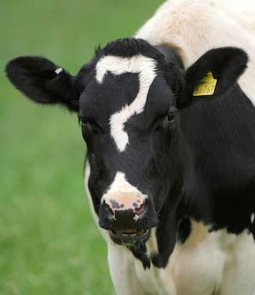
Questions?

Slide 28
Delly/Duppy
After removing the initial calls greater than 1 megabase and then merging:
Variant type | Total Calls | Avg. Size (bp) | Total Length | Largest call
Deletions | 1833 | 5219 | 9.6 Mb | 885 kb
Duplications | 97407 | 1217 | 118 Mb | 2.3 Mb

Slide 29
Pipeline: Resource Consumption

