Slide 1


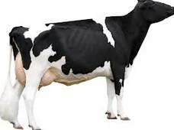

Increasing Predictive Ability using Dominance in Genomic Selection
C. Sun, P. M. VanRaden, J. B. Cole and J. O'Connell
National Association of Animal Breeders (NAAB), USA
Animal Genomics and Improvement Laboratory (AGIL), USDA
School of Medicine, University of Maryland, USA

Slide 2
Introduction
Dominance is an important non-additive genetic effect resulting from interactions between alleles at the same locus
Most of prediction models for dairy cattle have included only additive effects in genomic selection
Limited number of cows with both genotypes and phenotypes
Requiring greater computing resources

Slide 3
Introduction
Recently a few publications investigated dominance using SNPs (Su G, et al 2012; Sun C, et al 2013; Boysen TJ, et al 2013; Vitezica, ZG et al 2013; Da Y, et al 2014; Nishio M, et al 2014; …)
Most of them using simulated or small real data
Large data set with very many different kinds of relationships help to partition variation into many components in principle using modern statistical methods with the animal model (Hill, et al; 2008)
The increasing availability of cows with phenotypes and genotypes in the United States
Mating program including dominance earn benefit (Sun et al; 2013)

Slide 4
Introduction
Objective
Estimating additive and dominance variance components using Holstein and Jersey data for six traits
Comparing predictive ability of models that included additive and dominance effects with that of a model including only additive effects
Comparing predictions obtained using two different dominance coefficients
Testing model prediction by expanding the data set to include cows with derived genotype probabilities based on ancestor genotypes

Slide 5
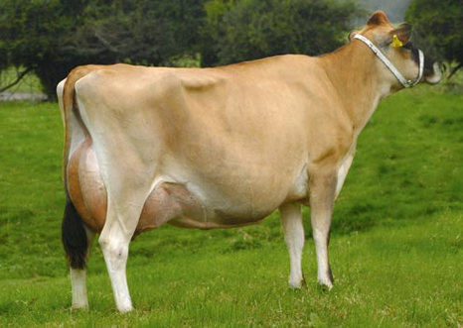
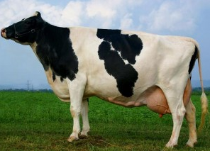
Materials and Methods
Data
DATA_{C} :Cows with own genotypes and phenotypes
DATA_{S-D} :Cow with phenotypes but genotype probabilities were calculated from genotyped sire and dam
DATA_{S-MGS}:Cows with phenotypes but genotype probabilities were calculated from genotyped sire and MGS
Each sire-MGS pair was required to have ≥20 observations for Holsteins and ≥8 observations for Jerseys
Fixed effects (age and parity group, herd management group, inbreeding, and heterosis) were first estimated using a multi-trait and multi-breed linear mixed model
Records from first parity were adjusted for fixed effects

Slide 6
Materials and Methods
 |  | Milk ( Fat , Protein ) | PL | DPR | SCS
HO | Cows | 30,482 | 14,780 | 23,811 | 30,352
 | S-D | 25,926 | - | - | -
 | S-MGS | 33,897 (2,278,652) | - | - | -
JE | Cows | 8,321 | 5,492 | 7,422 | 8,292
 | S-D | 4,896 | - | - | -
 | S-MGS | 11,823 (379,713) | - | - | -
All genotypes were imputed to a BovineSNP50 basis using findhap.f90 software before estimating genomic BV and dominance effects.

Slide 7
Materials and Methods
Two different Dominance coefficient matrices
Dominant Values
Dominant Deviations

Slide 8
Materials and Methods
Models for variance components
SNP additive and dominance effect
SNP-BLUP method with the variance components described previously

Slide 9
Materials and Methods
DATA_{C}
DATA_{C}
DATA_{S-D}
MA
MAD
MAD2
DATA_{S-MGS}
MAD3
Estimate variance components
SNP-BLUP
Estimate SNP additive and dominance effects
Ten-fold cross validation

Slide 10
Results
Variance components
Breed | Model | h2 | Milk | Fat | Protein | PL | DPR | SCS
HO | MA | Add | 0.288 | 0.253 | 0.221 | 0.043 | 0.056 | 0.087
 | MAD | Add | 0.270 | 0.233 | 0.202 | 0.042 | 0.057 | 0.084
 |  | Dom | 0.051 | 0.051 | 0.053 | 0.000 | 0.000 | 0.010
 | MAD2 | Add | 0.285 | 0.250 | 0.217 | 0.042 | 0.056 | 0.087
 |  | Dom | 0.037 | 0.034 | 0.039 | 0.005 | 0.000 | 0.010
 | MAD3 | Add | 0.215 | 0.202 | 0.186 | — | — | —
 |  | Dom | 0.024 | 0.024 | 0.025 | — | — | —
JE | MA | Add | 0.352 | 0.222 | 0.258 | 0.071 | 0.034 | 0.102
 | MAD | Add | 0.322 | 0.192 | 0.230 | 0.057 | 0.030 | 0.098
 |  | Dom | 0.070 | 0.072 | 0.070 | 0.038 | 0.012 | 0.012
 | MAD2 | Add | 0.344 | 0.214 | 0.251 | 0.070 | 0.034 | 0.102
 |  | Dom | 0.054 | 0.055 | 0.056 | 0.024 | 0.000 | 0.010
 | MAD3 | Add | 0.271 | 0.182 | 0.206 | — | — | —
 |  | Dom | 0.052 | 0.058 | 0.054 | — | — | —

Slide 11
Results
Variance components
Dominance variances were very small for PL, DPR and SCS regardless of breed, especially for DPR.
Two different dominance coefficient had a little difference on estimate additive and dominance heritabilities, but the sum of additive and dominance variances were similar
Based on two dominance coefficients (D₁ and D₂), dominance variance accounted for 5% and ≈4%, respectively, of phenotypic variance for Holstein yield traits and 7% and 5.5% of Jersey yield traits.
Including cows with derived genotype probabilities, additive heritability estimates were lower for both Holstein and Jersey; dominance variances were smaller for Holsteins.

Slide 12
Results
Prediction Accuracy
Average correlations between phenotype and genetic effects from ten-fold cross validation
For PL, DPR and SCS, the models including dominance did not improve prediction due to very small dominance variances
For yield traits, models including dominance have better prediction

Slide 13
Results
Prediction Accuracy
The differences between correlations from MAD or MAD2 and that from MA were statistically significant for Holstein and Jersey yield traits (P < 0.001)
For models including dominance, the standard deviation of correlations from ten-fold cross-validation ranged from 0.017 to 0.024 for Holstein, and from 0.016 to 0.027 for Jersey on yield traits
Enlarging the data set using Sire-MGS data did not improve prediction for either Holsteins or Jerseys.

Slide 14
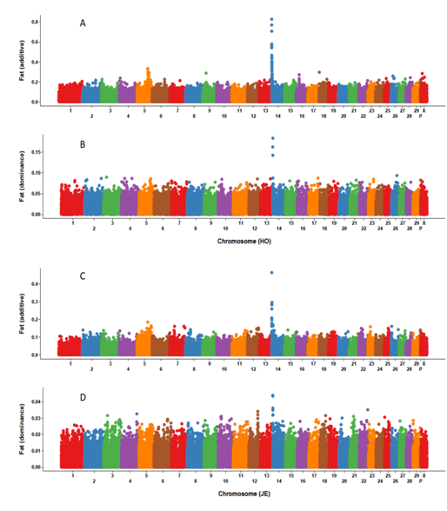
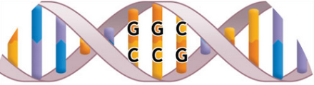
Results
Largest SNP effects
The largest additive SNP effects are located on chromosome 14 near DGAT1 for all three yield traits and both breeds.
For Holstein milk and fat yields as well as Jersey fat yield, the SNP with largest additive effect also had the largest dominance effect

Slide 15
Discussions
For DPR fertility trait, Dominance variance close to zero
“Inbreeding depression implies directional dominance in gene effects but, for a given rate of inbreeding depression, as the number of loci increases and the gene frequencies move toward 0 or 1.0, the dominance variance decreases towards zero”( Hill, et al; 2008)
Homozygous lethal embryo is lost
Including cows with derived genotype probabilities did not improvement prediction ability
A better model might treat the three groups as correlated phenotypes to account for differences in genotype accuracy and phenotype distributions between them.
Pre-selection may have affected the results and caused bias

Slide 16
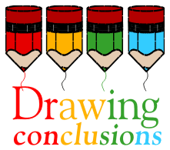

Conclusions
Dominance variance accounted for about 5 and 7% of total variance for yield traits for Holsteins and Jerseys, respectively
For PL, DPR, SCS, dominance variances were very small
The MAD model had smaller additive and larger dominance variance estimates compared with MAD2
Based on ten-fold cross-validation, the models including dominance can increase prediction ability for yield traits; improvements from MAD and MAD2 were similar.

Slide 17
Conclusions
Prediction accuracy from 30,000 cows did not further improve by including 2 million more cows with derived genotypes
The largest additive effects were located on chromosome 14 for all three yield traits for both breeds, and those SNP also had the largest dominance effects for fat yield as well as Holstein milk yield
Dominance effects can be considered for inclusion in routine genomic evaluation models to improve prediction accuracy and exploit specific combining ability

Slide 18
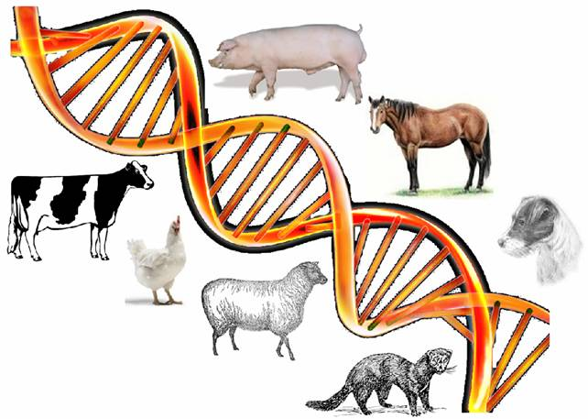
Thank you
QUESTIONS?

