Slide 1
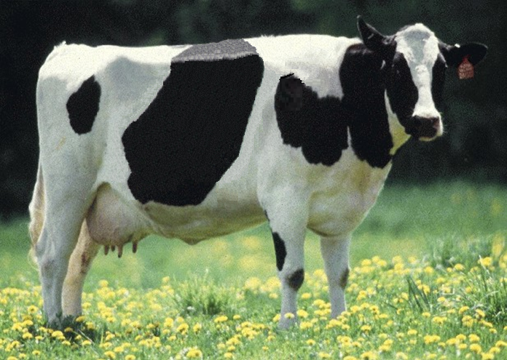
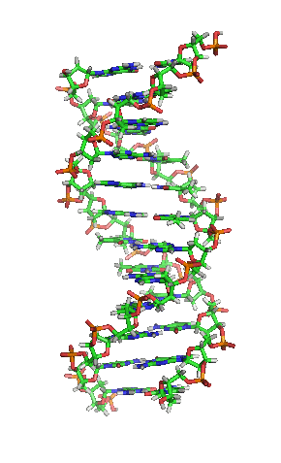
Increasing the number of SNPs used in genomic evaluations of dairy cattle
Comm. 301

Slide 2
Reasons for changes in SNP set
History
Single list created across breeds
Poor performing SNPs removed
SNP selection criteria changed
Updated assembly changed SNP locations
Additional QTLs as discovered
New chip provides more SNP
Fast imputation essential to support change as prior haplotype library cannot be used

Slide 3
Genotype chips
Chip Name | No. of SNP |  | Chip Name | No. of SNP
50K | 54,001 |  | GHD | 77,068
50K V2 | 54,609 |  | GP2 | 19,809
3K | 2,900 |  | ZLD | 11,410
HD | 777,962 |  | ZMD | 56,955
Affy | 648,875 |  | ELD | 9,072
LD | 6,909 |  | LD2 | 6,912
GGP | 8,762 |  | GP3 | 26,151

Slide 4
Background
GeneSeek created successor to Illumina® BovineSNP50 genotyping chip by adding SNPs to Illumina® LD chip
Can reliability of genomic evaluations be increased by using more SNPs?

Slide 5
Why more SNPs?
Accuracy of genomic evaluations should improve if more SNPs better track causative genetic variants
Improving chip technology provides more SNPs for the same price
Improving computer technology and methods enable processing more SNPs
Sequence data will provide more SNPs

Slide 6
GeneSeek 77K chip (GHD)
Designed to include the most informative SNPs
76,934 SNPs typically provided, including:
Y
Single-gene tests
About 28,200 50K SNPs included (mostly low MAFs excluded)
Other SNPs selected from HD based on MAF and magnitude of effect

Slide 7
Issues in using the GHD chip
Will adding SNPs increase accuracy enough to overcome imputation errors?
As genotypes accumulate, problem decreases
Which SNPs should be included?
Are all new SNPs equally valuable?
Should all SNPs being used be retained?

Slide 8
Plan
Holstein cutoff studies with 3 SNP sets
91K union of GHD and then current 45,195 SNPs
74K SNPs on GHD chip
61K (61,013) SNPs (45,195 + 16K SNPs with effect in top 1,000 for at least 1 trait)
Evaluations based on August 2009 data to predict April 2013 performance

Slide 9
Data
Imputation of 16K new SNPs using findhap based on
2,262 animals with HD genotypes
4,037 animals with GHD genotypes
24,356 predictor bulls and cows
810 to 4,395 validation bulls depending on trait

Slide 10
Holstein genomic evaluation reliabilities
Trait | Reliability (%) and gain for SNP set*
 | 45K |  | 61K |  |  | 74K |  |  | 91K
Milk yield | 69.2 |  | 69.3 | (0.1) |  | 68.9 | (−0.3) |  | 69.2 | (0.0)
Fat yield | 68.4 |  | 68.7 | (0.3) |  | 68.6 | (0.2) |  | 68.4 | (0.0)
Protein yield | 60.9 |  | 60.8 | (−0.1) |  | 60.6 | (−0.3) |  | 60.8 | (−0.1)
Net merit | 51.6 |  | 51.7 | (0.1) |  | 51.6 | (0.0) |  | 51.3 | (−0.3)
Productive life | 73.7 |  | 74.0 | (0.3) |  | 73.1 | (−0.6) |  | 73.8 | (0.1)
Somatic cell score | 64.9 |  | 65.8 | (0.9) |  | 65.6 | (0.7) |  | 65.6 | (0.7)
Daughter pregnancy rate | 53.4 |  | 54.1 | (0.7) |  | 53.6 | (0.2) |  | 53.8 | (0.4)
Final score | 58.8 |  | 58.7 | (−0.1) |  | 58.4 | (−0.4) |  | 58.7 | (−0.1)
Stature | 68.5 |  | 69.0 | (0.5) |  | 68.8 | (0.3) |  | 69.1 | (0.6)
All traits | 62.3 |  | 62.8 | (0.5) |  | 62.4 | (0.1) |  | 62.7 | (0.4)
*Differences from 45K evaluation reliability in parentheses

Slide 11
More SNPs not always better
74K SNP set excluded some low MAF SNPs from SNP50 chip that were informative
Benefit of 61K SNP set improves as more GHD genotypes included because of reduced imputation error
91K SNP set nearly the same as 61K SNP set but more variable
SNPs with incorrect map locations reduce imputation accuracy

Slide 12
Evaluation comparison
Correlation
Close to 0.99 for all traits
>0.996 for milk, fat, and protein; daughter pregnancy rate; productive life; SCS; and final score
Greatest changes for
3K genotypes
Neither parent genotyped

Slide 13
Current SNP set for genomic evaluations
60,671 SNPs used after culling on
MAF
Parent-progeny conflicts
Percentage heterozygous (departure from HWE)
SNPs for HH1, BLAD, DUMPS, CVM, POLLED, RED, and MULEFOOT included
JH1 included for Jerseys
96 more SNPs may be eliminated because incorrect location => haplotype non-inhertance

Slide 14
Future
Causative genetic variants do not have linkage decay
Added to chips as discovered
Used when enough genotypes exist to support imputation
As cost per SNP genotype declines, benefit from larger SNP sets will be evaluated
Lower-cost sequence data expected to accelerate discovery of causative genetic variants

Slide 15
Conclusions
Mean gain in reliability across traits of 0.5 percentage points for 61K SNP set (slightly larger after adding more GHD genotypes)
Gains smaller for 74K SNP set and about the same for 91K SNP set
Genomic evaluations based on 61K SNPs implemented in December 2013

