Slide 1
Recent advances and future needs in genotype imputation “Abstract Tracking Number: 38039”
P.M. VanRaden^{1*}, D.J. Null¹, and A.S. Al-Khudhair¹
¹USDA, Agricultural Research Service, Animal Genomics and Improvement Laboratory, Beltsville, MD, USA.
paul.vanraden@usda.gov

Slide 2
Goals
Review imputation strategies to improve accuracy or efficiency and expand the variants included
Impute unknown (missing) genotypes
Estimate alleles of ungenotyped relatives
Outline imputation currently used in large, routine analyses of chip genotypes
Compare potential use of sequence vs. chip data in future genomic predictions

Slide 3
Linear estimation by pedigree
Estimate genotype at each locus separately
Use genotyped animals (g₂) to estimate the others (g₁)
g₁ = 1µ + A₁₂ A₂₂⁻¹ (g₂ – 1µ)
Gengler et al., 2007 (gene content)
Single-step genomic BLUP
g₁ = 1µ + A₁₂ A₂₂⁻¹ (g₂ – 1µ)
Estimates relationships of genotyped with non-genotyped

Slide 4
Before imputation
Choose optimum variant set for prediction and imputation
Add SNPs and QTLs with larger effects on individual traits
Keep SNPs that improve imputation even if no effect on traits
Reduce cost of genotyping by using less dense chips
Remove SNPs not useful in any breed or trait (save CPU)
Set SNPs with poor quality to unusable on individual chips
Suppress Mendelian conflicts
Use a high-quality, edited reference genome

Slide 5
Reference and target animals
Standard: full set of SNPs in reference, subset in target
Example subsets: 6K -> 50K -> 777K -> sequence
Desirable if all low- or medium- set variants are in highest
Sequence files do not contain many SNPs currently used
Problem: lower density chips introduce new SNPs, QTLs
No chip includes all variants to be imputed (49 chips used)
Solution: Impute reference and target jointly (no distinction)

Slide 6
Genotype and haplotype output options
Genotype coding:
0 = BB, 1 = AB or BA, 2 = AA Best call
3 = B_, 4 = A_, 5 = __ One or both alleles missing
allele frequency is used for missing alleles
prob(AA), prob(AB or BA), prob(BB) Posterior probabilities
0.25, 0.5, 0.25 OR p², 2pq, and q² Prior probabilities
Real numbers between 0 and 2 Genotype dosage
Haplotype coding also has several options
Outputs from imputation is often recycled as inputs

Slide 7
Faster imputation using pedigree
Use parent or grandparent haplotypes to speed search:
Check 2 haplotypes from each parent first
If parent not genotyped, check 4 grandparent haplotypes
Detect and output new crossover haplotypes
Search the large haplotype library if ancestors are not genotyped or animal’s genotype does not match their haplotypes
Segment inheritance (example)
Son has haplotype numbers 5 and 8
Sire has haplotype numbers 8 and 21
Son got haplotype number 5 from dam

Slide 8
Example imputation output from Findhap.f90
Output file | Size (GB) | Description
genotypes.filled | 395 | Imputed 79K genotypes for 5 million HO (1 byte / SNP)
hap.list | 31 | List of all haplotypes across 805 segments
hap.found | 37 | Numbered haplotypes found for each animal
hap.inherit | 22 | Paternal / maternal inheritance of haplotypes
cross.overs | 7 | List of recombination events in the pedigree
hap.filled | 0.3 | Estimated accuracy of imputation for each animal
allele.frequency | 0.006 | Simple, base, and current allele frequencies
VCF output may be 4,000 GB, about 10X larger
SNP effect estimation optionally can use just 68 GB from hap.list and hap.found
Findhap input file genotypes.raw is 118 GB

Slide 9
Test of UMD3 vs ARS-UCD1 reference map
Locations for the 60,367 usable SNPs were converted to ARS-UCD1
Genotypes were imputed to 60K from 30 chips of differing density
Genotypes from 5 breeds were imputed separately:
1,748,453 Holsteins (HO)
215,800 Jerseys (JE)
32,724 Brown Swiss (BS)
4,834 Ayrshires (AY)
3,517 Guernseys (GU)
From Null et al. 2019 Interbull

Slide 10
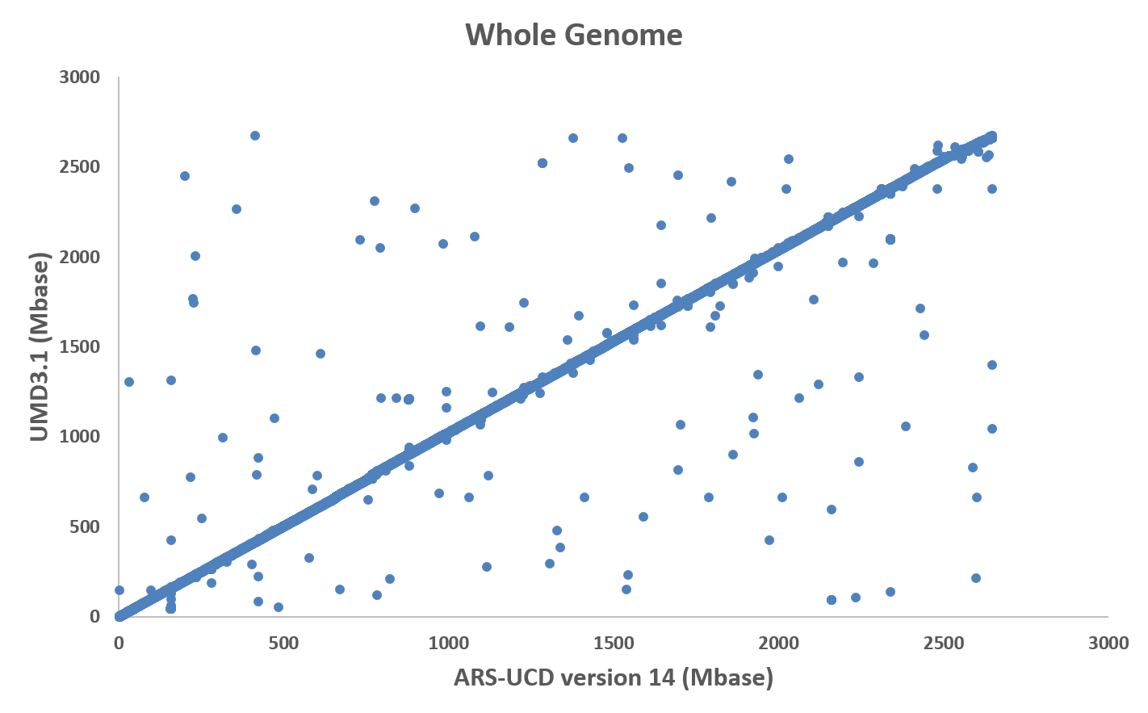
SNPs now on different chromosomes (~100 of 60,000)
From Null et al. 2019 Interbull
Notes:
142 SNP changed chromosome (.24%)

Slide 11
Potentially mismapped sections of ARS-UCD1 edited
From Null et al. 2019 Interbull

Slide 12
1: Maximum haplotypes (100-SNP segments of 60K SNPs: Null et al 2019)
Imputation using UMD3 or ARS-UCD1 reference map
Maximum number of haplotypes per segment
Breed | UMD3 | ARS-UCD1
 | edited | original | edited
HOL | 47,987 | 81,316 | 36,690
JER | 39,628 | 33,034 | 29,732
BSW | 11,602 | 12,846 | 9,447
RDC | 2,030 | 2,512 | 1,606
GUE | 1,970 | 1,657 | 1,427
Haplotype counts and inheritance improved for all breeds
Much better on the X chromosome and its pseudoautosomal region
Further edits used HD data to identify smaller regions potentially mismapped

Slide 13
Imputation using UMD3 or ARS-UCD1 reference map
2: Haplotype non-inheritance (100-SNP segments of 60K SNPs)
Haplotypes with parent-progeny non-inheritance (%)
Breed | UMD3 | ARS-UCD1
 | edited | original | edited
HOL | 1.6 | 1.3 | 1.1
JER | 4.3 | 3.9 | 3.8
BSW | 1.5 | 1.3 | 1.2
RDC | 1.8 | 1.5 | 1.4
GUE | 1.6 | 1.4 | 1.3
Maximum non-inheritance within any haplotype (%)
Breed | UMD3 | ARS-UCD1
 | edited | original | edited
HOL | 13 | 31 | 12
JER | 25 | 35 | 18
BSW | 17 | 21 | 10
RDC | 16 | 27 | 10
GUE | 18 | 16 | 9
ib2019null.pptx
Notes:
A good reference map is important for imputation:

Slide 14
Multi-breed imputation
Purebred imputation often preferred for low SNP densities
Animals >90% pure are imputed within breed
Breed-specific frequencies used for missing alleles
Multi-breed imputation preferred for high density or sequence
Same SNP list used for all breeds
Crossbred imputation needs all breeds in reference
Parents of crossbreds are added to reference

Slide 15
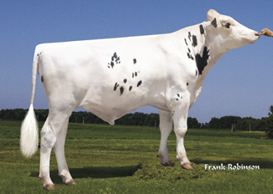
Imputation strategies tested for U.S. dairy data
4.6 million genotyped Holsteins
78,964 SNPs imputed from 48 chips
Speed
Using Prior Hap Library
Using NO Prior Hap Library
Accuracy
Notes:
Comparing imputation strategies parameters (speed and accuracy)
using prior libraries vs using no priors

Slide 16
Strategies compared using Findhap version 3
Create initial haplotype library for new SNP list
Use 4 iterations with all 4.6M animals, OR
Use 4 iterations with subset of 369,063 bulls + 73,813 dams, then 1 iteration with all animals
Impute ~30,000 new animals each week
Use prior haplotype library from previous month
Update library with ~120,000 new animals each month
Update and edit SNP list each year

Slide 17
Computation required and accuracy for Holsteins
Processing | Iterations | Animals | Time
Initial priors using All, OR | 4 | 4.6 million | 24 days
Initial priors using Subset | 4 for subset, 1 for all | 0.4 million, 4.6 million | 9 days
Monthly update | 1 | 120,000 | 10 hours
Weekly update | 1 | 30,000 | 1 hour
30 processors used and ~ 500 Gbytes memory
71.7% of genotypes missing initially
0.6% of genotypes missing after imputation
0.992-0.999 correlations of weekly with full monthly genomic predictions for all traits, but weekly imputation is less accurate in smaller breeds (Wiggans et al., 2015)

Slide 18
Other recent tests of Findhap options
Reduce maximum haplotype length from 700 to 265 SNPs to improve speed
Time was reduced by 80%
Maximum memory & numbers of haplotypes reduced by 50%
Implemented in 2021
Increase assumed error rate from 0.004 to 0.011 to improve haplotype inheritance
Inheritance rate improved
Tested using 100-SNP haplotypes and 79K SNPs

Slide 19
Impute using 2 stages instead of 1 to improve accuracy
Imputation accuracy (% correct)
Markers | Animals | Findhap All |  | FImpute
 |  |  |  | All |  | 2-step¹
330,000 | 1,112 | 99.89 |  | 99.96 |  | 99.96
41,250 | 72,532 | 99.0 |  | 99.3 |  | 99.3
5,130 | 1,000 | 94.6 |  | 94.7 |  | 96.1
¹Imputing lower densities to 41,250 SNP and then imputing to
330,000 SNP in a second stage instead of all together
VanRaden et al. (2012 Interbull)
Notes:
Accuracy is sometimes higher with multi-breed than single-breed imputation or using two steps instead of directly imputing all variants from the lowest density (VanRaden et al., 2013).
Imputation strategies for large datasets must balance accuracy with computing costs and adapt to properties such as array densities, sequence depth, error rates, and population structure in the input data. Imputation methods developed in animal breeding are often hundreds of times faster than from human genetics but with similar accuracy, especially with pedigree available (Sargolzaei et al., 2014; Miar et al., 2017).

Slide 20
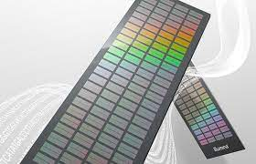
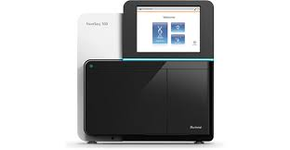
Analysis of chip vs. sequence data
Chip data | Sequence data
Genotypes are observed | Genotype probabilities
AA, AB, BB | Counts of A, counts of B
Exact data, SNP subset | Approximate data, all SNP
Error rate < 0.05% | Error rate > 0.5%
6K, 50K, 777K | 30 million SNPs, indels, CNVs
Bi-allelic SNPs | Multiple alleles per locus
Computation important | Computation is crucial

Slide 21
Choosing source of sequence input data
Compared 1000 Bull Genomes Project run7 to local AGIL data using chromosome 29 (Null et al., 2020 JDS abstract)
1000 Bull Genomes Project run7 identified 149,684 variants on chromosome 29
AGIL data identified 99,600 variants on chromosome 29
Only 48,266 variants overlapped between the two datasets
Variant quality better from raw than final 1000 Bull data
Raw sequence genotypes had 98.6% concordance with chip
Beagle-imputed sequence had 98.0% concordance with chip

Slide 22
Rare low-frequency variants (RLFV)
Rare or less frequent alleles may have poor imputation accuracy and may thus not improve prediction even if their actual effects are larger than nearby genotyped markers
(Zhang et al., 2018)
“On average the prediction reliability hardly changed, regardless of how the RLFV were selected” (Zhang et al., 2018).
To obtain the gains in prediction accuracy expected from larger reference populations, well-designed genotyping strategies and accurate imputation are needed (Judge et al., 2017).
Notes:
Imputation to sequence can discover better markers or QTL,
but high accuracy is needed for imputed sequence variants to outcompete highly linked array genotypes directly measured in the reference population.
Rare or less frequent alleles may have poor imputation accuracy and may thus not improve prediction even if their actual effects are larger than nearby genotyped markers (Zhang et al., 2018).
For example, the best linked marker from an array may be correlated by 0.97 with the true QTL but have nearly 100% correct genotypes compared to only 95% correctly imputed QTL genotypes for animals not sequenced. Reference cows may contribute much less to the reliability of prediction or marker selection if their sequence genotypes are imputed from only 6,000 to 20,000 usable SNPs and their individual phenotypes have low heritability. To obtain the gains in prediction accuracy expected from larger reference populations, well-designed genotyping strategies and accurate imputation are needed (Judge et al., 2017).

Slide 23
Efficient sequence processing
Store only alternate bases, not homozygous reference bases
Referential compression (cram instead of bam format)
Align to both reference and alternate genome
Store only the alternate alleles for each animal
Process zipped rather than visually readable files

Slide 24
Low-coverage sequence
Greatly reduce costs that are proportional to read depth
Mix DNA from many animals in same flow cell
Requires accurate indexing of individual DNA reads
Advantages: no design time required
Read all variants instead of only SNPs in chip manifest
Disadvantages:
Requires imputation to obtain genotypes from reads
Accuracy per genotype less than from chips

Slide 25
Allele counts instead of observed genotypes
Poisson distributions for allele counts (n_{A} and n_{B})
Choose 2 haplotypes with highest likelihood from list
Use prior allele frequencies and each new animal’s data to update haplotype posteriors
Requires more time and storage for probabilities

Slide 26
Low-coverage sequence vs. chips (VanRaden et al., 2015)
Simulated sequence data for 30 million SNPs, 500 animals
Better imputation from 1x coverage than from 60K chip
2-stage imputation could improve accuracy from chips
Accuracy from 600K HD chip about equal to 1x coverage

Slide 27
Human sequence imputation
Much larger populations imputed for humans than livestock
300 million sequence variants from are imputed for free
30 million humans imputed from HD chips to sequence
97,256 reference samples with average read depth 38X
5 reference panels, phased by Eagle, impute with minimac2
TOPMed Imputation Server:
https://imputation.biodatacatalyst.nhlbi.nih.gov/#!pages/home
Provided by National Institutes of Health, Bethesda, MD

Slide 28
Conclusions
Recent advances have improved imputation:
Timely service
Very large reference panels
Improved reference assemblies
New chips with more QTLs directly genotyped
Future needs:
Reduce storage, improve speed and accuracy
Impute from low-coverage sequence

Slide 29
Acknowledgments
USDA-ARS project 8042-31000-002-00-D, “Improving Dairy Animals by Increasing Accuracy of Genomic Prediction, Evaluating New Traits, and Redefining Selection Goals” (AGIL funding).
Council on Dairy Cattle Breeding and its industry suppliers for data
1000 Bull Genomes Project
Mention of trade names or commercial products in this presentation is solely for the purpose of providing specific information and does not imply recommendation or endorsement by USDA.

